Slide 1
Chapter 4: Threads

Slide 2
Chapter 4: Threads
Overview
Multithreading Models
Threading Issues
Pthreads
Windows XP Threads
Linux Threads
Java Threads

Slide 3
From Processes to Threads

Slide 4
Processes and Threads
Process abstraction combines two concepts
  Concurrency
    Each process is a sequential execution stream of instructions
  Protection
    Each process defines an address space
    Address space identifies all addresses that can be touched by the program
Threads
  Key idea: separate the concepts of concurrency from protection
  A thread represents a sequential execution stream of instructions
  A process defines the address space that may be shared by multiple threads

Slide 5
The Case for Threads
Consider the following code fragment
for(k = 0; k < n; k++)
a[k] = b[k] * c[k] + d[k] * e[k];
Is there a missed opportunity here? On a Uni-processor?
On a Multi-processor?

Slide 6
The Case for Threads
Consider a Web server
get network message from client
get URL data from disk
compose response
send response
How well does this web server perform?

Slide 7
Introducing Threads
A thread represents an abstract entity that executes a sequence of instructions
  It has its own set of CPU registers
  It has its own stack
  There is no thread-specific heap or data segment (unlike process)
Threads are lightweight
  Creating a thread is more efficient than creating a process.
  Communication between threads is easier than between processes.
  Context switching between threads requires fewer CPU cycles and memory references than switching processes.
  Threads only track a subset of process state (share a list of open files, pid, …)
Examples:
  OS-supported: Sun’s LWP, POSIX’s threads
  Language-supported: Modula-3, Java

Slide 8
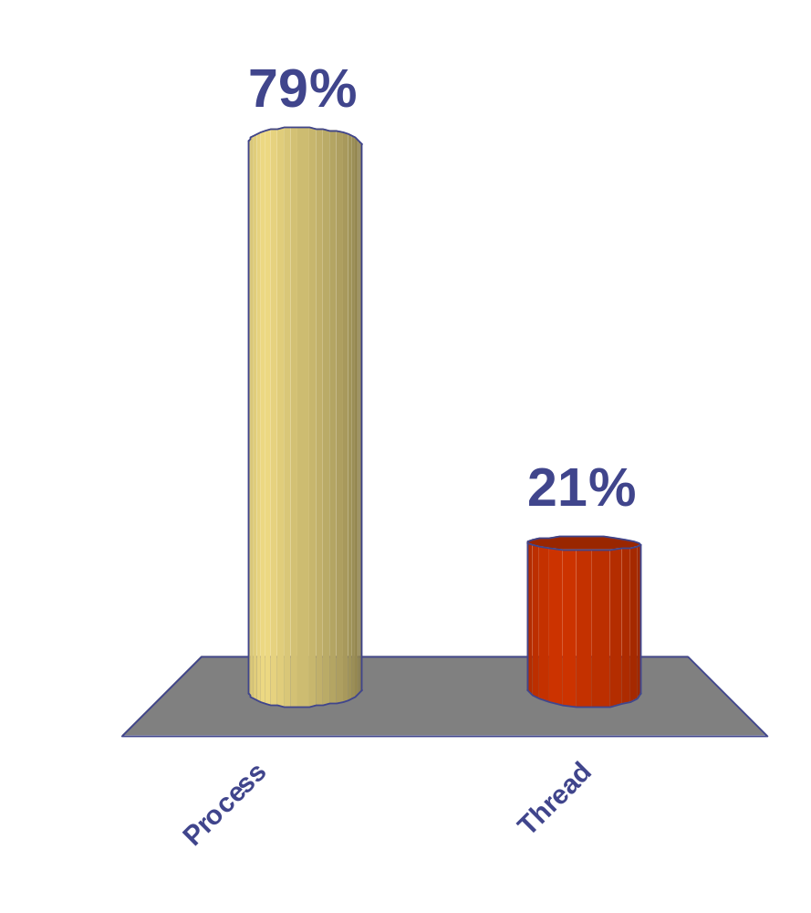
Context switch time for which entity is greater?
65
Process
Thread
47

Slide 9
Programmer’s View
void fn1(int arg0, int arg1, …) {…}
main() {
…
tid = CreateThread(fn1, arg0, arg1, …);
…
}
At the point CreateThread is called, execution continues in parent thread in main function, and execution starts at fn1 in the child thread, both concurrently

Slide 10
How Can it Help?
Consider the following code fragment
  for(k = 0; k < n; k++)
  a[k] = b[k] * c[k] + d[k] * e[k];
Rewrite this code fragment as:
  CreateThread(fn, 0, n/2);
  CreateThread(fn, n/2, n);
  fn(l, m) {
  for(k = l; k < m; k++)
  a[k] = b[k] * c[k] + d[k] * e[k];
  }
What did we gain?

Slide 11
How Can it Help?
Consider a Web server
Create a number of threads, and for each thread do
    get network message from client
    get URL data from disk
    compose response
    send response
What did we gain?

Slide 12
Overlapping Requests (Concurrency)
Request 1
Request 2
    get network message from client
    get URL data from disk
    compose response
    send response
    get network message from client
    get URL data from disk
    compose response
    send response
Time

Slide 13
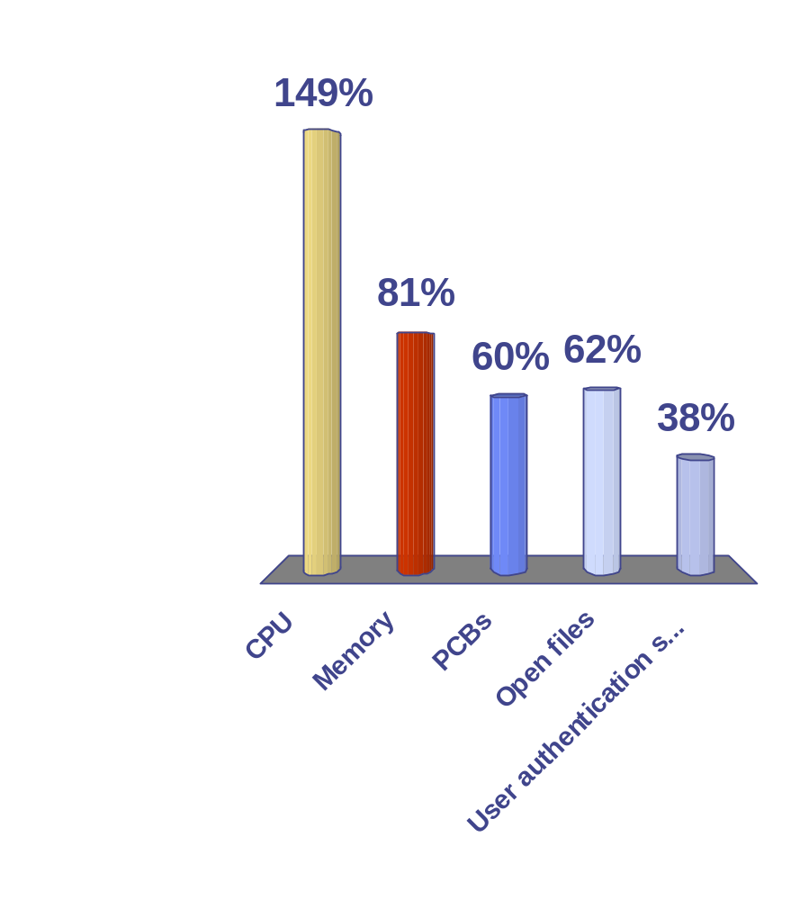
Threads allow you to multiplex which resources?
65
47
of
65
CPU
Memory
PCBs
Open files
User authentication structures
0

Slide 14
What is a Thread?
We assumed in Chapter 3, even though it was not stated, that a process was an executing program with a single thread of control.
Most modern OS now allow multiple threads of control rather than just processes.
A thread is a basic unit of CPU utilization.
It consists of an ID, a program counter, a register set, and a stack.
It shares with other threads belonging in the same process its code section, data section, and other OS resources such as open files and signals.
A traditional process with a single thread of control is called a heavyweight process.
If a process has multiple threads of control, it can perform more than one task at a time.

Slide 15

Single and Multithreaded Processes
Example: A web browser might have one process display images or text while another thread retrieves data from network.

Slide 16
Making A Case for Threads
Suppose a single application must perform several similar tasks – i.e. web server having many clients accessing it.
If web server runs as a single process with no threads, it could service only one client at a time.
Before threads were introduced, this situation was handled by having the server create a separate process to handle a request.
One difficulty with this approach is that process creation and context switching is expensive.
Today, if threads are supported, the web server will listen for a request with a thread.
After receiving a request, it would create another thread to handle the request.

Slide 17
Threads Are Useful in Remote Procedure Call (RPC) Systems
RPCs allow interprocess communication by providing a mechanism similar to ordinary function calls.
When a multithreaded server receives a message, it creates a separate thread to service the message.
This allows the server to service several concurrent requests.
Java's RMI systems work like this also.

Slide 18
Multithreaded Kernels Make the OS More Efficient
Each thread in the kernel handles a different task of the kernel – i.e. managing devices, handling interrupts, etc.
Examples:
  Solaris – creates a set of threads in the kernel just for interrupt handling
  Linux – uses a kernel thread for managing the amount of free memory.

Slide 19
Benefits of Multithreaded Programming
Responsiveness
Example: While loading an image, a web browser could interact with the user instead of just waiting for the image to load.
Resource Sharing
By default, threads share memory, code, and data. So, different activities can take place in the same address space.
Economy
Context switching and creation is less expensive than for processes as threads share resources with the process that owns them.
Utilization of Multiprocessor Architectures
If parallel execution is possible, threads give a huge boost to performance. A single threaded process can use only one CPU.

Slide 20
Threads vs. Processes
Threads
A thread has no data segment or heap
A thread cannot live on its own, it must live within a process
There can be more than one thread in a process, the first thread calls main & has the process’s stack
Inexpensive creation
Inexpensive context switching
If a thread dies, its stack is reclaimed
Inter-thread communication via memory.
Processes
A process has code/data/heap & other segments
There must be at least one thread in a process
Threads within a process share code/data/heap, share I/O, but each has its own stack & registers
Expensive creation
Expensive context switching
If a process dies, its resources are reclaimed & all threads die
Inter-process communication via OS and data copying.

Slide 21
Implementing Threads
Processes define an address space; threads share the address space
Process Control Block (PCB) contains process-specific information
  Owner, PID, heap pointer, priority, active thread, and pointers to thread information
Thread Control Block (TCB) contains thread-specific information
  Stack pointer, PC, thread state (running, …), register values, a pointer to PCB, …
Process’s
address space
TCB for
Thread1
mapped segments
PC
SP
State
Registers
…
DLL’s
Heap
TCB for
Thread2
Stack – thread2
PC
SP
State
Registers
…
Stack – thread1
Initialized data
Code

Slide 22
Implementing Threads (pseudocode)
CreateThread(pointer_to_procedure, arg0, …) {
// allocate a new TCB and stack
TCB tcb = new TCB();
Stack stack = new Stack();
// initialize TCB and stack with initial register values and address of first instruction
tcb.pc = Stub;
tcb.stack = stack;
tcb.arg0reg = pointer_to_procedure;
tcb.arg1reg = arg0;
…
// Tell the dispatcher about the newly created thread
ReadyQ.add(tcb);
}
Stub(proc, arg0, arg1, …) {
(*proc)(arg0, arg1, …);
DeleteCurrentThread();
}

Slide 23
Threads' Life Cycle
Threads (just like processes) go through a sequence of start, ready, running, waiting, and done states
Start
Done
Ready
Running
Waiting
Notes:
Besides memory state and processor state, there’s also execution state.
In this class we’ll use a simple 3-state model of process execution.
— At all times a process is always in one of these three states.
— We assume a single processor so there’s only ever one process in the running state.
There are queues associated w/ the waiting and ready states.
— More later.
Do an example of a process making state transitions upon performing I/O.
— Note that the READ operation causes two process transitions: one from the running to the waiting state, and one from the ready to the running state.

Slide 24
Two Types of Threads
User Threads
  Supported above the kernel
  Managed without kernel support
Kernel Threads
  Supported and managed directly by the OS
  Almost all modern OS support kernel threads.

Slide 25
User Threads
Thread management done by user-level threads library
Three primary thread libraries:
  POSIX Pthreads
  Win32 threads
  Java threads

Slide 26
User-level Threads
Motivation
  Threads are a useful programming abstraction
  Calling OS to manage threads is expensive.
  Implement thread creation/scheduling using procedure calls to a user-level library rather than system calls
User-level threads
  User-level library implementations for
    CreateThread()
    DestroyThread()
    Yield()
    …
  User-level library performs the same set of actions as the corresponding system calls
  Main difference: thread management is under the control of user-level library
  What happens if a user-level thread makes a system call?

Slide 27
Kernel Threads
Supported by the Kernel
Examples
  Windows XP/2000
  Solaris
  Linux
  Tru64 UNIX
  Mac OS X

Slide 28
User-level threads
  OS does not know about user-level threads (e.g., pthreads)
  OS does know about the process which contains the threads
  OS schedules processes, not threads
  Programmer uses a threads library to manage threads (create, delete, synchronize and schedule)

Slide 29
User-level Threads (Cont’d.)
Benefits:
  Small context for switching between threads of a process
  Thread scheduling is more flexible
    Can use application-specific scheduling policy
    Each process can use a different scheduling algorithm
    Threads voluntarily give up CPU
Drawbacks:
  OS is unaware of the existence of user-level threads
    Poor scheduling decisions can result
    If a user-level thread waits for I/O – entire process waits
  OS schedules processes independent of number of threads within a process

Slide 30
Multithreading Models
Ways of relating user threads and kernel threads:
  Many-to-One
  One-to-One
  Many-to-Many

Slide 31

Many-to-One Model

Slide 32
Many-to-One
Many user-level threads mapped to single kernel thread
Thread management is done by the thread library in user space.
It is efficient, but the entire process will block if a thread makes a blocking system call.
Can't run in parallel on a multiprocessor because only one thread can access the kernel at a time
Examples:
  Solaris Green Threads
  GNU Portable Threads

Slide 33

One-to-one Model

Slide 34
One-to-One
Each user-level thread maps to kernel thread
This provides more concurrency than the many-to-one model as another thread can run when one is blocked due to a blocking system call.
Allows multiple threads to run in parallel on microprocessors.
Disadvantage: Creating a user thread requires creating the corresponding kernel thread.
Creating kernel threads is expensive and, consequently, there are limits placed on the number of threads allowed.
Examples
  Windows NT/XP/2000
  Linux
  Solaris 9 and later

Slide 35

Many-to-Many Model

Slide 36
Many-to-Many Model
Allows many user level threads to be mapped to many kernel threads which are smaller or equal in number to the user level threads.
Allows the operating system to create a sufficient number of kernel threads
Solaris prior to version 9
Windows NT/2000 with the ThreadFiber package

Slide 37
Models Compared With Respect to Concurrency Allowed
Many-to-one-
  Developer can create as many user threads as desired, but don't get true concurrency as the kernel can schedule only one thread at a time.
One-to-one-
  Allows for more concurrency than the above, but developer has to be careful to not create too many threads within an application.
Many-to-many –
  None of the shortcomings above manifest themselves.
  A developer can create as many user threads as desired and the corresponding kernel threads can run in parallel on a multiprocessor.
  When a thread performs a blocking system call, the kernel can schedule another thread for execution.

Slide 38

Two-level Model

Slide 39
Two-level Model
Similar to M:M, except that it allows a user thread to be bound to kernel thread also
Examples
  IRIX
  HP-UX
  Tru64 UNIX
  Solaris 8 and earlier – beginning with Solaris 9, they went to the 1:1 model.

Slide 40
Thread Libraries
A thread library provides an API for creating and managing threads.
The implementation of a thread library is done in two ways:
  Provide the library in user space with no kernel support. Thus, no system calls are used, only local calls.
  Implement a kernel-level library supported directly by OS. Thus, system calls are used.
There are 3 main thread libraries in existence today:
  POSIX Pthreads
  Win32
  Java

Slide 41
Comparison of Thread Libraries
Pthreads –provided as either a user- or kernel-level library.
Win32 – is a kernel-level library available through Windows
Java –Since JVM is running on a host machine, the Java thread library is usually implemented using the thread library available on host machine:
  On Windows – uses Win 32
  On UNIX or Linux – often use Pthreads
Examples are shown in text of using thread libraries described above (pg. 132-137) although we will see a lot more examples of the Java threads.

Slide 42
Threading Issues
Semantics of fork() and exec() system calls
Thread cancellation
Signal handling
Thread pools
Thread specific data
Scheduler activations

Slide 43
Semantics of fork()
With a process, fork() creates a separate duplicate process.
In a multithreaded environment, things are different.
Does fork() duplicate only the calling thread or all threads?
  Some UNIX systems have two versions of fork
    One duplicates all threads
    Another duplicates only the thread that invoked the fork command.
Typically exec() works in the same way as it does for processes –
  i.e. If a thread invokes exec(), the program specified in the parameter to exec() will replace the entire process including all threads.

Slide 44
Which Fork Should Be Used?
Suppose exec() is called immediately after fork()?
  Duplicating all threads is unnecessary as the program specified in the call to exec() will replace the process.
    Therefore, best to duplicate only the calling thread.
  If the separate process does not call exec() after forking, the separate process should duplicate all threads.

Slide 45
Thread Cancellation
Terminating a thread before it has finished its work
When might this be done?
  Example 1: Multiple threads are searching a database and one has the result.
  Example 2: A web page is loading an image with various threads and the user decides to stop the loading.
The thread that is to be canceled is often called the target thread.
Two general approaches:
  Asynchronous cancellation terminates the target thread immediately
  Deferred cancellation allows the target thread to periodically check if it should be cancelled
Which is the best approach?
  It depends …

Slide 46
Thread Cancellation Problems
1) Resources have been allocated to a canceled thread
2) Thread is canceled while updating data that is shared with other threads.
These are particularly troublesome with asynchronous cancellation where threads are canceled immediately.
With deferred cancellation, a thread can check whether or not it should be canceled at some point.

Slide 47
Signal Handling
Signals are used in UNIX systems to notify a process that a particular event has occurred –
Signals may be received either synchronously or asynchronously, but all follow this pattern:
  A signal is generated by the occurrence of an event.
  A generated signal is delivered to a process.
  Once the signal is delivered, it must by handled.
Each signal has a default signal handler that is run by the kernel when handling that signal.
A user can write a user-defined signal handler that can override the default handler.

Slide 48
Signal Handling
Examples of synchronous signals
  Illegal memory access
  Divide by zero
Synchronous signals in single-threaded programs are delivered to the process that performed the operation that caused the signal.
Examples of asynchronous signals
  A timer expires
  User presses <CTRL> C
Asynchronous signals in a single-threaded program are usually sent to another process to handle the signal.

Slide 49
Signal Handlers
A signal handler is used to process signals
  Signal is generated by particular event
  Signal is delivered to a process
  Signal is handled
These are more complicated in a multi-threaded environment.
Options:
  Deliver the signal to the thread to which the signal applies
  Deliver the signal to every thread in the process
  Deliver the signal to certain threads in the process
  Assign a specific thread to receive all signals for the process

Slide 50
Some Problems with Threads
Although creating a thread is less time consuming than creating a process, it still takes time to create it and it will typically be discarded when it has done its work.
If all concurrent requests (say to a database or a web server) are serviced by a new thread, we have no bound on the number of threads in a system and we could exhaust system resources (like CPU time or memory).
How can we correct these problems?

Slide 51
Thread Pools – a Solution
Create a number of threads in a pool where they await work
Advantages:
  Usually slightly faster to service a request with an existing thread than waiting to create a new thread
  Allows the number of threads in the application(s) to be bound to the size of the pool
The number of threads can be set heuristically based on the hardware and can even be dynamically adjusted taking into account user statistics.

Slide 52
Thread Specific Data
Threads belonging to a process normally share the data of the process. (One of the benefits of multithreaded systems).
But, we may need to provide different data to different threads.
  Example: Different threads handle different transactions in a bank.
It would be useful to allow each thread to have its own copy of data sometimes.
Useful when you do not have control over the thread creation process (i.e., when using a thread pool).
Most thread libraries provide some way to do this.
Such data is called thread specific data.

Slide 53
Scheduler Activations
Both M:M and Two-level models require communication between the kernel and the thread library to maintain the appropriate number of kernel threads allocated to the application
These typically place a data structure (known as a lightweight process or LWP) between the kernel thread and the user thread.
This acts as a virtual processor on which the application can schedule a user thread to run.
Each LWP is attached to a kernel thread and kernel threads are what the OS schedules to run on physical processors.

Slide 54
Scheduler Activations
An application may require any number of LWPs to run efficiently.
  Example: A CPU-bound application on a single processor.
    Needs only one LWP.
  Example: An I/O-bound application
    May need many LWPs- one for each concurrent blocking system since if there are not enough LWPs, the unassigned threads must wait for one of the LWPs to return from the kernel.

Slide 55
Scheduler Activations (best of both worlds)
Why not a user level thread scheduler that spawns a kernel thread for blocking operations?
  Forget spawning, use a pool of kernel threads.
  But how do we know if an operation will block?
    read might block, or data might be in page cache.
    Any memory reference might cause a page fault to disk.
Solution : Scheduler Activations
Kernel tells user when a thread is going to block, via an upcall.
  Kernel can provide a kernel thread to run the user-level upcall handler (or preempt user thread).
  User-level scheduler suspends blocking thread and can give back kernel thread it was running on.

Slide 56
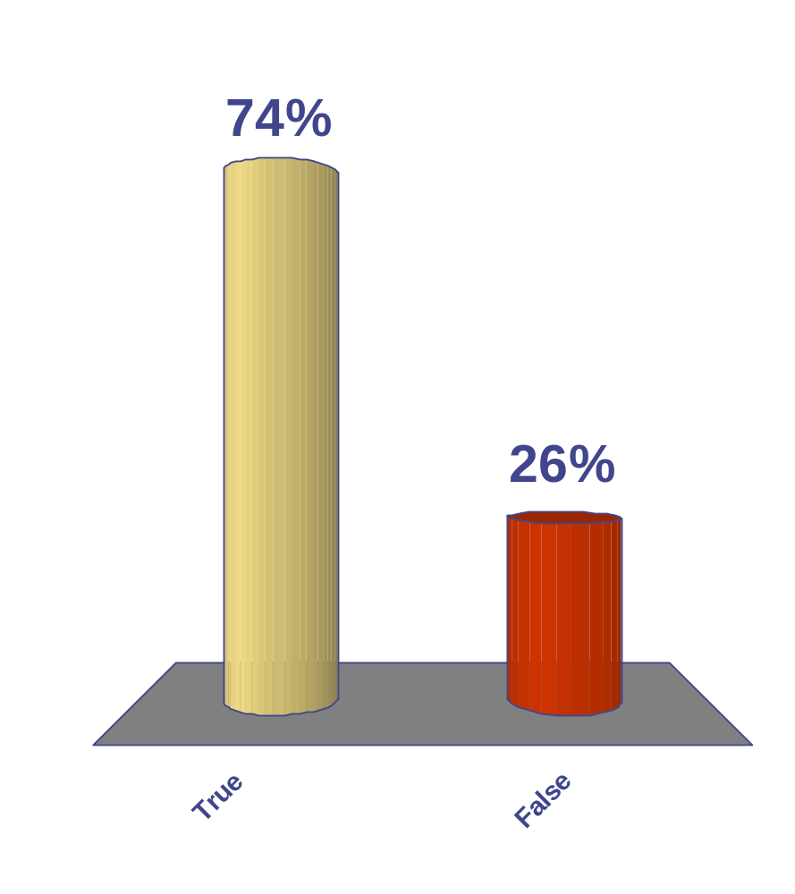
When a user level thread does I/O it blocks the entire process.
True
False
(Note – says different OS handle this question differently)
43 of 65

Slide 57
Sharing among threads is great …
int a = 1, b = 2;
main() {
CreateThread(fn1, 4);
CreateThread(fn2, 5);
}
fn1(int arg1) {
if(a) b++;
}
fn2(int arg1) {
a = arg1;
}
What are the value of a & b
at the end of execution?

Slide 58
… But it can lead to problems!!
int a = 1, b = 2;
main() {
CreateThread(fn1, 4);
CreateThread(fn2, 5);
}
fn1(int arg1) {
if(a) b++;
}
fn2(int arg1) {
a = 0;
}
What are the values of a & b
at the end of execution?

Slide 59
Some More Examples
What are the possible values of x in these cases?
Thread1: x = 1; Thread2: x = 2;
Initially y = 10;
Thread1: x = y + 1; Thread2: y = y * 2;
Initially x = 0;
Thread1: x = x + 1; Thread2: x = x + 2;

Slide 60
This is because …
Order of thread execution is non-deterministic
  Multiprocessing
    A system may contain multiple processors ➔ cooperating threads/processes can execute simultaneously
  Multi-programming
    Thread/process execution can be interleaved because of time-slicing

Slide 61
Operations are often not “atomic”
  Example: x = x + 1 is not atomic!
Goal:
  Ensure that your concurrent program works under ALL possible interleaving
Challenge
  Enumerating all cases is not possible!
  Need to define synchronization constructs and programming style for developing concurrent programs
  We will do this shortly

Slide 62
Pthreads
A POSIX standard (IEEE 1003.1c) API for thread creation and synchronization
API specifies behavior of the thread library, implementation is up to development of the library
Common in UNIX operating systems (Solaris, Linux, Mac OS X)

Slide 63
Windows XP Threads
Implements the one-to-one mapping
Each thread contains
  A thread id
  Register set
  Separate user and kernel stacks
  Private data storage area
The register set, stacks, and private storage area are known as the context of the threads
The primary data structures of a thread include:
  ETHREAD (executive thread block)
  KTHREAD (kernel thread block)
  TEB (thread environment block)

Slide 64
Linux Threads
Linux refers to them as tasks rather than threads
Thread creation is done through clone() system call
clone() allows a child task to share the address space of the parent task (process)

Slide 65
Java Threads
Java threads are managed by the JVM
Java threads may be created by:
  Extending Thread class
  Implementing the Runnable interface
We will investigate these in much more detail.

Slide 66
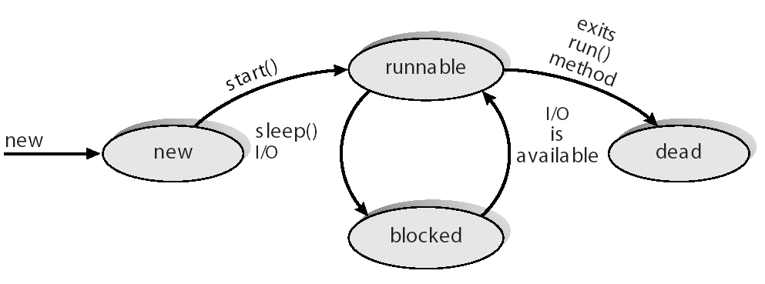
Java Thread States

