Slide 1
Chapter 5: CPU Scheduling

Slide 2
Chapter 5: CPU Scheduling
Basic Concepts
Scheduling Criteria
Scheduling Algorithms
Multiple-Processor Scheduling
Real-Time Scheduling
Thread Scheduling
Operating Systems Examples
Java Thread Scheduling
Algorithm Evaluation

Slide 3
Basic Concepts
The maximum CPU utilization is obtained with multiprogramming
CPU–I/O Burst Cycle – Process execution consists of a cycle of CPU executions and I/O waits followed finally by termination
Knowing the CPU-I/O burst distribution of typical jobs can be important in selecting appropriate CPU-scheduling algorithms.
I/O-bound programs has many short CPU bursts.
CPU-bound programs have a few long CPU bursts.

Slide 4

Am Example of an Alternating Sequence of CPU And I/O Bursts

Slide 5

Histogram of CPU-burst Times
CPU burst durations have been measured extensively and many programs tend to follow a curve similar to the one above with a large number of short CPU bursts followed by a small number of long CPU bursts.

Slide 6
CPU Scheduler
What it does - Selects from among the processes in memory that are ready to execute, and allocates the CPU to one of them
CPU scheduling decisions may take place when a process:
  1. Switches from running to waiting state
  2. Switches from running to ready state
  3. Switches from waiting to ready
  4. Terminates
When scheduling occurs only under 1 and 4, it is called non-preemptive or cooperative scheduling.
All other scheduling is preemptive scheduling.

Slide 7
Dispatcher
Dispatcher module gives control of the CPU to the process selected by the short-term scheduler; this involves:
  switching contexts
  switching to user mode
  jumping to the proper location in the user program to restart that program
Dispatch latency – time it takes for the dispatcher to stop one process and start another running

Slide 8
Scheduling Criteria
CPU utilization – goal is to keep the CPU as busy as possible while managing:
Throughput – # of processes that complete their execution per time unit
Turnaround time –The sum of the periods a process spends waiting to get into memory, waiting in the ready queue, executing on the CPU, and doing I/O. So, it is the length of the interval from the time of submission until the termination time.
Waiting time – amount of time a process has been waiting in the ready queue
Response time – amount of time it takes from when a request was submitted until the first response is produced, not the time it takes to produce a result output (for time-sharing environment)

Slide 9
Optimization Criteria
Normally we want to:
Max CPU utilization
Max throughput
Min turnaround time
Min waiting time
Min response time
Different algorithms provide different optimizations as the CPU-I/O burst times vary.
What are some of the algorithms that are used?

Slide 10
First-Come, First-Served (FCFS) Scheduling
Easy to implement – use a FIFO queue.
Code is simple to write and easy to understand.
But, we have to consider what will happen in various cases where our processes are mixed in characteristics.
Note: In this case, a process relinquishes the CPU only if it executes an I/O request or terminates.

Slide 11
First-Come, First-Served (FCFS) Scheduling
Process Burst Time
P₁ 24
P₂ 3
P₃ 3
Suppose that the processes arrive in the order:
P₁ , P₂ , P₃
The Gantt Chart (a bar chart that depicts activities as blocks over time) for the schedule is:
Waiting time for P₁ = 0; P₂ = 24; P₃ = 27
Average waiting time: (0 + 24 + 27)/3 = 17
P₁
P₂
P₃
0
24
27
30

Slide 12
FCFS Scheduling (Cont.)
Suppose that the processes arrive in the order
P₂ , P₃ , P₁
The Gantt chart for the schedule is now:
Waiting time for P₁ = 6; P₂ = 0; P₃ = 3
Average waiting time: (6 + 0 + 3)/3 = 3
Much better than previous case
P₂
P₃
P₁
0
3
6
30

Slide 13
FCFS Scheduling (Cont.)
But, consider a Convoy effect when short processes stack up behind a process that hogs the CPU.
FCFS scheduling is non-preemptive – i.e. once the CPU has been allocated to a process, that process keeps the CPU until it releases it by either terminating or requesting I/O.
This scheduling algorithm is particularly bad with timesharing systems.

Slide 14
Shortest-Job-First (SJF) Scheduling
Associate with each process the length of its next CPU burst. Use these lengths to schedule the process with the shortest time
Two schemes:
  non-preemptive – once CPU is given to the process it cannot be preempted until it completes its CPU burst
  preemptive – if a new process arrives with CPU burst length less than remaining time of current executing process, preempt. This scheme is know as the
  Shortest-Remaining-Time-First (SRTF)
SJF is optimal – gives minimum average waiting time for a given set of processes

Slide 15
Example of Non-Preemptive SJF
Process Arrival Time Burst Time
P₁ 0.0 7
P₂ 2.0 4
P₃ 4.0 1
P₄ 5.0 4
SJF (non-preemptive)
Average waiting time = (0 + 6 + 3 + 7)/4 = 4
P₁
P₃
P₂
P₄
0
3
7
8
12
16

Slide 16
Example of Preemptive SJF
Process Arrival Time Burst Time
P₁ 0.0 7
P₂ 2.0 4
P₃ 4.0 1
P₄ 5.0 4
SJF (preemptive)
Average waiting time = (9 + 1 + 0 +2)/4 = 3
P₁
P₂
P₃
P₂
P₄
P₁
0
2
4
5
7
11
16

Slide 17
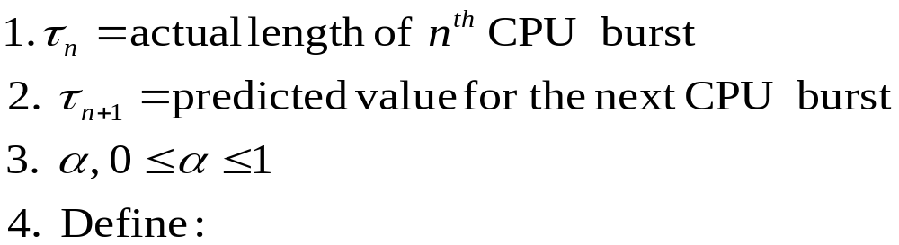

Determining Length of Next CPU Burst
Can only estimate the length obviously
However, it can be estimated by using the length of previous CPU bursts, using exponential averaging:

Slide 18

Prediction of the Length of the Next CPU Burst
blue is guess (although second 6 is plotted as a 5- an error in text)
black is actual
Uses α = ½ and τ_{o} = 10

Slide 19
Examples of Exponential Averaging
α =0
  τ_{n+1} = τ_{n}
  Recent history does not count
α =1
  τ_{n+1} = α t_{n}
  Only the actual last CPU burst counts
If we expand the formula, we get:
    τ_{n+1} = α t_{n}+(1 - α)α t_{n} -1 + …
    +(1 - α )^{j} α t_{n} _{-j} + …
    +(1 - α )^{n +1} τ₀
Since both α and (1 - α) are less than or equal to 1, each successive term has less weight than its predecessor. This captures the idea that the next CPU burst will be similar in length to the previous ones.

Slide 20
Priority Scheduling
A priority number (integer) is associated with each process
The CPU is allocated to the process with the highest priority (smallest integer ≡ highest priority)
  Preemptive
  non-preemptive
SJF is a priority scheduling where priority is the predicted next CPU burst time
Problem ≡ Starvation – low priority processes may never execute
Solution ≡ Aging – as time progresses increase the priority of the process

Slide 21
Starvation Example
Rumor has it that at MIT when the IBM 7094 was shut down in 1973, they found a low-priority process that had been submitted in 1967 and had not yet been run!
If true, that process was REALLY starved!

Slide 22
Round Robin (RR)
Each process gets a small unit of CPU time (time quantum), usually 10-100 milliseconds. After this time has elapsed, the process is preempted and added to the end of the ready queue.
If there are n processes in the ready queue and the time quantum is q, then each process gets 1/n of the CPU time in chunks of at most q time units at once. No process waits more than (n-1)q time units.
Performance
  q large ⇒ FIFO
  q small ⇒ q must be large with respect to context switch, otherwise overhead is too high

Slide 23
Example of RR with Time Quantum = 20
Process Burst Time
P₁ 53
P₂ 17
P₃ 68
P₄ 24
The Gantt chart is:
Typically, higher average turnaround than SJF, but better response
P₁
P₂
P₃
P₄
P₁
P₃
P₄
P₁
P₃
P₃
0
20
37
57
77
97
117
121
134
154
162

Slide 24

Time Quantum and Context Switch Time
Observe that the time quantum and context switch time affect the efficiency of the system.
Typically, modern systems use 10 – 100 milliseconds for the quantum as the typical time of a context switch is less than 10 microseconds (a small fraction of the quantum time).

Slide 25

Turnaround Time Varies With The Time Quantum
This assumes all enter memory at the same time, there is no I/O and the process are taken in order on the CPU. So,
P1 runs at time 0, P2 runs at time 1, P3 runs at time 2, P4 runs at time 3, P1 runs at time 4, P2 runs at time 5, P4 runs at time 6 etc- as P3 runs only once.
So, P3 takes 3 units; P2 takes 9 units; P1 takes 15 units; P4 takes 17 units. Avg = 44/4 or 11.0

Slide 26
Turnaround Time Varies With The Time Quantum
Note that the average turnaround time of a set of processes does not necessarily improve as the time-quantum size increases.

Slide 27
In General …
The overall turnaround time can be improved if most processes finish their next CPU burst in a single time quantum.
Example-
  3 processes of 10 time units each and a quantum of 1 time unit.
    P1 runs in time 0, 3, 6, 9, 12, 15, 18, 21, 24, 27 and finishes in time 28.
    P2 runs in time 1,4,7,10,13,16,19,22,25,28 and finishes in time 29.
    P3 finishes in time 30.
    So average turnaround time is (28+29+30)/3 = 87/3 = 29
  3 processes of 10 time units each and a quantum of 10 time units
    Average turnaround time is (10+ 20 + 30)/3 = 20.

Slide 28
Mixed Scheduling Algorithms
Examples: The ready queue is partitioned into separate queues:
foreground (interactive)
background (batch)
Each queue has its own scheduling algorithm- maybe
  foreground – RR
  background – FCFS
Scheduling must now be done between the queues
  Fixed priority scheduling; (i.e., serve all from foreground then from background). Possibility of starvation.
  Time slice – each queue gets a certain amount of CPU time which it can schedule amongst its processes; i.e., 80% to foreground in RR and 20% to background in FCFS

Slide 29

An Example of Multilevel Queue Scheduling
If processes cannot move between the queues after entering the system, the scheduling has low overhead, but is inflexible. Starvation is possible.

Slide 30
Multilevel Feedback Queue
A better approach: A process can move between the various queues; aging can be implemented this way
Multilevel-feedback-queue scheduler defined by the following parameters:
  number of queues
  scheduling algorithms for each queue
  method used to determine when to upgrade a process
  method used to determine when to demote a process
  method used to determine which queue a process will enter when that process needs service

Slide 31
Example of Multilevel Feedback Queue
Three queues:
  Q₀ – RR with time quantum 8 milliseconds
  Q₁ – RR time quantum 16 milliseconds
  Q₂ – FCFS
Scheduling
  A new job enters queue Q₀ which is served FCFS. When it gains CPU, job receives 8 milliseconds. If it does not finish in 8 milliseconds, job is moved to tail of queue Q₁.
  In Q_{1,}, job is again served FCFS if queue 0 is empty and then it receives 16 additional milliseconds. If it still does not complete, it is preempted and moved to queue Q₂ and is served FCFS, but only when queues 0 and 1 are empty.

Slide 32
Multilevel Feedback Queues
This example gives highest priority to any process with a CPU burst of 8 milliseconds or less. These will get the CPU quickly, finish their burst, and go off to its next I/O burst.
Processes needing more than 8 milliseconds, but less than 24 (8+16) milliseconds are served quickly also, but with lower priority than shorter processes.
Long processes sink to the last queue and are served with left over cycles from queues 1 and 2.
Since multilevel feedback queues can be configured to match various systems, this type of scheduler is the most general type.
But, it is obviously the most complex algorithm we have seen and can be difficult to tune since the various parameters must be defined.
It should be clear that no single scheduling algorithm can be declared to be the best for all possible loads and mixes.

Slide 33
Multiple-Processor Scheduling
CPU scheduling is more complex when multiple CPUs are available
Load sharing becomes possible although the scheduling problem becomes even more complex than for single CPUs.
We will consider only homogeneous processors within a multiprocessor, however, even with this assumption, life is not simple as only one processor may be set up to handle I/O, for example.
The simplest case is when we have asymmetric multiprocessing – only one processor accesses the system data structures, alleviating the need for data sharing.
This is the where we have a master server and all the other processors execute only user code.

Slide 34
Multiple-Processor Scheduling
A second approach uses symmetric multiprocessing (SMP) where each processor is self-scheduling.
Many choices now become available:
  Keep all processes in a common ready queue
  Each processor keeps its own ready queue.
Regardless of the approach, we will have multiple processes trying to access and update common data structures and as we have so painfully seen, this can cause trouble.
In addition, we must be sure that different processors don't choose the same process and that processes are not lost by the algorithm
Most modern OS support the SMP model: Windows XP, Windows 2000, Solaris, Linux, Max OS X.
Note: We will not cover 5.4.2 -5.4.4, but if you have had the parallel course you might find those sections interesting.

Slide 35
Real-Time Scheduling – Another Complication
Hard real-time systems – These are required to complete a critical task within a guaranteed amount of time
Soft real-time computing – These require that critical processes receive priority over less fortunate ones.

Slide 36
Thread Scheduling
Earlier when we introduced threads, we distinguished between user-level and kernel-level threads.
Initially, we simplified things by saying the CPU schedules processes, not threads. That is not quite true.
On OS that support them, kernel-level threads ARE scheduled by the CPU, not processes. A process in that case is just a single-thread.
However, user-level threads are managed by a thread library and the kernel is unaware of them.
To run on a CPU, a user-level thread must ultimately be mapped to an associated kernel-level thread.
However, the mapping may be indirect and use a lightweight process (LWP).

Slide 37
LWPs and Thread Scheduling
A lightweight process is a single-threaded sub-process which, unlike a thread, has its own process identifier and may also differ in its inheritance and controlling features.
Saying the thread library schedules user threads we do NOT mean the thread can be selected to run on the CPU
Two different methods are used to make the selection:
  Process-contention scope (PCS): On systems that use the many-to-one and many-to-many threads, the thread library schedules user-level threads to run on an available LWP.
    Competition for the CPU takes place between threads belonging to the same process.
  System-contention scope (SCS): On systems using the one-to-one model, competition for the CPU takes place among all threads in the system.
Some thread libraries allow the user to specify which method to use.

Slide 38
PCS
Typically done by priority – the scheduler selects the runnable thread with the highest priority to run.
User-level thread priorities are set by the programmer and the thread library does not adjust them.
Some thread libraries will allow the programmer to change the priority of a thread.
With PCS, threads will be preempted in favor of higher priority threads, but there is no guarantee of time slicing among threads of equal priority.

Slide 39
Thread Scheduling
Local Scheduling – How the threads library decides which thread to put onto an available LWP
Global Scheduling – How the kernel decides which kernel thread to run next

Slide 40
Operating System Examples
Solaris
Windows XP
Linux
Mac OS X
UNIX BSD
Windows 2000 and NT
Early Systems
Choose 3 that you would like to consider and rank in priority order (1 = highest).

Slide 41
Finding Information on Various OS
I want details as seen in, for example section 5.6.
There is a lot of information scattered throughout the book and in Chapter 23.
At the student site for the book,
http://bcs.wiley.com/he-bcs/Books?action=index&itemId=0471694665&bcsId=2217
are three appendices of use for some of the systems.
Powerpoint slides for illustrations in the text are available on the site and can be used (for example, see slide #43).
And, of course, google the OS.

Slide 42
Exact Organization
Right now, assume that each topic we study such as
  processes
  threads
  cpu scheduling
will be discussed relative to your OS choice.
Discussed how – you will have various times when I will ask you to present information on your chosen OS – one weekend in advance notice.

Slide 43
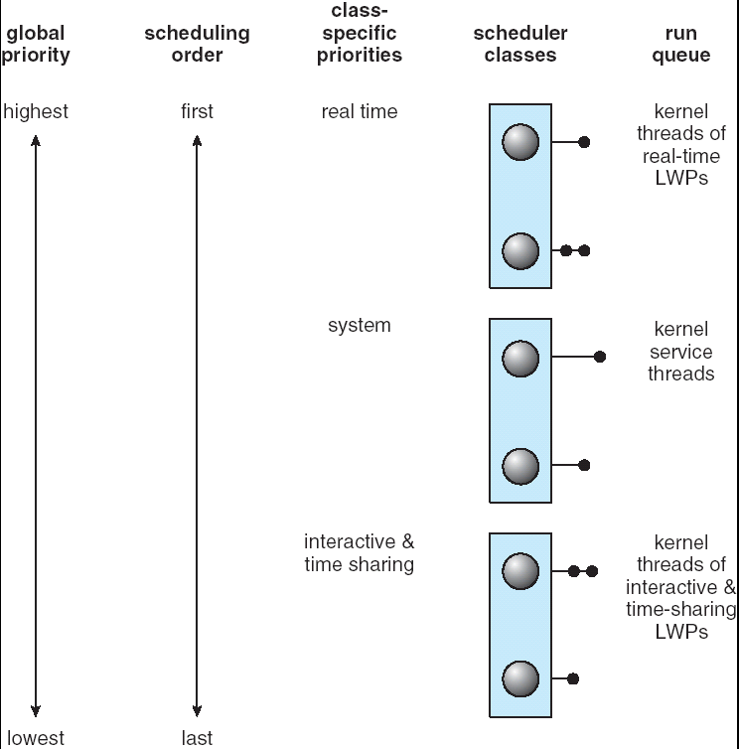
Solaris 2 Scheduling
An example of a slide you can use from text.

Slide 44
What Should You Begin Researching for Your OS?
Brief history of OS-
  When was it introduced?
  On what hardware does it run?
  Overview of significant versions
  Any other interesting background on OS?
What type of IPC (interprocess communication) is used? – i.e. like section 3.5
Are threads handled and how? – i.e. like section 4.5
What type of scheduling policies are used? i.e. like section 5.6.1
Don’t forget to read the exercises, even those not assigned, as there is some insights given in those.

Slide 45
Algorithm Evaluation
How do we select a CPU algorithm for a particular system as each algorithm has different characteristics?
Methods used:
  Deterministic modeling – takes a particular predetermined workload and defines the performance of each algorithm for that workload
  Queueing models
  Simulations
  Implement the algorithm and test

Slide 46
Deterministic Modeling
Analytic evaluation takes an algorithm and a system workload to produce a formula that will evaluate the performance of that algorithm for that workload.
One example of analytic evaluation is deterministic modeling:
Example: We have 5 processes, all arriving at time 0, in the order shown, and the length of the CPU burst is given in milliseconds:
Process Burst Time
P1 10
P2 29
P3 3
P4 7
P5 12
We pose the question: Given the FCFS, SJF, and RR with quantum = 10 milliseconds), which algorithm will give us the minimum average waiting time?

Slide 47

FCFS Algorithm Behavior
Wait times:
P1 0
P2 10
P3 39
P4 42
P5 49
So average wait time is (0+10+39+42+49)/5 = 28

Slide 48
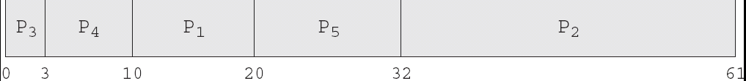
Non-premptive SJF Scheduling
Wait times:
P1 10
P2 32
P3 0
P4 3
P5 20
So average wait time is (10+32+0+3+20)/5 = 13

Slide 49

RR Scheduling
Wait times:
P1 0
P2 32
P3 20
P4 23
P5 40
So average wait time is (0+32+20+23+40)/5 = 23
For this load, the SJF gives us half the time of FCFS and RR is an intermediate value.

Slide 50
Deterministic Modeling Evaluation
Simple
Fast
Gives exact numbers allowing easy comparison
Obviously, best used if the load is stable and will be run multiple times.
Over a set of examples we may see trends that will help us choose a good scheduling algorithm.
For example, it can be shown that for all processes and their times available at time = 0,the SJF algorithm will give the minimum waiting time.

Slide 51
Queueing Models
Suppose instead of knowing all the processes that will run, we only know the distribution of CPU and I/O bursts either by direct measurement or an approximation.
Commonly this distribution is exponential and the mean is known. Moreover, if you take CPSC 361:Simulation in the spring term, you will see we can model the arrival times of processes.
Knowing arrival rates and service rates, using mathematics (queueing-network analysis) we can compute utilization, average queue length, average wait time, etc.
Unfortunately, this approach also has limitations as the classes of algorithms that can be studied and the distributions can be difficult to estimate.
Consequently, only very rough approximations are possible and we won’t pursue this approach further.
See Section 5.7.2 if you are curious.

Slide 52
Simulations
A more accurate evaluation in this type of situation is to use a simulation.
Simulations are useful in many situations where we can strip out extraneous information and capture the behavior of something by basically executing a simplified model of a system and collecting statistics.
Again, we will see many places where this is useful in CPSC 361: Simulations.
However, simulations can be expensive if built from scratch- luckily there are several systems that allow us to construct fairly sophisticated simulations rather quickly.

Slide 53

Fig 5.15 Evaluation of CPU Schedulers by Simulation

Slide 54
Implementation
Most accurate approach is to vary parameters in the OS and record what happens.
Obviously, if OS won’t let you play with the parameters, this would be very expensive.
And, of course, your environment can change. Just because you get a faster machine, if the scheduling algorithms are not chosen well, you can bog down everything.
Obvious question: Does your OS allow this to be done and, if yes, how do youdo it?

Slide 55
Java Thread Scheduling
JVM Uses a preemptive, priority-based scheduling algorithm
FIFO Queue is used if there are multiple threads with the same priority

Slide 56
Java Thread Scheduling (cont)
As we saw, JVM Schedules a Thread to run when:
  The Currently Running Thread Exits the Runnable State
  A Higher Priority Thread Enters the Runnable State
* Note – the JVM does not specify whether threads are time-sliced or not

Slide 57
Time-Slicing
Since the JVM doesn’t ensure time-slicing, the yield() method may be used:
while (true) {
// perform CPU-intensive task
. . .
Thread.yield();
}
This yields control to another thread of equal priority

Slide 58
Thread Priorities
Priority Comment
Thread.MIN_PRIORITY Minimum Thread Priority
Thread.MAX_PRIORITY Maximum Thread Priority
Thread.NORM_PRIORITY Default Thread Priority
Priorities may be set using setPriority() method:
setPriority(Thread.NORM_PRIORITY + 2);

