Slide 1
Chapter 8: Memory Management

Slide 2
Chapter 8: Memory Management
Background
Swapping
Contiguous Allocation
Paging
Segmentation
Segmentation with Paging

Slide 3
Background
Program must be brought into memory and placed within a process for it to be run
Input queue – collection of processes on the disk that are waiting to be brought into memory to run the program
User programs go through several steps before being run

Slide 4
Binding Instructions and Data to Memory
Address binding of instructions and data to memory addresses can
happen at any of three different stages
Compile time: If the memory location is known a priori, absolute code can be generated; must recompile code if starting location changes
Load time: Must generate relocatable code if the memory location is not known at compile time
Execution time: Binding can be delayed until run time if the process can be moved during its execution from one memory segment to another. This needs hardware support for address maps (e.g., base and limit registers).

Slide 5

Multistep Processing of a User Program

Slide 6
Logical vs. Physical Address Space
The concept of a logical address space that is bound to a separate physical address space is central to proper memory management
  Logical address – generated by the CPU; also referred to as virtual address
  Physical address – address seen by the memory unit
Logical and physical addresses are the same in compile-time and load-time address-binding schemes
Logical (virtual) and physical addresses differ in execution-time address-binding scheme

Slide 7
Memory-Management Unit (MMU)
What is it? It is a hardware device that maps virtual to physical address
In the MMU scheme, a value is placed in a register, called the relocation register, that is added to every address generated by a user process at the time it is sent to memory
The user program deals with logical addresses; it never sees the real physical addresses

Slide 8

Dynamic Relocation Using a Relocation Register

Slide 9
Dynamic Loading
A routine is not loaded until it is called
Have better memory-space utilization; an unused routine is never loaded
Useful when large amounts of code are needed to handle infrequently occurring cases
No special support from the operating system is required as this is implemented through program design

Slide 10
Dynamic Linking
Linking postponed until execution time
Small piece of code, stub, used to locate the appropriate memory-resident library routine
Stub replaces itself with the address of the routine, and executes the routine
Operating system is needed to check if routine is in processes’ memory address
Dynamic linking is particularly useful for libraries

Slide 11
Swapping
A process can be swapped temporarily out of memory to a backing store, and then brought back into memory for continued execution
Backing store – fast disk large enough to accommodate copies of all memory images for all users; must provide direct access to these memory images
Roll out, roll in – swapping variant used for priority-based scheduling algorithms; a lower-priority process is swapped out so higher-priority process can be loaded and executed
Major part of swap time is transfer time; total transfer time is directly proportional to the amount of memory swapped. Modified versions of swapping are found on many systems (i.e., UNIX, Linux, and Windows)

Slide 12

Schematic View of Swapping

Slide 13
Contiguous Allocation
Main memory is usually segmented into two partitions:
  Resident operating system, usually held in low memory with interrupt vector
  User processes then held in high memory
Single-partition allocation
  Relocation-register scheme used to protect user processes from each other, and from changing operating-system code and data
  Relocation register contains value of smallest physical address; limit register contains range of logical addresses – each logical address must be less than the limit register

Slide 14
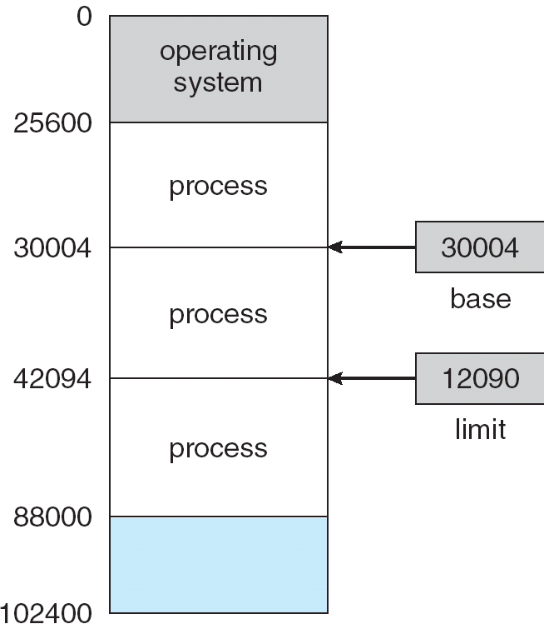
A base and a limit register define a logical address space

Slide 15

Hardware Address Protection with Base and Limit Registers

Slide 16
Contiguous Allocation
Multiple-partition allocation
  Hole – block of available memory; holes of various size are scattered throughout memory
  When a process arrives, it is allocated memory from a hole large enough to accommodate it
  An operating system maintains information about:
  a) allocated partitions b) free partitions (holes)
OS
OS
OS
OS
process 5
process 5
process 5
process 5
process 9
process 9
process 8
process 10
process 2
process 2
process 2
process 2

Slide 17
Dynamic Storage-Allocation Problem
How do we satisfy a request of size n from a list of free holes?
First-fit: Allocate the first hole that is big enough
Best-fit: Allocate the smallest hole that is big enough; must search entire list, unless ordered by size. Produces the smallest leftover hole.
Worst-fit: Allocate the largest hole; must also search entire list. Produces the largest leftover hole.
It can be demonstrated that first-fit and best-fit are better than worst-fit in terms of speed and storage utilization

Slide 18
Fragmentation
External Fragmentation – total memory space exists to satisfy a request, but it is not contiguous
Internal Fragmentation – allocated memory may be slightly larger than requested memory; this size difference is memory internal to a partition, but not being used
Reduce external fragmentation by compaction
  Shuffle memory contents to place all free memory together in one large block
  Compaction is possible only if relocation is dynamic, and is done at execution time
  I/O problem
    Latch job in memory while it is involved in I/O
    Do I/O only into OS buffers

Slide 19
Paging
Logical address space of a process can be noncontiguous; process is allocated physical memory whenever the latter is available
Divide physical memory into fixed-sized blocks called frames (size is power of 2, between 512 bytes and 8192 bytes)
Divide logical memory into blocks of same size called pages.
Keep track of all free frames
To run a program of size n pages, need to find n free frames and load program
Set up a page table to translate logical to physical addresses
Internal fragmentation can result with this scheme.

Slide 20
Address Translation Scheme
Address generated by CPU is divided into two parts:
  Page number (p) – used as an index into a page table which contains base address of each page in physical memory
  Page offset (d) – combined with base address to define the physical memory address that is sent to the memory unit

Slide 21
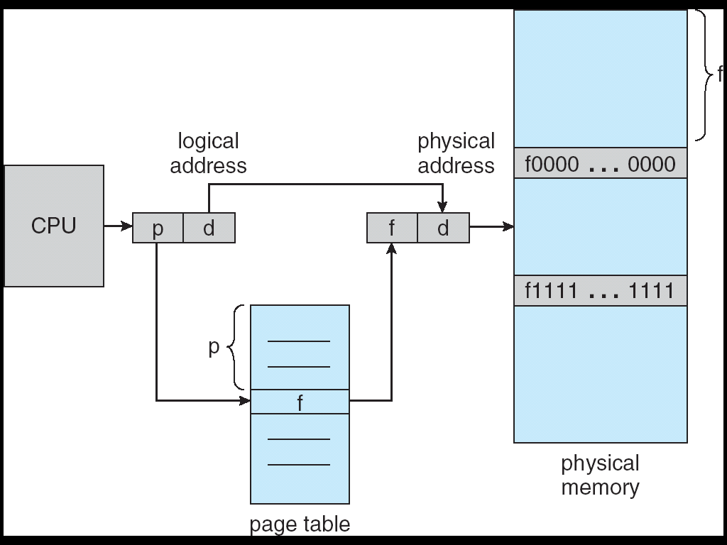
Address Translation Architecture
p = index into page table where base address in physical memory for each page is shown.
d = displacement from start base address
Hardware support for paging.

Slide 22

Paging Example
Note: Pages are the same size so no external fragmentation occurs.
This just shows the page mapping, not the displacement in the page.

Slide 23

Simple Paging Example
LA=logical address; pa=physical address
LA=0 ⇒ page = 0, offset = 0 ⇒
pa = 5*4 + 0 = 20
LA=3 ⇒ page = 0, offset = 3 ⇒
pa = 5*4 + 3 = 23
LA=13 ⇒ page = 3, offset = 1 ⇒
pa = 2*4 + 1 = 9
Note: Locate the page and offset in LA; index by page into page table to get page number; multiply page number by size (4 bytes) and add offset to obtain PA.
Assume
page = 4 bytes and physical memory is 32 bytes

Slide 24
Observe User Space vs Memory
User views program as residing in contiguous memory.
In reality, program is scattered throughout the physical memory.
OS must keep track of which frames are allocated, which frames are free, how many frames there are, etc.
This information is kept in a frame table.

Slide 25

Free Frames
Before allocation
After allocation

Slide 26
Implementation of Page Table
The page table is kept in main memory
The page-table base register (PTBR) points to the page table
The page-table length register (PRLR) indicates the size of the page table
In this scheme every data/instruction access requires two memory accesses. One for the page table and one for the data/instruction.
The two memory access problem can be solved by the use of a special fast-lookup hardware cache called associative memory or translation look-aside buffers (TLBs)

Slide 27
Associative Memory
Associative memory – parallel search - just like a SIMD machine
Address translation (A´, A´´)
  If A´ is in associative memory, get frame # out
  Otherwise get frame # from page table in memory
Page #
Frame #

Slide 28

Paging Hardware With TLB

Slide 29
Effective Access Time
Associative Lookup = ε time unit
Assume memory cycle time is 1 microsecond
Hit ratio – percentage of times that a page number is found in the associative registers; ration related to number of associative registers
Hit ratio = α
Effective Access Time (EAT)
EAT = (1 + ε) α + (2 + ε)(1 – α)
= 2 + ε – α

Slide 30
Memory Protection
Memory protection implemented by associating protection bit with each frame
Valid-invalid bit attached to each entry in the page table:
  “valid” indicates that the associated page is in the process’ logical address space, and is thus a legal page
  “invalid” indicates that the page is not in the process’ logical address space

Slide 31

Valid (v) or Invalid (i) Bit In A Page Table

Slide 32
Page Table Data Structure
Hierarchical Paging
Hashed Page Tables
Inverted Page Tables

Slide 33
Hierarchical Page Tables
Most modern computers support a large logical address space and the page table can become excessively large.
We don't need to keep the page table in contiguous memory.
So, we'll break up the logical address space into multiple page tables
A simple technique is a two-level page table

Slide 34
Two-Level Paging Example
A logical address (on 32-bit machine with 4K page size) is divided into:
  a page number consisting of 20 bits
  a page offset consisting of 12 bits
Since the page table is paged, the page number is further divided into:
  a 10-bit page number
  a 10-bit page offset
Thus, a logical address is as follows:
where p_{i} is an index into the outer page table, and p₂ is the displacement within the page of the outer page table
page number
page offset
p_{i}
p₂
d
10
10
12

Slide 35

Two-Level Page-Table Scheme
Note that the page table is paged itself.

Slide 36

Address-Translation Scheme
Address-translation scheme for a two-level 32-bit paging architecture
Since this scheme moves from the outer page table to an inner one, it is called a forward-mapping page table.

Slide 37
Hashing
It is common in address spaces > 32 bits to use hashed page tables.
In Data Structures, you will learn (or did learn) about
hashing functions – functions that map integers to integers so that the function spreads out the values, has minimal collisions (i.e. mapping to the same value), and is quick and easy to calculated.
An example would be f(i) = i mod k where we map i to a number between 0 and k-1.
We say a number is hashed when we apply the hash function to a number.

Slide 38
Hash Tables
Typically, to store data in a hash table we hash into an array of pointers and each pointer points to a chain where we store the data:
2
16
9
23
Using the function on the last slide with k = 7

Slide 39

Hashed Page Table
The virtual page number is hashed into a page table.
This page table contains a chain of elements hashing to the same location.
Virtual page numbers are compared in this chain searching for a match. If a match is found, the corresponding physical frame is extracted.

Slide 40
Some Observations
Usually each process has an associated page table.
The page table has one entry for each page that the process is using or one slot for each virtual address.
This is a natural representation since processes reference pages through the pages' virtual addresses.
The OS then translates this reference into a physical memory address.
Since the table is sorted by virtual address, the OS is able to calculate where in the table the associated physical address entry is and is able to use the value directly.
One drawback, however, is that each page table may consist of millions of entries and the tables may consume large amounts of physical memory just to keep track of how that memory is being used.

Slide 41
Inverted Page Tables
Inverted page table solve some of the problem just mentioned.
Use one entry for each real page of memory
An entry consists of the virtual address of the page stored in that real memory location, with information about the process that owns that page
This decreases the memory needed to store each page table, but increases the time needed to search the table when a page reference occurs
Use hash table to limit the search to one — or at most a few — page-table entries
As we will see, this approach makes it difficult, however, to implement shared memory.

Slide 42

Inverted Page Table Architecture

Slide 43
Shared Pages
Shared code
  One copy of read-only (reentrant) code shared among processes (i.e., text editors, compilers, window systems).
  Shared code must appear in same location in the logical address space of all processes
Private code and data
  Each process keeps a separate copy of the code and data
  The pages for the private code and data can appear anywhere in the logical address space

Slide 44
Shared Pages
One advantage of paging it is possible to share common code without too much difficulty.
Just think of multiple users using a text editor and not sharing the code. This would require duplication of the code for each user.
Of course, the data space would not be shared, but would be separately mapped for each user.
Other commonly shared programs are compilers, libraries, data base systems, etc.

Slide 45
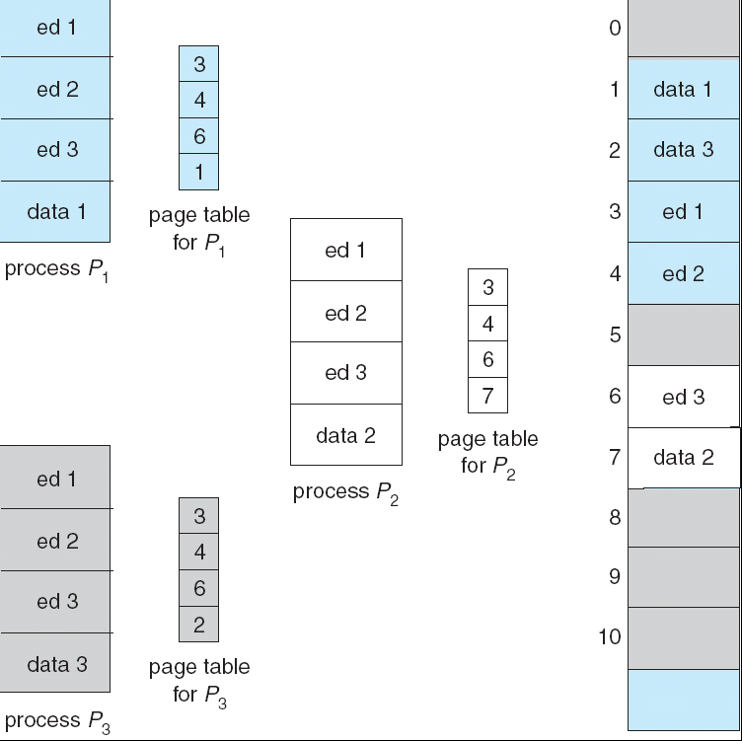
Shared Pages Example

Slide 46
Segmentation – Another Way of Managing Memory
Memory-management scheme that supports user view of memory
A program is a collection of segments. A segment is a logical unit such as:
main program,
procedure,
function,
method,
object,
local variables, global variables,
common block,
stack,
symbol table, arrays

Slide 47

User’s View of a Program

Slide 48
Logical View of Segmentation
1
1
4
2
3
2
4
3
user space
physical memory space

Slide 49
Segmentation Architecture
Logical address consists of a two tuple:
<segment-number, offset>,
Segment table – maps two-dimensional physical addresses; each table entry has:
  base – contains the starting physical address where the segments reside in memory
  limit – specifies the length of the segment
Segment-table base register (STBR) points to the segment table’s location in memory
Segment-table length register (STLR) indicates number of segments used by a program;
segment number s is legal if s < STLR

Slide 50
Segmentation Architecture
Relocation.
  dynamic
  by segment table
Sharing.
  shared segments
  same segment number
Allocation.
  first fit/best fit
  external fragmentation

Slide 51
Segmentation Architecture
Protection. With each entry in segment table associate:
  validation bit = 0 ⇒ illegal segment
  read/write/execute privileges
Protection bits associated with segments; code sharing occurs at segment level
Since segments vary in length, memory allocation is a dynamic storage-allocation problem
A segmentation example is shown in the following diagram

Slide 52

Address Translation Architecture

Slide 53

Example of Segmentation

Slide 54
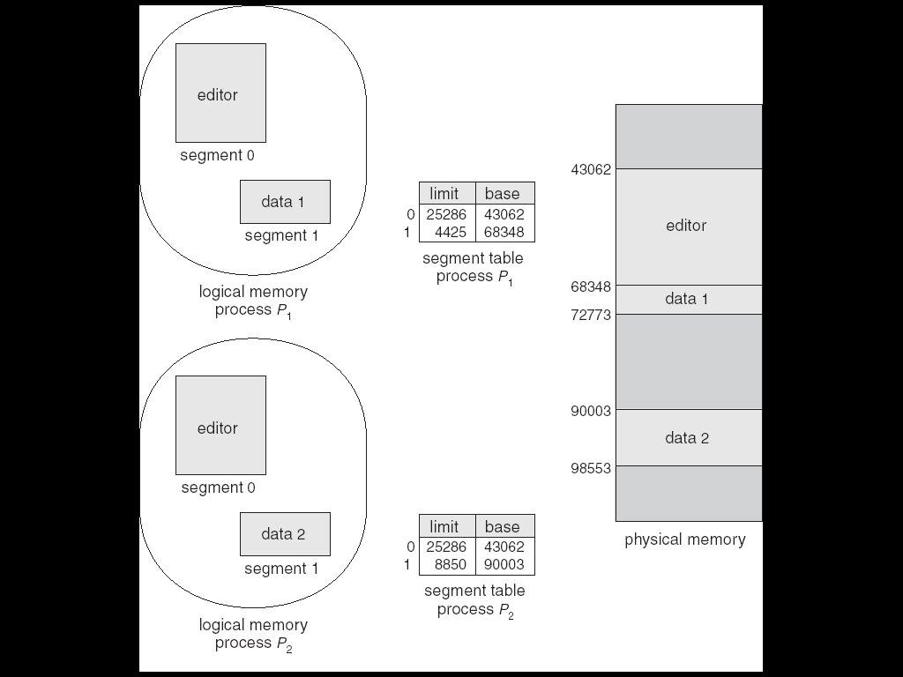
Sharing of Segments

Slide 55
Summary
Memory-management schemes for multiprogrammed OS go from a single-user system approach to paged segmentation.
Which system is used is determined predominately by the hardware that must be present.
Every memory address generated by the CPU must be checked for legality and, if legal, mapped to a physical address. This can't be done efficiently in software.
Thus, this area, more than any other, is constrained by the hardware.
We have considered several memory management algorithms: continuous allocation, paging, segmentation.
When you look at specific systems, you will find some combinations of paging and segmentation.

Slide 56
Evaluating Memory Management Schemes
We need to consider the following when evaluating each of these schemes:
  Hardware support
  Performance
  Fragmentation
  Relocation
  Swapping
  Sharing
  Protection

Slide 57
Evaluation
Hardware support
  For single and multiple-partition schemes, the simple base register and base-limit register suffices.
  Paging and segmentation need mapping tables to define the address map.
Performance
  The more complex the algorithm, the more time that is consumed in mapping the logical address to a physical address.
  Paging and segmentation can be fast if the mapping table is handled by fast registers.
  But, if it is kept in memory, memory accesses will degrade performance substantially. A TBL (table look-aside buffer – i.e. a special fast, small lookup hardware cache that is associative) can help in paging.

Slide 58
Evaluation
Fragmentation
  In a multiprogrammed environment, it is best to pack a lot of processes into memory.
  To do this, we need to decrease wasted memory – i.e. control fragmentation.
  Systems with fixed-sized allocation units (such as a single partition scheme or paging) suffer from internal fragmentation.
  Systems with variable-sized allocation units (such as a multiple-partition scheme or segmentation) suffer from external fragmentation.
Relocation
  Compacting helps with the external fragmentation problem, but this requires that logical addresses must be able to be relocated dynamically

Slide 59
Evaluation
Swapping
  Swapping can be added to any of the schemes.
Sharing
  This generally requires that either paging or segmentation be used.
  Sharing allows us to run a large number of processes even if memory is tight.
Protection
  If paging or segmentation is used, different portions of a user program can be given different protections such as execute-only, read-only, read-write, etc.
  This restriction is necessary with shared code or data and is handled by simple run-time checks.

