Slide 1
Chapter 9: Virtual Memory

Slide 2
Chapter 9: Virtual Memory
Background
Demand Paging
Process Creation
Page Replacement
Allocation of Frames
Thrashing
Demand Segmentation
Operating System Examples

Slide 3
Schemes in Last Chapter
Goal of all schemes in last chapter – to keep many processes in memory simultaneously to allow multiprogramming.
But, they tend to require that the entire process is memory-resident before it can execute.
Virtual memory is a technique that allows the execution of processes that are not completely in memory.
As we will see, there are many advantages of this approach.

Slide 4
Background
Virtual memory – separation of user logical memory from physical memory.
  Only part of the program needs to be in memory for execution.
  Logical address space can therefore be much larger than physical address space.
  Allows address spaces to be shared by several processes.
  Allows for more efficient process creation.
Virtual memory can be implemented via:
  Demand paging
  Demand segmentation

Slide 5
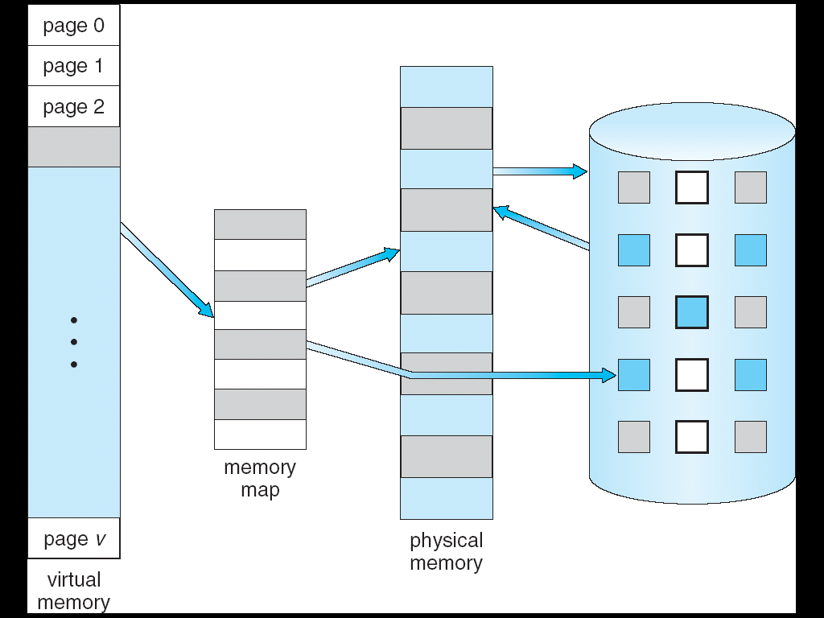
Virtual Memory That is Larger Than Physical Memory
⇒

Slide 6

Virtual-address Space
Heap grows upward in memory as it is used for dynamic memory allocation.
A stack grows downward in memory as is used, for example, for successive function calls.
Blank space in virtual-address space must be maintained in physical memory only if heap or stack grows.

Slide 7

Shared Pages Using Virtual Memory
Shared libraries are usually mapped into read-only memory.
Shared memory can also be used for interprocess communication.
Shared memory can speed up process creation if used with fork() system call.

Slide 8
Demand Paging – Typically Used in Virtual Address Systems
Bring a page into memory only when it is needed
  Less I/O needed
  Less memory needed
  Faster response
  More users
Page is needed ⇒ reference to it
  invalid reference ⇒ abort
  not-in-memory ⇒ bring to memory

Slide 9
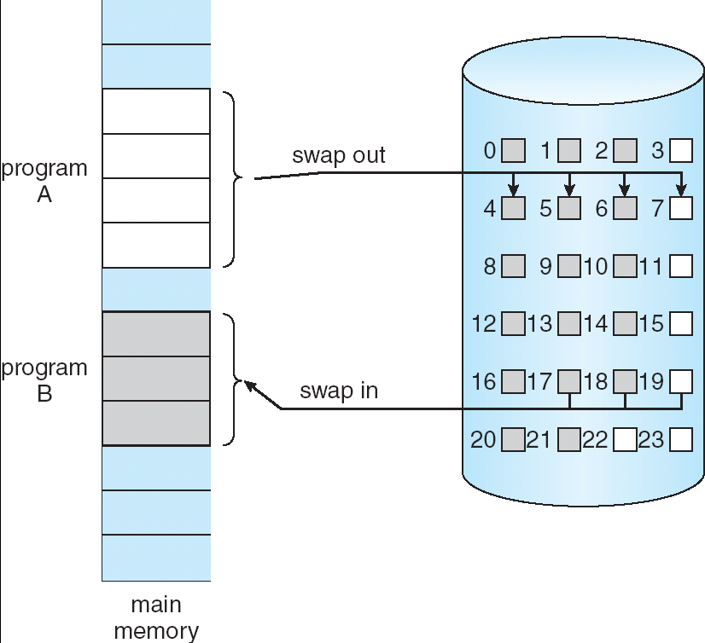
Transfer of a Paged Memory to Contiguous Disk Space
Similar to swapping, but use a lazy swapper – i.e. a page is not loaded unless it is needed.
Typically, we call this a pager, not a swapper, when working with demand paging.

Slide 10
Valid-Invalid Bit
With each page table entry a valid–invalid bit is associated
(1 ⇒ in-memory and legal,
0 ⇒ not-in-memory or not legal)
Initially valid–invalid bit is set to 0 on all entries
During address translation, if valid–invalid bit in page table entry is 0 ⇒ page fault
Note that marking a page invalid has no effect if the process never tries to access that page
Thus, if bring in only those pages that are needed, the process will run as if it is memory resident.

Slide 11

Page Table When Some Pages Are Not in Main Memory

Slide 12
Page Fault Handling
If there is ever a reference to a page, first reference will trap to OS ⇒ page fault
OS looks at another table to decide:
  Invalid reference ⇒ abort.
  Just not in memory.
Get empty frame.
Swap page into frame.
Reset tables, validation bit = 1.
Restart instruction.
Note: In the extreme case, we can start executing a process with no pages in memory. (Known as pure demand paging.)

Slide 13

Steps in Handling a Page Fault

Slide 14
Critical for Demand Paging
Must be able to restart any instruction after a page fault.
We are saving the state (registers, condition codes, instruction counter) of the interrupted process when the page fault occurs. Thus
  If page fault occurs on an instruction fetch, restart by doing a new fetch.
  If page fault occurs on operand fetch, we must fetch and decode the instruction again and then do a fetch of operand.
  The worst case scenario can occur – see next slide.

Slide 15
Worst Case
Consider a 3-address machine. The following shows steps in executing ADD A,B,C:
  Fetch and decode ADD
  Fetch A
  Fetch B
  Add A and B
  Store sum in C
If we fault when we try to store into C, we need to get the desired page, correct the page table, fetch the instruction again, decode it again, fetch the two operands again. Add again, and, finally, store the result.
Note there is little repeated work so all this must be done.
However, a snag can occur …

Slide 16
Worst Case
Suppose you have an instruction that can move multiple bytes in memory and either source bytes or destination bytes straddle a page boundary and the fault occurs after some of the memory locations have been modified.
Solutions:
  Attempt to access both ends of the array. If a page fault will occur, it will happen at this point and the restart is easy.
  Or, use temporary registers to hold the values of overwritten locations. (The problem here, is you may not have enough registers.)
Although technically, paging can be added to a computer system if it is not supported in hardware (although performance will degrade), it is not true that demand paging can be added without the hardware support.
Note: there are other issues that arise with demand paging if hardware doesn’t support it, but we won’t pursue those here.

Slide 17
What Happens If There is no Free Frame?
Page replacement – find some page in memory, but not really in use, swap it out
  Algorithm – how is the page located?
  Performance – want an algorithm which will result in minimum number of page faults
This implies the same page may be brought into memory several times without being executed.

Slide 18
Servicing a Page Fault
A page fault sequence is:
  Trap to OS
  Save user registers and process state
  Determine that the interrupt was a page fault
  Check that the page reference was legal and determine the location of the page on disk.
  Issue a read from the disk to a free frame.
    Wait in a queue for this device until read request is serviced.
    Wait for a device seek and/or latency time.
    Begin transfer of page to a free frame…
Note: latency time is the time it takes for the read/write head to be positioned in the correct sector.

Slide 19
Servicing a Page Fault – Not Finished Yet
While waiting, allocate the CPU to some other user by the scheduling algorithm in effect.
Receive an interrupt from disk I/O signaling the transfer is complete.
Save the registers and state for other user on CPU
Determine that interrupt was from the disk.
Correct the page table and other tables to show that the desired page is now memory resident.
Wait for CPU to be allocated for this process again.
Restore the user registers, process state, and new page table and resume the interrupted instruction.
Note: If not in a multiprogramming environment, some of these steps may be skipped.

Slide 20
Major Components of Page Falut Service Time
Service the page-fault interrupt
Read in the page
Restart the process.

Slide 21
Performance of Demand Paging
Page Fault Rate 0 ≤ p ≤ 1.0
  if p = 0 no page faults
  if p = 1, every reference is a fault
Effective Access Time (EAT)
EAT = (1 – p) x memory access
+ p (page fault overhead
+ [swap page out ]
+ swap page in
+ restart overhead)

Slide 22
Demand Paging Example
Servicing the page-fault interrupt and restarting the process can be reduced to several hundred instructions with careful coding and we can achieve 1 to 100 microsecond timings on these typically.
Page-switch time is often close to 8 milliseconds.
Typical hard disks today have an average latency of 3 milliseconds, a seek time of 8 milliseconds, and a transfer time (of a block) of 0.05 milliseconds. Thus, total paging time is about 8 milliseconds (not counting queueing time).
If we take an average page-fault service time of 8 milliseconds and a memory-access time of 200 nanoseconds, the effect access time in nanoseconds …

Slide 23
Demand Paging Example
EAT = (1-p) X 200 + p(8 milliseconds) =
    (1-p) X 200 + p X 8,000,000 =
    100 + 7,990,800 X p
    Thus, EAT is directly proportional to the
    page-fault rate.
If 1 access out of 1,000 causes a page fault, the EAT is 8.2 microseconds which says
the computer will be slowed down by a factor of 40 when demnd paging is used!

Slide 24
Demand Paging Example
It is reasonable to implement a procedure which only degrades the system performance by 10%. To do this, we need
  220 > 200 + 7,999,800 X p (from last formula)
  = 20 > 7,999,800 X p
  i.e. p < 0.0000025
This would require fewer than one memory access out of 399,990 to result in a page fault.

Slide 25
Performance of Demand Paging
Obviously a very bad case is when a page fault occurs for every instruction.
Discuss:
  Why structured programming and the elimination of goto resulted from observing the above fact.

Slide 26
Another Thing to Worry About in Demand Paging
We must handle the overall use of the swap space.
We will probably explore this further when we discuss file system.
A few remarks can be seen on page 325.

Slide 27
Process Creation
Virtual memory allows other benefits during process creation:
- Copy-on-Write
- Memory-Mapped Files (later)

Slide 28
Copy-on-Write
Copy-on-Write (COW) allows both parent and child processes to initially share the same pages in memory
If either process modifies a shared page, only then is the page copied
COW allows more efficient process creation as only modified pages are copied
Free pages are allocated from a pool of zeroed-out pages

Slide 29
Page Replacement
Prevent over-allocation of memory by modifying page-fault service routine to include page replacement
Use modify (dirty) bit to reduce overhead of page transfers – only modified pages are written to disk
Page replacement completes separation between logical memory and physical memory – large virtual memory can be provided on a smaller physical memory

Slide 30

Need For Page Replacement

Slide 31
Basic Page Replacement
Find the location of the desired page on disk
Find a free frame:
- If there is a free frame, use it
- If there is no free frame, use a page replacement algorithm to select a victim frame
Read the desired page into the (newly) free frame. Update the page and frame tables.
Restart the process

Slide 32

Page Replacement

Slide 33

Graph of Page Faults Versus The Number of Frames Available

Slide 34
Page Replacement Algorithms
Want lowest page-fault rate
Evaluate algorithm by simulating it on a particular string of memory references (reference string) and computing the number of page faults on that string
In all our examples, a reference string is picked.
Obviously, to really evaluate the algorithms, you would need different strings.

Slide 35

FIFO Page Replacement
How many page faults?
15

Slide 36
First-In-First-Out (FIFO) Algorithm
Reference string: 1, 2, 3, 4, 1, 2, 5, 1, 2, 3, 4, 5
3 frames (3 pages can be in memory at a time per process)
4 frames
FIFO Replacement – Belady’s Anomaly
  more frames ⇒ more page faults
1
1
4
5
2
2
1
3
9 page faults
3
3
2
4
1
1
5
4
2
2
1
5
10 page faults
3
3
2
4
4
3

Slide 37

FIFO Illustrating Belady’s Anomaly
Note the page-fault rate may actually increase as the number of allocated frames increases.

Slide 38
Optimal Algorithm
Replace page that will not be used for longest period of time
4 frames example: 1, 2, 3, 4, 1, 2, 5, 1, 2, 3, 4, 5
How do you know this?
  Don’t
Used for measuring how well your algorithm performs
1
4
2
6 page faults
3
4
5

Slide 39

Optimal Page Replacement
It can be shown that Optimal Page Replacement can never exhibit Belady’s anomaly.

Slide 40
Least Recently Used (LRU) Algorithm
Reference string: 1, 2, 3, 4, 1, 2, 5, 1, 2, 3, 4, 5
Counter implementation
  Every page entry has a counter; every time page is referenced through this entry, copy the clock time into the counter
  When a page needs to be changed, look at the counters to determine which are to change
1
5
2
3
5
4
4
3

Slide 41

LRU Page Replacement
It can be shown that Least Recently Used Page Replacement can never exhibit Belady’s anomaly.

Slide 42
LRU Algorithm
Stack implementation – keep a stack of page numbers in a double link form:
  Page referenced:
    move it to the top
    requires 6 pointers to be changed
  No searching for replacement

Slide 43

Use Of A Stack to Record The Most Recent Page References
Note the 6 pointers needing changing.

Slide 44
Needed Hardware Support for LRU Page Replacement
Few computer systems provide sufficient hardware for supporting true LRU page replacement – in fact, some provide none at all and other algorithms such as FIFO must be used.
Some do provide limited support by making a reference bit available at the hardware level.
Reference bits are associated with each entry in a page table and is set to 0 initially and set to 1 if the page is referenced.
This bit, while not showing the order of access, does provide enough information to use a LRU-approximation algorithm.

Slide 45
LRU Approximation Algorithms
Reference bit
  With each page associate a bit, initially = 0
  When page is referenced set bit to 1
  Replace one which is 0 (if one exists). We do not know the order, however.
Second chance algorithm (sometimes called the clock algorithm)
  Need reference bit
  Select tentatively using a FIFO replacement algorithm based on clock time it entered the system.
  If page to be replaced (in clock order) has reference bit = 1 then:
    set reference bit 0
    leave page in memory (giving it a second chance)
    replace next page (in clock order), subject to same rules
  Thus, a page given a second chance will not be replaced until all other pages have been replaced or given a second chance.
  If the page is used often enough to keep its reference bit set, it will never be replaced.

Slide 46

Second-Chance (clock) Page-Replacement Algorithm Implementation
replace

Slide 47
Counting Algorithms For Page Replacement
Keep a counter of the number of references that have been made to each page
LFU (Least Frequently Used) Algorithm: replaces page with smallest count
MFU (Most Frequently Used) Algorithm: based on the argument that the page with the smallest count was probably just brought in and has yet to be used
Note- these are expensive to implement and, consequently, they are not used much.

Slide 48
Allocation of Frames
Each process needs a minimum number of frames because it needs all frames required to handle at least a single instruction (otherwise page faults would continually occur and we’d end up restarting instructions continually.)
For example: IBM 370 can use 6 frames to handle SS MOVE instruction:
  instruction is 6 bytes, might span 2 frames
  2 frames to handle from
  2 frames to handle to
This minimum is determined by the hardware.
Two major allocation schemes
  fixed allocation
  priority allocation

Slide 49


Fixed Allocation
Equal allocation – For example, if there are 100 frames and 5 processes, give each process 20 frames.
Proportional allocation – Allocate according to the size of process
Example
This is fairer if there are processes with a large difference in size.

Slide 50
Priority Allocation
Use a proportional allocation scheme using priorities rather than size
If process P_{i} generates a page fault,
  select for replacement one of its frames
  select for replacement a frame from a process with lower priority number

Slide 51
Global vs. Local Allocation
Global replacement – process selects a replacement frame from the set of all frames; one process can take a frame from another
Local replacement – each process selects from only its own set of allocated frames

Slide 52
Thrashing
If a process does not have “enough” pages, the page-fault rate is very high. This leads to:
  low CPU utilization
  the operating system thinks that it needs to increase the degree of multiprogramming
  another process added to the system
Thrashing - a process is spending more time swapping pages in and out than executing

Slide 53

Thrashing (Cont.)
At the point that thrashing occurs, performances degrades rapidly.

Slide 54
Demand Paging and Thrashing
Locality model of process execution
  A locality is a set of pages that are actively used together.
  A program is composed of several different localities.
  A process migrates from one locality to another
  Localities may overlap
  Localities are defined by the program structure and its data structures.
Why does thrashing occur?
Σ size of locality > total memory size

Slide 55

Locality In A Memory-Reference Pattern

Slide 56
Working-Set Model
Δ ≡ working-set window ≡ a fixed number of page references Example: 10,000 references
WSS_{i} (working set of Process P_{i}) =
total number of pages referenced in the most recent Δ (varies in time)
  if Δ too small will not encompass entire locality
  if Δ too large will encompass several localities
  if Δ = ∞ ⇒ will encompass entire program
D = Σ WSS_{i} ≡ total demand for frames;
m = total available frames
  If D > m ⇒ Thrashing
  Policy if D > m, then suspend one of the processes

Slide 57

Working-set Model
Assuming Δ=10

Slide 58
Using the Working Set Model
Select Δ.
The OS monitors the working set of each process and allocates to the working set enough frames to provide it with its working-set size.
If there are enough extra frames, another process may be initialized.
If the sum of the working set size increases and exceeds the total number of available frames, the OS selects a process to suspend.
The process' pages are swapped and its frames are reallocated to another process.
The suspended process can be restarted later.
This procedure prevents thrashing, but keeps the degree of multiprogramming as high as possible.

Slide 59
Keeping Track of the Working Set
Approximate with interval timer + a reference bit
Example: Δ = 10,000
  Timer interrupts after every 5000 time units
  Keep in memory 2 bits for each page
  Whenever a timer interrupt occurs, copy and set the values of all reference bits to 0
  If a page fault occurs subsequently, examine the reference bits.
  If one of the bits in memory = 1 ⇒ page in working set
Why is this not completely accurate?
  We don't know where within the 5000 time unit interval the reference occurs.
Improvement- increase history bits and frequency of interrupts: 10 bits and interrupt every 1000 time units

Slide 60

Page-Fault Frequency Scheme
The working set model is useful for prepaging, but a bit clumsy for controlling thrashing.
Thrashing has a high page-fault rate so we want to control the page-fault rate.
Establish “acceptable” page-fault rate
  If actual rate is too low, process loses frame
  If actual rate is too high, process gains frame

Slide 61
Page-Fault Frequency Scheme
This scheme directly measures and controls the page-fault rate to prevent thrashing.
As with the working set model, we may have to suspend a process if no frames are available.
Freed frames are then distributed among processes with high page-fault rates.
There is a direct relationship between working sets and page fault rates assuming the process isn't thrashing.
  Recall that a working set changes over time.
  See the graph on page 348 which graphs page fault rate over time.
  A peak occurs when we enter a new working set (initially as we start demand paging for a process and then later as the set changes.)
  It then begins to fall as the working set is brought into memory.

Slide 62
Other Issues: Memory-Mapped Files
Memory-mapped file I/O allows file I/O to be treated as routine memory access by mapping a disk block to a page in memory
A file is initially read using demand paging. A page-sized portion of the file is read from the file system into a physical page. Subsequent reads/writes to/from the file are treated as ordinary memory accesses.
This approach simplifies file access by treating file I/O through memory rather than using read() write() system calls
This also allows several processes to map the same file which allows the pages in memory to be shared

Slide 63
Other Issues -- Prepaging
Prepaging
  Designed to reduce the large number of page faults that occurs at process startup
  Prepage all or some of the pages a process will need, before they are referenced
  But if prepaged pages are unused, I/O and memory was wasted

Slide 64
Other Issues – Page Size
Page size selection must take into consideration:
  fragmentation
  page table size
  I/O overhead
  locality
This is an issue when a new machine is being designed.
Typically, the size is a power of 2.

Slide 65
Page Size
Decreasing the page size increases the number of pages and the size of the page table. Remember each active process must have its own page table.
  Example: 4MB virtual memory uses
    4096 pages of 1024 bytes
    512 pages of 8,192 bytes
Memory is better utilized with smaller pages.
  Roughly, we can assume ½ of each last page is wasted.
  If the page size is large, this yields a larger waste than if the size is small.

Slide 66
Page Size
I/O overhead is the time to move data between memory and a backing store.
  i.e. seek, latency, and transfer time
  The seek and latency time dwarf the transfer time so larger pages are best.
  Example:
    28.4 milliseconds to read 1024 byte page, but 56.4 milliseconds to read two 512 byte pages.
A smaller page size allows each page to match program locality more exactly.
  Example: If page is large, we have to bring all of it in even on a 1 byte reference.
  But, to minimize page faults, we want large pages. (A page size of 1 byte would result in every reference generating a page fault!)

Slide 67
Page Size- Summary
Arguing for a small page size:
  Internal fragmentation concerns
  Locality
Arguing for a large page size:
  Table size
  I/O time
Historically, the trend is towards larger page sizes and this is driven somewhat by the next consideration.

Slide 68
Other Issues – TLB Reach
TLB Reach - The amount of memory accessible from the TLB (translation look-aside buffer).
Recall the TLB is the associative bugger.
TLB Reach = (TLB Size) X (Page Size)
Recall the TLB hit ratio is the percentage of virtual address translations that are resolved in the TLB rather than in the page table.
Ideally, the working set of each process is stored in the TLB. Otherwise there is a high degree of page faults.
If we double the number of entries in the TLB, we double the TLB reach.
But, this may not prove sufficient for storing the working set in the TLB. What else can we do?

Slide 69
Other Approaches to Increasing the TLB Reach
Increase the Page Size.
  However, this may lead to an increase in fragmentation as not all applications require a large page size
Provide Multiple Page Sizes.
  This allows applications that require larger page sizes the opportunity to use them without an increase in fragmentation.
  Now the OS, not the hardware, must manage the TLB – ie. one of fields of TLB must indicate the size of the page frame corresponding to the TBL entry.
  Software implementations, however, will affect performance.
  There is a trend towards providing multiple page sizes, however.

Slide 70
Other Issues – Program Structure
Program structure
  Int[128,128] data;
  Each row is stored in one page
  Program 1
  for (j = 0; j <128; j++)
  for (i = 0; i < 128; i++)
  data[i,j] = 0;
  128 x 128 = 16,384 page faults
  Program 2
  for (i = 0; i < 128; i++)
  for (j = 0; j < 128; j++)
  data[i,j] = 0;
  128 page faults

Slide 71
Other Issues – I/O interlock
I/O Interlock – Pages must sometimes be locked into memory
Consider I/O. Pages that are used for copying a file from a device must be locked from being selected for eviction by a page replacement algorithm.

Slide 72

Reason Why Frames Used For I/O Must Be In Memory

