Slide 1
Elementary Cryptography
Part 1
Chapter 2

Slide 2
Introduction
Cryptography is the strongest tool that can be used to control against security threats.
Cryptography is grounded in some beautiful mathematics (group theory, field theory, computational complexity, real analysis, probability, and statistics), but it is not necessary to understand the mathematics to understand how encryption is used.
  In many books and courses, all the details about cryptography are handled early and more practical techniques are often not covered as a result.
  This book separates the theory from the basic ideas (see Chapter 12) and we'll look at this at the end of the course if we have time.

Slide 3
What We Will Explore
What does encryption do and how does it work?
Some simple methods used historically.
Three popular algorithms used today: DES, AES, and RSA,
How these algorithms and others can be used to perform the signing of documents, the detection of modification, and the exchanging of sensitive data.
How encryption can fail (because weak or flowed encryption only gives the illusion of protection.)

Slide 4
Cryptography
Introduction
  Cryptography is a science about making sure information can be exchanged so that only people meant to get the information can access it.
  It has been used for over 4000 years.
  Yet, currently cryptography encompasses other features such as data integrity and authentication.

Slide 5
Cryptography - Some History
Cryptography has a long history dating from the Egyptians some 4000 years ago
Ancient Egyptians enciphered some of their hieroglyphic writing on monuments
Ancient Hebrews enciphered certain words in the scriptures
One of the most famous uses comes from Roman times - message passed between generals
Roger Bacon described several methods in 1200
Geoffrey Chaucer included several ciphers in his works

Slide 6
Cryptography - Some History
Leon Alberti devised a cipher wheel, and described the principles of frequency analysis in the 1460s
Blaise de Vigenère published a book on cryptology in 1585 and described the polyalphabetic substitution cipher

Slide 7
Cryptography Background
A complete non-technical account of cryptography from its beginning through early 1960's is
  D. Kahn, The Codebreakers, Macmillan Publishing Company, 1976.
  Relates historical aspects which were most significant to development of modern cryptography, including developments related to two world wars.
For a summary of important developments in 1970's and their relation to cryptography today see:
A. Menezes, P. van Oorschot, and S. Vanstone,
Handbook of Applied Cryptography, CRC Press, 1997

Slide 8
Cryptography Definitions
Terminolgy
  Encryption
    Process of encoding a message so that its meaning is not obvious
  Decryption
    Reversal process transform message back to original form
  Plaintext
    Original message
  Ciphertext
    Encrypted form of original message

Slide 9
Note - Other Terminology
Technically there are slight differences in the following pairs of words, although we won't worry about differentiating them.
  Encode - decode
  Encipher - decipher
  Encrypt - decrypt
Encode - process of translating entire words or phrases to other words or phrases.
Encipher - process of translating letters or symbols individually.
Encrypt - covers both encoding and enciphering.

Slide 10
Cryptography Definitions
Terms - again, some don't distinguish between these.
  Cryptanalyst
    Studies encryption and encrypted messages
    Works for unauthorized interceptor
  Cryptographer
    Works on behalf of a legitimate sender or receiver

Slide 11
Cryptography Definitions
Formal Notation
  C = E(P) and P = D(C)
  where
  P represents plaintext
  C represents ciphertext
  E is encryption rule
  D is decryption rule
  A cryptosystem is where
  P = D(E(P))
  as we want to convert a message for protection but we also want to be able to retrieve it.

Slide 12
Cryptography Concepts
In cryptosystems the idea of a key is extremely important
A key is used to both encrypt and decrypt messages
May be different keys depending upon the crypto algorithm
Key length is also important in determining a crypto system’s strength

Slide 13
Cryptosystem
A cryptosystem is a set of rules for how to encrypt plaintext and how to decrypt ciphertext
The process is similar to using mass produced house locks
  Have a few well-known companies produce standard locks that differ according to the physical key
  You and your neighbor have same lock model, but your key will only open your lock
So, we have a few well-examined encryption algorithms that everyone uses
  People using an algorithm have different keys

Slide 14
Cryptography – Types
Symmetric
  When encryption and decryption keys (K) are the same
    D and E are mirror images of each other
      P = D (K, E(K,P))
Asymmetric
  When the encryption and decryption keys are different
      P = D(K_{D} E (K_{E} ,P))

Slide 15
Cryptoanalysis
A cryptanalyst’s job is to break an encryption
  i.e., deduce the original message from ciphertext
  Ideally, if the actual decryption algorithm can be deduced, then the encryption of all messages sent by sending party can be decrypted.
  How do you break an algorithm?
    Use a variety of information
      Encrypted messages, known encryption algorithms, intercepted plaintext, math or statistical tools, ingenuity and luck!

Slide 16
Breakable Encryption
Breakable Algorithm
  Given enough time and data, an analyst can determine the algorithm used.
    Yet, it may be impractical to try to break
    Example
      25 character message – just uppercase letters
      So, 26²⁵ possibilities
      If computer can perform 10¹⁰ operations/sec then finding correct decipherment would take 10¹¹ years
      However, cryptanalyst can try to reduce the search space

Slide 17
Some Simple Encryption Techniques
A transposition cipher is an encoding process that does not change any of the letters of original message, but changes the position of letters
One simple transposition cipher reverses order of letters. For example, the message
  THE GAME IS AFOOT becomes
  EHT EMAG SI TOOFA.
  Such "backward writing" is easy to recognize and decode.
  By analogy, transposition ciphers are like jigsaw puzzles
  All pieces are present, its just a matter of putting them in the correct order.

Slide 18
Encryption Techniques
A substitution cipher is an encoding process that maintains the order of the letters in the message, but changes their identity
  Each letter is replaced by another letter or symbol
  Example, Morse code is a substitution cipher in which each letter is replaced by a specific set of dots and dashes
  Many substitution ciphers use only one alphabet, and are called monoalphabetic
  This means that we substitute one and only one letter for a particular letter in the message

Slide 19
Substitution Cipher
  For example, every T in a message is replaced by the same substitute letter or symbol.
    A cipher scheme is easy to remember, but is also vulnerable to "cracking" using frequency analysis (letter counting)
  Given a sufficiently large encoded message derived using a monoalphabetic substitution cipher, it can be "cracked" by comparing the frequency of letter occurrences in coded message with the frequency of letter occurrences in the language used for the message

Slide 20
Substitution Cipher
What was the first recorded use of a substitution cipher?
  Julius Caesar was first to use this type of scheme which was called the Caesar Cipher.
    It is also called a shift cipher
    A key number, k is agreed upon by sender and receiver
    Then the standard alphabet is shifted k positions so that the k-th letter in the alphabet is substituted for letter A, the k+1st for B, etc and the alphabet is wrapped to maintain a one-to-one correspondence

Slide 21
Substitution Cipher
Example Caesar Cipher
  Caesar used a shift of 3 places
  Example:
    T R E A T Y I M P O S S I B L E
    w u h d w b l p s r v v l e o h
  A B C D E F G H I J K L M N O P Q R S T U V W X Y Z
  d e f g h i j k l m n o p q r s t u v w x y z a b c

Slide 22
Early Ciphers
Needed to be easy to use
  Not written down
  Very easy to break
  A secure encryption shouldn’t allow an interceptor to use a small piece of ciphertext to predict the entire pattern.
Caesar ciphers provide many clues from the ciphertext
  a) Breaks between words are preserved
  b) Double letters are preserved = SS = vv
  c) Letters always map to the same substituted letter
    T I E -> w l h

Slide 23
Key Substitution Cipher
Other Substitution Ciphers
    A permutation is a reordering of the elements of a sequence
    One way to scramble letters of an alphabet is to use a
      key: A word that controls the permutation
    If key = word, sender or receiver first writes alphabet and then writes key under it.
    The alphabet is written next, skipping all the letters that are in the key - i.e. in this case, skipping "w", "o", "r", and "d".

Slide 24
Key Substitution Cipher
  Use: word as the key
  A B C D E F G H I J K L M N O P Q R S T U V W X Y Z
  w o r d a b c e f g h i j k l m n p q s t u v x y z
  This key is short so most plaintext letters are one or two positions off
  Longer keywords – distance is greater and less predictable. Note that double letters are not used in the key.
  Use: professional as key
  A B C D E F G H I J K L M N O P Q R S T U V W X Y Z
  p r o f e s i n a l b c d g h j k m q t u v w x y z

Slide 25
Other Substitution Schemes
To make substitution ciphers more secure, more than one alphabet can be used
Such ciphers are called polyalphabetic, which means that same letter of message can be represented by different letters when encoded
  Such a one-to-many correspondence makes use of frequency analysis much more difficult in order to crack code
One such cipher is named for Blaise de Vigenere a 16th century Frenchman
  The Vigenere cipher

Slide 26
Mary, Queen of Scots and Encryption
An interesting story where a queen lost her life because an encryption scheme was broken by her enemies:
http://hamletdarcy.blogspot.com/2007/09/mary-queen-of-scots-guide-to.html

Slide 27
Vigenere cipher
Is a polyalphabetic cipher based on using successively shifted alphabets
  A different shifted alphabet for each of the 26 English letters
The procedure is based on the table shown in the next slide and the use of a keyword
  The letters of the keyword determine the shifted alphabets used in the encoding process

Slide 28
Vigenère Tableau
ABCDEFGHIJKLMNOPQRSTUVWXYZ
BCDEFGHIJKLMNOPQRSTUVWXYZA
CDEFGHIJKLMNOPQRSTUVWXYZAB
DEFGHIJKLMNOPQRSTUVWXYZABC
EFGHIJKLMNOPQRSTUVWXYZABCD
FGHIJKLMNOPQRSTUVWXYZABCDE
GHIJKLMNOPQRSTUVWXYZABCDEF
HIJKLMNOPQRSTUVWXYZABCDEFG
IJKLMNOPQRSTUVWXYZABCDEFGH
JKLMNOPQRSTUVWXYZABCDEFGHI
KLMNOPQRSTUVWXYZABCDEFGHIJ
LMNOPQRSTUVWXYZABCDEFGHIJK
MNOPQRSTUVWXYZABCDEFGHIJKL
NOPQRSTUVWXYZABCDEFGHIJKLM
OPQRSTUVWXYZABCDEFGHIJKLMN
PQRSTUVWXYZABCDEFGHIJKLMNO
QRSTUVWXYZABCDEFGHIJKLMNOP
RSTUVWXYZABCDEFGHIJKLMNOPQ
STUVWXYZABCDEFGHIJKLMNOPQR
TUVWXYZABCDEFGHIJKLMNOPQRS
UVWXYZABCDEFGHIJKLMNOPQRST
VWXYZABCDEFGHIJKLMNOPQRSTU
WXYZABCDEFGHIJKLMNOPQRSTUV
XYZABCDEFGHIJKLMNOPQRSTUVW
YZABCDEFGHIJKLMNOPQRSTUVWX
ZABCDEFGHIJKLMNOPQRSTUVWXY
Historical Note:
Standard Vigenere was the
main cryptographic system
used by the Confederated States during the American Civil War, and the four key phrases used by Confederates have survived to this day:
IN GOD WE TRUST
COMPLETE VICTORY
MANCHESTER BLUFF
and, as the war-luck turned:
COME RETRIBUTION

Slide 29
Vigenere Cipher
For example, suppose we wish to encipher the plaintext message:
TO BE OR NOT TO BE THAT IS THE QUESTION
Keyword = RELATIONS
We begin by writing the keyword, repeated as many times as necessary, above plaintext message.
To derive ciphertext using the tableau, for each letter in the plaintext, one finds the intersection of the row given by the corresponding keyword letter and the column given by the plaintext letter itself to pick out the ciphertext letter.

Slide 30
Vigenere Cipher
Keyword: RELAT IONSR ELATI ONSRE LATIO NSREL
Plaintext: TOBEO RNOTT OBETH ATIST HEQUE STION
Ciphertext: KSMEH ZBBLK SMEMP OGAJX SEJCS FLZSY
In the table of slide 27, in row R and column T one finds a K.
Note, to encrypt, the row is from the keyword and the column from the plaintext.
Decipherment of an encrypted message is equally straightforward.

Slide 31
Vigenere Cipher
To decipher, one writes the keyword repeatedly above the ciphertext:
Keyword: RELAT IONSR ELATI ONSRE LATIO NSREL
Ciphertext: KSMEH ZBBLK SMEMP OGAJX SEJCS FLZSY
Plaintext: TOBEO RNOTT OBETH ATIST HEQUE STION
This time one uses the keyword letter to pick a column of the table and then traces down the column to the row containing the ciphertext letter.
The letter in the intersection is the plaintext letter.
One problem with all the schemes so far - both the sender and receiver need to have the keyword.
How is the keyword distributed safely?

Slide 32
Vigenere Cipher
The strength of the Vigenere cipher against frequency analysis can be seen in previous example
Note there are 7 'T's in plaintext message and that they have been encrypted by 'H,' 'L,' 'K,' 'M,' 'G,' 'X,' and 'L' respectively
This successfully masks frequency characteristics of English 'T.'
Thus, any message encrypted by a Vigenere cipher is a collection of as many simple substitution ciphers as there are letters in the keyword

Slide 33
Cracking the Vigenere Cipher
For 300 years, the Vigenere cipher was considered to be practically unbreakable
Then in 1863 a Prussian military officer devised a method to determine the length of keyword and then divide the message into simpler forms to which letter frequency analysis could be applied
For further information see the URLs
http://www.trincoll.edu/depts/cpsc/cryptography/vigenere.html
http://math.ucsd.edu/~crypto/java/EARLYCIPHERS/Vigenere.html

Slide 34
One-time Pad
  Supposed to be “in theory” the perfect cipher
  Name comes from method
    Large, non-repeating set of keys written originally to pads of paper by women in DOD (The Department of Defense)!!
  If keys are 20 characters long and one had to send a message of 300 characters, then would use the next 15 pages of keys.
  The sender would write keys one at a time above plain text and encipher plaintext with Vigenère Tableau chart
  The sender then destroys the keys.

Slide 35
One-time Pad
For encryption to work, the receiver needs same pad as sender
    Then, the receiver takes the correct number of keys and deciphers message as if it were a plain substitution with a long key
  The one-time pad has some problems
    Need to synchronize between sender and receiver (as all the methods have so far).
    Need for unlimited number of keys
    Key generation is not hard but
      Distribution, storing and accounting for keys is hard … ongoing problem

Slide 36
One-time Pad
Random Numbers
  A close approximation of a one-time pad is random-number generator
  Computer random numbers are not really random
    They are a sequence with a long period
    If we wanted to use a random number generator to send a message,
    - Generate 300 random numbers, scale them to be between 0 and 25, and use one number to encipher each character
The sender and receiver must use the same generator.

Slide 37
A One-Time Pad
Vernam Cipher
Encode a letter as a number between 0 and 25 and call it lttr.
  Compute (lttr + random number) mod 26
  Need (pseudo) random number generator
  Example:
  V = 21
  (V +76) mod 26 = 97 mod 26 = 19
  19 = t

Slide 38
Book Ciphers
Another way to generate “random numbers” is to use books, music or other objects with structure
(poems etc)
  Sender and receiver need access to same object
  Example
    Sender and receiver agree to use same phone book and start on page 35
    Use two middle digits of each 7 digit phone number
      (ddd – DDdd) mod 26 as a key letter for a substitution cipher
      Use Vigenère Tableau chart

Slide 39
Book Ciphers
  Passage from Descarte’s Meditation:
    What of thinking? I am, I exist, that is certain.
  Example message: Machines cannot think
  Plaintext: MAC H I NESCA NNOTT HIN K
    Key: i a m i e x i s t t h a t i s c e r t
    Then use a table, like Vignere tableau,
    with row M column i
    Then row A, column a
    Row C, column m etc.
Cipher: u a o p m k m k v t u n h b l j m e d

Slide 40
Book Ciphers
How to Break it?
  Neither original message or key text is evenly distributed
  Cluster around high frequency letters
    50% of all letters, A E O T N I
    Compute probability of both being one of the 6 is
    .5 X .5 = .25 or 1 in 4 chance that both letters are in the message and key
    Otherwise need to consider 26¹⁹ possible encodings

Slide 41
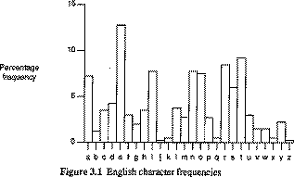
Character Frequencies
In most languages letters are not equally common
In English e is by far the most common letter
  Have tables of single double & triple letter frequencies
  These are
  different
  for different
  languages

Slide 42
Transposition
Rearrange the letters of the message
Want diffusion – wide spreading of information across ciphertext
Try to break established pattern
For example, a simple example is a column transposition.
We arrange the plaintext in a fixed number of columns.
  c1 c2 c3 c4 c5
  c6 c7 c8 c9 c10
  c11 c12 etc.

Slide 43
Simple Example of Transposition
  Form ciphertext by reading from the columns
    This is a message to show how a columnar
    transposition works, read down the colums
    Thisi
    sames
    saget
    oshow
    howac
    olumn
    artra
    nspos
    ition
    works
tssoh oaniw hasso lrsto imghw utpir seeoa mrook lstwc nasns
Length of message just happens to be a multiple of 5
If message length is not equal to the length of a row use some infrequent letters to fill in gaps

Slide 44
Hybrid Methods
Combination Approach
  Substitution and Transposition
  Cipher building blocks
  Combination of two ciphers
    Product Cipher – ciphers are performed one right after another E₂(E₁(P, K₁) K₂)
    Caution: just because you apply two ciphers doesn’t mean the result is stronger than each individual cipher!

Slide 45
What is a Good Encryption Algorithm?
So far the algorithms we've investigated have been trivial - designed to illustrate some of the early work in the area.
We have also stressed that for every encryption scheme devised, cryptanalysts try to break the encryption.
We now turn to algorithms that are used in the commercial world.
But, unlike the earlier algorithms, we won't study the details - that is postponed until Chapter 12.

Slide 46
What is a Good Encryption Algorithm?
The meaning of good depends on the context in which the encryption scheme will be used.
For example, contrast a military use with a scheme to encrypt standard email.
In 1949, Claude Shannon proposed several characteristics that identify a good scheme:
1) The amount of secrecy needed should determine the amount of labor appropriate for encrypting or decrypting.
2) The set of keys and the enciphering algorithm should not be complex.

Slide 47
Shannon's Principles for a Good Cipher
3) The implementation of the process should be as simple as possible.
  This was originally included because implementations were done by hand.
  But, even with computers, this principle is still important.
  A complex algorithm may take too long to execute to be used or may even be programmed incorrectly.
4) Errors in ciphering should not propagate and cause corruption of further information in the message.
5) The enciphered text should not be larger than the original text.

Slide 48
Properties of Trustworthy Encryption Systems
Commercial users have requirements that must be satisfied when using encryption
Encryption is commercial grade if it :
  Is based on sound mathematics – derived from solid principles
  Is analyzed by experts and found to be sound -review by critical outside experts is essential
  Stood the “Test of Time” – a new algorithm gains popularity and people continue to review it both for math foundations and the way it builds upon those foundations
    Flaws of algorithms are discovered often soon after their release

Slide 49
Three Popular Commercial World Algorithms
  DES – Data Encryption Standard
  RSA – Rivest – Shamir – Adelman
  AES – Advanced Encryption Standard
    DES and RSA – as well as others, meet the criteria for commercial grade encryption
    AES – rather new – meets first two criteria for trustworthy encryption systems and is starting to achieve widespread adoption.
      It just hasn't stood the test of time yet.

Slide 50
Symmetric and Asymmetric Systems
There are two types of encryption systems that are distinguished by the nature of their key.
  Symmetric systems are also called "secret key" systems.
  Asymmetric systems are also called "public key" systems.
The systems we have considered so far have been symmetric systems.

Slide 51
Symmetric Systems
  Uses the same key for both encryption and decryption.
  The decryption algorithm is closely related to the encryption one.
    Think of all the systems we've seen so far.
  As long as the key remains secret, this type of system can be used for authentication - proof that a received message was not fabricated.
  But, there is a problem - how is the key distributed securely?

Slide 52
Asymmetric Systems
With the public key approach, you can send a public key or even publish it on a web.
The public key is used for encrypting the plaintext.
All encrypted messages can be decrypted with a private key which only the receiver has.
Thus, no key must be passed securely between the sender and the receiver - i.e. only the receiver must keep the one key secure.

Slide 53
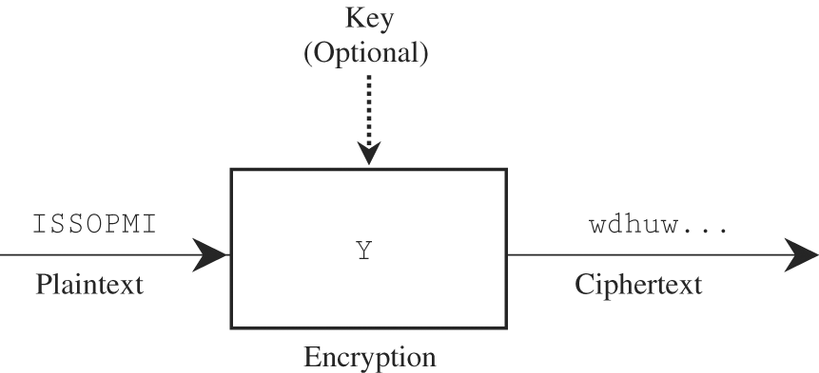
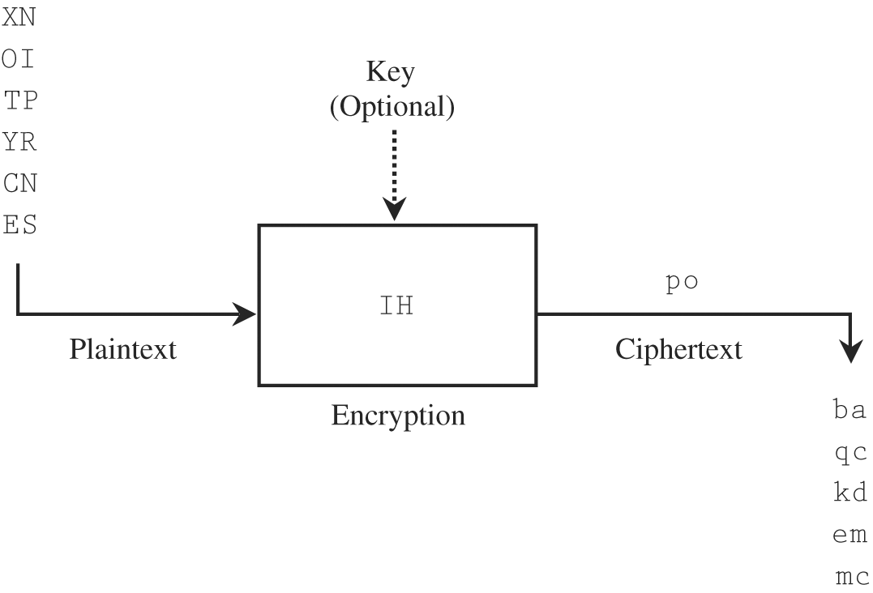
Stream and Block Ciphers
Stream ciphers convert basically one symbol of plaintext immediately into a symbol of ciphertext.
  With the exception of the transposition ciphers, all that we have considered so far a stream ciphers.
Block ciphers encrypt a group of plaintext symbols as one block.
Figure 2-6
Figure 2-7

Slide 54
Stream Ciphers
Advantages:
  Quick transformation because each symbol is encrypted and decrypted independent of others.
  Low error propagation as each symbol is handled independent of others.
Disadvantages:
  Low diffusion - good diffusion means a lot of the ciphertext must be obtained in order to break the code.
  High susceptibility to malicious insertions and modifications.

Slide 55
Block Ciphers
Advantages:
  High diffusion
  Immunity to insertion of symbols
Disadvantages:
  Slow to encrypt
  Errors propagate easily.

Slide 56
Breaking Encryption Schemes
All of the ciphers studies so far can be broken with varying amount of effort.
Trying to do some of the work (i.e. counting frequencies) can be done easily by programs.
In fact, there are a some cryptanalysis tools on the web:
Letter frequency counter:
http://pages.central.edu/emp/LintonT/classes/spring01/cryptography/java/textanalyzer.html
Cracking tool for substitution ciphers:
http://simonsingh.net/The_Black_Chamber/frequencypuzzle.htm

Slide 57
DES
(Data Encryption Standard)
Background and History of DES
Overview of DES
Double and Triple DES
Security of DES

Slide 58
Background and History of DES
Early 1970’s - NBS (National Bureau of Standards) recognized general public’s need for a secure crypto system
    Now: NIST – National Institute of Stand’s & Technology
Existing US government crypto systems were not meant to be made public
    i.e. the DoD, State Department etc. systems
There were problems with the proliferation of commercial encryption devices
    They were incompatible
    They were not extensively tested by independent bodies.

Slide 59
Background and History of DES
1972 - NBS called for proposals for a public crypto system
  Criteria to satisfy:
    Highly secure / easy to understand / publishable /
    Available to all / adaptable to diverse applications / economical / efficient to use / able to be validated /
    Exportable
    In truth: Not too strong (for NSA, etc.)

Slide 60
Background and History of DES
1974 – IBM proposed software it had been working on - Lucifer
  DES based on it
  Tested by NSA (National Security Agency) and the general public
Nov. 1976 – DES adopted as US standard for sensitive but unclassified data / communication
  Later adopted by ISO (International Standards Organization)
  Official name: DEA - Data Encryption Algorithm / DEA-1 abroad

Slide 61
Overview of DES
A block cipher
A product cipher
A careful and complex combination of substitution and transposition:
  Uses 16 rounds (iterations) on the input bits using substitutions (for confusion) and permutations (for diffusion)
Each round uses a key generated from a user-supplied key
Easy to implement in software or hardware.
Details of the algorithm are explained in Chapter 12.

Slide 62
Overview of DES
Basic Structure
Input: 64 bits (a block)
Li/Ri– left/right half of the input block for iteration i (32 bits) – subject to substitution S and permutation P (cf. Fig 2-8– text)
K - user-supplied key
Ki - round key:
  56 bits used +8 unused
  (unused for E but often used for error checking)
Output: 64 bits (a block)
Note: Ri becomes L(i+1)
All basic op’s are simple logical ops
  Left shift / XOR
Input
Input Permutation
L0
R0
S
K
P
L1
R1
K1
L16
R16
K16
Final Permutation
Output

Slide 63
-
Problems with DES
Diffie, Hellman 1977 prediction: “In a few years, technology would allow DES to be broken in days.”
Key length is fixed (= 56)
  2⁵⁶ keys ~ 10¹⁵ keys
  Becoming too short for faster computers
    1997: 3,500 machines – 4 months
    1998: special DES cracker hardware – 4 days
Design decisions not public
  Suspected of having backdoors
    Speculation: To facilitate government access?

Slide 64
Double and Triple DES
Double DES:
  Use double DES encryption
    C = E(k2, E(k1, P) )
  Expected to multiply difficulty of breaking the encryption
    Not true!
      In general, 2 encryptions are not better than one [Merkle, Hellman, 1981]
      Only doubles the attacker’s work

Slide 65
Double and Triple DES
Triple DES:
  Is it C = E(k3, E(k2, E(k1, P) ) ?
  Not soooo simple!
Tricks used:
  D not E in the 2nd step, k1 used twice (in steps 1 & 3)
It is:
  C = E(k1, D(k2, E(k1, P) ) and
  P = D(k1, E(k2, D(k1, C) )
  Doubles the effective key length
    112-bit key is quite strong even for today’s computers for all feasible known attacks

Slide 66
Security of DES
So, is DES insecure?
No, not yet
  1997 attack required a lot of cooperation
  The 1998 special-purpose machine is still very expensive
  Triple DES still beyong the reach of these 2 attacks
But ...
  In 1995, NIST (formerly NBS) began searching for new strong encryption standard

Slide 67
The Clipper Story
... Or: How not to set up a standard
A scenario
  Only a single electronic copy of a corporation’s crucial (and sensitive) document
  To prevent espionage, strong encryption used to protect that document
  Only CEO knows the key
  CEO gets hit by a truck
  Is the document lost forever?
Key escrow (a depository) facilitates recovery of the document if the key is lost,

Slide 68
The Clipper Story
1993 - Clipper - U.S. Government’s attempt to mandate key escrows for encryption schemes
  Secret algorithm, invented by National Security Agency
  Only authorities, can recover any communications
    Add an escrow key and split into halves
    Give each half to a different authority
    If there is a search warrant, authorities can combine their halves and recover intercepted communication
    Of course, government will use it for legitimate purposes only!
    Note: This was before the Patriot Act!!!!

Slide 69
The Clipper Story
Clipper failed big time:
  Classified algorithm, hardware (the Clipper chip)
  Equipment AND keys provided by the government
  No export of equipment allowed
  Public relations disaster
    “Electronic civil liberties" organizations (Electronic Privacy Information Center & Electronic Frontier Foundation)) challenged the Clipper chip proposal

Slide 70
Arguments Against the Clipper Chip
The Electronic Privacy Information Center & Electronic Frontier Foundation claimed
    It would subject citizens to increased, possibly illegal, government surveillance
    The strength of encryption could not be evaluated by the public because the algorithm was secret.
    Thus, the chip might be insecure .

Slide 71
AES (Advanced Encryption Standard)
... Or: How to set up a standard
  The AES Contest
  Overview of Rijndael
  Strength of AES
  Comparison of DES and AES

Slide 72
The AES Contest
1997 – NIST calls for proposals
  Criteria:
    Unclassifed code
    Publicly disclosed
    Royalty-free worldwide
    Symmetric block cipher for 128-bit blocks
    Usable with keys of 128, 192, and 256 bits
1998 – 15 algorithms selected

Slide 73
The AES Contest
1999 – 5 finalists
  MARS by IBM
  RC6 by RSA Laboratories
  Rijndael by Joan Daemen and Vincent Rijmen
  Serpent by Ross Anderson, Eli Biham and Lars Knudsen
  Twofish by Bruce Schneier, John Kelsey, Doug Whiting, Dawid Wagner, Chris Hall and Niels Ferguson

Slide 74
Evaluation of the Proposals
Evaluation of finalists:
  Public and private scrutiny
  Key evaluation areas:
    security / cost or efficiency of operation /
    ease of software implementation
2001- … and the winner is …
  Rijndael (RINE-dahl)
  Authors: Vincent Rijmen + Joan Daemen (Dutchmen)
Adopted by US government as
Federal Info Processing Standard 197 (FIPS 197)

Slide 75
Overview of Rijndael/AES
Similar to DES – cyclic type of approach
  128-bit blocks of P
  # of iterations based on key length
    128-bit key => 9 “rounds” (called rounds, not cycles)
    192-bit key => 11 rounds
    256-bit key => 13 rounds
Basic ops for a round:
  Substitution – byte level (confusion)
  Shift row (transposition) – depends on key length (diffusion)
  Mix columns – LSH and XOR (confusion +diffusion)
  Add subkey – XOR used (confusion)

Slide 76
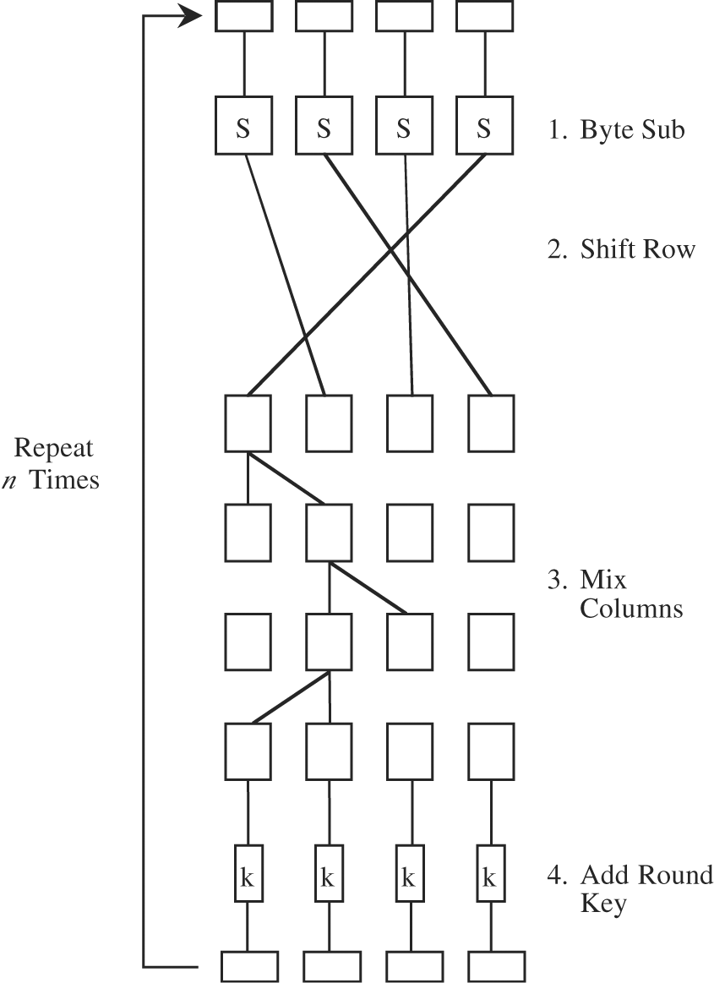
Figure 2-9 The AES Algorithm

Slide 77
Strengths of AES
Only experience so far (since 2001)
But:
  Extensive cryptanalysis by US government and independent experts
  Dutch inventors have no ties to NSA or other US government bodies (less suspicion of trapdoor)
  Solid math basis
    Despite seemingly simple steps within rounds

Slide 78
Comparison of DES & AES
DES AES
Date 1976 1999
Block size [bits] 64 128
Key length [bits] 56 (effect.) 128, 192, 256, or more
Encryption substitution, substitution, shift, bit
Primitives permutation mixing
Cryptographic confusion, confusion,
Primitives diffusion diffusion
Design open open
Design closed open
Rationale
Selection secret secret, but accepted
Process public comments
Source IBM, enhan- independent Dutch
ced by NSA cryptographers

Slide 79
Comparison of DES & AES
Weaknesses in AES?
  20+ yrs of experience with DES eliminated fears of its weakness (intentional or not)
    Might be naïve…
  Experts pored over AES for a 2-year review period
  A mark of confidence - the US government has approved AES for protecting Secret and Top Secret classified documents.
    This was a first especially considering AES was a commercial algorithm developed outside the US!

Slide 80
Comparison of DES & AES
DES is nearly 30 yrs old (1976)
    DES-encrypted message can be cracked in days
Longevity of AES more difficult to answer
  Can extend key length to > 256 bits (DES: 56)
      2 * key length => 4 * number of keys
    Can extend number of rounds (DES: 16)
  Extensible AES seems to be significantly better than DES, but..
    Human ingenuity is unpredicatble!
    => Need to incessantly search for better and better encryption algorithms

Slide 81
Public Key Encryption (PKE)
What Is It?
RSA

Slide 82
Introduction
Traditional Encryption Algorithms
  Symmetric Key encryption and popular algorithms
  Based on a secret shared key
  DES, AES – Block Ciphers
Today
  Asymmetric key encryption and popular algorithms
  Based on a public and private key set
  Three popular ones: RSA, Diffie-Hellman or Diffie-Hellman-Merkle

Slide 83
Secret Key Cryptography
In traditional cryptography, sender and receiver know and use the same secret key
Sender uses secret key to encrypt message, and Receiver uses same secret key to decrypt message
Method is known as secret key or symmetric cryptography

Slide 84
Secret Key Cryptography
The main challenge is getting a sender and a receiver to agree on a secret key without anyone else finding out
  Anyone who overhears or intercepts key in transit can later read, modify, and forge all messages encrypted or authenticated using that key
  The generation, transmission and storage of keys is called key management
  All keys in secret-key cryptosystem must remain secret
  Secret-key cryptography often has problems with secure key management especially in open systems with a large number of users

Slide 85
Public Key Cryptography
Public-key cryptosystems are networks of users rather than a single pair of users
Each user in a network has a pair of keys associated with him/her
  Public key
    Published under the users name in a public directory accessible for everyone to read
  Private-key
    Known only to the owner
A pair of keys is generated by running a key-generation algorithm.
The mathematics of Public Key Cryptography involves an understanding of the mathematical manipulations of very large numbers

Slide 86
Public Key Cryptography
To solve the key management problem, Whitfield Diffie and Martin Hellman introduced the concept of public-key cryptography in 1976
Public-key cryptosystems have two primary uses, encryption and digital signatures
Each person gets a pair of keys, a public key and a private key
  The public key is published, while the private key is kept secret
The need for the sender and the receiver to share secret information is eliminated
All communications involve only public keys, and no private key is ever transmitted or shared

Slide 87
Message Passing
The only requirement is that public keys be associated with their users in a trusted (authenticated) manner
Anyone can send a confidential message by just using public information,
But message can only be decrypted with a private key, which is in the sole possession of the intended recipient.
  Furthermore, public-key cryptography can be used for privacy (encryption) and authentication (digital signatures)

Slide 88
Message Passing
When Alice wishes to send a secret message to Bob, she looks up Bob's public key in a directory, uses it to encrypt the message and sends it off.
Bob then uses his private key to decrypt the message and read it.
No one listening in can decrypt the message.
Anyone can send an encrypted message to Bob, but only Bob can read it (because only Bob knows Bob's private key).
Note: Alice and Bob often appear in scenarios involving message passing (along with Trudy who tries to intercept the messages!)

Slide 89
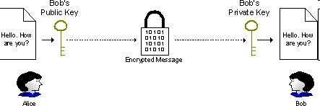
Message Passing
Alice wants to send a secret message to Bob:
  1. Alice passes a secret message and Bob's public key to an appropriate encryption algorithm to construct an encrypted message
  2. Alice transmits the encrypted message
  (perhaps via e-mail) to Bob
  3. Bob decrypts the transmitted, encrypted message with his private key using an appropriate decryption algorithm

Slide 90
Digital Signatures
Beyond assuring privacy of communications, it is also important to know with whom you are communicating
Plus, it is important to know the message content has not been altered in transmission
In an asymmetric encryption model, public/private keys are also used to provide confirmation of both
  The source i.e. who sent the message and
  The integrity of a message i.e. the message has not been tampered with
This is accomplished through the use of digital signatures

Slide 91
Digital Signatures
A digital signature is a message digest, checksum, or hash, of the message encrypted with the sender’s private key
If Alice wishes to digitally sign a message sent to Bob
  She first creates a hash of the message and encrypts it with her private key
  This is the digital signature, which is attached to the message itself
The message with the signature attached is sent to Bob.

Slide 92
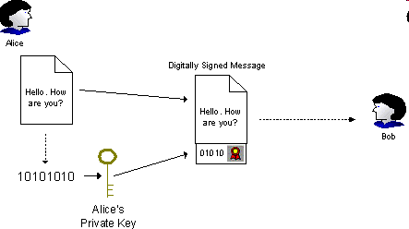

Alice Digitally Signs A Message

Slide 93
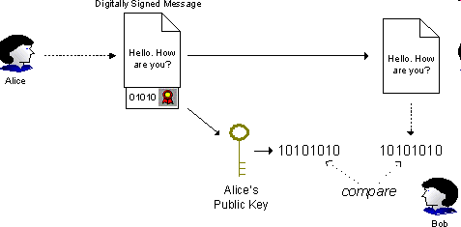
Bob Authenticates Message
When Bob gets message, he decrypts the digital signature with Alice’s public key, recalculates the hash of the message itself, and compares the two.
If results match, Bob is assured that the message is in fact from Alice and not from an imposter, and he also is assured that the message has not been tampered with in transit.

Slide 94
Public Key Cryptography
Technology Maturity
Public key cryptography has been in use for more than 30 years
  Secure Sockets Layer (SSL) defined by Netscape is a popular application of public key cryptography in Web-enabled applications requiring secure communications and authentication.
  Pretty Good Privacy (or PGP) is another popular application of public key cryptography used to send confidential electronic mail and digitally signing electronic documents.
Plus a number of commercial companies have become third party providers of public key cryptography software including:
  RSA Security, Inc., Sun Microsystems, Microsoft, Entrust, Inc., and VeriSign, Inc.

Slide 95
PGP
Pretty Good Privacy (PGP) is a computer program that provides cryptographic privacy and authentication . PGP is often used for signing, encrypting and decrypting e-mails to increase the security of e-mail communications. It was originally created by Philip Zimmermann in 1991.
PGP and other similar products follow the OpenPGP standard (RFC 4880) for encrypting and decrypting data.
See http://na.store.pgp.com/ for a 30 day free trial (or $83 for a basic license).

Slide 96
Modulo Arithmetic
Before describing the basic algorithms, we need to learn (or review) modulo arithmetic.
  Most public key algorithms are based on modulo arithmetic.
    x mod n = remainder of x when divided by n
    Example: mod 10 arithmetic
    3 + 7 = 0
        3 + 9 = 2
        2 + 2 = 4
    Example: mod 10 multiplication
      8 * 2 = 6
      8 * 3 = 4

Slide 97
Modulo Arithmetic
For crypto purposes, we are interested in multiplicative inverses in mod arithmetic.
  A multiplicative inverse of a number, x⁻¹ , is a number you multiply to get 1. i.e. x * x ⁻¹ = 1
  A inverse of a number are the primes with respect to a given mod n
  Example: mod 10, look for an m that makes this true
    7 * m ≡ 1 (mod 10)
    3 is a multiplicative inverse of 7, 9 is its own inverse
    What’s another one for 7? (13 is another one.)
  There is no obvious way to find a multiplicative inverse mod n if n is large

Slide 98
Modulo Arithmetic
Euclid’s Algorithm
  Look up on your own if interested
    http://en.wikipedia.org/wiki/Euclidean_algorithm
  Efficiently finds the inverse mod n by using the gcd
    (the greatest common devisor).
  Given x and n it finds y such that x*y mod n = 1
  Turns out that all numbers relatively prime to n will have multiplicative inverses and none of the other numbers will
  Ask, How many numbers < n are relatively prime to n?

Slide 99
Modulo Arithmetic
Turns out that the totient function φ(n) is useful for determining the number of prime numbers .
  The name comes from quotient and total
  If n is prime, then all integers {1,2,3 ... n-1} are relatively prime to n, so φ(n) = n-1
    Relatively prime or coprime means that there is no other common denominator between two numbers other than 1 or -1
  If n is the product of two primes, then n = pq and φ(n) = (p-1)(q-1)

Slide 100
Modulo Arithmetic
Examples:
  φ(10) = 4 {1,3,7,9}
  φ(21) = 12 {1,2,4,5,8,10,11,13,16,17,19,20}
Also, exponentiation inverses are of special interest to public key cryptography.
  Special case where
  y = 1 mod φ(n)
  if y = 1 mod φ(n) then for any number x,
    x ^{y} = x mod n
Used in Public Key Encryption!!
There is a reason for this.

Slide 101
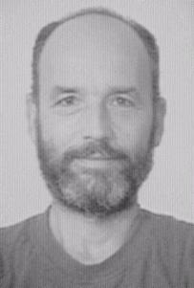
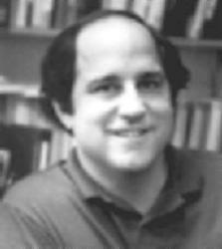
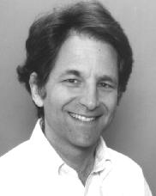
RSA Inventors
The algorithm was publicly described in 1977
  Ron Rivest, Adi Shamir, and Leonard Adleman
  from MIT
  Letters RSA are the initials of their surnames
  Adi Shamir Ron Rivest Leonard
  Adleman

Slide 102
RSA
The RSA Public Key Cryptography was invented by Ronald Rivest, Adi Shamir, and Leonard Adelman in 1977
Encrypted messages can be passed from the sender to the receiver, and decrypted by the receiver, without having to pass a secret decryption key between them.
Instead a public/private key pair is used
The public key, which can be safely published for all to know, is used to encrypt the message
The private key, which is held by the owner, and which is never shown to anybody, is used to decrypt the message.

Slide 103
RSA
The most common key length is 512 bits
  But can vary – longer keys mean more security
Data must be < key length
  But data size can vary too
Ciphertext will be size of the key
Relatively Slow Algorithm
  Used for encryption of the secret key of a symmetric algorithm
  Symmetric algorithm then used for encryption

Slide 104
RSA
Overview
  Choose an integer e < n relatively prime to n.
  Find second integer d, such that
  e * d mod φ(n) = 1
  Public key is (e,n) and private key is d
  Assume m is the message. So,
  c = m^{e} mod n and m = c^{d} mod n
  encryption decryption

Slide 105
RSA Algorithm
Example
First, generate a Public Key and a Private Key
Choose, two large prime numbers, p and q (they remain secret)
To make the example easy to follow small numbers are used, but this is not secure.
To find random primes, we start at a random number and go up ascending odd numbers until we find a prime.

Slide 106
RSA Algorithm
1) Lets use:
  p = 7
  q = 19
2) Then n = pq
n = 7 * 19 = 133 n is part of the public key
3) Let m = (p - 1)(q - 1) = φ(n)
m = (7 - 1)(19 - 1)
= 6 * 18
= 108 m is used in the calculation and is φ(n)

Slide 107
RSA Algorithm
4) Choose a small number, e coprime to m
e coprime to m, means that the largest number that can exactly divide both e and m (their greatest common divisor, or gcd) is 1.
Euclid's algorithm is used to find the gcd of two numbers, but the details are omitted here.
  e = 2 => gcd(e, 108) = 2 (no)
  e = 3 => gcd(e, 108) = 3 (no)
  e = 4 => gcd(e, 108) = 4 (no)
  e = 5 => gcd(e, 108) = 1 (yes!) e is part of the public key

Slide 108
RSA Algorithm
5) Find d, such that d * e mod m = 1
This is equivalent to finding d which satisfies
d * e = 1 + nm where n is any integer.
We can rewrite this as d = (1 + nm) / e. Now we work through the values of n until an integer solution for e is found:
  n = 0 => d = 1 / 5 (no) d is the private key
  n = 1 => d = 109 / 5 (no)
  n = 2 => d = 217 / 5 (no)
  n = 3 => d = 325 / 5
  = 65 (yes!)

Slide 109
RSA Algorithm
Encryption Example
  For this example, lets use the message "6".
    C = P^{e} mod n
    = 6⁵ mod 133
    = 7776 mod 133
    = 62
Public Key
n = 133
e = 5
Secret Key
n = 133
d = 65

Slide 110
RSA Algorithm
Decryption
Note: % is mod
This works very much like encryption, but involves a larger exponentiation, which is broken down into several steps.
P = C^{d} % n
= 62⁶⁵ % 133
= 62 * 62⁶⁴ % 133
= 62 * (62²)³² % 133
= 62 * 3844³² % 133
= 62 * (3844 % 133)³² % 133
= 62 * 120³² % 133
Public Key
n = 133
e = 5
Secret Key
n = 133
d = 65

Slide 111
RSA Algorithm
We now repeat the sequence of operations that reduced 62⁶⁵ to 120³² to reduce the exponent down to 1.
= 62 * 36¹⁶ % 133
= 62 * 99⁸ % 133
= 62 * 43 % 133
= 62 * 92⁴ % 133
= 62 * 85² % 133
= 2666 % 133
= 6
And that matches the plaintext we put in at the beginning, so the algorithm worked!

Slide 112
RSA Summary
Rivest, Shamir, Adleman, 1978: a good method for public-key cryptography:
  Choose two large primes, p and q (typically 1024 bits today)
  Compute n = p * q and z = (p-1) * (q-1)
  Choose a number relatively prime to z and call it d
  Find e such that e * d = 1 mod z
To encrypt a message, P, Compute C = P^{e} (mod n)
To decrypt C, compute P = C^{d} (mod n)
The public key consists of the pair (e, n)
The private key consists of the pair (d, n)

Slide 113
Security of RSA Encryption
How secure is RSA?
  So far remains secure (after all these years...)
  Will somebody propose a quick algorithm to factor large numbers?
  Will quantum computing break it?
The difficulty is an underlying hard problem from number theory – determining prime factors of a very large number
  So far the computing power available is not able to do this.

Slide 114
Continue in Part 2

