Slide 1

INFORMATION SYSTEM BUILDING BLOCKS
Chapter 2
The basis of these slides are those provided by the authors at the McGraw Hill site for the textbook, “System Analysis Design methods, 6th ed”. However, changes have been made by O. Slotterbeck for the course CPSC 359 at Hiram College

Slide 2
Information System Building Blocks
Overview
Differentiate between front- and back-office information systems.
Expand further on the different classes of information system applications (transaction processing, management information, decision support, expert, communication and collaboration, and office automation systems) and how they interoperate to supplement one another.
Describe the role of information systems architecture in systems development.
Notes:
No additional notes

Slide 3
Overview
We need to identify
  High-level goals that provide system owners and system users with a perspective of an information system.
  Goal-oriented perspectives for any information system.
  Technologies that provide system designers and builders with a perspective of an information system.

Slide 4
Overview
We need to describe
  Building blocks of the KNOWLEDGE goal for an information system.
  Building blocks of the PROCESS goal for an information system.
  Building blocks of the COMMUNICATIONS goal for an information system.
    and then
  The role of network technologies as it relates to Knowledge, Processes, and Communications building blocks.

Slide 5
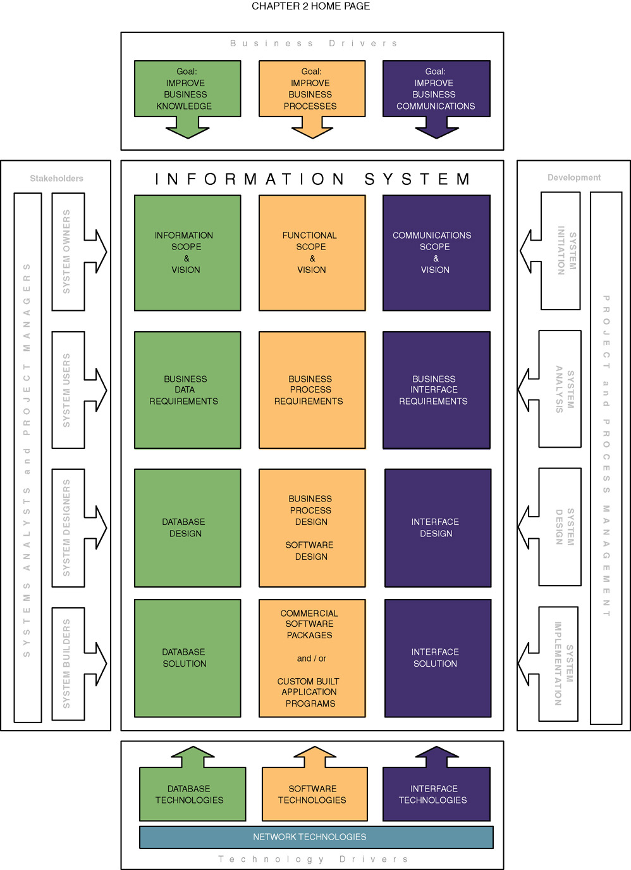
Chapter Map
CHAPTER OVERVIEW
Notes:
Teaching Notes
This is the capstone figure for the chapter—the complete information systems building blocks framework.
Emphasize that ALL building blocks are relevant to ALL information systems that the student will encounter or develop during the course of their career.
Emphasize that the building blocks must be synchronized both horizontally and vertically when building information systems.
Vertical synchronization ensures that each block represents fully the perspectives of the other blocks in the same column. For example, a database schema must implement the intended data requirements.
Horizontal synchronization ensures that each block in a given row is consistent and complete with respect to the other blocks in that same row. For example, each table in a database schema requires application software and specifications to maintain the data stored in those tables.

Slide 6
Front- and Back-Office Information Systems
Front-office information systems support business functions that extend outward to the organization’s customers (or constituents).
  Marketing
  Sales
  Customer management
Back-office information systems support internal business operations of an organization, as well as reach out to suppliers (of materials, equipment, supplies, and services).
  Human resources
  Financial management
  Manufacturing
  Inventory control
Notes:
Teaching Notes
This classification scheme comes from popular usage in the trade literature.
This terminology is not to be confused with office automation. In fact, office automation systems can be either front-office or back-office, just as with other types of information system applications.

Slide 7
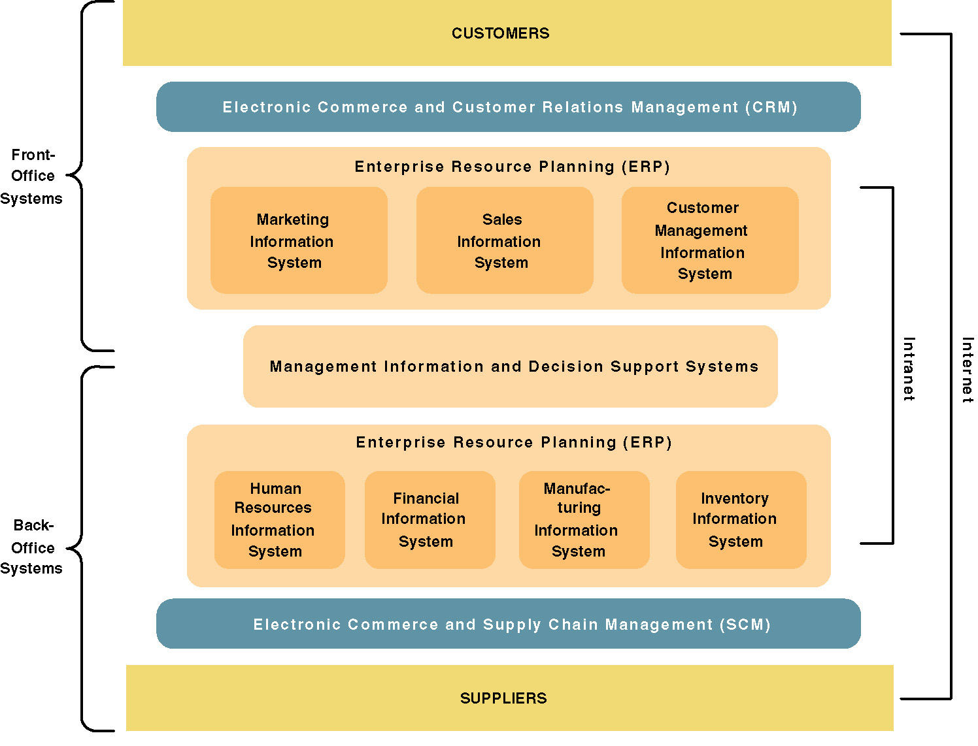
A Federation of Information Systems
Notes:
Teaching Notes
This slide visually illustrates front- and back-office applications and highlights the following:
Many organizations purchase their back-office systems in the form of enterprise resource planning (ERP) products such as SAP, PeopleSoft, and Oracle.
The ERP industry is trying to expand into the front-office applications.
It might be noted that electronic commerce and business extensions are being added to both front- and back-office applications in order to streamline interfaces to both customers and suppliers.
E-commerce is being driven by the Internet (and private extranets).
E-business is being enabled by intranets.

Slide 8
Recall the Types (or Classes) of Information Systems
  Transaction processing system (TPS)
  Management information system (MIS)
  Decision support system (DSS)
  Executive information system (EIS)
  Expert system
  Communications and collaboration system
  Office automation system
  The next slide shows how the types overlap and interrelate in a typical generic business setting... (see pages 60-61)
Notes:
Conversion Notes
These definitions on this and the next slide were not in the 5th edition.
These definitions can be useful to help students understand what an information system is in all its varieties and flavors. Depending on the prerequisites of your course, you may want to cover these in more or less detail.

Slide 9
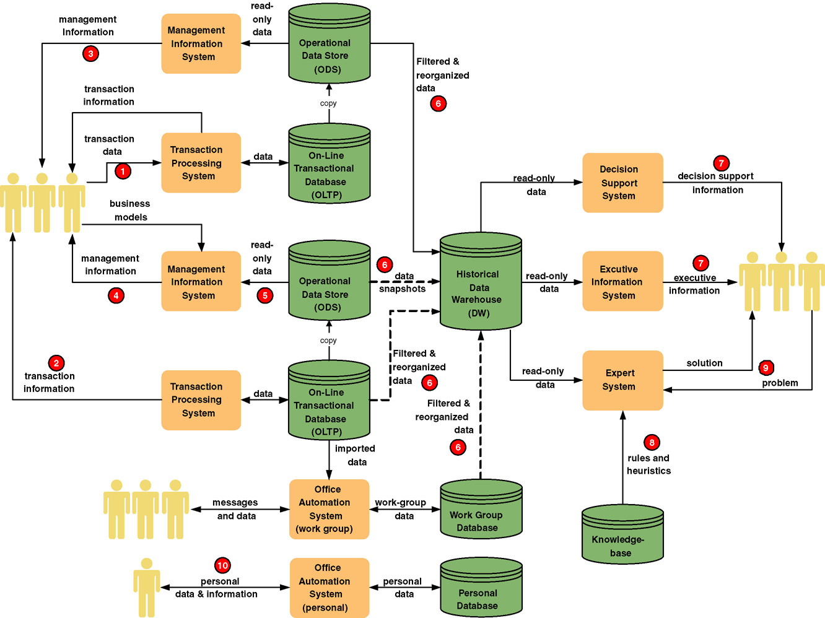
Information System Applications
11
Notes:
Teaching Notes
It may be useful to walk through this diagram in class. The textbook coverage included numbered annotations that highlight portions of this diagram.
Remind students that any given information system may include many instances of each of these IS application processes and databases.

Slide 10
Information Systems Architecture
To deal with the complexity of IS, we often organize building blocks into what are called architectures. For example,
Information systems architecture - a unifying higher level framework into which various stakeholders with different perspectives can organize and view the fundamental building blocks of information systems.
Examples of others are data architectures, application architectures, network architectures, software architectures etc.
Notes:
No additional notes

Slide 11
Focuses for Information Systems
Knowledge — the raw material used to create useful information.
Process — the activities (including management) that carry out the mission of the business.
Communication — how the system interfaces with its users and other information systems.
Note: The book uses the above color scheme to talk about each of these areas (although the Communication one in print is a darker purple.)
Notes:
Conversion Notes
The KNOWLEDGE building block was called DATA in the 5th edition.
The PROCESS building block was called PROCESSES in the 5th edition.
The COMMUNICATION building block was called INTERFACES in the 5th edition.

Slide 12
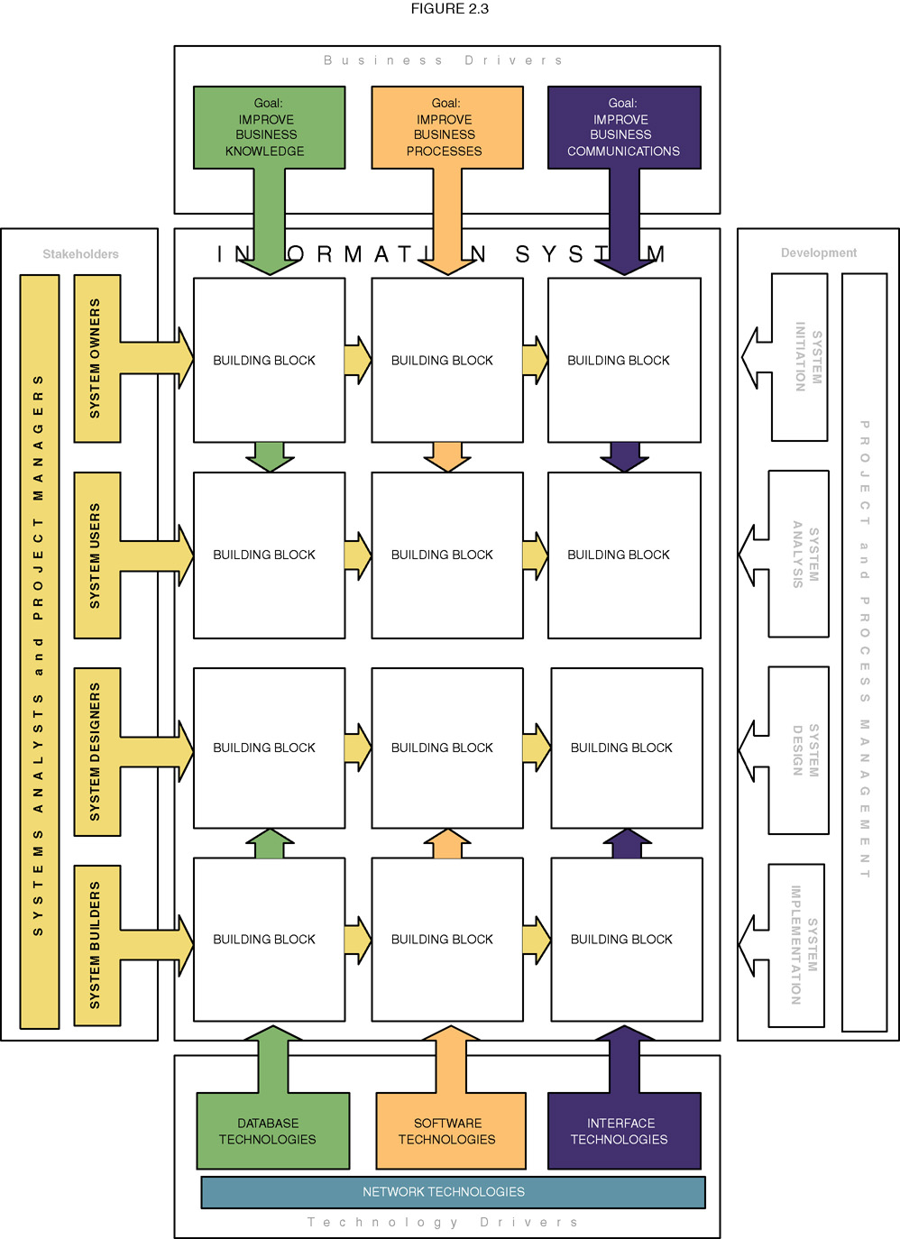
Information System Perspectives and Focuses
Notes:
Teaching Notes
This slide serves to establish the focus for the chapter. The highlighted cells are the information system building blocks that are described in detail as this chapter unfolds.

Slide 13
Views of KNOWLEDGE Differ
System owners’ view
  Normally not interested not in raw data but in information that adds new business knowledge and information that help managers make intelligent decisions.
  Focuses on business entities (i.e. Customers, Orders) and business rules (i.e. A Customer can place Orders).
  Concerned with the big picture.
  Typically not interested in details such as the internal workings of a database.
  Primary role:
    Define the scope and vision for a project.
Notes:
Teaching Notes
This slide places definitions and key terms relevant to the KNOWLEDGE focus into the context of stakeholders.

Slide 14
Views of KNOWLEDGE Differ
System users’ view
  View data as something recorded on forms, stored in file cabinets, recorded in books and binders, organized into spreadsheets, or stored in computer files and databases.
  Tend to focus on the business issues as they pertain to the data.
  More concerned with details than system owner (i.e. need to differentiate between Perspective Customer, Active Customers, etc.)
  Concerned with Data requirements– a representation of users’ data in terms of entities, attributes, relationships, and rules independent of the data technology.

Slide 15
Views of KNOWLEDGE
System designers’ view
  Concerned about data structures, database schemas, fields, indexes, and constraints of the particular database management system (DBMS).
  Concerned with technical views.
  Consists of system analysts or database specialists.
System builders’ view
  Represents data in a language (such as SQL)
  DBMS or other data technologies must be understood.

Slide 16
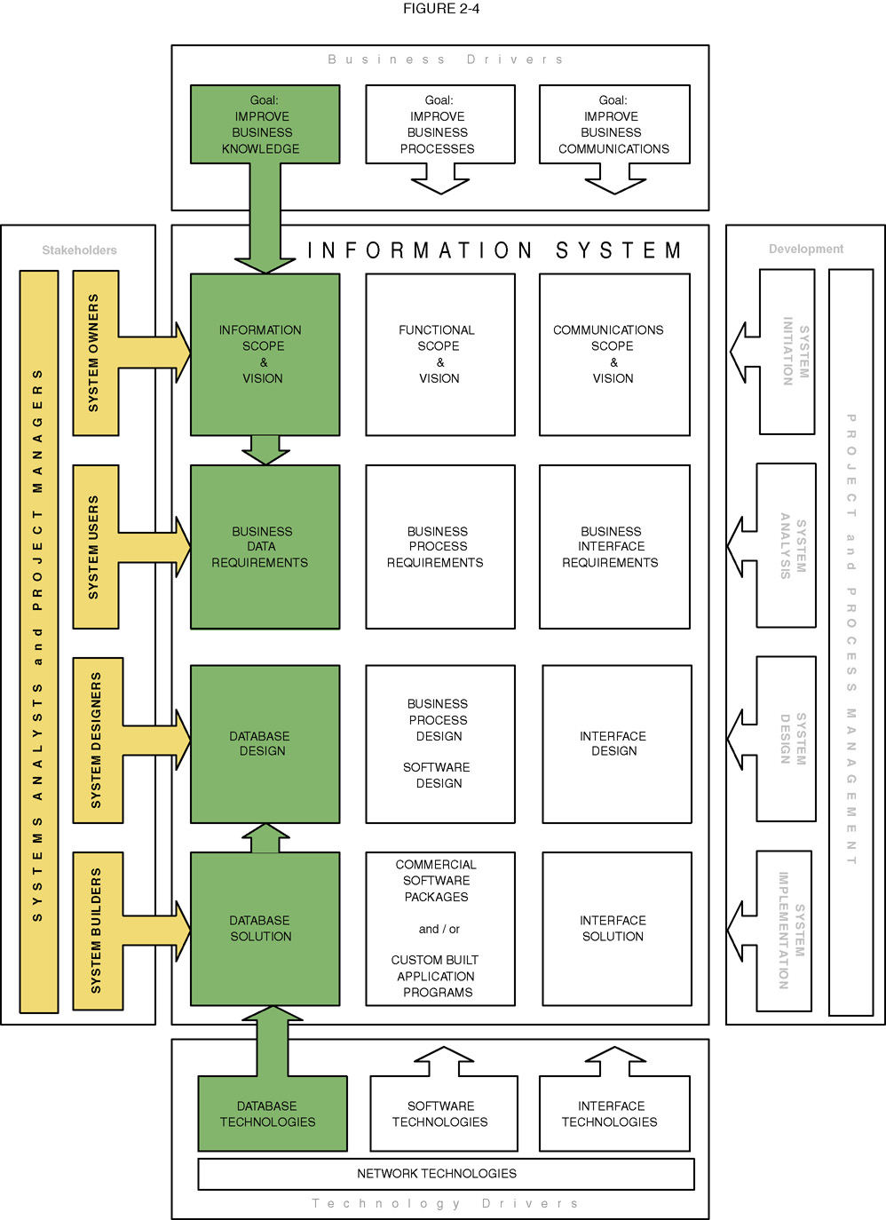
Summary of KNOWLEDGE Building Blocks
Notes:
Conversion Notes
The KNOWLEDGE building block was called DATA in the 5th edition.
Teaching Notes
This slide visually illustrates the chapter’s discussion of the KNOWLEDGE focus as seen by different stakeholders.
If your students have taken a database course, it can be useful to summarize that experience within the context of the KNOWLEDGE column.

Slide 17
Views of PROCESS
System owners’ view
  Concerned with high-level processes called business functions.
  Business function – a group of related processes that support the business. Functions can be decomposed into other subfunctions and eventually into processes that do specific tasks.
    Examples are: Sales, service, manufacturing, shipping, receiving, accounting, etc.
  In the past, many of these were handled by separate systems.
  Today we find cross-functional information systems instead.
.
Notes:
Teaching Notes
This slide places definitions and key terms relevant to the PROCESS focus into the context of stakeholders.

Slide 18
Views of PROCESS
System users’ view
  Concerned with work that must be performed to provide the appropriate responses to business events. Challenge is to identify, express, and analyze the following:
    Business processes – activities that respond to business events.
    Process requirements – a user’s expectation of the processing requirements for a business process and its information systems.
    Policy – a set of rules that govern a business process.
    Procedure – a step-by-step set of instructions and logic for accomplishing a business process.
    Work flow – the flow of transactions through business processes to ensure appropriate checks and approvals are implemented.
Notes:
Teaching Notes
This slide places definitions and key terms relevant to the PROCESS focus into the context of stakeholders.

Slide 19
Views of PROCESS
System designers’ view
  Concerned with which processes to automate and how to automate them
  Constrained by limitations of application development technologies being used (i.e. Java, Visual Basic, C++, C#.netm COTS [commercial off the shelf]).
  If building in-house, need to develop software specifications – the technical design of business processes to be automated or supported by computer programs to be written by system builders.
Notes:
Teaching Notes
This slide places definitions and key terms relevant to the PROCESS focus into the context of stakeholders.

Slide 20
Views of PROCESS
System builders’ view
  Concerned with programming logic that implements automated processes
  Design application programs – language-based, machine-readable representations of what a software process is supposed to do, or how a software process is supposed to accomplish its task.
  Often by introducing a prototype – a functioning, but incomplete model of the information system using rapid application development tools.

Slide 21
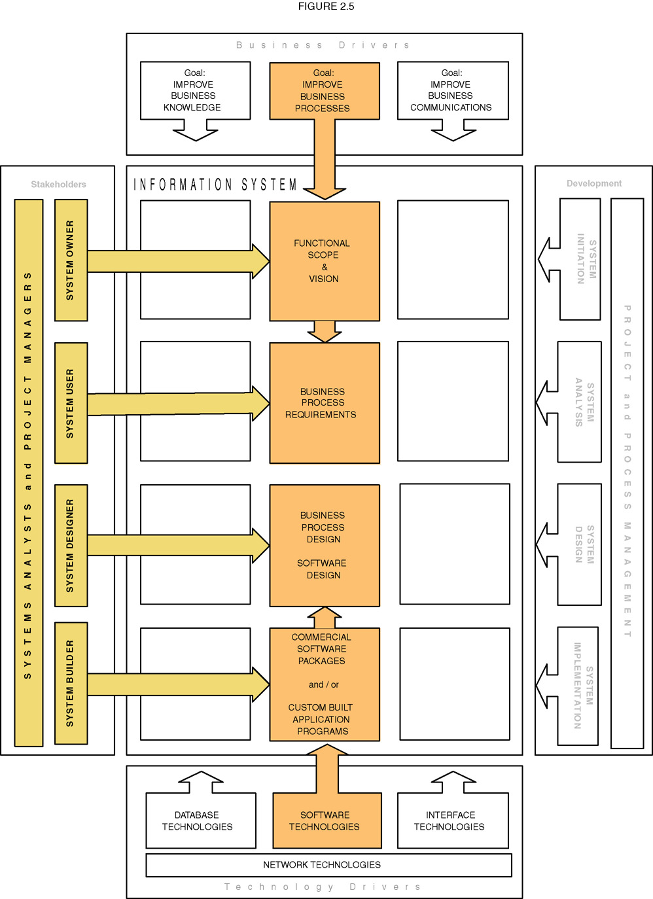
Summary of PROCESS Building Blocks
Notes:
Conversion Notes
The PROCESS building block was called PROCESSES in the 5th edition.
Teaching Notes
This slide visually illustrates the chapter’s discussion of the PROCESS focus as seen by the different stakeholders.
Most students have some programming experience. Accordingly, it can be useful to summarize that experience within the context of the PROCESS column. Consider summarizing that experience by working bottom-to-top in the column to reinforce their perspective of the “application programs” they wrote.
The programming instructor typically played the roles of system owners, users, and analysts when they wrote the programming assignments.
The student typically played the roles of designer (e.g., flowcharts) and builder (e.g, programming code).

Slide 22
Views of COMMUNICATION
System owners’ view
  Concerned with communications scope of an information system.
    Who (which business units, employees, customers, and partners) must interact with the system?
    Where are these business units, employees, customers, and partners located?
    What other information systems will the system have to interface with?
Notes:
Teaching Notes
This slide places definitions and key terms relevant to the COMMUNICATION focus into the context of stakeholders.

Slide 23
Views of COMMUNICATION
System users’ view
  Concerned with the information system’s inputs and outputs.
  Concerned with the requirements and format of interfaces in particular
    Interface specifications – technical designs that document how system users are to interact with a system and how a system interacts with other systems.

Slide 24
Views of COMMUNICATION
System designers’ view
  Concerned with the technical design of both the user and the system-to-system communication interfaces.
  System-to-system interfaces are the hardest to design.
  Like the system users, they are concerned with interface specifications, but with consistency, compatibility, completeness, and user dialogues.
  User dialogue – a specification of how the user moves from window to window or page to page, interacting with the application programs to perform useful work.
Notes:
Teaching Notes
This slide places definitions and key terms relevant to the COMMUNICATION focus into the context of stakeholders.

Slide 25
Views of COMMUNICATION
System builders’ view
  Concerned with the construction, installation, testing and implementation of user and system-to-system interface solutions.
  System-to-system interfaces are harder to build than user interfaces.
  A popular approach is to build Middleware – utility software that allows application software and systems software that utilize differing technologies to interoperate by creating a middle layer through which two different systems communicate.
    Example: Build a system that allows different application programs to interact with a database.

Slide 26
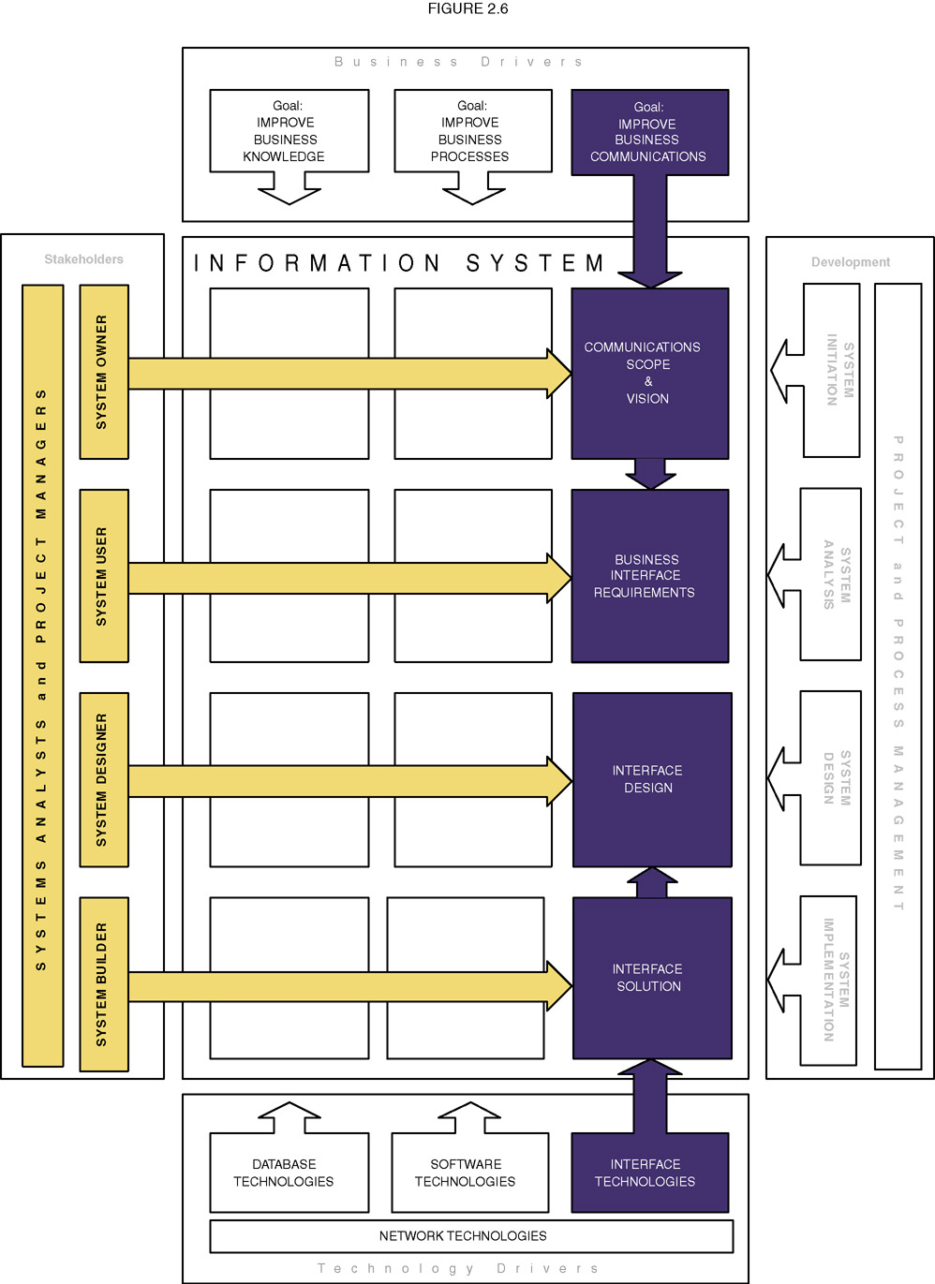
Summary of COMMUNICATION Building Blocks
Notes:
Conversion Notes
The COMMUNICATION building block was called INTERFACE in the 5th edition.
Teaching Notes
This slide visually illustrates the chapter’s discussion of the COMMUNICATION focus as seen by the different stakeholders.
Many students have written programs for graphical user interfaces using languages such as Access, Visual Basic and HTML. Accordingly, it can be useful to summarize that experience within the context of the INTERFACE column.
While it is conceptually and practically useful to separate COMMUNICATION and PROCESS, it should be noted that many of today’s contemporary application development environments (ADEs) such as .NET effectively integrate the technology used to construct both the user interface and the application logic. Some students find this confusing.
Interestingly, the emphasis on Web-based applications is truly separating the concerns. For example, the interface elements of a Web are written in HTML while the application logic is written in C++ or Java.

Slide 27
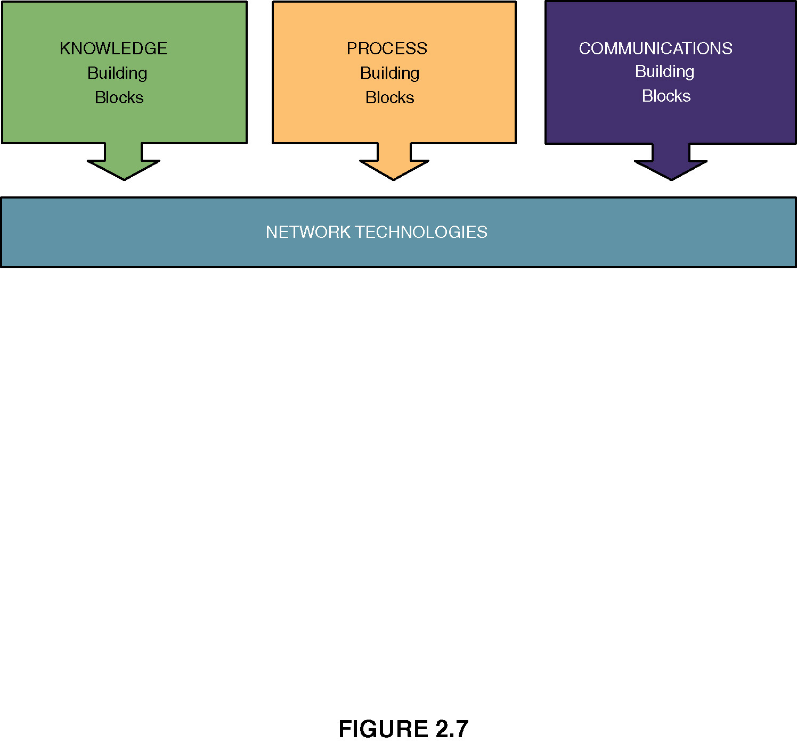
The Zachman “Framework for IS Architecture”
Approach taken in this chapter based on John Zachman’s approach.
He includes a fourth group called similar to what the textbook calls network technologies.
This is not really discussed here as Networks is usually taught as a separate course. However, realize we really have

Slide 28
Network Technologies and the IS Building Blocks
Notes:
Teaching Notes
This slide illustrates the classic model of separating and partitioning the layers of an information system application across a network.
This clean-layering approach allows any one building block to be replaced with another while having little or no impact on the other building blocks.
This is called a distributed computing architecture and it can be implemented using either client/server or Internet/intranet technology, or a combination of both.

