Slide 1

System Design
Chapter 12

Slide 2
Systems Design Overview
Describe the design phase in terms of your information building blocks.
Identify and differentiate between several systems design strategies.
Describe the design phase tasks in terms of a computer-based solution for an in-house development project.
Describe the design phase in terms of a computer-based solution involving procurement of a commercial systems software solution.
Notes:
No additional notes

Slide 3
System Design
Systems design – the specification of a detailed computer-based solution.
  Also called physical design.
  Where systems analysis emphasizes the business problems, systems design emphasizes the technical or implementation concerns of the system.
Notes:
No additional notes

Slide 4
System Design Approaches
Model-Driven strategy- a system design approach that emphasizes drawing system models to document technical and implementation aspects of a system. The most commonly used ones are:
  Modern structured design
  Information engineering
  Prototyping
  Object-oriented
RAD – rapid application development
JAD – joint application development
Notes:
Teaching Notes
These will be expanded upon in the next slides.

Slide 5
Model-Driven Approaches:
Modern Structured Design
Modern structured design – a system design technique that decomposes the system’s processes into manageable components.
  Synonyms often used (although technically inaccurate) are top-down program design and structured programming.
  Design in a top-down hierarchy of modules
  Easier to implement and maintain (change).
  Modules should be highly cohesive
    Accomplish one function only
  Modules should be loosely coupled
    Minimally dependent on one another
Notes:
Teaching Notes
Note that modern structured design is the first of three model-drive approaches that will be discussed.

Slide 6
Modern Structured Design
This is considered a process-oriented technique because its emphasis is on the process building blocks of the system.
The software is modeled by a structure chart.
  Derived by studying the flow of data through the system (normally with a DFD).
  Does not address all concerns – for example, input, output, and database design are ignored.
  Not as popular as in the past, but still used heavily for mainframe-based applications.

Slide 7
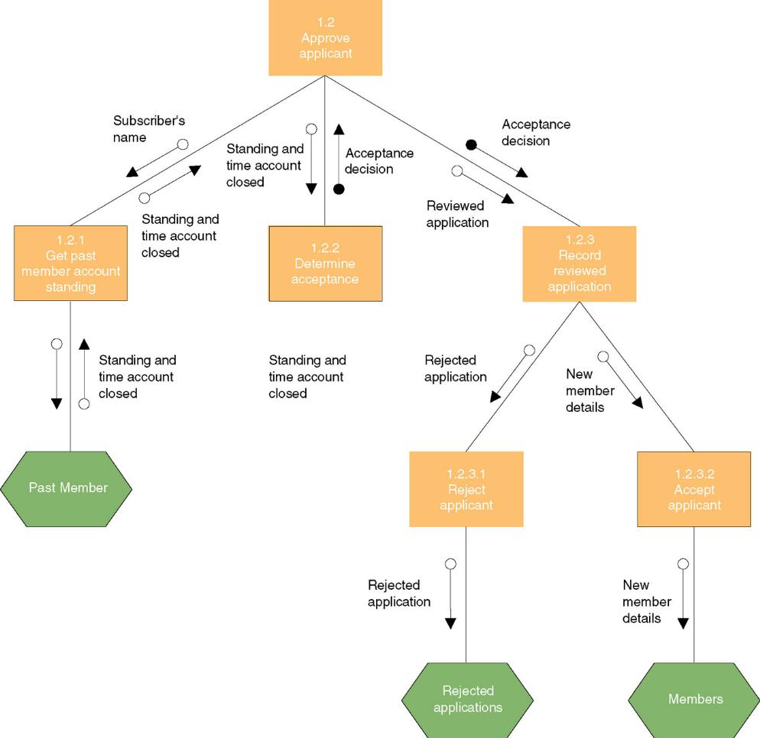
Structure Chart
Notes:
Teaching Notes
The software model derived from structured design is a structure chart.
You may query the students to see if they either developed or were provided with a structure chart in one of their programming courses.

Slide 8
Model-Driven Approaches:
Information Engineering (IE)
Information engineering – a model-driven and data-centered, but process-sensitive technique for planning, analyzing, and designing information systems.
IE models are pictures that illustrate and synchronize the system’s data and processes.
  The primary tool of IE is a data model diagram (or physical entity relationship diagram)
Notes:
Teaching Notes
Information engineering was introduced in Chapter 5 as a systems analysis tool. It can be used for system design also.

Slide 9
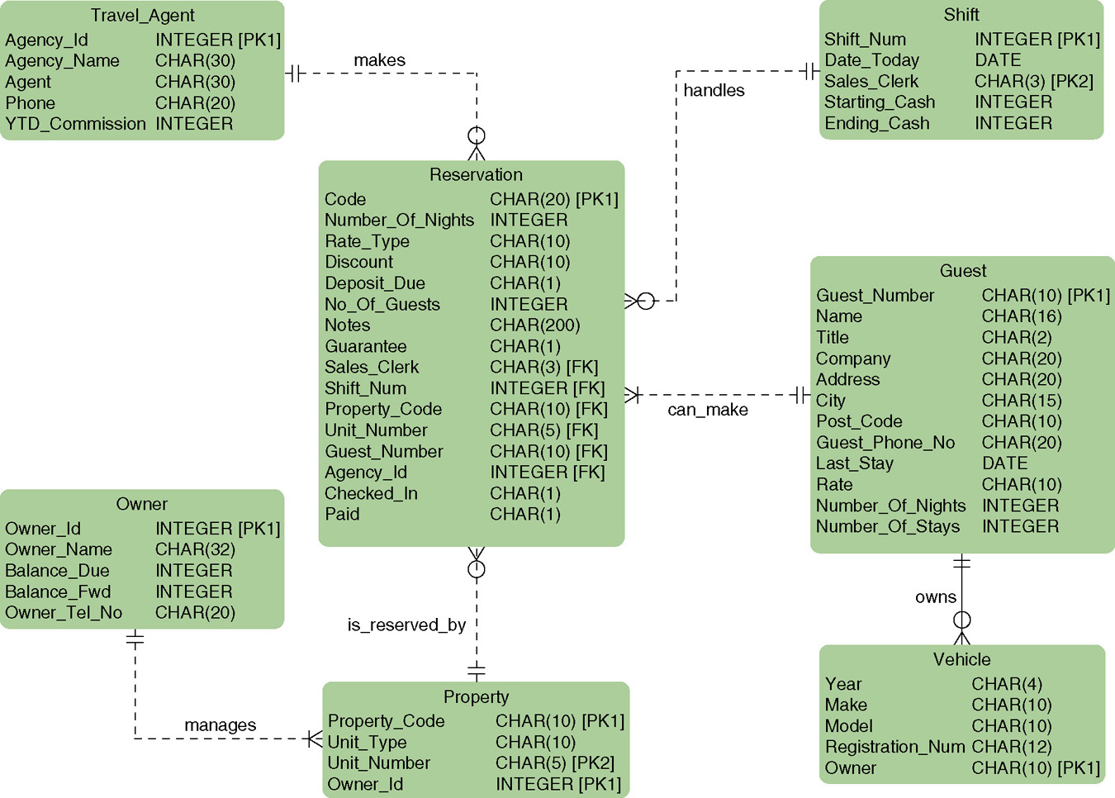
Physical Entity Relationship Diagram
Notes:
No additional notes.

Slide 10
Model-Driven Approaches:
Prototyping
Prototype – a small-scale, incomplete, but working sample of a desired system
The prototyping approach is an iterative process involving a close working relationship between the designer and the users.
Typically, physical design was a paper and pencil process.
Pictures were drawn that laid out and structured output, input, databases, flow of dialogue, and procedures.
Prototyping was introduced and has become popular as it minimizes the paper and pencil process.
Notes:
Teaching Notes
Looking ahead, you might mention that the students will learn more about prototyping and perhaps do problems, exercises, and case study milestones that will require them to develop prototypes.
There are numerous PowerPoint slides of input, output, and dialogue screens provided with Chapters 15, 16, and 17.

Slide 11
Prototyping
Key Benefits:
  Encourages and requires active end-user participation.
  Iteration accommodates end-users who tend to change their minds.
  Endorses philosophy that end-users won’t know what they want until they see it.
  Active model that end-users can interact with.
  Errors can be detected earlier.
  Can increase creativity as it allows for quicker user feedback.
  Accelerates several phases of the life cycle.

Slide 12
Prototyping
Disadvantages and Pitfalls:
  Encourages “code, implement, and repair” life cycle that cause maintenance nightmares.
  Still need systems analysis phases, but so easy to skip.
  Cannot completely substitute a prototype for a paper specification (like architect without a blueprint).
  Numerous design issues are not addressed by prototyping.
  Often leads to premature commitment to a design (usually the first).
  Scope and complexity of the system can expand out of control.
  Can reduce creativity in designs (implementation can drive out analysis).
  Often suffer from slower performance because of language considerations (rapidly becoming a non-issue).
Notes:
Teaching Notes
Prototyping encourages ill-advised shortcuts through the life cycle.
However, with proper discipline, prototyping can greatly enhance and speed up the life cycle.

Slide 13
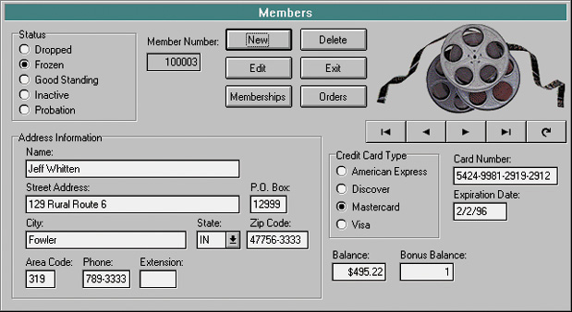
Example: A Prototype screen
Notes:
No additional notes.

Slide 14
Model-Driven Approaches:
Object-Oriented Design
Object-oriented design (OOD) techniques are used to refine the object requirements definitions identified earlier during analysis, and to define design specific objects.
  Extension of object-oriented analysis
  Attempt to eliminate the separation of concerns about data and process.
Notes:
Teaching Notes
Object-oriented analysis was introduced in Chapter 5. It is also a system design technique.
Refer the students to Chapters 11, and 18 for more on the subject of object-oriented analysis and design.

Slide 15
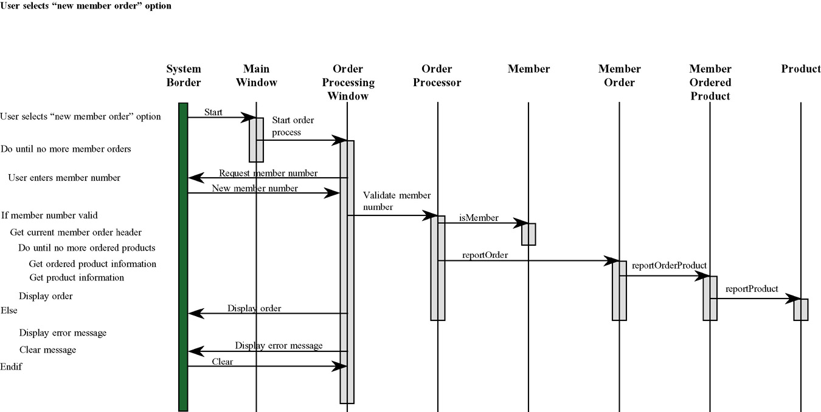
An Object-Oriented Design Model
Notes:
No additional notes.

Slide 16
Rapid Application Development (RAD)
Rapid application development (RAD) – a systems design approach that utilizes structured, prototyping, and JAD techniques to quickly develop systems.
  The merger of various structured techniques to accelerate systems development
    Data-driven information engineering
    Prototyping
    Joint application development
Notes:
Teaching Notes
JAD was introduced in Chapter 5 and discussed in detail in Chapter 6.

Slide 17
Joint Application Development (JAD)
Joint Application Development (JAD) is a technique that complements other systems analysis and design techniques by emphasizing participative development among system owners, users, designers, and builders.
During the JAD sessions for systems design, the systems designer will take on the role of facilitator for possibly several full-day workshops intended to address different design issues and deliverables.
Notes:
No additional notes

Slide 18
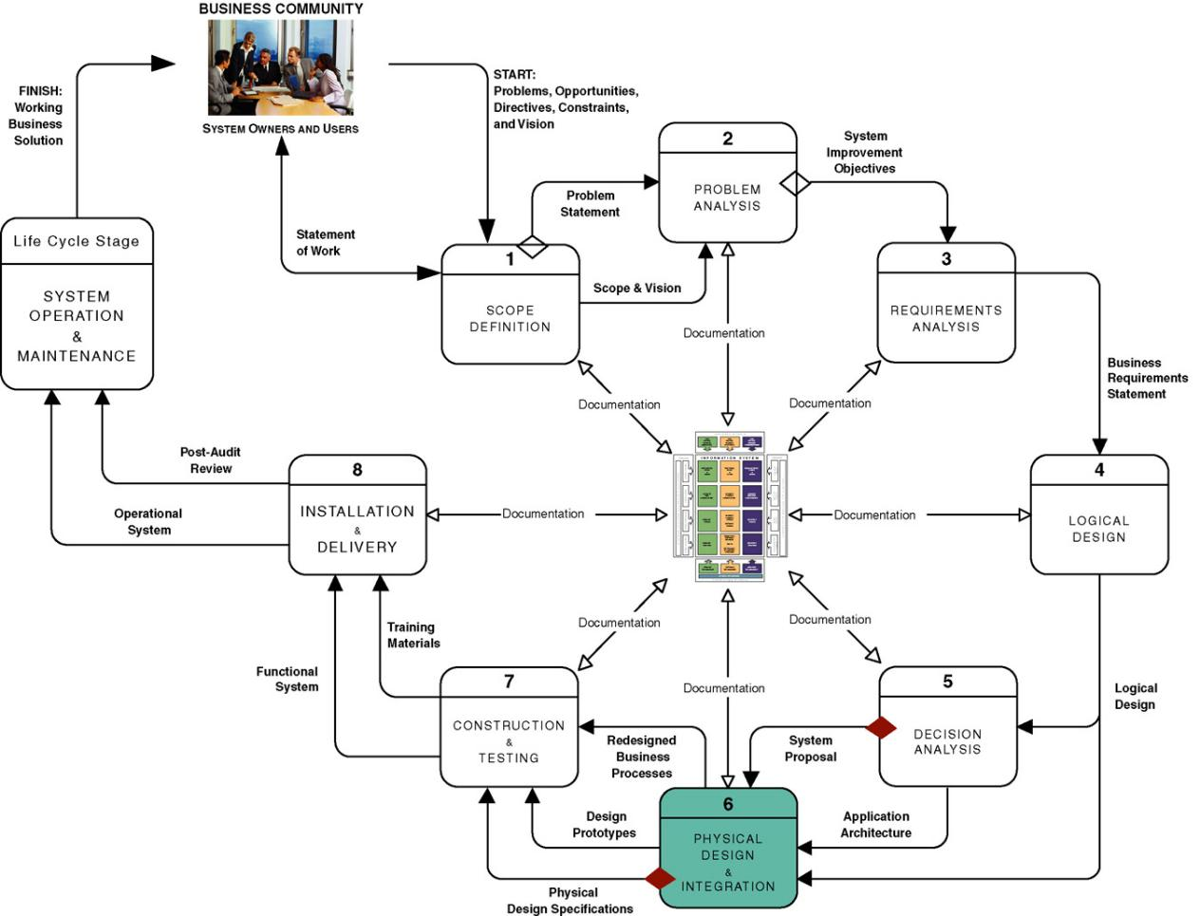
Context Of In-House Development Projects (Build)
Notes:
No additional notes

Slide 19
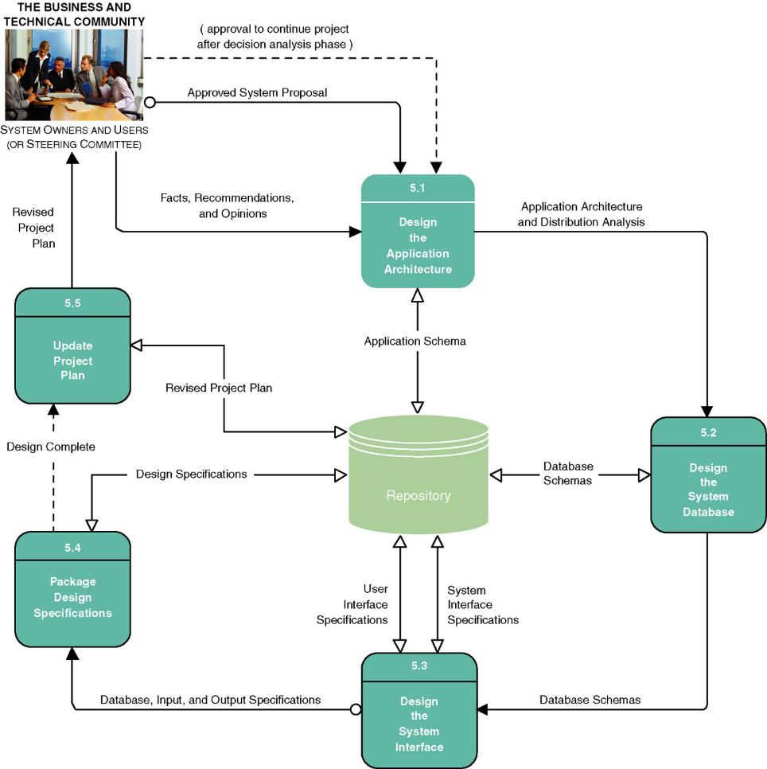
System Design Tasks For In-House Development
Notes:
No additional notes

Slide 20
System Design Tasks For In-House Development (Build)
Design the Application Architecture
  Defines the technologies to be used by (and used to build) one, more, or all information systems.
  Revise models as physical models (e.g. Physical Data Flow Diagram)
Design the System Databases
  Database schema
  Optimized for implementation DBMS
Design the System Interface
  Input, output, and dialogue specifications
  Prototypes
Package Design Specifications
  Specifications to guide programmers
Update Project Plan
Notes:
No additional notes.

Slide 21
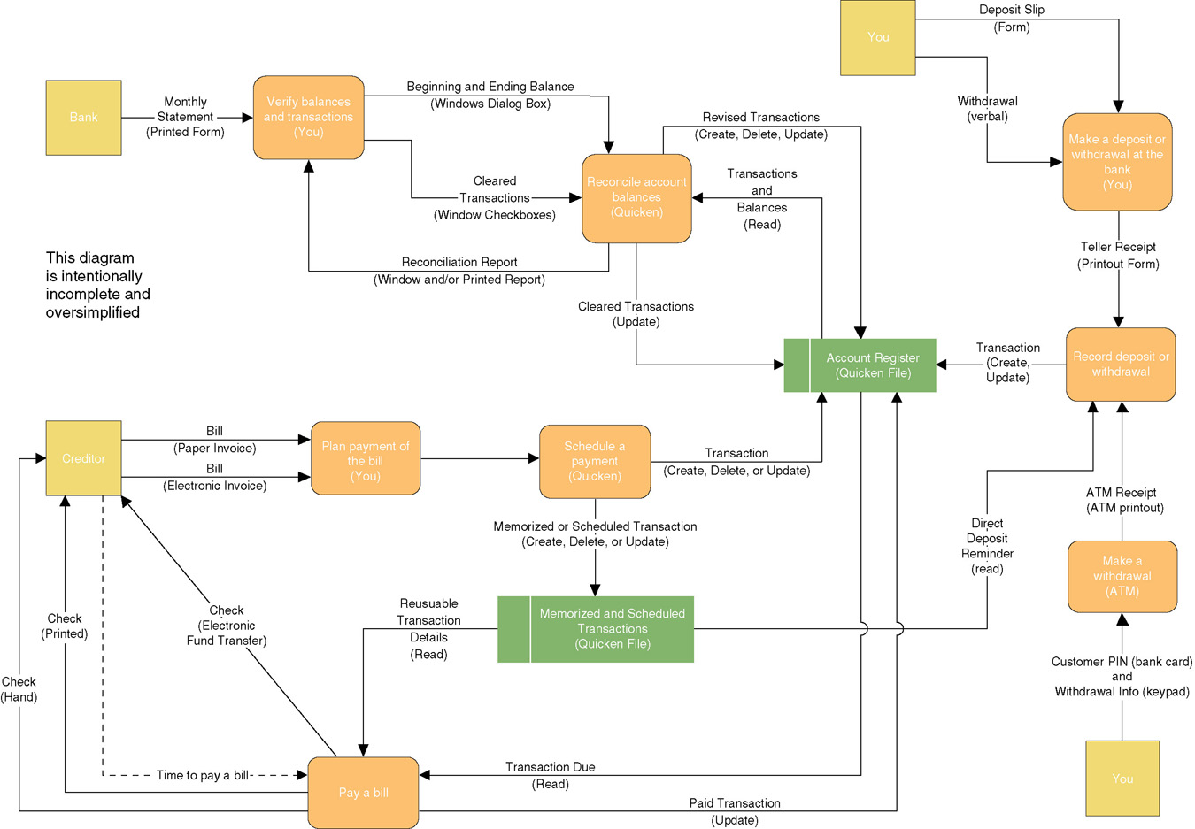
Physical Data Flow Diagram
Notes:
No additional notes

Slide 22
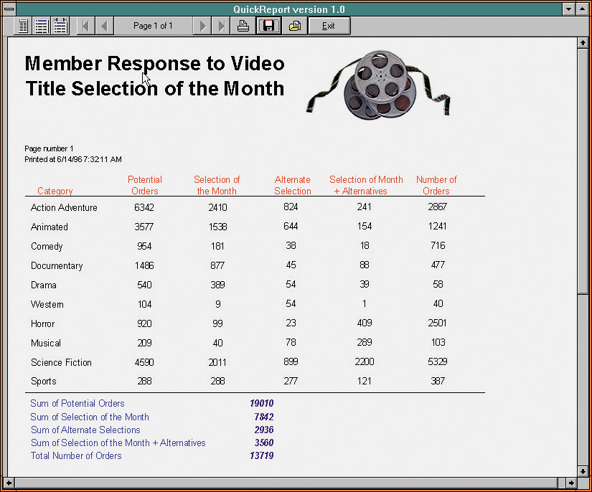
Output Prototype Screen
Notes:
No additional notes

Slide 23
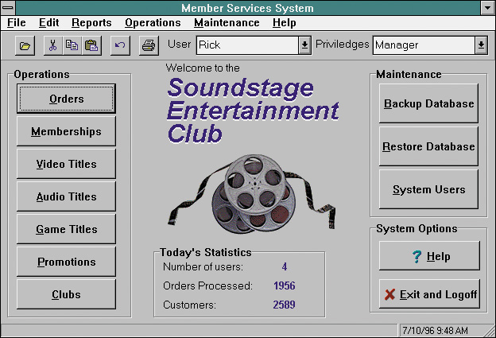
Dialogue Interface Prototype Screen
Notes:
No additional notes

Slide 24
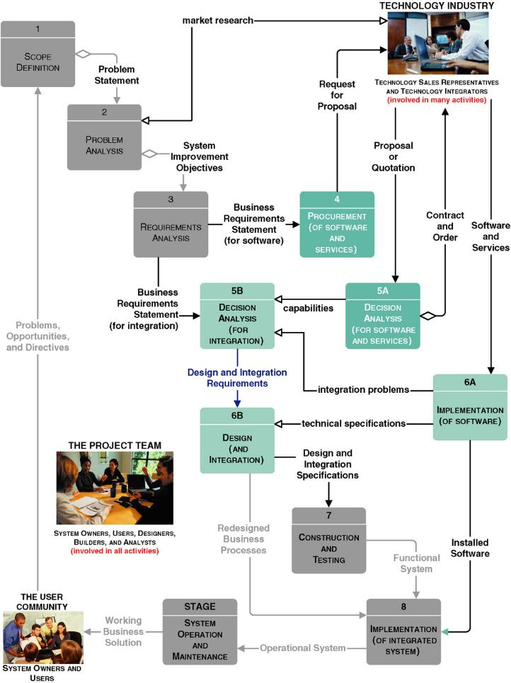
Context Of System Design For Project “Buy” Solutions
Notes:
No additional notes

Slide 25
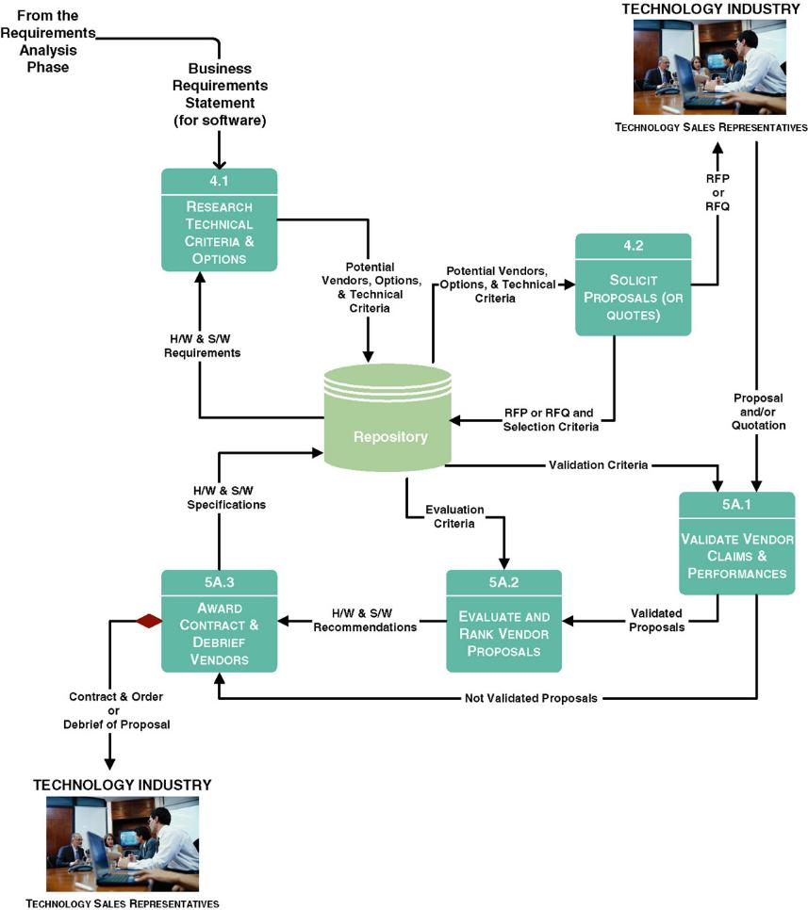
Tasks for Procurement Phase
Notes:
Teaching Notes
The most notable differences between the buy and the in-house development projects is:
A new procurement phase
A special decision analysis phase (labeled 5A)

Slide 26
Research Technical Criteria and Options
Magazines and journals
Internal standards may exist for hardware and software selection.
Information services are primarily intended to constantly survey the marketplace for new products and advise prospective buyers on what specifications to consider.
Trade newspapers and periodicals offer articles and experiences on various types of hardware and software that you may be considering.
Notes:
No additional notes

Slide 27
Solicit Proposals (or Quotes) From Vendors
Request for Proposals (RFP) – used to communicate requirements and desired features to prospective vendors. Several different vendors and/or products are candidates. They will respond with a proposal.
Request for Quotations (RFQ) – used when you have already decided on a specific product that can be acquired from multiple sources. They respond with a price quotation.
Notes:
No additional notes.

Slide 28
Typical Outline for Request For RFP
Introduction
  Background
  Brief summary of needs
  Explanation of RFP document
  Call for action on part of vendor
Standards and instructions
  Schedule of events leading to contract
  Ground rules that will govern selection decision
    Who may talk with whom and when
    Who pays for what
    Required format for a proposal
    Demonstration expectations
    Contractual expectations
    References expected
    Documentation expectations
Requirements and features
  Hardware
    Mandatory requirements, features, and criteria
    Essential requirements, features, and criteria
    Desirable requirements, features, and criteria
  Software
    Mandatory requirements, features, and criteria
    Essential requirements, features, and criteria
    Desirable requirements, features, and criteria
  Service
    Mandatory requirements
    Essential requirements
    Desirable requirements
Technical questionnaires
Conclusion
Notes:
Teaching Notes
It is not difficult to find RFPs on the Internet. Consider printing one out and passing it around so students can see what one looks like. You will probably only want to print one due to their number of pages. Discuss with students why they need to be so complete.

Slide 29
Validate Vendor Claims and Performances
Review vendor proposals and eliminate any that does not meet all mandatory requirements.
Validate the vendor claims and promises against validation criteria.
  User References
  Technical Manuals
  Demonstrations
Notes:
Teaching Notes
You might want to share any horror stories you know about inaccurate vendor claims

Slide 30
Evaluate and Rank Vendor Proposals
Feasibility assessment
Scoring system
  Hard-dollar costs – you will have to pay to the selected vendor.
  Soft-dollar costs – additional costs you will incur if you select a particular vendor (to overcome a shortcoming, etc.)
Notes:
Teaching Notes
Feasibility assessment was covered in Chapter 11.

Slide 31
Award Contract and Debrief Vendors
Negotiate contract with selected vendor.
Debrief vendors that submitted losing proposals.
  Not to offer a second chance.
  But to inform them of precise weaknesses in their proposals and/or products.
Notes:
Teaching Notes
Consider asking students to explain why it is a good idea to tell losing vendors that they lost.

Slide 32
Impact of Buy Decision on Remaining Life-Cycle Phases
Must integrate or interface the new system to other existing systems.
Decision Analysis
  Make revisions in models to reflect purchased solution.
  Implement purchased solution.
  Integration problems lead to revised business requirements statements.
Design
  Technical specification for a subset of programs to integrate purchased and built solutions.

