Slide 1
CPSC 359
SYSTEM ANALYSIS
AND
DESIGN
Dr. Oberta A. Slotterbeck
Obie
Spring, 12 week, 2002
Class Website: http://cs.hiram.edu/~obie/cs359

Slide 2
Text Overview
Chapters in Green Will be Emphasized
The other chapters are covered in more detail in other courses and will be only briefly discussed in this course.
1. Scope of Software Engineering
2. The Software Process
3. Software Life-Cycle Model
4. Teams
5. Tools of the Trade
6. Testing - details are in CPSC 221: Verification
7. From Modules to Objects

Slide 3
Text Overview
8. Reusability, Portability, and Interoperability
9. Planning and Estimating - details are in CPSC 223: Project Management
10. Requirements Phase
11. Specification Phase
12. Object-Oriented Analysis Phase
13. Design Phase
*
* The major emphasis of the course. The text will be supplemented with additional material.

Slide 4
Text Overview
14. Implementation Phase- not emphasized in the Computer System Management major or minor, but in the Computer Science major
15. Implementation and Integration Phase - details are in CPSC 221: Verification
16. Maintenance Phase - discussed in some detail, but this has been established as a new course.
Note: The textbook talks about a software project. We will be doing a project (parts of an analysis and design), but not a software project (meaning you will not do the coding) ; so ignore comments about implementation matters.

Slide 5
CLASS REQUIREMENTS
Class participation and homework 30%
Project- paper and presentation 30%
  details later as we encounter the background material that is necessary to understand the assignment
  due date will be the last class
Two one hour tests 20%, 20%
  at the end of class 4 and class 7

Slide 6
CHAPTER 1
THE SCOPE OF
SOFTWARE ENGINEERING

Slide 7
First use of the words "Software Engineering"
1968 NATO Conference, Garmisch, Germany
Aim: to solve the “Software Crisis”
We are still talking about the software crisis.
Normally a crisis is something that has just happened! Should be called the software depression.
In 1968, it was observed that software was being delivered
    Late
    Over budget
    With residual faults

Slide 8
WE STILL HAVE A CRISIS!
In 2001, it was observed that software was being delivered
    Late
    Over budget
    With residual faults
In 2002, we will probably observe that software is being delivered
    Late
    Over budget
    With residual faults

Slide 9

WHY DOES SOFTWARE HAVE BUGS?
(Some reasons --- but not all)
Miscommunication
No communication
Software complexity
Programming errors
Poor requirements
Changed requirements
Time pressures
Changed environments
Poorly documented code
Misuse of tools
Errors in system support software
Poor planning
Egos
Lack of experience
Featuritis
Inadequate testing

Slide 10
SOFTWARE COMPLEXITY
GUI interfaces
MDI environments
Client/server applications
Distributed applications
Data communications
Enormous databases
Sheer size
Object-oriented techniques (if not well-engineered)
Event-driven logic
Heterogeneous hardware
Multiple software vendors

Slide 11
CNET’S 10 GREAT BUGS OF HISTORY
A subjective list of the most
dangerous
ornery
news-making
expensive
scandalous
bugs of all time!
Ref: (Nov. 1998)
http://www.cnet.com/Content/Features/Dlife/Bugs/ss05.html

Slide 12
10. Mariner 1 Venus probe loses its way: 1962
Cape Canaveral probe was to go to Venus.
After takeoff, the unmanned rocket went off course, and NASA had to blow up the rocket.
NASA attributed the error to a faulty line of Fortran code.
"Somehow a hyphen had been dropped from the guidance program loaded aboard the computer, allowing the flawed signals to command the rocket to veer left and nose down...Suffice it to say, the first U.S. attempt at interplanetary flight failed for want of a hyphen."
The vehicle cost more than $80 million, prompting Arthur C. Clarke to refer to the mission as "the most expensive hyphen in history."

Slide 13
9. Radiation machine kills four: 1985 to 1987
Faulty software in a Therac-25 radiation-treatment machine resulted in several cancer patients receiving lethal overdoses of radiation. Four patients died.
An investigation by independent scientists found that accidents occurred even after Atomic Energy of Canada Limited (AECL) thought it had fixed particular bugs.
They wrote in their report. "The basic mistakes here involved poor software-engineering practices and building a machine that relies on the software for safe operation."

Slide 14
8. AT&T long distance service fails: 1990
Switching errors in AT&T's call-handling computers caused the company's long-distance network to go down for nine hours, the worst of several telephone outages in the history of the system.
The meltdown affected thousands of services and was eventually traced to a single faulty line of code.

Slide 15
7. Patriot missile misses: 1991
The U.S. Patriot missile's battery was designed to track and knock out incoming Scuds during the Gulf War. The system failed to track several incoming Scud missiles and one killed 28 U.S. soldiers in a barracks in Dhahran, Saudi Arabia.
The problem stemmed from a software error that put the tracking system off by 0.34 of a second.
The system was originally supposed to be operated for only 14 hours at a time. In the Dhahran attack, the missile battery had been on for 100 hours. So errors in the system's clock accumulated to the point that the tracking system no longer functioned.
The military had in fact already found the problem but hadn't sent the fix in time to prevent the barracks explosion.

Slide 16
6. Pentium chip fails math test: 1994
Professor Thomas Nicely at Lynchburg College discovered that the Pentium chip gave incorrect answers to certain complex equations.
In fact, the bug occurred rarely and affected only a tiny percentage of Intel's customers. The real problem was the nonchalant way Intel reacted.
"We didn't realize how many people would know about it, and some people were outraged when we said it was no big deal."
Intel eventually offered to replace the affected chips, which cost the company $450 million.

Slide 17
5. Intuit's MacInTax leaks financial secrets: 1995
Intuit's tax software for Windows and Macintosh has suffered a series of bugs, including several that prompted the company to pledge to pay any resulting penalties and interest.
The scariest bug was discovered in March 1995.
The code included in a MacInTax debug file allowed Unix users to log in to Intuit's master computer, where all MacInTax returns were stored.
From there, the user could modify or delete returns.
Intuit later ended up winning BugNet's annual bug-fix award in 1996 by responding to bugs faster than any other major vendor.

Slide 18
4. New Denver airport misses its opening: 1995
The Denver International Airport was designed as a state-of-the-art airport, with a complex, computerized baggage-handling system and 5,300 miles of fiber-optic cabling.
Unfortunately, bugs in the baggage system caused suitcases to be chewed up and drove automated baggage carts into walls.
The airport eventually opened 16 months late, $3.2 billion over budget, and with a mainly manual baggage system.

Slide 19
3. Java opens security holes; browsers simply crash:1996 to 1997
This is not a single bug but a veritable bug collection.
In 1996, research began to uncover a series of security holes in Java that could, theoretically, allow hackers to download personal information from someone's PC.
To date, no one has reported a real case of a hacker exploiting this particular flaw, but knowing that the possibility existed prompted many to disable Java in their browsers.
Meanwhile, Netscape and Microsoft began battling in earnest in the much-publicized browser wars. That competition inspired both companies to accelerate their release schedules, and the result was a swarm of bugs, ranging from JavaScript flaws in Netscape's Communicator to a reboot bug in Microsoft's Internet Explorer.

Slide 20
2.Deregulation of California utilities had to wait: 1998
Two new electrical power agencies charged with deregulating the California power industry postponed their plans by at least three months. The delay let them debug the software that ran the new power grid.
Consumers and businesses were supposed to be able to choose from 200 power suppliers as of January 1, 1998.
The project was postponed after a seven-day simulation of the new system revealed serious problems.
The delay cost as much as $90 million--much of which was eventually footed by ratepayers, and which caused some of the new power suppliers to go into debt or out of business before they even started.

Slide 21
1. The millennium bug: 2000
For a long time, programmers saved memory space by leaving only two numeric fields for the year instead of four. When the clocks struck midnight on January 1, 2000, this programming shorthand had the potential of making millions of computers worldwide think it's 1900, if their software wasn't fixed before then.
The so-called year 2000 (Y2K) bug gave birth to a cottage industry of consultants and programming tools dedicated to making sure the modern world didn't come to a screeching halt .
At the very least, this bug was a huge and expensive logistical problem, although most vital organizations fixed the critical portions of their systems in time.

Slide 22
CMM: Capability Maturity Model
Developed by SEI (Software Engineering Institute at Carneige-Mellon)
Levels 1 - 5 are defined that determine the effectiveness of delivering quality software.
Assessment of 533 organizations was made during 1992-1996.
The median size of organizations was 100 software engineering/maintenance personnel.

Slide 23
RESULTS OF THE STUDY
Level 1: Chaos, periodic panics, heroic efforts required by individuals to complete projects. Few processes in place. 62%
Level 2: Software project tracking, requirements management, realistic planning, configuration management processes used. 23%
Level 3: Standard software development and maintenance processes integrated throughout the organization; a group is in place to oversee software processes, and training programs are used to ensure understanding and compliance. 13%
Level 4: Metrics are used to track productivity, processes, and products. Product performance is predictable and quality is consistently high. 2%
Level 5: Focus is on continuous process improvement. The impact of new processes and technologies can be predicted and effectively implemented when required. 0.4%

Slide 24
We are not doing a very good job at system development!
Of all US IT projects only 16% come in on-time, on-budget, & with all features. (Standish Group, 1995)
Average project comes in approximately 3 times budget and 3 times schedule.
30% of software projects are canceled before completion (higher for government).¹
¹Although some projects should be canceled, so this is not always a bad thing!

Slide 25
WHAT IS "SOFTWARE ENGINEERING"?
We can define software engineering as the study of disciplines which aim to produce fault-free software, delivered on time, delivered within budget, and easy to modify.
Software engineering is an attempt to solve the problems we continually encounter with software development.
Software Engineers, System Analysts
These are typical titles of people who try to design and monitor activities that apply good software engineering principles to the development of software.

Slide 26
WHAT DOES A SYSTEM ANALYST (Software Engineer) DO?
Title and duties NOT well-defined.
Typically beginning analysts do mostly low level analysis tasks such as interviewing.
Typically more experienced analysts coach and direct junior analysts and serve as team leaders for projects.
The range of duties is considerable and varies by organization.

Slide 27
SOME TYPICAL DUTIES OF A SYSTEM ANALYST
Work directly with executives to elicit their strategies, goals, objectives, and what factors they view as necessary for success of a project.
Flesh out more detailed requirements for a project while working with users and modelers.
Work with modelers, to draw the conceptual diagrams of how the system will look and function.
Work with technical analysts and designers, to do technical designs of a system.
Work with programmer/analysts and programmers to finalize the specifications and generate code.

Slide 28
Duties, continued
Work with project coordinators to manage CASE tools and related information.
Work with technical analysts who will be responsible for the look and feel of the entire system.
Work with the quality assurance personnel to assure the quality of the project at the end.
Transcribe and translate users’ business needs into workable plans for implementing a system that satisfies the needs.

Slide 29
Duties, continued
Ask questions to solicit information without making people feel defensive.
Help users stop fixating on the current system and the current way of doing things.
Help users to form a vision of how they will be able to better accomplish their work.
Study the problems and needs of an organization in order to determine how people, methods, and information technology can best be combined to bring about improvements in the organization.

Slide 30
SKILLS NEEDED BY A SYSTEM ANALYST
Know systems development methodologies.
Some programming competency.
Project management skills.
CASE tool skills.
Managerial skills.
Analytic skills.
Able to understand both computer science and business concepts.
Can write and communicate with both the technical and the business world.
Interpersonal skills ---probably most important!

Slide 31
Is "Software Engineering" Engineering?
Originally, it was believed (and hoped) that is was.
Some people still believe software can be built using sound engineering principles as used when building bridges. But ....
Why cannot bridge-building techniques be used to build operating systems?
  Attitude to collapse
    Engineers redesign and rebuild after a collapse.
    Software engineers assume we can't handle all possible fault points so we should design to minimize the damage.
  Imperfect engineering
    Most engineering projects are based on well understood mathematical and engineering principles.
    Software engineers don't understand all possible fault points.
    We cannot model well what happens when software executes.

Slide 32
Is "Software Engineering" Engineering?
Why cannot bridge-building techniques be used to build operating systems?
  Complexity
    Engineers deal with continuous systems where mathematics can be used.
    Software engineers deal with discrete systems which are harder to model.
  Maintenance
    In engineering projects, this means maintaining the system into the future, but normally not changing it.
    With software, this means enhancing the system and changing it typically by 50%!

Slide 33
Conclusion
Software Engineering is not “Engineering” as usually defined.
Realize that not all people in the software engineering world will agree with the first statement.
However, as we will see, some practices from engineering can be employed that can help us build better software than when we don't follow those practices.

Slide 34
Is Software Engineering the Same as Computer Science?
The computer scientist investigates the ways to produce software, some good and some bad.
The software engineer, is interested only in techniques that are economically from a business standpoint.
Coding method CM_{new} is 10% faster than currently used method CM_{old}. Should it be used?
  Common sense answer
    Of course!
  Software Engineering answer
    Consider the effect of CM_{new} on maintenance
    What is the cost of introducing CM_{new} into the organization.

Slide 35
Life-cycle Model
Years ago, we thought of the life-cycle of software as a waterfall model in which one phase was completed before the other began. That is not true today, although the concepts of "phases" of software development still make sense:
1. Requirements phase
  What is desired and whether it is possible is explored via a feasibility study.
  Interaction with client to determine what should be done.
  A requirements document is produced which the client and the software engineering team sign off on.

Slide 36
Life-cycle Model (Con't)
2. Specification phase
  Often called the analysis phase although in some models of the development cycle, this phrase can mean other things.
  The client's requirements are analyzed and a specification document and software project management plan is proposed describing possible scenarios for building or configuring the software.
3. Design phase - two designs are produced
  Architectural design - what are the different components
  Detailed design - details on all aspects of the designed software
  The design documents answer the question "how is the product going to be produced".

Slide 37
Life-cycle Model (Con't)
4. Implementation phase
  Coding and testing of the various components.
  Typically done by individuals who have a computer science background.
  The code and documentation for the code comes out of this phase.
  Individual modules are tested by the team responsible for them.
5. Integration phase (in parallel with 4)
  Testing, but across modules and components.
  Best if done by people other than those responsible for phase 4.

Slide 38
Life-cycle Model (Con't)
6. Maintenance phase
  Includes all changes to the product from the time the client has accepted the product until it is retired or completely reconfigured into a totally different format.
  Includes
    Corrective maintenance ---17.5% time
    Enhancement maintenance
      Perfective- changes client thinks will improve the product ---60.5% time
      Adaptive - changes made in response to changes in the environment in which the product operates.---18% of time
  Typically see version numbers on software product when a major change is made.
7. Retirement
  Outlived it usefulness to the organization.

Slide 39
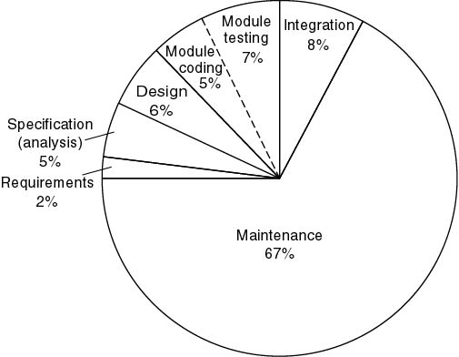
Approximate Relative Cost of Each Phase
1976–1981 data although current data is similar.
Maintenance constitutes 67% of total cost

Slide 40
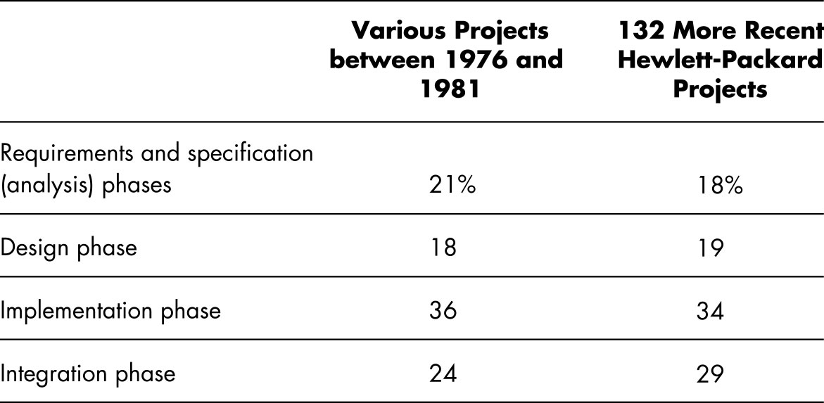
Comparative Relative Cost of Each Phase
Note: Does not show maintenance time which is ~ 2/3 of total cost. Costs as high as 80% of the total are not uncommon.

Slide 41
THE COST OF FAULTS
Clearly the earlier in the life-cycle that we detect a fault, the less damage it will do and the less costly it will be.
Early phases are like paper and pencil discussions and drawings so they can be changed easily.
60 to 70 percent of faults are specification and design faults [Boehm, 1979 and newer studies.
Data of Kelly, Sherif, and Hops [1992]
  1.9 faults per page of specification
  0.9 faults per page of design
  0.3 faults per page of code
Data of Bhandari et al. [1994]
  13% from earlier versions
  In remaining errors, 16% from specification phase and 71% from design phase.

Slide 42
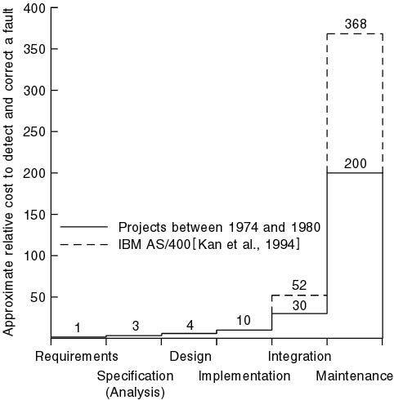
Cost to Detect and Correct a Fault

Slide 43
Team Programming Aspects
Hardware is cheap
  We usually build products that are too large to be written by one person in the available time
  The myth of the "person year"
Teams
  How to organize
  Interfacing components can cause problems
  Meetings take time and need to be productive
  Communication problems
  Personality problems

Slide 44
The Classical Paradigm
The structured paradigm had great successes initially
  It started to fail with larger products (> 50,000 LOC)
Maintenance problems (today, up to 80% of effort)
Reason: structured methods are
We will study some structured methodogies as they are still used today by many organizations and they do supplement more recent methods.
  Action oriented (finite state machines, data flow diagrams); or
  Data oriented (entity-relationship diagrams, Jackson’s method);
  But not both
  But, both data and actions are of equal importance

Slide 45
The Object-Oriented Paradigm
.Most (but not all) of you were first introduced to computer science with this paradigm
Object:
  Software component that incorporates both data and the actions that are performed on that data
Example:
  Bank account
    Data: account balance
    Actions: deposit, withdraw, determine balance
Realize, however, that there are MANY in the industry that did not start with object-oriented concepts.

Slide 46
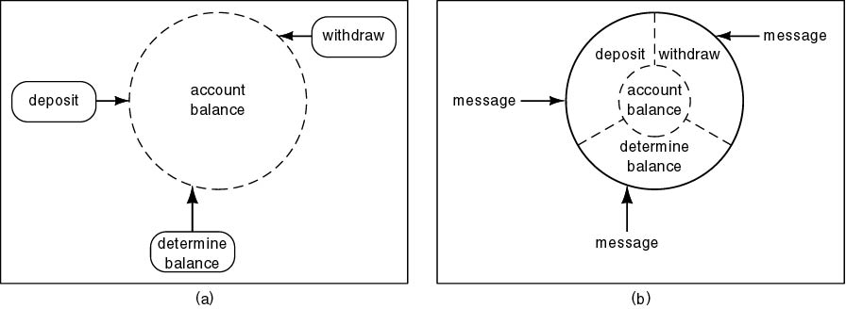
Structured versus Object-Oriented Paradigm
Information hiding
Responsibility-driven design or design by contract
Impact on maintenance, development

Slide 47
Key Aspects of An Object-Oriented Solution
Conceptual independence
  Encapsulation
  Everything the object needs to do is bound to it.
Physical independence
  Information hiding
  Can change representation without changing application programs that access the object.
Impact on development
  Implementation details are localized so a natural for team development
Impact on maintenance
  Independence effects

Slide 48
Responsibility-Driven Design
Also called “Design by Contract”
Send flowers to your aunt in Iowa City
  Do all the work yourself to find a florist and call them
    OR
  Call 1-800-FLOWERS
  Where is 1-800-FLOWERS?
  Which Iowa City florist does the delivery?
  You don't care! This is an example of information hiding
Object-oriented paradigm
  “Send a message to a method [action] of an object“

Slide 49
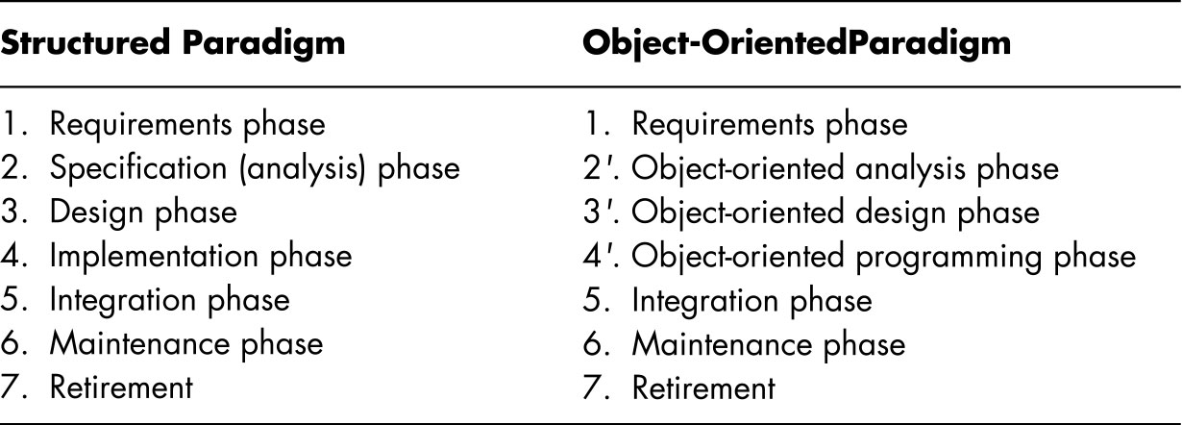
Transition From Analysis to Design
Structured paradigm:
  Jolt between analysis (what) and design (how)
Object-oriented paradigm:
  Objects enter from very beginning

Slide 50
Analysis/Design “Hump”
Systems analysis
  Determine what has to be done
Design
  Determine how to do it
  Architectural design—determine modules
  Detailed design—design each module

Slide 51
Removing the “Hump”
Object-oriented analysis
  Determine what has to be done
  Determine the objects
Object-oriented design
  Determine how to do it
  Design the objects

Slide 52
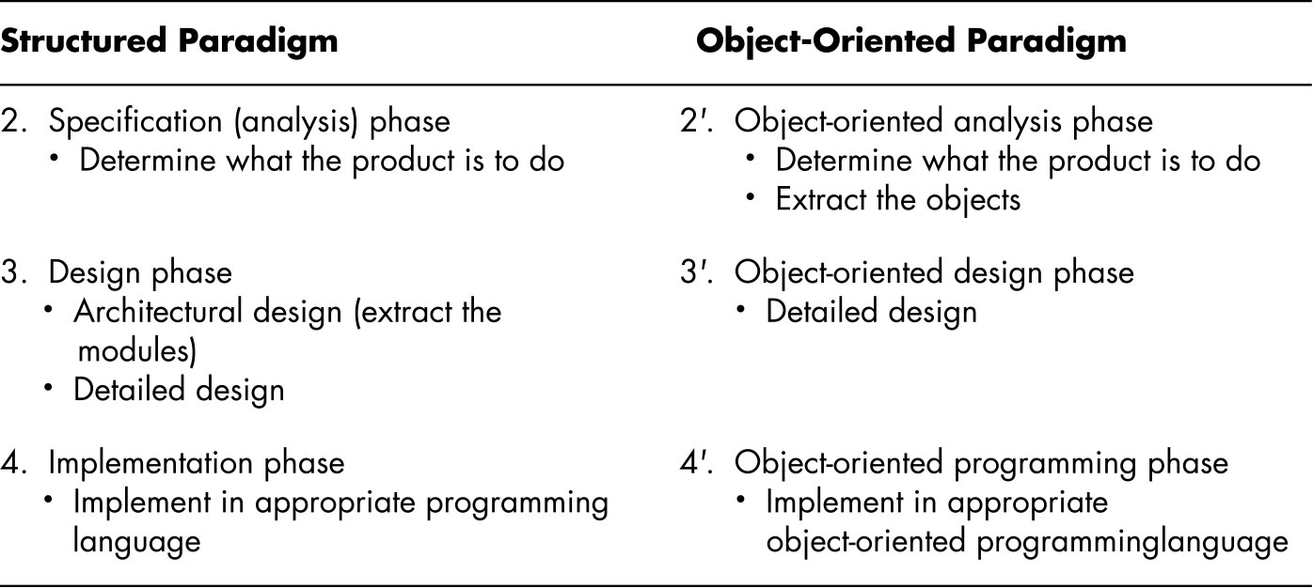
In More Detail
Objects enter here

Slide 53
Warning
Do not use the object-paradigm to enhance a product developed using the structured paradigm
  Water and oil do not mix
Exception: if the new part is totally disjoint
  Example: adding a GUI (graphical user interface)

Slide 54
Terminology
Software - Everything, not just code
Quality
Program, system, product
Methodology, paradigm
Method and technique
Client, developer, user
Bug 
  “A bug  crept into the code”
  instead of
  “I made a mistake”

Slide 55
Object-Oriented Terminology
Data component of an object
  State variable
  Instance variable (Java)
  Field (C++)
  Attribute (generic)
Action component of an object
  Member function (C++)
  Method (generic)
Invoking a method for an object is often termed sending a message to the object. (Carryover from the language Smalltalk)

Slide 56
Object-Oriented Terminology (cont'd)
C++: A member is either an
  Attribute (“field”), or a
  Method (“member function”)
Java: A field is either an
  Attribute (“instance variable”), or a
  Method

