Slide 1
CHAPTER 10
REQUIREMENTS PHASE

Slide 2
Overview
Requirements elicitation
Requirements analysis
JAD - not in book
GSS - not in book
Rapid prototyping
Human factors
Rapid prototyping as a specification technique
Reusing the rapid prototype
Management implications of the rapid prototyping model
Experiences with rapid prototyping

Slide 3
Overview (cont'd)
Techniques for requirements elicitation and requirements analysis
Testing during the requirements phase
CASE tools for the requirements phase
Metrics for the requirements phase
Object-oriented requirements?
Air Gourmet case study: Requirements phase
Air Gourmet case study: Rapid prototype
Challenges of the requirements phase

Slide 4
Requirements Phase
Misconception
  Must determine what client wants
“I know you believe you understood what you think I said, but I am not sure you realize that what you heard is not what I meant!”
      1967 Presidential candidate George Romney
Must determine client’s and user's needs
  Chances for success are slim if you don’t figure this out!

Slide 5
Challenges of the Requirements Phase
Employees of the client organization feel threatened by computerization
Requirements team members must be able to negotiate
The client’s needs may have to be scaled down
Key employees of the client organization may not have the time for essential in-depth discussions
  Leave this up to the "techie types"
Flexibility and objectivity are essential

Slide 6
Requirements gathering is an investigation
. . . a search for what is and what could
(or should) be
When conducting an investigation be a detective:
  Be impertinent, question everything
  Be impartial, look for the best solution, not a justification
  Relax constraints, assume anything is possible but eliminate the infeasible
  Attend to details, every fact must fit together, don’t assume, ask and find the answer
  Reframe, look at the problem, opportunity or system in new ways

Slide 7
TECHNIQUES FOR REQUIREMENTS DETERMINATION
OLDER METHODS NEWER METHODS
Interviewing
  individuals
  groups
Listening
Using questionnaires
Observing workers
Becoming a worker
Analyzing procedures
Collecting business documents
Joint Application Design (JAD)
Group support systems (GSS)
CASE tools
Rapid Prototyping
Rapid Application Development (RAD)
Video Cameras
Scenarios
  Storyboarding

Slide 8
Interviewing
Structured vs. Unstructured
  What is the difference? What are the tradeoffs?
Contextual Inquiry
  Way of understanding users’ needs & work practices
  Master – apprentice model allows customer to teach us what they do!
    Master does the work and talks about it while working
    We interrupt to ask questions as they go
  The Where, How, and What expose the Why
Notes:
structured interviews are harder to adapt to real time response of interviewee
- can do some amount of branching (I.e., predefined if answer yes to question #8, then skip to question #12, otherwise #9)
unstructured require a more experienced interviewer to get better data, but they can be a big win

Slide 9
Contextual Inquiry Principles
Context
  Go to the workplace & see the work as it unfolds
  People summarize, but we want details – keep it concrete
    “We usually get reports by email”, ask “Can I see one?”
Partnership
  Master-apprentice relationship
    avoid interviewer/interviewee (stops work)
  Allows more apprentice interaction (alternate: watching & probing)
Interpretation
  Good facts are only the starting point – designs based on interpretations
  Validate – run interpretations by the user to see if you are right
Focus
  Interviewer needs data about specific kind of work
    “steer” conversation to stay on useful topics
Notes:
not there to get a list of questions answered
not there to answer their questions either

Slide 10
Users: Unique or One of Many?
“Take the attitude that nothing any person does is done for no reason; if you think it’s for no reason, you don’t yet understand the point of view from which it makes sense. Take the attitude that nothing any person does is unique to them, it always represents an important class of customers whose needs will not be met if you don’t figure out what’s going on.”
    -- p. 63, Contextual Design, by Beyer & Holtzblatt

Slide 11
Requirements: There is a need to determine...
Business objectives
Information people need to do their jobs
Data handled within the organization to support jobs
When, how and by whom data is moved, transformed or stored
Sequence and other dependencies in data handling
Rules governing how data is handled
Policies and guidelines in business operations
Key events affecting data

Slide 12
Interviewing Individuals
Primary method for gathering information
Will provide facts, opinions and speculation, and a chance to observe body language, emotions, surroundings
Guidelines
  Plan ahead: appointment, pre-questions to interviewee, have checklist, agenda, questions
  Listen carefully; take notes (maybe tape?)
  Review notes within 48 hours and summarize
  Be neutral -- seek diverse and differing views

Slide 13
To determine requirements---ask questions.
Some samples…but lots more!
How do employees perform or will need to perform to meet future business conditions?
How does the current system function?
Is the system manual or automated? Which should it be?
What data are necessary for the proper functioning of the supported business area?
What types of reports are generated?
How do people use the system to perform their work?
How should a new or replacement system function?
What data would be needed for the system to operate smoothly?
What kinds of reports are needed?
How would a new system alter employees’ jobs?
What new or improved information services are needed to support the future organizational goals, objectives, strategies and functions?

Slide 14
Interview Questions
Open-ended: require much time
  probe when you cannot anticipate all possible responses, or don’t know the precise question to ask
  “What is most helpful about the advising system?
  “What are your most frequent advising needs?
Closed-ended: require less time
  give a range of answers to choose, when most answers to questions are well known and desired
  “What advice to you seek from your advisor---career, personal, college related information?”

Slide 15
Some interview guidelines
Do not phrase questions to imply a right or wrong answer
Ask only one question at a time (no double-barreled questions!)
LISTEN very carefully to what is being said
Type your interview notes as soon as possible after the interview -- list unclear points, separate facts from opinion, list any additional questions arising from interview
Do not set expectations about the new system- this is the most common error made when interviewing

Slide 16
Interviewing Groups
Several key people at once
Can reconcile apparent contradictions
Synergies occur -- “Say that reminds me ...”
Usually requires more than one analyst
  scribe
  interviewer
Group interviews are at the core of JAD (to be discussed later!)

Slide 17
Survey Groups of People: Questionnaires
Helpful when there are more people to survey than you can handle in individual or group interviews
A passive technique
Can gather information from a large number in a short time
Less biased in the interpretation of results
Choose the sample to be representative of all users
  convenience, random, purposeful, stratified
Typically use closed-ended questions with a few open-ended ones
Questions must be extremely clear and logical

Slide 18
Questionnaires vs Interviews
Questionnaires
Med to Low
Less
Cheaper
No
No
Can be
Passive
Can be large, IF
returned
Information richness
Time
Expense
Follow-up possible
Probing possible
Confidential
Subject Involved
Audience
Interviews
High
Extensive
Expensive
Yes
Yes
No
Yes
Limited, but can get complete responses

Slide 19
Observation
Structured observation
  same elements in each observed setting
Individual observation
  spend a day (or some portion) with someone performing the job to be automated
Individual performance
  take over someone’s job for the day

Slide 20
Study Business Documents
Discover the difference between formal systems and informal systems of work
  Does data flow as intended?
  Are there bottlenecks in processing (slowed/stopped work)?
  Is there unnecessary duplication?
  Is there a lack of understanding of inter-relatedness
Choose samples of work documents:
  Examples: procedures manuals, decision making reports, performance reports, records, data capture forms (official & unofficial, completed)

Slide 21
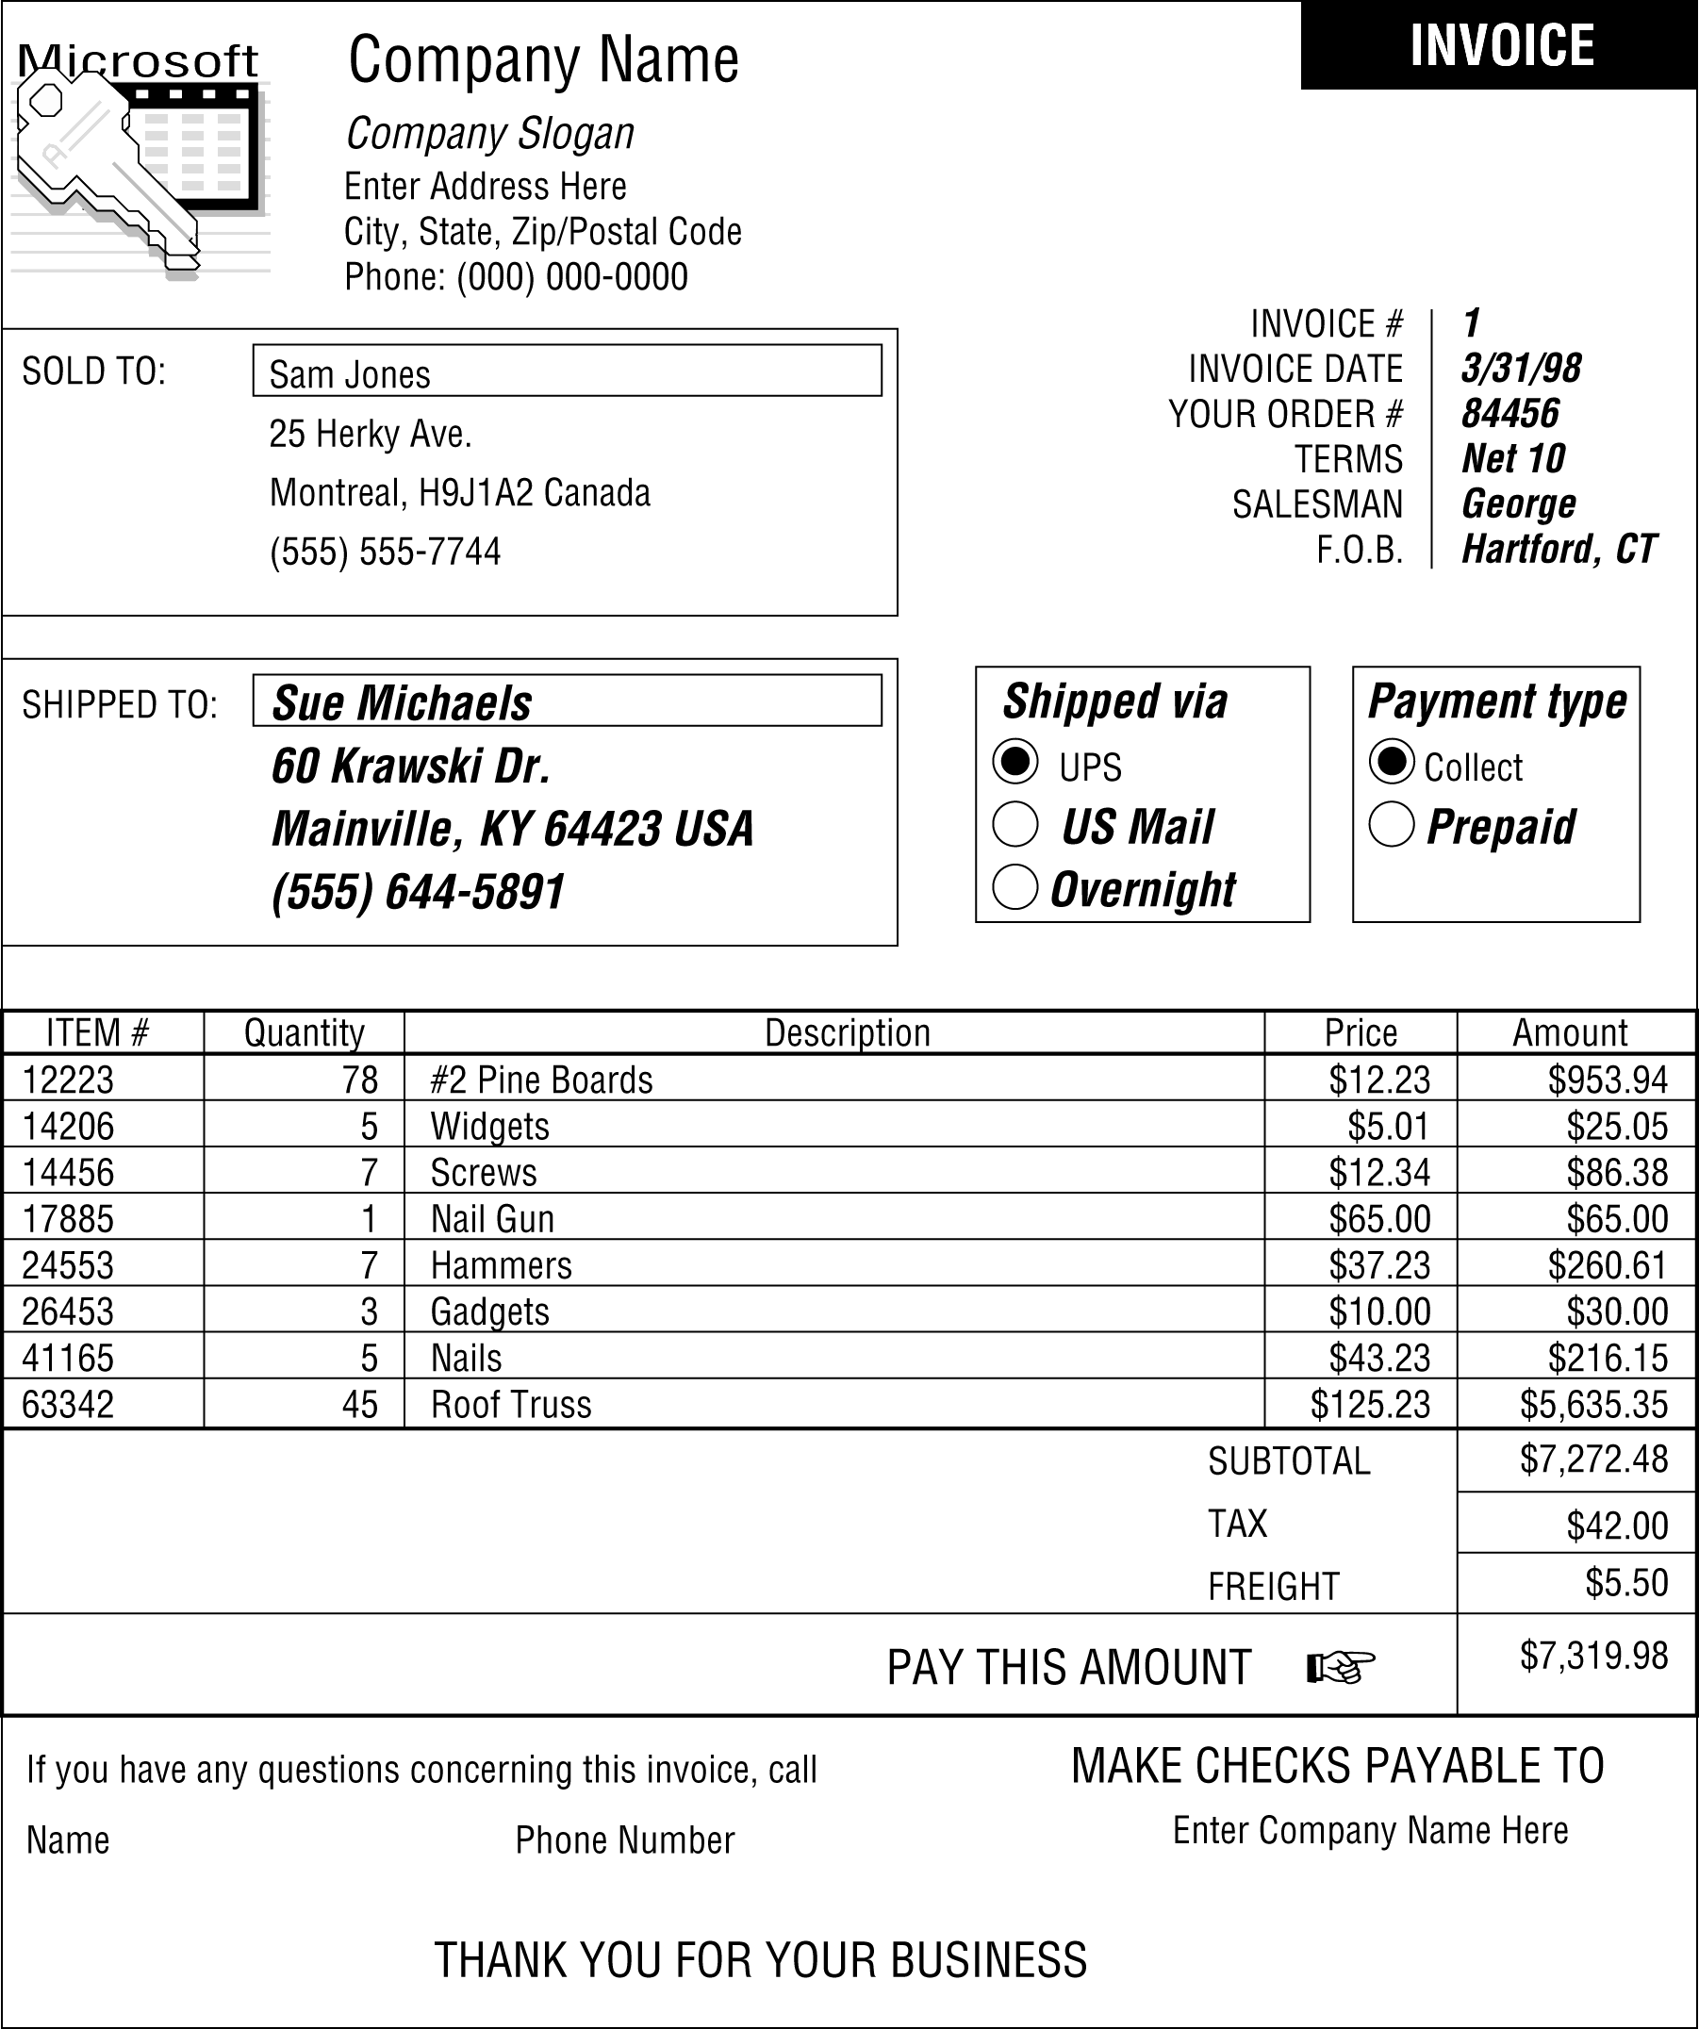

Example of a Business Form

Slide 22
JAD
Started in the late 1970s by IBM.
Spread through many companies and industries today.
Like a group interview, but more structured and controlled.
Don’t want to conduct in the usual work place.
Can last 4 hours to entire week.

Slide 23
Joint Application Design (JAD)
Brings together key users, managers and systems analysts
Extended meetings with pre-defined agendas and rules for conduct
Try to hold off-site or in a specially-designed environment
Purpose: collect systems requirements simultaneously from all key people
Surfaces areas of agreement and areas of conflict
Intense Structured Highly Effective

Slide 24
Who are the players in JAD?
ANALYSTS
SPONSOR
USERS
JAD
MANAGERS
SESSION
LEADER
OTHER IS
STAFF
SCRIBE

Slide 25
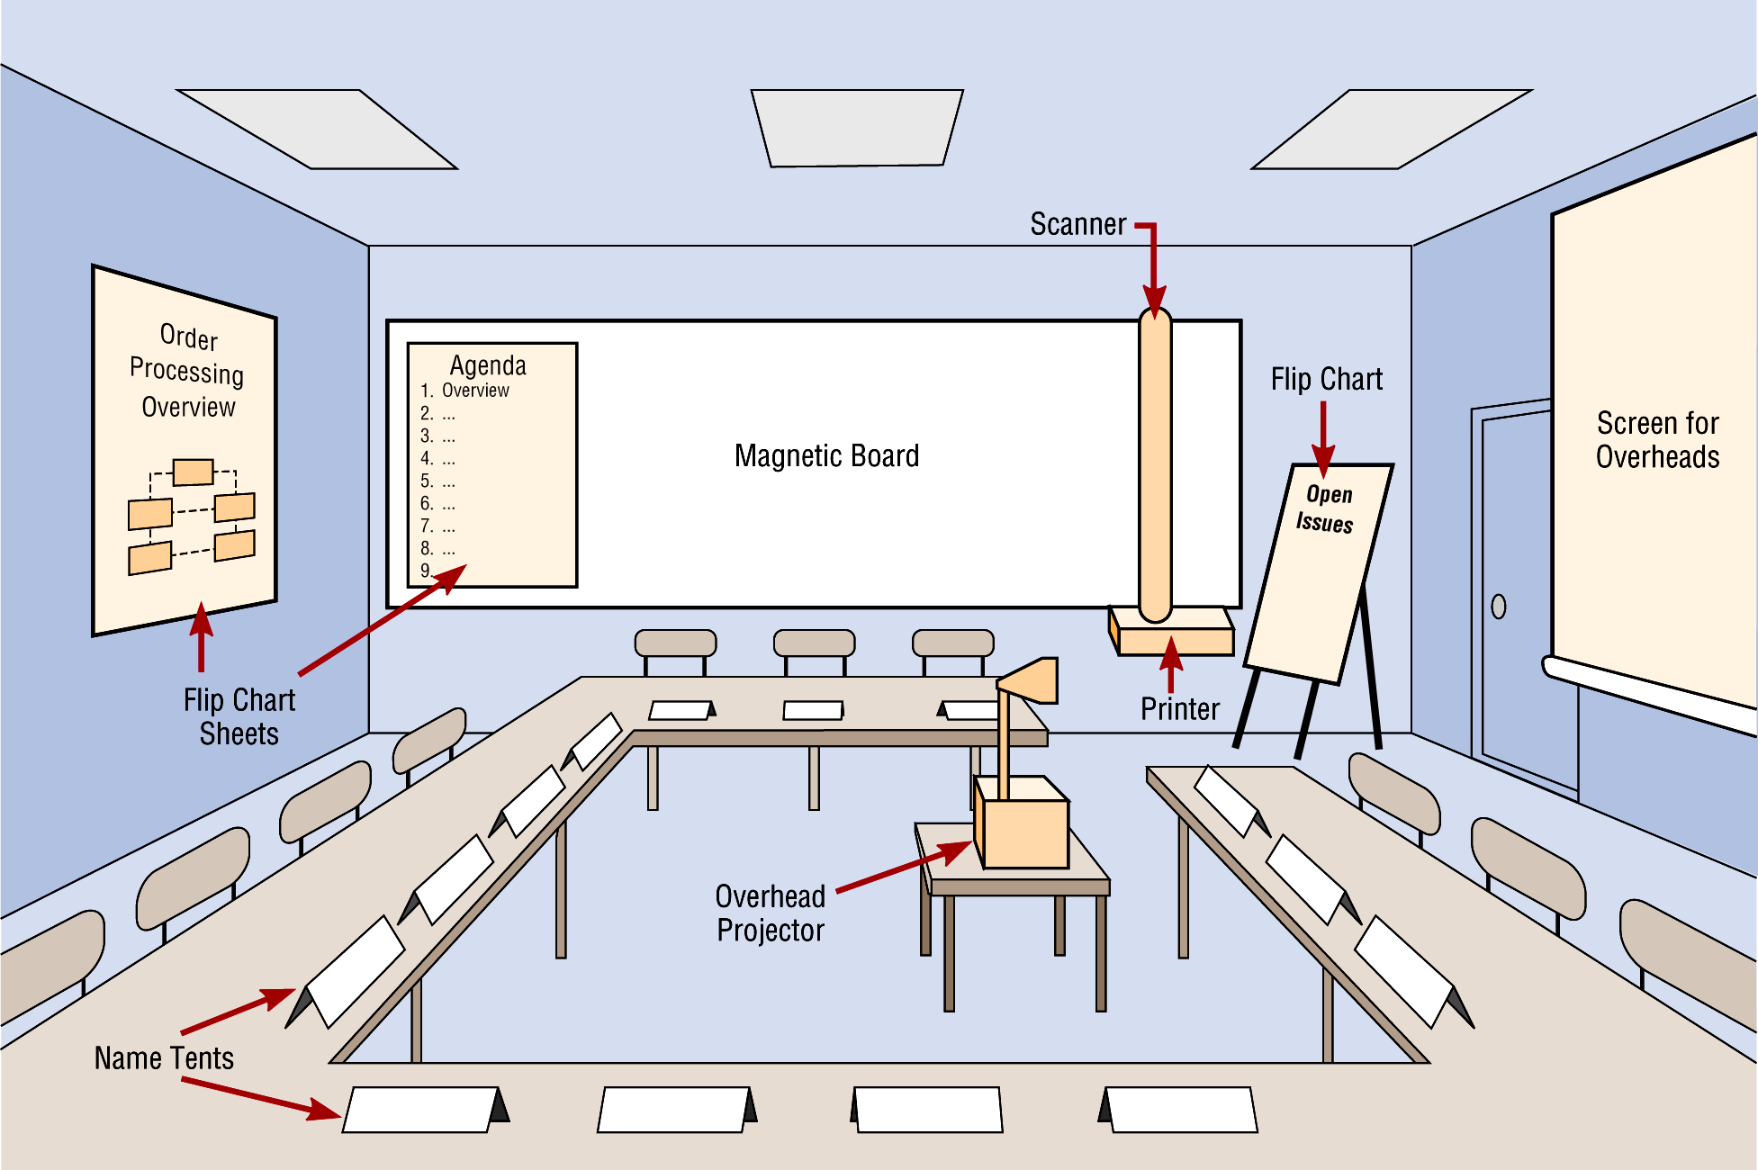
Illustration of the Typical Room Layout for a JAD (Joint Application Design)
computer

Slide 26
JAD OPTIONS
GSS - group support system
Participants type comments anonymously into computers and these are displayed.
With GSS
Gives everyone an opportunity to speak
Allows anonymity
Provides an automatic record of what is “said”
With CASE Tools
Upper case tools
Can model as discussion ensues -- consistency is built in
Immediate feedback on translation from verbal to requirements

Slide 27
JAD
Pros: Cons:
Having all players together highlights agreement and conflict areas quickly.
Many conflicts can be resolved in the session.
No outside distractions dilute the concentration.
Records are easily kept.
Expensive because of the number of people involved.
Expensive if held off site.
Success is very dependent upon the skills of a few key players.
As in all group activities, a few individuals can dominate.
Some individuals may be timid about participating.

Slide 28
GSS
Pros: Cons:
Sessions are less structured.
The lack of structure and the anonymity can make it more difficult to identify and resolve conflicts.
There can be less interactions between participants.
Often more people participate.
There can be less domination by a few individuals.
Can be more time efficient.
Anonymous comments can help timid individuals voice their opinions.
The resulting information can be less biased as more people participate.

Slide 29
Human Factors
Client and intended users must interact with the user interface
It is a key aspect of successful software product
Human-computer interface (HCI)
  Menu, not command line
  “Point and click”
  Windows, icons, pull-down menus
  Requires very, very careful planning with the client and the users (see next slide)
Some believe a rapid prototype of HCI is obligatory

Slide 30
Human Factors
Human factors must be taken into account
  Lengthy sequence of menus are not good
  Determine the expertise level and cognitive abilities needed to handle the interface
    Who uses?
    What do they need to do?
    When do they need to do it?
  Uniformity of appearance
  Advanced psychology vs. common sense?
    Be careful of book’s hint that good UI design might just be “common sense”
    Can only be made successful by involving user in repeated process of design, prototype, test
    This has been shown to be true time & time again
    Don't fall prey to designer ego bias – we are not the users anymore
Take CPSC 222 (Interface Design) if you want to really study this.

Slide 31
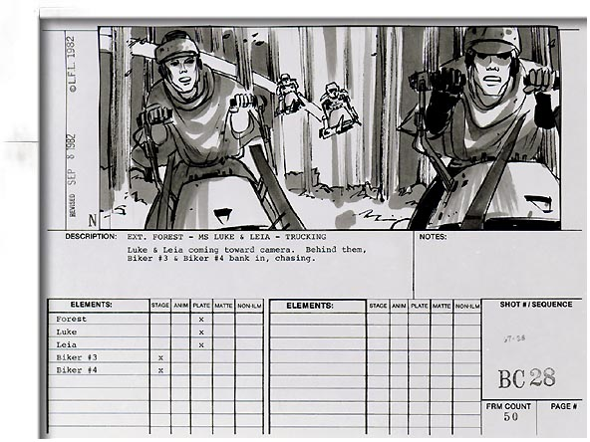
Scenarios
Illustrate the major events/actions to users
  Often use storyboards & paper prototypes
    Storyboards are used a lot in the movie industry
    Especially useful for UI design

Slide 32
STORYBOARDING SOFTWARE
There are many possibilities:
StoryBoard Quick, Artist, and Artist Studio by Power Production:
http://www.powerproduction.com/quick/example/example.html
http://www.powerproduction.com/artistdemo.html
Board Master has several possibilities:
http://www.boardmastersoftware.com/
and the big names:
  Adobe After Effects
  Macromedia's Director

Slide 33
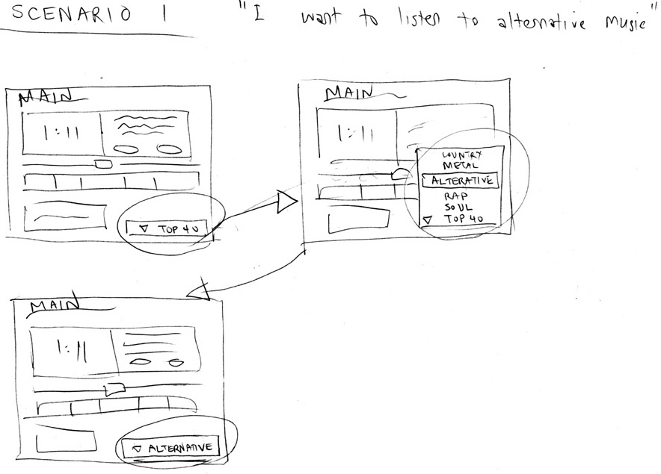
Illustrate the major events/actions to users
  While there are software tools for storyboarding.
  Hand drawn scenarios are useful also.

Slide 34
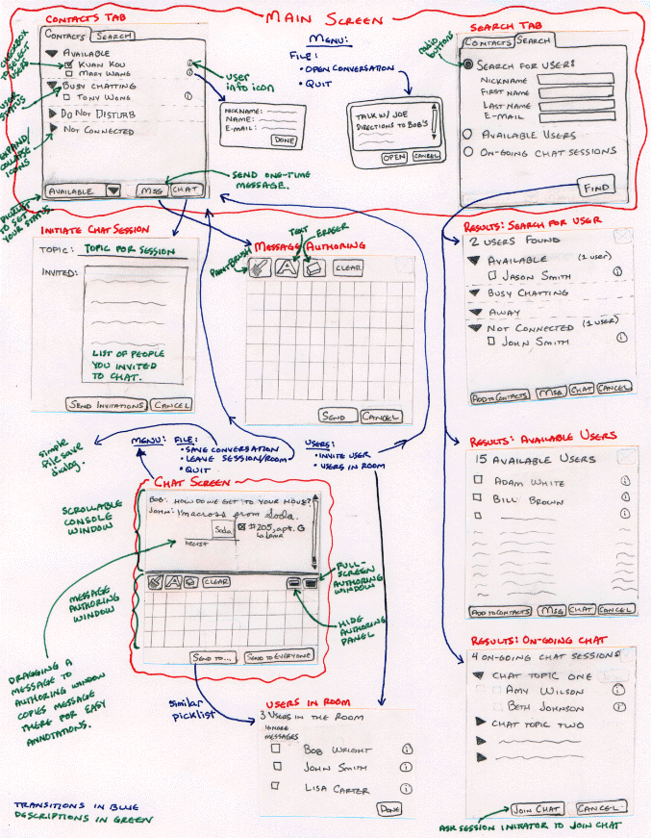

Slide 35
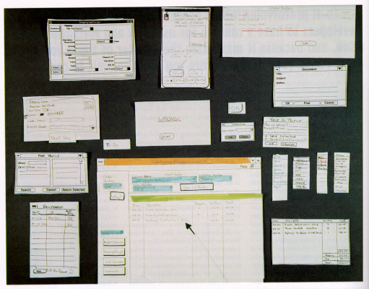

Slide 36
DENIM: From Scenarios to Rapid Prototypes
Reference (and free software):
http://guir.berkeley.edu/projects/denim/research/
DENIM is a system that helps GUI designers in the early stages of design.
DENIM
  supports sketched input,
  allows design at different refinement levels, and
  unifies the levels through zooming.

Slide 37
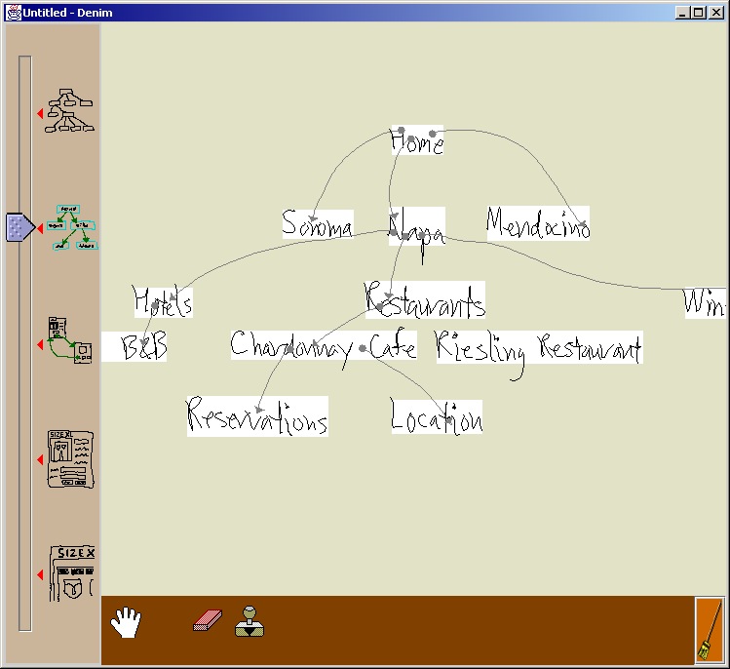
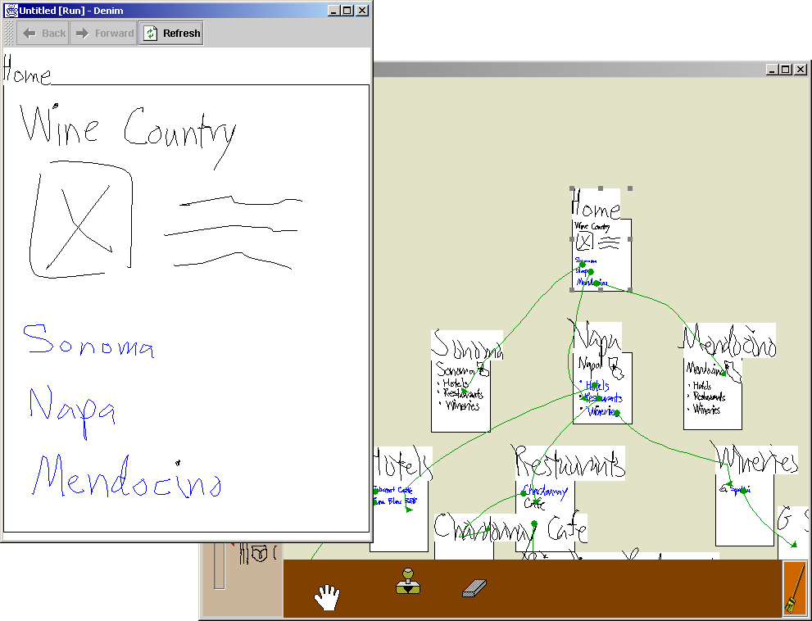
DENIM SCREENS

Slide 38
Prototyping
Building model of the system
Iterative process involving client, users and analysts
Used to help determine requirements
Must first determine basic requirements, then build prototype, obtain feedback, rebuild prototype, obtain feedback, rebuild prototype, obtain feedback, rebuild . . .

Slide 39
Prototyping
Most useful when
  requirements are unclear or not well understood
  building new systems without existing systems
  building decision support systems
  complexity requires modeling
  tools are available to support modeling
Drawbacks
  tendency to avoid documentation
  idiosyncratic to initial user
  may put the prototype model into production
  tempted to shortcut well-designed procedures for producing good software

Slide 40
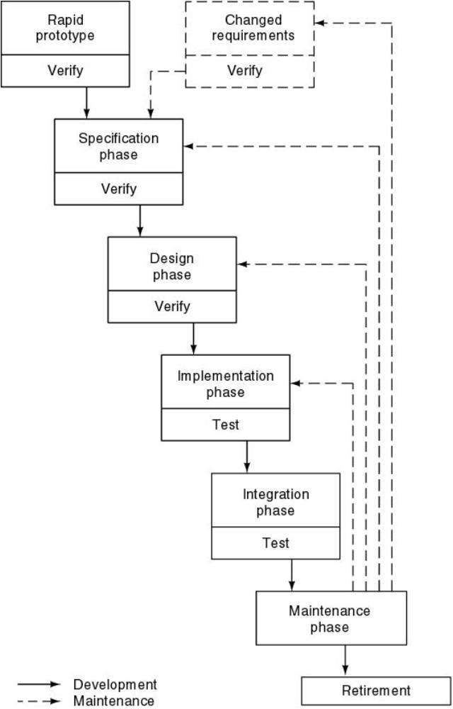
Rapid Prototyping
Hastily built (“rapid”)
Key functionality
What the client sees
Experimentation and change
Languages for rapid prototyping
  Smalltalk
  Lisp
  Perl
  Visual C++
  Visual J++
  Visual Basic

Slide 41
Rapid Prototyping
Tools & Techniques
  UI prototyping & other rapid development tools help
    e.g. Storyboard tools mentioned earlier
  HTML / Hypertext
    Simply mock up a UI in HTML to flip screens
    Also done in PowerPoint, Director, HyperCard, etc.
  Interpreted languages & development environments
    Smalltalk, Lisp, Java, Visual Basic

Slide 42
Rapid Prototyping
Allows users to “see” & use proposed solutions
Develop specification from the prototype requirements
  Proceed with rest of stages in waterfall model
Prototype must be constructed & changed quickly
  Key functionality
    Omits things like scalability, error checking, saving, etc.
  Do not spend time perfecting the code or structure
    It is OK if it hardly works or crashes every few minutes
    Plan to throw it away! You will and should!
  Put in front of customer ASAP & modify in response

Slide 43
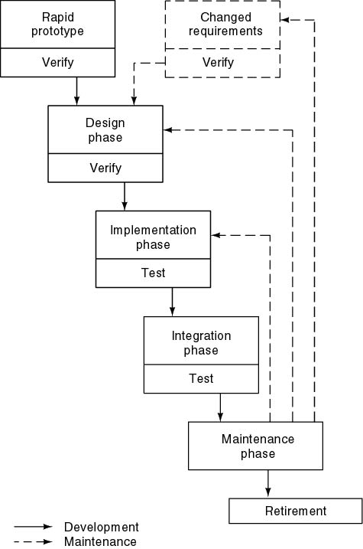
Rapid Prototyping as Specification Technique
No specification phase
Rapid prototype replaces specification document

Slide 44
Rapid Prototyping as Specification Technique
Specifications: Rapid prototype plus list of additional features
Advantages
  Speed
  No ambiguities, omissions, contradictions
Disadvantages
  Specification document is contract
  Testing requires specifications
  Maintenance requires specifications
Conclusion: Do not use rapid prototype as specifications

Slide 45
Dangerous Variants of RP
Use the rapid prototyping as the specification ?
  “Product will do what RP does plus file updating, etc.”
    No time wasted drawing up specs
  Problems
    Unlikely to be accepted as a legal contract
    Hard to make good test cases w/o a spec.
    There is no specification to refer to during maintenance
Refine the rapid prototype until it is the product ?
  Becomes build-and-fix -> expensive!
    Remember, put it together fast & now you are gonna change it!
  Performance constraints unlikely to be met
  Prototype in a different language to avoid this!
Notes:
becomes worse as the product changes – as it will!
Can safely retain (parts of) rapid prototype if: (CONTROVERSIAL)
- prearranged
- passes SQA inspections

Slide 46
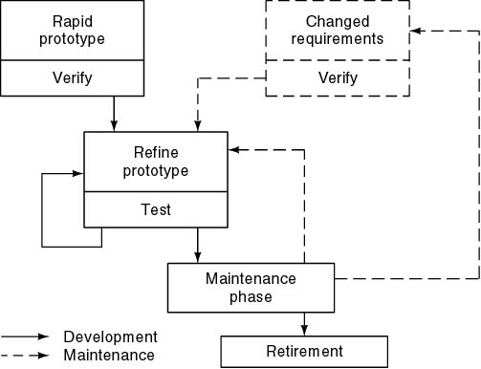
Reusing the Rapid Prototype
Build-and-fix
No specifications, no design
Quality
Maintenance
Real-time constraints
Bottom line: DO NOT JUST MODIFY THE PROTOTYPE!

Slide 47
Reusing the Rapid Prototype
Expensive option
  Reuse rapid prototype
Cheap option
  Discard rapid prototype
Use a different language
Can safely retain (parts of) rapid prototype if
  Prearranged
  Passes SQA inspections
  This is not the “classical” approach.

Slide 48
Other Uses of Rapid Prototyping
Consensus
Management Implications
  Immediate delivery
  Instant maintenance
  Waterfall model—get it right first time
  Rapid prototyping—many changes, then discard
  Increased interaction with clients

Slide 49
Case for Rapid Prototyping
Not proven beyond all doubt
Experiment of Boehm, Gray, and Seewaldt (1984)
  Seven different versions of product compared
    four specified, three prototyped
  Prototyping, specifying yielded equivalent performance
  Prototyped versions had 40% less code, 45% less effort
  Prototyped versions were lower on functionality and robustness, higher on ease of use and ease of learning
  Specifying made integration easier

Slide 50
Case for Rapid Prototyping (cont'd)
Important facts (not often mentioned)
  Experiment was on seven teams of graduate students
  Three teams of size 2, and four teams of size 3
  Ten week duration
  No maintenance
Treat results as indications, not facts

Slide 51
Experiences with Rapid Prototyping
Analysis of 34 case studies [Gordon and Bieman, 1992]
29 successes, 2 failures, 3 neutral
  (But few failures are published!)
All agreed
  User participation was essential, user needs were met
Not all issues were addressed in all case studies
Only 16 mentioned ease of use, but all 16 were positive
Choice of prototyping language was not important

Slide 52
Controversy
Discard or retain rapid prototype?
  Diametrically different processes used
  22 recommended retention, 8 said discard
  7 out of 7 large (over 100K LOC) projects recommended retention
How do you rapid prototype a project involving
  COTS?
  New and different hardware?
  Purchased software that must all interface with each other?
  ...

Slide 53
Rapid Application Development (RAD)
Alternative systems development methodology
More structured than just rapid prototyping
Can decrease amount of time to design/implement
Relies on user involvement, integrated CASE tools, prototyping and code generators
Iterative process

Slide 54
Testing during the Requirements Phase
Aim: Establish client’s real needs
Users must interact thoroughly with rapid prototype
Issues must reach client

Slide 55
CASE Tools for the Requirements Phase
Language for Rapid Prototyping
  Interpreted languages + environments (Lisp, Smalltalk)
  Hypertext (HTML) for user interfaces
  4GL
    Fewer statements
    Often interpreted
    Often powerful CASE tools
Danger of 4GL
  Part of larger environment
  Cheap solution: separate tool

Slide 56
Metrics for the Requirements Phase
Quality, reliability?
  Track errors in requirements that impact the project in its later phases.
Volatility, convergence
  How often to requirements change during requirements phase? (Shows how rapidly the requirements converge.)
Changes during subsequent phases
  How many?
Number of times each feature is used (useful in rapid prototyping)

Slide 57
Object-Oriented Requirements Phase
On the one hand
  The aim is to find the client’s needs
  Objects don’t enter into it
On the other hand
  Using an object-oriented language for the rapid prototype may help to identify classes

Slide 58
Air Gourmet Case Study: Rapid Prototype
See pages 308 through 313 of the text.
C and Java rapid prototypes are available on the Web at
http://www.mhhe.com/engcs/compsci/schach5/air_gourmet.mhtml
(You should look at the code, but you are not responsible for it on a test!)
For speed in implementation
  Data are stored in fixed-size arrays
  Only two reports are implemented (the other four are similar)
  Interface is menu driven

Slide 59
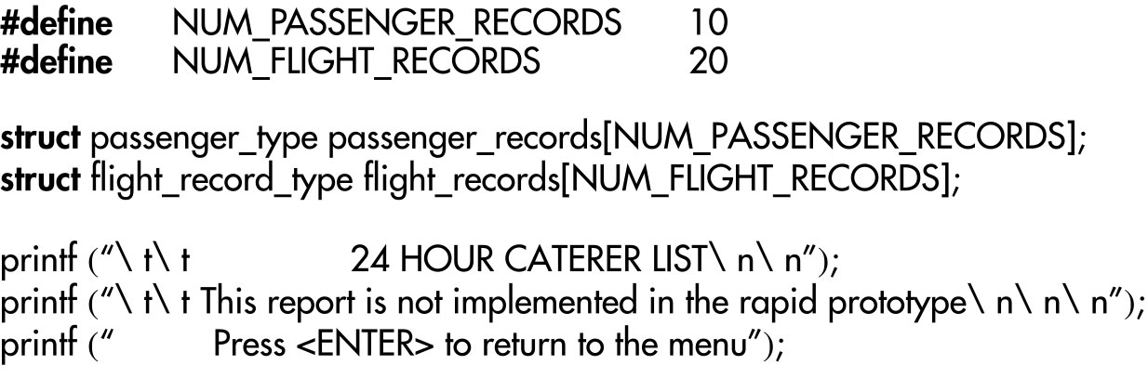
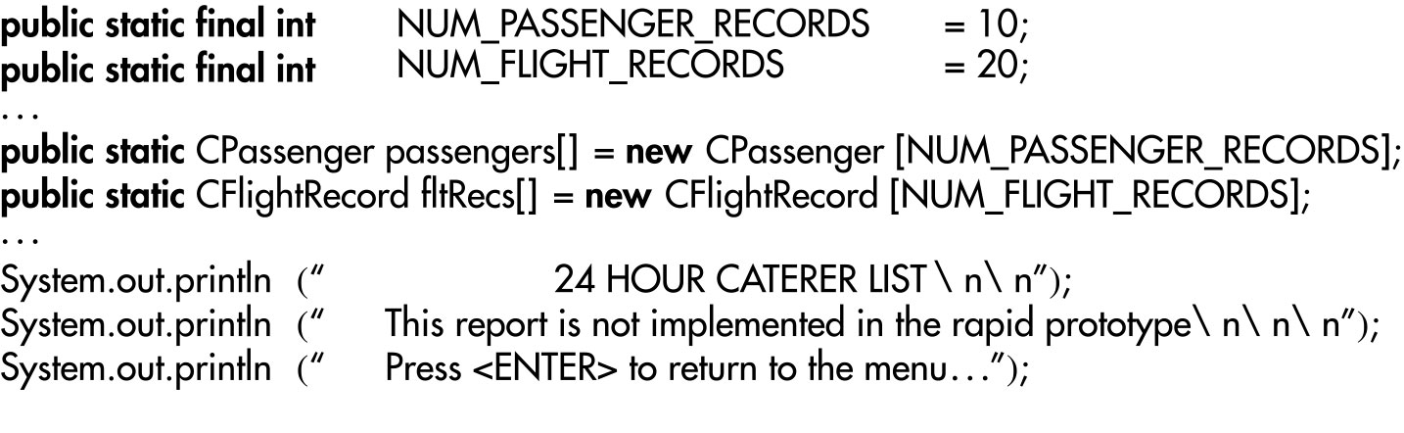
Portion of Rapid Prototype
C
Java

Slide 60
Management Implications of Rapid Prototyping
Can use rapid prototyping to achieve consensus
Expectations must be managed in advance
  Immediate delivery of finished product
  Instant maintenance of operating product
RP shown to lead to products w/ less code & effort
  Incentive to leave unessential features out of the RP -> often leave out of the final product
  Also lead to easier to learn & use products
Waterfall model assumes get things right 1st time
  Bad assumption… iterative RP is more realistic
Be prepared for more client/user interaction
Notes:
becomes worse as the product changes – as it will!
Can safely retain (parts of) rapid prototype if:
- prearranged
- passes SQA inspections

Slide 61
AT THE END OF THE REQUIREMENTS PHASE, WHAT DO WE HAVE?
Information, in various forms, that describes:
1. The current system being studied
2. New and different capabilities to be included in possible new systems
3. Justification for the described needs

Slide 62
WHAT HAPPENS NEXT?
Analysts study the information and structure it into standard formats suitable for identifying problems and unambiguously describing the specifications for new systems.
Requirements structuring means to document
1) The flow or movement of data through the organization and information systems
2) The logic and timing of transforming data into information
3) The rules that govern the relationships between different data handled by the system
The documentation is usually graphical.

Slide 63
BUSINESS PROCESS REENGINEERING (BPR)
(Bug question: Should we do this?)
Traditional requirement determinations tries to automating existing practices, without major changes.
BPR tries to change the practices extensively---i.e. overall the system.
Concentrate on reorganizing the complete data flow
Try to eliminate unnecessary steps on business practices
Tries to change the way information is stored and shared
Breaks long-held business rules if necessary (called disruptive technologies )
Assumes that a radical improvement in business practices can not be achieved by just tweaking the existing system

Slide 64
Summary
The requirements phase is about determining the needs of the client.
Key techniques
  Interviewing
  JAD
  Scenarios / storyboards
    Key for UI design
  Rapid prototyping
    Create quickly & iterate based upon user feedback
    Do not use as a specification!
    Do not turn into final product – plan to throw away!
    Need to manage client expectations

