Slide 1
CHAPTER 11
SPECIFICATION PHASE

Slide 2
Overview
The specification document
Informal specifications
Structured systems analysis
Other semiformal techniques
Entity-relationship modeling
Finite state machines
Petri nets
Other formal techniques

Slide 3
Overview (cont'd)
Comparison of specification techniques
Testing during the specification phase
CASE tools for the specification phase
Metrics for the specification phase
Air Gourmet Case Study: structured systems analysis
Air Gourmet Case Study: software project management plan
Challenges of the specifications phase

Slide 4
Specification Phase
Specification document must be
  Informal enough for client
  Formal enough for developers
  Free of omissions, contradictions, ambiguities

Slide 5
Specification Document
Constraints
  Cost
  Time
  Parallel running
  Portability
  Reliability
  Rapid response time
Acceptance criteria
  Vital to spell out series of tests
  Product passes tests, deemed to satisfy specifications
  Some are restatements of constraints

Slide 6
Solution Strategy
General approach to building the product
Find strategies without worrying about constraints
Modify strategies in the light of constraints, if necessary
Keep a written record of all discarded strategies, and why they were discarded
  To protect the specification team
  To prevent unwise new “solutions” during the maintenance phase

Slide 7
Informal Specifications
An Example
  “If sales for the current month are below target sales, then report is to be printed, unless difference between target sales and actual sales is less than half of difference between target sales and actual sales in previous month, or if difference between target sales and actual sales for the current month is under 5%”

Slide 8
What Was Meant by Specification
Sales target for January was $100,000, actual sales were only $64,000 (36% below target)
  Print report
Sales target for February was $120,000, actual sales were only $100,000 (16.7% below target)
  Percentage difference for February (16.7%) less than half of previous month’s percentage difference (36%), do not print report
Sales target for March was $100,000, actual sales were $98,000 (2% below target)
  Percentage difference < 5%, do not print

Slide 9
But Specifications Do Not Say This
“Difference between target sales and actual sales”
  There is no mention of percentage difference
Difference in January was $36,000, difference in February was $20,000
  Not less than half of $36,000, so report is printed
“Difference … of 5%”
  Again, no mention of percentage
Ambiguity—should the last clause read “percentage difference … [of] 5%” or “difference … [of] $5,000” or something else entirely?
Style is poor

Slide 10
Informal Specifications (cont'd)
Claim
  This cannot arise with professional specifications writers
Refutation
  Text Processing case study (Sections: 6.5.2 and 11.2.1)

Slide 11
Episode 1
1969 — Naur Paper
  Given a text consisting of words separated by blank or by newline characters, convert it to line-by-line form in accordance with following rules:
  (1) line breaks must be made only where text has blank or newline ;
  (2) each line is filled as far as possible, as long as
  (3) no line will contain more than maxpos characters
Naur constructed a procedure (25 lines of Algol 60), and informally proved its correctness

Slide 12
Episode 2
1970 — Reviewer in Computing Reviews
  First word of first line is preceded by a blank unless the first word is exactly maxpos characters long

Slide 13
Episode 3
1971 — London found 3 more faults
  Including: procedure does not terminate unless a word longer than maxpos characters is encountered

Slide 14
Episode 4
1975 — Goodenough and Gerhart found 3 further faults
  Including—last word will not be output unless it is followed by blank or newline
Goodenough and Gerhart then produced new set of specifications, about four times longer than Naur’s

Slide 15
Case Study (cont'd)
1985 — Meyer detected 12 faults in Goodenough and Gerhart’s specifications
Goodenough and Gerhart’s specifications
  Were constructed with the greatest of care
  Were constructed to correct Naur’s specifications
  Went through two versions, carefully refereed
  Were written by experts in specifications
  With as much time as they needed
  For a product about 30 lines long
What chance do we have of writing fault-free specifications for a real product?

Slide 16
Episode 5
1989 — Schach found fault in Meyer’s specifications
  Item (2) of Naur’s original requirement (“each line is filled as far as possible”) is not satisfied

Slide 17
Informal Specifications
Conclusion
  Natural language is not a good way to specify product
Fact
  Many organizations still use natural language, especially for commercial products
Reasons
  Uninformed management
  Undertrained computer professionals
  Management gives in to client pressure
  Management is unwilling to invest in training

Slide 18
Structured Systems Analysis
Three popular graphical specification methods of ’70s
  DeMarco
  Gane and Sarsen
  Yourdon
All equivalent
All equally good
Many U.S. corporations use them for commercial products
Gane and Sarsen used for object-oriented design

Slide 19
Structured Systems Analysis Case Study
  Sally’s Software Store buys software from various suppliers and sells it to the public. Popular software packages are kept in stock, but the rest must be ordered as required. Institutions and corporations are given credit facilities, as are some members of the public. Sally’s Software Store is doing well, with a monthly turnover of 300 packages at an average retail cost of $250 each. Despite her business success, Sally has been advised to computerize. Should she?
Better question
  What sections?
Still better
  How? Batch, or online? In-house or out-service?

Slide 20
Case Study (cont'd)
Fundamental issue
  What is Sally’s objective in computerizing her business?
Because she sells software?
  She needs an in-house system with sound and light effects
Because she uses her business to launder “hot” money?
  She needs a product that keeps five different sets of books, and has no audit trail
Assume: Computerization “in order to make more money”
  A cost/benefit analysis for each section of business is needed. (This is a project management item- more later)

Slide 21
Case Study (cont'd)
The danger of many standard approaches
  First produce the solution, then find out what the problem is!
Gane and Sarsen’s method
  Nine-step method
  Stepwise refinement is used in many steps ---i.e. postpone decisions on details until as late as possible to concentrate on the important issues

Slide 22
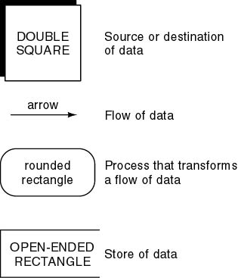
Case Study (cont'd)
Data flow diagram (DFD) shows logical data flow (either existing system or a proposed system)
  “What happens, not how it happens”
Other methods use different symbols, but the basic ideas are the same.
Usually you can switch to another method without any difficulties.

Slide 23
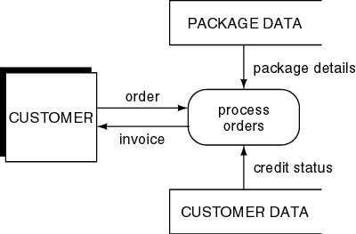
Step 1. Draw the DFD
First refinement
Infinite number of possible interpretations

Slide 24
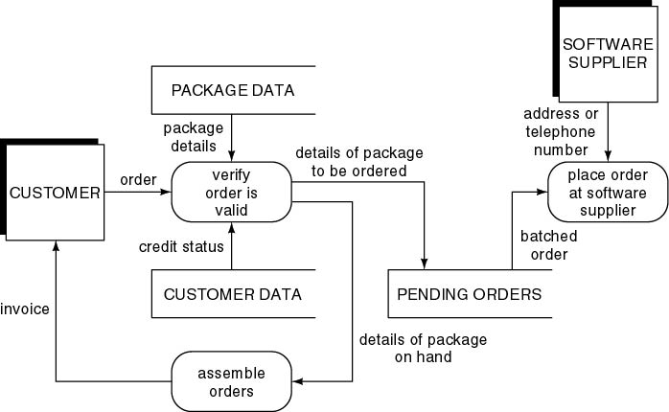
Step 1 (cont'd)
Second refinement
Pending orders scanned daily

Slide 25
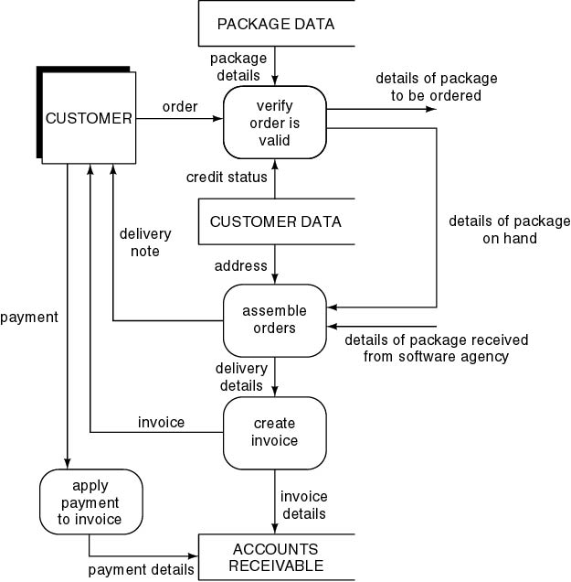
Step 1 (cont'd)
Portion of third refinement

Slide 26
CONCENTRATE ON ONE TECHNIQUE FIRST:
THE USE OF DATA FLOW DIAGRAMS (DFDs)
BEFORE WE CONSIDER THE OTHER STEPS
Used to model
  How the data flows through an information system
  The relationships between data flows
  How data will be stored at particular places
Is a graphical technique.
Called process modeling because the diagrams concentrate on the movement between processes.

Slide 27
Data Flow Diagrams (DFDs)
Process-oriented
Describe business activities in a graphical/ pictorial form
  transforming activities,
  source and destination of data,
  flow of data,
  data storage
Hierarchical, each process is decomposed into subprocesses

Slide 28
DEFINITIONS
Data flow: Data in motion, moving from one place to another.
Data store: Data at rest or stored.
Process: Actions performed on data to transform, store, or distribute it.
Source/sink: Origin/destination of the data. (Also called external entities.)- These are outside the system and we do not
  consider interactions between sources/sinks
  explore how a source/sink uses the information
  try to control or design a source or sink
  provide direct access to stored data

Slide 29
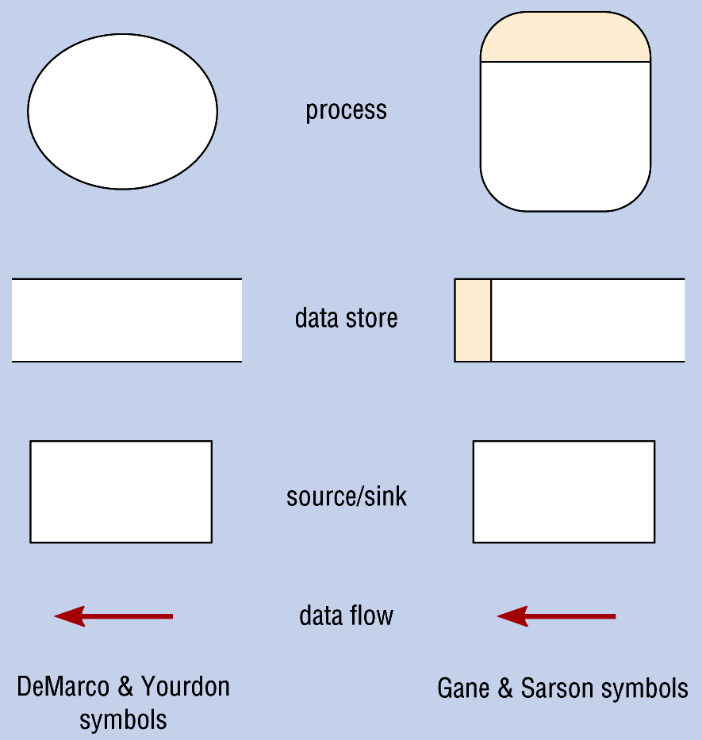
Comparison of DeMarco & Yourdan and Gane & Sarson DFD Symbol Sets
different in our book also

Slide 30
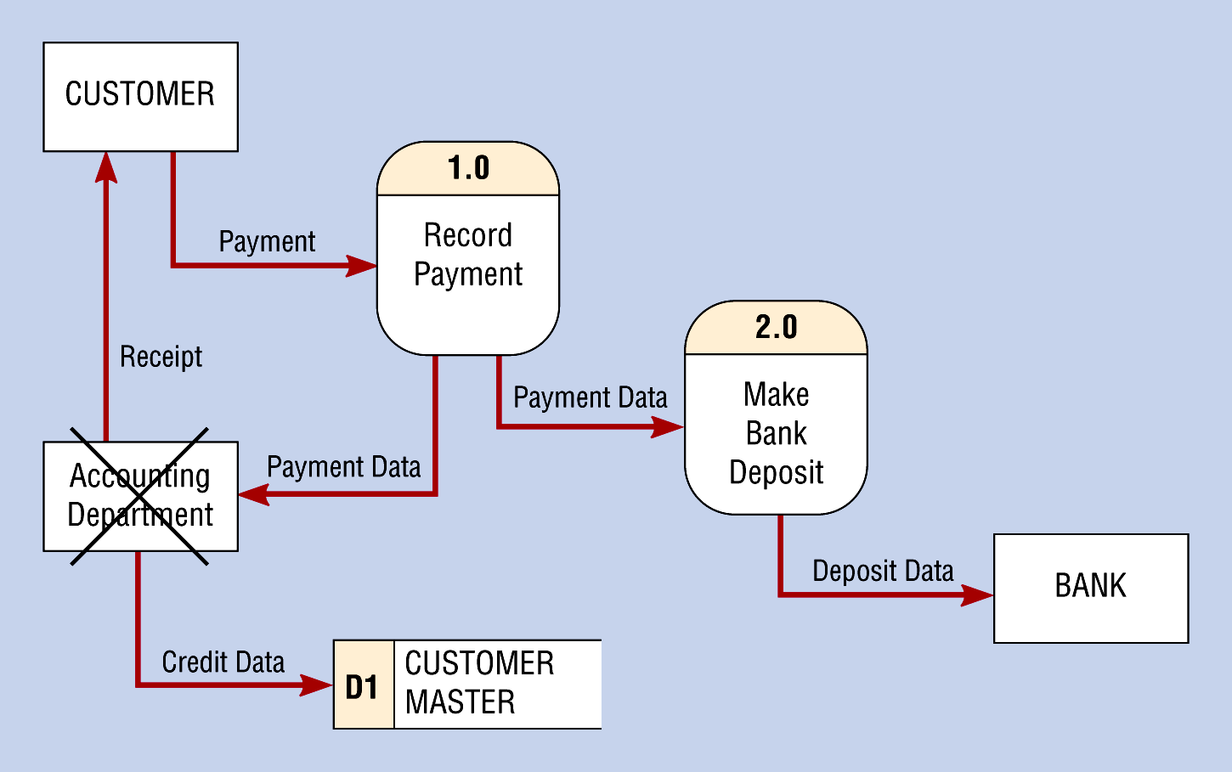
Differences between Sources/Sinks and Processes
(a) Improperly Drawn DFD showing a process as a source/sink

Slide 31
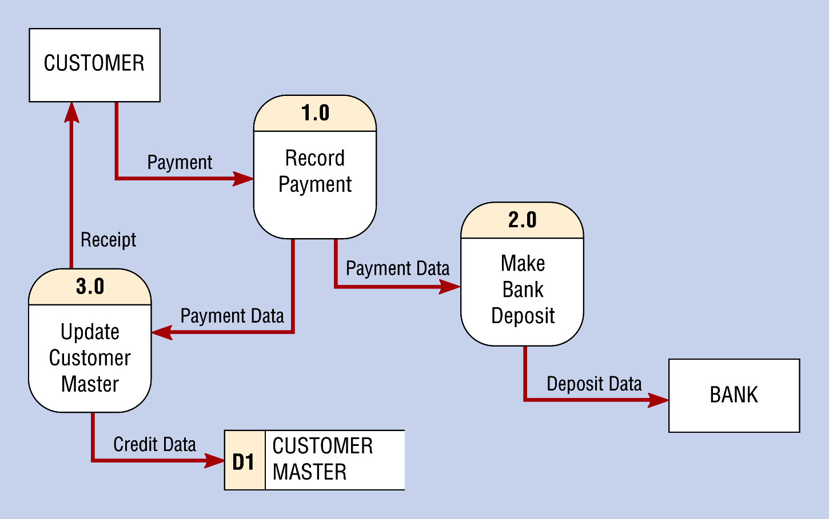
Differences between Sources/Sinks and Processes
(b) Proper Use of a Process

Slide 32
Processes -- actions, transforming activities
VALID Active Verbs
INVALID Verbs
(Non transforming)
Add
Build
Calculate
Change
Check
Compute
Create
Delete
Distribute
Examine
Find
Format
Generate
Initialize
Insert
List
Merge
Perform
Post
Print
Produce
Read
Record
Register
Sort
Terminate
Test
Update
Validate
Display
Get
Inquire
Open
Report
Store

Slide 33
Context Level DFD
Supplier
Packing Slip
Purchasing
Dept.
0
Sink
Freight
Receiving
System
Purchase Order
Discrepancies
Source
Accounts
Payable
System
Process
Receiving
Notice

Slide 34
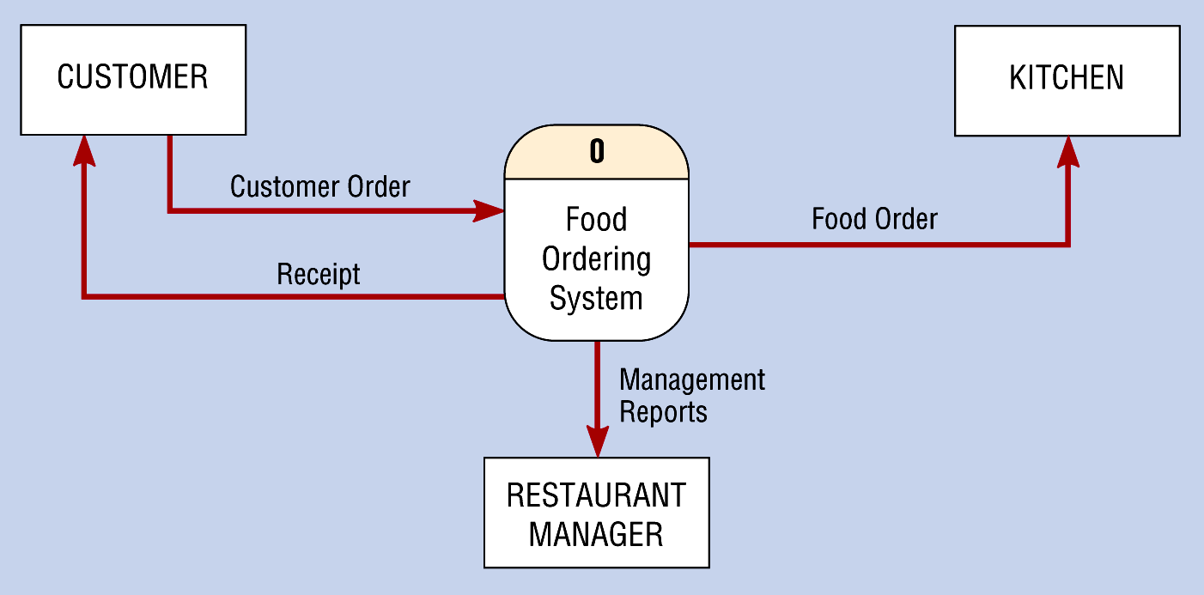
Context Diagram of a Food Ordering System
Context Diagram = highest level view of a system

Slide 35
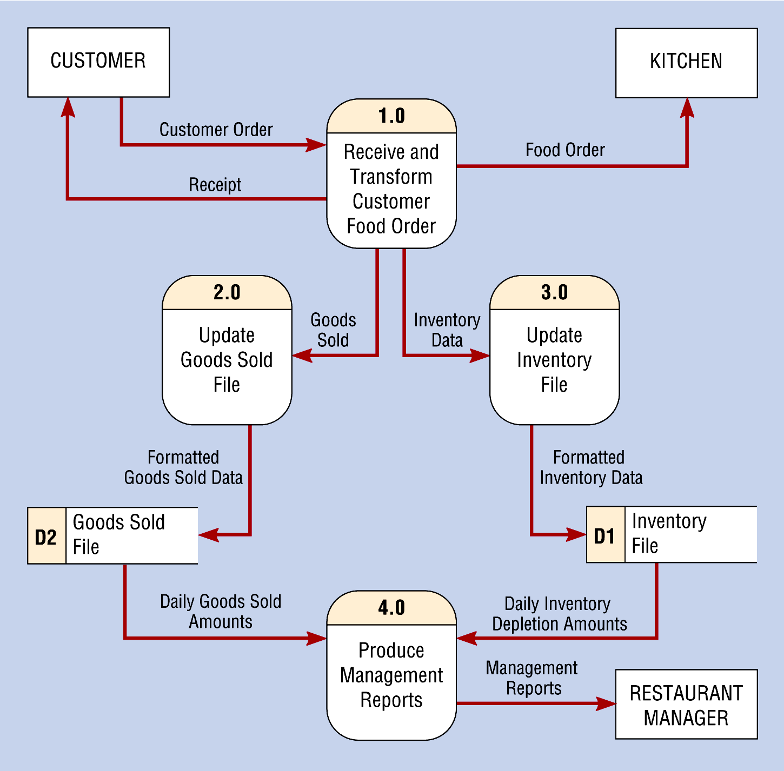
Level-0 DFD of a Food Ordering System

Slide 36
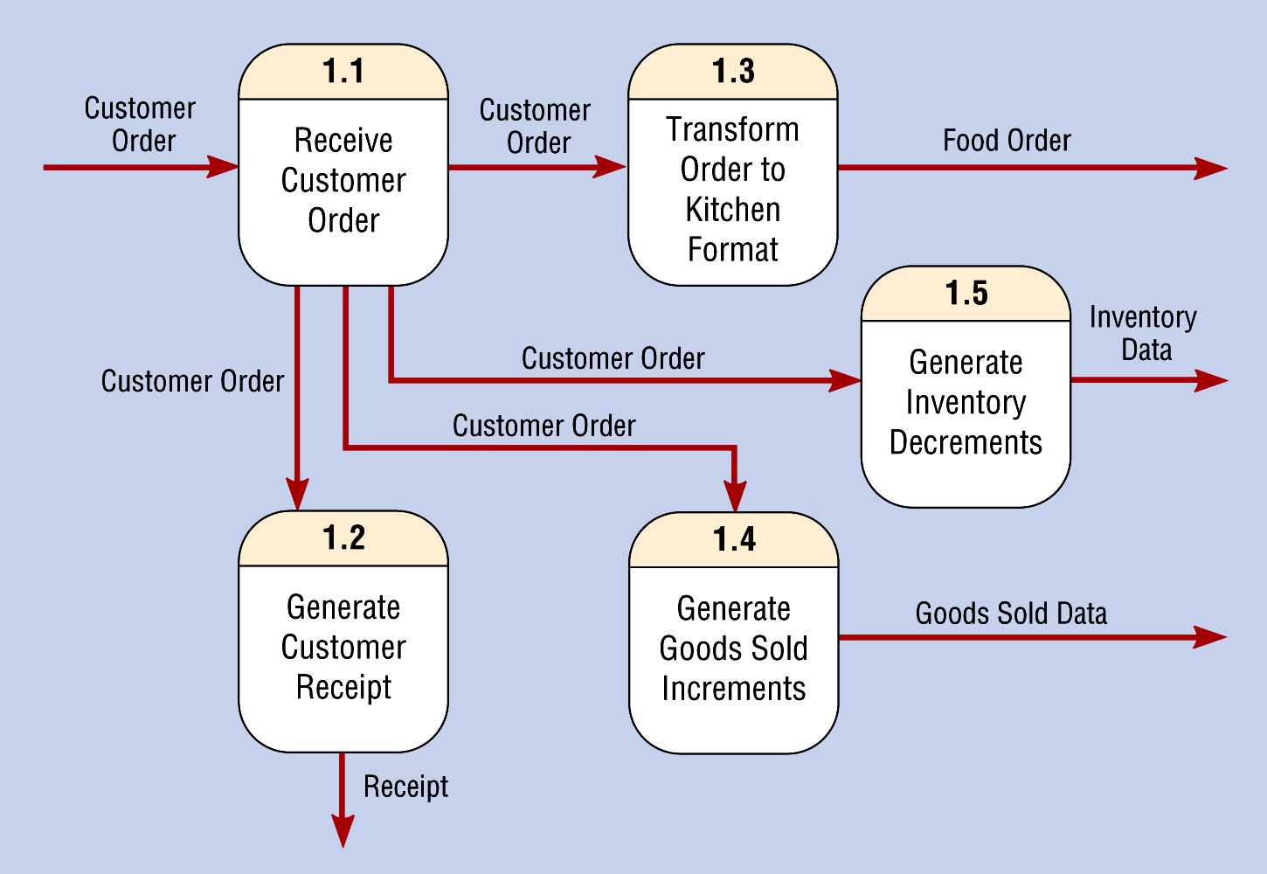
Level-1 Diagram Showing Decomposition of Process 1.0 from the Level-0 Diagram

Slide 37
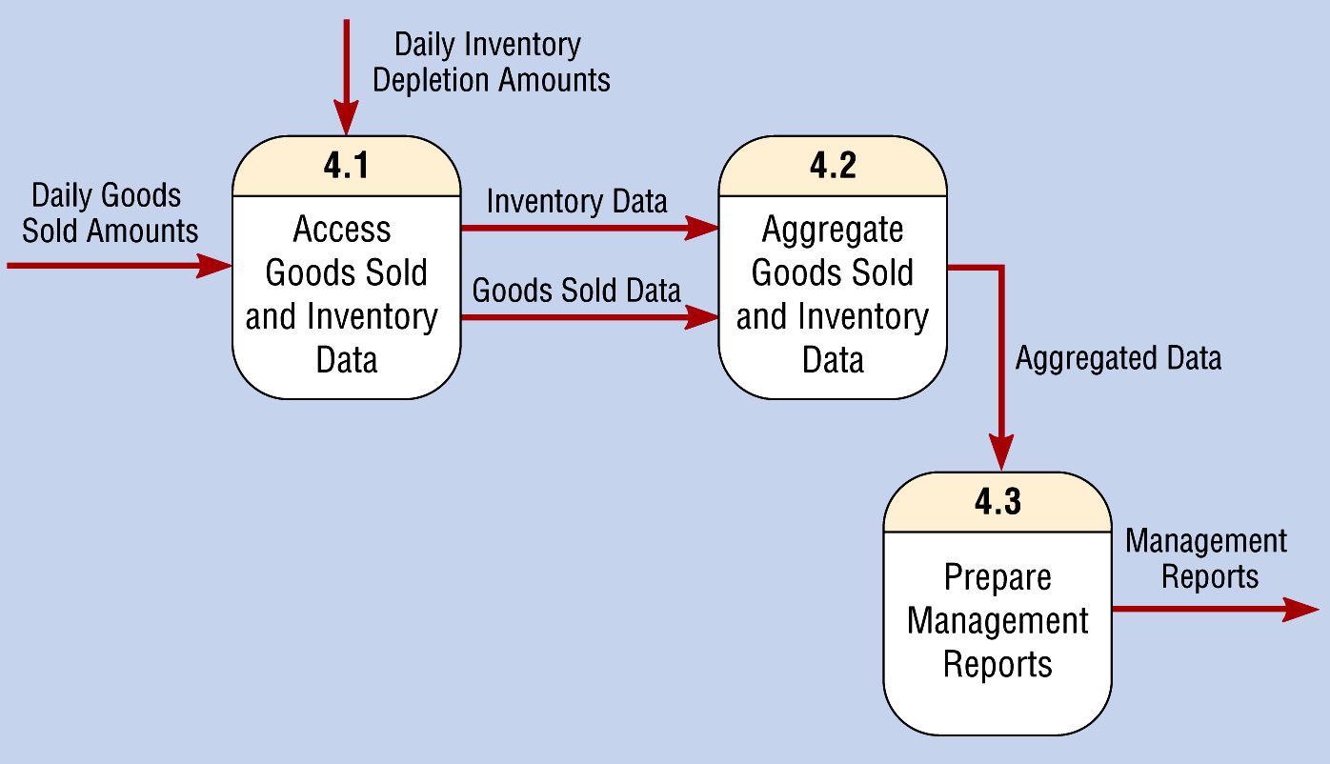
Level-1 Diagram Showing the Decomposition of Process 4.0 from the Level-0 Diagram

Slide 38
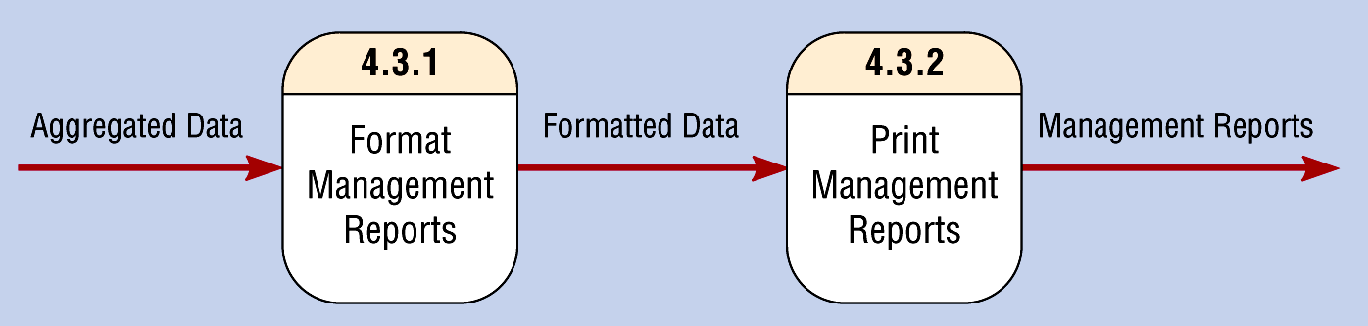
Level-2 Diagram Showing the 4.0 Decomposition of Process 4.3 from the Level-1 Diagram for Process

Slide 39
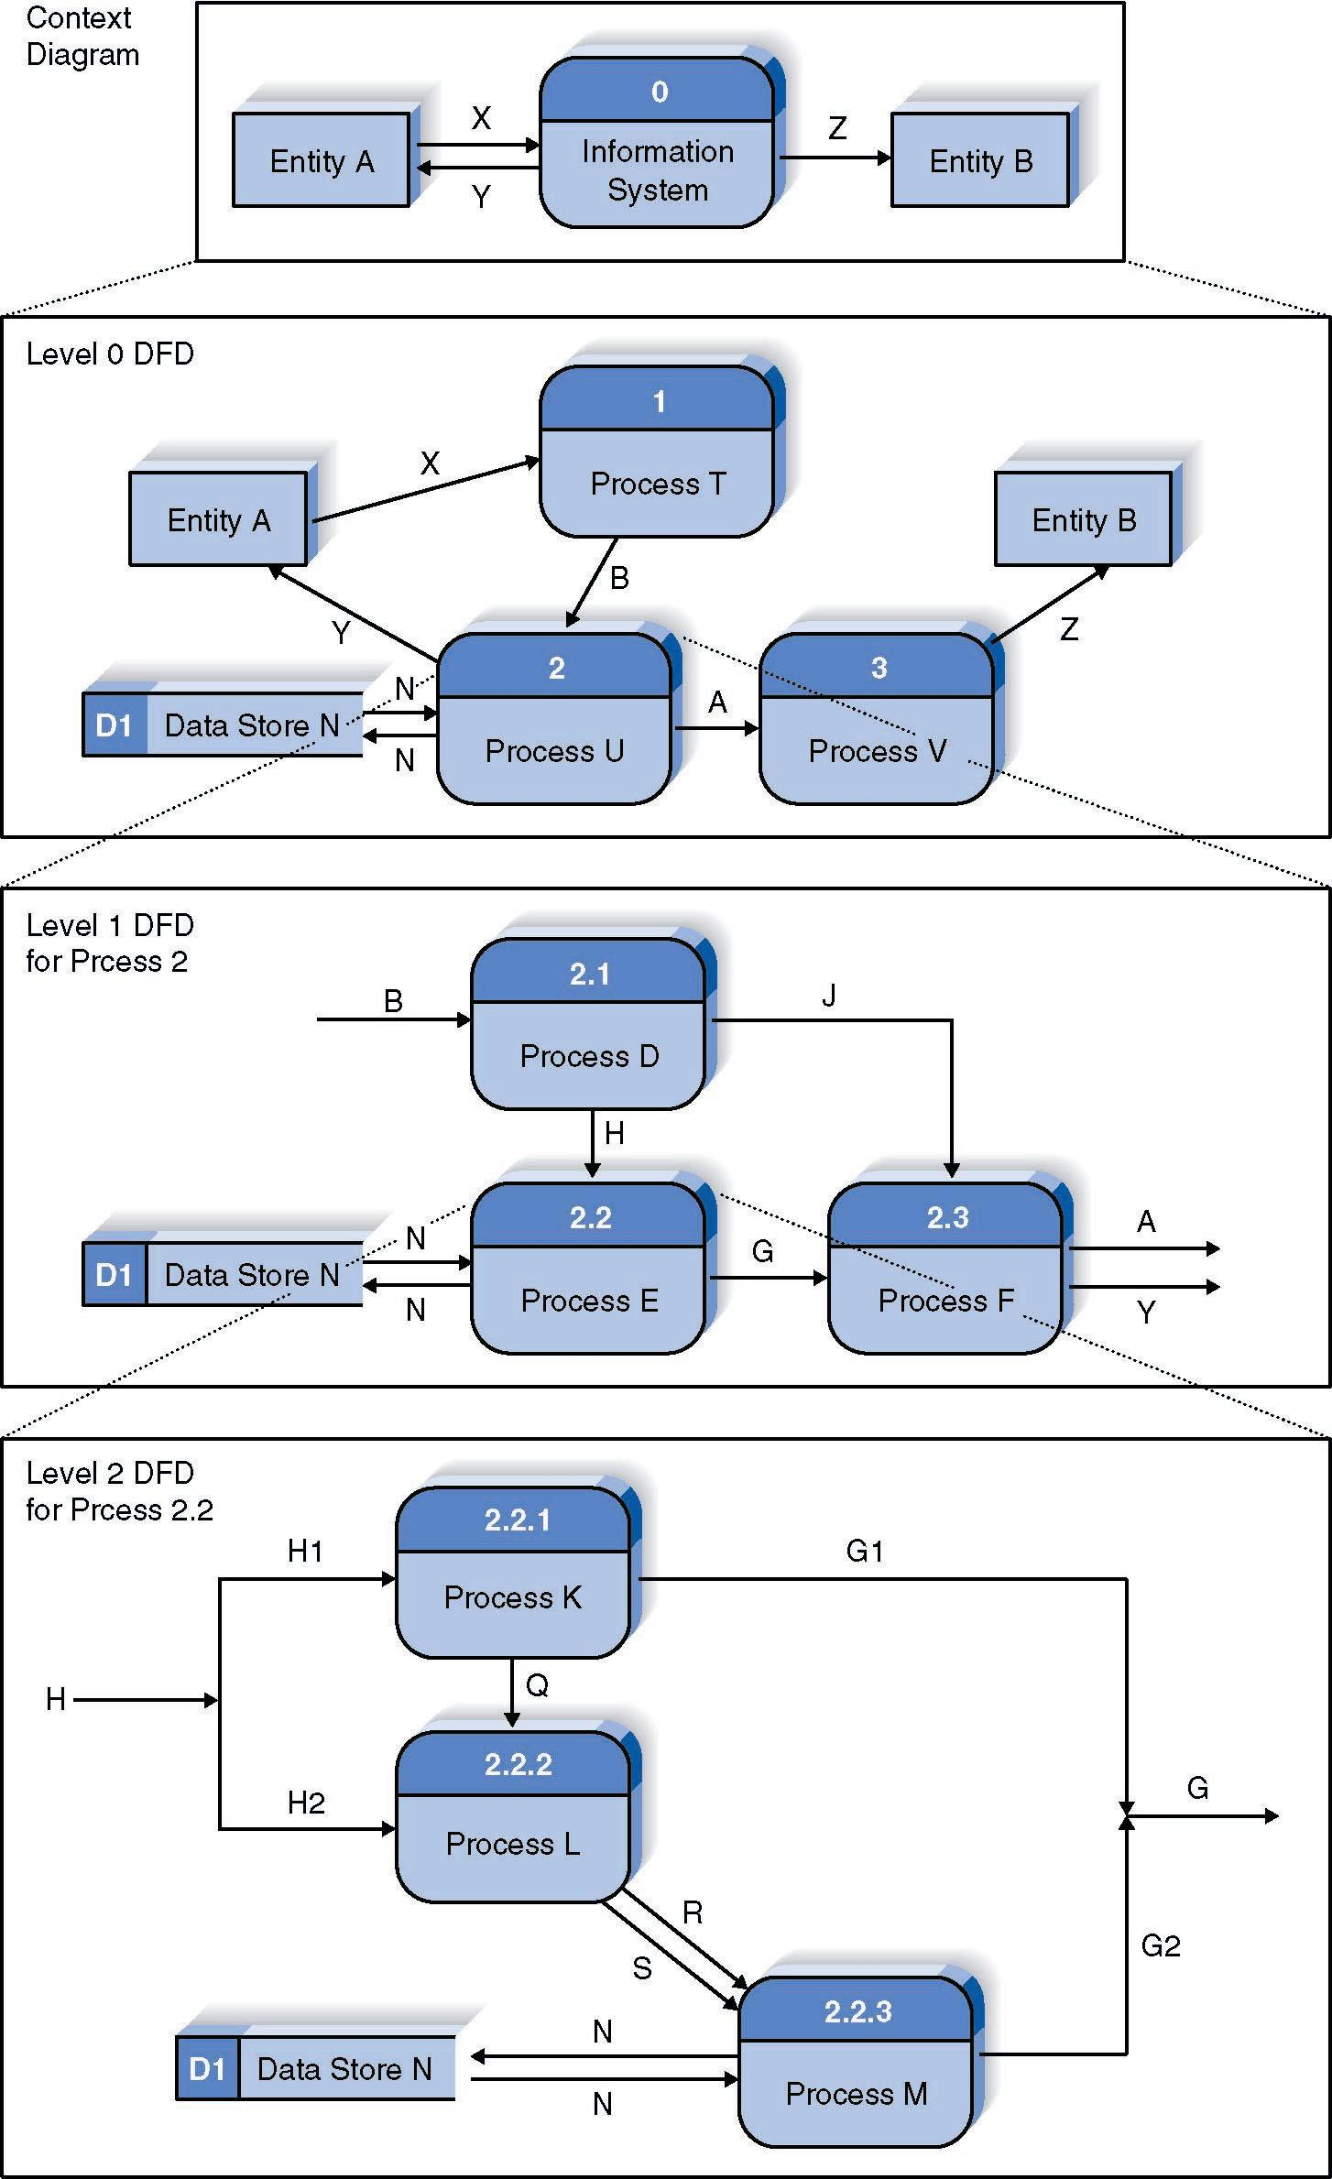
Relationship Among DFD levels

Slide 40
DATA FLOWS ARE GOVERNED BY RULES
The following are NOT allowed:
Need process
Need input
Need output
Need process
Need process
Need process
Need 2 data flows
A
A
A
B
B
A
B
A
A
Data flows must be same name
Data flows must be same name
C

Slide 41
DFD Guidelines
PROCESSES are transforming: the inputs to a process are different from the outputs of that process
OBJECTS on a DFD have unique names: data flow names represent specific sets of data, processes are different activities (exception: data stores and sources/sinks may be the same!)

Slide 42
MORE DEFINITIONS
Functional decomposition: An iterative process which creates a set of hierarchically related charts in which an n-level DFD is the refinement of one process at the n-1 level DFD, n =1,2,...
Context diagram: First chart which has one process labeled 0 which represents the system being described.
Level-0 diagram: A DFD representing a system’s major processes, data flows, and data stores at a high level of detail.
Level-n diagram: A DFD that has been constructed from n nested decompositions of sub-processes from a process in the level 0 diagram, n = 1,2,…
Primitive DFD: Lowest level DFD. An exact definition will be given later.

Slide 43
PROS AND CONS OF DFD
Final DFD
  Large, But easily understood by client
  "One picture is worth 1000 words"
Can be tedious to draw
  Remember: You are trying to understand what is going on
A frequent problem
  Process P at level L, expanded at level L+1
  Correct place for sources and destinations of data for process P is level L+1
  Clients cannot understand DFD as sources and destinations of data for P are “missing”
  Solution :Draw “correct” DFD, modify by moving sources and destinations of data one or more levels up

Slide 44
Try a context level . . . level - 0
Letters of complaint received from citizens are entered into a complaints master file by the City Clerk’s office. The date, department code, and a complaint description are stored for each letter. Weekly reports are produced from the complaints master file and given to the City Manager. Two weekly reports are produced: a department summary and a detail list.

Slide 45
Data Flows
SCOPE -- City
Complaint Handling
Letters of complaint received from citizens are entered into a complaints master file by the City Clerk’s office. The date, department code, and a complaint description are stored for each letter. Weekly reports are produced from the complaints master file and given to the City Manager. Two weekly reports are produced: a department summary and a detail list.
Sources of Data
Sinks of Data

Slide 46
Context Level Diagram:
City Complaint Handling System
Citizen
Citizen Complaint
Complaint
Detail Report
0
Complaint
Handling
System
City
Manager
Department
Summary

Slide 47
Level - 0 Diagram
Letters of complaint received from citizens are entered into a complaints master file by the City Clerk’s office. The date, department code, and a complaint description are stored for each letter. Weekly reports are produced from the complaints master file and given to the City Manager. Two weekly reports are produced: a department summary and a detail list.
Main Activities
Data Storage

Slide 48
Citizen
Level - 0 DFD: City Complaint
Handling System
1.0
2.0
Produce
Weekly
Reports
Dept. Summary
Enter
Data
Citizen
Complaint
Complaint (Date, Description,Dept Code)
City
Manager
Weekly
Complaint Detail
Complaint
Detail Report
Complaints Master

Slide 49
Some notes on decomposition:
When decomposing you must think about all the different tasks that a process must perform -- logically separate functions
Each process is a candidate for decomposition until you have reached the point where no sub-processes can logically be broken down further
  primitive processes
  primitive DFD
Knowing when to stop is difficult!

Slide 50
When to stop decomposing:
Each process is reduced to a single decision or calculation or single database operation
Each data store represents data about a single entity
The system user doesn’t want to see any more detail
Every data flow doesn’t need to be split further to show the differences in data handling
Each business form or transaction, on-line display, report is a single data flow

Slide 51
Balancing DFDs
Net inputs and outputs on one level must match the net inputs and outputs at the next level

Slide 52
DFD Goals
COMPLETENESS
Have you included all the components necessary for the system you are modeling?
CONSISTENCY
Is the system depicted the same way at each level -- are the diagrams compatible?
Note: Some diagramming software checks for diagramming errors and consistency.
FREE OF ERRORS:
1) In logic
2) In diagramming

Slide 53
Find errors on this DFD . . .
1
A
B
3
2
C
D

Slide 54
Find the Errors on this DFD for the student advising process . . .
Student
Students
Review
Next Quarter’s
Classes
Choose course,
professor,
time
Advice
Advisor
Meet to verify
Verify eligibility
and transcripts
Transcripts

Slide 55
Some more suggestions to help you build logical DFDs . . .
Organize all the information in the problem by type:
  data (data flows, data stores, data elements)
  people (sources/sink or physical)
  activities (processes)
  hardware/software (physical)
  places (physical)
Build the decomposition diagram first to identify activities (processes), then work on lower level DFDs

Slide 56
DFD Building Hints
All data flows should be labeled. (These are the most common labeling omissions.) If you can’t name a data flow, re-evaluate it’s existence -- is it really a data flow?
External entities (or agents) are outside the system: sources or sinks of data. Individuals performing functions within the system are NOT entities -- their functions are captured as processes.
If you find yourself naming a data flow a verb -- take another look -- it may be a process! Data flows should be noun clauses.
All external entities shown on sub-diagrams (Level 0+) should be on the context level diagram.
Make certain your labels are meaningful!

Slide 57
DELIVERABLES FROM PROCESS MODELING
Context DFD
DFDs of current logical system
DFDs of new logical system
Thorough descriptions of each DFD component

