Slide 1
CHAPTER 11
SPECIFICATION PHASE
Part 2

Slide 2
Overview
The specification document
Informal specifications
Structured systems analysis- continued
Other semiformal techniques
Entity-relationship modeling
Finite state machines
Petri nets
Other formal techniques

Slide 3
Overview (cont'd)
Comparison of specification techniques
Testing during the specification phase
CASE tools for the specification phase
Metrics for the specification phase
Air Gourmet Case Study: structured systems analysis
Air Gourmet Case Study: software project management plan
Challenges of the specifications phase

Slide 4
Structured Systems Analysis Case Study
(Recall we were handling this)
  Sally’s Software Store buys software from various suppliers and sells it to the public. Popular software packages are kept in stock, but the rest must be ordered as required. Institutions and corporations are given credit facilities, as are some members of the public. Sally’s Software Store is doing well, with a monthly turnover of 300 packages at an average retail cost of $250 each. Despite her business success, Sally has been advised to computerize. Should she?
Better question: What sections?
Still better: How? Batch, or online? In-house or out-service?

Slide 5
We were considering several steps for the Gane-Sarsen specification methodology:
Step 1. Draw the DFD
  Current system
Step 2. Decide What Parts to Computerize
  Depends on how much client is prepared to spend
  Large volumes, tight controls: Batch
  Small volumes, in-house microcomputer: Online
  Cost/benefit analysis is needed.

Slide 6
Step 3. Refine Data Flows
Data items for each data flow
Refine each flow stepwise
Refine further
Need a data dictionary for any product of any size
  A data dictionary describes all the names that will be used in the product.
  These would include the dataflows, the stores, the sources, the sinks, and eventually the processes that will become procedures or functions.

Slide 7
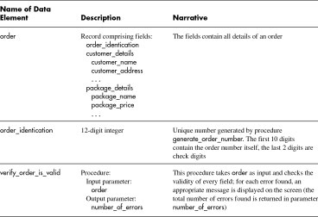
Sample Data Dictionary Entries

Slide 8
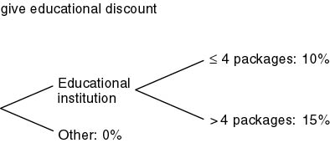
Step 4. Refine Logic of Processes
We have a process give educational discount
  Sally must explain discount for educational institutions
  10% on up to 4 packages, 15% on 5 or more
Translate into decision tree:

Slide 9
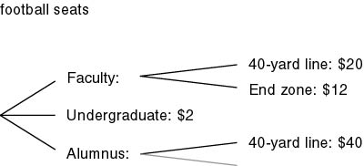
Step 4 (cont'd)
Advantage of decision tree
  Missing items are quickly apparent
Can also use decision tables
  CASE tools exist for automatic translation
Or even structured English (pseudocode)

Slide 10
Step 4 is Called Logic Modeling
Describes what occurs within the “black box” of the primitive processes
Provides structured descriptions of logic within the primitive processes
Primitive processes can specified by:
  structured English
  decision tables
  decision trees
  state-transition diagrams or tables (a formal method we will study a later)

Slide 11
Structured English---Pseudocode of CPSC 171
Uses English statements/phrases to describe the logic in a primitive process
Generally relies on noun phrases and action verbs
Can use to represent sequence, conditional statements and repetition

Slide 12
Structured English: Sequence
A block of instructions where no branching occurs
Sequence is implied by writing one statement after another:
  Action 1
  Action 2
  Action 3
  EXAMPLE:
  READ homework assignment
  FIND matching student record
  ADD assigned grade on homework assignment to student cumulative total on student record

Slide 13
Structured English: Conditional Statements are represented by IF or CASE structures
Only IF a condition is true, complete the following statements, otherwise jump to the else
BEGIN IF
IF condition A is true
THEN implement action A
ELSE implement action B
END IF
CASE is a special type of decision structure where the cases are mutually exclusive (if one occurs than the others cannot)
SELECT CASE
CASE # 1, DO action #1
CASE # 2, DO action #2
CASE # 3, DO action # 3
END CASE

Slide 14
Structured English:
Conditional Statements Examples
  BEGIN IF
  IF grade assigned is
  less than 70%
  THEN notify student
  ELSE do nothing
  END IF
  SELECT CASE
  CASE 1 (grade assigned is less than 70%)
  DO notify student
  CASE 2 (grade assigned is less than 75% and greater than or equal to 70%)
  DO send student warning
  CASE 3 (grade assigned is greater than or equal to 75%)
  DO nothing
  END CASE

Slide 15
Structured English: Repetition
Blocks of statements that are repeated until done
Represented by DO-Until or Do-While Loops
DO
Action #1
Action #2
UNTIL condition
WHILE NOT condition DO
  Action #1
  Action #2
END DO

Slide 16
Structured English: Repetition is represented by DO-Until or Do-While Loops
DO
READ homework assignment
FIND matching student record
ADD assigned grade on homework assignment to student cumulative total on student record
UNTIL end-of-file
READ homework assignments
WHILE NOT end-of-file DO
FIND matching student record
ADD assigned grade on homework assignment to student cumulative total on student record
END DO

Slide 17
Try one . . .
Homeowners insurance, of course, depends on the type of policy and location of the home, but once this is determined there are other factors that increase or decrease the premium to the homeowners. One factor is the construction. A brick home will save the homeowner 10 percent in the annual premium, if there is a burglar alarm, 5 percent will be deducted from the premium beyond that. There are choices that homeowners make that will increase the premium, too. If the homeowner wishes to be paid the replacement, rather than depreciated value, add 10 percent to the base. The homeowner may choose to carry a $100 deductible; this will increase the premium by 15 percent.

Slide 18
Some ambiguities:
1 - What is the “base”?
2 - What does “beyond that” refer to?
3 - When the “premium” is modified it is not clear if the deduction or increase is applied to the original premium or the adjusted premium, or the order in which this is done.
Would need to clarify these with the user!

Slide 19
Organize the Problem
What are the conditions and alternatives?
  Type of construction (brick, other)
  Existence of burglar alarm (yes/no)
  Choice of replacement option (yes/no)
  Choice of deductible ($100 option, standard $250)
Conditions/alternatives are IF or CASE structures
What actions result for each condition alternative?
  Brick -- deduct 10% of base from subtotal
  Burglar alarm is yes -- deduct 5% off adjusted subtotal
  Replace option is yes -- add 15% of base to subtotal
  $100 option deductible chosen -- add 10% of subtotal to subtotal
Actions are the DO part of the IF or CASE structure

Slide 20
CALCULATE premium base
BEGIN IF
  IF construction is brick
  THEN deduct 10 percent of base to total
END IF
BEGIN IF
  IF replacement option is chosen
  THEN add 10 percent of base to subtotal
END IF
BEGIN IF
  IF owner chooses $100 deductible
  THEN add 15 percent of subtotal to total
END IF
BEGIN IF
  IF home has burglar alarm
  THEN deduct 5 percent of adjusted subtotal to adjusted subtotal
END IF
One solution. (There is more than one way to represent this logic.)

Slide 21
Decision Trees
Graphical representation of a logic that implies sequence in the decision
Displays a series of
  nodes (decision points),
  branches (decision alternatives)
  termination ovals (actions)
Action
Decision
Alternative

Slide 22
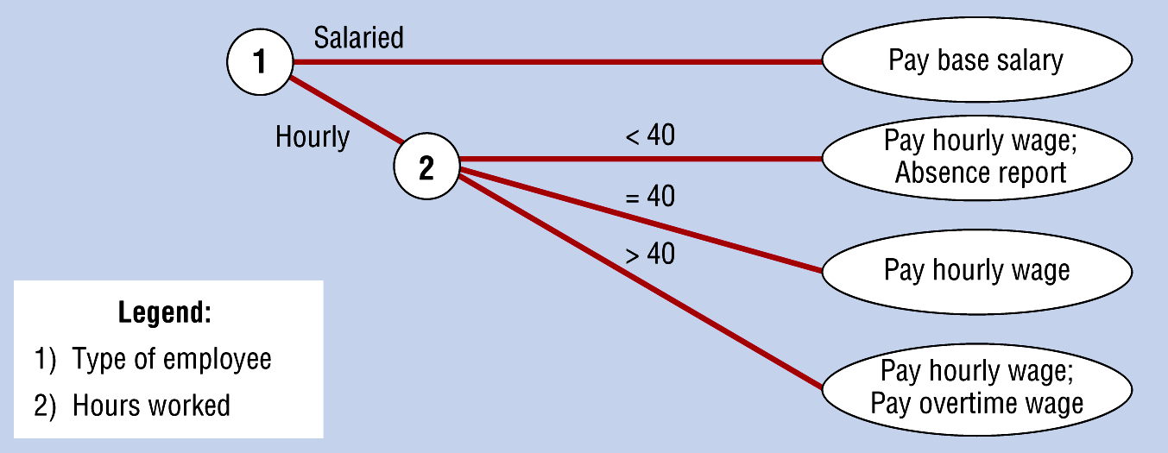
Decision Tree with Multiple Choices per Decision Point

Slide 23
Decision Tree Example: Deciding whether to register a student for CPSC 359.
Yes
Register for 359
Yes
2
3
Yes
No
1
No
Hold and recheck
next time
No
Delete from list,
not eligible for CPSC 359
Legend:
1. Student
2. Successfully completed CPSC 171?
3. Successfully completed CPSC 172?

Slide 24
Try one . . .
When you are checking out a customer at a register, first check to see what the amount of the purchase is. If the amount is under $50 and the customer writes a check, first check the customer’s social security number with CheckIt. If the number is approved, ring up the sale. If the customer uses a credit card, run the card through for a credit check with the bank. If the total sale is greater than $50 and the customer writes a check, then call a supervisor for approval, and enter the customers social security number for check verification with CheckIt. If the customer uses a credit card, run the card number through to check credit with the bank.

Slide 25
Assumptions . . . Questions
Must have approval from CheckIt to ring up the customer’s sale for a check
Must have approval from the bank credit card check to ring up the customer sale
The terms total sale and amount of purchase refer to the same quantity --
  does this include tax?

Slide 26
1st Draft Decision Tree: Verification When Completing a Customer Sale Transaction
no
do not ring sale
check
4
yes
ring sale
2
< $50
credit
no
do not ring sale
3
1
>=$50
credit
yes
ring sale
Legend:
1. Amount of purchase
2. Payment method
3. Bank check approved?
4. CheckIt approved?
5. Supervisor approved?
check
2
no
do not ring sale
4
yes
5
no
yes
ring sale

Slide 27
Reorganize . . .
< $50
ring sale
yes
4
yes
2
>= $50
5
no
check
no
do not ring sale
1
do not ring sale
credit
yes
ring sale
3
Legend:
1. Payment method
2. CheckIt approved?
3. Bank check approved?
4. Amount of purchase?
5. Supervisor approved?
no
do not ring sale

Slide 28
no
do not ring sale
check
4
2
yes
ring sale
< $50
credit
no
do not ring sale
1
credit
3
>=$50
yes
ring sale
Legend:
1. Amount of purchase
2. Payment method
3. Bank check approved?
4. CheckIt approved?
5. Supervisor approved?
2
check
no
4
do not ring sale
yes
5
no
yes
ring sale
======================================================================================================
< $50
ring sale
yes
4
yes
2
>= $50
5
no
check
no
do not ring sale
1
do not ring sale
credit
Legend:
1. Payment method
2. CheckIt approved?
3. Bank check approved?
4. Amount of purchase?
5. Supervisor approved?
yes
3
ring sale
no
do not ring sale

Slide 29
Decision Table
A matrix (or table) that represents the conditions, alternatives and actions in a primitive process
  condition stubs -- list of relevant conditions with corresponding alternatives
  action stubs -- list of actions that occur when a given ‘set’ of conditions are met
  rules -- specifies which action is taken given a ‘set’ of conditions

Slide 30
Decision Table Structure
Conditions, Actions
Rules
Conditions
Condition Alternatives
Actions
Action Entries

Slide 31
To construct a decision table:
List the conditions, and the values (or alternatives) that a condition may assume
List all possible actions that may occur as the result of any condition alternative
Determine the number of possible rules -- combinations of alternatives -- the initial number of rules is calculated by multiplying the number of alternatives for each condition
List the possible rules -- start with the first condition, divide the number of rules by the number of alternatives and fill in, continue repeating this pattern for each condition
Define the action for each rule (set of alternatives) -- watch for impossible, redundant or contradicting rules
Simplify the decision table -- combine rules where it is apparent that an alternative does not make a difference in the outcome

Slide 32
Example Decision Table
Simplify
Conditions, Actions
Rules
Project Score %
Case Tool Score %
> =70 < 70 >= 70 <70
>=70 <70 <70 >=70
Fail Student
Pass Student
X X X
X

Slide 33
Choosing between logic modeling methods:
Complex logic? decision table
Transforming conditions and actions into sequence? decision tree or structured English
Consistency and completeness? decision tables
Simple to understand? decision tree
Simple problem? decision tree or structured English
Sequence without action alternatives? structured English
More details: see page 331 of text

Slide 34
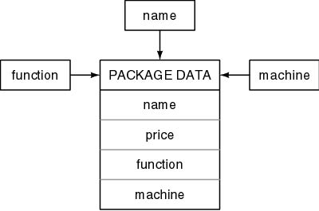
Step 5. Refine Data Stores
Define exact contents and representation (format)
  COBOL: specify to pic level
  Ada: specify digits or delta
Specify where immediate access is required
  Data immediate access diagram (DIAD)-i.e. name, function, and machine

Slide 35
Step 6. Define Physical Resources
For each file, specify
  File name
  Organization (sequential, indexed, etc.)
  Storage medium
  Blocking factor
  Records (to field level)
Step 7. Determine Input/Output Specs
Specify input forms, input screens, printed output

Slide 36
Step 8. Perform Sizing
Numerical data for Step 9 to determine hardware requirements
  Volume of input (daily or hourly)
  Size, frequency, deadline of each printed report
  Size, number of records passing between CPU and mass storage
  Size of each file

Slide 37
Step 9. Determine the Hardware Requirements
CPU power
Disk requirements
Mass storage for back-up
Input needs
Output devices
Is existing hardware adequate?
If not, recommend buy/lease

Slide 38
However
Response times cannot be determined
Number of I/O channels can only be guessed
CPU size and timing can only be guessed
Nevertheless, no other method provides these data for arbitrary products
The method of Gane and Sarsen/De Marco/Yourdon has resulted in major improvements in the software industry

