Slide 1
CHAPTER 11
SPECIFICATION PHASE
Part 3

Slide 2
Overview
The specification document
Informal specifications
Structured systems analysis- continued
Other semiformal techniques
Entity-relationship modeling
Finite state machines
Petri nets
Other formal techniques

Slide 3
Overview (cont'd)
Comparison of specification techniques
Testing during the specification phase
CASE tools for the specification phase
Metrics for the specification phase
Air Gourmet Case Study: structured systems analysis
Air Gourmet Case Study: software project management plan
Challenges of the specifications phase

Slide 4
Formality versus Informality
Informal method
  Only English (or other natural language)
Semiformal methods
  Gane & Sarsen/DeMarco/Yourdon
  Entity-Relationship Diagrams
  Jackson/Orr/Warnier,
  SADT, PSL/PSA, SREM, etc.
Formal methods
  Finite State Machines
  Petri Nets
  Z
  ANNA, VDM, CSP, etc.

Slide 5
CONCEPTUAL DATA MODELING
DFDs show data in motion (data flows) and data at rest (data stores). But, definitions, structure, and relationships between data are not captured.
Much data modeling uses entity-relationship (E-R) diagrams.
These represent organizational data and the rules about the meaning and inter-relationships among data.
Detailed models capture the overall structure of organizational data, but are independent of any database or implementation considerations.
Some analysts feel these are the most important part of a system’s requirements.

Slide 6
Data Modeling: Entity-Relationship Modeling
Depicts associations among types of data
Data describes tangible things
Describes the attributes associated with data
DATA ENTITY TYPE: a noun, i.e. roles, events, locations, people, tangible things about which we wish to maintain data
RELATIONSHIP: verb phrase, an association between entities of interest to the organization
ATTRIBUTE: noun, data elements that describe characteristics of the entity type

Slide 7
USING A DFD TO OBTAIN ENTITIES, ATTRIBUTES, AND RELATIONSHIPS
Names of data stores on primitive DFDs often correspond to the names of data entities on E-R diagram.
Data elements associated with data flows on DFDs must be accounted for by attributes of entities and relationships in the E-R diagrams.

Slide 8
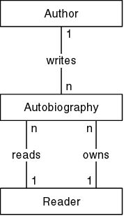
Entity-Relationship Diagrams
Semi-formal technique
Widely used for specifying databases
Can be used for object-oriented analysis

Slide 9
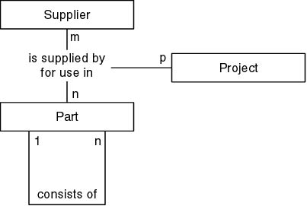
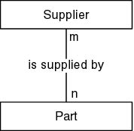
Entity-Relationship Diagrams (cont'd)
Many-to-many relationship
More complex entity-relationship diagrams

Slide 10
Symbols in an ERD
Entity
Relationship
One mandatory: one and only one
Mandatory many: one to many
Optional many: zero to many
Many with maximum of N
N

Slide 11
Symbols in an ERD
This symbol is not used when we model with CASE . . . the attributes are recorded in the project repository, not on the diagram
Attribute
  Also Note:
  A Relationship
    Can be read in two directions
    Two entities can have more than one relationship

Slide 12
ERD Example
Reading top down
Reading bottom up
CUSTOMER
A customer places zero or more orders
An order is placed by one and only one customer
Places
Placed by
ORDER
A part is contained on zero or more orders
Order contains at least one, or one or more parts
Contains
Contained on
PART

Slide 13
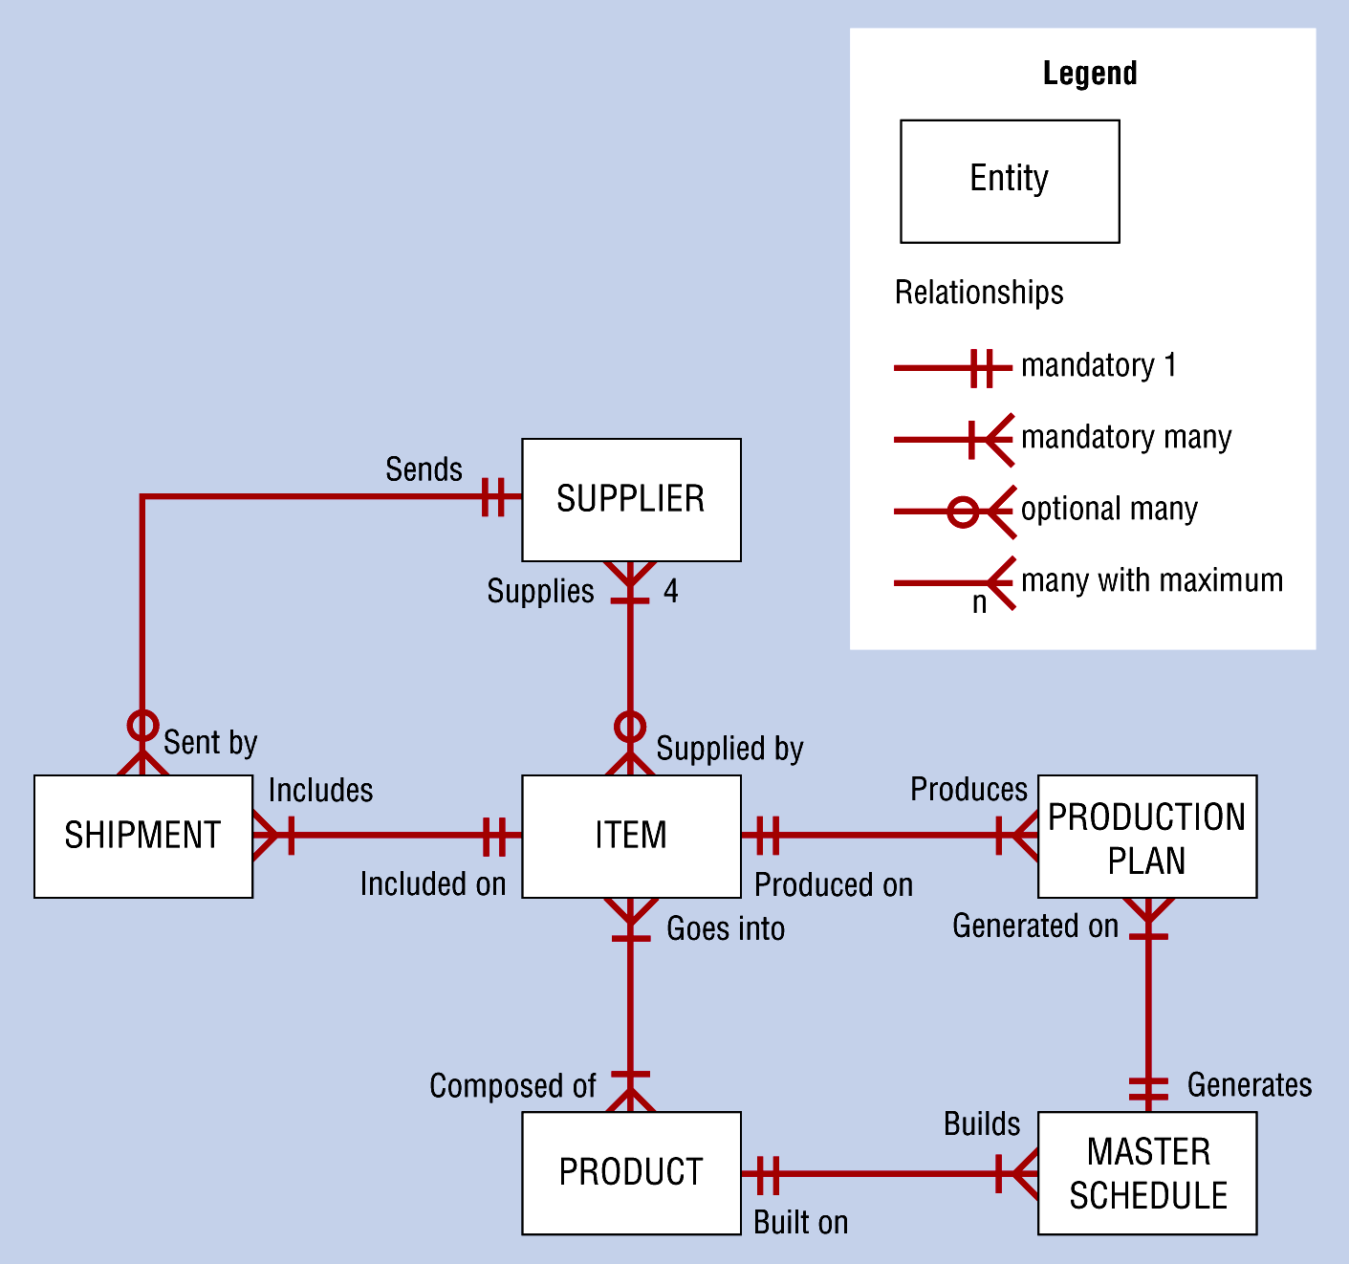
Sample Conceptual Data Model Diagram

Slide 14
OFTEN PRODUCE FOUR E-R DIAGRAMS DURING CONCEPTUAL DATA MODELING
Document data needed in project application
  Concentrate on data requirements for current project
Document application system being replaced
  Compare with above and you see changes needed to convert old database to new application
Document the entire database from which the new application’s data is extracted.
  This and first diagram show how data can be shared.
Document the entire database from which data for the application system being replaced is drawn.
  Differences between this and third diagram show global changes to the database that must be made for the current project.

Slide 15
ER Modeling: Challenges
Distinguishing between an entity type (or entity class) and an instance of that entity
  Entity: Instructor
  Instance of the Entity Instructor: Obie
  Another Instance of the Entity: Maher
  The entity type (or entity) represents a class or collection of people, places, objects, events about which we store data
  An entity instance (or instance) is a single occurrence of the entity type

Slide 16
ER Modeling: Challenges
Distinguishing between an entity and an attribute of that entity
  Entity: Instructor
  Attribute of the Entity: Name
  Employee No.
  Office Number
  Telephone Number
  Attributes describe properties or characteristics of an entity that the organization wishes to track

Slide 17
ER Modeling Challenges
Attributes of the Entity
Student Name
Social Security No. (Key)
Major
Mailbox Number
Permanent Address
Street
City
State
Zip
Credit Hours Earned
Entity
Student

Slide 18
ER Modeling Challenges
Is it an entity type?
Give it the Entity Test:
1. Is it within the scope of the system to store data about the object?
2. Are there two or more occurrences of it?
3. Does it have two or more attributes?

Slide 19
Which of the following would be potential entities in a system for student registration?
student
registrar
course number
room
class standing
course
pre-requisites
name
junior
sophomore
Jane Stevens
CPSC 359
instructor
password/pin
bill

Slide 20
Potential entities in a system for student registration . . .
Entity Types: student, course, and depending on scope ---bill, instructor
Instances: Jane Stevens, CPSC 359
Attributes of Entity: course number, room, class standing, pre-requisites, name, password/pin, and depending on scope instructor
Possible Attribute Values: junior, sophomore
Part of the system, not data to be used by organization: registrar (NOTE if knowing whether the student went to the registrar was important, this could be an attribute)

Slide 21
ER Modeling: Challenges
Determining candidate keys and primary keys (or identifiers)
Entity: Instructor
Candidate: Employee No. OR (Name, Office No.)
Primary Key: Employee No.
A candidate key uniquely identifies each instance (Obie,Colton 5) versus (Ellen,Colton 15a) of entity type
A candidate key is an attribute or a set of attributes.
The primary key is a candidate selected to be used as the identifier for an entity type

Slide 22
Criteria for Selecting Primary Key
The value will not change over the life of each instance of the entity
For each instance of the entity, you are guaranteed to have a value for the attribute
Avoid “intelligent keys” -- a key whose structure indicates classification or location -- these often change
Single attribute keys are easier to work with than large multi-attribute composite keys (create a separate surrogate key)

Slide 23
If you include attributes on the E-R diagram, the identifier is underlined:
Name
Address
Phone_Number
Student_ID
Student
For multivalued attributes---one that can have more than one value for an instance (ex. Phone_Number), often use a double-lined ellipse.

Slide 24
Choosing Primary Key
ENTITY: Course
Course Number
Registrar Designation
Term Offered
Instructor
Course Description
Time Offered
Day Offered
Candidates?
Course Number
Term Offered
Registrar Designation
Primary Key Choice?
Registrar Designation
Combined

Slide 25
Choosing Primary Key
ENTITY: VIDEO
Movie Title
Length
Format
Copy Number
Awards
Lead Actors/Actresses
Availability (logical)
Candidates?
Movie Title?
Movie Title and Copy No.?
How to distinguish between a remake and original with the same title?
May need to create an attribute that is unique -- video id number

Slide 26
Try one . . .
In the instructor’s grade keeping system, the instructor records each grade received by a student on each exam, assignment or project. At the end of the quarter, the instructor sums and averages all grades received by one student to determine an overall score for that student for the quarter.

Slide 27
Instructor Grade Keeping System
What are entities? attributes? instances of entities?
“Potential Entities” . . . are these all entities?
Instructor Overall Score
Student Averaging
Tests Record Grades
Assignments Term
Projects Course

Slide 28
Some questions to ask . . .
What’s the scope of the system?
  For all instructors in a department, college or university?
  For one instructor’s personal use?
  For all courses the instructor teaches, or one course in particular?
You must determine the scope to do ER modeling, just as you must determine the scope with DFDs
Assume Scope: single instructor, for a single class
What objects are of interest (from a data storage perspective)?

Slide 29
RELATIONSHIPS
Glue that holds together the components.
An association between the instances of one or more entity types that is of interest to the organization.
The degree of relationship is the number of entity types that participate in that relationship.
Special degrees of interest:
  Unary: also called recursive
  Binary
  Ternary

Slide 30
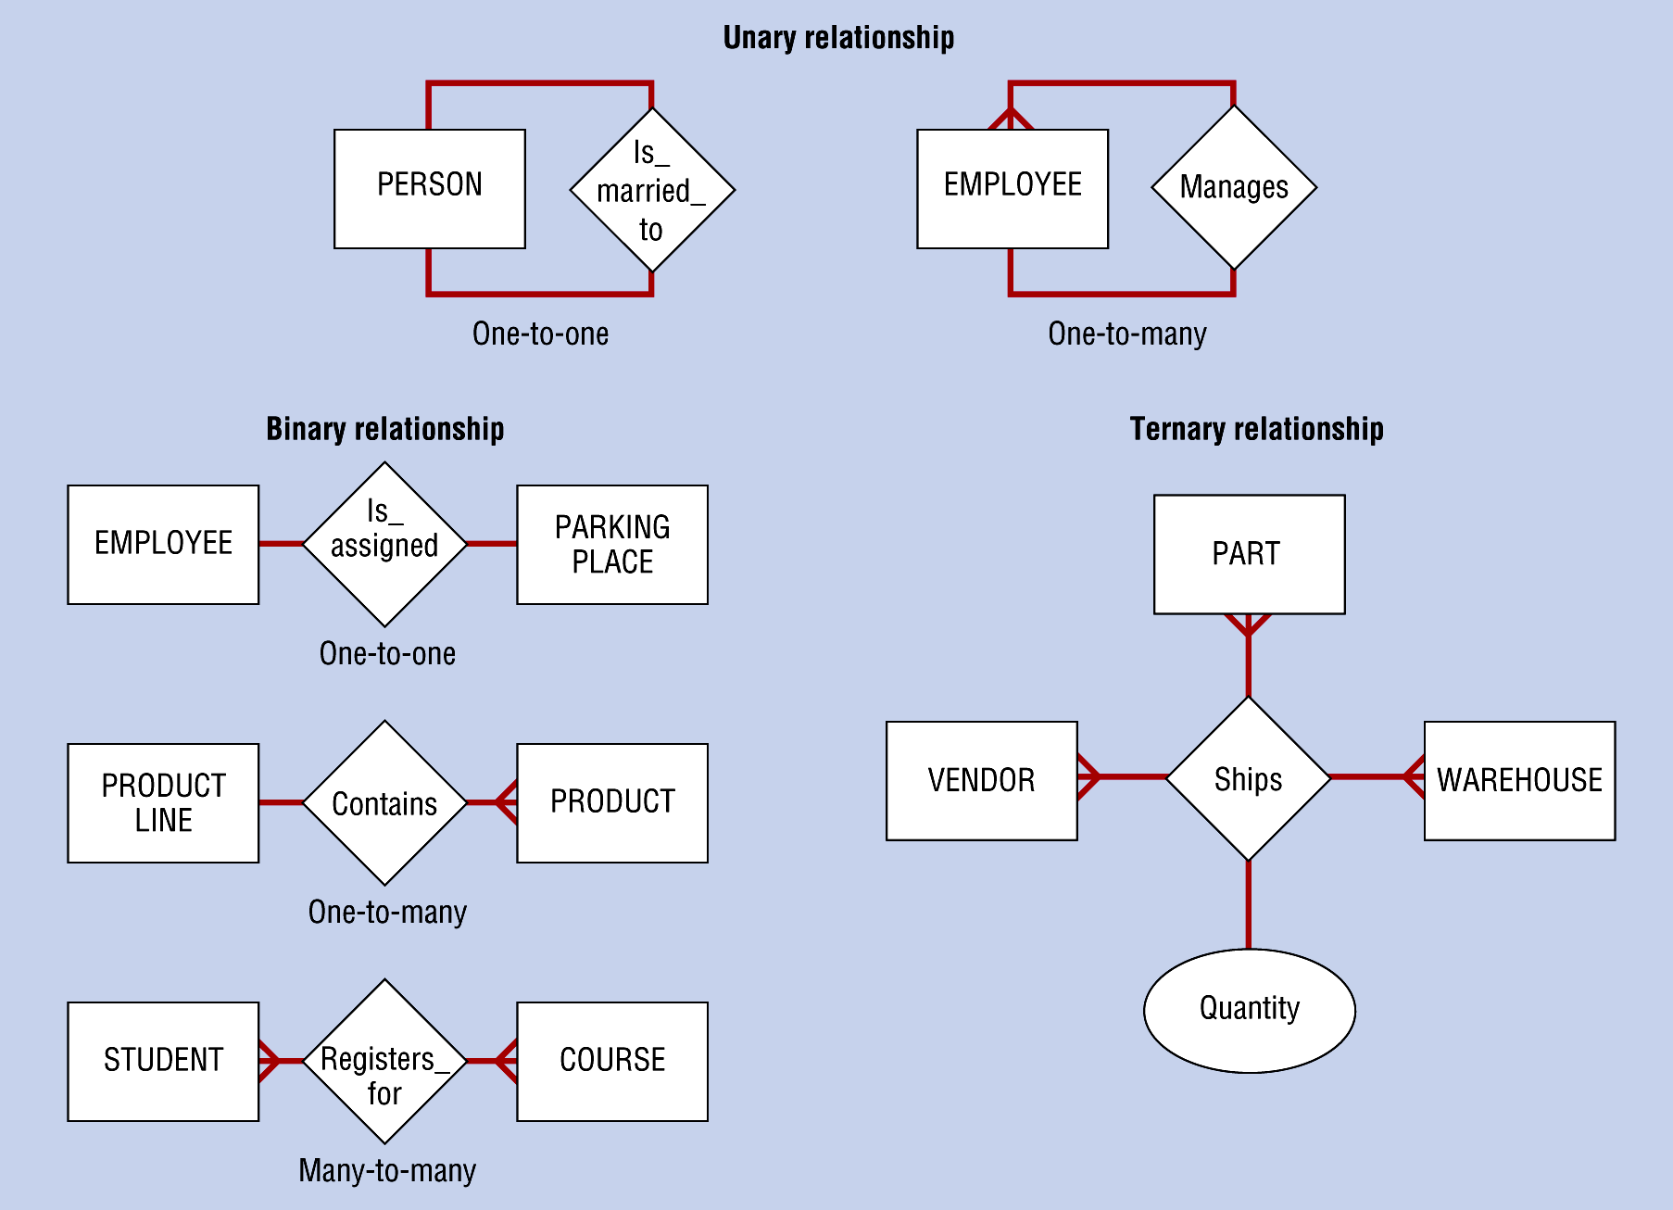
Example Relationships of Different Degrees

Slide 31
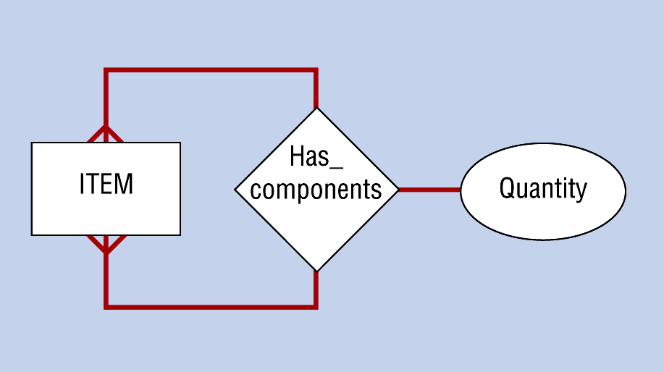
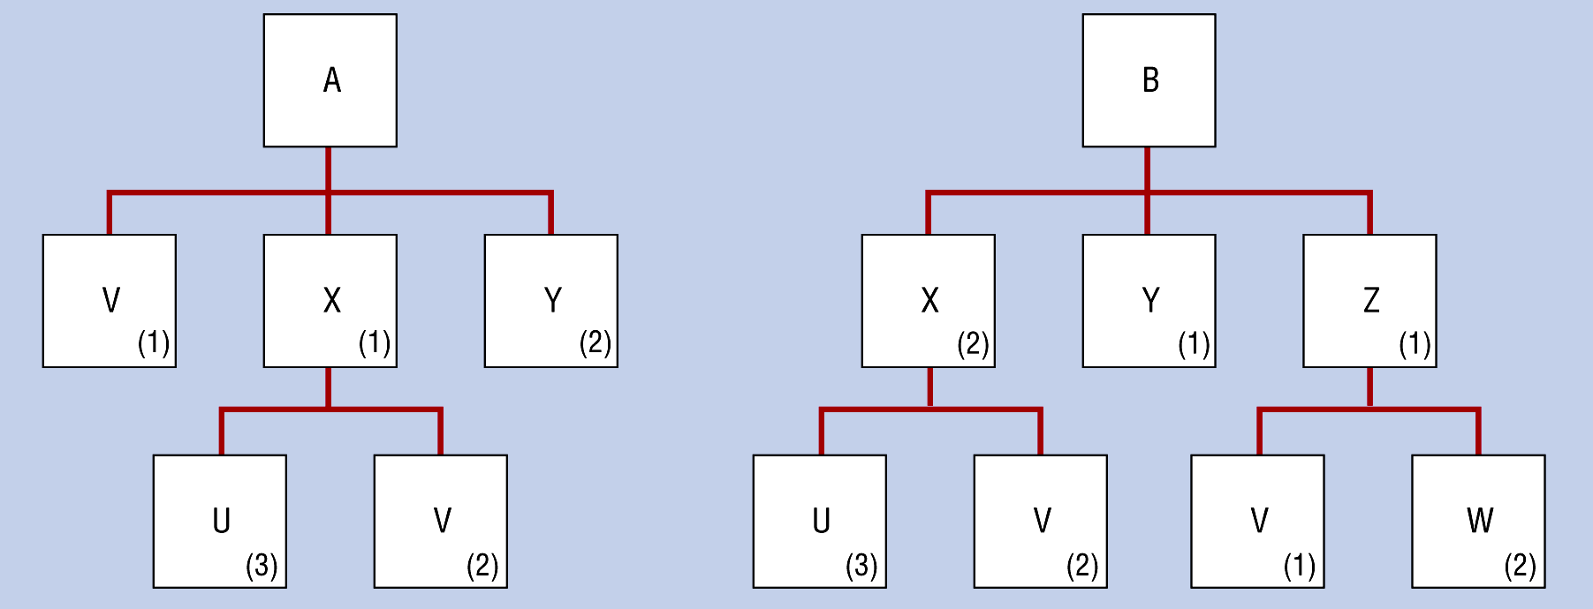
Bill of Materials Unary Relationship
(a) Many-to-Many Relationship
(b) Two Instances

Slide 32
Has
Patient
Patient History
Cardinalities mandatory
Assigned
Project
Employee
One optional cardinality on right and one mandatory on left

Slide 33
ER Modeling Example
What are the attributes of student? of requirement? student: name, ssn, e-mail requirement: type, points possible for each student, the score on each requirement
Student
Requirement
??
How are student and requirement related?
student completes requirement
requirement is completed by student

Slide 34
A simple ERD . . .
Type
Points
Possible
Name
SSN
STUDENT
completes
REQUIREMENT
is completed by
Email
Entities (student and requirement) with their attributes

Slide 35
Add Cardinality
Type
Points
Possible
Name
SSN
completes
STUDENT
REQUIREMENT
is completed by
Email
Notice, we have still not worked with the grade each student received on a requirement

Slide 36
completes
STUDENT
REQUIREMENT
is completed by
Cardinality describes the number of instances of one entity that may be associated with the other entity in this case:
  Many students to many requirements -- many requirements to many students
A difficulty arises in many to many relationships
Look for attribute(s) that are associated with this relationship -- an entity in disguise?
Called a gerund or an associative entity

Slide 37
There is data associated with this relationship:
this is a gerund -- or an associative entity
Score Received
STUDENT
completes
REQUIREMENT
is completed by

Slide 38
Shown with associative entity . . .
Score Received
Name
SSN
Type
Points
STUDENT
REQUIREMENT
Completes
Note: There is no stated relationship description between student and completes. The relationship is still between student and requirement.
Email

Slide 39
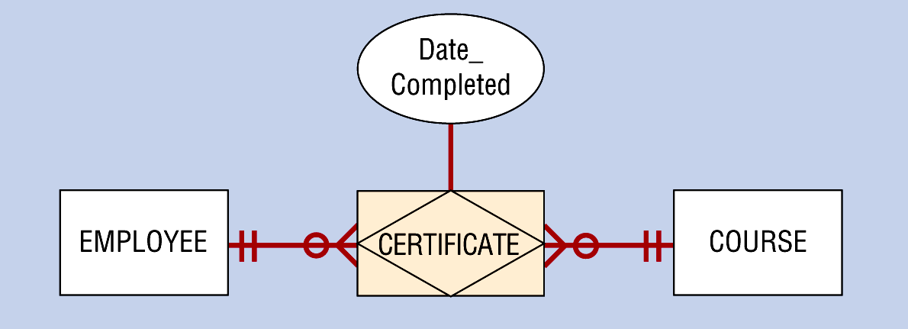
Example Associative Entity

Slide 40
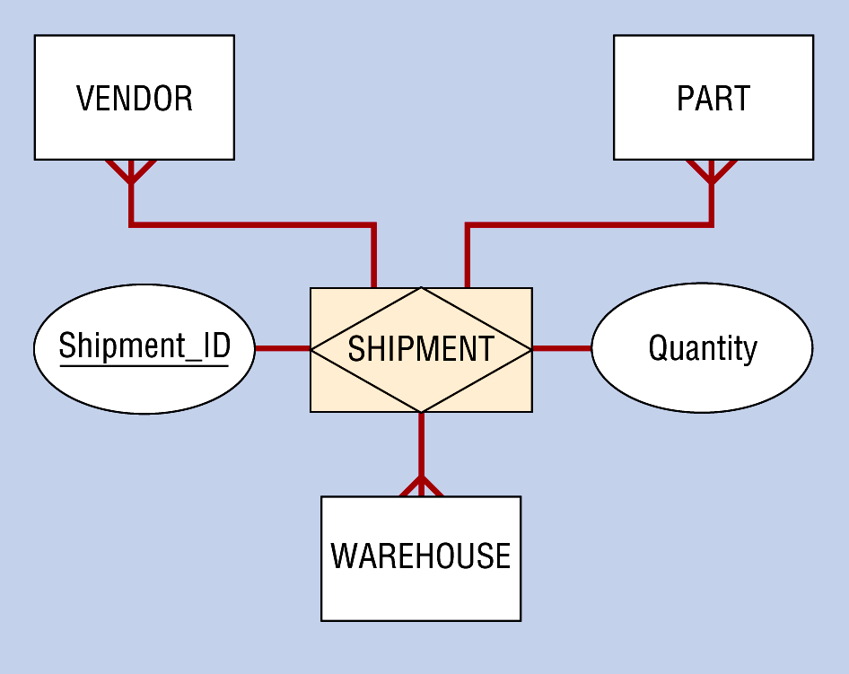
SHIPMENT Entity Type (an Associative Entity)

Slide 41
Business Rules for Data Modeling
Specifications that preserve the integrity of a conceptual or logical data model
Four types:
  Entity integrity
    Must have unique, non-null identification for instances
  Referential integrity constraints
    Rules concerning relationships between entities
  Domains
    Constraints on valid values for attributes
  Triggering operations
    Other business rules that protect the validity of attribute values

Slide 42
Business Rules: Unique Identification
Each instance of an entity type must have a unique identifier (primary key)
The value of the unique identifier must not be null

Slide 43
Business Rules: Domain
A domain is a set of data types and ranges of values that an attribute may assume
  data type (character, numeric, logical, etc.)
  length (size of the attribute)
  format (picture, $###,###.##)
  range (< 100, between -1 and +1)
  allowable values (freshman, sophomore, junior)
  meaning (short description of the attribute)
  uniqueness (is it unique for every instance?)
  null support (whether or not this attribute may be null -- the primary key may not be null)

Slide 44
Return to registration system to define domain
One of the entity types in the registration system is student
What are some attributes of student?
  student id, student name, student permanent address, student major, student credit hours completed, student overdue fines (parking, library)
  Give the domain definition for student id, student address, student major

Slide 45
Domain Definition
STUDENT ID
data type: character
length: 10
format: ##########
range: not applicable
allowable values: remove final 0, check digit SSN
meaning: student tracking number, equivalent to social security number with 0 as final digit
uniqueness: yes
null support: no
STUDENT MAJOR
data type: character
length: 3
format: ###
range: 100 - 799
allowable values: specified in the major table
meaning: the student’s current declared major
uniqueness: no
null support: yes, null implies no declared major

Slide 46
Domain Definition: Permanent Address
Permanent attribute is actually a composite attribute composed of the following:
  Street Address - State
  P.O. Box - Zip Code
  City
Would specify domain definitions for each of these elements
To specify on diagrams, carry the structure “permanent address”, define the structure as containing the above data attributes, then define each attribute’s domain

Slide 47
Triggering Operations (or Trigger)
Governs the validity of data manipulation operations such as insert, update, and delete.
Normally includes:
User rule - concise statement of business rule being enforced by the operation
Event - what initiates the operation
Entity name - name of entity being accessed or modified
Condition - that causes the operation
Action - what is done when the trigger occurs

Slide 48
Return to registration system . . .
For the entity course, which of the following attributes may require a triggering operation?
  course number, call number, hours completed
Define the triggering operation?

Slide 49
Triggering Operation for Hours Completed
User Rule: student may not register at a given time unless they have completed enough credit hours to qualify for the registration period
Event: allow new registration
Entity Name: student
Condition: hours completed > hours required
Action: reject the student’s registration

Slide 50
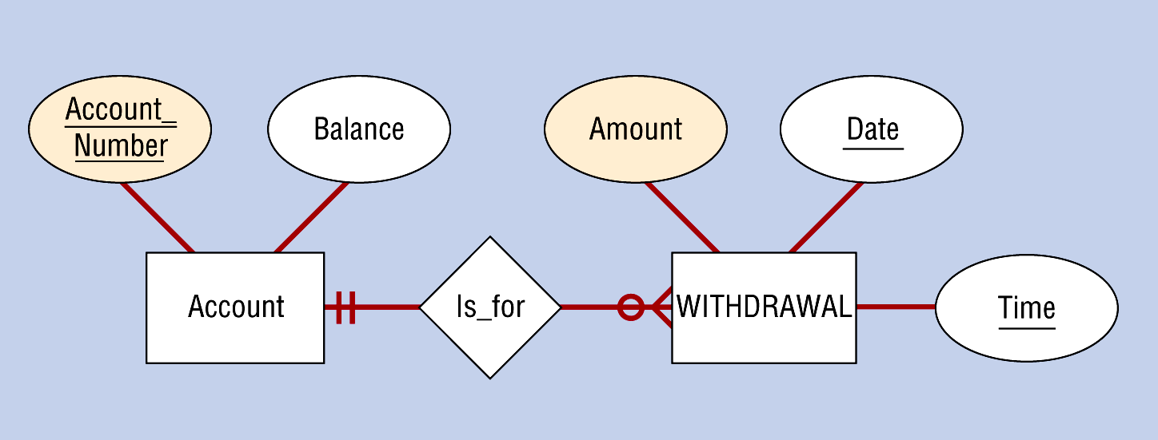
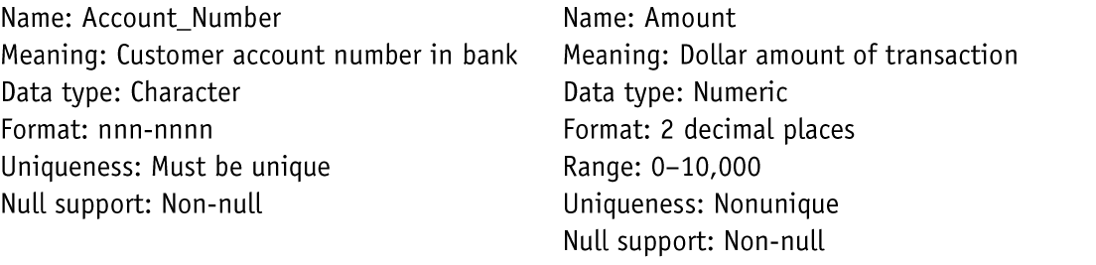
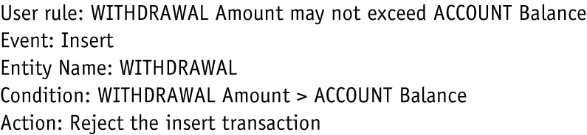
Examples of Business Rules
(a) Simple Banking Relationship
(b) Typical Domain Definitions
(c) Typical Triggering Operation

Slide 51
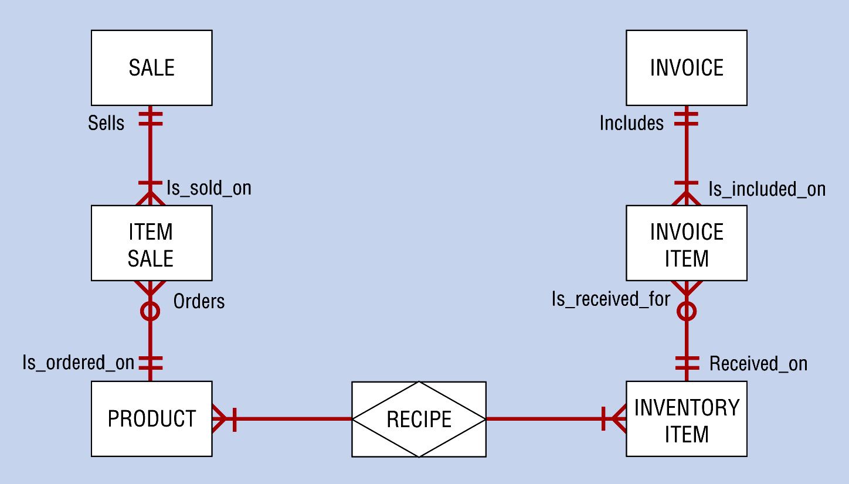
Preliminary E-R Diagram for an Inventory Control System

Slide 52
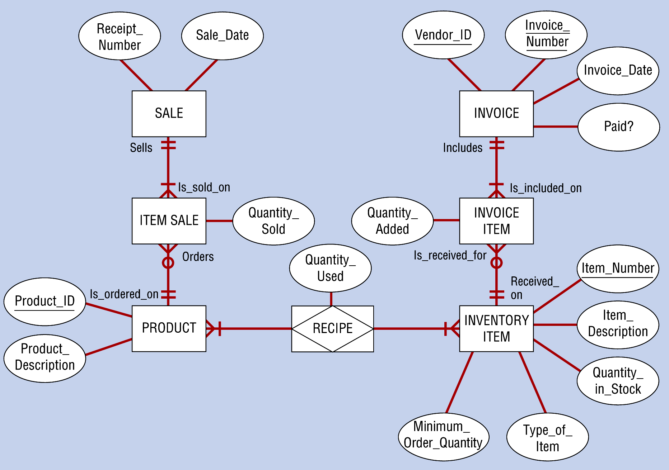
Final E-R Diagram for an Inventory Control System Showing Attributes

Slide 53
SUMMARY
What have we done with data modeling?
Defined the entities (objects about which we store data) of the system
Defined relationships between entities (verb phrase description and cardinality)
Defined the attributes associated with the entities, and with many-to-many relationships (gerund)
Defined characteristics of data attributes (domain, triggering operations)

