Slide 1
CHAPTER 11
SPECIFICATION PHASE
Formal Methods
(Very Brief Overview)

Slide 2
Formality versus Informality
Informal method
  English (or other natural language)
Semiformal methods
  Gane & Sarsen/DeMarco/Yourdon
  Entity-Relationship Diagrams
  Jackson/Orr/Warnier,
  SADT, PSL/PSA, SREM, etc.
Formal methods
  Finite State Machines
  Petri Nets
  Z
  ANNA, VDM, CSP, etc.

Slide 3
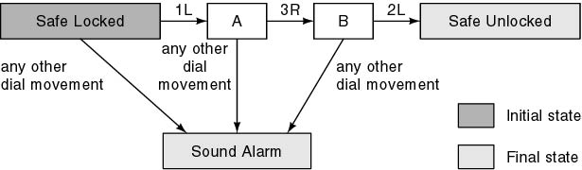
Finite State Machines
Case study
  A safe has a combination lock that can be in one of three positions, labeled 1, 2, and 3. The dial can be turned left or right (L or R). Thus there are six possible dial movements, namely 1L, 1R, 2L, 2R, 3L, and 3R. The combination to the safe is 1L, 3R, 2L; any other dial movement will cause the alarm to go off
Finite State Diagram

Slide 4
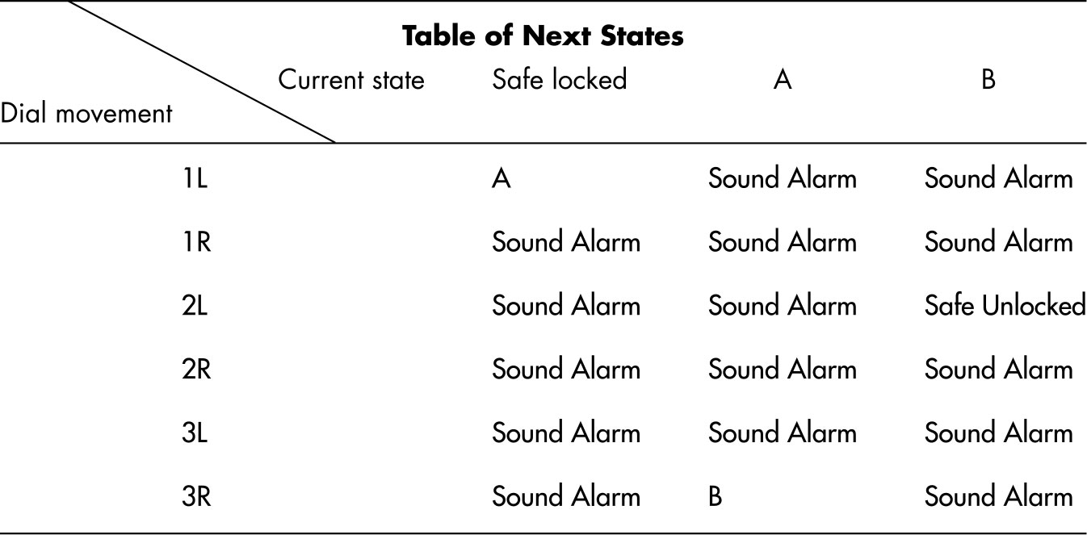
Finite State Machines (cont'd)
Transition table

Slide 5
Extended Finite State Machines
Extend FSM with global predicates
Transition rules have form
  state and event and predicate ⇒ new state

Slide 6
Elevator Problem
  A product is to be installed to control n elevators in a building with m floors. The problem concerns the logic required to move elevators between floors according to the following constraints:
  1. Each elevator has a set of m buttons, one for each floor. These illuminate when pressed and cause elevator to visit corresponding floor. Illumination is canceled when corresponding floor is visited by elevator
  2. Each floor, except the first and the top floor, has 2 buttons, one to request an up-elevator, one to request a down-elevator. These buttons illuminate when pressed. The illumination is canceled when an elevator visits the floor, then moves in the desired direction
  3. If an elevator has no requests, it remains at its current floor with its doors closed

Slide 7
Elevator Problem: FSM
Two sets of buttons
  Elevator buttons—in each elevator, one for each floor
  Floor buttons—two on each floor, one for up-elevator, one for down-elevator
  EB(e, f): Elevator Button in elevator e pressed to request floor f

Slide 8

Elevator Buttons (cont'd)
Two states
  EBON(e, f): Elevator Button (e,f) ON
  EBOFF(e,f): Elevator Button (e,f) OFF
  If button is on and elevator arrives at floor f, then light turned off
  If light is off and button is pressed, then light comes on

Slide 9
Elevator Buttons (cont'd)
Two events
  EBP(e,f): Elevator Button (e,f) Pressed
  EAF(e,f): Elevator e Arrives at Floor f
Global predicate
  V(e,f): Elevator e is Visiting (stopped at) floor f
Transition Rules
  EBOFF(e,f) and EBP(e,f) and not V(e,f) ⇒ EBON(e,f)
  EBON(e,f) and EAF(e,f) Þ EBOFF(e,f)

Slide 10

Floor Buttons
Floor buttons
  FB(d, f): Floor Button on floor f that requests elevator traveling in direction d
States
  FBON(d, f): Floor Button (d, f) ON
  FBOFF(d, f): Floor Button (d, f) OFF
  If floor button is on and an elevator arrives at floor f, traveling in correct direction d, then light is turned off
  If light is off and a button is pressed, then light comes on

Slide 11
Floor Buttons (cont'd)
Events
  FBP(d, f): Floor Button (d, f) Pressed
  EAF(1..n, f): Elevator 1 or … or n Arrives at Floor f
Predicate
  S(d, e, f): elevator e is visiting floor f
  Direction of motion is up (d = U), down (d = D), or no requests are pending (d = N)
Transition rules
  FBOFF(d, f) and FBP(d, f) and not S(d, 1..n, f) ⇒ FBON(d, f)
  FBON(d, f) and EAF(1..n, f) and S(d, 1..n, f) ⇒ FBOFF(d, f),
  d = U or D

Slide 12
Elevator Problem: FSM (cont'd)
State of elevator consists of component substates, including:
  Elevator slowing
  Elevator stopping
  Door opening
  Door open with timer running
  Door closing after a timeout

Slide 13
Elevator Problem: FSM (cont'd)
Assume elevator controller moves elevator through substates
  Three elevator states
  M(d, e, f): Moving in direction d (floor f is next)
  S(d, e, f): Stopped (d-bound) at floor f
  W(e,f): Waiting at floor f (door closed)
  For simplicity, three stopped states S(U, e, f), S(N, e, f), and S(D, e, f) are grouped into one larger state

Slide 14
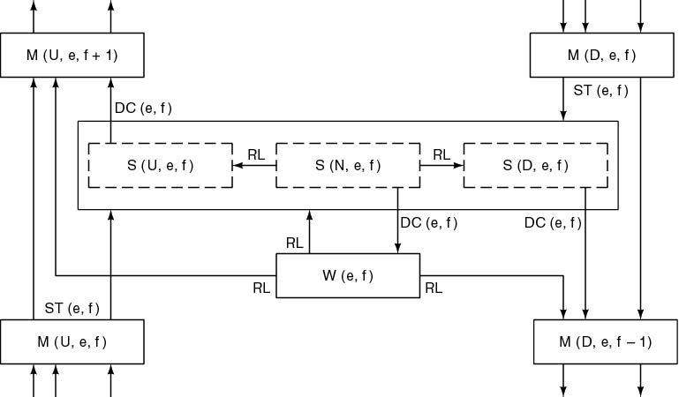
Elevator Problem: FSM (cont'd)

Slide 15
Elevator Problem: FSM (cont'd)
Events
  DC(e,f): Door Closed for elevator e, floor f
  ST(e,f): Sensor Triggered as elevator e nears floor f
  RL: Request Logged (button pressed)
Transition Rules
  If elevator e is in state S(d, e, f) (stopped, d-bound, at floor f), and doors close, then elevator e will move up, down, or go into wait state
  DC(e,f) and S(U, e, f) ⇒ M(U, e, f+1)
  DC(e,f) and S(D, e, f) ⇒ M(D, e, f-1)
  DC(e,f) and S(N, e, f) ⇒ W(e,f)

Slide 16
Power of FSM to Specify Complex Systems
No need for complex preconditions and postconditions
Specifications take the simple form current state and event and predicate ⇒ next state

Slide 17
Power of FSM to Specify Complex Systems
Using an FSM, a specification is
  Easy to write down
  Easy to validate
  Easy to convert into design
  Easy to generate code automatically
  More precise than graphical methods
  Almost as easy to understand
  Easy to maintain
However
  Timing considerations are not handled

Slide 18
Who Is Using FSMs?
Commercial products
  Menu driven
  Various states/screens
  Automatic code generation a major plus
System software
  Operating system
  Word processors
  Spreadsheets
Real-time systems
  Statecharts are a real-time extension of FSMs
    CASE tool: Rhapsody

Slide 19
Petri Nets`
A major difficulty with specifying real-time systems is timing
  Synchronization problems
  Deadlock
Often a consequence of poor specifications

Slide 20
Petri Nets (cont'd)
Petri nets
  Powerful technique for specifying systems with potential timing problems
A Petri net consists of four parts:
  Set of places P
  Set of transitions T
  Input function I
  Output function O

Slide 21
Petri Nets (cont'd)
Petri nets can also be used for design
Petri nets possess the expressive power necessary for specifying timing aspects of real-time systems

Slide 22
Z (“zed”)
Formal specification language
Z specification consists of four sections:
  1. Given sets, data types, and constants
  2. State definition
  3. Initial state
  4. Operations

Slide 23
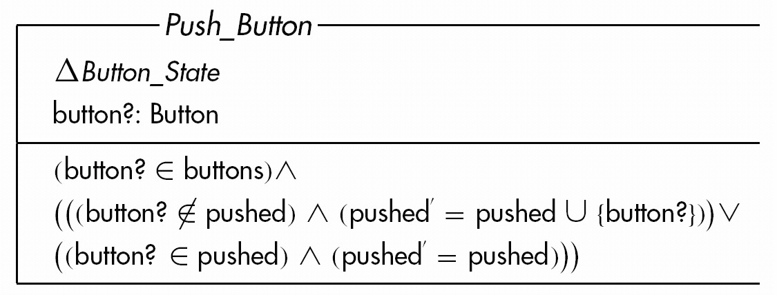
Elevator Problem: Z (cont'd)
Operations only
Button pushed for first time is turned on, and added to set pushed
Without third precondition, results would be unspecified

Slide 24
Analysis of Z (cont'd)
Difficulties
  Symbols
  Mathematics
Reasons for great success
  Easy to find faults in Z specification
  Specifier must be extremely precise
  Can prove correctness
  Only high-school math needed to read Z- (maybe in some high-schools!)
  Decreases development time
  “Translation” clearer than informal specification

Slide 25
Other Formal Methods
Anna
  Ada
Gist, Refine
  Knowledge-based
VDM- Vienna Definition Method
  Denotational semantics
CSP-Communicating Sequential Processes
  Sequence of events
  Executable specifications
  High squiggle factor

Slide 26
Comparison of Specification Techniques
We must always choose the appropriate specification method
Formal methods
  Powerful
  Difficult to learn and use
Informal methods
  Little power
  Easy to learn and use
Trade-off
  Ease of use versus power

Slide 27
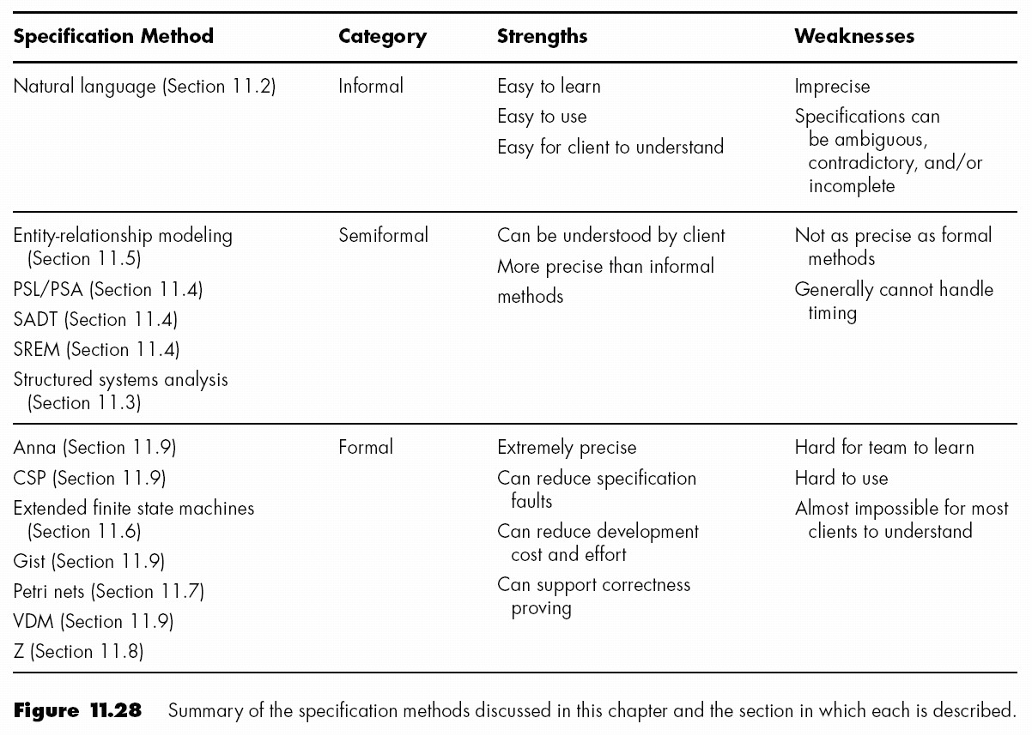
Comparison of Specification Techniques (cont'd)

Slide 28
Newer Methods
Many are untested in practice
Risks
  Training costs
  Adjustment from classroom to actual project
  CASE tools may not work properly
However, possible gains may be huge

Slide 29
Which Specification Method to Use?
Depends on the
  Project
  Development team
  Management team
  Myriad other factors
It is unwise to ignore the latest developments

