Slide 1
Object-Oriented Analysis
Chapter 12

Slide 2
Outline
Review
Motivation
Overview
The 3 Steps
Use case modeling
Class modeling
Dynamic modeling

Slide 3
Review
Specification document
  Explicitly defines functionality & constraints
3 Types- used for both requirements and specification
  Informal
    e.g., Natural Language
    Very ambiguous, but easy to understand
  Semi-formal
    e.g., DFD, E-RDs
    Easy to understand, but more precise
  Formal
    e.g., FSMs, Petri Nets, Z
    Very precise & powerful, but hard to learn
    Useful where safety or reliability is a concern

Slide 4
OO Analysis Phase
Specification phase is sometimes called the “analysis phase”
Def.
  The object-oriented counterpart of the classical specification phase
  Note- there is no requirements phase in OO paradigm
Structured paradigm has problems ? Why?
  Failed w/ larger projects
  Models either
    Actions
      Structured systems analysis, FSMs
    Data
      entity-relationship modeling
Notes:
structured paradigm worked much better than build-and-fix, which was all that most developers were doing up to this point

Slide 5
OOA: Data & Action Equal
Actions & data are intertwined
  Data cannot change unless an action is performed on it
  Actions without associated data are equally meaningless
Object consists of ?
  Data
    attributes, state variables, instance vars, fields, …
  Actions
    methods, member functions
  Plus inheritance
Objects should
  Model all aspects of one physical entity
Objects are independent units
  Easier to maintain & combine into a larger product -> fewer faults

Slide 6
The Three Steps of OAA
Semi-formal specification technique
  Many different equivalent methods (Booch, OMT, …)
  Represent all using UML (unified modeling language)
3 Iterative (parallel) steps (w/ diagrams)
  1. Use-case modeling
    Determine how various results are computed w/o sequencing
    Largely action-oriented
  2. Class modeling (AKA object modeling)
    Determine the classes, their attributes, & their interrelationships
    Purely data-oriented
  3. Dynamic modeling ?
    Determine the actions performed by or to each class
    Purely action-oriented

Slide 7
The Elevator Problem-Revisited
Product to control n elevators over m floors
Constraints
  Each elevator has m buttons, 1 per floor
    Illuminate when pressed & cause elevator to visit corresponding floor
    Illumination canceled when the floor is visited
  Each floor, except top & bottom, has 2 buttons
    1 to request an up-elevator & 1 to request a down-elevator
    Illuminate when pressed
    Illumination cancelled when elevators visits floor & moves in desired direction
  When an elevator has no requests, it remains at its current floor w/ its doors closed

Slide 8
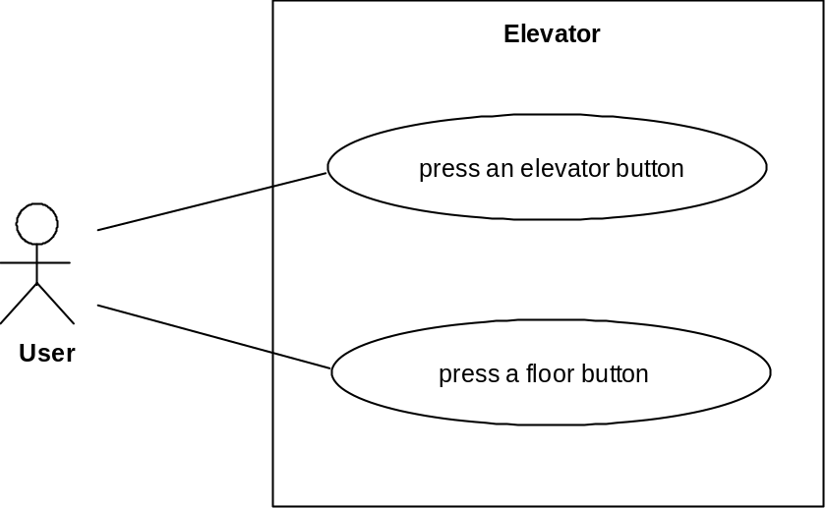
1. Use-Case Modeling
Use case
  Generic description of overall functionality
  Describes interaction between
    classes of the product
    actors (users) of the product
  Presents in the form of a use-case diagram
Scenario
  Specific instance of a use case
  List typical actions performed by each class
  Extract several from the general description
    Normal/abnormal scenarios
    Extended scenarios (w/ alternatives)
Use-case modeling gives us insight into behavior of product

Slide 9
Scenarios
Normal scenario
  1. User A presses up button on floor 3. Wishes to go to floor 7
  2. Up floor button turned on
  3. An elevator arrives at floor 3. It contains user B who entered at floor 1 & pressed the button for floor 9
  4. Up floor button turned off
  5. Elevator doors open. timer starts. User A enters elevator
  6. User A presses button for floor 7
  7. Floor 7 button is turned on
  8. Elevator doors close after timeout
  9. Elevator travels to floor 7
  10. Floor 7 elevator button is turned off
  11. Elevator doors open to allow user A to exit elevator
  12. Timer starts. User A exits
  13. Elevator doors close after timeout
  14. Elevator proceeds to floor 9 with user B

Slide 10
Scenarios
Abnormal (i.e. exception) scenario
  1. User A presses up button on floor 3. Wishes to go to floor 1
  2. Up floor button turned on
  3. An elevator arrives at floor 3. It contains user B who entered at floor 1 & pressed the button for floor 9
  4. Up floor button turned off
  5. Elevator doors open. Timer starts. User A enters elevator
  6. User A presses button for floor 1
  7. Floor 1 button is turned on
  8. Elevator doors close after timeout
  9. Elevator travels to floor 9
  10. Floor 9 elevator button is turned off
  11. Elevator doors open to allow user B to exit elevator
  12. Timer starts. User B exits
  13. Elevator doors close after timeout
  14. Elevator proceeds to floor 1 with user A

Slide 11
2. Class Modeling
Extract classes & their attributes
  Ignore methods until design phase
Represent using an entity-relationship (ER) diagram
Three approaches
  Deduce from use cases & their scenarios
    Identify the items that play a role
    Danger: many scenarios -> too many classes
      easier to add later than remove
  Noun extraction- details follow in slides
    Works fairly well
  CRC cards
    May need domain expertise to use
    Cn use after noun extraction to check
Often hard to get right on the 1st try
  iterate!
Author
1
writes
n
Autobiography
n
n
reads
owns
1
1
Reader

Slide 12
Noun Extraction
Stage 1. Concise Problem Definition- no details
  Define product in a single sentence
    Buttons in elevators and on floors are to be used to control motion of n elevators in building with m floors
Stage 2. Informal Strategy
  Incorporate constraints, express in 1 (short) paragraph
    Buttons in elevators and on floors control movement of n elevators in building with m floors. Buttons illuminate when pressed to request elevator to stop at specific floor; illumination is canceled when request has been satisfied. If elevator has no requests, it remains at its current floor with its doors closed.

Slide 13
Noun Extraction (cont'd)
Stage 3. Formalize the Strategy
  Identify nouns in informal strategy as candidate classes
    Buttons in elevators and on floors control movement of n elevators in building with m floors. Buttons illuminate when pressed to request elevator to stop at specific floor; illumination is canceled when request has been satisfied. If elevator has no requests, it remains at its current floor with its doors closed.
  Button, elevator, floor, movement, building, illumination, request, door
  Exclude abstract nouns
    Eliminates movement, illumination, request
  Abstract nouns may become class attributes
    Ex. illumination is an attribute of button
  Exclude nouns outside problem boundary
    floor, building, and door
  Leaves button (2 types), elevator

Slide 14
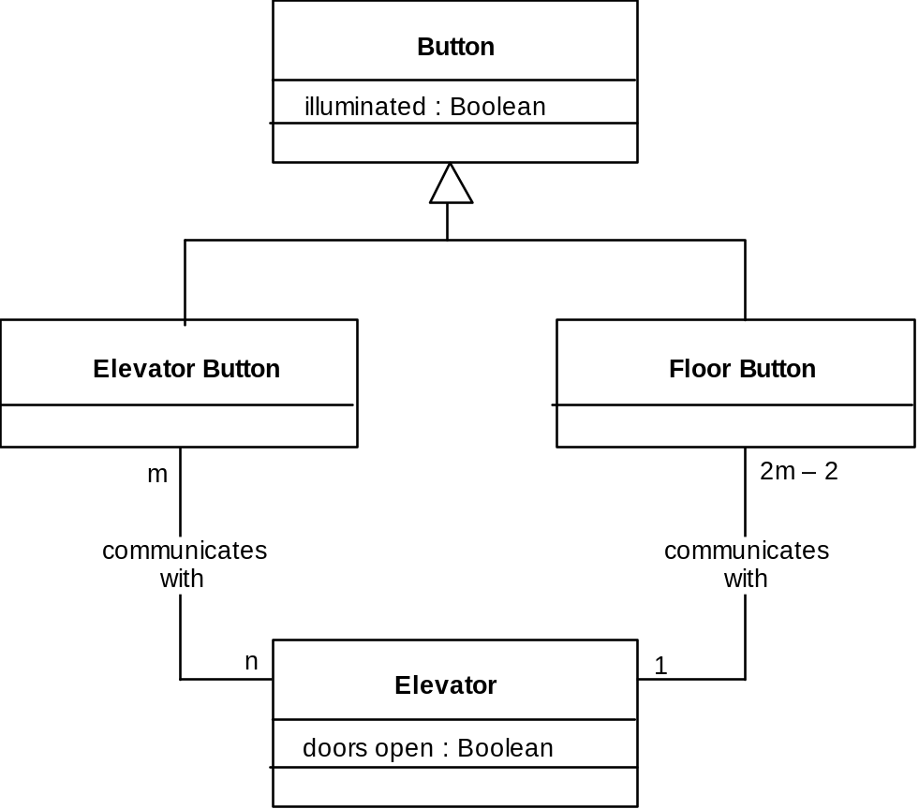
2. Class Modeling
Denotes inheritance in UML
m = #floors
n= #elevators
Fig:12.4, pg 373
Problem?
  Buttons do not communicate directly with elevators

Slide 15
2. Class Modeling (Con't)
Problem: Buttons do not communicate directly with elevators
In real elevators, an elevator controller communicates with the elevators.
As is typical in many problem statements, this is not mentioned, but implied.
  This is why we don't have an algorithm to translating descriptions into analysis documents!
Emphasize: Noun Extraction is a starting point for finding candidate classes, but it cannot do the entire job!!!

Slide 16
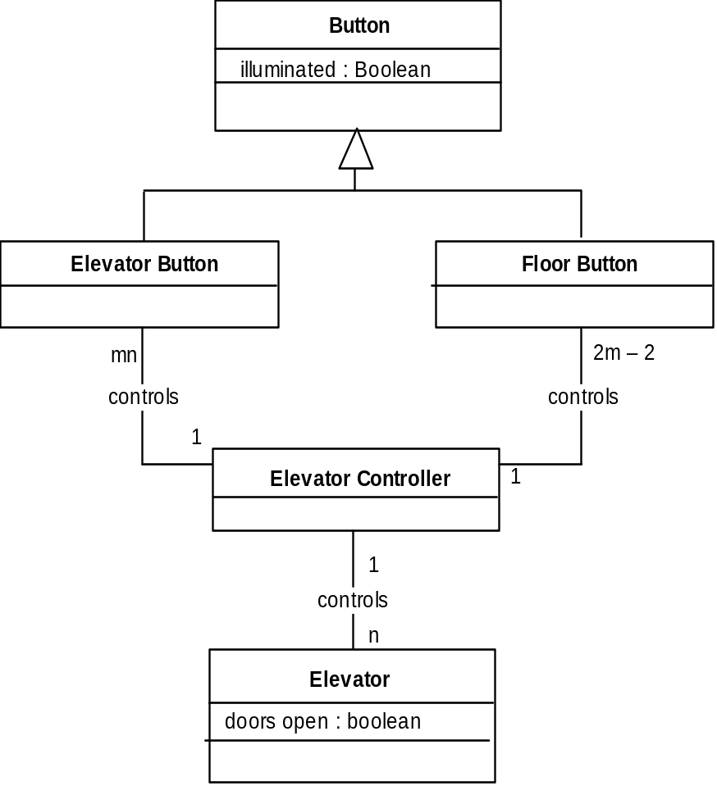
2. Class Modeling (Con't)
Fig:12.5, pg 374
All relationships now 1-to-n
  Makes design, implementation easier (easier to maintain state)

Slide 17
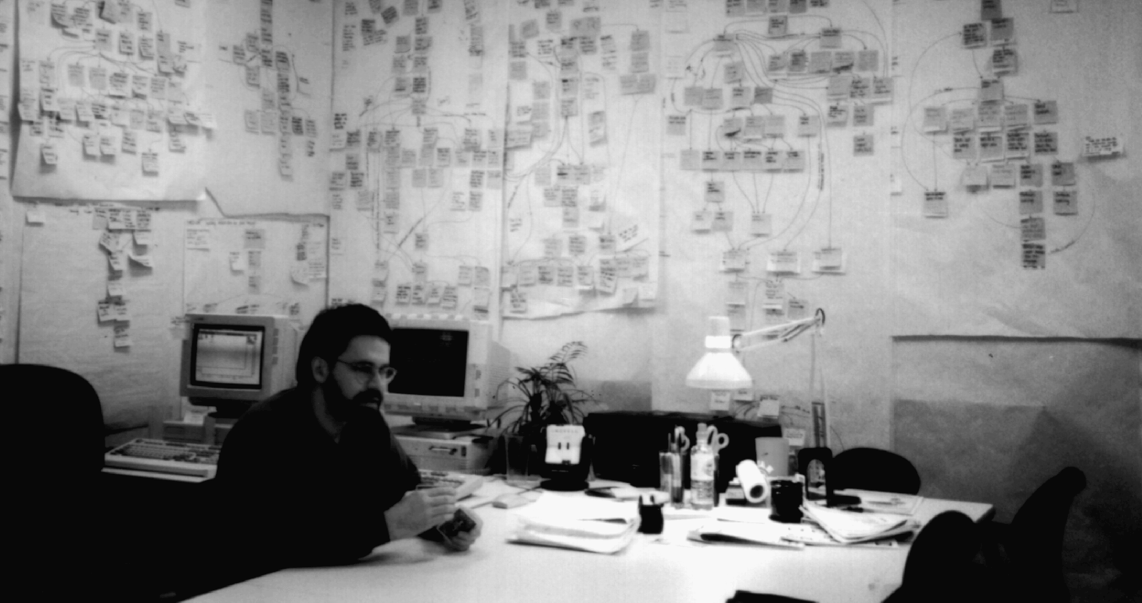
CRC Cards
(Class-Responsibility-Collaboration)
Used since 1989 for OOA
  For each class, fill in card showing
    Name of Class
    Functionality (Responsibility)
    Classes it invokes (Collaboration)
  Done on cards, post-its, or online
Strength
  When acted out by team, powerful tool for highlighting missing or incorrect items
Weakness
  Hard to maintain

Slide 18
3. Dynamic Modeling
Determine the actions performed by/to each class
  Present in a UML state diagram
  A UML state diagram is a description of the target product similar to a finite state machine, for each class.
    Less formal than an FSM
      State, event, predicate distributed over state diagram
      UML “guards” (or predicates) appear in brackets
    UML reserved word do indicates the action is to be carried out
  See Pg 376, Fig. 12.6- a state diagram for the Elevator Controller Class

Slide 19
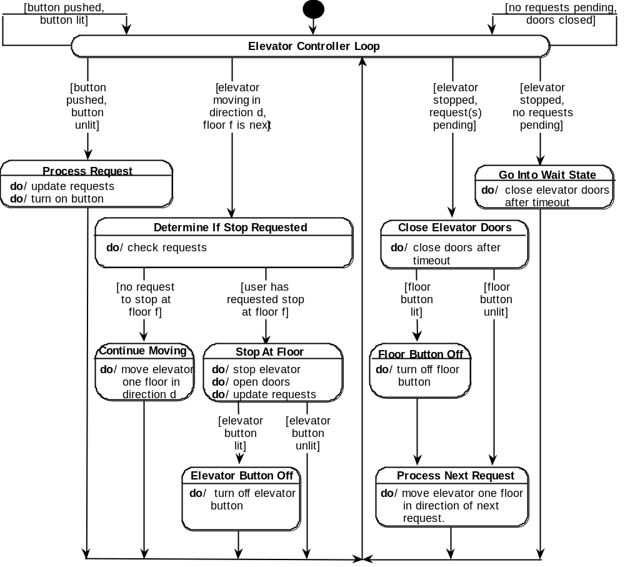
3. Dynamic Modeling

Slide 20
Testing During the OOA Phase
CRC cards are an excellent testing technique
Problems with this card?
  Controller shouldn’t be changing state of other classes!
    Send messages to get information hiding
  A class has been overlooked
    Elevator doors have a state that changes -> item needs a class
    Add class Elevator Doors
  Reconsider class & dynamic models (iterate!)
CLASS
Elevator Controller
RESPONSIBILITY
Turn on elevator button
Turn off elevator button
Turn on floor button
Turn off floor button
Open elevator doors
Close elevator doors
Move elevator one floor up
Move elevator one floor down
COLLABORATON
Class Elevator Button
Class Floor Button
Class Elevator

Slide 21
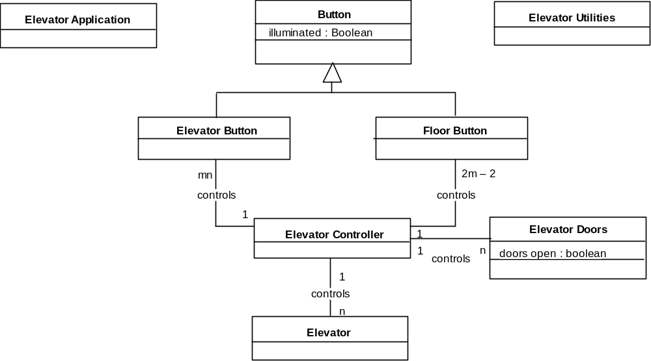
Class Model (3rd try)

Slide 22
New CRC Card
CLASS
Elevator Controller
RESPONSIBILITY
Send message to Elevator Button to turn on button
Send message to Elevator Button to turn off button
Send message to Floor Button to turn on button
Send message to Floor Button to turn off button
Send message to Elevator Doors to open doors
Send message to Elevator Doors to close doors
Send message to Elevator to move one floor up
Send message to Elevator to move one floor down
COLLABORATON
Class Elevator Button
Class Floor Button
Class Elevator Doors
Class Elevator

Slide 23
Iteration
Done for now, but will return to during OO Design Phase
Why so much iteration?
  Iteration is key to getting software designs right
    Iterate on rapid prototype
    Iterate in the incremental & spiral models
    Expect iteration in the OO paradigm also
    Works better when you admit it & plan for it!

Slide 24
Case Tools for OOA Phase
Diagrams play a major role
Diagrams change often
  Need a diagramming or drawing tool
    Visual Thought is an example
  Many CASE tools go further
  Check the integrity of the diagrams
  Can be carried over into other phases
  Examples include:
    Rational Rose;
    Software through Pictures
    Together

Slide 25
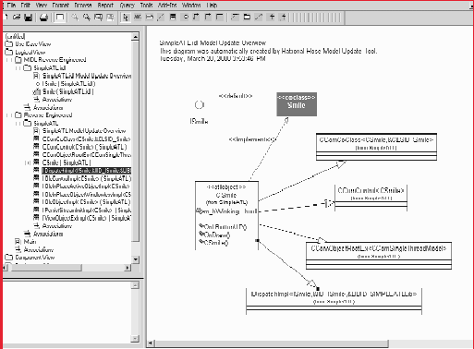

Slide 26
Advantages of OOA
IBM analyzed 3 major projects [Capper, et. al. ’94]
  Major decreases in # of faults
  Far fewer change requests during development/maintenance
  Adaptive & perfective maintainability increased
  Modest improvement in usability
  No impact on performance

Slide 27
Summary
OOA reaction to problems with SSA, focuses on
  Data & actions instead of only 1 or the other
3 main steps
  Use-case modeling
    Use case diagram & scenarios
    Gives insight into overall behavior (actions)
  Class modeling
    Determine the classes, their attributes, & their interrelationships
    Create E-R or class diagram -> mainly data-oriented
  Dynamic modeling
    Determine the actions performed by or to each class
    Create UML state diagram
Iterate between the 3 steps (check with CRC cards)

