Slide 1
CHAPTER 13
DESIGN PHASE

Slide 2
Overview
Design and abstraction
Action-oriented design
Data flow analysis
Transaction analysis
Data-oriented design
Object-oriented design
Elevator problem: object-oriented design

Slide 3
Overview (cont'd)
Formal techniques for detailed design
Real-time design techniques
Testing during the design phase
CASE tools for the design phase
Metrics for the design phase
Air Gourmet Case Study: object-oriented design
Challenges of the design phase

Slide 4
Data and Actions
Two aspects of a product
  Actions which operate on data
  Data on which actions operate
The two basic ways of designing a product
  Action-oriented design
  Data-oriented design
Third way
  Hybrid methods
  For example, object-oriented design

Slide 5
Design Activities
Architectural design
  Input: Specifications
  Output: Modular decomposition
  Abstraction
Detailed design
  Each module is designed
    Specific algorithms
    Data structures
Design testing

Slide 6
Action-Oriented Design Methods
Data flow analysis
When to use it
  With most specification methods (Structured Systems Analysis here)
Key point: Have detailed action information from DFD

Slide 7
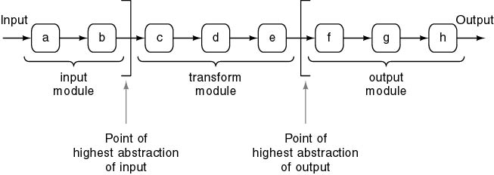
Data Flow Analysis
Product transforms input into output
Determine
  “Point of highest abstraction of input”
  “Point of highest abstract of output”

Slide 8
Data Flow Analysis (cont'd)
Decompose into three modules
Repeat stepwise until each module has high cohesion
  Minor modifications may be needed to lower coupling

Slide 9
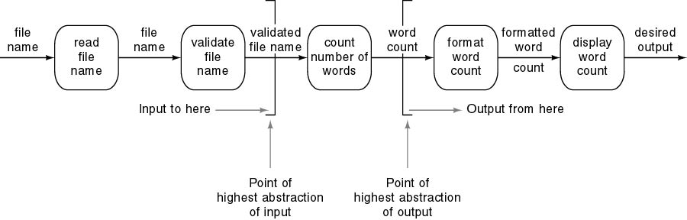
Data Flow Analysis (con'd)
Example
  Design a product which takes as input a file name, and returns the number of words in that file (like UNIX wc )

Slide 10
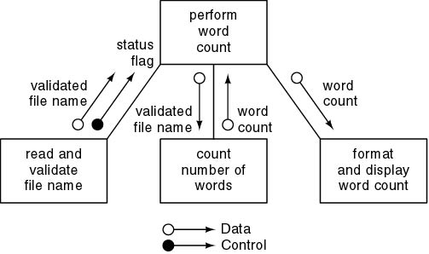
Data Flow Analysis Example(cont'd)
First refinement
Refine modules of communicational cohesion

Slide 11
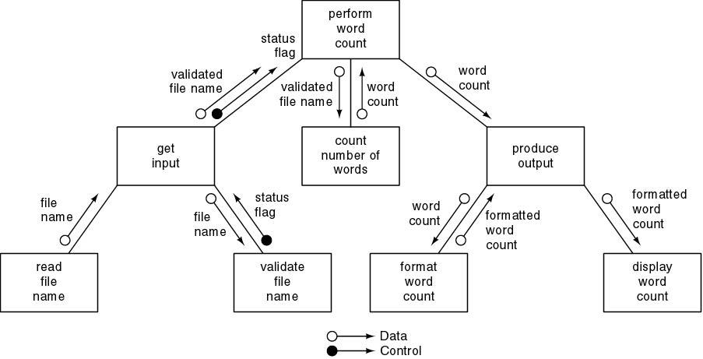
Data Flow Analysis Example(cont'd)
Second refinement
All eight modules have functional cohesion

Slide 12
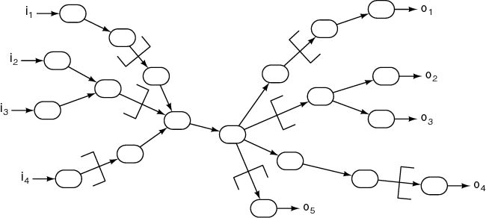
Multiple Input and Output Streams
Point of highest abstraction for each stream
Continue until each module has high cohesion
  Adjust coupling if needed

Slide 13
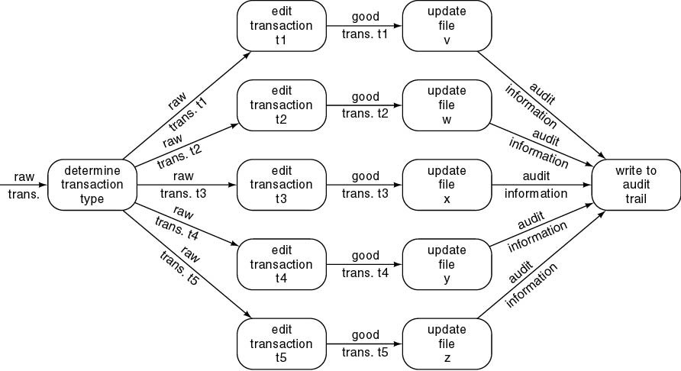
Transaction Analysis
DFA poor for transaction processing products
  Example: ATM (Automatic Teller Machine)
Poor design
  Logical cohesion, control coupling

Slide 14
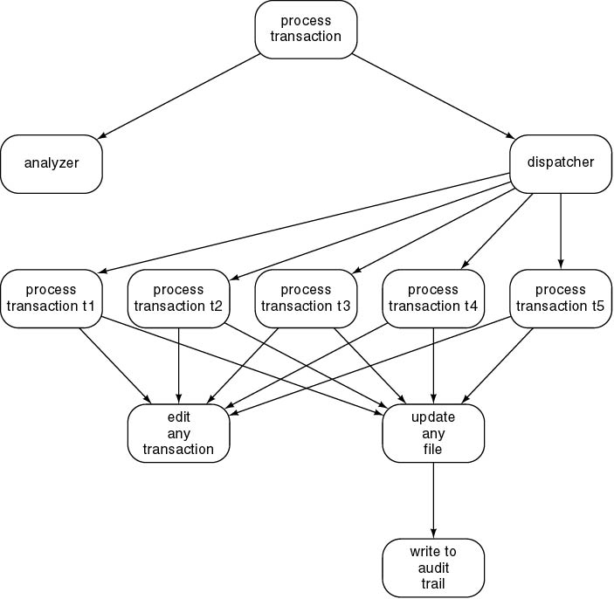
Corrected Design Using Transaction Analysis
Software reuse

Slide 15
Data-Oriented Design
Basic principle
  The structure of a product must conform to the structure of its data
Three very similar methods
  Warnier
  Orr
  Jackson
Data-oriented design
  Has never been as popular as action-oriented design
  With the rise of OOD, data-oriented design has largely fallen out of fashion

Slide 16
Object-Oriented Design (OOD)
Aim
  Design product in terms of objects extracted during OOA
If we are using a language without inheritance (C, Ada 83)
  Use abstract data type design
If we are using a language without a type statement (FORTRAN, COBOL)
  Use data encapsulation

Slide 17
Object-Oriented Design Steps
OOD consists of four steps:
  1. Construct interaction diagrams for each scenario
  2. Construct the detailed class diagram
  3. Design the product in terms of clients of objects
  4. Proceed to the detailed design

Slide 18
Elevator Problem: OOD
Step 1. Construct interaction diagrams for each scenario
Sequence diagrams
Collaboration diagrams
  Both show the same thing
  Objects and messages passed between them
But in a different way

Slide 19
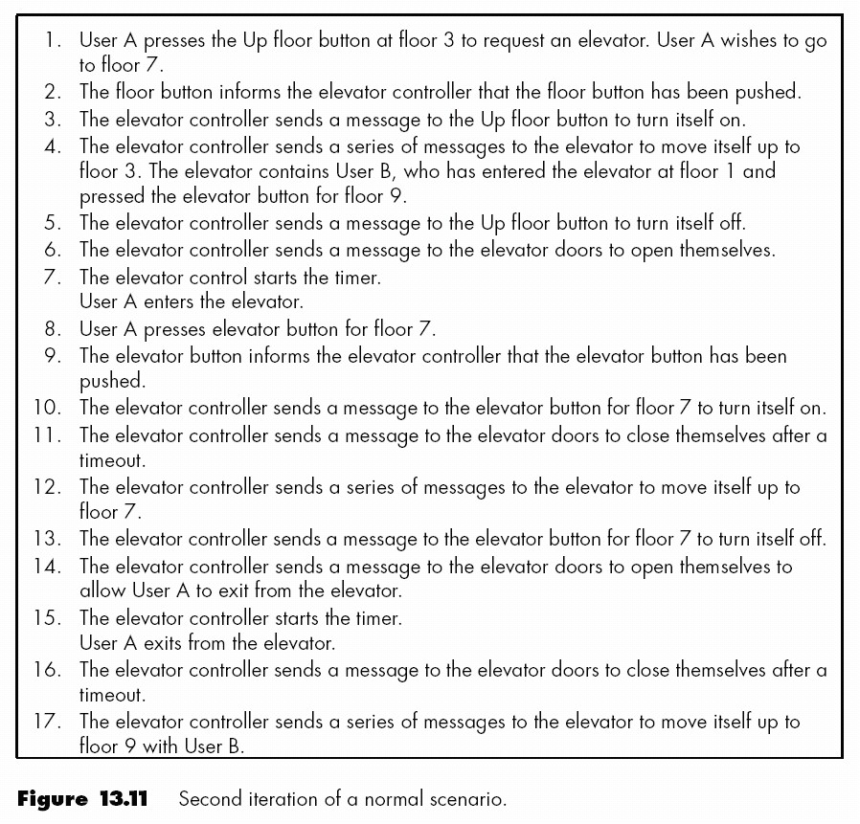
Elevator Problem: OOD (cont'd)
Normal scenario

Slide 20
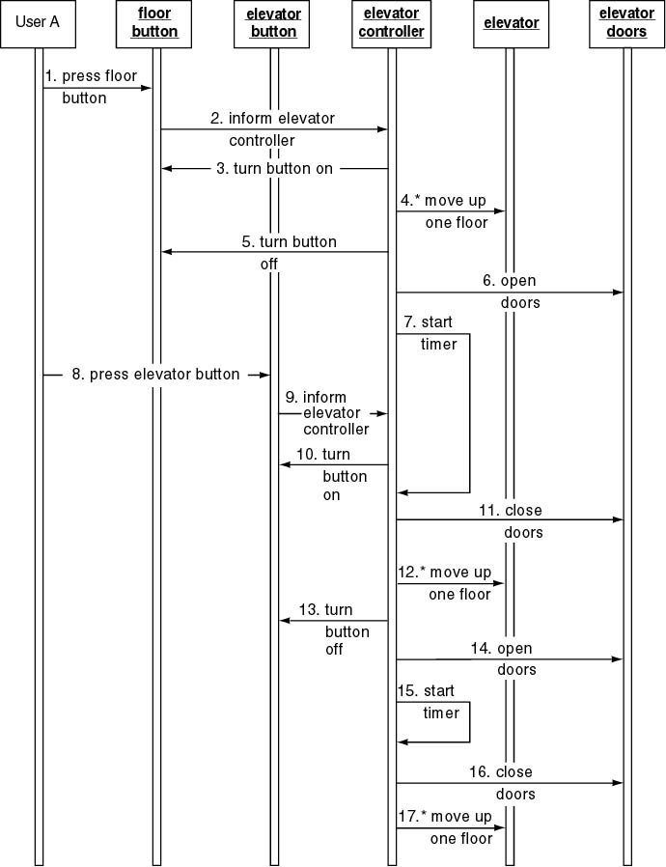
Elevator Problem: OOD (cont'd)
Sequence diagram

Slide 21
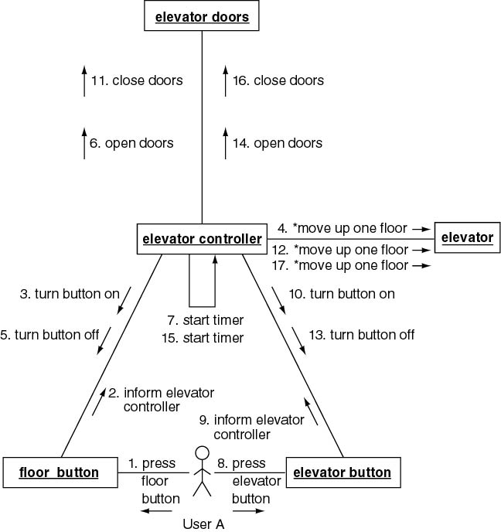
Elevator Problem: OOD (cont'd)
Collaboration diagram

Slide 22
Elevator Problem: OOD (cont'd)
Step 2. Construct Detailed Class Diagram
Do we assign an action to a class or to a client of that class?
Criteria
  Information hiding
  Reducing number of copies of action
  Responsibility-driven design
Examples
  close doors is assigned to Elevator Doors
  move one floor down is assigned to Elevator

Slide 23
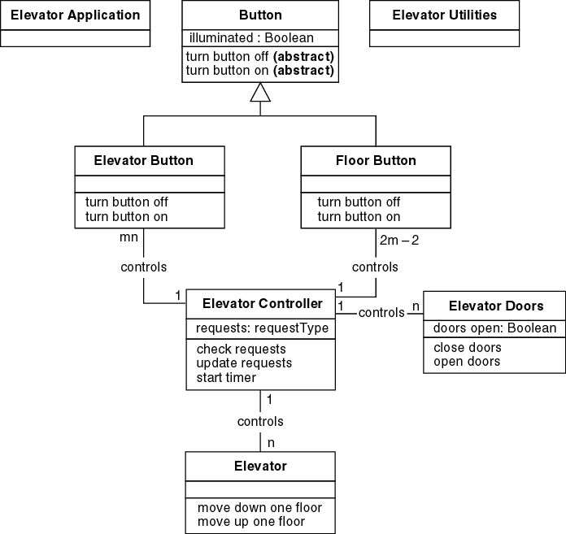
Elevator Problem: OOD (cont'd)
Detailed class diagram

Slide 24
Elevator Problem: OOD (cont'd)
Step 3. Design product in terms of clients of objects
Draw an arrow from an object to a client of that object
Objects that are not clients of any object have to be initiated, probably by the main method
  Additional methods may be needed

Slide 25
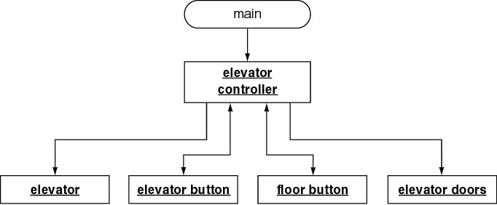
Elevator Problem: OOD (cont'd)
C++ Client-object relations

Slide 26
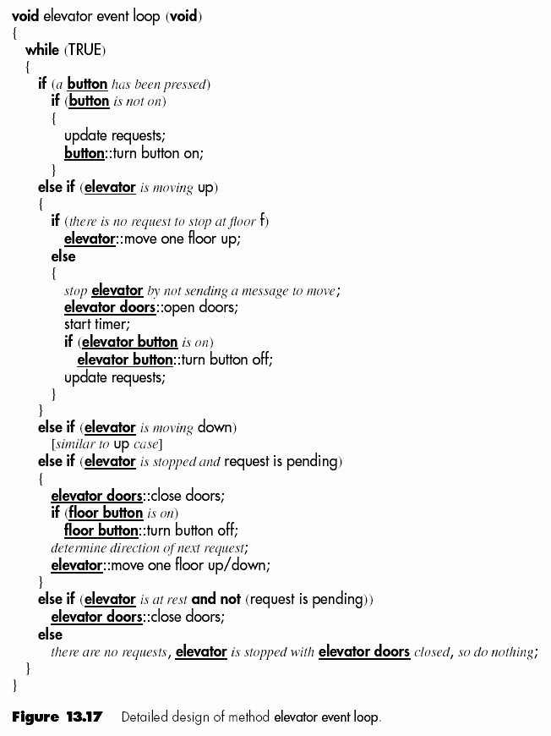
Elevator Problem: OOD (cont'd)
Step 4. Perform detailed design
Detailed design of method elevator controller loop

Slide 27
Formal Techniques for Detailed Design
Implementing a complete product and then proving it correct is hard
However, use of formal techniques during detailed design can help
  Correctness proving can be applied to module-sized pieces
  The design should have fewer faults if it is developed in parallel with a correctness proof
  If the same programmer does the detailed design and implementation
    The programmer will have a positive attitude to the detailed design
    Should lead to fewer faults

Slide 28
Design of Real-Time Systems
Difficulties associated with real-time systems
  Inputs come from real world
    Software has no control over timing of inputs
  Frequently implemented on distributed software
    Communications implications
    Timing issues
  Problems of synchronization
    Race conditions
    Deadlock (deadly embrace)
Major difficulty in design of real-time systems
  Determining whether the timing constraints are met by the design

Slide 29
Real-Time Design Methods
Usually, extensions of nonreal-time methods to real-time
We have limited experience in use of any real-time methods
The state-of-the-art is not where we would like it to be

Slide 30
Testing during the Design Phase
Design reviews
  Design must correctly reflect specifications
  Design itself must be correct
  Transaction-driven inspections

Slide 31
CASE Tools for the Design Phase
UpperCASE tools
  Built around data dictionary
  Consistency checker
  Screen, report generators
  Modern tools represent OOD using UML
  Examples: Software through Pictures, Rose

Slide 32
Challenges of the Design Phase
Design team should not do too much
  Detailed design should not become code
Design team should not do too little
  It is essential for the design team to produce a complete detailed design
We need to grow great designers

