Slide 1
CHAPTER 2
THE SOFTWARE PROCESS

Slide 2
Review
Software engineering was a reaction to?
  the software crisis – faulty, late, expensive
SE's aim is the production of?
  fault-free software, delivered on time and within budget, that satisfies the user’s needs
Faults?
  software behaviors unaccounted for in its design
Software life cycle?
  requirements & specification → maintenance & retirement
How does cost of flaws relate to where found?
  from double to an order of magnitude with each stage
Notes:
Software life cycle?
series of stages development moves through

Slide 3
Terminology
Systems analysis
  Requirements + specifications phases
Operations mode
  Maintenance
Design
  Architectural design, detailed design
Client, developer, user
Internal software development/contract software

Slide 4
Documentation Phase?
There is NO documentation phase
Every phase must be fully documented before starting the next phase
  Postponed documentation may never be completed
  The responsible individual may leave
  The product is constantly changing—we need the documentation to do this
  The design (for example) will be modified during development, but the original designers may not be available to document it

Slide 5
Testing Phase?
There is NO testing phase
Testing is an activity performed throughout software production
Verification
  Are we building the product correctly?
  Performed at the end of each phase
Validation
  Did we build the right product?
  Performed before delivering the product to the client

Slide 6
Requirements Phase
Assumption (usually after a feasibility study)
  The software being considered is economically justifiable and desirable for the organization
Concept exploration
  Determine what the client needs, not just what the client wants
Moving target problem

Slide 7
Requirements Phase Testing and Documentation
Rapid prototyping might be performed for both testing and documentation by a Software Quality Assurance (SQA) group
Requirements document
  Spells out in detail the requirements agreed upon by the client and the software engineering team
  Often overseen by a lawyer as it will act as the start of a contract.
  Checked by client, selected users, development team and SQA group.

Slide 8
Specification Phase
Specifications document (“specifications”)
  Legal document
  Must not have phrases like “optimal,” or “98% complete”
Specifications must not be
  Ambiguous
  Incomplete
  Contradictory
Once the specifications have been signed off
  The software product management plan (SPMP) is drawn up
  This is the earliest possible time for the SPMP

Slide 9
Specification Phase
Testing
  Traceability
  Review
  Check the SPMP
Documentation
  Specification document (specifications)
  SPMP

Slide 10
Design Phase
Specification—what
Design—how
Retain design decisions
  When a dead-end is reached
  For the maintenance team
  Ideally, the design should be open-ended
Architectural design
  Decompose the product into modules
Detailed design
  Design each module: data structures, algorithms

Slide 11
Design Phase
Testing
  Traceability
  Review
Documentation
  Architectural design
  Detailed design

Slide 12
Implementation Phase
Testing
  Reviews
  Test cases
    Informal testing (desk checking)
    Formal testing (SQA)
Documentation
  Source code
  Manuals- inline and exterior
  Test cases (with expected output)

Slide 13
Integration Phase
Combine the modules and check the product as a whole
Testing
  Product testing
  Acceptance testing
Documentation
  Commented source code
  Test cases for the product as a whole

Slide 14
COTS Software
“Shrink-wrapped software”- earlier term
Commercial off-the-shelf (COTS)
Nowadays, COTS software is often downloaded
“Click-wrapped software” - later term used as often downloaded from a site
Not developed for a specific client.

Slide 15
Maintenance Phase
Maintenance
  Any change once the client has accepted the software
The most money is devoted to this phase
The problem of lack of documentation
Testing
  Regression testing - is functionality from earlier versions compromised by the change?
Documentation
  Record of all changes made, with reasons
  Regression test cases

Slide 16
Retirement
Good software is maintained
Sometimes software is rewritten from scratch
  Software is now unmaintainable because
    A drastic change in design has occurred
    The product must be implemented on a totally new hardware/operating system
    Documentation is missing or inaccurate
    Hardware is to be changed—it may be cheaper to rewrite the software from scratch than to modify it
True retirement is a rare event

Slide 17
A Multitude of Difficulties
Process-specific difficulties
  Does the product meets the user’s real needs?
  Is the specification document free of ambiguities, contradictions, and omissions?

Slide 18
Inherent Problems of Software Production
Hardware has inherent limits
So does software
No Silver Bullet¹
  Complexity
  Conformity
  Changeability
  Invisibility
Aristotelian categories
  Essence- difficulties inherent in the nature of software
  Accidents - just plain goofs
¹ A delightful article by Brooks summarizing some ideas from his book, "The Mythical Man-Month".

Slide 19
Brooks lists four aspects of software production which are inherently difficult:
1. Complexity
  Software is far more complex than hardware
  Traditional abstraction will not work
  We cannot understand the whole, so we cannot understand any part
  Management is difficult
  Maintenance is a nightmare (documentation, too)

Slide 20
Brooks :
Conformity
  Type 1: Existing gold refinery
  Type 2: New gold refinery
Changeability
  Software is easier to change than hardware
  Pressure to change
    Reality
    Useful software
    Easier to change
    Software has a long lifetime (~15 yrs) compared to hardware (~4 yrs)
Invisibility

Slide 21
Brooks :
Invisibility
  Software is "invisible and unvisualizable"
  Complete views are incomprehensible
  Partial views are misleading
  However, all views can be helpful

Slide 22
Is There a Silver Bullet?
What about
  High-level languages
    4GL
    Visual
    Object-oriented
  Time sharing
  CASE tools
These did not solve the intrinsic problems
We have experienced
  6% annual productivity increase
But, no “silver bullet” (order-of-magnitude increase) seems to be possible!!

Slide 23
Improving the Software Process
U.S. Department of Defense initiative
Software Engineering Institute (SEI)
The fundamental problem with software
  The software process is badly managed
Software process improvement initiatives
  Capability maturity model (CMM)
  ISO 9000-series
  ISO/IEC 15504

Slide 24
Capability Maturity Model
Not a life-cycle model
Set of strategies for improving the software process
  SW–CMM for software
  P–CMM for human resources ( i.e. people)
  SE–CMM for systems engineering
  IPD–CMM for integrated product development
  SA–for software acquisition
These strategies are being unified into CMMI (capability maturity model integration)

Slide 25
SW–CMM for Software
A strategy for improving the software process
  Put forward in 1986 by the SEI (Software Engineering Institute) at Carnegie Mellon University
    http://www.sei.cmu.edu/
  Fundamental idea:
  Improving the software process leads to
    Improved software quality
    Delivery on time, within budget
  Improved management leads to
    Improved techniques
Five levels of “maturity” are defined
  Organization advances stepwise from level to level

Slide 26
Capability Maturity Model (CMM)
RISK
Level
5
OPTIMIZED
Level
4
MANAGED
Level
3
DEFINED
Level
2
REPEATABLE
Level
1
INITIAL
COMPETITIVENESS
Notes:
No additional notes

Slide 27
Level 1. Initial Level
Ad hoc approach
  Entire process is unpredictable
  Management consists of responses to crises
  Chaos
  Periodic panics
  Heroic efforts required by individuals to complete projects.
  Few processes in place.
Most organizations world-wide are at level 1- 62%¹
(¹From a study made of 533 organizations 1992-1996. Still believed to be true today, 5 years later!)

Slide 28
Level 2. Repeatable Level
Basic software management- 23%
  Management decisions should be made on the basis of previous experience with similar products
  Measurements (“metrics”) are made
  These can be used for making cost and duration predictions in the next project
  Problems are identified, immediate corrective action is taken
  Software project tracking
  Requirements management
  Realistic planning
  Configuration management processes used
    The specific version of each module from which a given version of the complete product is built is called the configuration of that version.

Slide 29
Level 3. Defined Level
The software process is fully documented- 13%
  Managerial and technical aspects are clearly defined
  Continual efforts are made to improve quality, productivity
  Reviews are performed to improve software quality
  CASE tools are applicable now (and not at levels 1 or 2)
  Standard software development and maintenance processes integrated throughout the organization
  A group is in place to oversee software processes
  Training programs are used to ensure understanding and compliance.

Slide 30
Level 4. Managed Level
Quality and productivity goals are set for each project- 2%
  Quality, productivity are continually monitored
  Statistical quality controls are in place
  Metrics are used continuously to track productivity, processes, and products.
  Product performance is predictable and quality is consistently high.

Slide 31
Level 5. Optimizing Level
Continuous process improvement- 0.4%
  Statistical quality and process controls
  Feedback of knowledge from each project to the next
  The impact of new processes and technologies can be predicted and effectively implemented when required.

Slide 32
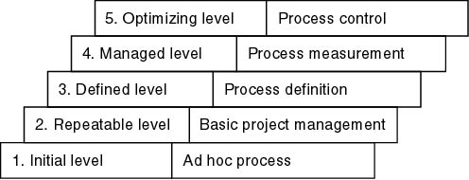
Summary
Keywords Characterizing the Levels

Slide 33
Key Process Areas
There are key process areas (KPAs) for each level specified by SEI that an organization should target in order to reach the next level. For example:
Level 2 KPAs include:
  Requirements management
  Project planning
  Project tracking
  Configuration management
  Quality assurance
Compare
  Level 2: Detection and correction of faults
  Level 5: Prevention of faults

Slide 34
Experience
It takes:
  3 to 5 years to get from level 1 to level 2
  1.5 to 3 years from level 2 to level 3
  SEI questionnaires highlight shortcomings, suggest ways to improve the process
Original idea: Defense contracts would be awarded only to capable firms

Slide 35
Other SPI Initiatives
Other software process improvement (SPI) initiatives:
  ISO 9000-series
  ISO/IEC 15504

Slide 36
ISO 9000
Set of five standards for industrial activities
  ISO 9001: for quality systems
  ISO 9000-3: guidelines to apply ISO 9001 to software
  There is an overlap with CMM, but they are not identical
  Not process improvement
  Stress on documenting the process
  Emphasis on measurement and metrics
  ISO 9000 is required to do business with the E.U. (European Union)
  Also by many U.S. businesses, for example, GE
  More and more U.S. businesses are ISO 9000 certified

Slide 37
ISO/IEC 15504
Original name: Software Process Improvement Capability dEtermination (SPICE)
  International process improvement initiative
  Started by British Ministry of Defence (MOD)
  Includes process improvement, software procurement
  Extends and improves CMM, ISO 9000
  Framework, not a method
    CMM, ISO 9000 conform to this framework
  Now referred to as ISO/IEC 15504
  Or just 15504 for short

Slide 38
DOES SPI LEAD TO INCREASED PROFITABILITY?
Many studies suggest that the answer is "Yes":
  Hughes Aircraft (Fullerton, CA) spent $500K (1987–90)
    Savings: $2M per year, moving from level 2 to level 3
  Raytheon moved from level 1 in 1988 to level 3 in 1993
    Productivity doubled
    Return of $7.70 per dollar invested in process improvement

Slide 39
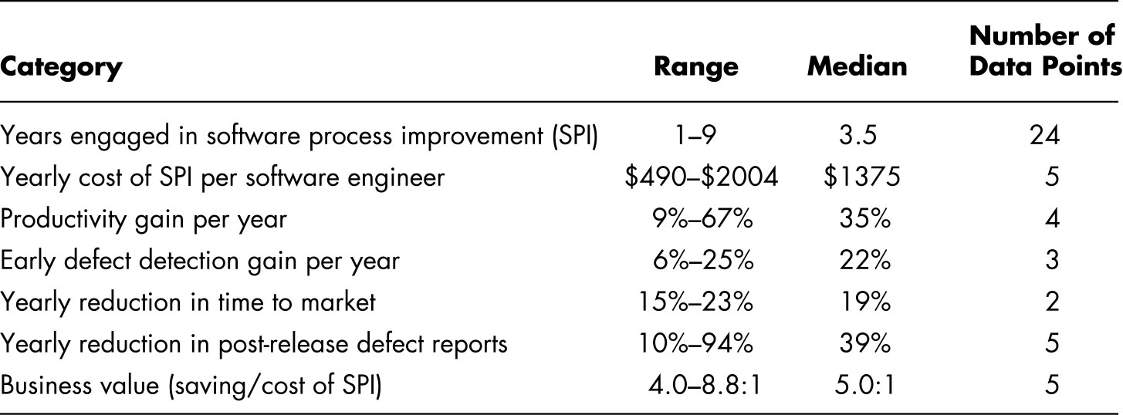
Process Improvement Data
(Figure 2.2, page 56)
SEI report on 13 organizations in the original study in 1994
They used a variety of process improvement techniques, not just SW–CMM

Slide 40
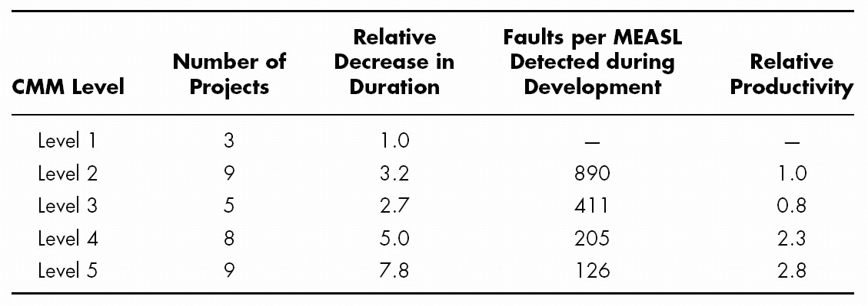
Process Improvement Data (contd)
Results of 34 Motorola projects reported in 1997
MEASL = faults per million equivalent assembler source lines

Slide 41
Summary
Documentation important for each phase. Why?
  people & products change
Testing is essential throughout life cycle
  traceability?
    tying a piece of doc/design back to previous doc
CMM
  capability maturity model
  what type of process do you have?
  high levels characterized by improving process
  improving saves money/time & reduces faults

