Slide 1
CHAPTER 3
SOFTWARE
LIFE-CYCLE
MODELS

Slide 2
Overview
Build-and-fix model
Waterfall model
Rapid prototyping model
Incremental model
Extreme programming
Synchronize-and-stabilize model
Spiral model
Object-oriented life-cycle models
Comparison of life-cycle models

Slide 3
System Life Cycle vs System Development Methodology vs Software Life Cycle Model
A system life cycle divides the life of an information system into two stages
  systems development
  systems operation and support.
A system development methodology is a very formal and precise system development process that defines (as in CMM Level 3)
  a set of activities
  methods
  best practices
  deliverables
  automated tools
that system developers and project managers are to use to develop and maintain information systems and software.
Notes:
No additional notes.

Slide 4
A System Life Cycle
Conversion
LIFE CYCLE STAGE
LIFE CYCLE STAGE
Lifetime
System Development
System Operation
of a
and Support
using
System
System Development
using
Methodology
Information Technology
Obsolescence
Notes:
Teaching Notes
This slide formally differentiates between the life cycle and a systems development methodology that is used to to implement the development stage of the life cycle.
A common synonym for “system operation” is “production.”

Slide 5
Software Life-Cycle Models
Life-cycle model (formerly called the process model)
The ordering of the steps through which the product progresses:
  Requirements phase
  Specification phase
  Design phase
  Implementation phase
  Integration phase
  Maintenance phase
  Retirement

Slide 6
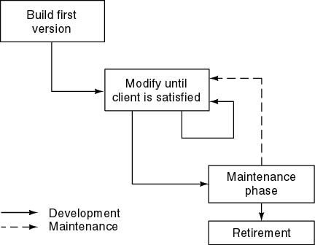
Build and Fix Model
Problems
  No specifications
  No design
Totally unsatisfactory
Need life-cycle model
  “Game plan”
  Phases
  Milestones

Slide 7
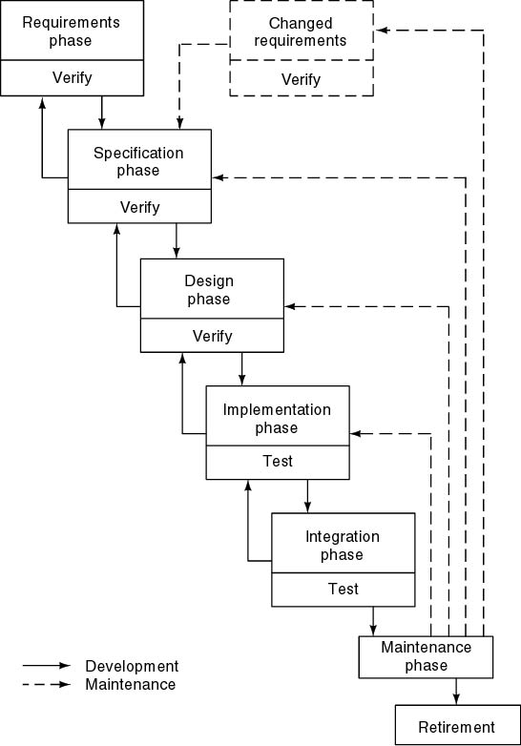
Waterfall Model
Characterized by
  Feedback loops
  Documentation-driven
  No phase is complete until
    documented
    products are accepted
  Examples of documents produced include
    feasibility study
    requirements document
    project management plan
    project timetable
    specification document
    architectural design
    detailed design ...

Slide 8
Waterfall Model
Advantages
  Simple to understand
  Discipline is enforced
  Documentation must be produced
  Testing is inherent in every phase before the project can proceed
  Maintenance is easier partly because everything is documented at each step.
Disadvantages
  Testing is often viewed as something done at the end of a phase
  Specifications are long, technical, and hard to understand
    Joe and Jane Johnson's House Example
      Architect provides great detail in technical language.
      Joe and Jane don't understand and say, "Go ahead!"
  Marberry's suits
    Buying from mail order from a written description

Slide 9
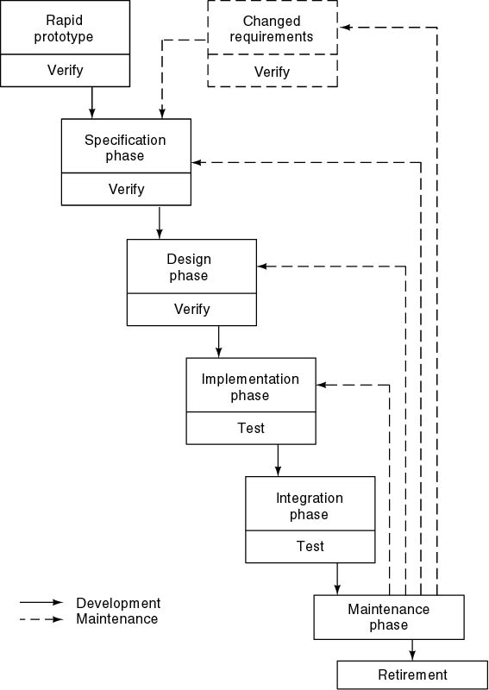
Rapid Prototyping Model
Linear model
  Less likely to need feedback loops
Prototype feeds s downstream phases
Key features
  “Rapid”
  Prototype is modified until client is satisfied with basic idea

Slide 10
Three Key Points
Do not turn the prototype into the product
Rapid prototyping may replace specification phase—never the design phase
Comparison:
  Waterfall model—try to get it right first time
  Rapid prototyping—frequent change, then discard

Slide 11
Integrated Waterfall and Rapid Prototyping Model
Waterfall model
  Many successes
  Client needs are often not met
Rapid prototyping model
  Many successes, but not as proved
  Has its own problems as we'll see later
One approach is to use
  Rapid prototyping for requirements phase
  Waterfall for rest of life cycle

Slide 12
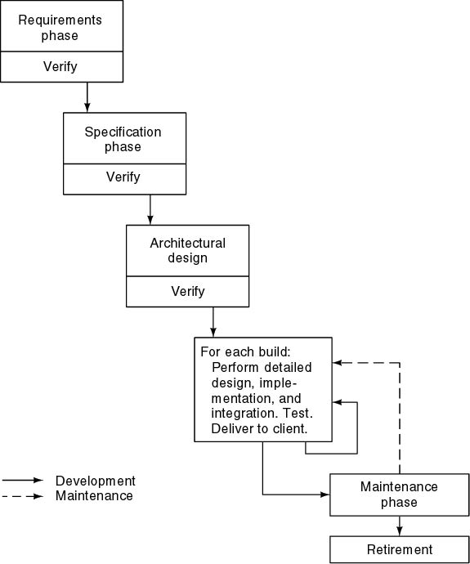
Incremental Model
Takes an engineering approach as in building a house
Divide project into builds

Slide 13
Incremental Model (cont'd)
Waterfall, rapid prototyping models
  Operational quality is complete with product at end
  Theoretically should meet all client's expectations
Incremental model
  Operational quality portion of product within weeks
  But, only a subset of the client's desires.
Less traumatic
Smaller capital outlay, rapid return on investment
Need open architecture—good maintenance implications
Variations are used in object-oriented life cycles
Problems
  Build-and-fix danger
  Contradiction in terms- view as whole while working with only part

Slide 14
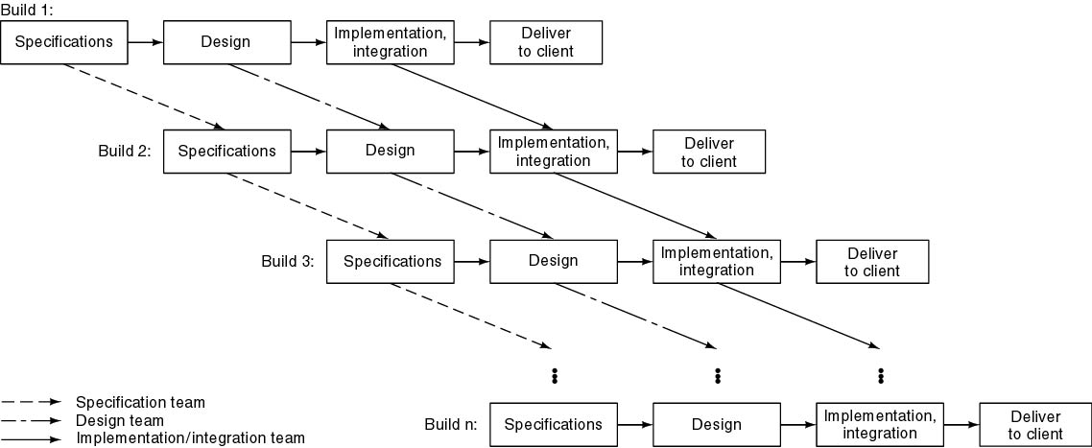
Concurrent Incremental Model
More risky version of basic incremental model
  pieces may not fit

Slide 15
Extreme Programming (XP)
Somewhat controversial new approach
Stories developed (i.e. features client wants)
Estimate duration and cost of each story
Client selects stories for next build
Each build is divided into tasks
Test cases for tasks are drawn up first and retained for the next build
Pair programming (Two per computer)
Continuous integration of tasks

Slide 16
Unusual Features Required in "true XP"
Computers are put in center of large room lined with cubicles
Client representative is always present
Cannot work overtime for 2 successive weeks
No specialization- all are capable of working on any phase
Refactoring- design modification takes place while a build is taking place---i.e. there is no real design phase
If test case fails, reorganize the code until the team is satisfied

Slide 17
Evaluating XP
XP has had some successes
  Mostly small and medium projects
    9 person-month to 100-person-year projects
Good when requirements are vague or changing- for example, in AI settings
Too soon to evaluate XP

Slide 18
Synchronize-and Stabilize Model
Microsoft’s life-cycle model
Requirements analysis—interview numerous potential customers
Draw up specifications
Divide project into 3 or 4 builds
Each build is carried out by small teams working in parallel

Slide 19
Synchronize-and Stabilize Model (cont'd)
At the end of the day—synchronize (test and debug)
At the end of the build—stabilize (freeze build)
Claim components always work together
  Get early insights into operation of product

Slide 20
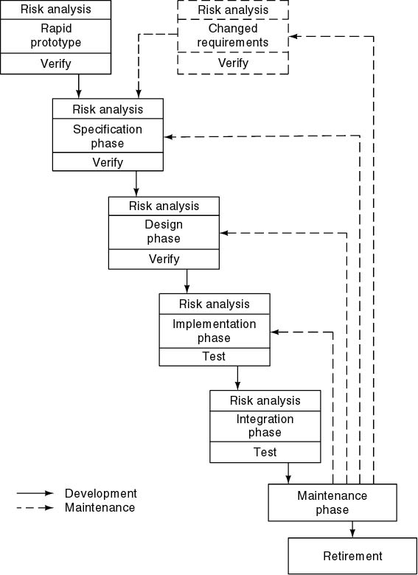
Spiral Model
Incorporates Aspects of All Models
Simplified form
  Waterfall model plus risk analysis
Precede each phase by
  Alternatives
  Risk analysis
Follow each phase by
  Evaluation
  Planning of next phase

Slide 21
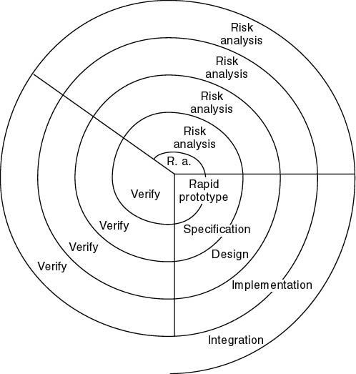
Simplified Spiral Model
If risks cannot be resolved, project is immediately terminated

Slide 22
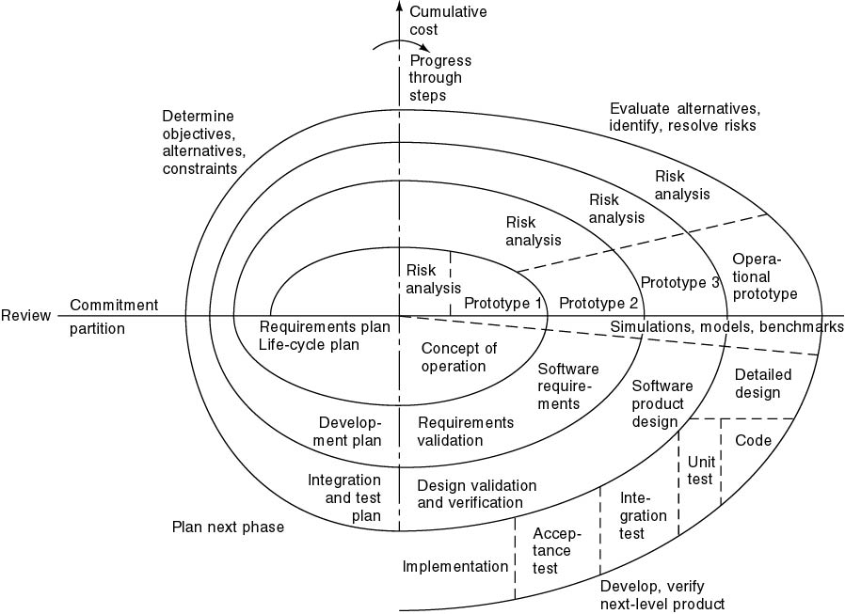
Full Spiral Model
Radial dimension: cumulative cost to date
Angular dimension: progress through the spiral

Slide 23
Analysis of Spiral Model
Strengths
  Easy to judge how much to test
  No distinction between development, maintenance
Weaknesses
  For large-scale software only
  For internal (in-house) software only
  Because driven by risk analysis and just because risk is determined, a contract cannot be broken.

Slide 24
Object-Oriented Life-Cycle Models
Need for iteration within and between phases
  Fountain model-1990 Henderson-Sellers, Edwards
  Recursive/parallel life cycle- 1993,Berard
  Round-trip gestalt-1994, Booch
  Unified software development process-1999, Jackson,Booch, Rumbaugh
All incorporate some form of
  Iteration
  Parallelism
  Incremental development
Danger
  CABTAB (code a bit- test a bit)

Slide 25
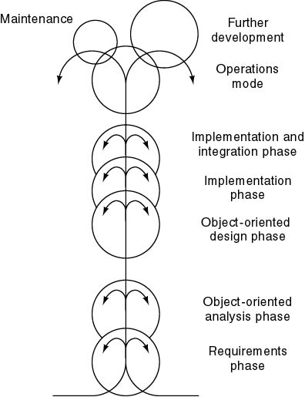
Fountain Model
Features
Overlap (parallelism)
Arrows (iteration)
Smaller maintenance circle

Slide 26
Conclusions
Different life-cycle models
Each with own strengths
Each with own weaknesses
Criteria for deciding on a model include
  The organization
  Its management
  Skills of the employees
  The nature of the product
Best suggestion
  “Mix-and-match” life-cycle model
  But, disciplined and following a plan
See a summary on pg 85 of strengths and weaknesses of different models.

