Slide 1
CHAPTER 4
TEAMS

Slide 2
Overview
Team organization
Democratic team approach
Classical chief programmer team approach
Beyond chief programmer and democratic teams
Synchronize-and-stabilize teams
Extreme programming teams

Slide 3
Programming Team Organization
A product must be completed within 3 months, but 1 person-year of programming is still needed
Solution
  If one programmer can code the product in 1 year, four programmers can do it in 3 months
Nonsense
  Four programmers will probably take nearly a year
  The quality of the product is usually lower

Slide 4




Mythical Man/Month
Why can’t we calculate team size with?
  person/months * time allocated = persons
Teams don’t scale this way because
  some tasks can be shared, others cannot
Notes:
Adding an extra programmer to a late project means everyone needs to get this person up to date and communicate with them
This makes the project even later. This is known as Brook’s Law

Slide 5
Full task sharing is a requirement for a team to be effective in decreasing time demands
If one farm hand can pick a strawberry field in 10 days, ten farm hands can pick same strawberry field in 1 day
One woman can produce a baby in 9 months, but nine women cannot possibly produce that baby in 1 month

Slide 6
Task Sharing
Unlike baby production, it is possible to share coding tasks between members of team
Unlike strawberry picking, team members must interact in meaningful and effective way

Slide 7
Programming Team Organization
Example:
  Freda and Joe code two modules, mA and mB, say.
What can go wrong?
  Both Freda and Joe may code mA, and ignore mB
  Freda may code mA, Joe may code mB. When mA calls mB it passes 4 parameters; but mB requires 5 parameters
  Or, the order of parameters in mA and mB may be different
  Or, the order may be same, but the data types may be slightly different
This has nothing whatsoever to do with technical competency
  Team organization is a managerial issue

Slide 8
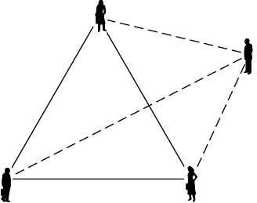
Communications Problems
Example
  There are three channels of communication between 3 programmers working on project. The deadline is rapidly approaching but the code is not nearly complete
“Obvious” solution:
  Add a fourth programmer to the team

Slide 9
Communications Problems
But other three have to explain in detail
  What has been accomplished
  What is still incomplete
Brooks’s Law (popularized in his book)
  Adding additional programming personnel to a team when product is late has the effect of making the product even later

Slide 10
Team Organization
Teams are used throughout software production
  Especially during implementation
  Here, the discussion is presented within the context of programming teams
Two extreme approaches to team organization
  Democratic teams (Weinberg, 1971)
  Chief programmer teams (Brooks, 1971; Baker, 1972)

Slide 11
Democratic Team Approach
Basic underlying concept—egoless programming
Programmers can be highly attached to their code
  They even name their modules after themselves
  They see their modules as extension of themselves
  They "own" the code- "Don't touch that!"

Slide 12
Democratic Team Approach
If a programmer sees a module as an extension of his/her ego, he/she is not going to try to find all the errors in “his”/“her” code
  If there is an error, it is termed a bug 
  The fault could have been prevented if code had been better guarded against the “bug”
  “Shoo-Bug” aerosol spray

Slide 13
Democratic Team Approach
Proposed Solution
Egoless programming
  Restructure the social environment
  Restructure programmers’ values
  Encourage team members to find faults in code
  A fault must be considered a normal and accepted event
  The team as whole will develop an ethos, group identity
  Modules will “belong” to the team as whole
  A group of up to 10 egoless programmers constitutes a democratic team

Slide 14
Difficulties with Democratic Team Approach
Management may have difficulty
  Hard to introduce into an undemocratic environment
  Is everyone truly equal (in terms of raises, evaluation, promotion, ...)???
  Approach says "Yes"
Difficult to impose either the composition or the approach from above
Few teams stay intact for long
  What happens when some members leave?
  Will new members bond with the team as well?

Slide 15
Strengths of Democratic Team Approach
Democratic teams are enormously productive
They work best when the problem is difficult
They function well in a research environment
Major problem:
  Democratic teams have to spring up spontaneously

Slide 16
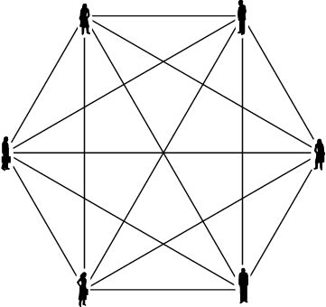
Chief programmer teams- introduced in 1971
Consider a 6-person team
  Fifteen 2-person communication channels
  The total number of 2-, 3-, 4-, 5-, and 6-person groups is 57
  The team cannot do 6 person-months of work in 1 month

Slide 17
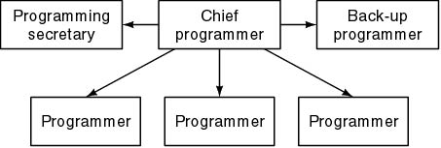
Chief Programmer Teams
Six programmers, but now only 5 lines of communication
Basic idea behind the concept:
  Chief surgeon directing operation, assisted by Other surgeons, anesthesiologists,Nurses, Other experts, such as cardiologists
Two key aspects
  Specialization
  Hierarchy

Slide 18
Classical Chief programmer teams
Chief programmer
  Successful manager and highly skilled programmer
  Does the architectural design
  Allocates coding among the team members
  Writes the critical (or complex) sections of code
  Handles all the interfacing issues
  Reviews the work of the other team members
  Is personally responsible for every line of code

Slide 19
Classical Chief programmer teams
Back-up programmer
  Necessary only because the chief programmer is human
  The back-up programmer must be in every way as competent as the chief programmer
  Must know as much about the project as the chief programmer
  Does black-box test case planning and other tasks that are independent of the design process

Slide 20
Classical Chief Programmer Teams
Programming secretary
  A highly skilled, well paid, central member of the chief programmer team
  Responsible for maintaining the program production library (documentation of project), including:
    Source code listings
    JCL
    Test data
  Programmers hand their source code to the secretary who is responsible for
    Conversion to machine-readable form,
    Compilation, linking, loading, execution, and running test cases (originally introduced in 1971, remember!)

Slide 21
Classical Chief Programmer Teams
Programmers
  Do nothing but program
  All other aspects are handled by the programming secretary
  Often fairly new to the organization and not experienced
  Allows new personnel to "learn the ropes" under mentors

Slide 22
The New York Times Project
Chief programmer team concept
  first used in 1971
  by IBM
  to automate the clippings data bank (“morgue“) of The New York Times
Chief programmer—F. Terry Baker

Slide 23
The New York Times Project
83,000 source lines of code (LOC) were written in 22 calendar months, representing 11 person-years
After the first year, only the file maintenance system had been written (12,000 LOC)
Most code was written in the last 6 months
Only 21 faults were detected in the first 5 weeks of acceptance testing
Only 25 further faults were detected in the first year of operation

Slide 24
The New York Times Project
Principal programmers averaged one detected fault and 10,000 LOC per person-year
The file maintenance system, delivered 1 week after coding was completed, operated 20 months before a single failure occurred
Almost half the subprograms (usually 200 to 400 lines of PL/I) were correct at first compilation

Slide 25
The New York Times Project
But, after this fantastic success, no comparable claims for the classical chief programmer team concept have been made
Why?
It is not unusual for "new methods" to produce a "halo effect"
What was unusual about this project? ....

Slide 26
Why Was the NYT project Such a Success?
Prestige project for IBM
  First real trial for PL/I (developed by IBM)
  IBM, with superb software experts, used its best people
Very strong technical backup
  PL/I compiler writers helped the programmers
  JCL experts assisted with the job control language

Slide 27
Why Was the NYT project Such a Success?
F. Terry Baker
  Superprogrammer
  Superb manager and leader
  His skills, enthusiasm, and personality “carried” the project
Strengths of CPT Approach
  It works if all is right
  Numerous successful projects have used, however, variants of CPT

Slide 28
Impracticality of Classical CPT
Chief programmer must be a highly skilled programmer and a successful manager
  Shortage of highly skilled programmers
  Shortage of successful managers
  Programmers and managers “are not made that way”

Slide 29
Impracticality of Classical CPT
Back-up programmer must be as good as the chief programmer
  But he/she must take a back seat (and normally this means a lower salary) waiting for something to happen to the chief programmer
  Top programmers, top managers will not do that
Programming secretary does only paperwork all day
  Software professionals hate paperwork!
Classical CPT has been found to be impractical
However, notes it works in a surgical environment

Slide 30
Beyond CP and Democratic Teams
We need ways to organize teams that
  Make use of the strengths of democratic teams and chief programmer teams, and
  Can handle teams of 20 (or 120) programmers
Democratic teams
  Positive attitude to finding faults
Use CPT in conjunction with code walkthroughs or inspections

Slide 31
Beyond CP and Democratic Teams (cont'd)
Potential Pitfalls:
Chief programmer is personally responsible for every line of code.
  He/she must therefore be present at reviews
Chief programmer is also the team manager
  He/she must not be present at reviews!
How can we handle this conflict in roles?
One answer: split the chief programmer into two people, differentiated by the roles played.

Slide 32
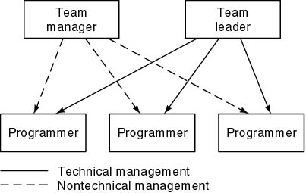
Beyond CP and Democratic Teams (cont'd)
One solution
  Reduce the managerial role of the chief programmer

Slide 33
Beyond CP and Democratic Teams
It is easier to find a team leader than a chief programmer
Each employee is responsible to exactly one manager—lines of responsibility are clearly delineated
Team leader is responsible for only technical management

Slide 34
Beyond CP and Democratic Teams
Budgetary and legal issues and performance appraisal are not handled by the team leader
Team leader participates in reviews—the team manager is not permitted to do so
Team manager participates at regular team meetings to appraise the technical skills of the team members

Slide 35
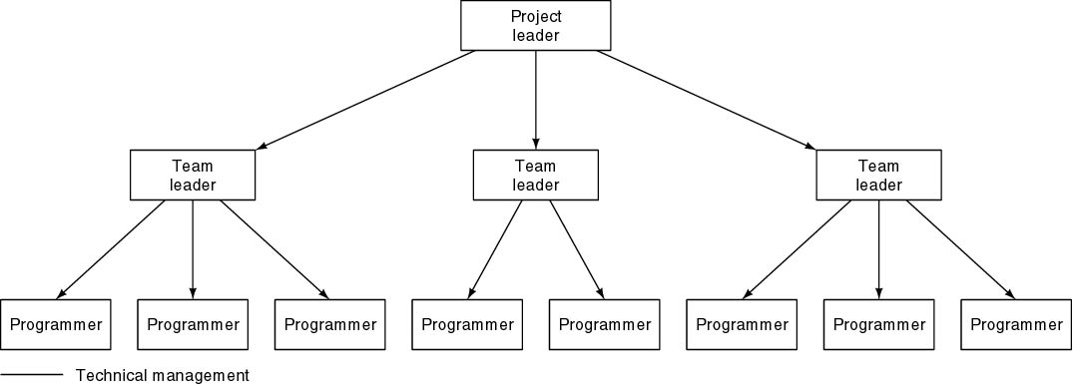
Larger Projects- Technical Side
Non-technical side is similar
For even larger products, add additional layers
Be careful- many companies call the manager the Project Leader and this one the Technical Leader.

Slide 36
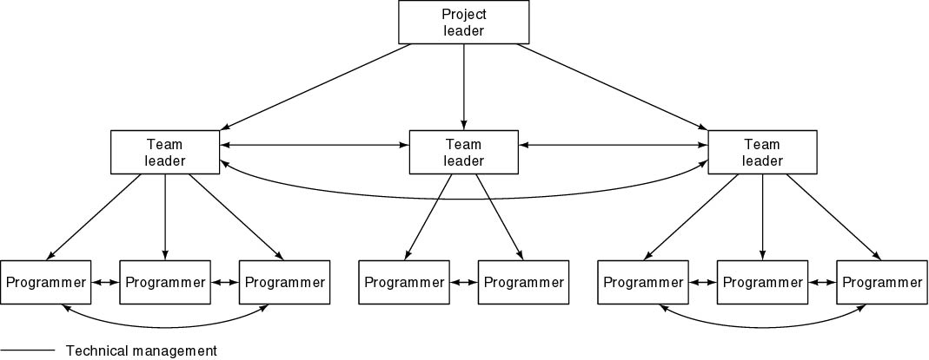
Beyond CP and Democratic Teams (contd)
Decentralize the decision-making process where appropriate
Useful where the democratic team concept works

Slide 37
Synchronize-and-Stabilize Teams
Used by Microsoft
Products consist of 3 or 4 sequential builds
Small parallel teams
  3 to 8 developers
  3 to 8 testers (work one-to-one with developers)
  Team is given the overall task specification
  They may design the task as they wish
Why this does not degenerate into hacker-induced chaos
  Daily synchronization step enforced strictly
  Individual components must work together or work continues
  Let children do what they like all day…… but with a 9 P.M. bedtime!

Slide 38
Synchronize-and-Stabilize Teams
Will this work in all companies?
  Perhaps if the software professionals are as good as many at Microsoft
  Again, more research is needed
  But, research is extremely difficult to carry out!

Slide 39
Extreme Programming Teams
Feature of XP
  All code is written by two programmers sharing a computer
  “Pair programming”
Advantages of pair programming
  Test cases drawn up by one member of team
  Knowledge not all lost if one programmer leaves
  Inexperienced programmers can learn from others
  Centralized computers promote egoless programming

Slide 40
Teams vs. Groups
Groups
  strong leader
  individual accountability
  organizational purpose
  individual work products
  efficient meetings
  measures performance by influence on others
  delegates work
Teams
  shared leadership
  individual & mutual accountability
  specific team purpose
  collective work products
  open-ended meetings
  measures performance from work products
  does real work together
Teams & good performance are inseparable
  a team is more than the sum of its parts

Slide 41
Keys to Team Success
Common commitment
  requires a purpose in which team members can believe
    “prove that all children can learn”, “revolutionizing …”
Specific performance goals
  comes directly from the common purpose
    “increasing the scores of graduates form 40% to 95%”
  helps maintain focus – start with something achievable
A right mix of skills
  technical/functional expertise
  problem-solving & decision-making skills
  interpersonal skills
Agreement
  action item assignment, when to meet & work, schedules

Slide 42
Final Remarks
There is no one solution to the problem of team organization
The “correct” way seems to depends too much on
  The product
  The outlook of the leaders of the organization
  Previous experience with various team structures
More research is needed to truly compare structures
Most of the research has concentrated on the programming teams.

Slide 43
Final Remarks
Very little research has been done on software team organization
  Instead, team organization has been based on research on group dynamics in general
Without relevant experimental results, it is hard to determine optimal team organization for a specific product

Slide 44
WHERE NOW?
At any given moment, there are often many possible projects waiting to be chosen.
The selection of which project to move forward will be an upper management decision based on many factors.
    P the need to improve performance
    I the need to improve information (and data)
    E the need to improve economics, control costs, or increase profits
    C the need to improve control or security
    E the need to improve efficiency of people and processes
    S the need to improve service to customers, suppliers, partners, employees, etc.

Slide 45
EACH OF THESE CAN GENERATE PROJECTS
    Problems are undesirable situations that prevent the organization from fully achieving its purpose, goals, and/or objectives.
    Opportunities are chances to improve the organization even in the absence of specific problems.
    Directives are new requirements that are imposed by management, government, or some external influence.
Every organization should have a well-defined strategy for selecting which projects to initiate.

Slide 46
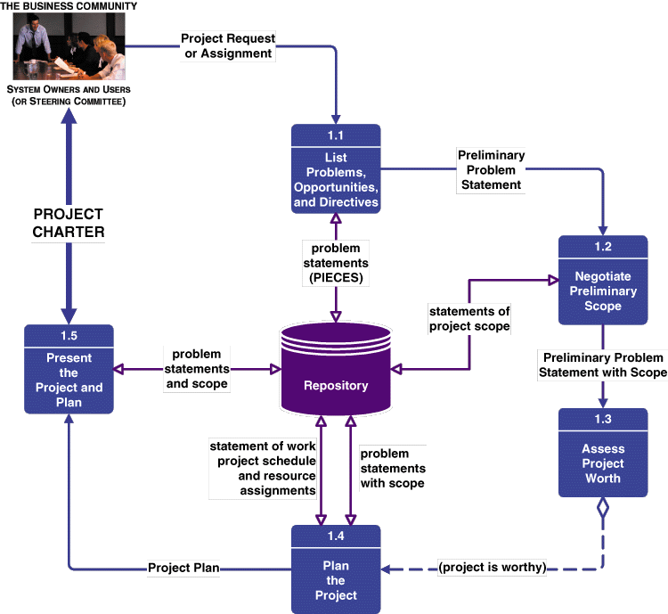
Preliminary Investigation Phase Tasks
Ref: Whitten et al, " System Analysis & Design, 5th ed., McGraw
Notes:
Teaching Notes
This is called a task diagram for a phase.
It is only a guideline. Each project will adapt these tasks to the project at hard. Tasks may be added, split, or deleted according to the methodology and route used.
The dashed line is a control flow (as contrasted to a solid data flow). In this case, it represents a decision that determines whether the next task is necessary.

Slide 47
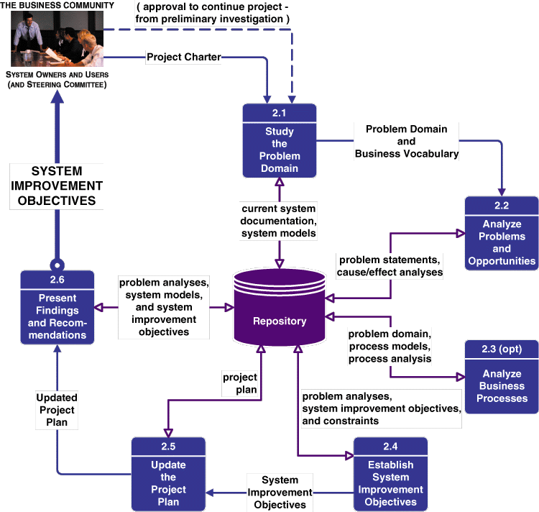
Problem Analysis Phase Context
Ref: Ibid
Notes:
No additional notes

Slide 48
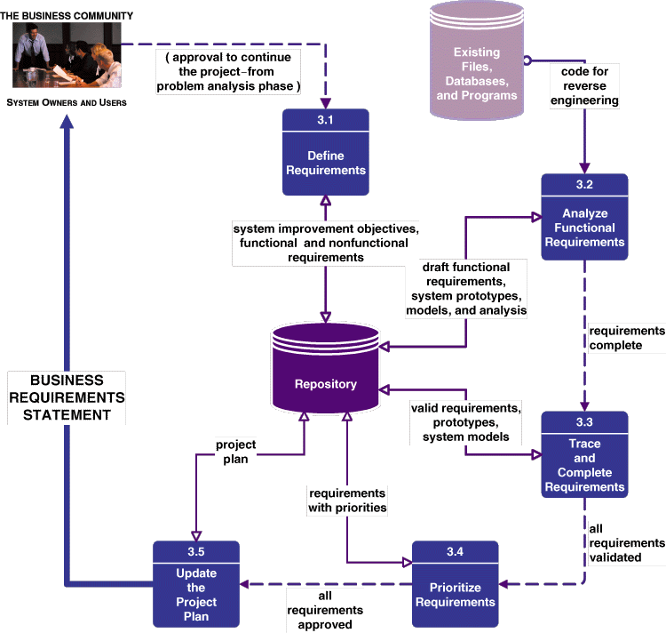
Requirements Analysis Phase Tasks
Ref: Ibid
Notes:
Teaching Notes
Some of the tasks are completed in parallel.

Slide 49
WHAT WE WILL DO NEXT
Many of the details from the first two dataflow charts are covered in the Project Management course, but we will summarize a few main points later.
We will jump to Chapter 10 and look at Chapters 10-12 next.
Don't worry. We will dip in and out of the skipped chapters at different points.
Therefore, read Chapters 10-12, 9 (in that order)

