Slide 1
CHAPTER 7
FROM MODULES TO OBJECTS

Slide 2
Overview
What is a module?
Cohesion
Coupling
Data encapsulation product maintenance
Abstract data types
Information hiding
Objects
Inheritance, polymorphism and dynamic binding
Cohesion and coupling of objects

Slide 3
Introduction to Module Design
What is a module?
  A lexically contiguous sequence of program statements, bounded by boundary elements, with an aggregate identifier
Depending on the language, a module could be a class, a function, a procedure, a package, etc.
The design of a product involves designs its modules.

Slide 4
MODULES AND DESIGN
Two designs can be functionally equivalent, but one can be
    Hard to understand
    Hard to locate faults
    Difficult to extend or enhance
    Cannot be reused in another product
Modules must exhibit certain "good characteristics":
  Maximal relationships within modules
  Minimal relationships between modules

Slide 5
Composite/Structured Design
Method for breaking up a product into modules for
  Maximal interaction within module, and
  Minimal interaction between modules
Module cohesion- want to maximize
  Degree of interaction within a module
Module coupling- want to minimize
  Degree of interaction between modules

Slide 6
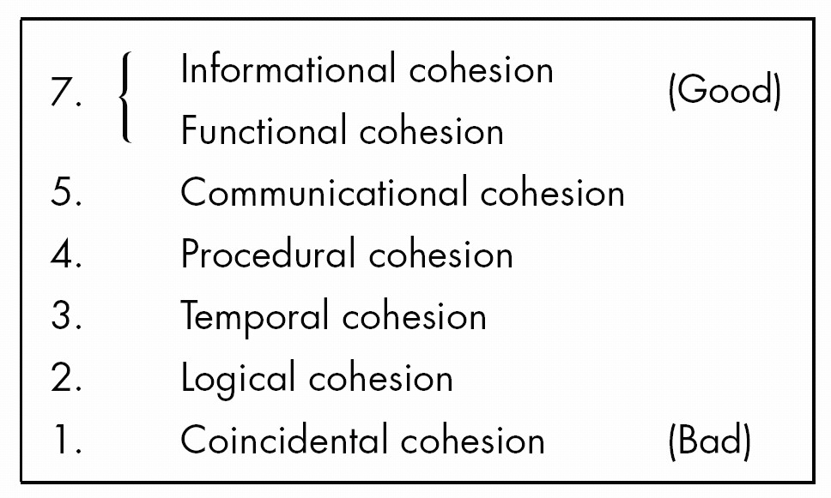
Cohesion
Degree of interaction within a module
Seven categories or levels of cohesion (non-linear scale)

Slide 7
1. Coincidental Cohesion
A module has coincidental cohesion if it performs multiple, completely unrelated actions
Example
  Print next line, reverse string of characters comprising second parameter, add 7 to fifth parameter, convert fourth parameter to floating point
Arise from rules like
  “Every module will consist of between 35 and 50 statements”

Slide 8
Why Is Coincidental Cohesion So Bad?
Degrades maintainability
Modules are not reusable
This is easy to fix
  Break into separate modules each performing one task

Slide 9
2. Logical Cohesion
A module has logical cohesion when it performs a series of related actions, one of which is selected by the calling module
Example 1
    function code = 7;
    new operation (op code, dummy 1, dummy 2, dummy 3);
    // dummy 1, dummy 2, and dummy 3 are dummy variables,
    // not used if function code is equal to 7
Example 2
  Module performing all input and output
Example 3
  One version of OS/VS2 contained a logical cohesion module performing 13 different actions. Interface contained 21 pieces of data!

Slide 10
Why Is Logical Cohesion So Bad?
The interface is difficult to understand
Code for more than one action may be intertwined
Difficult to reuse

Slide 11
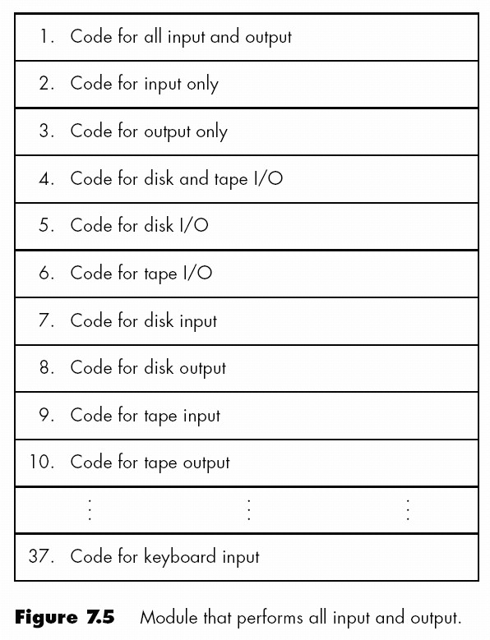
Why Is Logical Cohesion So Bad? (cont'd)
A new tape unit is installed
What is the effect on the laser printer?

Slide 12
3. Temporal Cohesion
A module has temporal cohesion when it performs a series of actions related in time
Example
  Open old master file, new master file, transaction file, print file, initialize sales district table, read first transaction record, read first old master record (a.k.a. perform initialization)

Slide 13
Why Is Temporal Cohesion So Bad?
Actions of this module are weakly related to one another, but strongly related to actions in other modules.
  Consider sales district table
Not reusable

Slide 14
4. Procedural Cohesion
A module has procedural cohesion if it performs a series of actions related by the procedure to be followed by the product
Example
Read part number and update repair record on master file
Why Is Procedural Cohesion So Bad?
  Actions are still weakly connected, so module is not reusable

Slide 15
5. Communicational Cohesion
A module has communicational cohesion if it performs a series of actions related by the procedure to be followed by the product, but in addition all the actions operate on the same data
Example 1
  Update record in database and write it to audit trail
Example 2
  Calculate new coordinates and send them to terminal
Why Is Communicational Cohesion So Bad?
  Still lack of reusability

Slide 16
6. Informational Cohesion
A module has informational cohesion if it performs a number of actions, each with its own entry point, with independent code for each action, all performed on the same data structure

Slide 17
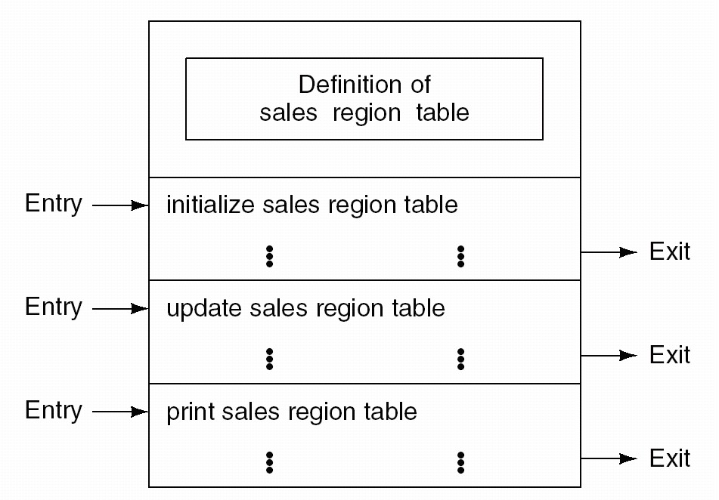
Why Is Informational Cohesion So Good?
Essentially, this is an abstract data type (see later)

Slide 18
7. Functional Cohesion
Module with functional cohesion performs exactly one action
Example 1
  get temperature of furnace
Example 2
  compute orbit of electron
Example 3
  write to floppy disk
Example 4
  calculate sales commission

Slide 19
Why is functional cohesion so good?
More reusable
Corrective maintenance easier
  Fault isolation
  Fewer regression faults
Easier to extend product

Slide 20
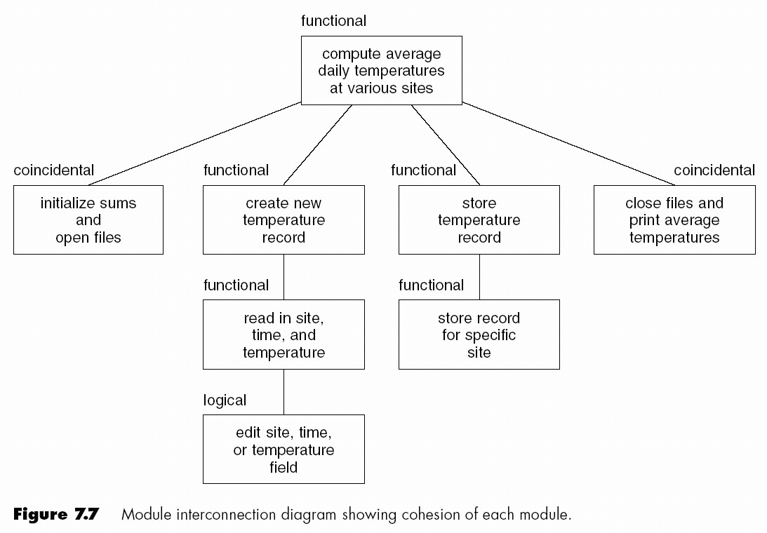
Cohesion Case Study

Slide 21
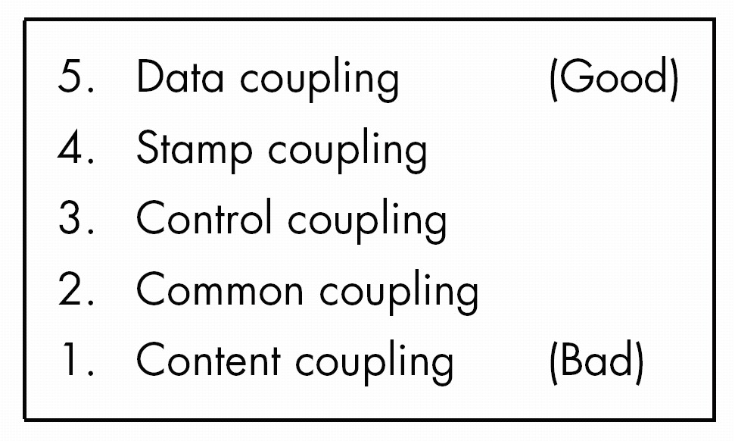
Coupling
Degree of interaction between two modules
Five categories or levels of coupling (non-linear scale)

Slide 22
1. Content Coupling
Two modules are content coupled if one directly references contents of the other
Example 1
  Module a modifies statement of module b
Example 2
  Module a refers to local data of module b in terms of some numerical displacement within b
Example 3
  Module a branches into local label of module b

Slide 23
Why Is Content Coupling So Bad?
Almost any change to b, even recompiling b with new compiler or assembler, requires change to a
Warning
  Content coupling can be implemented in Ada through use of overlays implemented via address clauses

Slide 24
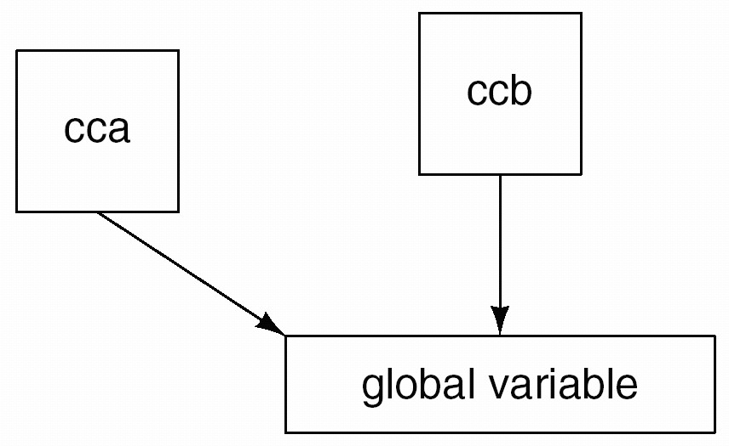
2. Common Coupling
Two modules are common coupled if they have write access to global data
Example 1
  Modules cca and ccb can access and change value of global variable

Slide 25
2. Common Coupling (cont'd)
Example 2
  Modules cca and ccb both have access to same database, and can both read and write same record
Example 3
  FORTRAN common
  COBOL common (nonstandard)
  COBOL-80 global

Slide 26
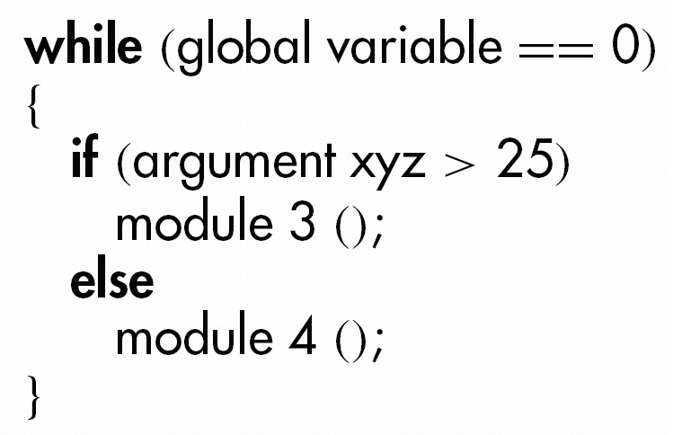
Why Is Common Coupling So Bad?
Contradicts the spirit of structured programming
  The resulting code is virtually unreadable

Slide 27
Why Is Common Coupling So Bad? (cont'd)
Modules can have side-effects
  This affects their readability
Entire module must be read to find out what it does
Difficult to reuse
Module exposed to more data than necessary

Slide 28
3. Control Coupling
Two modules are control coupled if one passes an element of control to the other
Example 1
  Operation code passed to module with logical cohesion
Example 2
  Control-switch passed as argument

Slide 29
Why Is Control Coupling So Bad?
Modules are not independent; module b (the called module) must know internal structure and logic of module a.
  Affects reusability
Associated with modules of logical cohesion

Slide 30
4. Stamp Coupling
Two modules are stamp coupled if a data structure is passed as a parameter, but the called module operates on some but not all of the individual components of the data structure
Some languages allow only simple variables as parameters
  part number
  satellite altitude
  degree of multiprogramming
Many languages also support passing of data structures
  part record
  satellite coordinates
  segment table

Slide 31
Why Is Stamp Coupling So Bad?
It is not clear, without reading the entire module, which fields of a record are accessed or changed
  Example
    calculate withholding (employee record)
Difficult to understand
Unlikely to be reusable
More data than necessary is passed
  Uncontrolled data access can lead to computer crime
There is nothing wrong with passing a data structure as a parameter, provided all the components of the data structure are accessed and/or changed
  invert matrix (original matrix, inverted matrix);
  print inventory record (warehouse record);

Slide 32
5. Data Coupling
Two modules are data coupled if all parameters are homogeneous data items [simple parameters, or data structures all of whose elements are used by called module]
Examples
  Display time of arrival (flight number);
  Compute product (first number, second number);
  Get job with highest priority (job queue);

Slide 33
Why Is Data Coupling So Good?
The difficulties of content, common, control, and stamp coupling are not present
Maintenance is easier

Slide 34
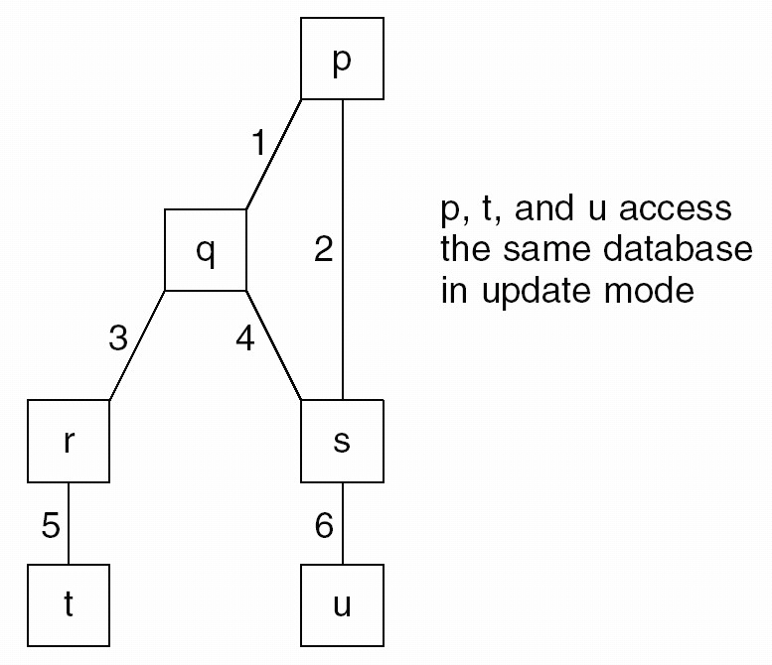
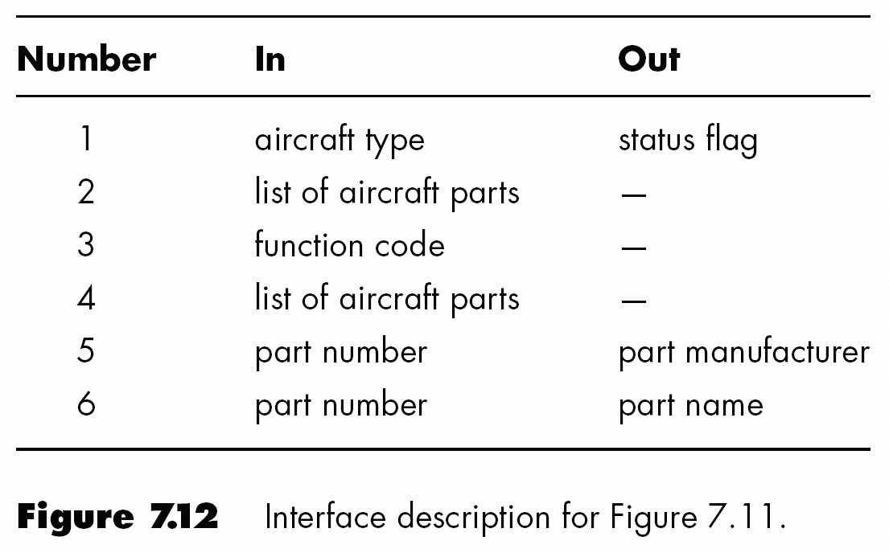
Coupling Case Study
An interface defined below

Slide 35
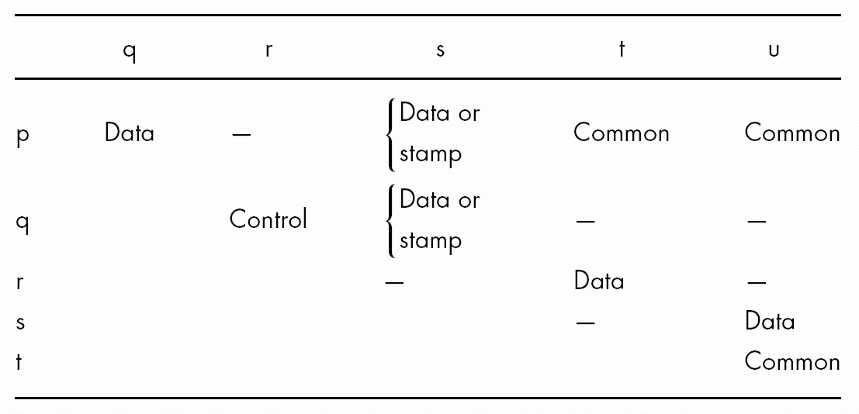
Coupling Case Study (cont'd)
Coupling between all pairs of modules
Deduced from previous slide

Slide 36
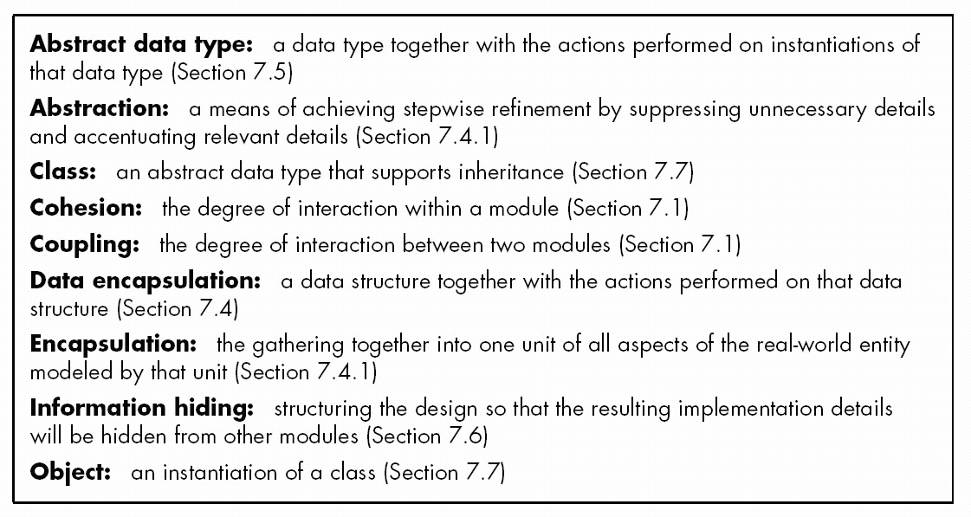
Good Design
Good design has high cohesion and low coupling
  What else characterizes good design?

Slide 37
Advantages of Objects
Same as as advantages of abstract data types
  Information hiding
  Data abstraction
  Procedural abstraction
Inheritance provides further data abstraction
  Easier and less error-prone product development
  Easier maintenance
Objects are more reusable than modules with functional cohesion

