Slide 1
Tools
Chapter 5

Slide 2
Outline
Metrics
CASE Tools

Slide 3
Software Metrics
Needed to detect & correct problems
  by analogy, what are metrics for your car?
    coolant level, gas, mpg, weight, mileage – act as early warning system!
  antidote to poor estimates, scheduling, & progress visibility
    “the only thing worse than being late is not knowing you’re late”
    focuses people’s activities on these characteristics
Classes of metric
  product metric – measure some aspect of the product itself
    e.g., size, reliability
  process metric – used to deduce information about the process
    e.g., efficiency of fault detect during development
  phase specific
    e.g., lines of code isn’t relevant until implementation

Slide 4
Fundamental Metrics
Five fundamental metrics
  cost (dollars)
  duration (months)
  effort (person-months)
  size (lines of code – LOC)
    what is wrong with using LOC?
  quality (# faults) – relative to size
    size & # faults uninteresting alone
Each must be measured by phase
There is a cost to collecting & interpreting metrics
  even with tools, still need people to interpret
  more detailed data gathering only toward a specific objective

Slide 5
Bottom Line on Metrics
Organizations with full measurement programs
  improve quality by 40%/year
  improve productivity by 15%/year (Jones 91 & 94)
  tend to dominate their industries
Cost
  4-5% of total software budget
Keys to success
  track time-level accounting data at a fine level of granularity
    break up time by phase & subtasks in phase
  start with a small set of key measurements
  don’t just collect data, analyze it & provide feedback

Slide 6
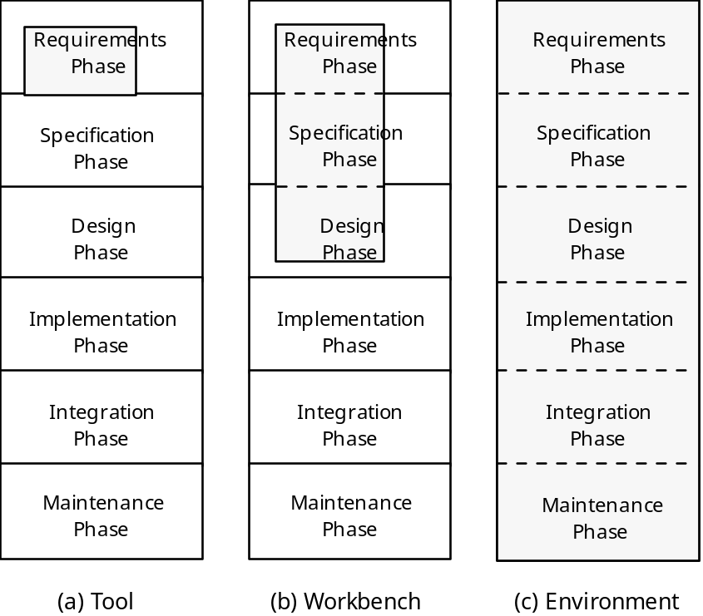
CASE Tools
Def.
  Computer-Aided Software Engineering
Tools can support entire life-cycle or a phase
UpperCASE vs. lowerCASE
  front-end vs. back-end

Slide 7
Specification & Design Workbench
Consists of
  data dictionary
    list of all data defined in the product
      variable names, types, locations defined, methods, parameters, etc.
  consistency checker
    check that every data item in the spec is reflected in the design and vice-versa
  screen & report generators
    help create the UIs (mainly for database apps)
Examples
  PowerBuilder, Software through Pictures

Slide 8
Syntax-Directed Editor
AKA Structured-Editor
“Understands” programming language
  detects syntax faults during text entry
    speeds up implementation – don’t need to wait until compile time to find these faults
  pretty printer makes it easier to find things
  online interface checking
    detect proper calls to methods (check name & args)
    again don’t need to wait until compile/link time
    editor must know name of every procedure
Important features for programming-in-the-large
  if one programmer changes interface, all calling modules must be fixed

Slide 9
Examples of Online Interface Checking
Example #1
  User enters call
    average = computeAverage (dataArray, numberOfValues);
  Editor immediately responds with message such as
    Procedure computeAverage not known
  Programmer is given two choices
    correct the name of the procedure
    declare new procedure & specify parameters
Example #2
  Declaration of q is
    void q (float floatVar, int intVar, String s1);
  Call is
    q (intVar, floatVar, s1);
  Online interface checker detects fault

Slide 10
Software Versions
During maintenance, at least two versions ?
  old version and new version
Two types of versions
  revisions
    version to fix fault in module
    cannot throw away incorrect version. Why?
  variation
    version for different operating system/hardware
    variations designed to coexist in parallel
Revisions
Variations

Slide 11
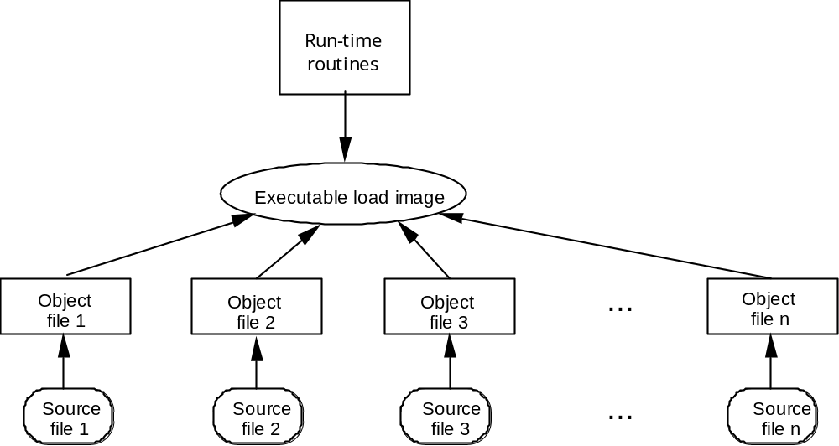
Configuration Control
Every module exists in three forms
  source code, object code, executable load image
Configuration
  version of each module from which given version of product is built

Slide 12
Version Control Tool
Essential for programming-in-the-many
  first step towards configuration management
Must handle
  updates
  parallel versions
Simple version control not always enough – maintenance issues
  two programmers working on the same module & check in one after the other (newer tools handle)
Examples
  RCS, SCCS, CVS, SourceSafe

Slide 13
Benefits of CASE Tools
Keeps specs consistent & up to date
  everyone accesses through the CASE tool
Encourage/facilitate team communication
  most have e-mail features
Productivity improvements
  survey of 45 companies in 10 industries [Myers 92]
  10% annual productivity gains, $125K/seat
Other justifications
    faster development
    fewer faults
    easier maintenance
    improved morale

Slide 14
CASE TOOL RESOURCES
http://www.cs.queensu.ca/SoftwareEngineering/tools.html
http://www.cs.queensu.ca/Software-Engineering/toolcat.html

