Slide 1
DEALING WITH 2D GRAPHICS
DISPLAYS, SCANNERS, IMAGES

Slide 2
DRAW OBJECTS
Graphics- the heart of any multimedia application.
We'll deal with some basic ideas and concepts that are independent of 2D or 3D graphics.
draw object - often called line art or vector graphics
  Classic draw objects are lines, rectangles, arcs, and curves.
  If there is an inside to the object, it can be filled with color.

Slide 3
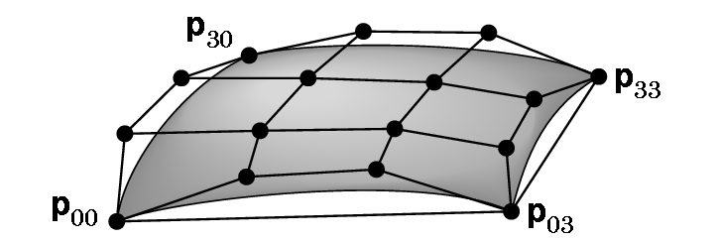
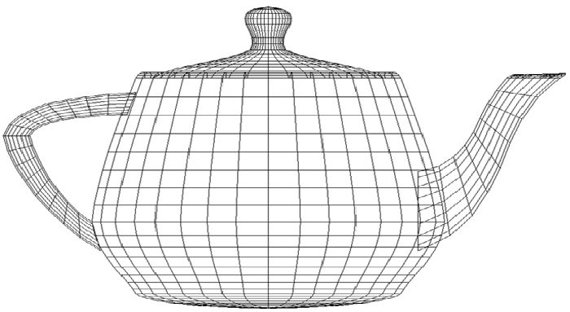
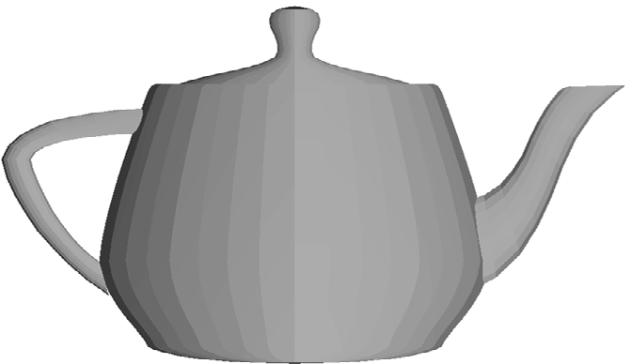
Don't assume that draw objects can't be sophisticated:
An example of a Bezier patch
Famous
teapot

Slide 4
BITMAPS
Exists only as a pattern of dots.
If a draw object is moved, it leaves a hole.
If a bitmap is moved, the dots become bigger and the image becomes cruder looking.
A bitmap can start as a draw object, and then be turned into a bitmap.
Scanner produce bitmaps.
JPEG and GIF images are bitmaps.

Slide 5
PREDICTING HOW AN IMAGE WILL LOOK
Not easy to do.
Defining an image in terms of size as we do with print images (i.e. 8 inch x 12 inch print) is not useful as we cannot predict the screen size.
Colors are displayed differently on various display devices.
We must contend with the speed of the display which is dependent on factors we can't control- speed of computing device, speed of the nets, speed of modem, etc.

Slide 6
DEFINITIONS
pixel - a picture element, or one dot, in image
  The more there are, the higher the quality of the image
dot pitch- the amount of space separating adjacent dots, given in millimeters
  The smaller the number, the finer the image-
  0.28 or smaller is good for monitor
(display) resolution- the number of rows by the number of columns for a display device
  1600 x 1200 on a 17 inch display monitor is nice
dot resolution- dpi- number of pixels per inch
  72 or 75 dpi is a typical number for a reasonable monitor display

Slide 7
SCANNERS
To show the image on a screen, 300 dpi suffices.
For printing, want a higher value - 2540 dpi may be needed.
optical resolution- level of resolution for the scan
interpolated resolution- level of resolution that the scanner's software can extract (by inserting additional dots)
Example: 300 dpi optical resolution and 1200 interpolated resolution inserts 4 times more dots

Slide 8

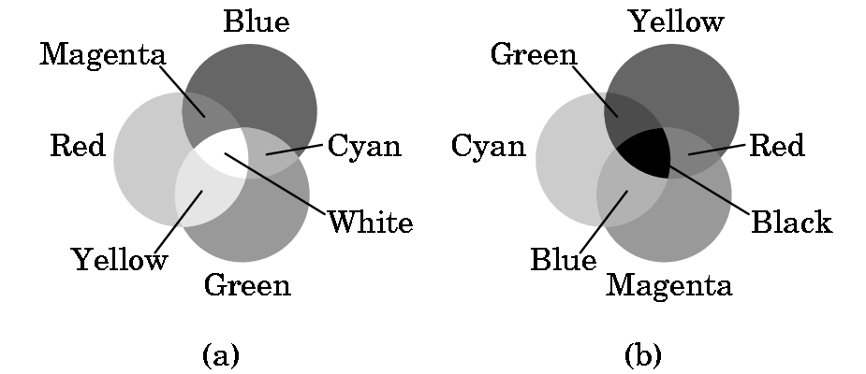
COLOR
Color graphics is based on the three-color theory or the additive model of color
This model assumes we add 3 colors (red, green and blue) as if they were spotlights on a dark floor. Note- painters use the primary colors red, yellow, and blue.
Printing uses the subtractive model.
That model assumes we subtract color from white.

Slide 9
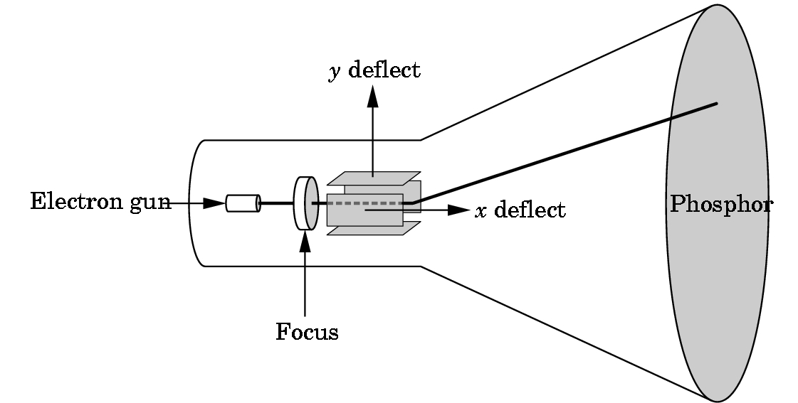
One of most common display devices- CRT or cathode ray tube
When
electrons
strike the
phosphor,
it glows

Slide 10
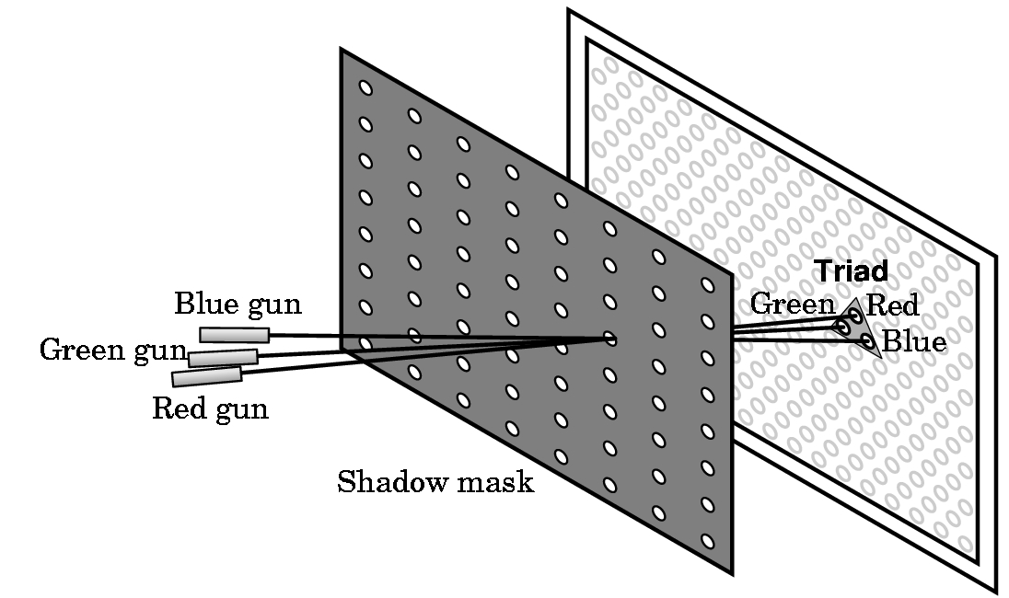
RGB (red-green-blue) shadow mask CRT

Slide 11
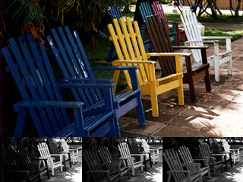
DESCRIBING COLOR
red filter green filter blue filter
Hue - color
saturation - how pure is the color
brightness - how much full power is used for each color

Slide 12
BITS - recall from CPSC 171
1 bit = a binary digit
  i.e. a 0 or 1
2 bits can represent 2²=4 numbers
3 bits can represent 2³=8 numbers
n bits can represent 2^{n} numbers
Example:3 bits
  000
  001
  010
  011
  100
  101
  110
  111

Slide 13
ONE WAY TO REPRESENT COLOR- RGB COLOR a simple example
2 bits per gun
  00 dark or off
  01 dim
  10 2/3 brightness
  11 bright
Thus, a color of 011100 gives
  1/3 red + 1 green + 0 blue
  i.e. dim red, bright green, and no blue
  i.e. perceived as yellow tint

Slide 14
CONSEQUENCES OF USING 6 BITS PER PIXEL WITH RGB COLOR
We can represent (and display simultaneously) 2⁶ = 64 colors only.
An image with a 1000 x 1000 display image resolution will require 1000 x 1000 x 6 = 6,000,000 bits = 6,000,000/8 bytes = 750,000 bytes (or roughly 750 KB)
Remember: The larger the image file, the longer time that is required to display the file.

Slide 15
SOME EXAMPLES OF GUN SETTINGS FOR COLOR
R G B
black 0.0 0.0 0.0
white 1.0 1.0 1.0
dark gray 0.25 0.25 0.25
light gray 0.75 0.75 0.75
brown 0.60 0.40 0.12
pumpkin orange 0.98 0.625 0.12
pastel pink 0.98 0.04 0.70
purple 0.6 0.4 0.7
There are lists of these available (search web).
These are gun intensities and lie between 0.0 and 1.0.

Slide 16
Another Way to Handle Color
If we say an image is an 8-bit image with indexed color, then only 8 colors can be represented. We can select which 8 colors we will use by using a LUT or lookup table. We say we are using a 3-plane graphics display.
index red green blue result
===============================================
0 00 00 00 black
1 10 00 00 medium red
2 11 00 10 reddish purple
.
.
7 11 11 11 white
Note: Different LUTs can be defined

Slide 17
The LUT size determines the number of colors that can be displayed simultaneously
Thus, a 3-plane graphics system has a 2³= 8 LUT size and can display only 8 colors simultaneously.
The palette of a device is the number of colors that can be displayed and is a function of the number of color bits stored per pixel.
In our first example, 6 bits were used (2 bits per gun, so the palette is 2⁶= 64 colors.

Slide 18
MORE ON COLOR
Low end displays are typically 8-plane devices, i.e. can display only 256 colors simultaneously.
But, palettes typically exist for 8 bits/gun---i.e. have a palette of 2²⁴= 2⁴ * 2²⁰ = 16M of colors (what is called true color in a Windows system)
Note: Number of bits/gun is what determines the size needed for the image (and the device's frame buffer) as the frame buffer must hold a copy of the image internally

Slide 19
FRAME BUFFER SIZES
Let
  r = number of rows in display
  c = number of columns in display
  b = number of bits/pixel
Then need frame buffer size of r * c * b
i.e.,
  For r = c = 1024 and b = 24, need
  24 * 2¹⁰ * 2¹⁰ = 3 * 8 * 2²⁰ = 3 M bytes per picture
Most systems are at least double buffered for speed
High end workstations have higher numbers for r, c, and the number of frame buffers

Slide 20
HOW IS THE FRAME BUFFER USED?
Picture is created in frame buffer and scanned out to the screen by deflection circuitry:
Refresh rate is given in hertz (Hz)
50-75 Hz required to avoid flicker
i.e. 50-75 scans per second
Inexpensive screens are interlaced on scan--- scan every other row for each refresh.

Slide 21
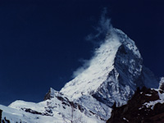
24 BIT IMAGE OF MATTERHORN
8 bits per gun- gives 256 possible values for each gun = 256³ =16,777,216 possible colors
More colors than the eye can distinguish
If 200 x 150 pixels, size of image is 30,000 x 3 bytes or ~90KB

Slide 22
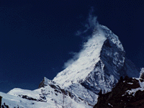
8 BIT IMAGE
Takes the most used 256 colors and maps entire picture to those colors.
Called an adaptive palette
Uses indexed color instead of RGB color.
Image of 200 x 150 pixels is now of size
200 x 150 x 1 bytes =
30,000 bytes =
30KB

Slide 23
WHAT IS LOST?
24 bit
8 bit

Slide 24
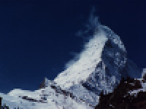
CAN JUST CUT IMAGE SIZE
100 x 75 pixels
But when enlarge, you see distortion.

Slide 25
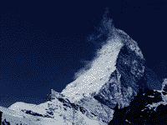
3 BIT IMAGE
Now have only 8 colors available.
Colors that can't be shown are shown as randomly scattered dots- called dithering

Slide 26
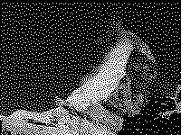
1 BIT IMAGE
Monochrome image.
Dithering is used to make up image.
Note how disturbing it is.
File size is about 3 KB.

Slide 27
HOW MANY COLORS DO WE NEED?
24 bits allows 16,777,216 colors.
The human eye can only distinguish ~10,000,000 colors so 24 suffices for screen.
Scanners typically scan at 10 or 12 bits per color, yielding 30 or 36 bits. Done so the color rendition can be adjusted on the screen to make the colors look natural.
The gamma of a device is the relationship between the brightness of the original (the input to the device) and the way the signal is displayed by a monitor or on a printed page (the output of the device).

Slide 28
GAMMA
Every display device has a gamma, and PC, television sets, and MACs have different gammas.
This is why an image made on a MAC will not necessarily look good on a PC, or vice versa.
You can adjust the gamma of an image, but working with only 24-bit colors results in some colors disappearing---try using PhotoShop's "level" facility.
PNG is a new 48-bit Web format. Changes in the gamma can be done nicely with it.

Slide 29
HOW ABOUT SHADES OF GRAY?
The eye can distinguish between 256 shades of gray.
But, this does not suggest that 256 shades suffice as the eye is extremely sensitive to the transition between very similar shades.
However, 256 gray shades is usually considered "good enough" for most images.
For color images, usually somewhere between 16-bit and 24-bit is considered good enough.

Slide 30
CUSTOMIZED COLOR
If trying to reproduce art, might wish to use indexed color techniques.
Example: Reproducing Monet- use a lot of pastel shades in pink and blue. Don't need bright colors.
Often using a 256 color set will produce images indistinguishable from a full 24-bit image.
As a designer, you need to know how your choices will impact your image on different display devices.

Slide 31
TAKING LESS SPACE
Large files can require
  High download times
  High storage requirements
  Strains on networks
Methods for reducing the amount of space include
  Degrade the image by reducing the number of pixels
  Change the color depth of the image
  Compress the file to a format that will allow the smaller file to be displayed

Slide 32
COMPRESSION---GRAPHICS
compression- in computing, this always means reducing the amount of data needed to carry information. Also called bit rate reduction.
Many compression algorithms exist:
  lossless compression- the original can be retrieved from the compressed file without any changes or errors
  lossy compression- the original cannot be retrieved from the compressed file

Slide 33

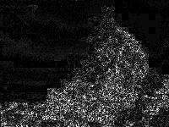
JPEG COMPRESSION

