Slide 1
MULTIMEDIA BUILDING BLOCKS
3D MODELING AND ANIMATION
The Basics

Slide 2
3D MODELING- DEPTH CUES
Definition: Processes used to create an object that appears to be 3 dimensional in a computer application
These processes provide an illusion that the image is 3 dimensional.The processes have been known for years to artists.
Examples include the use of :
  shadows
  reflections
  shading
  lighting
  highlights
  fogging effects
  size
  various projections

Slide 3
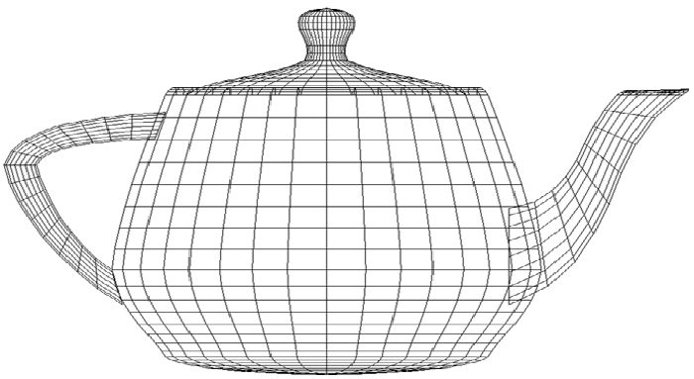
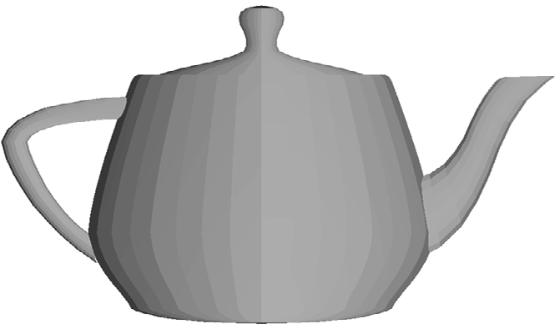
VISIBILITY
Most objects are modeled with polygons as polygons are easier to generate with a computer than curves. Recall the teapot.
Obtaining depth cues via visibility requires hidden surface algorithms that eliminate lines and surfaces.
A wireframe teapot
shows limited depth.
A filled in image provides
more depth cues.

Slide 4
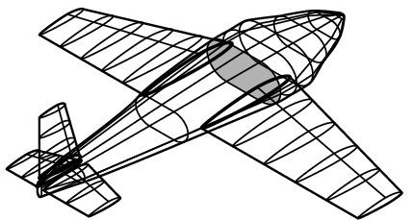
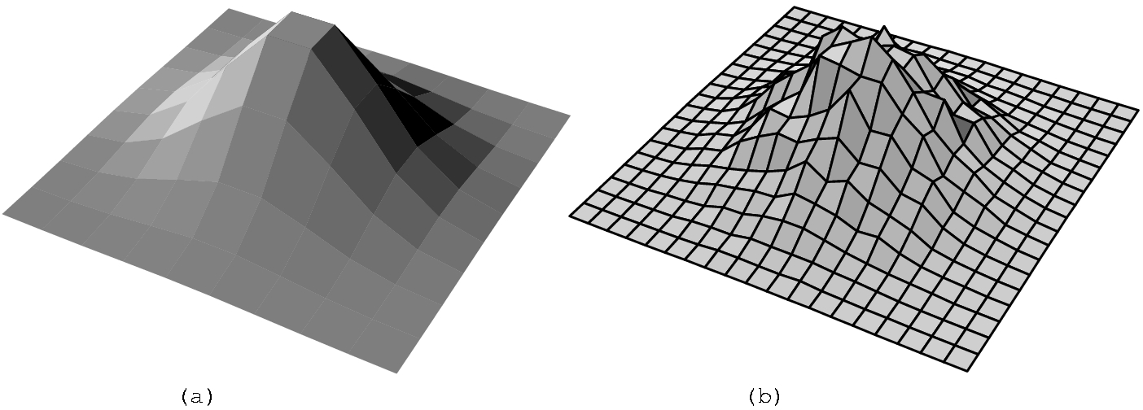
FURTHER EXAMPLES

Slide 5
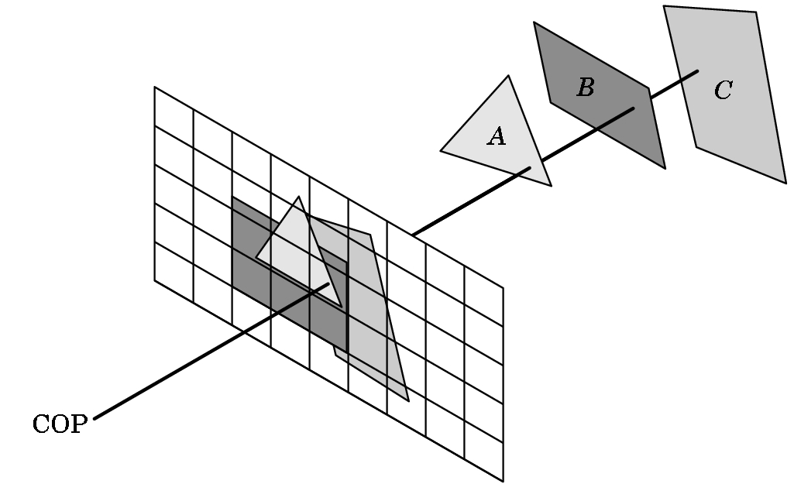
HIDDEN SURFACE REMOVAL
The Basic Idea
COP = Center of the projection- location of the eye
The mesh is the viewing plane
Objects A, B, and C are projected onto the viewing plane
The viewing plane is rendered on the display device, i.e. a screen.

Slide 6
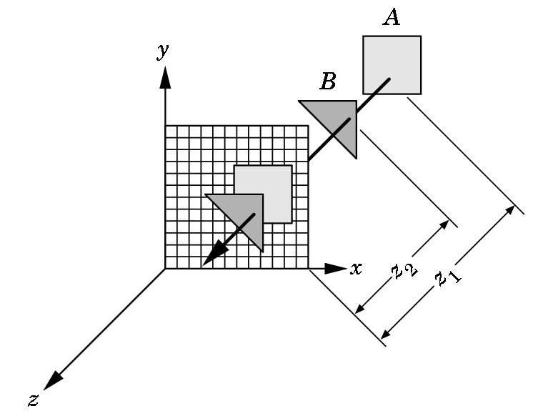
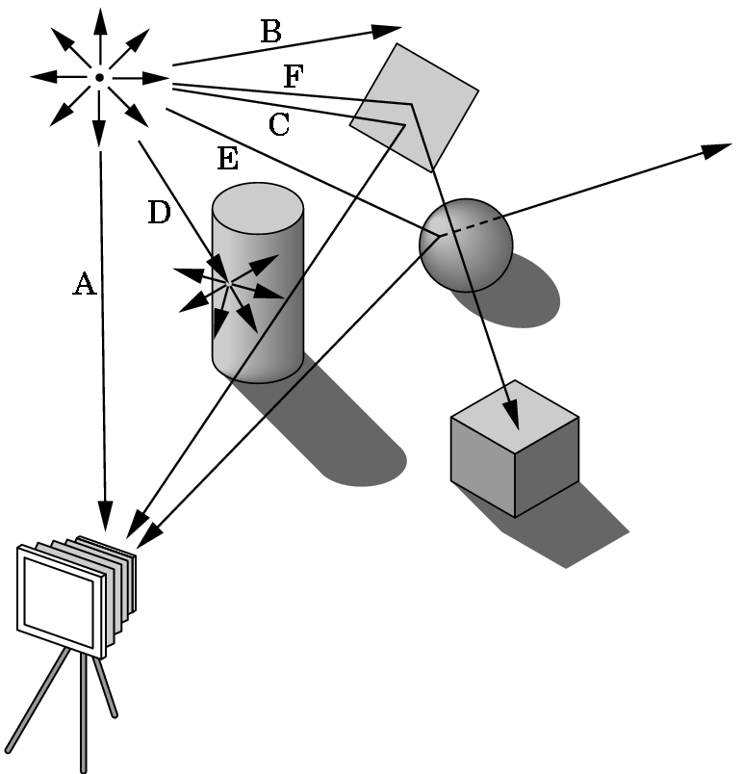
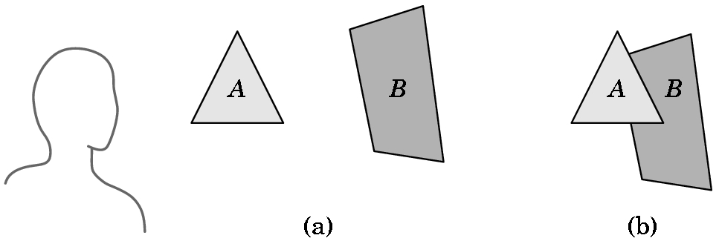
WHICH OBJECTS ARE VISIBLE IS A FUNCTION OF THE RENDERING ALGORITHM USED
z-buffer painter's ray-tracing
3 COMMONLY USED ALGORITHMS

Slide 7
Z-BUFFER ALGORITHM
Requires extra memory in addition to the usual frame buffer.
Normally a frame buffer stores only
(x,y) - location information for the screen
color information for the screen.
With this algorithm, it stores the depth (z-value) as well.

Slide 8
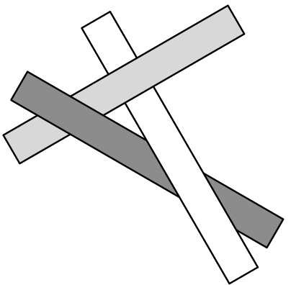
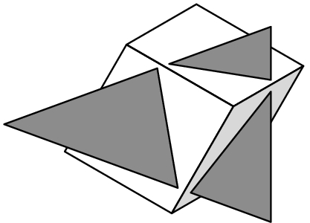
EACH ALGORITHM CAN HAVE PROBLEMS WITH SOME OBJECTS

Slide 9
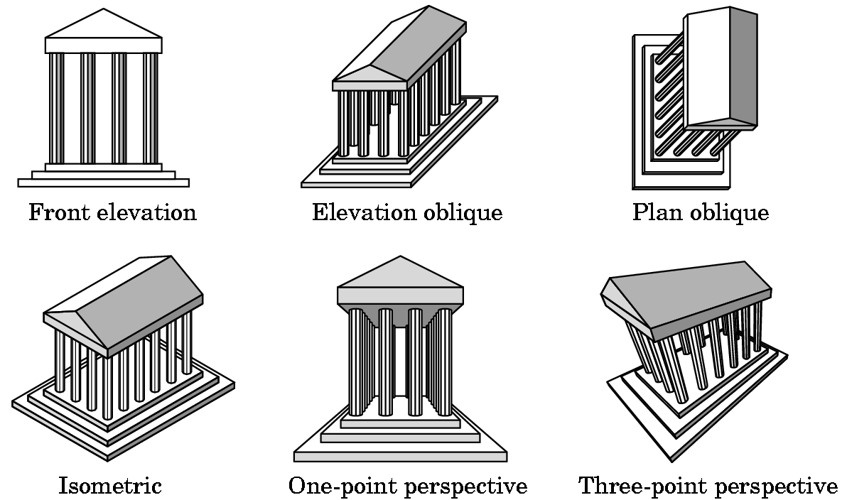
A PROJECTION PROVIDES DEPTH CUES
There are many different kinds of projections.
A one-point perspective projection is commonly used
in painting.

Slide 10
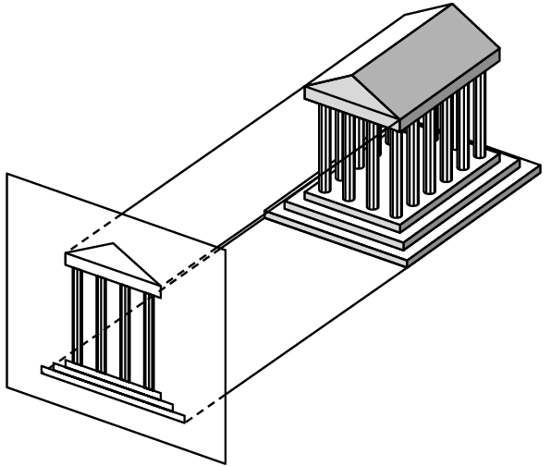
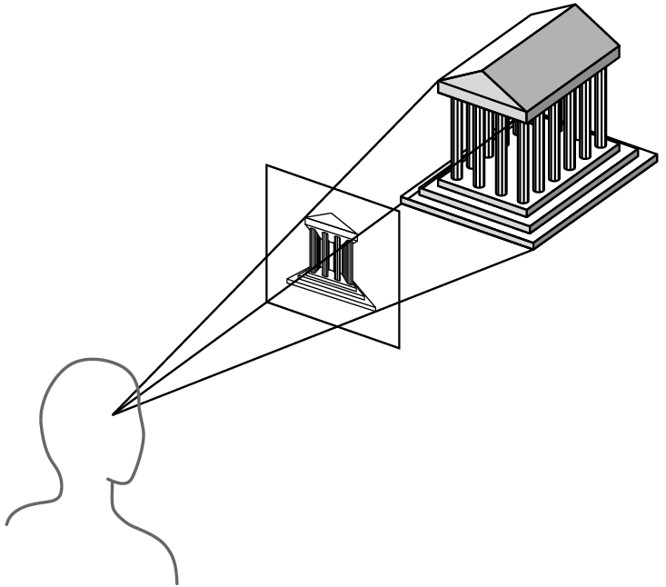
HOW A PROJECTION IS OBTAINED
Orthographic Projection
Used in architect drawings
and CAD-CAM--- anytime
you want to preserve lengths
and angle sizes.
Perspective Projection
Most commonly used by painters and artists.
What most people view as
realistic.

Slide 11
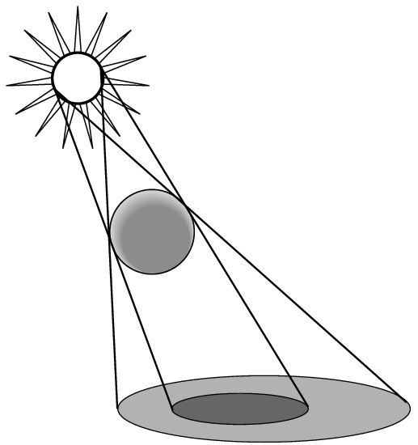
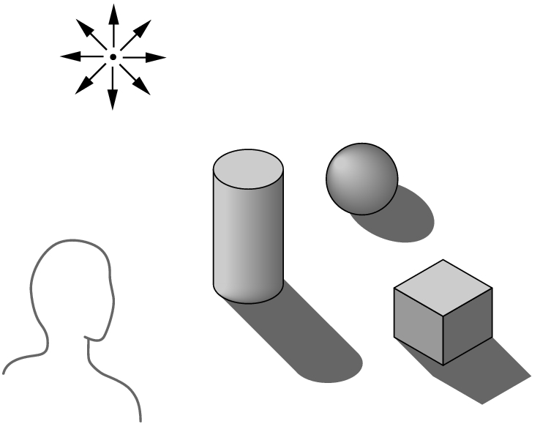
SHADOWS
Without shadows, objects seem to float above their supporting surface.
Shadows add realism to an image as well as depth cues.
The difficulty (or ease) of providing shadows depends upon which algorithms are used to render the scene.
With z-buffer algorithm,we just reproduce appropriate parts of the object in the appropriate spots.

Slide 12
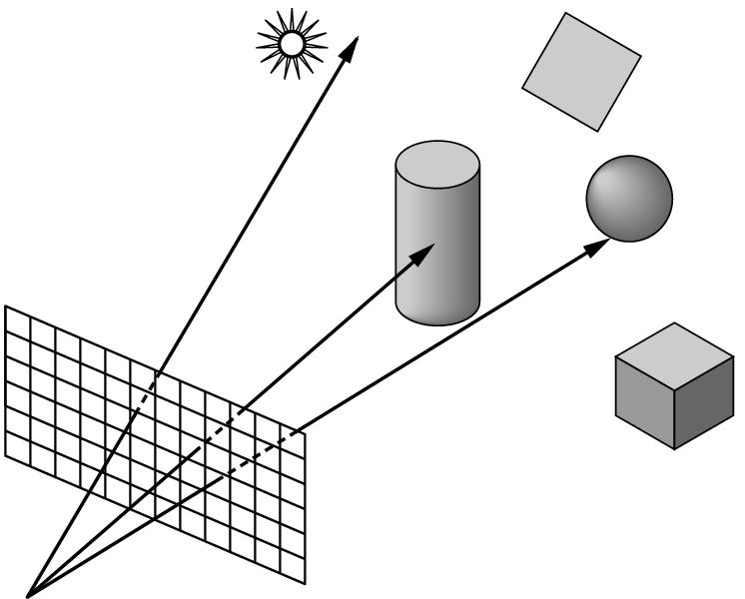
RAY TRACING CAN EASILY PRODUCE SHADOWS
But, casting rays from a light source can be a waste of computing power.
Most rays don't ever reach the eye.
Instead, from the eye, we cast one ray for each pixel. Each ray either intersects an object, hits the light source, or goes to infinity.

Slide 13
RAY TRACING- Changing the direction of the cast.
If the ray goes to infinity, it should receive a background color.
If the ray intersects an object
then we must calculate a shade for the point of intersection.
But what is seen, depends upon the relationship between the object and the light source so we use shadow rays...

Slide 14
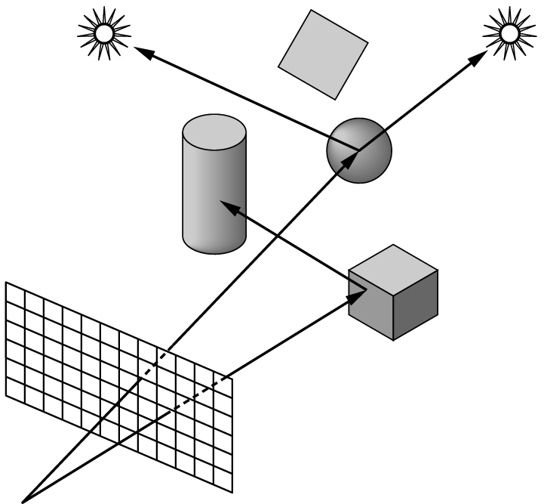
SHADOW RAYS
If a shadow ray intersects an object before it hits a light source, then the light is blocked and the point is in shadow from that source.
If the surface is opaque and doesn't scatter light, we have our shadow areas identified.
Shadow rays are also called feeler rays.

Slide 15
REFLECTIONS
Very easy to do if ray tracing:
Shoot a ray and see what it hits.
If nothing, color as background.
If hit something, project the ray towards a light source.
If another object is hit, the original one is in a shadow.
If the object itself is hit, then the pixel is on the dark side of the object.
If nothing else is hit, we must decide how to color the pixel based on certain properties of the object...

Slide 16
COLORING THE PIXEL
We need to see how lighting is handled in 3D graphics in order to see how a pixel is colored.
Light is categorized as directional or ambient.
Directional light: Comes directly from a light source.
Ambient light: Light reflected from other surfaces and comes from all directions. Only outer space scenes have no ambient light.
Although directional light casts shadows, scenes with strong ambient light will have shadows also.

Slide 17
LIGHTING
When light strikes an object, some of it is reflected and the rest is absorbed as heat.
For example, a red surface absorbs all of the light components except the red ones which are what your eye sees. Color is really a reflection property.
We separate reflected light into two types
diffuse -- light that scatters in all directions; gives an object its color
specular-- light reflects in a specific direction' and provides highlights on an object.

Slide 18
DIFFUSE REFLECTOR
BRIGHTNESS DEPENDS UPON:
The components of white light it reflects.
The strength of the ambient and direct light striking the surface.
The position of the direct light sources.
The orientation of the reflecting surface relative to the direct light source.
The type of surface.
Matte surfaces such as flat paint and ordinary paper
are predominately diffuse reflectors.

Slide 19
SPECULAR REFLECTOR
BRIGHTNESS DEPENDS UPON:
The strength of directional light sources.
The position of directional light sources.
The orientation of the surface with respect to the light sources,
The position of the viewer.
The surface roughness.
A mirror is an example of a perfect specular reflector.
Shiny plastic exhibits both diffuse and specular reflection,
but the specular component is high.

Slide 20
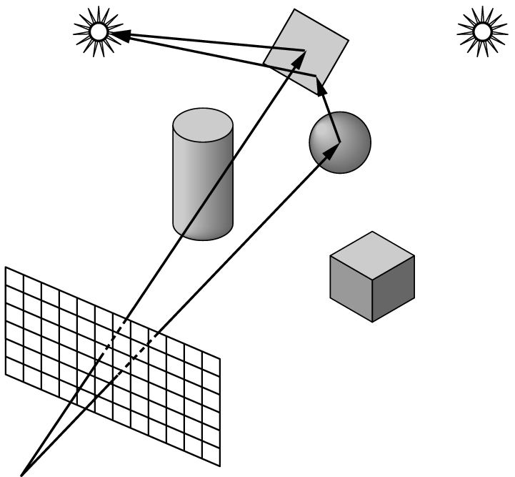
REFLECTIONS WITH RAY TRACING
If a surface is highly reflective, the cast shadow ray bounces from surface to surface until it
goes to infinity or intersects a source.
Calculations take into account the absorption of light as surfaces.

Slide 21
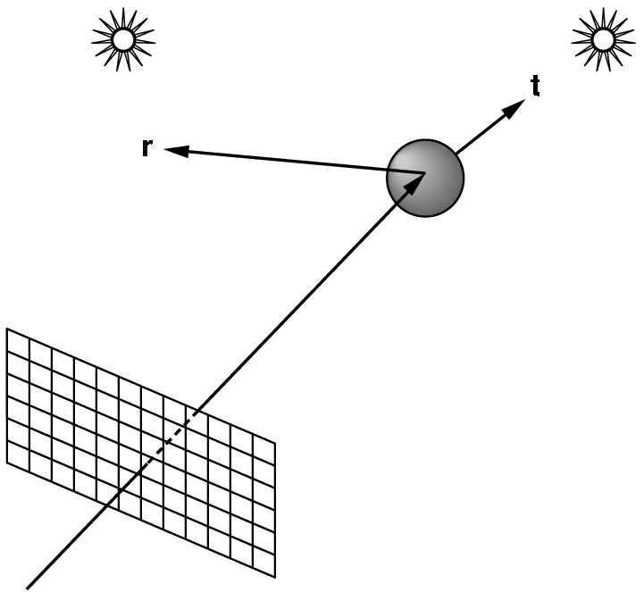
REFLECTIONS & TRANSMISSION WITH RAY TRACING
Assume the light is partially
absorbed and contributes to
the diffuse reflection. The rest of the light is split between a transmitted ray t and a reflected ray r.
These new rays are treated just like the original ray.

Slide 22
ALGORITHMS
The lighting model used by graphics software determines which color computations are performed.
Shading algorithms dictate how often the color computation is performed. There are basically 4 types:
  Constant shading
  Faceted shading
  Gouraud shading
  Phong shading
Recall that most objects are a collection of polygons.
These models are used by non-ray-tracing software, also.

Slide 23
SHADING ALGORITHMS
Constant shading
  simplest, but not realistic
  give same color to every polygon
Faceted shading
  determine orientation
  do one color computation per polygon
Gouraud shading
  averages color over intersecting polygons
  blends color along the edges of polygons by interpolation
Phong shading
  does a color calculation for every pixel based on the lighting model used
Quess which is the most realistic;
the most expensive.

Slide 24
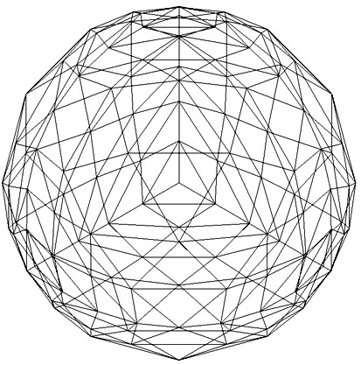
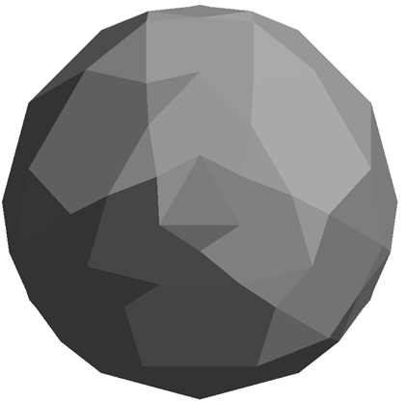
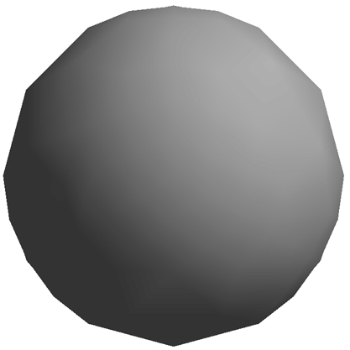
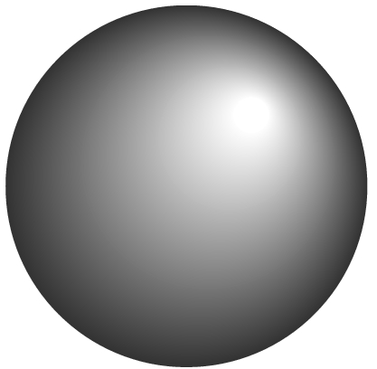
SHADING ALGORITHMS
wireframe
faceted
Phong
Gouraud

Slide 25
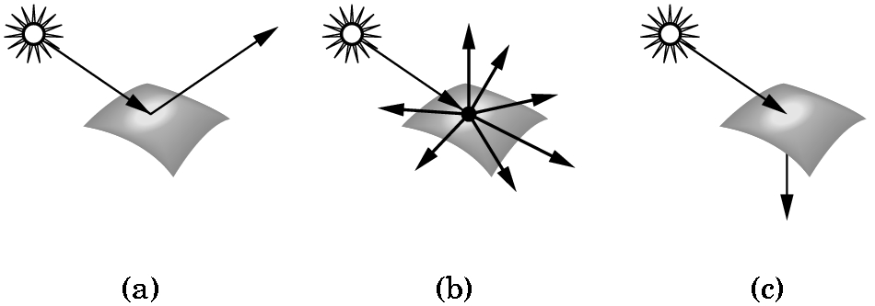

LIGHT-MATERIAL INTERACTION
(a) specular surface
(b) diffuse surface
(c) translucent surface
Contrast
opaque surface vs
translucent surface.

Slide 26
RADIOSITY
Radiosity: The production of soft shadows where a colored object picks up some color from surrounding objects.
For example, objects in a room with red walls will pick up a little extra warm color.
We say the walls bleed their color onto other objects in the room.
The radiosity algorithm is computationally intensive and is based on thermal heat transfer type calculations.

Slide 27
TEXTURE MAPPING
Computer images can look artificial because they lack the details we see in real life.
Walls in images look
smooth and clean
while real walls reflect of history of
scuff marks
spots
bumps in plaster
etc.
Texture mapping adds interest to our images with either
raytracing or z-buffering.

Slide 28
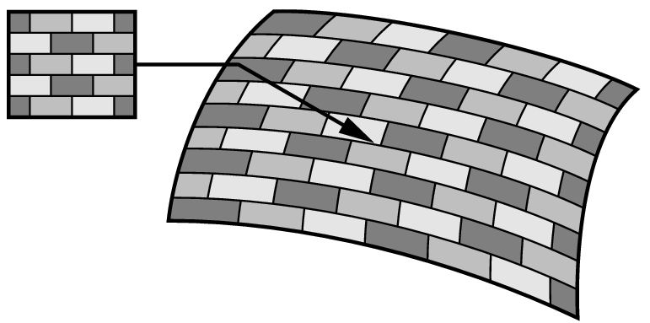
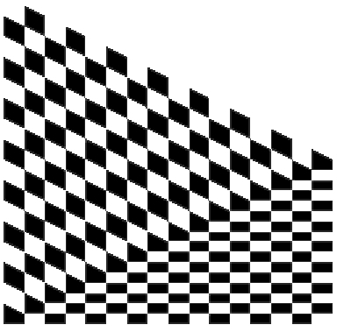
TEXTURE MAPS- 2D => 3D
Almost any source can be used
  scanned photographs
  images created in paint or drawing package
  captured video
  rendered graphics
The texture is wrapped around an object:

Slide 29
BUMP MAPPING AND ENVIRONMENTAL MAPS
Texture mapping uses a pattern to determine the color of an object.
Bump maps distort the shape of a surface to produce realism --- i.e. add bumps on an orange.
Environmental maps are mappings of what appear to be reflections onto objects to allow z-buffer rendered objects to look like ray-traced objects.

Slide 30
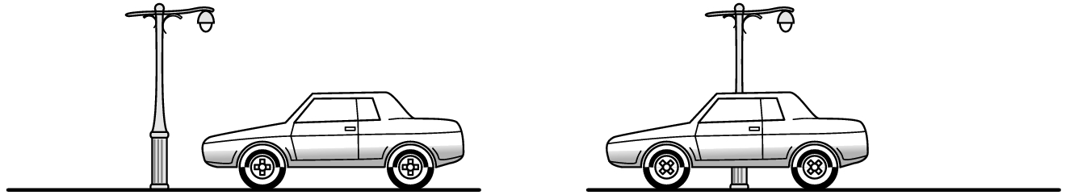
ANIMATIONS
Animations are just the rendering of frames of image at a rapid enough rate that the eye perceives the change as motion.
Movies are typically shown at the rate of 24 images per second.
VCRs use 30 images per second.
The megahertz rating of a monitor specifies its research rate:
I.e. 60 MHz = 60 refreshes per second.

Slide 31
ANIMATIONS
Speed is critical when doing animations.
If the animation is going on film, the animation need not be done in real time.
But, if the animation is part of a live presentation, speed becomes critical.
After playing around with some of the basics introduced, we'll look at the cost of doing all these things.

