Slide 1
FILE FORMATS
GRAPHICS AND VIDEO

Slide 2
History
1839: Daguerreotype Cameras
1893: Telephone Audio Broadcasting (Puskas)
1895: Wireless Communication (Marconi, Popov)
1895: Film Presentation (Lumiere Brothers)
1919: Radio Broadcasting (Holland, Canada)
1934: US establishes FCC
1935: TV Broadcasting (Germany, Britain)
1941: US black and white TV

Slide 3
History (cont.)
1951: Videotape Recorder (Bing Crosby Enterprises)
1953: US Color TV (NTSC)
1963: Geostationary Satellites
mid ‘70s: Fiber Optic Transmission - cable
1985: FCC establishes ATSC - standard by 1993?
1989: Analog HDTV Broadcasting (Japan)
1996: ATSC Standard Adopted

Slide 4
HISTORY TIMELINE WAS QUITE SELECTIVE-- could include:
Invention of telephone
Founding of ATT
First radio networks/stations
First cable system,
First consumer VCR
Direct TV
First HTDV broadcasts

Slide 5
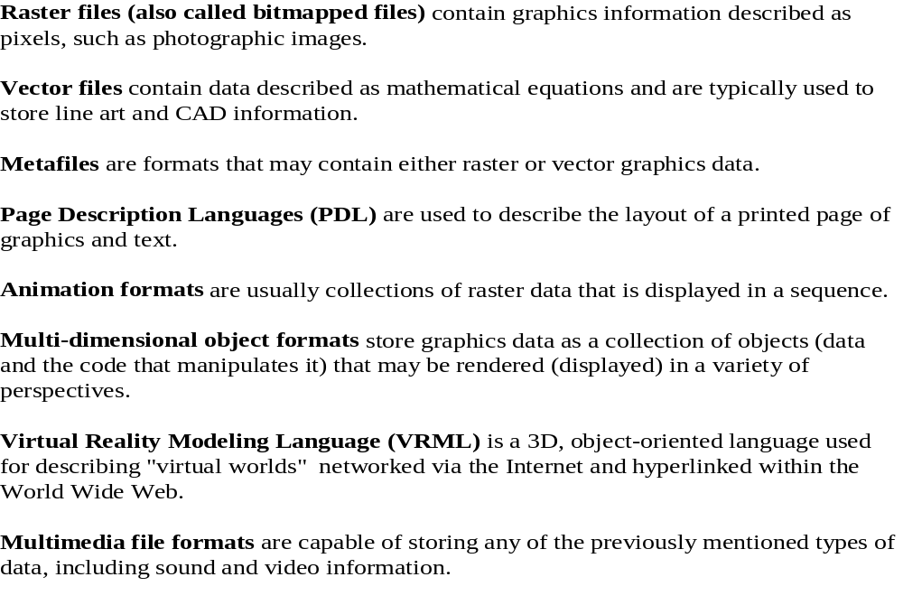
THERE ARE MANY KINDS OF FILES

Slide 6
USUALLY, FOR YOUR GRAPHICS APPLICATION
The destination will be
  a CD-ROM
  a DVD-ROM
  the Web
  possibly film or tape
Many tools exist for creating
Regardless of destination or tool used, want the smallest file possible for storing your images.

Slide 7
CODECS
A codec is software that compresses and decompresses files by utilizing a compression-decompression algorithm.
There are many, many codecs and all are designed for different purposes.
There are some general categories that handle different types of file formats:
  flat file formats - provide a snapshot of a scene
  digital video and animation formats - provide multiple
  snapshots in a sequence to produce motion
  audio file formats - provide sound

Slide 8
COMPRESSION-DECOMPRESSION
Many of the algorithms are copyrighted and to use the
algorithm, not the product of the algorithm, in software you write, you must pay a licensing fee whether or not you distribute your software free or charge for it.
If you "break" software that does the compression and
decompression and distribute it, you are violating the
copyright.
There have been several major court cases over these issues.

Slide 9
HOW DOES COMPRESSION-DECOMPRESSION WORK?
Here's a VERY simple example of compression:
Suppose we want to compress the string:
aaaaaaccccccccccccddddddddeeeeeeb
We could write this as
6a12c8d6e1b
Decompression is easy if we assume there are no numbers in the string.
Obviously this won't handle all textual material as you couldn't handle numbers--- is 12 twelve, or one 2?
Note the 1b requires more space than the original b, but for the other substrings, there is a size reduction.

Slide 10
FLAT-FILE FORMATS
MOST COMMON ONES- mentioned in test
JPEG- Joint Photographic Experts Group
  Supports high color and image resolution
  Consumes little file space
  Offers a choice of the percentage of full qualityin which you want to store the image
  Very good file compression --- i.e. small file usually results
  Lossy compression --- i.e. some quality is lost
  Used by many web applications
BMP- Windows Bitmap
  Not a compression format so full quality.
  Just an image displayed as an array of colored dots or pixels in the Windows environment.

Slide 11
FLAT-FILE FORMATS
MOST COMMON ONES- mentioned in test
TIFF-Tagged Image File Format
  Used by both Windows and Macs
  Another non-compressed, full quality format
  Good for maintaining the fidelity of an image when doing a scan, for example.
GIF- Graphics Image Format
  Defined by Compuserve
  A compression format that uses the LZW (Lempel-Ziv-Welch) compression algorithm that is quite sophisticated.
  Has been the center of a lot of lawsuits.
Specs say GIF is pronounced "jif" as in "jiffy"; but many pronounce it with the hard "g" as in "graphics"!

Slide 12
FLAT-FILE FORMATS
MOST COMMON ONES- mentioned in test
TGA- Targa
  Strange that this one is listed
  The TrueVision graphics display adapter which first used it.
  Used by postscript files which are not used much outside of the academic and scientific communities.
Don't get the idea that these are the only flat-file formats around !

Slide 13
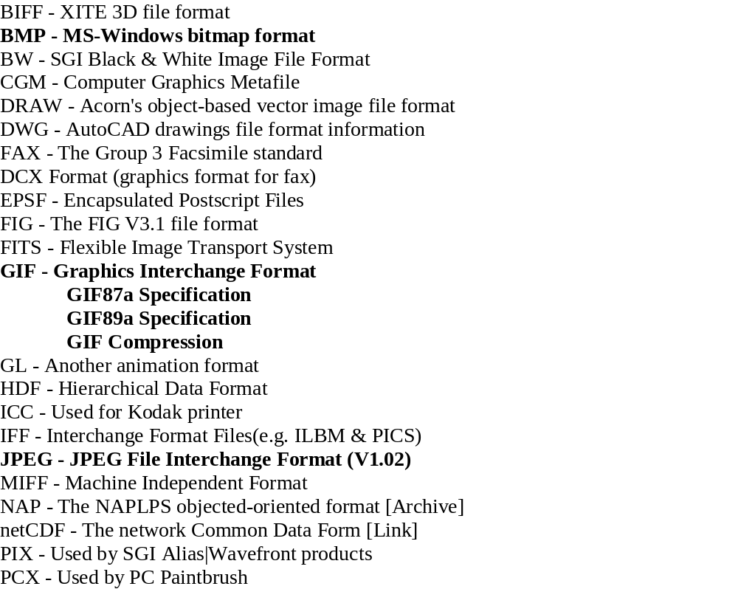
SOME FLAT-FILE FORMATS

Slide 14
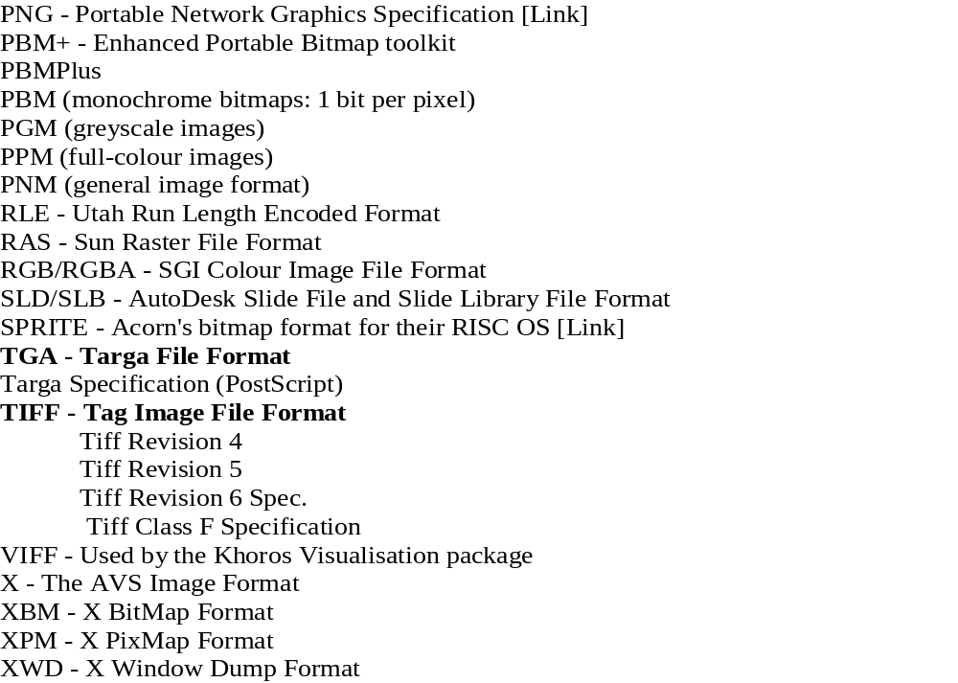
AND SOME MORE FLAT-FILE FORMATS!

Slide 15
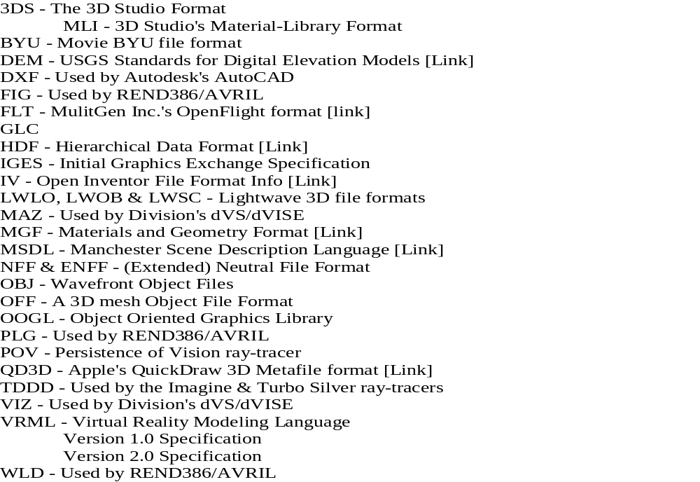
AND, SOME 3D GEOMETRY FILE FORMATS!!
As you might guess, others could be listed!!!

Slide 16
WHAT IS A FILE FORMAT?
Text files store ASCII character codes in a straight linear fashion.
When a text file is dumped to the screen or to a simple printer, the ASCII codes are automatically converted to the proper configuration for the letter, numeral, or other characters.
The file formats we have listed earlier, all contain extra characters with formatting information that tells software that can read that kind of file, how to interpret the stored data.
For example, word processors store data in files with information about whether the next characters are boldfaced, italicized, underlined, or even in color.

Slide 17
WHAT IS A FILE FORMAT?
A defined, and standardized, file format specifies the exact form of a file. For example, the GIF format requires:
GIF Signature
Screen Descriptor
Global Color Map
Image Descriptor
Local Color Map Repeated 1 to n times
Raster Data
If you open a .gif file in WordPad, you'll see:
GIF89aF_x0002_h
€À €ÿ @ € À ÿ À@ À€ ÀÀ Àÿ à@ à€ àÀ àÿ ÿ@ ÿ€ ÿÀ ÿÿ@ @@
The first few characters are ASCII and are the signature. The rest are
binary codes and are not printable in PowerPoint.

Slide 18
WHO OR WHAT NEEDS TO KNOW THE FILE FORMAT?
Obviously, any programmer writing software that will need to read or write the format.
Any software reading or writing that kind of file.
What does the general user need to know?
  Rarely the exact form of the format.
  Whether or not certain readers, writers, or converters are available for various formats.
  The advantages or disadvantages of choosing one format over another.
  Which platforms (Windows, Mac, Unix-Linux) support which formats
  How compatible is the format with other software you intend to use--- for example, PowerPoint etc.

Slide 19
Many sites on the web are helpful.
Here are two:
http://www.matisse.net/files/formats.html
  Not being updated, so a bit out of date. But, includes much information about software that will read different formats. Many of the programs are public domain or shareware.
http://www.cica.indiana.edu/graphics/image.formats.html
  A rather comprehensive list of image graphics file formats. Lists some of the programs that will read or write the different formats.

Slide 20
MOTION FORMATS
Not as many choices in this arena.
Animation is stored as a series of images, one for each frame of animation (if uncompressed)
A 3-sec animation sequence with 30 frames/sec requires 90 individual images!
While it is desirable to keep single flat files small, animation applications must try for the smallest file possible with the desired quality.

Slide 21
There are many problems encountered when handling animation:
Storage of the animation sequence
  Just the shear number of images
Screen refresh times
Download times
  Early users refused to download big files
  Didn't know if you wanted it until you waited "forever" for the download
  Even connect speeds at a site were slow (300 baud = 30 bytes/sec)

Slide 22
SPEED, OR THE LACK OF IT
30 frames/sec (i.e. 30 fps) of new 24-bit color 640 X 480 images is an effective data rate of 30 MB/sec!
Such a rate can overwhelm the frame buffer (where the image is stored before the screen is refreshed) of a computer.
Even a 32X CD-ROM can push optimally only 4.8 MB per sec of data.
The perceived smoothness of motion depends upon the fps.

Slide 23
Yet, animation requires a "good" fps.
At 12 fps, the eye sees a flicker as in the early movies. The motion looks jerky.
• At 24-30 fps, most people will see a reasonably smooth motion.
Movie film is shot at 24 fps.
Domestic non-HDTV TV is 29.97 fps
• Still, at 30 fps, a person's peripheral vision will still
detect a flicker. Try watching TV peripherally and you'll
probably detect the flicker.
•IMAX theaters achieve such realistic films because they
show on huge screens and the film is shot at 60 fps.
This provides no flicker in the peripheral range.

Slide 24
Broadcast System
Transmitter
Receiver
Goals:
  Efficient use of bandwidth
  High viewer perception of quality

Slide 25
Scanning and Interlace
Transmission is continuous signal
  Transmitter captures images and encodes
  Receiver decodes for display
Image is traced out line-by-line
  Left-to-right top-down scanning
  vertical/horizontal blanking interval
Signal is interlaced
  Improves perception of motion
  Alternative is progressive scanning

Slide 26
SO, CAN FAKE FPS A BIT
Early TVs had the problem that the phosphor on the screen would fade at the top before the electron gun could scan out the last few lines on the 484 line screens.
Interlacing the screen helped solve the problem:
  Scan out the odd numbered lines
  Then scan out the even numbered lines
  This would cause the fading to be spread out on the screen and the eye wouldn't see it so readily.
Poorer quality monitors use this technique also. This allows the refresh rate to be lower

Slide 27
Digitizing
Analog TV is a continuous signal
Digital TV uses discrete numeric values
  Signal is sampled
  Samples are quantized
  Small, discrete regions are digitized
Image represented by pixel array

Slide 28
Aspect Ratio/Refresh Rate
Aspect ratio
  Conventional TV is 4:3 (1.33)
  HDTV is 16:9 (2.11)
  Cinema uses 1.85:1 or 2.35:1
Refresh Rate
  NTSC is 60Hz (59.94Hz)
  PAL is 50Hz
  Cinema is 48Hz (but still only 24 fps)

Slide 29
NTSC Video
(525-lines, 60-fields/sec)
525 scan lines repeated 29.97 times per second (i.e.33.37 msec/frame)
Interlaced scan lines divide frame into 2 fields each 262.5 lines (i.e.16.68 msec/field)
20 lines reserved for control information at the beginning of each field
  Only 483 lines of visible data
  Laserdisc and S-VHS display around 420 lines (perception)
  Normal broadcast TV displays around 320 lines (“)
Line lasts 63.6 usec(10.9 usec blanked)

Slide 30
PAL Video
(625-lines, 60-fields/sec)
625 scan lines repeated 25 times per second (i.e. 40 msec/frame)
Interlaced scan lines divide frame into 2 fields each 312.5 lines (i.e. 20 msec/field)
Approximately 20% more lines than NTSC
NTSC vs. PAL ➔ roughly same bandwidth

Slide 31
DOWNLOAD TIMES
Recall that a 32X CD-ROM can push optimally only 4.8 MB per sec of data.
While cable and DSL connections are becoming more common, not everyone can afford them or can even obtain them.
Modem speeds vary, also, and an individual rarely has much control over the connect speed.
For example, having a high bps (bits per sec) modem, does not guarantee you will have that speed through your internet provider.
  For example, I have a 56K modem, but through Hiram I can only achieve 24K bps.

Slide 32
STREAMING
Streaming is a technique that allows a file to began displaying while it is being downloaded.
As long as the download and decompression time proceeds at a faster rate than the display time, the display will appear smooth to the viewer.
Although we are talking about video streaming here, the same terminology is used for audio files.
Thus, we can have
  streaming video
  streaming audio
The principle is the same.

Slide 33
DIGITAL VIDEO AND ANIMATION FILE FORMATS
Not as complicated, yet, as the formats for single images.
Basically, 5 types:
  Windows AVI format - Audio-Video Interleave Format
  MPEG Motion Picture Export Group
  QuickTime
  FLI/FLC Autodesk's Flic Animation Format
  ANIMATED GIF - After version 89a, provided animated pictures

Slide 34
TYPES OF VIDEO COMPRESSION
SPATIAL
  compresses size of individual images using flat image formats
  usually lossy compression
  compresses size of individual images using flat image formats
  usually lossy compression
TEMPORAL (frame differencing)
  Save only some frames (called keyframe)
  Usually save at rate of 1 or 2 per second
  Save the differences between the frames
Example: A talking head with an unchanging background. Differences might be the mouth only or perhaps slight changes for expressions in eyebrows.

Slide 35
TYPES OF VIDEO COMPRESSION
symmetric compression
  compress time
  decompress time
    are the same
asymmetric compression
  compress time is longer
  decompress time is shorter
Normally, asymmetric compression can yield higher quality files that are small
Some codecs are scalable - i.e. they can determine the characteristics of playback systems and scale the video quality accordingly.

Slide 36
DIGITAL VIDEO AND ANIMATION FILE FORMATS
Windows AVI format - Audio-Video Interleave Format
  Microsoft product
  Supported on all Windows platforms
  Is supplied with Win 95/98/2000
  Good compression and performance
  To use on a Mac, a user needs to obtain software
  If used for development purposes, the developer should supply the cross platform software.
  symmetric compression

Slide 37
DIGITAL VIDEO AND ANIMATION FILE FORMATS
MPEG Motion Picture Export Group
  DirecTV, DVD, and HDTV uses
  Growing in popularity for general applications
  Several earlier versions, MPEG-1, MPEG-2 exist
  MPEG-4 is current version, but MPEG-7 is being developed
  MPEG-4 has very good CD quality audio
  highly asymmetric compression and can require expensive hardware to do top quality compression
  Few applications render to this format
  Adobe Premiere 5 can encode
  Image files based on JPEG format, modified

Slide 38
DIGITAL VIDEO AND ANIMATION FILE FORMATS
QuickTime
  Supported on both Windows and Mac systems although Window users may need to install software
  Best choice for cross platform development
  Developed by Apple and is supplied on Mac
FLI/FLC Autodesk's Flic Animation Format
  Very specialized
  I suspect author included this because he was going to provide Autodesk software (but, hasn't yet!)

Slide 39


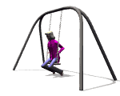
DIGITAL VIDEO AND ANIMATION FILE FORMATS
ANIMATED GIF - After version 89a, provided animated pictures
  Used for Web applications
  Animation is stored in a series of images which create large files
  These are best if played in a loop--- i.e. a short repeated sequence
  Examples:

Slide 40

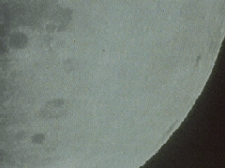
EXAMPLE OF AN AVI FORMAT FILE
EMBEDDED IN .ppt FILE
1,323 kb file
4,670 kb file

Slide 41
OTHER VIDEO APPLICATIONS THAT ARE HANDY
Videoconferencing
NetMeeting video-conferencing software in MS Office
Broadcasting
PowerPoint’s presentation broadcasting

Slide 42
CAN STRAIN THE QUALITY BY CHANGING THE RESOLUTION

Slide 43
THE CHANGE IS EVEN MORE OBVIOUS WITH THIS ONE

