Slide 1
OVERVIEW OF SOUND AND MUSIC FILE FORMATS

Slide 2
IMPORTANCE OF SOUND
Passive viewing (e.g. film, video, etc.)
  Very sensitive to video breaks
  Visual channel more important than sound channels (ask film makers!)
  Tolerate occasional frame drops
Video conferencing
  Sound channel is more important
  Visual channel still conveys information
  Some people report that video teleconference users turn off video
  Need to create 3D space and locate remote participants in it

Slide 3
Audio -vs- Video
Some people argue that sound is easy and video is hard because data rates are lower
  Not true ⇒ audio is every bit as hard as video, just different!
Computer scientists will need to learn about both audio and video just as we learned about printing with the introduction of desktop publishing

Slide 4
AUDIO FUNDAMENTALS
Acoustics is the study of sound
  I.e., the generation, transmission, and reception of sound waves
What is a sound wave?
Energy causes a disturbance in a medium
An example is the striking of a drum:
  The head of the drum vibrates => disturbs air molecules close to head
  Sound is transmitted by molecules bumping into each other

Slide 5
SENDING/RECEIVING
Receiver
  A microphone placed in sound field moves according to pressures exerted on it
  Transducer transforms energy to a different form (e.g., electrical energy)
Sending
  A speaker transforms electrical energy to sound waves

Slide 6
ANALOG vs DIGITAL
Sound travels in waves represented by a mathematical function called a sin (pronounced "sign") wave:
The vibrations travel through air particles and other materials just as waves travel through water particles.
sin wave
amplitude
time
This represents an analog signal.

Slide 7
ANALOG vs DIGITAL
The continuous changing level format of sound is called an analog sound. You find it on nondigital tape or vinyl records.
Digitizing is the process of converting an analog signal to a digital one.
Digitizing requires that the continuous curve be sampled at various points in order to determine the value. For example, sampling on left side of each box:
amplitude
amplitude

Slide 8
DIGITAL SAMPLING
The frequency of sampling is called the sampling rate
Audio CDs take 44,000 samples per second (44KHz)
Even at this rate, some sound is lost.
That is why audiophiles still prefer analog equipment.
The frequency response of a sound device is the range of frequencies the device can respond to or work with.
For digital audio, the frequency response is about half of its sampling rate.
Why is this important?
  We examine the frequency response of various devices ...

Slide 9
FREQUENCY RESPONSE OF VARIOUS DEVICES
Human ear-
  Up to about 20kHz
  Higher pitched sounds are too high for our ears
  So a CD quality recorded with a sampling rate of 44 kHz will produce a frequency response of 22 kHz which is within our entire frequency range.
Telephone-
  200 Hz to 4 kHz
Piano-
  Surprisingly, less than 5 kHz--- but harmonic and overtone frequencies add to its full-bodied tone.

Slide 10
WAVE LENGTHS
Wave length is distance sound travels in one cycle
  20 Hz is 56 feet
  20 kHz is 0.7 inch
Bandwidth is frequency range
Transducers cannot linearly produce human perceived bandwidth
  Frequency range is limited to [20 Hz, 20 kHz]
  Frequency response is not flat

Slide 11
SOUND PHENOMENA
Sound is typically a combination of waves
  Sin wave is fundamental frequency
  Other waves added to it to create richer sounds
  Musical instruments typically have fundamental frequency plus overtones at integer multiples of the fundamental frequency
Waveforms out of phase cause interference
Other phenomena
  Sound reflects off walls if small wave length
  Sound bends around walls if large wave lengths
  Sound changes direction due to temperature shifts

Slide 12
HUMAN PERCEPTION
Speech is a complex waveform
  Vowels and bass sounds are low frequencies
  Consonants are high frequencies
Humans most sensitive to low frequencies
  Most important region is 2 kHz to 4 kHz
Hearing dependent on room and environment, all other things being equal.
Sounds are masked by overlapping sounds

Slide 13
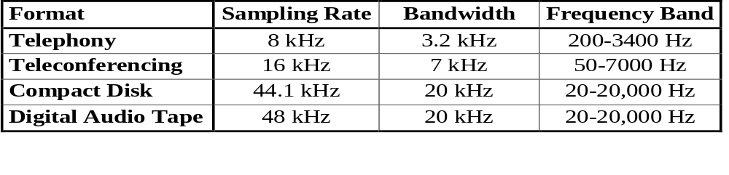
AUDIO REPRESENTATIONS
Optimal sampling frequency is twice the highest frequency to be sampled (Nyquist Theorem)

Slide 14
JARGONS/STANDARDS
As usual, a mess of different ones:
Emerging standard formats
  8 kHz 8-bit U-LAW mono
  22 kHz 8-bit unsigned linear mono and stereo
  44 kHz 16-bit signed mono and stereo
  48 kHz 16-bit signed mono and stereo
Actual standards
  G.711 - A-LAW/U-LAW encodings (8 bits/sample)
  G.721 - ADPCM (32 kbs, 4 bits/sample)
  G.723 - ADPCM (24 kbs and 40 kbs, 8 bits/sample)
  G.728 - CELP (16 kbs)
  GSM 06.10 - 8 kHz, 13 kbs (used in Europe)
  LPC (FIPS-1015) - Linear Predictive Coding (2.4kbs)
  CELP (FIPS-1016) - Code excitied LPC (4.8kbs, 4bits/sample)
  G.729 - CS-ACELP (8kbs)
  MPEG1/MPEG2, AC3 - (16-384kbs) mono, stereo, and 5+1 channels

Slide 15
MIDI vs RECORDED SOUND
Digital music files are called MIDI (Musical Instrument Digital Interface) files. These store music data that is read by a computer's sound hardware or by an electronic keyboard attached to it.
The format was originally designed for communication between musical instruments.
The file size is small as only instructions for generating the appropriate sound are included, not the actual sounds.
Can create attractive sound with small files, but often sound synthesized or tinny to the ear.
They can't record actual speech or sounds.

Slide 16
MIDI vs RECORDED SOUND
To record the actual sound of a single note for one second, 44,000 data points must be saved in one of several formats:
  WAV - a PC format
  AIFF - a Mac format
  RA - RealAudio used for audio streaming on the internet
  MP3 (MPEG3) -personal digital music players
As usual, we have the space versus time dilemma!

Slide 17
REALAUDIO and QUICKTIME
RealAudio and QuickTime are perhaps the most widely used formats on the web for audio files of recorded sound.
Both are streaming formats and web sites provide free players if your operating system doesn't contain the players.
Adobe's Premiere and Sonic Foundry's Sound Forge allow conversions between different formats.

Slide 18
Interactive Time Constraints
+
+
Maximum time to hear own voice: 100 msec
Maximum round-trip time: 300 msec

Slide 19
WHAT DO WE NEED FOR THE WEB?
AUDIO PACKETS AND DATA RATES
Telephone uses 8 kHz sampling
ATM = asynchronous transfer mode for high speed networks in the 100Mbit range
RTP = internet standard protocol for transporting real-time data (both audio and video)
  ATM uses 48 byte packets ➔ 6 msecs per packet
  RTP uses 160 byte packets ➔ 20 msecs per packet

Slide 20
WHAT DO WE NEED FOR THE WEB?
AUDIO PACKETS AND DATA RATES
Need many other data rates
  ≤ 30 kbs ➔ audio over 28.8 kbs modems
  32 kbs ➔ good stereo audio is possible
  56 kbs or 64 kbs ➔ conventional telephones
  128 kbs ➔ MPEG1 audio
  256 - 384 kbs ➔ higher quality MPEG/AC3 audio

Slide 21
COMPUTER HARDWARE CAPABILITIES
Must convert analog sound to digital sound and vice versa:
  Input audio from an analog source (microphone or stereo line feed)
  Computer digitizes that signal to create a digital sound file that is saved to disk.
    An analog-to-digital converter (ADC) does the conversion.
  The disk-based file can be played by converting the digital file to an analog signal that a line connected to a speaker can use.
    A digital-to-analog converter (DAC) does the conversion.

Slide 22
AGAIN, WHY DIGITAL?
There is no tape or vinyl record to wear out.
You can burn the file into a compact disk which does not wear out (unless mistreated).
Digital sound formats do not add any artifacts or noise/distortion to the sound--- tape does.
Each copy is a faithful clone.
Digital files can easily be incorporated into applications that support sound--- such as powerpoint slides.
Digital files can be edited to change the sound quite easily!!

Slide 23
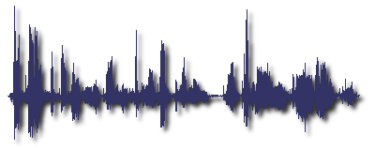
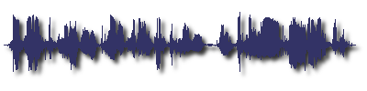
EDITING SOUND FILES
The following is 5 seconds of male speech.
But, if this is used without editing, the peaks will cause trouble if we try to amplify the sound. But, after editing, the peaks are not so high.

Slide 24
PRODUCING HIGH QUALITY AUDIO
Eliminate background noise
  Directional microphone gives more control
  Deaden the room in which you are recording
  Some audio systems will cancel wind noise
One microphone per speaker
Keep the sound levels balanced
Sweeten sound track with interesting sound effects

Slide 25
A Conventional TV Studio
audio production
studio
audio tape
audio mixer/control
line
output
TBC
production switcher
VTR
video
video production
audio
clock

Slide 26
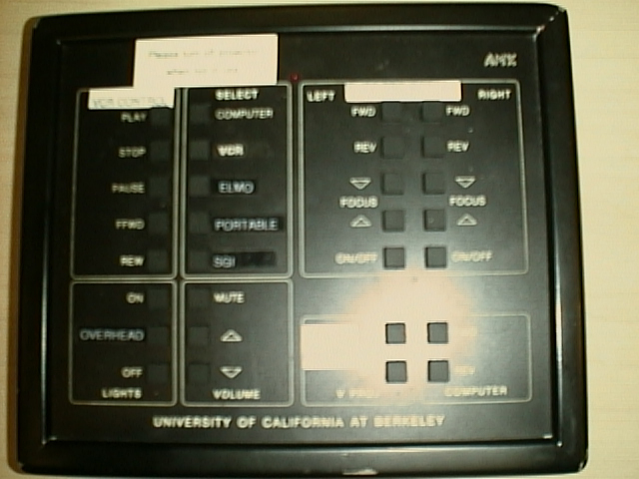
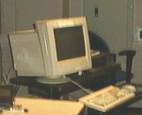
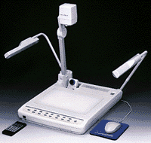

Multimedia Presentation
mic
Video Gateway
wireless control
PC
Elmo
computer
audience mic
Video Gateway
speaker camera
video projector
computer
matrix switcher
VCR
video
audio
control switcher
control
audience camera

