Slide 1

An Introduction to Probability and Statistics
Appendix C

Slide 2
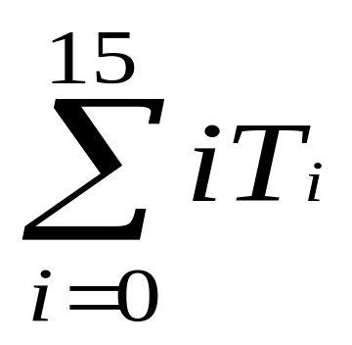
What We’ll Do ...
Ground-up introduction to the probability and statistics necessary to analyze simulations
A bit of calculus will be introduced
  The meaning of some calculus concepts
  Not the calculating aspects.
I'll assume familiarity with
  Algebraic manipulations
  Summation notation
i.e. 0T₀ + 1T₁ + 2T₂ + … + 14T₁₄ + 15T₁₅

Slide 3
What We’ll Do ...
Outline
  Probability
    basic ideas
    terminology
  Random variables, distributions, expected values
We'll return to this appendix and some of the concepts in it later.

Slide 4
Probability- Basic ideas
Experiment – activity with uncertain outcome
  Flip coins- Heads? Tails?
  Throw dice- What is on top?
  Pick cards- Suit? Rank?
  Draw balls from urn- Color?
  Drive tomorrow – Time? Accident?
  Operate a (real) call center – Number of calls? Average customer hold time? Number of customers getting busy signal?
  Simulate a call center – same questions as above

Slide 5
Probability- Basic ideas
Sample space – complete list of all possible individual outcomes of an experiment
  Could be easy or hard to characterize
  May not be necessary to characterize

Slide 6
Probability Basic Ideas
Event – a subset¹ of the sample space
  Describe by either
    listing outcomes
    “physical” description
    mathematical description
  Usually denote by E, F, E₁, E₂, etc.
  Example: In call center experiment, an event might be any day in which 50 calls are handled.
¹ Technically, in an advanced probability course, you need more than this--- the set must be measureable

Slide 7
Probability Basic Ideas
  Union, intersection, complementation operations make sense because an event is a set:
    E ∪ F is the union of E and F – i.e. all elements in E or F
    E ∩ F is the intersection of E and F – i.e. all elements in both E and F
    E^{c} is the complement of E – i.e. all elements being considered that are not in E
A Probability of an event is the relative likelihood that it will occur when you do the experiment
  A real number between 0 and 1 (inclusively)
  Denote by P(E), P(E ∩ F), etc. where, as usual, E and F are events.
  Interpretation – proportion of time the event occurs in many independent repetitions (replications) of the experiment
  May or may not be able to derive a probability

Slide 8

Probability Basic Ideas
Some properties of probabilities:
  If S is the sample space, then P(S) = 1
    Can have event E ≠ S with P(E) = 1
  If Ø is the empty event (empty set), then P(Ø) = 0
    Can have event E ≠ Ø with P(E) = 0
  If E^{C} is the complement of E, then P(E^{C}) = 1 – P(E)
  P(E ∪ F) = P(E) + P(F) – P(E ∩ F)
  If E and F are mutually exclusive (i.e., E ∩ F = Ø), then P(E ∪ F) = P(E) + P(F)
  If E is a subset of F (i.e., the occurrence in E implies the occurrence in F), then P(E) ≤ P(F)
  If o₁, o₂, … are the individual outcomes in the sample space, then

Slide 9

Probability Basic Ideas
Conditional probability 
  Knowing that an event F occurred might affect the probability that another event E also occurred
  Basic idea: Reduce the effective sample space from S to F, then measure “size” of E relative to its overlap (if any) in F, rather than relative to S
  Definition (assuming P(F) ≠ 0):
    P(E|F) is read as "the probability of E given F"

Slide 10
Probability Basic Ideas
Example: Let
  A denote the event that it rains on a given day
  B denote the event that it is cloudy on a given day
Suppose
  10% of the days are rainy and cloudy, i.e. P(A∩B) = .10
  30% of all days are cloudy, i.e. P(B) = .30
What is the probability that we will select a rainy day, given that we know the day is cloudy?
  i.e. What is P(A|B)?
  P(A|B) = P(A∩B)/P(B) = .1/.3 =1/3
Note: Some probability books write P(A∩B) as P(AB)

Slide 11
Probability Basic Ideas
E and F are independent if P(E ∩ F) = P(E) P(F)
  Implies P(E|F) = P(E) and P(F|E) = P(F), i.e., knowing that one event occurs tells you nothing about the other
  If E and F are mutually exclusive, are they independent?
    No- this is false if either P(E) or P(F) is nonzero.
    Pf: If E and F are mutually exclusive, this means if E occurs, then F cannot occur and vice versa. Then P(E|F) = 0. But, if P(E) <> 0, then P(E|F) <> P(E). A similar argument follows if P(F) <> 0.

Slide 12
Random Variables
One way of quantifying and simplifying events is to define random variable relating to them.
A random variable (RV) is a number whose value is determined by the outcome of an experiment
  i.e. It is a quantification of an experiment.
  Technically, this is a function or mapping from the sample space to the real numbers which assigns a number to each possible outcome of an experiment.
  But, we can usually define and work with a RV without going all the way back to the sample space.

Slide 13
Random Variables
  Intuitively think: An RV is a number whose value we don’t know for sure but we’ll usually know something about what it can be or it is likely to be.
    We might know its range of possible values.
    We might know its probability is equal to something.
    We might know its probability falls in some range.
  Usually denoted as capital letters: X, Y, W₁, W₂, etc.
The probabilistic behavior of a RV is described by its distribution function --- a concept we will explore shortly.

Slide 14
Discrete vs. Continuous RVs
Two basic “flavors” of RVs, used to represent or model different things
  Discrete
  Continuous
Discrete – can take on only certain separated values (technically a countable number of values)
  Number of possible values could be finite or infinite
  Examples:
    The number of defective bolts in a sample of 10 drawn from industrial production.
    The number of people in the waiting line in a doctor's office.
    The number of malfunctions of an airplane engine over a period of time.

Slide 15
Discrete vs. Continuous RVs
Continuous – can take on any real value in some range
  Number of possible values is always infinite
  Range could be bounded on both sides, just one side, or neither
Examples:
  The height of a human
  The length of life of a human cell
  The amount of sugar in an orange.
  The length of time required to complete an assembly operation in a manufacturing process.
Definitions of probability distributions are different for these two kinds of RVs.

Slide 16
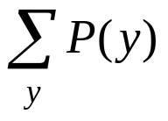
Probability Distributions For Discrete Random Variables
This is a formula, table, or graph that provides the probability associated with each value of the random variable.
It must satisfy the following for all random variables y:
  1. 0 <= P(y) <=1
  2. 1 =

Slide 17
Probability Distributions For Discrete Random Variables
Simple example: Consider flipping a coin twice. There are 4 possible events-- HH, HT, TH, TT
  Let y = the number of heads after the toss.
  Here is the probability distribution for y:
    y Sample Points P(y)
    0 TT 1/4
    1 HT, TH 1/2
    2 HH 1/4
Observe this meets our two conditions.

Slide 18
Probability Distributions For Discrete Random Variables
The distribution function can be presented in various ways.
In the previous example, we used a table.
We could have developed a formula such as:
P(y) = C(2,y)/4 where C(2,y) is the number of combinations of 2 things chosen y at a time since
  C(2,0) = 1
  C(2,1) = 2
  C(2,2) = 1
However, we don't always have to develop a formula. A table will do or a graph.

Slide 19
Probability Distributions For Discrete Random Variables
You should think of a graph of a probability distribution as a histogram showing the relative frequencies for each value of y.
Here is the one for our coin toss example:
1/2
1/4
0 1 2
Note that it shows us the relative frequencies of each y occurring.

Slide 20
Probability Distributions For Discrete Random Variables : Another Example
Consider an experiment consisting of tossing a coin until the first head appears.
Let y equal the number of tosses.
Find the probability distribution of y.
The sample points are infinite in number, although this is still a discrete problem:
  H
  TH
  TTH
  TTTH
  etc.
Let E_{i} denote the event with i-1 tails followed by a head.

Slide 21
Probability Distributions For Discrete Random Variables : Another Example
Consider
  P(E_{i}) y P(y)
  1/2 1 1/2
  1/4 2 1/4 Two independent events so product
  1/8 3 1/8 Three independent events so product
  ....
Does = 1? Yes, because (FACT) it is an infinite geometric progression with common ratio 1/2 .
The graph of the distribution looks like:
1/2
where I can't draw the remaining steps as PowerPoint won't let me keep halving the height.

Slide 22
Continuous Distributions
Let X be a continuous RV
  Possibly limited to a range bounded on left or right or both
  No matter how small the range, the number of possible values for X is always (uncountably) infinite
  Not sensible to ask about P(X = x) even if x is in the possible range
  Technically, P(X = x) is always 0
  Instead, describe behavior of X in terms of its falling between two values

Slide 23
Probability Distributions For Continuous Random Variables
We cannot assign probabilities to all the sample points associated with a continuous random variable.
Note: It is not just that there are an infinite number of points, as our last example had an infinite number of points. In a sense (which can be made mathematically precise) there are too many points when real numbers are used.¹
We can use our notion of the graph for the distribution for a discrete random variable to give us a clue as to how to interpret distributions for continuous random variables.
If we had a class with only a few individuals in it, we might obtain a relative frequency histogram when we looked at the probability of a student obtaining a certain score as:
¹ The mathematical concepts involved here are explained on the next couple of slides.

Slide 24
Size, Cardinal Numbers, Finite, and Infinite
The size of a set is given by its cardinal number.
The finite sets are what we tend to deal with in everyday life.
For example, we say {a, b, c} has cardinal number 3 and {x, y, z, w} has cardinal number 4.
We can assign cardinal numbers to infinite sets, also, but then we are faced with the fact that there are different cardinal numbers for different types of sets.
Definition: We say a set X has the same cardinal number as a set Y (or both have the same cardinality) if the elements in X and Y are in 1-1 correspondence (technically, there is a 1-1 function from X onto Y or, intuitively, the elements in X and Y can be paired uniquely).
Thus {a, b, c} and {x, y, z} have the same cardinal number (which we call 3) because we can do the following pairing:
  a ⬄ x, b ⬄ y, and c ⬄ z.
  Note: The pairing need not be unique – we could pair a with z, b with x, and c with y, for example.

Slide 25
Size, Cardinal Numbers, Finite, and Infinite
Definition: Any set is in 1-1 correspondence with a finite set or with the integers is said to be countable.
Definition: Any set that is in 1-1 correspondence with the set of positive integers is said to have cardinal number א₀ (read aleph-nought. Aleph is the first letter of the Hebrew alphabet).
Fact: The positive integers and the positive even integers both have cardinal number א₀ .
  Proof: A 1-1 correspondence between the two sets is established with a pairing n ⬄ 2n for all positive integers n.
Thus, …, 1 ⬄ 2, 2 ⬄ 4, 3 ⬄ 6, …
Clearly all the positive integers can be represented precisely once on the left of a pairing; all the positive even integers can be represented precisely once on the right of a pairing; and the pairings are different. QED

Slide 26
Size, Cardinal Numbers, Finite, and Infinite
Fact: The positive integers and the integers both have cardinal number א₀ .
  Proof: A 1-1 correspondence between the two sets is established with the pairing
    n ⬄ n/2 for n a positive integer and even
    n ⬄ - (n-1)/2 for n a positive integer and odd
Thus, 1 ⬄ 0, 2 ⬄1, 3 ⬄ -1, 4 ⬄ 2, 5 ⬄ -2, 6 ⬄ 3, 7 ⬄ -3…
Clearly, all the positive integers are represented precisely once on the left of a pairing; all the integers are represented precisely once on the right of a pairing; and the pairings are different. QED
So, do all infinite sets have cardinality א₀ ?
Surprisingly, NO!

Slide 27
Size, Cardinal Numbers, Finite, and Infinite
Fact: The set of real numbers between 0 and 1 exclusively does not have cardinal number א₀ .
  We use a proof technique known as "proof by contradiction".
  That is, we assume the negation of the statement and then show that we reach a contradiction.
  We use the fact that every real number between 0 and 1, but not including 0 or 1, can be uniquely represented as
    0.a[1]a[2]a[3]…. where each a[i] … is a digit.
  If this can be shown, then this set has a cardinal number which is not א₀ .
  We then say the set has cardinality c (read as the continuum ) and say it is uncountable.

Slide 28
Size, Cardinal Numbers, Finite, and Infinite
Fact: The set of real numbers between 0 and 1 exclusively does not have cardinal number א₀ .
  Proof: Assume the statement is false. Then the set of real numbers between 0 and 1 can be put in 1-1 correspondence with the positive integers.
  Assume this has been done and we have:
  1 ⬄ 0.a[1,1]a[1,2]a[1,3]...
  2 ⬄ 0.a[2,1]a[2,2]a[2,3] …
  etc. where a[k,i] is a digit.
  Now form a new number as follows:
  Choose b[1,1] so it is not a[1,1]; choose b[2,2] so it is not a[2,2]; choose b[3,3] so it is no a[3,3] etc. Clearly these choices can be made as each a[i,i] is only one digit.
  The number 0.b[1,1]b[2,2]b[3,3]…b[i.i]… is not in the above list on the right of any pairing. But if the 1-1 correspondence had existed, it would be.
  Consequently, no such 1-1 correspondence can exist.

Slide 29
Summary – and Other Interesting Facts
Two sets have the same cardinality if they can be put in 1-1 correspondence with each other.
Countable sets (which have cardinality א₀) include the set of integers, the set of positive integers, the set of even integers, the set of integers that are multiples o k for any finite cardinality k, …
Uncountable sets (which have cardinality c) include the set of reals between 0 and 1, the set of all reals, …
Fact (without proof): There are an infinite number of cardinalities as for any set A, the set of all its subsets is a strictly larger cardinality than the original set!
  This is fairly easy to see for finite sets as a set of cardinality n, it has 2^{n} subsets and 2^{n} >> n.
  With some work, this can be proved for infinite sets as well.
  In fact the notation 2^{n} is used to denote the cardinality of all subsets of a set of cardinality n.
  Thus, 2^{n} where n is א₀, is a cardinal number larger than א₀ and 2^{n} where n is c, is a cardinal number larger than c!

Slide 30
Probability Distributions For Continuous Random Variables (repeat of slide 23)
We cannot assign probabilities to all the sample points associated with a continuous random variable.
Note: It is not just that there are an infinite number of points, as our last example had an infinite number of points. In a sense (which can be made mathematically precise) there are too many points when real numbers are used.¹
We can use our notion of the graph for the distribution for a discrete random variable to give us a clue as to how to interpret distributions for continuous random variables.
If we had a class with only a few individuals in it, we might obtain a relative frequency histogram when we looked at the probability of a student obtaining a certain score as:
¹ The mathematical concepts involved here are explained on the next couple of slides.

Slide 31
Probability Distributions For Continuous Random Variables (Cont'd)
Along the x axis are scores and along the y axis are relative frequencies based on the size of the class. For example, with 30 in the class, the tallest portion might represent 7/30 of class obtained that score.
Suppose now we adjust the area under the curve so the total area is 1. Then the frequencies could represent the probability that a certain score or range of scores would be obtained in the class.

Slide 32
Probability Distributions For Continuous Random Variables (Cont'd)
Now we construct a model for this:
  Assume a RV, y, can take values on a real line as below.
  We will distribute one unit of probability along the line much as a person might distribute a handful of sand, each measurement of the population corresponding to a single grain.
  The probability, i.e. grains of sand, will pile up in certain places and the result will be a probability distribution represented perhaps by the graph:
The y axis shows relative frequencies and the x axis might be GPAs.
We build this so the area under the curve is 1. Then we have ...

Slide 33
Probability Distributions For Continuous Random Variables (Cont'd)
f(y)
The shaded area represents
P(a < y < b)
a
b
The function f(y) is called the probability distribution or the probability density function for the RV y.
The total area under the curve is 1.
The area lying above a given interval will equal the probability that y will fall in that interval.

Slide 34


Continuous Distributions
Summary: A Probability density function (PDF) is a function f(x) with the following three properties:
  f(x) ≥ 0 for all real values x
  The total area under f(x) is 1
  For any fixed a and b with a ≤ b, the probability that X will fall between a and b is the area under f(x) between a and b.

Slide 35
Fun facts about PDFs
  Observed X’s are denser in regions where f(x) is high
  The height of a density function value, f(x), is not the probability of anything
  – it can even be > 1
  With continuous RVs, you can be sloppy with weak vs. strong inequalities and endpoints

Slide 36

Continuous Distributions (cont’d.)
Cumulative distribution function (CDF) - probability that the RV will be ≤ a fixed value x:
Properties of continuous CDFs
  0 ≤ F(x) ≤ 1 for all x
  As x → –∞, F(x) → 0
  As x → +∞, F(x) → 1
  F(x) is nondecreasing in x
  F(x) is a continuous function with slope is equal to the PDF:
  f(x) = F '(x)
F(x) may or
may not have
a closed-form
formula
These four properties
are also true of
discrete CDFs

Slide 37
Two Questions?
1. How do we choose the appropriate model, i.e. the probability distribution, f(y), that "makes sense" for a given physical situation?
  This is the harder question.
  Certain types of distribution functions are typically used and their properties are studied.
  Given a physical situation, we utilize all the information we can to choose an appropriate modeling distribution function.
    Use general rules as to how to choose.
    Perhaps sample real data, build histograms, and see which kind of curve fits the data best.
    There are techniques in mathematical statistics that can be used, but they are beyond the scope of our work.

Slide 38
Two Questions?
2. How do we calculate the area under the curve corresponding to a given interval?
  Integral calculus.
  Do rectangular approximations.
  Use software that will handle the calculation for you.
  Look up values in tables. Many of these are calculated for much used distribution functions.

Slide 39
PDFs Supported by Arena
Recall we have already looked at the PDFs supported by Arena.
Moreover, we have discussed how the input analyzer can be used to help us choose an appropriate PDF for a simulation.
In just a moment we’ll discuss some of the parameters used with those PDFs.
But first, every computer scientist needs to know something about random number generation.

Slide 40
Random-Number Generators (RNGs)
Algorithm to generate independent, identically distributed draws from the continuous UNIF (0, 1) distribution
  These are called random numbers in simulations
These form the basis for generating observations from all other distributions and random processes
  We transform random numbers in a way that depends on the desired distribution or process (as we will see in a minute)
f(x)
1
0
1
x

Slide 41
Random-Number Generators (RNGs)
It’s essential to have a good RNG
There are a lot of bad RNGs
This is very tricky and complex area of computer algorithm design
  The methods and the coding are both prone to error.

Slide 42
Linear Congruential Generators (LCGs)
This is the most common of several different methods
Generate a sequence of integers Z₁, Z₂, Z₃, … via the recursion
Z_{i} = (a Z_{i–1} + c) (mod m)
a, c, and m are carefully chosen constants to allow the generated numbers to pass statistical tests of randomness.
Specify a seed, Z₀ to start
All the Z_{i}’s are between 0 and m – 1
Return the i th “random number” as U_{i} = Z_{i} / m

Slide 43
An Example of a “Toy” LCG
Choose parameters m = 63, a = 22, c = 4, Z₀ = 19:
Z_{i} = (22 Z_{i–1} + 4) (mod 63), seed with Z₀ = 19
i 22Z_{i–1}+4 Z_{i} U_{i} =z_{i} / m 19
  1 422 44 0.6984
  2 972 27 0.4286
  3 598 31 0.4921
  4 686 56 0.8889
  : : : :
  61 158 32 0.5079
  62 708 15 0.2381
  63 334 19 0.3016
  64 422 44 0.6984
  65 972 27 0.4286
  66 598 31 0.4921
  : : : :
Cycling — will repeat forever
Cycle length ≤ m
(could be < m depending
on parameters)
Need to pick m BIG
All RNGs generate
pseudo-random numbers,
not random numbers

Slide 44
Issues with LCGs
Cycle length: ≤ m
  Typically, m = 2.1 billion (= 2³¹ – 1) or more
  Other parameters chosen so that cycle length = m or m – 1
Statistical properties
  Uniformity, independence
  There are many tests of RNGs
    Empirical tests
    Theoretical tests — “lattice” structure
Speed, storage — both are usually fine
Must be carefully, cleverly coded — BIG integers
Reproducibility — streams (long internal subsequences) with fixed seeds

Slide 45
The Original (1983) Arena RNG
LCG with: m = 2³¹ – 1 = 2,147,483,647
a = 7⁵ = 16,807
c = 0
Cycle length = m – 1 = 2.1 × 10⁹
Ten different automatic streams with fixed seeds
In its day, this was a good, well-tested generator in an efficient code
But current computer speeds makes this cycle length inadequate
  Exhausts in 10 minutes on 2 GHz PC if we just generate random numbers
You can get this generator (not recommended)
  Place a Seeds module (Elements panel) in your model
  It is supplied for upward compatibility.

Slide 46
The Current (2000) Arena RNG
Uses some of the same ideas as LCG
  Modulo division, recursive on earlier values
But is not an LCG
  It combines two separate component generators
  Recursion involves more than just the preceding value
Combined multiple recursive generator (CMRG)
  A_{n} = (1403580 A_{n-2} – 810728 A_{n-3}) mod 4294967087
  B_{n} = (527612 B_{n-1} – 1370589 B_{n-3}) mod 4294944443
  Z_{n} = (A_{n} – B_{n}) mod 4294967087
  Seed = a six-vector of first three A_{n}’s, B_{n}’s
Two
simultaneous
recursions
Combine the two
  Z_{n} / 4294967088 if Z_{n} > 0
  4294967087 / 4294967088 if Z_{n} = 0
U_{n} =
The next
random
number

Slide 47
The Current (2000) Arena RNG – Properties
Extremely good statistical properties
  Good uniformity in up to 45-dimensional hypercube
Cycle length = 3.1 × 10⁵⁷
  To cycle, all six seeds must match up
  On 2 GHz PC, would take 2.8 × 10⁴⁰ millennia to exhaust
  Under Moore’s law, it will be 216 years until this generator can be exhausted in a year of nonstop computing
Only slightly slower than old LCG
  And RNG is usually a minor part of overall computing time

Slide 48
The Current (2000) Arena RNG – Streams and Substreams
Automatic streams and substreams
  1.8 × 10¹⁹ streams of length 1.7 × 10³⁸ each
  Each stream further divided into 2.3 × 10¹⁵ substreams of length 7.6 × 10²² each
    2 GHz PC would take 669 million years to exhaust a substream
Default stream is 10 (historical reasons)

Slide 49
The Current (2000) Arena RNG – Streams and Substreams
To use a different stream, append its number after a distribution’s parameters
  For example, EXPO(6.7, 4) to use stream 4
When using multiple replications, Arena automatically advances to next substream in each stream for the next replication
  Helps synchronize for variance reduction

Slide 50
Generating Draws for Other Input Distributions
Have: Desired input distribution for model (fitted or specified in some way), and RNG (UNIF (0, 1))
Want: Transform UNIF (0, 1) random numbers into “draws” from the desired input distribution
Method: Arena uses mathematical transformations of random numbers to “deform” them to the desired distribution
  Specific transform depends on desired distribution
  Details are in the online Help about methods used for all distributions

Slide 51

Discrete Expected Values
A data set has a “center” – the average (mean)
RVs also have a “center” – an expected value
  The expected value is called the mean or expectation of the RV X also.
  Other common notations: μ , μ_{X}
  It is the weighted average of the possible values x_{i}, with weights being their probability (relative likelihood) of occurring= i.e.
  Example: 2 coin toss, y = number of heads
    E(y) = 0*p(0) + 1*p(1) + 2*p(2) = 0 + 1*(1/2) + 2*(1/4) = 1.
    Says 1 is the "center" of the distribution or its expected value.

Slide 52
Discrete Expected Values (Cont'd)
  What expectation is not: The value of X you “expect” to get
    E(X) might not even be among the possible values x₁, x₂, …
  What expectation is:
    Repeat “the experiment” many times, observe many X₁, X₂, …, X_{n}
    E(X) is what converges to (in a certain sense) as n → ∞

Slide 53
Discrete Expected Values (Another Example)
8000 lottery tickets are to be sold at $1 each. The prize is $3,000. Person A has purchased two tickets. What is the expected gain for Person A.
Recall the expected value of a RV y is the average of the theoretical population that would result if the lottery were repeated an infinitely large number of times.
A's gain, y, can take on one of two values-
  a loss of $2 (i.e. -$2 gain) or
  a win (i.e. $2998 gain).
Thus, the expected value (or expected gain) is
  (-$2)*(7998/8000) + ($2998)*(2/8000) = -$1.25
  Since A is investing $2, this is not a good deal!

Slide 54

Continuous Expected Values
Expectation or mean of X is
  Roughly, a weighted “continuous” average of possible values for X
  Same interpretation as in discrete case: average of a large number (infinite) of observations on the RV X

Slide 55
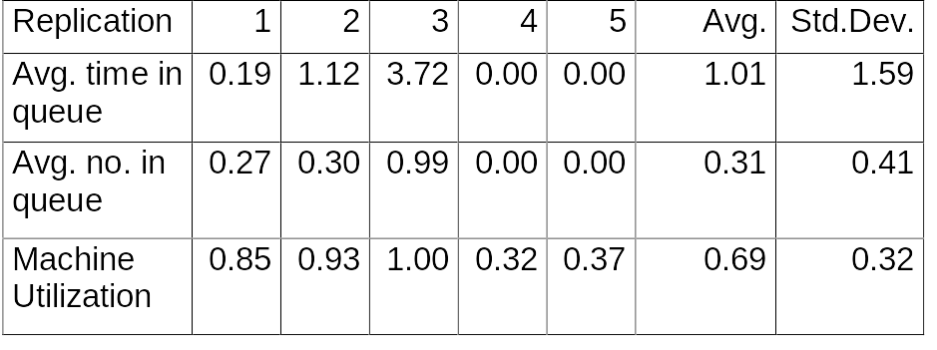
Measures Of Variability
In many of our examples, we did just one “replication”—a sample of size one
This is not worth much.
Suppose we made a total of five replications with varying data:
What does this mean?

Slide 56
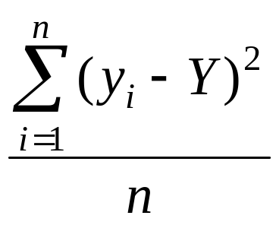
Measures Of Variability
There are many measures of the variability or dispersion of data.
Simplest measure is the range ---i.e. the difference between the largest and the smallest measurement.
Two other important measures are
  the variance
  the standard deviation
Definition: The variance of a set of n measurements y_{i}, for i=1,2,...n is the average of the square of the deviations of the measurements about their mean Y (or average):

Slide 57
Example
Given measurements of 5, 7, 1, 2, 4 we can calculate the variance to be 4.56.
What does this tell us?
Unfortunately, this measure on one set of data doesn't provide us with too much information.
It is true that if the variance is large, there is a lot of variation. But, we need another measure which will provide us with more data about our measurements--- the standard deviation.

Slide 58
The Standard Deviation
Definition: The standard deviation of a set of n measurements y_{i}, i=1,2,...n, is the positive square root of the variance.
This is an important measure because of a theorem due to the Russian mathematician, Tchebysheff:
Theorem: Given a number k greater than or equal to 1 and a set of n measurements y_{i}, i=1,2,...n, at least 1 - 1/k² of the measurements will lie within k standard deviations of their mean.
Note: This is very conservative as it applies to any distribution.
Calculating 1 - 1/k² :
  If k =1, 0
  If k = 2, 3/4
  If k = 3, 8/9
We often let
μ = the mean
σ = the standard deviation

Slide 59
What σ can tell us:
Given a distribution of measurements that is approximately bell-shaped, i.e. a normal curve, we can do better than Tchebysheff’s Theorem. With that curve, the interval
μ ± σ will contain ~ 68% of the measurements
μ ± 2σ will contain ~ 95% of the measurements
μ ± 3σ will contain ~ all of the measurements

Slide 60
Point Estimation
What is it?
  A sample statistic that estimates (in some sense) a population parameter
    For example, a mean, a standard deviation etc.
Properties it must have:
  Unbiased: E(estimate) = parameter
  Efficient: Var(estimate) is lowest among competing point estimators
  Consistent: Var(estimate) decreases (usually to 0) as the sample size increases

Slide 61
Confidence Intervals
A point estimator is just a single number, with some uncertainty or variability associated with it
A Confidence Interval quantifies the likely imprecision in a point estimator
  It is an interval that contains (covers) the unknown population parameter with prespecified (high) probability 1 – α
  It is called a (1 – α)% confidence interval for the parameter
  Typically, we like 95% confidence intervals
  These are often reported by giving their half-width.

Slide 62
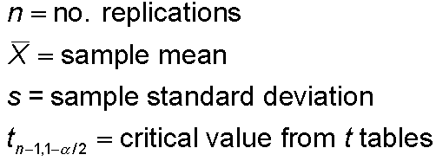


Half Width and the Number of Replications
Prefer smaller confidence levels
Notation:
Confidence interval:
Half-width =
Can’t control t or s
Must increase n — how much?
Want this to be “small,” say
< h where h is prespecified

Slide 63
Strategy for Data Collection and Analysis
Category Overview report will have some statistical-analysis results of the output across the replications
How do we decide on how many replications to run?
  Trial and error (now)
  Approximate number for acceptable precision (discuss later)
  Sequential sampling (Chapter 11)
Turn off all animation for max speed
  Run/Run Control/Batch Run (No Animation)

Slide 64
Interpretation of Confidence Intervals
The CI is an interval with random (data-dependent) endpoints that’s supposed to have the stated probability of containing, or covering, the expected value (be it the mean, the standard deviation etc.)
  “Target” expected value is a fixed, but unknown, number
  Expected value = average of infinite number of replications
Not an interval that contains, say, 95% of the data
  That’s a prediction interval … A prediction interval can be useful too, but it has different uses

Slide 65
Interpretation of Confidence Intervals
Usually calculation formulas assume normally-distributed data
  Never true in simulation
  Might be approximately true if output is an average, rather than an extreme
  Central limit theorem- says that under rather general conditions, sums and means of samples of random measurements drawn from a population tend to be bell-shaped in repeated samplings

Slide 66
Using Confidence Intervals in Simulations
Run multiple simulations, get results
View each replication of the simulation as a data point
Since random input ⇒ random output
  Form a confidence interval
  Bracket (with probability 1 – α) the “true” expected output (what you’d get by averaging an infinite number of replications)

Slide 67
Comparing Two Alternatives
Usually, want to compare alternative system configurations, layouts, scenarios, sensitivity analysis … here just two alternatives
Reasonable but not-quite-right idea: Make confidence intervals on expected outputs from each alternative, see if they overlap
  Doesn’t allow for a precise, efficient statistical conclusion
We will see shortly how to do this as Arena has some built in tools (output analyzer)

Slide 68
Hypothesis Testing
Test some assertion about the population or its parameters
Can never determine truth or falsity for sure – only get evidence that points one way or another
Null hypothesis (H₀) – what is to be tested
Alternate hypothesis (H₁ or H_{A}) – denial of H₀
  H₀: m = 6 vs. H₁: m ≠ 6
  H₀: s < 10 vs. H₁: s ≥ 10
  H₀: m₁ = m₂ vs. H₁: m₁ ≠ m₂
Traditional methods develop a decision rule to decide on H₀ or H₁ based on sample data

Slide 69
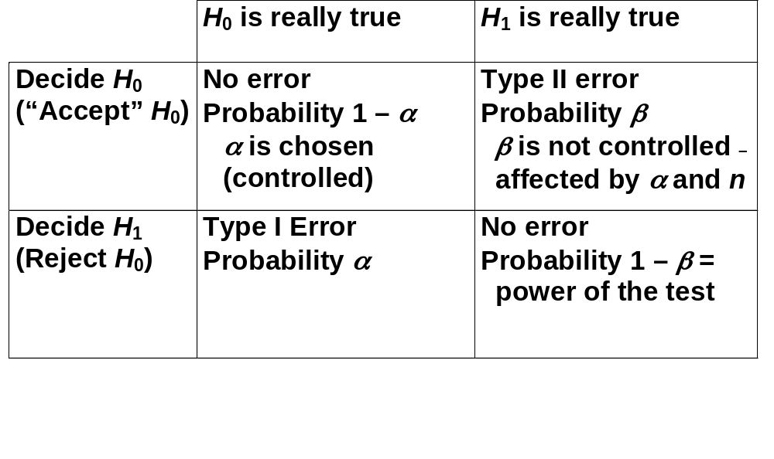
The traditional method is to “Accept” or Reject H₀ with the resulting Type I or Type II errors

Slide 70
p-Values for Hypothesis Tests
An alternate method – compute the p-value using some appropriate statistical test test
  p-value = probability of getting a test result more in favor of H₁ than what you got from your sample
  Small p (like < 0.01) is convincing evidence against H₀
  Large p (like > 0.20) indicates lack of evidence against H₀
Connection to traditional method
  If p < α, reject H₀
  If p ≥ α, do not reject H₀
The p-value quantifies the confidence in the decision

Slide 71
Hypothesis Testing in Simulation
Input side
  Specify input distributions to drive the simulation
  Collect real-world data on corresponding processes
  “Fit” a probability distribution to the observed real-world data
  Test H₀: the data are well represented by the fitted distribution
We’ve done this using the input analyzer in Arena.

Slide 72
Hypothesis Testing in Simulation
Output side
  Have two or more “competing” designs modeled
  Test H₀: all designs perform the same on output, or test H₀: one design is better than another
  Selection of a “best” model scenario
We’ll see that Arena has some built in tools for handling this type of situation also.

Slide 73
Summary of Concepts Introduced
Experiment
Sample space
Event
Probability of an event -P(E)
Conditional probability, P(F|E)
Independent events
Random variables
Probability (density) distributions, PDFs
Random number generators
Size, cardinality, finite, and infinite
Discrete RVs
Continuous RVs
Cumulative distribution function CDFs
Expected values
Measures of variability
  Range
  Variance
  Standard deviation
Confidence intervals
Hypothesis testing with p-values

