Slide 1

FUNDAMENTAL SIMULATION CONCEPTS
Prelude to Arena
CHAPTER 2

Slide 2
Topics/Approach
Underlying simulation ideas, methods, issues
  Software-independent (but setting up for Arena)
Centered basically around an example of a simple processing system described in Sect 2.1, pg 15. (Some numbers are changed)
  Decompose the problem
  Terminology
  Simulation by hand
  Some basic statistical issues
  Overview of a simulation study

Slide 3
The System:
A Simple Processing System
Machine
(Server)
Arriving
Blank Parts
Departing
Finished Parts
7
6
5
4
Queue (FIFO)
Part in Service
General intent:
  Estimate expected production
  Determine the time in the queue, queue length, proportion of time machine is busy
Time units: arbitrary, but …
  Be consistent (simulation doesn’t know)
  Be reasonable (interpretation, roundoff error)

Slide 4
Model Specifics
Initially (time 0) empty and idle
Time units: minutes
Arrival times: 0.00, 6.84, 9.24, 11.94, 14.53
  Interarrival¹ times: 6.84, 2.40, 2.70, 2.59, 0.73
Service times: 4.58, 2.96, 5.86, 3.21, 3.11
Stop when 15 minutes of (simulated) time have passed
¹The time between a part's arrival and that of the next part.

Slide 5
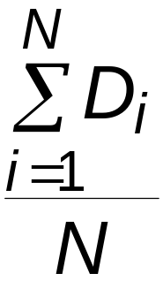
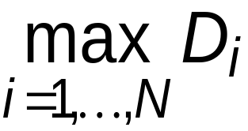
Goals of the Study:
Output Performance Measures
Total production of parts over the run (P)
Average waiting time of parts in queue¹:
Maximum waiting time of parts in queue:
N = no. of parts completing queue wait
D_{i} = waiting time in queue of ith part
Know: D₁ = 0 (why?)
N > 1 (why?)
¹These are called tally statistics as they are tallied when observed.

Slide 6
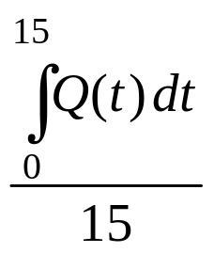
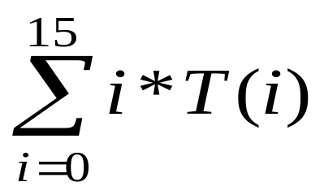
Goals of the Study:
Output Performance Measures (cont’d.)
Time-average number of parts in queue:
Q(t) = number of parts in queue
at time t
This is a weighted average--- i.e. if T(i) is the amount of time that i parts are in the queue, then the numerator in this example is the same as:
If you haven't had calculus, you just have to accept this as true although on the next slide I will try to intuitively explain the integral.

Slide 7
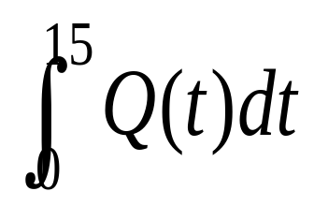
INTUITIVE CALCULUS
Q(t) = number of parts in queue at time t
This is read as "the integral from 0 to 15 of Q(t) ".
The integral calculates the area under the curve Q(t) between 0 and 15.
In calculus, given Q(t) as a "reasonable" function, you learn to calculate the area specified above. Here, the software will do the calculations for you.
But, I want you to intuitively see why this is the same as
where T(i) is the amount of time that i parts are in the queue

Slide 8
VERY simple example illustrating the equivalence claimed on the last slide:
Assume arrival times of 0, 1, 2 for parts A, B , and C
and a service time of 2 for each part. Then Q(t) would look like:
i Action Queue size
0 A arrives 0
1 B arrives, A on 1
2 C arrives, A out, B on 1
3 B on, no arrivals 1
4 B out, C on 0
Q(t)
A
B
C
The other calculation is
0*T(0) + 1*T(1) + 2*T(2) + 3*T(3)
= 0*2 + 1*3 + 2*0 + 3*0 = 3
because 2 intervals have 0 in queue and 3 have 1 in queue.
(T(i) is the number of parts in a queue of size i.
Area under Q(t) curve is 3
This is easy to calculate because the function Q is a simple box (or step) function.

Slide 9
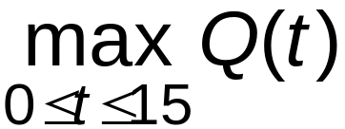
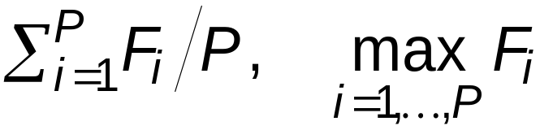
Goals of the Study:
Output Performance Measures (cont’d.)
Maximum number of parts in queue:
Average and maximum flowtime¹ of parts
F_{i} = flowtime of ith part
¹total time in system of a part that completes. This includes time on press plus queue time.
a.k.a. cycle time - Note- only completed parts are counted.

Slide 10
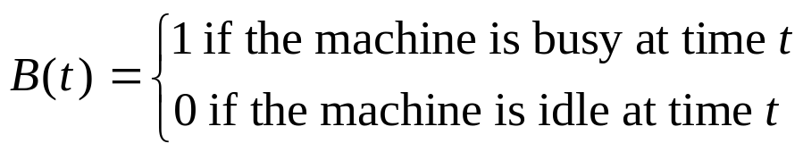
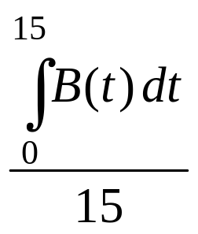
Goals of the Study:
Output Performance Measures (cont’d.)
Utilization of the machine (proportion of time busy)
Many others possible (information overload?)
Again – this integral is easy to calculate as it is a step function.

Slide 11
Analysis Options Other Than Simulation
Educated guessing
  Average interarrival time = 3.05 minutes
  Average service time = 3.94 minutes
In text, using Table 2.1, pg 16, these are calculated for the first listed 10 items of the book example by averaging the appropriate columns. (Check this!)There the first is 4.08 and the second is 3.46.
Our results average over 5 items and are
(6.84+2.4+2.7+2.59+.73)/5 and
(4.58+2.96+5.86+3.21+3.11)/5

Slide 12
In the text, average-interarrival-time > average-service-time
This implies the system will probably operate in a stable way over the long term as queues shouldn't grow unbounded. If these weren't averages, we would never have a queue!
In our example, average-interarrival-time < average-service-time
This implies model will “explode” eventually (but maybe not in 15 minutes)
But, in either case we only have rough estimates as they are only averages. With wide swings on either side of the average, we can't easily predict queue lengths.
Guessing has its limits

Slide 13
Analysis Options (cont’d.)
Queueing theory
  Requires additional assumptions about the model
  Popular, simple model: M/M/1 queue¹
  Assumes:
    Interarrival times are ~ exponential
    Service times are ~ exponential, independent of interarrivals
    E(service) < E(interarrival)
      For the example in the text, this is true, but not for this example.
    Steady-state (long-run, forever)
      Ours will explode, because E(service) ~ 3.94 and E(interarrival) ~ 3.05
¹M = Markovian. 1st is arrival process; 2nd is service time process.
1= single queue
E= expected value of the distribution (See the next slide for details.)

Slide 14
INTUITIVE PROBABILITY
Saying that a process is Markovian says the times are independent of each other and identically distributed draws from an exponential probability distribution.
What do these mean?
  Probability distribution
  Exponential probability distribution
  Identically distributed draws?

Slide 15
Different probability distributions represent different patterns (different relative frequencies) in the occurrence of random variables.
A probability density function (p.d.f. or p.m.f.) is the mathematical or graphical representation of a probability distribution.
  A p.d.f. (probability density function) is for a continuous variable:
    income, volume of water, etc.
  A p.m.f. (probability mass function) is for a discrete variable:
    # of redheads in a class, # crimes a day.

Slide 16
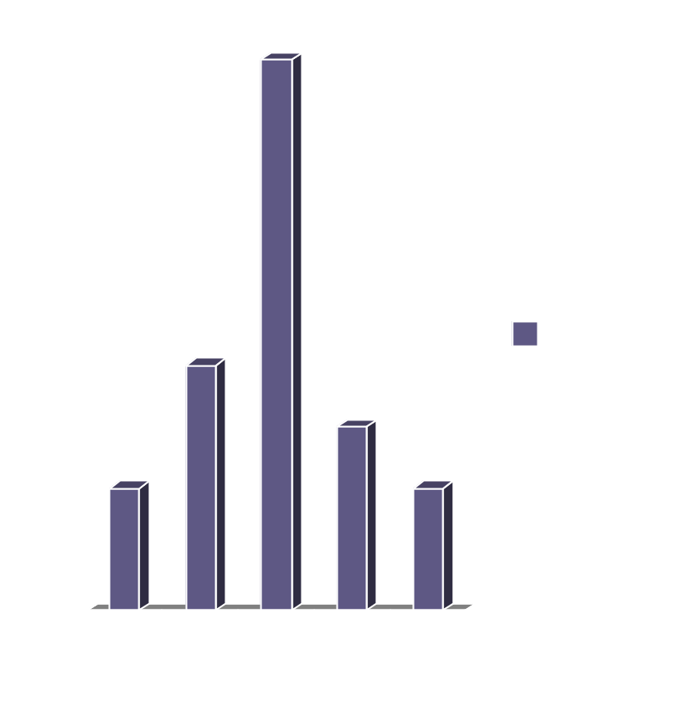
Building a p.m.f.
Random Variable = # of redheads in a class (of 30.)
Go to 200 classes, count how many redheads, and graph the result.
20 classes have no redheads, 40 have 1, etc.

Slide 17
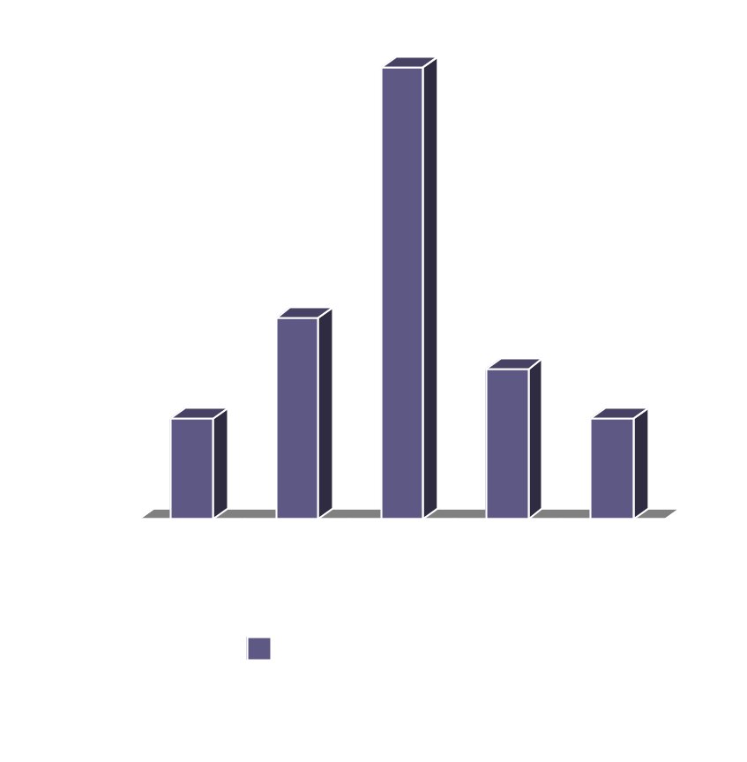
What is the probability of walking into a class with
no redheads (P(X=0))? What is the P(X=1)?
To find the probability divide the number of classes with zero redheads by the total number of classes.
Do this for each value of X and you have a probability distribution.
This looks somewhat like a normal curve (although it isn’t exactly)

Slide 18
An Exponential Distribution would look something like:
Left most is P(X=0), for some X. etc.
An identically distributed draw just means each event has the same probability distribution.

Slide 19
Back to our original statement:
Saying that a process is Markovian says the times are independent of each other and identically distributed draws from an exponential probability distribution
  Contrast this intuitively with a draw
    1) that is identically distributed
    2) from a normal probability distribution.

Slide 20
Choosing the Appropriate Distribution is Important
Exponential distributions are typically used to model interarrival times that are truly random and to model service times that are highly variable.
  Also, used to model the lifetimes of components that fail instantedly, like light bulbs.

Slide 21
Examples of variables with different probability distributions—don’t worry yet what these look like although some are pictures are in Appendix D
# of people absent from class each day.
  (Binomial Distribution -- discrete.)
Amount of corn harvested per acre.
  (Normal Distribution – continuous-pg 598)
Probability your professor is bald.
  (Uniform Distribution, believe it or not. -- discrete. Chosen from a list of profs –pg 601)
# of cars that pass by a store in a given period.
  (Poisson Distribution – discrete-pg 599)

Slide 22
INTUITIVE PROBABILITY
Saying that the expected value of X, E(X), is λ means
  You sample X many times (technically, infinitely many times)
  Observe the values obtained each time
  Compute the average of all the values of X you observe.
  That average should be λ .
It is NOT the value you expect to get when you draw a sample of type X.
As an approximation, you can compute E(service) and E(interarrival) as just the averages we computed earlier.

Slide 23
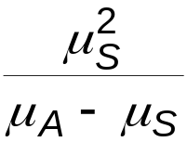
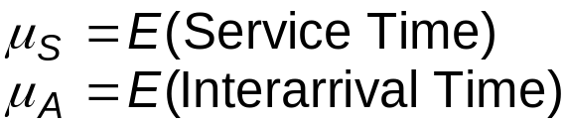
Analysis Options (cont’d.)
    If the assumptions are met for the M/M/1 model (see slide 13) you can obtain exact analytic results; e.g., average waiting time in queue is
  Problems: validity, estimating means, time frame, assumptions not met (or worst, not checked!)
  Viewed by some as useful as first-cut approximation

Slide 24
Mechanistic Simulation
Individual operations (arrivals, service times) will occur exactly as in reality
Movements, changes occur at the right “time,” in the right order
Different pieces interact
Install “observers” to get output performance measures
Concrete, “brute-force” analysis approach
Nothing mysterious or subtle
  But a lot of details, bookkeeping
  Simulation software keeps track for you

Slide 25
Pieces of a Simulation: 1.Entities
“Players” that move around, change status, affect and are affected by other entities
Dynamic objects—get created, move around, leave (maybe- can just circulate)
Usually represent “real” things, but not always.
Can have “fake” entities for modeling “tricks"
  Breakdown demon (arrives and takes the press out of service for a length of time and then restores it)
  Breakdown angel (arrives and takes the press off duty permanently)
Our model: entities are the parts being processed
We have only one entity, but many instances or realizations of it.
Usually have multiple realizations floating around
Can have different types of entities concurrently, also

Slide 26
Pieces of a Simulation (cont’d). 2. Attributes
Characteristics of all entities: describe, differentiate
All entities have same attribute “slots” but different values for different entities, for example:
  Time of arrival
  Due date
  Priority
  Color
An attribute value is tied to a specific entity
Like “local” (to entities) variables
Some automatic in Arena, some you define, assign values to, change, and use attributes of your own.

Slide 27
Pieces of a Simulation (cont’d.) 3. Variables
Global
Reflects a characteristic of the system, regardless of entities - can be a constant or can change during run
Needs a name and value, of which there’s only one copy for the whole model
Not tied to entities
Entities can access, change variables. Examples:
    Number of parts in system
    Simulation clock
    Current length of queue
    Status of the drill press
Some built-in by Arena; you can define others

Slide 28
Pieces of a Simulation (cont’d.) 4. Resources
What entities compete for
  People
  Equipment
  Space
An entity seizes a resource, uses it, releases it
Think of a resource being assigned to an entity, rather than an entity “belonging to” a resource
A resource can have several units of capacity
  Seats at a table in a restaurant
  Identical ticketing agents at an airline counter
Number of units of resource can be changed during the simulation

Slide 29
Pieces of a Simulation (cont’d.) 5. Queues
Place for entities to wait when they can’t move on (maybe since the resource they want to seize is not available)
Have names, often tied to a corresponding resource
Can have a finite capacity to model limited space—have to model what to do if an entity shows up to a queue that’s already full
Usually watch the length of a queue, waiting time in it

Slide 30
Pieces of a Simulation (cont’d.) 6. Statistical Accumulators
Variables that “watch” what’s happening
Depend on output performance measures desired
“Passive” in model—don’t participate, just watch
Many are automatic in Arena, but some you may have to set up and maintain during the simulation
At end of simulation, used to compute final output performance measures

Slide 31
Pieces of a Simulation (cont’d.)
Statistical Accumulators for the Example
  Number of parts produced so far
  Total of the times spent in queue so far
  No. of parts that have gone through the queue
  Max time in queue we’ve seen
  Total of flowtimes
  Max flowtime we’ve seen
  Area so far under queue-length curve Q(t)
  Max of Q(t) so far
  Area so far under server-busy curve B(t)

Slide 32
SUMMARY OF PIECES OF SIMULATION
Entities
Attributes- typically input or calculated during run
Variables
Resources
Queues
Statistical Accumulators- typically desired output
Note: Coding in a high level language would require you to handle all of the above with specific code.

Slide 33
QUIDING PRINCIPLE:
All of these 6 components must be specified before attempting a simulation.

Slide 34
Simulation Dynamics: The Event-Scheduling World View
Identify characteristic events—these change states
  initialization
  arrivals
  departures
  the end
Decide on logic to: effect state changes for each event type, observe statistics
Keep a simulation clock, future event calendar
Jump from one event to the next, process, observe statistics, update event calendar
Identify a Stopping rule

Slide 35
Events and Logic for Our Example
2. Arrival of new part to the system
  Update time-persistent statistical accumulators (from last event to now)
    Area under Q(t)
    Max of Q(t)
    Area under B(t)
  “Mark” arriving part with current time (use later)
  If machine is idle:
    Start processing (schedule departure); Make machine busy; Tally time in queue (0)
  Else (machine is busy):
    Put part at end of queue; Increase queue-length variable
  Schedule the next arrival event

Slide 36
Events and Logic for Our Example
3. Departure (when a service is completed)
  Increment number-produced statistical accumulator
  Compute & tally flowtime (now - time of arrival)
  Update time-persistent statistics
  If queue is non-empty:
    Take first part out of queue, compute & tally its time in queue, begin service (schedule departure event)
  Else (queue is empty):
    Make the machine idle (Note: there will be no departure event scheduled on the future events calendar)

Slide 37
Events and Logic for Our Example
4. The End
  Update time-persistent statistics (to end of the simulation)
  Compute final output performance measures using current values of statistical accumulators
After each event, the event calendar’s top record is removed to see what time it is, what to do
Also must initialize everything 1. initialization (Note: The first event logic discussed was labeled 2. on slide 35)

Slide 38
Further Details for Our Example
Simulation clock (internal in Arena)
Event calendar: List of event records:
  [Entity No., Event Time, Event Type]
  Keep ranked in increasing order on Event Time
  Next event always in top record
  Initially, schedule first Arrival, The End
State variables: describe current status
  Server status B(t) = 1 for busy, 0 for idle
  Number of customers in queue Q(t)
  Times of arrival of each customer now in queue (a list of random length)

Slide 39
Simulation by Hand
Manually track state variables, statistical accumulators
Use “given” interarrival, service times
Keep track of event calendar
“Lurch” clock from one event to the next
Will omit flowtimes, “max” computations here (see text for complete, gory details)

Slide 40
Event-Oriented Simulation
Arena uses this technique although, as you will see, you won't model this way.
  a master controller keeps track of all events, entities, attributes, variables, and statistical accumulators.
Modeling and computation centers around events, when they occur, and what happens when they occur.
For very simple models, this view can be hand traced.
But, as models become more complex with lots of events, entities, and resources, this approach can be tedious to follow.
We will do one example here. There is another example in the book.

Slide 41
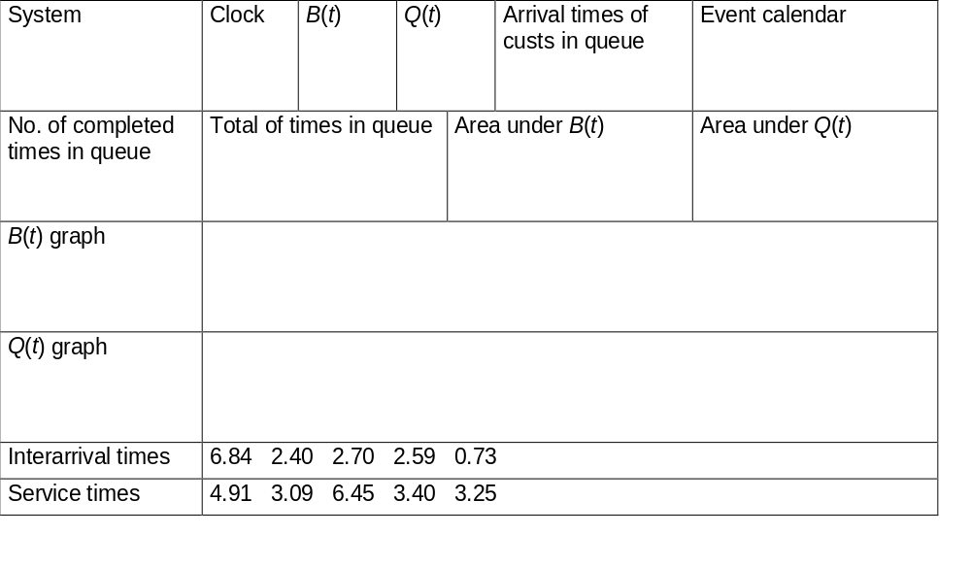
Simulation by Hand:
Setup
1
0
t
3
2
1
0
t

Slide 42
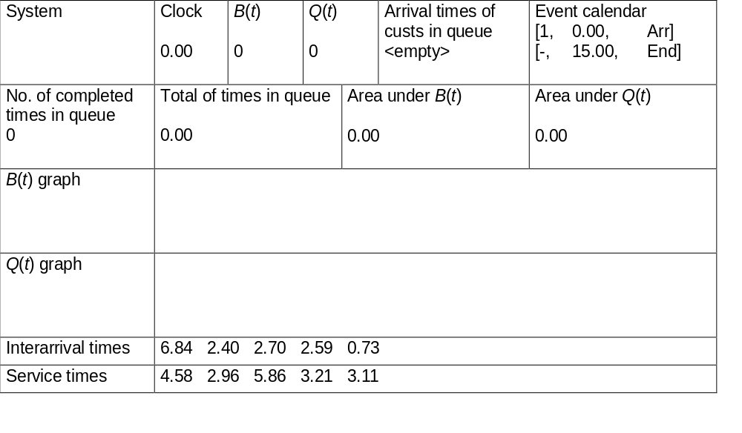
Simulation by Hand:
Initialize at t = 0.00
1
0
t
3
2
1
0
t

Slide 43
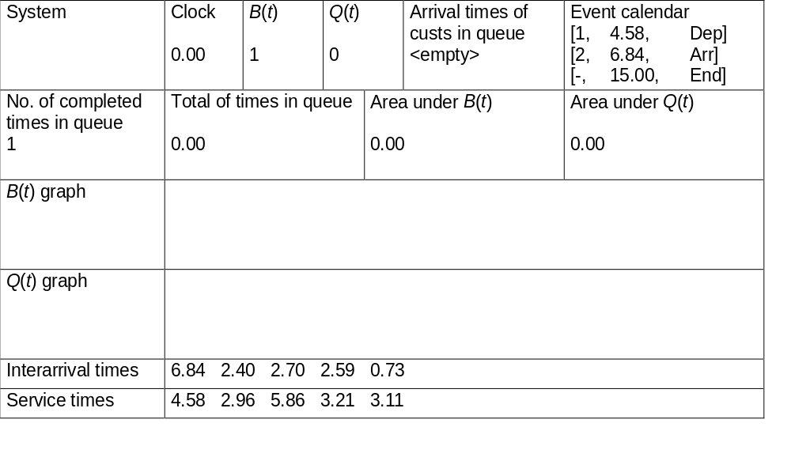
Simulation by Hand:
Arrival of Part 1 at t = 0.00
Pop the event calendar and push arrival info for 2 and departure info for 1
1
1
0
t
3
2
1
0
t

Slide 44

Simulation by Hand:
Departure of Part 1 at t = 4.58
Pop event calendar.
1
0
t
3
2
1
0
t

Slide 45

Simulation by Hand:
Arrival of Part 2 at t = 6.84
Schedule 2's departure (t + service time as press is idle) and 3's arrival.
2
1
0
t
3
2
1
0
t

Slide 46

Simulation by Hand:
Arrival of Part 3 at t = 9.24
3
2
1
0
t
3
2
1
0
t

Slide 47
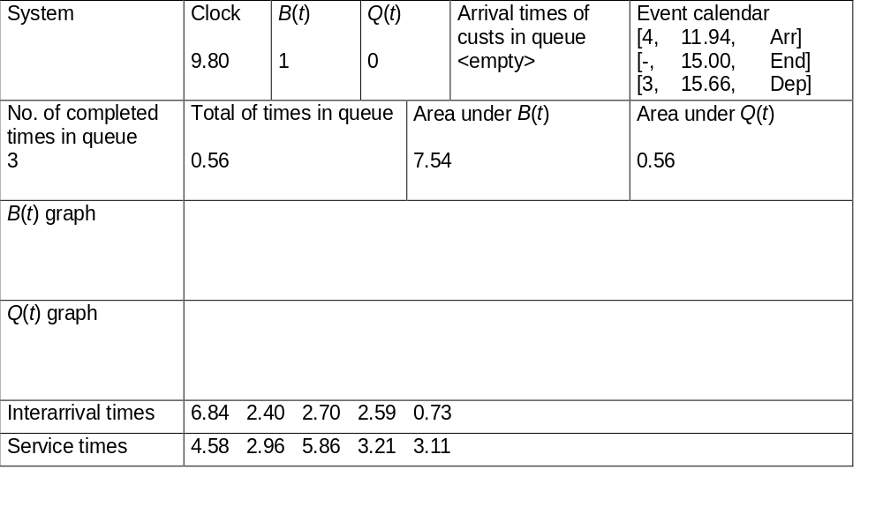
Simulation by Hand:
Departure of Part 2 at t = 9.80
3
1
0
t
3
2
1
0
t

Slide 48

Simulation by Hand:
Arrival of Part 4 at t = 11.94
4
3
1
0
t
3
2
1
0
t

Slide 49
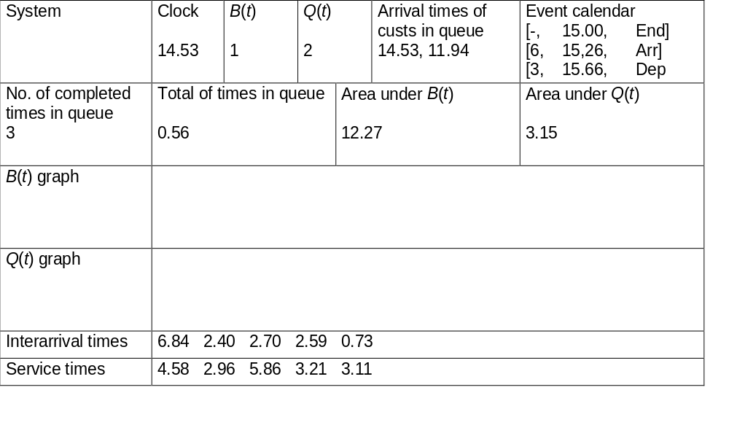
Simulation by Hand:
Arrival of Part 5 at t = 14.53
5
4
3
1
0
t
3
2
1
0
t

Slide 50

Simulation by Hand:
The End at t = 15.00
5
4
3
1
0
t
3
2
1
0
t

Slide 51
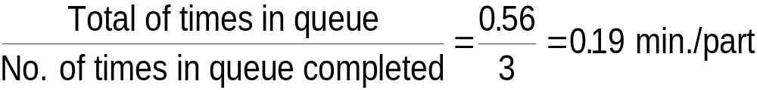
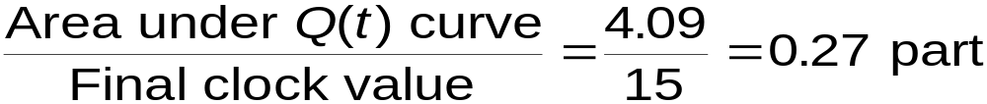
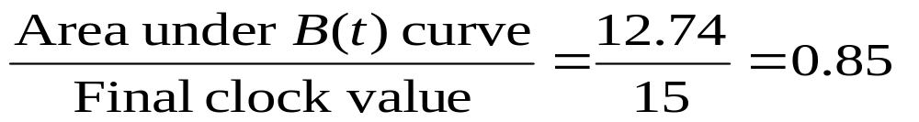
Simulation by Hand:
Finishing Up
Average time in queue: Only completed parts
Time-average number in queue:
Server utilization

Slide 52
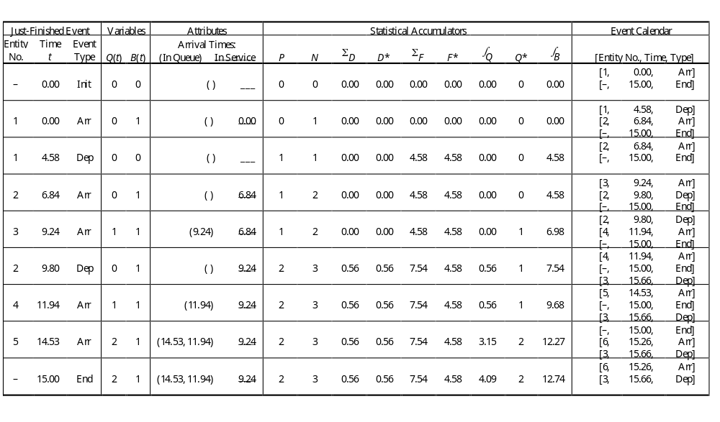
Complete Record of the Hand Simulation
(The book example chart is on pg 27)

Slide 53
The Gory Details for the Book Example
See pages 28-32.
I did this graphically for our example.
Ours used only 5 events and the book example is larger.
As tedious as the example is, fighting your way through it blow by blow will help you understand the process much better.

Slide 54
Event-Oriented Simulation
The example we just did uses this technique
  a master controller keeps track of all events, entities, attributes, variables, and statistical accumulators.
Modeling and computation centers around events, when they occur, and what happens when they occur.
For simple models, this view works well.
But, as models become more complex with lots of events, entities, and resources, this approach can be tedious to follow.

Slide 55
Process-Oriented Simulation
Here we think about what happens to a typical entity as it works its way through the model.
This approach centers on the processes that entities undergo.
The approach is somewhat like flowcharting the logic of a program in a procedure-oriented language.
In this approach, the previous example would be viewed as follows:

Slide 56
Process-oriented View of Example
Create yourself.
Record the current time.
Enter the queue.
Wait in the queue until the drill press is empty – note: the time could be zero.
Seize the drill press and exit the queue.
Compute your time in the queue.
Stay on the drill press for a time equal to your service time.
Release the drill press at the end of your service time.
Increment the production counter accumulator and tally your total time in the system.
Dispose of yourself and go away.

Slide 57
What You Don’t See in Process-Oriented Simulation
This approach requires more behind the scenes help for such things as
  Time advances
  Keeping track of time-persistent statistics
  Obtaining data for output report generation
  etc.

Slide 58
Two approaches in Arena
With Arena,
  You model and design the logic in a process-oriented mode
  But, Arena executes in an event-oriented mode.

Slide 59
Simulation Dynamics:
The Process-Interaction World View
Identify characteristic entities in the system
Multiple copies of entities co-exist, interact, compete
“Code” is non-procedural
Tell a “story” about what happens to a “typical” entity
May have many types of entities, “fake” entities for things like machine breakdowns
Usually requires special simulation software
  Underneath, still executed as event-scheduling
The view normally taken by Arena
  Arena translates your model description into a program in the SIMAN simulation language for execution

Slide 60
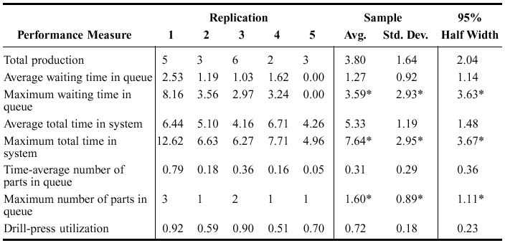
Randomness in Simulation
The above was just one “replication” — a sample of size one (not worth much)
Made a total of five replications (IID) on the book example:
Note
substantial
variability
across
replications
What do the columns mean?

Slide 61
Terminology
Avg. – just the arithmetic mean, or μ (pronounced mu) i.e. add the values and divide by the total number of values.
Std. dev. – the standard deviation, or σ (pronounced sigma)
  This is the most common measure of how widely spread the values in a data set are.
  If all the data points are close to the mean, then the standard deviation is close to 0.
  If we assume the distribution of data points is basically a normal curve, then we can use the following to understand the data …

Slide 62
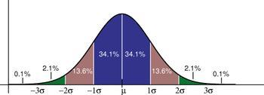
Distribution of Data Points with Respect to the Standard Deviation

Slide 63
Observe What These Standard Deviations Tell Us

Slide 64
95% Half Width
This records a confidence interval.
When a statistic such as the mean is reported for a large number of samplings, we want some assurance that the numbers we are obtaining are close to the real value.
Saying the average is 1.27 with a 95% half width of 1.14 (2nd row on earlier slide) means if we run this simulation many, many times, we will find that 95% of the times the mean will fall between 1.27 – 1.14 and 1.27 + 1.14, i.e. between 0.13 and 2.31.
Note: The smaller this number is the better.

Slide 65
One More Concern
Look at the entries with asterisks next to them.
Although reported, it is not clear what they mean.
All of these deal with maximums and it is not really clear what the mean and standard deviation of maximum measures are.
See note page 35 on table.

Slide 66
Comparing Alternatives
Usually, simulation is used for more than just a single model “configuration”
Often want to compare alternatives, select or search for the best (via some criterion)
Simple processing system: What would happen if the arrival rate were to double?
  This would cut interarrival times in half
Rerun the model for double-time arrivals
  Make five replications

Slide 67
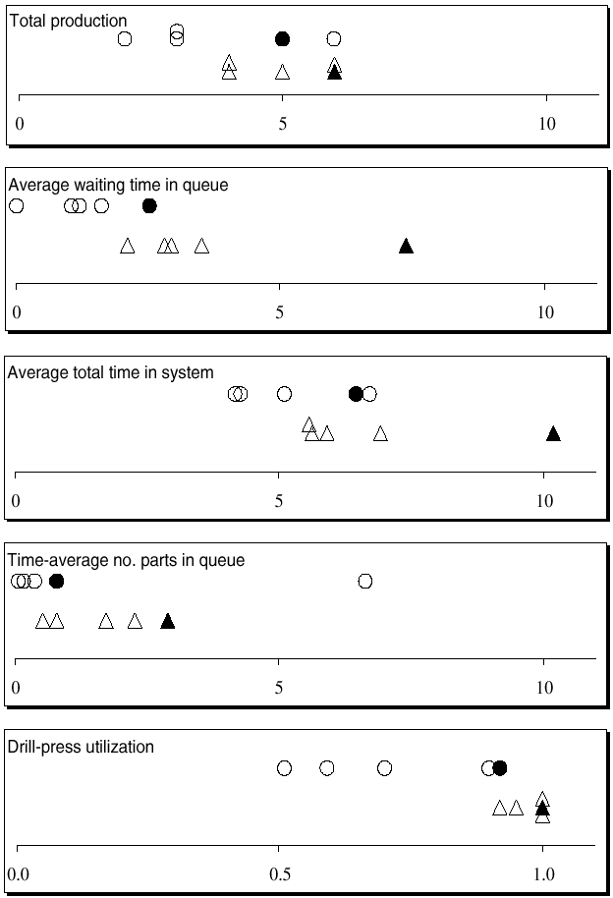
Results: Original vs. Double-Time Arrivals
Original – circles
Double-time – triangles
Replication 1 – filled in
Replications 2-5 – hollow
Note variability
Danger of making decisions based on one (first) replication
Hard to see if there are really differences
Need: Statistical analysis of simulation output data (which Arena provides).

Slide 68
Simulating with Spreadsheets:
Introduction
Popular, ubiquitous tool
Can use for simple simulation models
  Typically, static models
    Risk analysis, financial/investment scenarios
  Only the simplest of dynamic models
Two examples in book
  Newsvendor problem
  Waiting times in single-server queue
    Special recursion valid only in this case

Slide 69
Simulating with Spreadsheets:
Newsvendor Problem – Setup
Newsvendor sells newspapers on the street
  Buys for c = $0.55 each, sells for r = $1.00 each
Each morning, buys q copies
  q is a fixed number, same every day
Demand during a day: D = max (⎣X⎤, 0)
  X ~ normal (μ = 135.7, σ = 27.1), from historical data
  ⎣X⎤ rounds X to nearest integer
If D ≤ q, satisfy all demand, and q – D ≥ 0 left over, sell for scrap at s = $0.03 each
If D > q, sells out (sells all q copies), no scrap
  But missed out on D – q > 0 sales
What should q be?

Slide 70
Simulating with Spreadsheets:
Newsvendor Problem – Formulation
Choose q to maximize expected profit per day
  q too small – sell out, miss $0.45 profit per paper
  q too big – have left over, scrap at a loss of $0.52 per paper
Classic operations-research problem
  Many versions, variants, extensions, applications
  Much research on exact solution in certain cases
  But easy to simulate, even in a spreadsheet
Profit in a day, as a function of q:
W(q) = r min (D, q) + s max (q – D, 0) – cq
  W(q) is a random variable – profit varies from day to day
Maximize E(W(q)) over nonnegative integers q
Sales revenue
Scrap revenue
Cost

Slide 71
Simulating with Spreadsheets:
Newsvendor Problem – Results
If we have time at the end of the course, we'll look at a few problems that can be done with spreadsheets and look at the details of this example.
However, using a full scale simulation package is a lot easier – once the package is learned.
Results (of an Excel simulation)
  Best q is about 140, maybe a little less
  Higher q ⇒ more variability in profit

Slide 72
Simulating with Spreadsheets:
Recap
Popular for static models
  Add-ins – @RISK, Crystal Ball
Inadequate tool for dynamic simulations if there’s any complexity
  Extremely easy to simulate the single-server queue in Arena – It is Chapter 3's main example
  We can build very complex dynamic models with Arena – as we will see throughout the rest of the book

Slide 73
Overview of a Simulation Study
Understand the system
Be clear about the goals
Formulate the model representation
Translate into modeling software
Verify “program”
Validate model
Design experiments
Make runs
Analyze, get insight, document results

