Slide 1

Modeling Basic Operations and
Inputs
Chapter 4

Slide 2
What We’ll Do ...
Model 4-1: Electronic assembly/test system
  Modeling approaches
  New Arena modules (Decide, Record)
Model 4-2: Enhanced electronic assembly/test
  Resource Schedules, States, and Failures
  Frequency outputs
  More on utilizations
Model 4-3: Enhancing the animation
  Queues, Entity Pictures, Resource Pictures
  Adding Plots and Variables

Slide 3
What We’ll Do
Model 4-4: Adding entity travel times
  Stations, Transfers, Routes, animation of entity movement
Debugging: Finding and fixing model errors
Input analysis
  Specifying input distributions, parameters
  Deterministic vs. random input
  Collecting and using data
  Fitting input distributions via the Input Analyzer
  No data? What to do
  Nonstationary arrival processes
  Multivariate and correlated input data

Slide 4
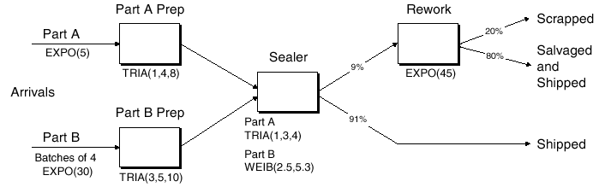
Electronic Assembly/Test System
(Model 4-1)
Produce two different sealed electronic units (A, B)
Arriving parts: cast metal cases machined to accept the electronic parts
Part A, Part B – use separate preparation areas
Both go to Sealer for assembly, testing – then to Shipping (out) if OK, or else to Rework
From Rework – Salvaged (and Shipped), or Scrapped

Slide 5
Part A
Interarrivals: expo (5) min.
From arrival point, go instantly to Part A Prep
  Process = (machine + deburr + clean) ~ tria (1,4,8) min.
Go immediately to Sealer
  Process = (assemble + test) ~ tria (1,3,4) min.
  91% pass, go to Shipped; Else go to Rework
Rework: (re-process + testing) ~ expo (45) min.
  80% pass, go to Salvaged; Else go to Scrapped

Slide 6
Part B
Interarrivals: batches of 4, expo (30) min.
Upon arrival, batch breaks into 4 individual parts
Proceed immediately to Part B Prep area
  Process = (machine + deburr +clean) ~ tria (3,5,10)
Go to Sealer
  Process = (assemble + test) ~ weib (2.5, 5.3) min. , note: different from Part A, though at same station
  91% pass, go to Shipped; Else go to Rework
Rework: (re-process + test) = expo (45) min.
  80% pass, go to Salvaged; Else go to Scrapped

Slide 7
Run Conditions, Output
Start empty & idle, run for 32 hours
Collect statistics for each work area on
  Resource utilization
  Number in queue
  Time in queue
For each exit point (Shipped, Salvaged, Scrapped), collect total time in system (a.k.a. cycle time)
Start empty & idle, run for 32 hours
Collect statistics for each work area on
  Resource utilization
  Number in queue
  Time in queue
For each exit point (Shipped, Salvaged, Scrapped), collect total time in system (a.k.a. cycle time)

Slide 8
Developing a Modeling Approach
Often multiple ways to model and represent the logic of a system.
We need to define pieces of model, modules, data structures, control logic.
For a real simulation you would need to
  Understand the process you plan to model
  Know at least some of the questions you want to answer (although while modeling, you may discover new ones.)
  Collect and analyze data you would use to build the model
    For example, what probability distributions would you use?
    Do you have enough raw data to use a tool to discover the probability distribution or will you have to use distributions that are somewhat standard?
Initially, we have specified things a great deal in order to concentrate on the process of building the model AFTER the specs are known.

Slide 9
General Plan for This Model
The Entities are the individual parts (two types)
We need separate Create modules for the two part types
We need separate Process modules for each Prep area
The process modules for Sealer and Rework are each followed by a Decide module (2-way by Chance)
  The Decide module works like an if-then-else, but the branching is based on a probability distribution.
Depart modules are needed for Shipped, Salvaged, and Scrapped and we'll use a Record module to record separate statistics at these points.

Slide 10
General Plan for This Model
Parts have different processing times at the Sealer
  So, we'll have two Assign modules to define an attribute called Sealer Time that will be assigned the proper sealer processing time after the parts are generated by the Create modules.
  In earlier models, recall we generated the processing time when the Process module was entered.
  Now we'll merely look at the attribute Sealer Time to determine the time.

Slide 11
Building the Model
Attach Basic Process panel (if needed)
Place modules
  Create (× 2)
  Assign (× 2)
  Process (× 4)
  Decide (× 2)
  Record (× 3)
  Dispose (× 3)
Right click — repeat last action (place module)
Auto-Connect, or manually connect
Alternate strategy – place one module at a time, fill it out completely

Slide 12
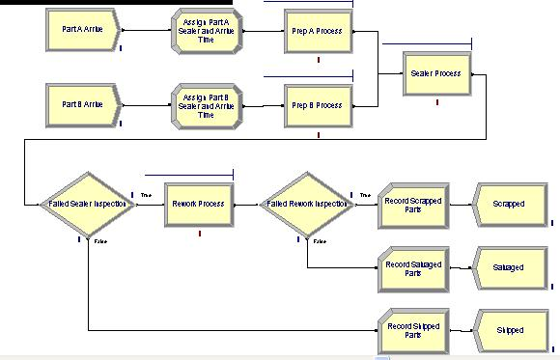
Module Placement

Slide 13
Part A Create Module
Once these entries are made, they are placed on the list for names of that type (Module Name, Entity Type, etc.) and will appear on future pull-down lists for that type of name.
Name: Part A Arrive
Entity Type: Part A
Time Between Arrivals
  Type: Random (Expo)
    Pull-down list with options
  Value: 5
  Units: Minutes
    Pull-down list with options
Default what’s not mentioned above

Slide 14
Part B Create Module
Name: Part B Arrive
Entity Type: Part B
Time Between Arrivals
  Type: Random (Expo)
    Pull-down list with options
  Value: 30
  Units: Minutes
    Pull-down list with options
Entities per Arrival: 4

Slide 15
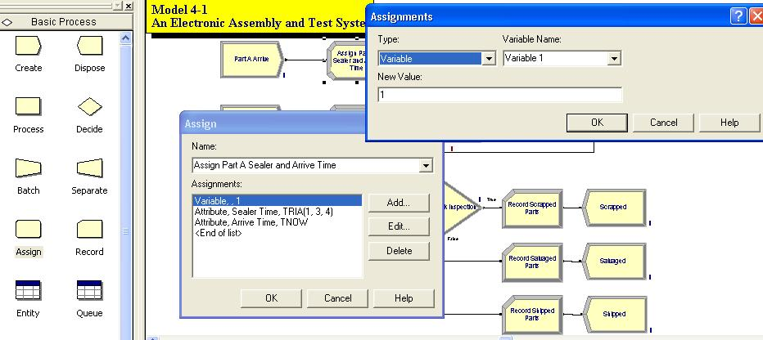
Assign Module – Choose Add for Box

Slide 16
Part A Attributes Assign Module
Name: Assign Part A Sealer and Arrive Time
Add button:
  Type: Attribute
  Attribute Name: Sealer Time
  New Value: TRIA(1, 3, 4)
Add button:
  Type: Attribute
  Attribute Name: Arrive Time
  New Value: TNOW (to compute time in system on exit)
TNOW is the internal Arena variable name for the simulation clock; see
Help > Arena Help > Contents >
Variables, Functions, and Distributions > Variables > Date and Time Variables

Slide 17
Part B Attributes Assign Module
Name: Assign Part B Sealer and Arrive Time
Add button:
  Type: Attribute
  Attribute Name: Sealer Time
  New Value: WEIB(2.5, 5.3)
Add button:
  Type: Attribute
  Attribute Name: Arrive Time
  New Value: TNOW
Names for things in Arena
– Default names usually suggested
– Names placed on appropriate pull-down lists for future reference
– All names in a model must be unique (even across different kinds of objects)

Slide 18
Prep A Process Module
Name: Prep A Process
Action: Seize Delay Release
Resources subdialog (Add button):
  Type: Resource (a pull-down option)
  Resource Name: Prep A
  Quantity: 1 (default)
Delay Type: Triangular
Units: Minutes
Minimum: 1
Value (Most Likely): 4
Maximum: 8
If several Resources were named (Add button), entity would have to Seize them all before the Delay could start.

Slide 19
Prep B Process Module
Name: Prep B Process
Action: Seize Delay Release
Resources subdialog (Add button):
  Type: Resource (a pull-down option)
  Resource Name: Prep B
  Quantity: 1 (default)
Delay Type: Triangular
Units: Minutes
Minimum: 3
Value (Most Likely): 5
Maximum: 10

Slide 20
Sealer Process Module
Name: Sealer Process
Action: Seize Delay Release
Resources subdialog (Add button):
  Type: Resource (a pull-down option)
  Resource Name: Sealer
  Quantity: 1 (default)
Delay Type: Expression
Units: Minutes
Expression: Sealer Time
Recall – Sealer Time attribute was defined upstream for both Parts A and B … now its value is being used … allows for different distributions for A and B.

Slide 21
Sealer Inspection-Result Decide Module
Decide module provides branch points
  By Condition (entity Attributes, global Variables)
  By Chance (multi-sided, possibly-biased hypercoin flip)
Name: Failed Sealer Inspection
Type: 2-way by Chance (default)
Percent True: 9
Different exit points for True, False results – connect appropriately downstream
Note it’s percent true, not probability of true … so “9” means 9%
We arbitrarily decided “true” meant part failed inspection … could have reversed (but would change numerical results obviously)
This is a rich, deep, versatile module … explore its Help button

Slide 22
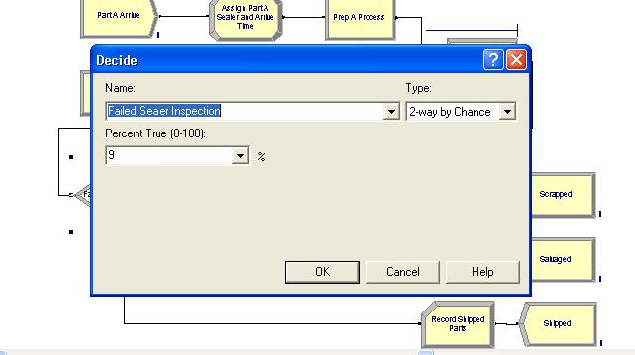
Decide Module

Slide 23
Completed Definitions Through Decide Module

Slide 24
Rework Process Module
Name: Rework Process
Action: Seize Delay Release
Resources subdialog (Add button):
  Type: Resource (a pull-down option)
  Resource Name: Rework
  Quantity: 1 (default)
Delay Type: Expression
Units: Minutes
Expression: EXPO(45)
We had to use the general Expression choice for Delay Type since what we want (EXPO) is not directly on the Delay Type pull-down list.

Slide 25
Rework Inspection-Result Decide Module
Name: Failed Rework Inspection
Type: 2-way by Chance (default)
Percent True: 20
We arbitrarily decided “true” meant part failed inspection

Slide 26
Record Modules
Arena collects and reports many output statistics by default, but sometimes not all you want
We want the time in system (avg, max) of parts sorted by their exit point (Shipped, Salvaged, Scrapped)
  It’s this sorting that Arena doesn’t do by default ... it would automatically sort by Entity Type if we had Entities checked in Run > Setup > Project Parameters (which we don’t) because we want to introduce this useful module.
The Record module can be placed in a flowchart to collect and report various kinds of statistics from within the model during the run as entities pass through it
It is useful for Tally-type output performance measures

Slide 27
Shipped Parts Record Module
Name: Record Shipped Parts
Type: Time Interval
  Records time elapsed up to now (TNOW) from when an entity attribute was marked with a time “stamp” upstream ... Attribute Name is below ...
  There are several other options for Type … explore via Record module’s Help button!
Attribute Name: Arrive Time
  This was defined upstream as the clock value in the Assign modules instantly after each entity was Created
Tally Name: Record Shipped Parts
  Determines the label in the reports
The other two Record modules –
just like this except for Name and Tally Name.

Slide 28
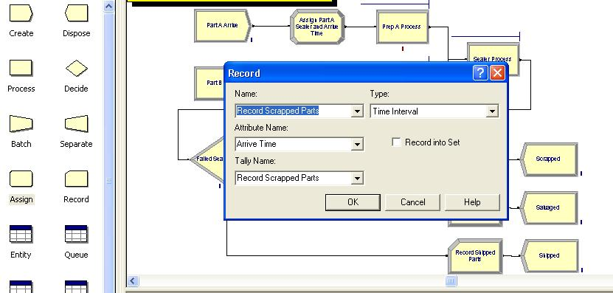
Record Module

Slide 29
Dispose Modules
Three separate exit points for three separate part dispositions (Shipped, Salvaged, Scrapped)
Could have directed all three exit types to a single Dispose module
  Separate modules provide animation counts of three dispositions
  Separate Dispose modules allows for differentially checking the boxes to Record Entity Statistics
  We can produce flow statistics separated by entity type (if Entities Statistics Collection is checked in Run > Setup > Project Parameters), not by final disposition of part … so we did need our Record modules and Arrive Time attribute

Slide 30
Run > Setup for Run Control
Without this, model would run forever – no defaults for termination rule
  That’s part of modeling, and generally affects results!
Project Parameters tab:
  Fill in Project Title, Analyst Name
  Defaults for Statistics Collection, but we cleared the check box for Entities
    Not needed for what we want (we installed our own Record modules), and would slow execution
Replication Parameters tab:
  Replication length: 32 (4 consecutive 8 hour shifts); accept Hours default for Time Units except for the Base Time Units set Minutes

Slide 31
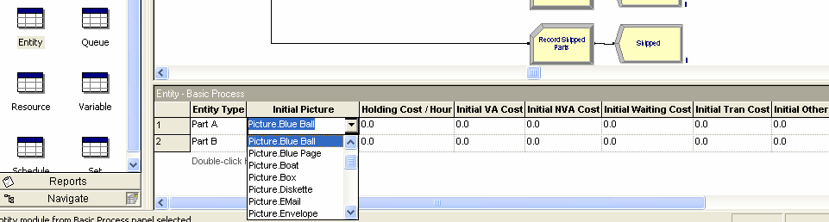
Different Part A, B Entity Pictures Will Enhance the Animation
Entity data module (just single-click on it in Project Bar, edit via spreadsheet only)
Row for each Entity Type (Part A, Part B)
Pull down Initial Picture pull-down menu, select different pictures for each Entity Type
  Edit > Entity Pictures to see, change the list of pictures that’s presented here … more later

Slide 32
Running the Model - Demo
Some graphics don’t show during run … will return when you End your run … You can control via View > Layers
Don't forget the Status Bar at the bottom shows run progress – replication number, simulation time, simulation status
Animation speed
  Slider bar at top (best approach), or increase (> key), decrease (< key) to change speed
  Can set in Run > Setup as shown earlier
  Note: This model doesn't do a whole lot so a single run is very fast. Try multiple replications.

Slide 33
Running the Model - Demo
Use Esc key to pause; to resume push Go
  When paused, double click on one of the entities to see an Entity Summary box.
  The box lists the values of each of the entity's attributes.
  This can be a useful debugging tool.
Run > Step to debug – more on this later with debugging work.
Run > Fast-Forward to turn off animation
Run > Run Control > Batch Run (No Animation) is fastest
Also, as we will see, typical debugging tools such as setting breakpoints and watching exist.

Slide 34
Viewing the Results
Counters are incremented during animation for modules
  Create, Dispose, Decide – incremented when entity leaves
  Process – number of entities currently in the module
Asked at end if you want to see reports
  What you get depends on Run > Setup > Project Parameters
Looks like the Rework area is a bottleneck – tentative conclusion at this point.
Generally it is difficult/unreliable to draw conclusions from just one run

Slide 35
Viewing the Results
Navigate through report with browsing arrows, tree at left investigating
  Tally, Time-Persistent, and Counter statistics
  Avg, Min, Max, and 95% Confidence Interval half-widths
    Confidence intervals are for steady-state expectations.
    We'll see what to do with these in Chapter 7
    May not be produced if run is not long enough for reliable statistics.

Slide 36
Model 4-2: The Enhanced Electronic Assembly and Test System
Let's pretend the original model was shown to a production manager who
  Pointed out that this is only the first shift of a two-shift day — on second shift there are two operators at Rework (the bottleneck station) … 16-hour days
  Pointed out that the Sealer fails sometimes
    Uptimes ~ expo (2) hours
    Repair times ~ expo (4) min.
  Wants to buy racks to hold rework queue
    A rack holds 10 parts
    How many racks should be bought?
  Wants runs for 10 days (16-hour days)
Now we need: Resource Schedules, Resource States, Resource Failures

Slide 37
Run Conditions – Some Easy Changes
Redefine a “day” to be 16 hours – Run > Setup > Replication Parameters
Change Replication Length to 10 (of these) days

Slide 38
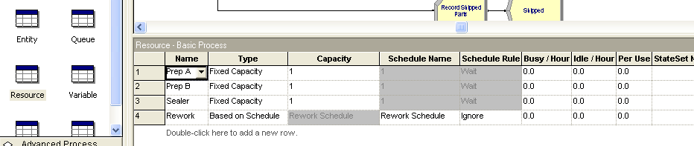
Schedules
We want to vary capacity (i.e. the number of units) of a resource over time
In Resource Data module (spreadsheet view)
  For Rework Resource, change Type from Fixed Capacity to Based on Schedule
  Two new columns – Schedule Name and Schedule Rule
  Type in a Schedule Name (Rework Schedule)

Slide 39
Schedules
Select a Schedule Rule
Of concern, how and when does the capacity decrease if the Resource is allocated to an entity and what effect does the choice have on the statistics collected?
Quick overview of choices:
  Wait (default) – Capacity decrease will wait until an entity releases Resource.
  Ignore – Capacity will go down immediately for statistical collection, but work will go on until finished.
  Preempt – Processing is interrupted and resumed when the preempting entity leaves.

Slide 40
More Details on the Schedule Rules
Suppose a capacity decrease is scheduled to occur and X units of resource are idle, all 3 options cause X units to become Inactive.
If fewer than X units are idle, each Schedule Rule responds differently.
Wait (default) – Capacity decrease will wait until an entity releases Resource.
  With this option, the reduced capacity time will always be of the specified duration, but the time between the reductions may increase.

Slide 41
More Details on the Schedule Rules
Ignore – Capacity will go down immediately for statistical collection, but work will go on until finished.
  When units of the resource are released, they are placed in an Inactive state.
  If the scheduled time at the lower capacity expires before the entity releases the resource, it would appear that the schedule change never happened.
  Consequently, the time for which reduced capacity is scheduled may be shortened by this choice.

Slide 42
More Details on the Schedule Rules
Preempt – Processing is interrupted and resumed when the preempting entity leaves.
  If the preempt is successful and a single unit of capacity is enough, then capacity is reduced immediately.
  The preempted entity is held by Arena until the resource become available. Then it will be reallocated the resource and continue with its remaining processing time.
  Typically, this can be used to model schedules and failures as the processing of a part is suspended at the end of a shift or when the resource fails.
  If the preempt is unsuccessful or if more than 1 unit is needed, the Ignore unit is invoked.

Slide 43
Cautions About Schedule Rule Choices
If the resource being considered is a bottleneck, your choice of a schedule rule can have a profound effect on the results.
It's best to try and mimic the actual behavior.
Some rules of thumb for choosing if the actual process behavior is not clear: (>> means "is very much larger")
  duration of scheduled decrease >> processing time ➔ try Ignore
  time between capacity decreases >> duration of the decrease ➔ try Wait
We'll choose Ignore for this system because typically an operator will finish the task before leaving and the additional work time is seldom considered (i.e. overtime without being specified in advance is not paid.)

Slide 44
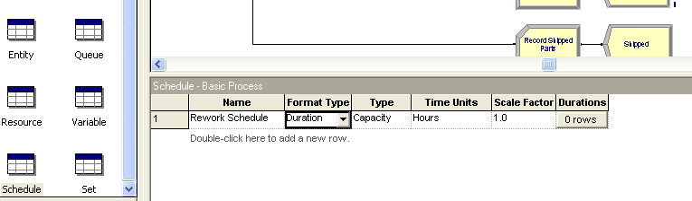
Schedules
Define the actual Schedule the Resource will follow.
Select the Schedule data module
  Row already there since we defined Rework Schedule
  Format Type is Duration for entries based on elapsed time past simulation start time
  Type is Capacity, for Resource schedule (more about this later on Arrival Type)

Slide 45
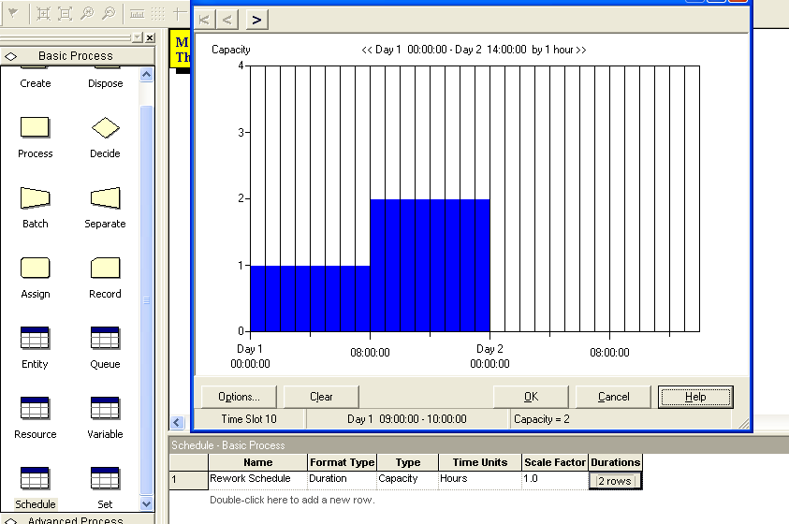
Schedules
Click in Durations column, to obtain the Graphical Schedule Editor (Note: the Durations column, not the Duration entry.)
  You can use the Graphical Schedule Editor only if time durations are integers, with no Variables or Expressions involved. Otherwise, data must be entered manually.

Slide 46
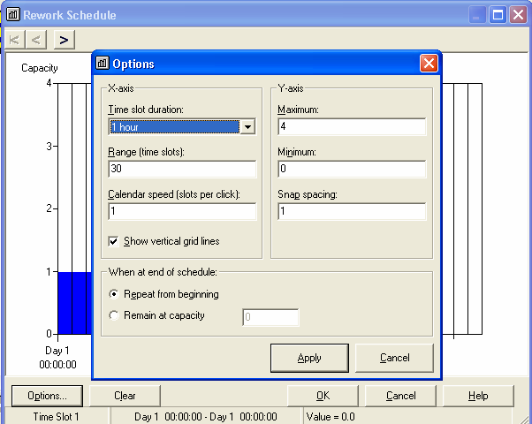
  The Options button controls axis scaling, time slots in editor,
  whether schedule loops or stays at a final level forever

Slide 47
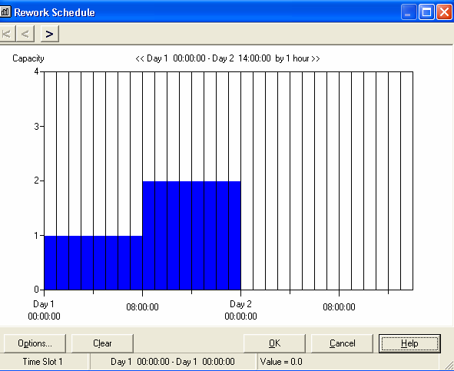
  X-axis is time, Y-axis is Resource Capacity.
  When you click on day 1, capacity 1, slot 1, a blue bar appears.
  Click and drag it to define the graph.
  Only day 1 must be specified in this case as this will repeat forever.

Slide 48
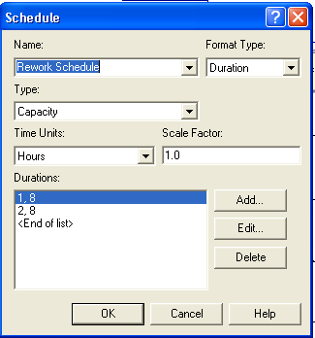
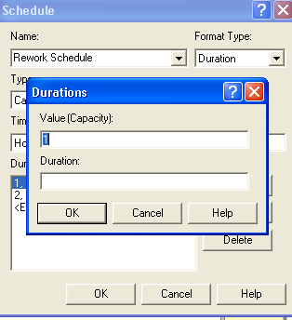
Or, Schedules Can Be Entered Manually
Manual entry is required if time durations are not integers or if Variables or Expressions are involved.
To do manual entry, right-click the Durations column in the Schedule module spreadsheet and select Edit via Dialog:
To enter Durations, press Add for each line to obtain:

Slide 49
Using the Graphical Schedule Editor vs Manual Entry with Dialog Box
If you use the Graphical Schedule Editor and then open the dialog box, you'll see the data already entered.
Conversely, if you enter via the dialog box, the Graphical Schedule Editor will show you the results graphically.
Note: You can use non-integer durations or durations determined by a random draw provided you use the dialog box.
Note: You can involve Variables and Expressions when specifying durations.

Slide 50
Schedules- Caution
    Enter pairs for Capacity, Duration … as many pairs as needed
    If all durations are specified, the schedule repeats forever
    If any duration is left empty, it defaults to infinity

Slide 51
Resource Failures
Usually for unplanned, random downtimes
Can start definition in Resource or Failure module (Advanced Process panel) … we’ll start in Failure
Attach Advanced Process panel if needed (File > Template Panel > Attach)
Single-click on Failure, get spreadsheet view
To create new Failure, double-click – add new row
Name the Failure
Type – Can be Time-based or Count-based (we’ll do Time)
Specify Up Time, Down Time, with Units for both

Slide 52
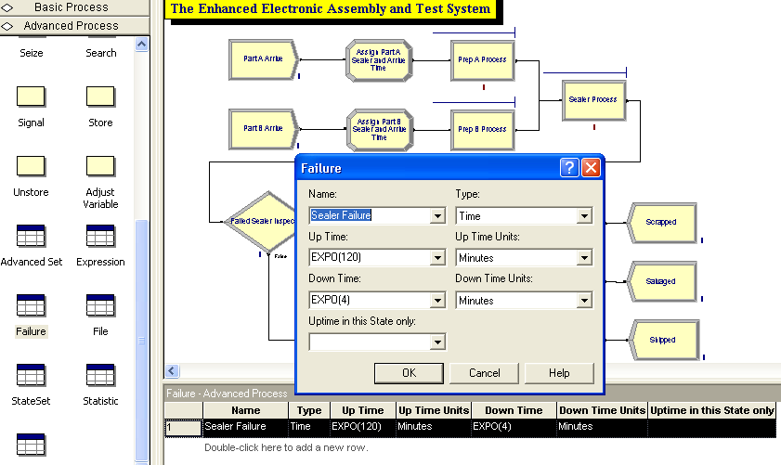

Slide 53
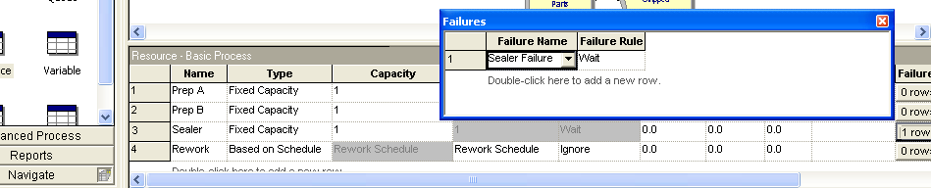
Resource Failures
Attach this Failure to the correct Resource
  Resource module, Failures column, Sealer row – click
  Get pop-up Failures window, pick Failure Name Sealer Failure from pull-down list
  Choose Failure Rule from Wait, Ignore, Preempt (as in Schedules)

Slide 54
Failures – A Few More Notes
Can have multiple Failures (separate names) acting on a resource
Can re-use defined Failures for multiple Resources (they operate independently if they involve random variables)
Count-based failures are quite common in industrial settings.
  They can be based on a fixed number or any expression.
  Examples are: tool replacement, cleaning, machine adjustment after a certain number of parts have been handled
We often use time-based failures because this is the way we collect our data.
  Many vendors provide such data based on operating hours.

Slide 55
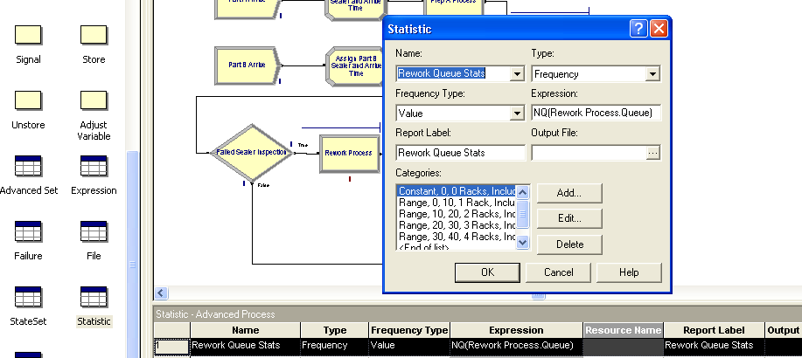
Frequencies
Record time-persistent occurrence frequency of variable, expression, or resource state
  Use here to record % of time rework queue is of length 0, (0, 10], (10, 20], … for info on number of racks needed
Statistic data module (Advanced Process panel)

Slide 56
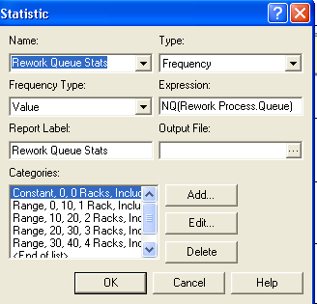
Statistic Dialog Box
Five Types of statistics, of which Frequencies is one
Specify Name (Rework Queue Stats), Frequency Type (Value)
Report Label (Rework Queue Stats)

Slide 57
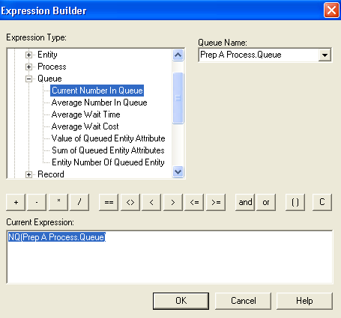
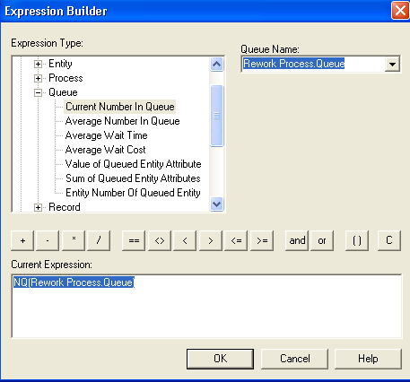
Specify Expression to track and categorize
  Right-click in field to get to Expression Builder
First choice is not the
right queue.
Choose Rework Process.queue from menu

Slide 58
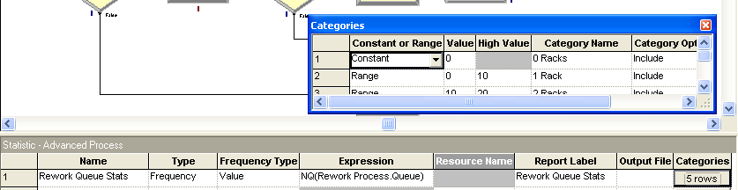
Establish Categories for Racks
Pop-up secondary spreadsheet for Categories (browse file) – push 0 rows area under Categories and enter in spreadsheet.
We set values for up to 40 items. If more are needed, Arena will create an out-of-range category and provide statistics on it.

Slide 59
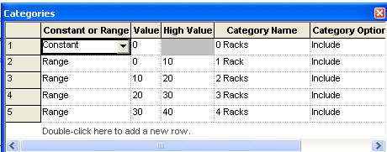
Final Categories Define Number of Racks
Note: The value is not included in the range. Thus this defines queues
  of length 0
  of length (0,10] i.e. greater than 0 and less than or equal to 10
  of length (10,20] etc.

Slide 60
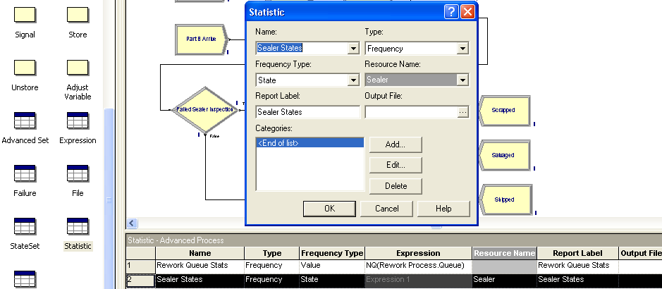
Frequencies
We'll add another Frequency (using the Statistic module again) to give a finer description of the Sealer states
  This produces statistics on proportion of time Sealer is in each of its three possible states – Busy, Idle, and Failed

Slide 61
Note
Frequencies are not part of default Category Overview report
  With this addition, if we open the Frequencies report from Project Bar (get separate window) and we'll see the frequencies for the different Sealer states.
Now run Model-2 for 10 days.

Slide 62
Results of Model 4-2
Differ from those of Model 4-1 since this is a longer run (10 16 hour days instead of 32 hours), and the modeling assumptions are different
  All of which causes underlying random-number stream to be used differently (Chapter 12 will explore this idea further.)
Prep A/B didn’t change (other than run length and random variation) …we still need to do a statistical analysis of the simulation output (Chapters 6, 7, 12 will explore this idea further.)
Sealer is more congested (not surprising since it now fails because we built in failures.)
Rework is less congested (the 50% higher staffing seems to have helped)
Frequencies report suggests one rack suffices about 95% of the time, two racks all the time

Slide 63
Utilizations – Some Fine Points
Two utilizations reported for each Resource.
Both supply interesting information under different circumstances.
Instantaneous Utilization is the time-average of the ratio of the number of units that are busy to the number of units that are scheduled
  By definition, counts periods when zero units are scheduled as zero-utilization periods
  If a Schedule is attached to a Resource and the scheduled capacities are either zero or a single positive constant, the reported Instantaneous Utilization tells you how busy the Resource was over the entire run.

Slide 64
Utilizations – Some Fine Points
Scheduled Utilization is the average number busy divided by the average number available
  No division-by-zero problem, assuming there were ever any units of the Resource scheduled at all (if not, it shouldn’t be in the model)
The two utilization results are identical for a fixed-capacity Resource
The results can differ for Resources on a variable Schedule
  If Resource capacity varies among several different positive values, it’s better to consider the Scheduled Utilization as it tells you how busy the Resource was over the time it was available – i.e. when its capacity was non-zero.

Slide 65
Utilizations – An Example
Suppose a Resource is
  Scheduled to be available 2/3 time with a capacity of 1
  Unavailable 1/3 of time (i.e. with capacity of 0).
  During the time it was available, it was busy half the time.
The Instantaneous Utilization would be reported at 0.3333
The Scheduled Utilization would be reported at 0.5000
These reported figures would say that over the entire run, the Resource was utilized 1/3 of the time, but during the time it was scheduled to be available, it was utilized ½ of the time.
More issues, even finer points – see text, but don't dwell on these at this point.
In particular, concentrate on interpretation, not calculations.

Slide 66
Model 4-3: Enhancing the Animation
We took the “Spartan” generic default animation for some things (queues, connector-animation movement)
  Usually sufficient for verification and validation of a model.
  Don't try to become fancy on the animation until you see that you have a good, working model.
But, certainly at some point, you will want to customize and enhance the animation a bit to obtain more realism and impact, especially for presentation purposes.
In fact, on IRC projects, most students end up with quite spectacular graphics.
However, be sure you do the other parts of the modeling first!!

Slide 67
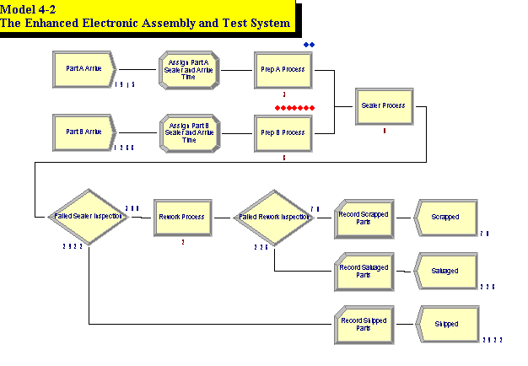
We Have Been Taking Default Animations So Far, Embedded in the Logic Model
When a Process module is selected, Arena automatically provides an animated queue.
Entities can be seen moving along the connections.
Variable counts are automatically placed to show tally statistics when some modules are exited.

Slide 68
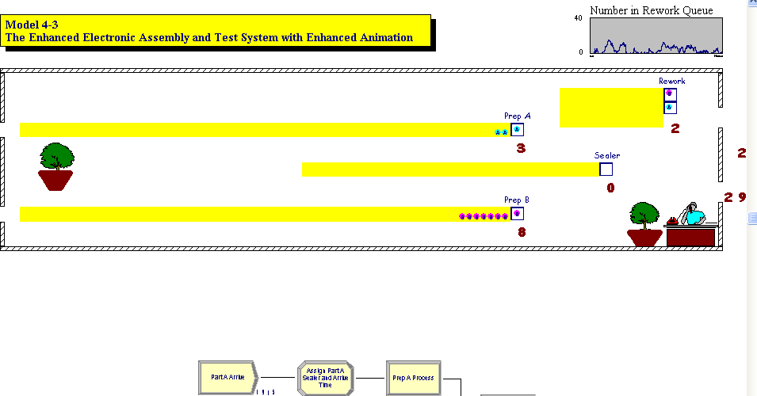
We will pull the animation away from the logic in model window
This is particularly useful for big models with complex animation
We'll use Named Views for model logic, animation, and perhaps close-ups of the graphics.

Slide 69
Changing Animation Queues
Lengthen (click, drag, maybe hold shift) to “hold” more entities
  Simulation logic, results OK if animated queue overflows
Rotate to re-orient for realism
Change the “form” of the queue from Line (the default) to Point — fixed places for entities
  Double-click on the queue
  Select Type to be Point
  Click Points… button
  Successively click Add for points, then OK
  Drag them around on screen- wait for the crosshairs to show before dragging anything.
  Check Rotate box to show entities turning

Slide 70
Demo Changing Queue Locations and Style

Slide 71
We Also Want to Do the Following
Change pictures for the parts – namely place an A on one and B on the other.
Add plot(s).
Make the area look like a work area, even adding a picture of a receptionist in one corner.

Slide 72
Demo to Change Balls to Balls With Letters on Them

Slide 73
Changing Entity Pictures
Earlier – used Entity data module to assign different Initial Pictures to different Entity Types
Can customize list, alter pictures in it
  Edit > Entity Pictures
  Left column – names, pictures currently on the list
  Right column –picture libraries (.plb filename extension)
  Add a hand-drawn picture – Add button on left, name it in Value field at top, double-click on blank depressed button, then do artwork (or paste in a copied graphics image)
    New name won’t appear in Entity data module until you type it there

Slide 74
Changing Entity Pictures
To edit an existing picture – double-click on it to highlight it and then do any artwork using the draw commands on the Draw toolbar.
After finishing and exiting the Picture Editor (with small X under the large X), copy the picture over from picture library.

Slide 75
Demo to Add Resource Pictures

Slide 76
Adding Resource Pictures from Arena's Libraries
Animate a Resource – Resource button in animate toolbar – get Resource Picture Placement window
Left column – default pictures for different Resource states
  Attach logically to a Resource by Identifier pull-down list
  Double-click to edit artwork by hand, or paste in previously copied graphics images (see next slide for this)
  Seize area – where seizing entity will “reside”
  Multiple seize areas for multi-capacity Resources
Right column – picture libraries (.plb files) – can copy over to selected (depressed) state pictures.
You can save in your own named library for later use.
Accept window, cross hairs, click to place
  Resize, reposition as desired

Slide 77
Importing Your Own Clip Art Choices
There are many clip art sites available, but be wary of malware embedded in some.
Download any picture as a .jpg file.
Open it and then copy to the clipboard and paste into Arena's workspace.
Or, if you wish to store it in a library for animation purposes or just to keep it for future use:
  Select Resource picture
  Delete the default pictures of Busy, Idle, etc.
  Add a new slot and double click on it to obtain the Picture Editor.
  Paste the picture into the Picture Editor and adjust the reference point to where you want it and close the editor.
  To create a new library, click New; otherwise click Open and move the new picture to the right.
  Save under your preferred name.
Please be careful you don't violate copyrights!

Slide 78
Adding Variables and Plots
Variable animation – just show a value of something as a number, watch it change
  Variable object from Animate toolbar
  Double-click, specify Expression to be shown (Expression Builder), and cosmetics
  Resize, reposition later
Dynamic animated plots – Chapter 3 covered these
Other animation objects from Animate toolbar
  Discussed later:
    Clock (TNOW), variety of formats
    Level (thermometer) animation
    Others

Slide 79
Model 4-4: Electronic Assembly and Test System with Part Transfers
Generalize Model 4-3
All part transfers now take 2 minutes (not instantaneous tranfers)
  Model, animate this
  Materially changes model logic, results
  Two-minute transfer times for:
    Arriving parts to prep areas
    Departing parts to appropriate exit
    All internal part transfers
  Transfers take two minutes regardless of distance
    We'll fix this (unrealistic) assumption in Chapter 8

Slide 80

New Arena Concepts
Station – location where some process occurs
  Arrivals, manufacturing cells, departures
  Each Station is given a unique name
  Can serve as an entry point for a section of model logic
  Station marker represents a logical station in the flowchart/animation
Station Transfer – entities move between Stations without direct connection
  Several different types – we’ll use Routes here, which allow for positive transfer time, but no other additional delays are due to constraints such as blocked passageways or equipment not being available.
  Route paths represent Routes in the flowchart/animation

Slide 81
Why Not Just Add Delays?
Simpler way to get the two-minute transfer times:
  Insert a Process module with Action = Delay for 2 minutes on each relevant connection
  Or, use Delay module from Advanced Process panel
This would work from modeling, numerical-output viewpoints
But would not allow animation of part transfers, so we’ll proceed with the Stations and Routes

Slide 82
Demo Model 4-4

Slide 83
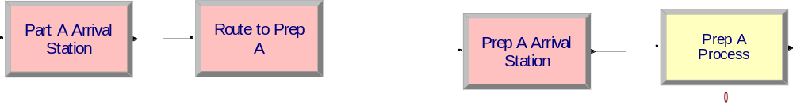
What is Going On Internally
When entity leaves a module that specifies a Route as the transfer mechanism:
  Arena places the entity on the event calendar with an event time dictated by the route duration.
    Ex:
Event Calendar receives a record
[5, TNOW + 2.0, RoutePrepA]

Slide 84
What is Going On Internally
  When the entity is to be removed from the event calendar, Arena returns the entity to the flow of model logic by finding the module that defines its destination station.
  The destination station is typically a Station module.

Slide 85
What is Going On Internally
Note the difference with what we have been doing:
  Direct connections existed between modules and were physically shown.
  Transfers between modules did not require the placement of a record on the event calendar.

Slide 86
Stations
Are represented in the flowchart view of the model using station marker symbols:
The stations establish locations on the model’s drawing where station transfers can be initiated or terminated.
The movement of entities between the stations is defined by route path objects, which visually connect the stations to each other for the animation and establish the path of movement for entities that are routed between the stations.

Slide 87
The Animation is Different
You can see the movement of entities between stations.
The path taken by an entity is seen visually.
This path movement is started when the entity record is placed on the event calendar.
The movement is timed so the entity finishes at its destination when the record comes off the event calendar.
Thus, we need to change two things:
  The logic (or flowchart)
  The animation

Slide 88
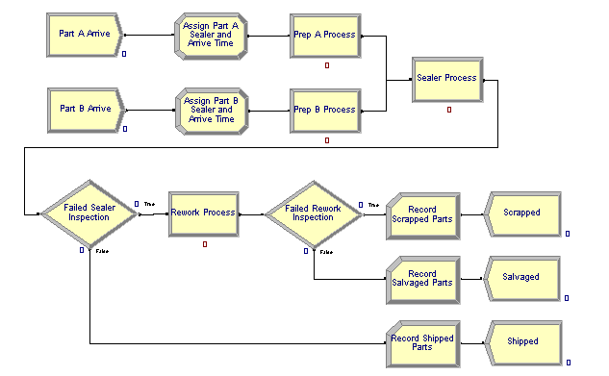
Adding the Route Logic – From Arrival
Stations and Station Transfers affect both the model logic and the animation
Start with Model 4-3 … change to Model 4-4

Slide 89
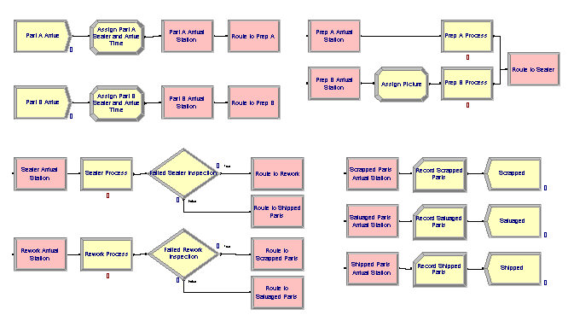
Model 4-4
Note how the model is now disconnected into pieces as there is no physical connection between Routes and Stations.
All of the pink modules are additions.

Slide 90
How Does Arena Handle Stations and Routes?
Stations are often used as physical locations in a model, but they need not exist physically.
As we saw when we hand traced a model run in Chapter 2, Arena moves entities through the system using the event calendar to direct the movement.
When an entity is placed in a Route for transfer, the event calendar receives an event time for the entity to exit and arrive at its destination station which is typically a Station module.
The physical connection between a Route and a Station, while not shown in the logic, is shown in the animation that we see.

Slide 91
Station Markers
Station modules in the flowchart view act as departure or destination points.
In the animation view, these are represented by station markers-
The movement of entities through the stations in the animation view are defined by route paths which are represented as polylines that establish a graphical path the entities will follow on their routes.
When the simulation runs, entity pictures will move along these route paths.
Arena's animation engine coordinates with its logic engine so that when a route is involved on the event calendar, the animation shows entities moving along the route path and movement stops when the transfer is complete.

Slide 92
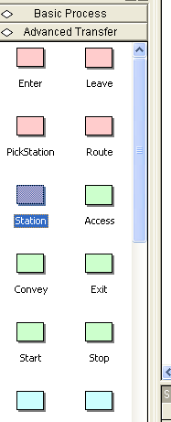
Adding the Route Logic – Part Arrivals
For incoming parts (A and B) delete the
connection from the Assign modules to “Prep”
Process modules and replace with
Station/Route module pairs
Be sure the Advanced Transfer panel is
attached.
Place the Station module which defines
the entity’s location

Slide 93
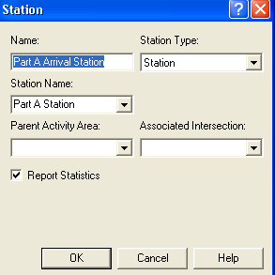
Adding the Route Logic – Part Arrivals
Click on the module and complete
the dialog box entries.
Module Name vs. Station Name
  The Name is the text for the
Station module in the flowchart
  The Station Name while be used
internally by Arena.

Slide 94
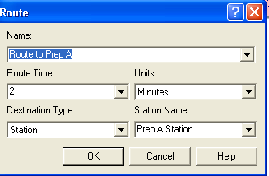
Adding the Route Logic – Part Arrivals
  Place the Route module (Advanced Transfer panel) – to send entity out
    Route Time, Destination Station, Time set
  There are no direct connections exiting from the Route modules – the Route module’s Destination Station Name defines that.

Slide 95
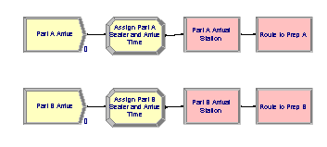
The Final Logic for Arrivals

Slide 96
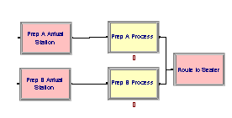
Adding the Remaining Route Logic
Add Station modules for entry to each Prep area
  Station names are Prep A Station, Prep B Station, and are the destination stations for Routes after arrivals
Process modules for Prep A, Prep B unchanged
After prep, entities connected to Route module to send to next station (sealer)
We don’t need a separate Station module for the outgoing side as all parts from the two processes are going to the same place.

Slide 97
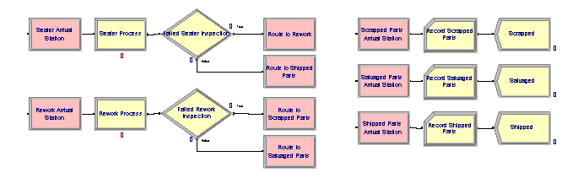
Adding the Remaining Route Logic
Similar changes for rest of model
  Station modules for incoming parts into sealer, rework, each of three Record modules (entity exit points)
  Route modules for outgoing parts out of sealer inspection, rework inspection (two for each Decide module – pass/fail)
Could run model now, get correct results … but you'd see no animation of transfers …

Slide 98
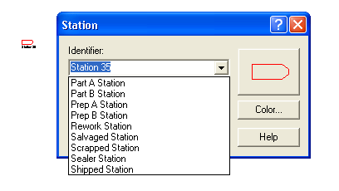
Altering the Animation – Stations
Add animation for Stations:
Be sure the Animate Transfer toolbar is showing.
Push the Station button , on the Animate Transfer toolbar
  You will obtain cross hairs
  Place (click) the marker in animation
  Attach Identifier to it from pull-down
  list of station names
You can place several station markers
for the same logical station (e.g., to represent incoming,
outgoing sides)
You can drag station markers around later

Slide 99
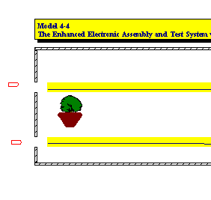
After Placing Station Markers for Part A Station and Part B Station

Slide 100
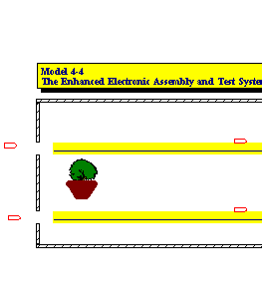
Add Prep A Station and Prep B Station Markers
Repeat as in the last slide, but place the markers above the queue (or anywhere you want the route to end.)

Slide 101
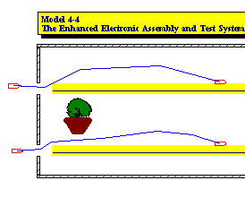
Altering the Animation – Routes
Push Route button from Animate Transfer toolbar
  Click first in Station marker and then anyplace you want the route to go, ending in
  the destination location.
  You'll get cross hairs; click in
  origin then the destination Station
  Markers
    Make intermediate clicks for
    corners along the route and also
    to show any animated entities.
  You can drag around endpoints,
  corners later

Slide 102
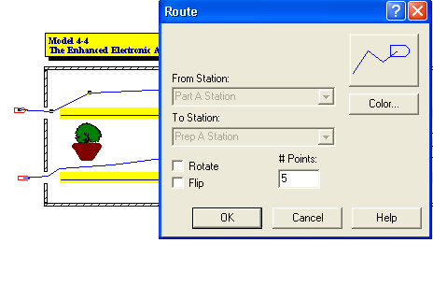
Altering the Animation – Routes
  Options for appearance of entities as they travel the route can be changed by clicking on the route to get a dialog box:

Slide 103
The Two Step Process Can Be Done in One Step
  Alternatively, use Route animation to create both Station markers and Route animation
    Click for beginning Station marker
    Intermediate clicks for route corners
    Double-click for ending Station marker
    Then go back and double-click on the two Station markers to define their logical Identifiers

Slide 104
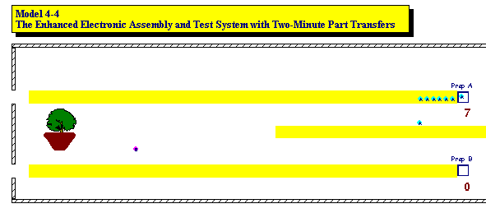
Altering the Animation – Entity Pictures
If you run the model at this point, you would notice a small problem.
Part B arrivals are in batches of four parts/batch.
However, in the animation, a single entity will appear to move across the route for Part B.
  The constant travel time to Prep B implies they travel “on top of each other” so it looks like just one part B

Slide 105
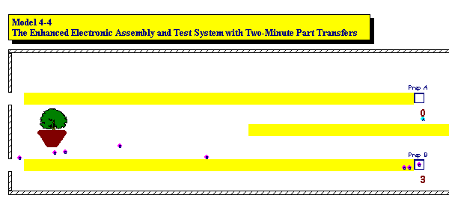
Altering the Animation – Entity Pictures
They do separate at the queue, however.
Try – changing Route time from 2 to EXPO(2) to see separation along the route
But, we want a constant time and still have this separation.
The trick is to change pictures at different points in the run.

Slide 106
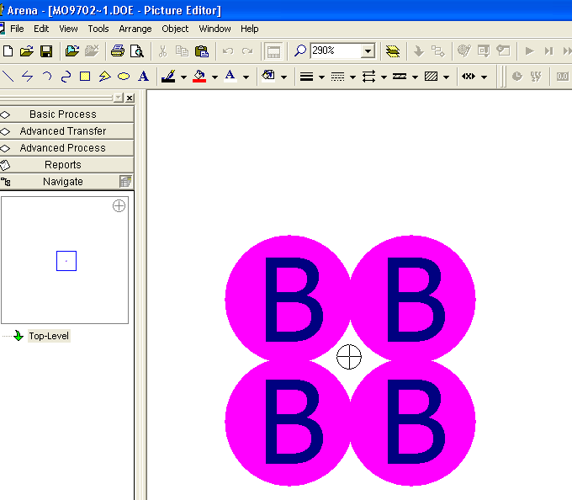
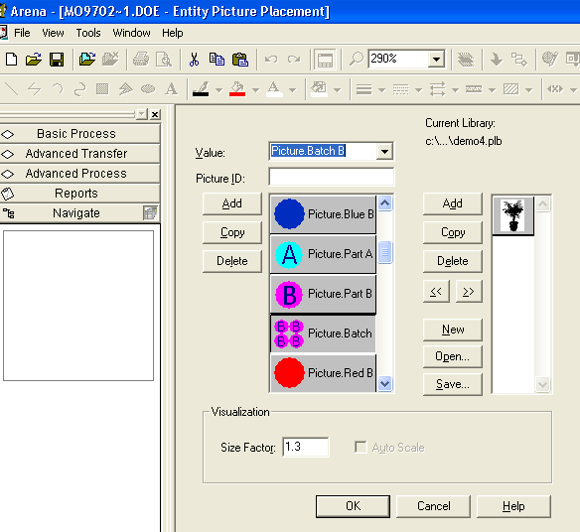
Altering the Animation – Entity Pictures
Edit > Entity Pictures to draw a new picture
  Copy Picture.Part B and rename it Picture.Batch B
  Double-click on picture, use Picture Editor to get four circles

Slide 107
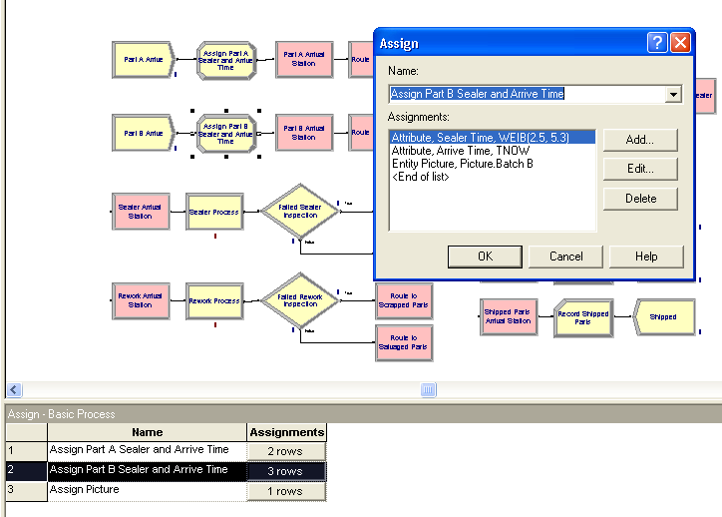
Altering the Animation – Entity Pictures
Add an Assign module just after Part B Arrive
Add assignment of Entity Picture to Picture.Batch B

Slide 108
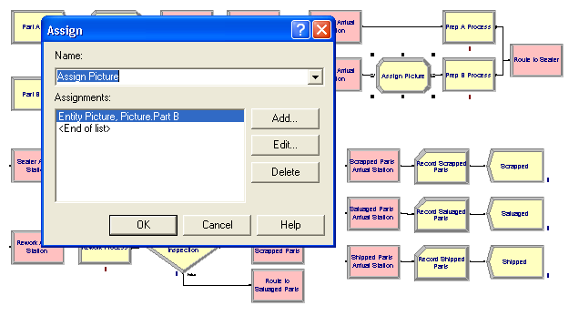
Altering the Animation – Entity Pictures
When batch arrives to Prep B, change to single circle
  Add Assign module after Prep B Arrival Station

Slide 109
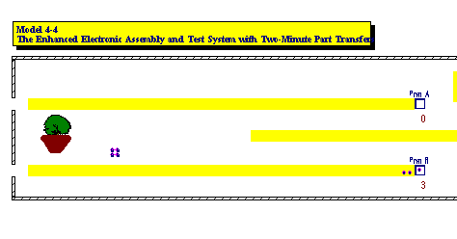
Altering the Animation – Entity Pictures
Now when we run Model 4-04, we will see 4 balls arrive together, but separated, , traverse the route together, and turn back to 4 separate balls at the Prep Station B.

Slide 110
Continue Chapter 4 in Part 2

