Slide 1

Modeling Basic Operations and
Inputs
Chapter 4 – Part 2

Slide 2
Check Errata for Book
There are several textbook errors in this section.
Be sure to check the Errata list at the publisher's book site:
http://www.arenasimulation.com/programs/ArenaBook4eErrata.htm

Slide 3
Debug Tools
Arena has a wealth of debug tools available.
It is unlikely that you will use all of them, but experiment and see which seem to help you the most.
Remember- Arena is a programming language, although not a general purpose one.
Consequently, you should expect to have the same difficulties in locating and correcting errors as you do with a programming language.

Slide 4
Finding and Fixing Model Errors
If an error prevents a model from running, Arena will try to detect the problem and lead you to it in Check or Run
Common errors include (but are not limited to)
  Undefined (or inconsistently spelled) Variables, Attributes, Resources
  Unconnected modules
  Duplicate names
  Inconsistent spelling
These types of errors are like compiler errors.
Read the example on page 165-166 (first paragraph).

Slide 5
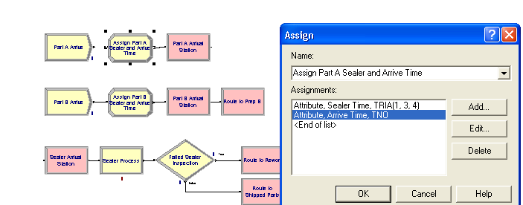
Tools for Finding Syntax-Like Errors
Insert errors – disconnect a module mess up the spelling of TNOW, and drop a Route module.

Slide 6
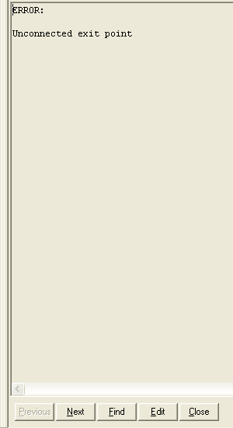
Checking Syntax-like Errors
Run > Check (or the Check Button on the
Run Interaction Toolbar) is similar to a
compile request.
When an error is flagged,
  Clicking the Find button will
  highlight the module that is in
  error.
  Clicking the Edit button will take
  you to the dialog box for the module
  that is in error.
  Clicking the Next button will take
  you to the next error.

Slide 7
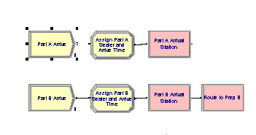
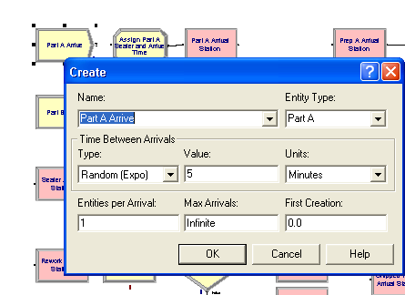
The result of pushing Find:
The result of pushing Edit:
In this case, the first choice is more useful as you can see the missing connector.

Slide 8
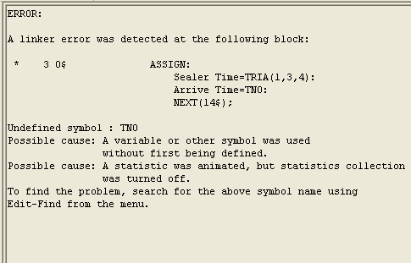
Hidden Errors
As with compiler errors, some errors will be masked initially.
In this instance, only two errors are found initially – the missing connector and the missing module.
Once those errors are corrected, the other error is exposed and the Edit button would be useful.

Slide 9
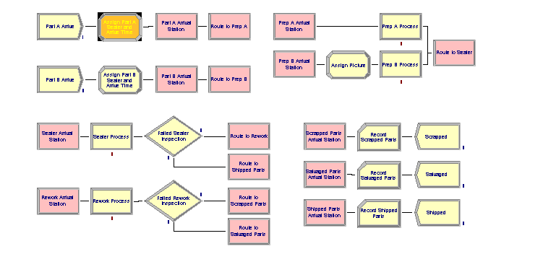
Tools for Finding Logic Errors and Checking Model Accuracy
1. Often the animation will enable you to see what is wrong.
2. Try using the Highlight Active Module – selects active module during run animation.
  Run > Run Control > Highlight Active Module
  The problem is this runs too quickly on most computers – try it on Model 4-4.
  However, if you are patient, Step (F10) will move you through one step at a time
  Don’t forget to clear the
  Highlight Active Module when
  you are finished with it.

Slide 10
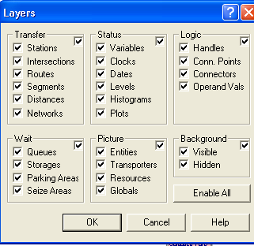
Tools for Finding Logic Errors and Checking Model Accuracy
3.View > Layers while running – changes what shows
There are two modes-
  Edit
  Run
If you change the settings
while editing, the change
doesn't affect the run.
If you change the settings
during a run, you will see
the change then. (Normally
this is what you want for
debugging.)

Slide 11
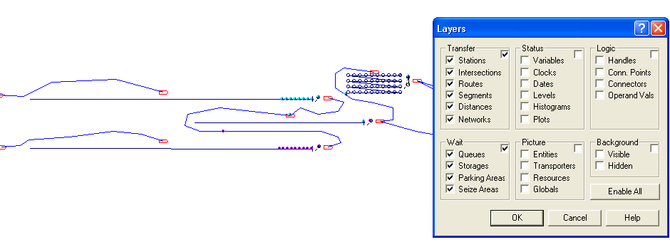
Sample Run With These Selections

Slide 12
Tools for Finding Logic Errors and Checking Model Accuracy
4. Module Break – stop when entity reaches module
Very useful when you suspect a problem is around a certain module – stop when the module is entered and then use step (F10) to move forward.
Highlight a module on which you want the simulation to stop. (This can be repeated for several modules.)
Select Run > Run Control> Break on Module or press the Module Break button on the Run Interaction toolbar.
To clear a break, do the same thing – i.e. highlight the module and press the Module Break button.

Slide 13
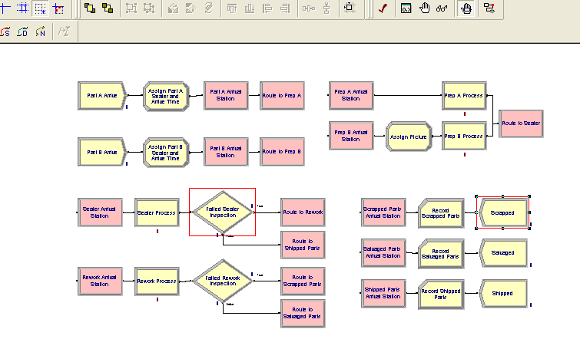
Selected Modules are Marked in Red
Run Interaction Toolbar – next to last is the Module Break button

Slide 14
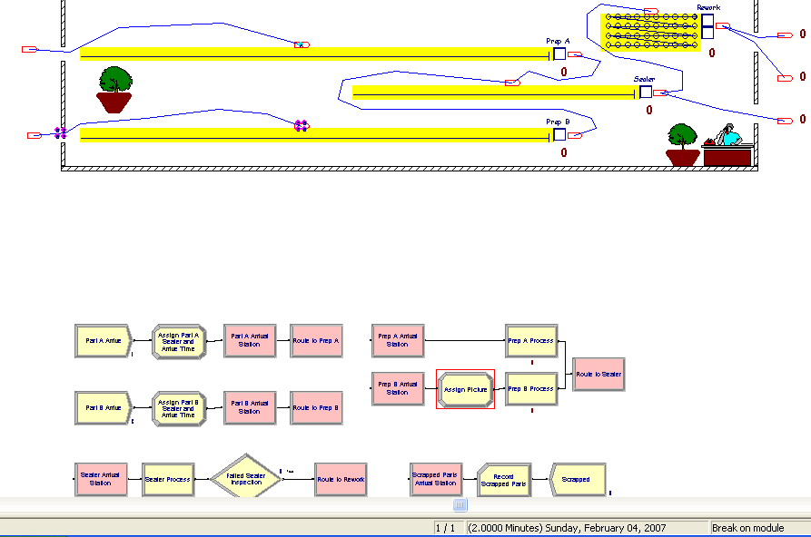
Example of a Run With a Break
Observe highlighted module, halt in animation, and time below.

Slide 15
Tools for Finding Logic Errors and Checking Model Accuracy
5. Debug Bar
  View > Debug Bar or Run > Run Control > Breakpoints
  Includes: Breakpoints, Calendar, Active Entity, Watch
  Breakpoints: Allow you to manipulate the execution to
    Examine operations and logic
    Evaluate changes in system status
    Make presentations to others
    Breaks in execution can be established
      At specific times
      When a specific entity number becomes active
      On a module
      On a conditional statement

Slide 16
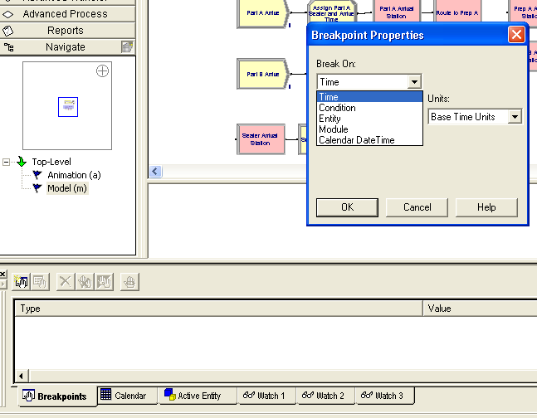
Breakpoint Example
Suppose you suspect a problem occurs around time 29.
Trying to Pause at that
time is probably impossible.
View > Debug Bar and
click on Breakpoints tab in
the new window.
Choose New Breakpoint
and select the type.

Slide 17
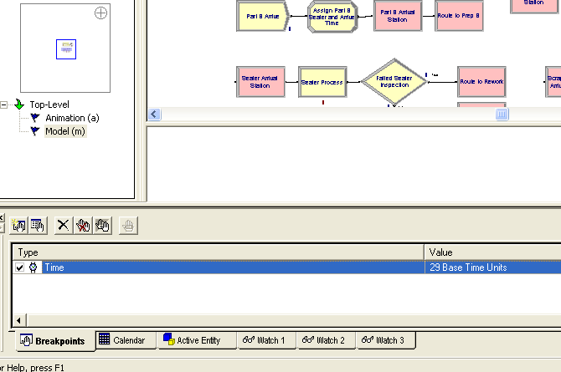
After Setting Time to 29
The next run will break at Time = 29.
To remove the breakpoint, push the X button.

Slide 18
Tools for Finding Logic Errors and Checking Model Accuracy
5. Debug Bar (Con't)
  Calendar: After a break, this window allows you to view all future events that have been scheduled on Arena's event calendar.
    Note: If an entity hasn't arrived yet, it won't show on the schedule.
    Calendar is usually invoked after a break has happened.

Slide 19
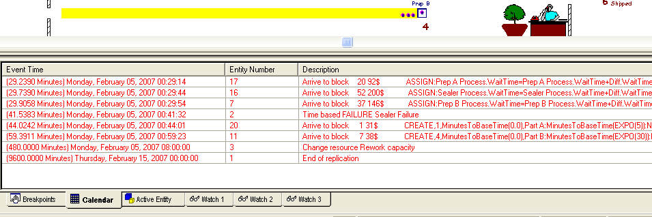
Suppose a Break at Time = 29 occurs
Click on the Calendar tab in the Breakpoint window to see the next events:
Note: Time is expressed differently here.
The value on the left(29.2390) is simulation time in fractional
parts of the base units.
The other time (00:29:14) is an expression based on hours,
minutes, and seconds.
Note

Slide 20
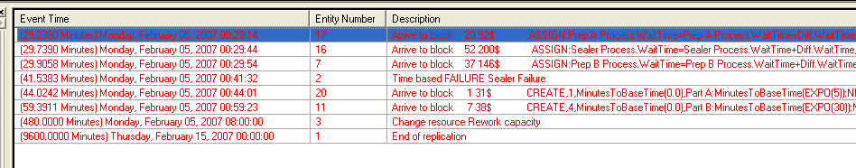
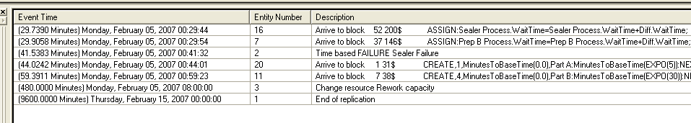
While the Calendar is Displayed
Try using Step (F10) to step through the simulation after the break.
Once an entity enters the system, the calendar will show what is scheduled for it.

Slide 21
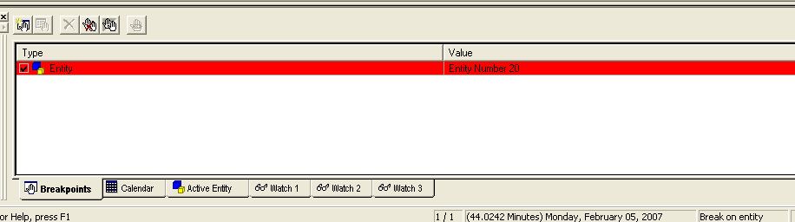
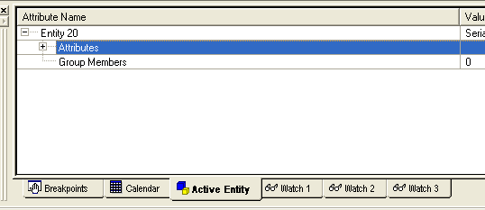
Tools for Finding Logic Errors and Checking Model Accuracy
5. Debug Bar (Con't)
  Active Entity: This window displays the attribute values of the active entity in a tree-view organization.
    On the Time break earlier, this window would not show anything.
    Set a breakpoint on an Entity and give it a number. Pressing Active Entity provides the tree.

Slide 22
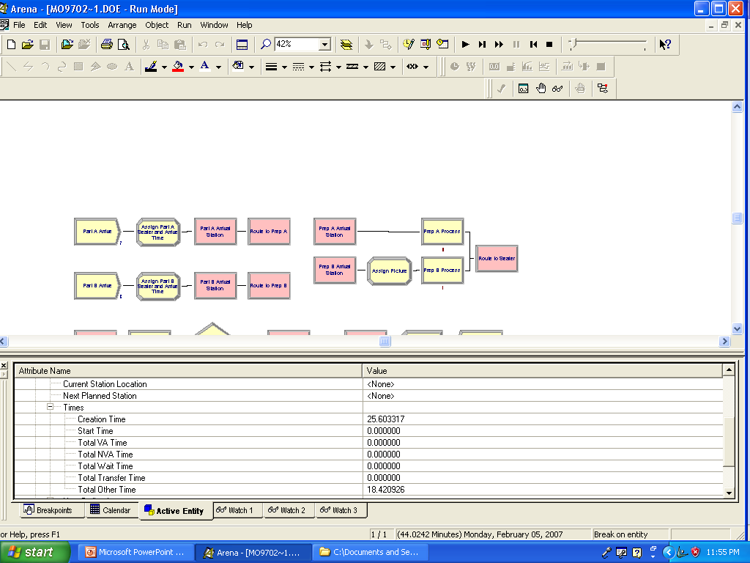
The Information Provided by Active Entity Can Help Locate Problems

Slide 23
Tools for Finding Logic Errors and Checking Model Accuracy
5. Debug Bar (Con't)
  Watch: Three different windows allow you to monitor the values of any expression in the simulation.
  If the simulation is paused (with Pause button or a breakpoint), the Watch window displays the current value of the expression.
  Setting the expression is done the usual way –
    Push Watch 1, for example,
    Right-click in the expression window,
    Choose expression builder, and
    Make the selection.
  Delete the watch by right-clicking and choosing Delete Watch.

Slide 24
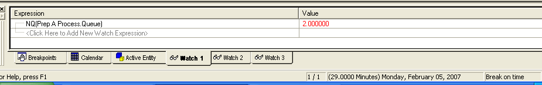
Tools for Finding Logic Errors and Checking Model Accuracy
Example: Breakpoints set at Time = 29 and Time = 41.
Watch expression chosen to be the number in Prep A's queue: NQ(Prep A Process.Queue)
On Time = 29 break:
On Time = 41 break:
You will see a similar window, but with the number being 0.
(Of course, this number is sort of silly to put in a watch as the animation will show the number also. ;-))

Slide 25
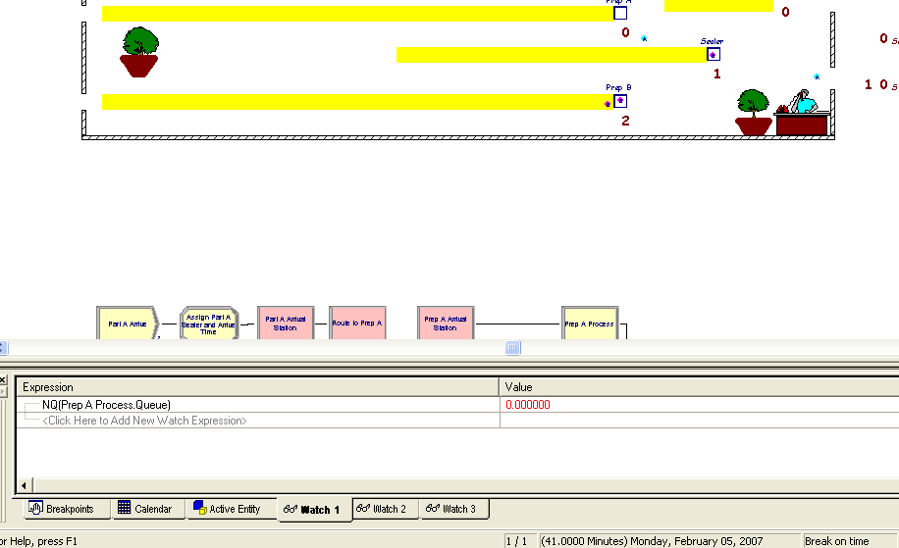
But, Other Expressions Might Be of Interest
You can watch 3 different expressions on any run.

Slide 26
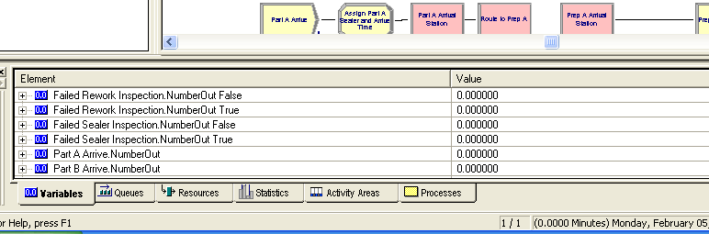
Tools for Finding Logic Errors and Checking Model Accuracy
6. Runtime Elements Bar
  Open View > Runtime Elements Bar. Run and Pause the simulation or break on a breakpoint.
  Current tabs are shown at the bottom.
  As new elements are defined, they will automatically be made available.
  Expand the various tabs and the trees at the bottom.

Slide 27
Tools for Finding Logic Errors and Checking Model Accuracy
You can stop the simulation by the Pause or by setting breakpoints as before.
When you are down in a tree in the Runtime Elements spreadsheet, you can change values and see what happens with the new values.
For example, try changing a picture attribute to another picture so you can see a specific entity move in the animation.

Slide 28
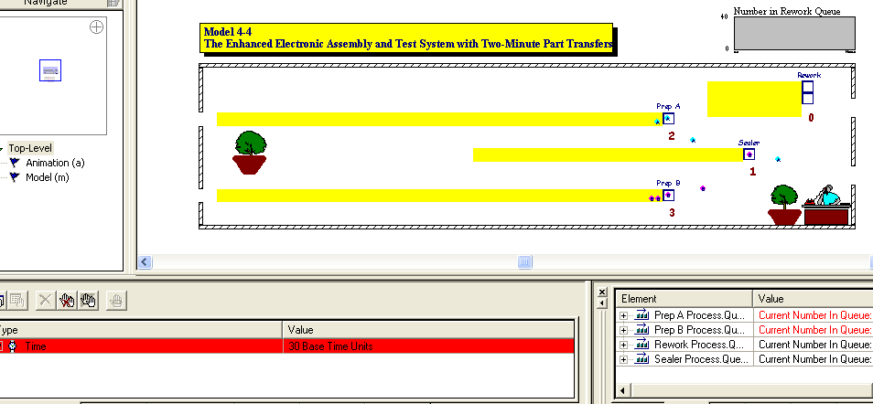
A Neat Way to Watch an Entity
Set a breakpoint for a time, entity, or condition and run until the simulation stops.

Slide 29
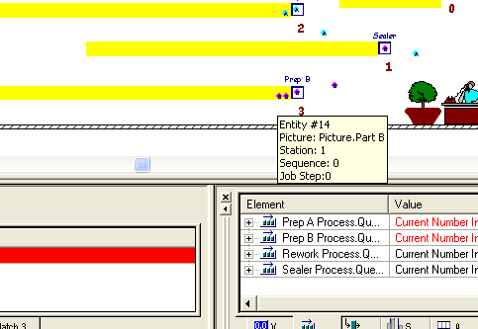
A Neat Way to Watch an Entity
At a breakpoint, you can identify entities by bringing the cursor over the entity:

Slide 30
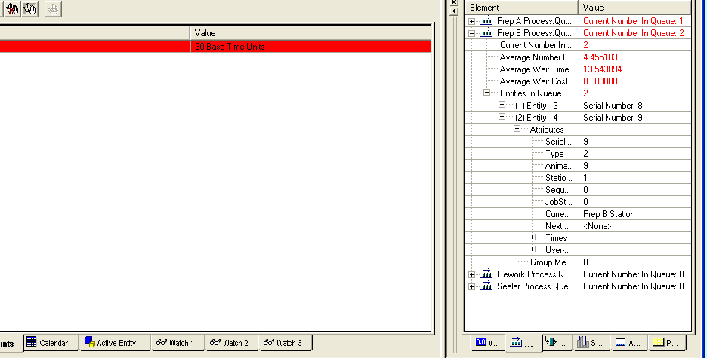
A Neat Way to Watch an Entity
Now we can change anything we wish and continue the run.
Let's change Entity 14's picture from 9 to 1 (an airplane!)

Slide 31
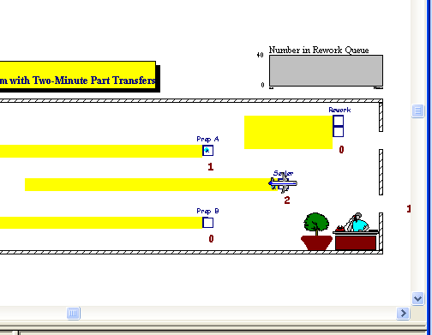
A Neat Way to Watch an Entity
After resuming the simulation after the change, Entity 14 is now an airplane.

Slide 32
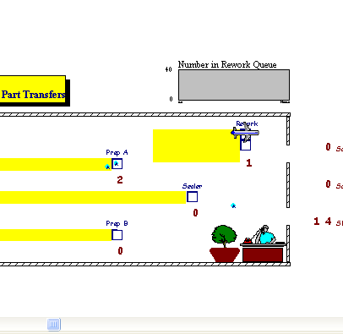
A Neat Way to Watch an Entity
Now we can see Entity 14 is going through the Rework station.

Slide 33
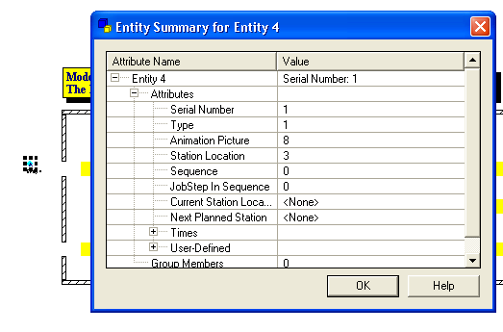
Difference Between Entity Number and Serial Number
The serial number refers to entities created by the model.
The entity number refers to entities created by Arena, including entities created by the model.
For example, in 4-4, using Step and stopping when the first entity appears we have:
Entity numbers represent things like initialization, a sealer failure, change of capacity of a resource etc.
Thus, serial number 1 is the first entity created by the model.

Slide 34
Other Uses of the Break – Change Values
When you break on a breakpoint, any variables, entities, etc. that are available at that moment in Arena can be examined for their values.
Moreover, you can change any of those values and then resume the run!
Example:
  Again, break on time = 29
  Change Entity 14 picture to an airplane
  Change sealer time to 100 - in Prep b, User-defined (times)
As expected, the sealer queue becomes more congested
Because of the airplane picture, you can see right where Entity 14 is.

Slide 35
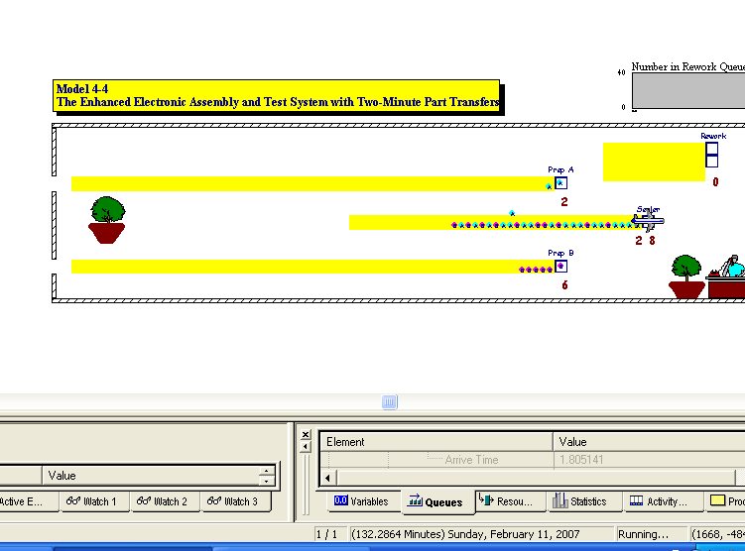

Slide 36
Other Uses of the Break – Change Values
This is an extremely useful procedure as it lets you change almost anything during the run.
You can make changes, add breaks, examine other objects in a wide variety of ways.
The idea is to drill down inside the model and use a magnifying glass to examine what is happening.
Note: These types of tools should be available in all programming environments.
As you gain experience, they can help you a great deal!
But, there is one more useful tool – the Run Controller.
Note: There are even other possibilities if you learn the Siman simulation language in which Arena is written, but we won't do that in this course!

Slide 37
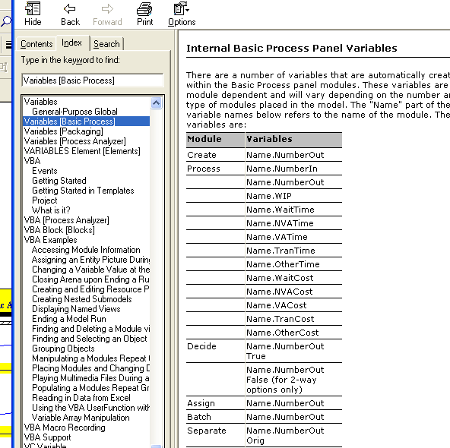
Tools for Finding Logic Errors and Checking Model Accuracy
7. Run Controller
  This is a command-driven interface that allows interaction during a run with various Arena variables.
  It is useful to know what variables are used by Arena.
  To see these, go to Help > Index and type Variables. You'll see several different choices.

Slide 38
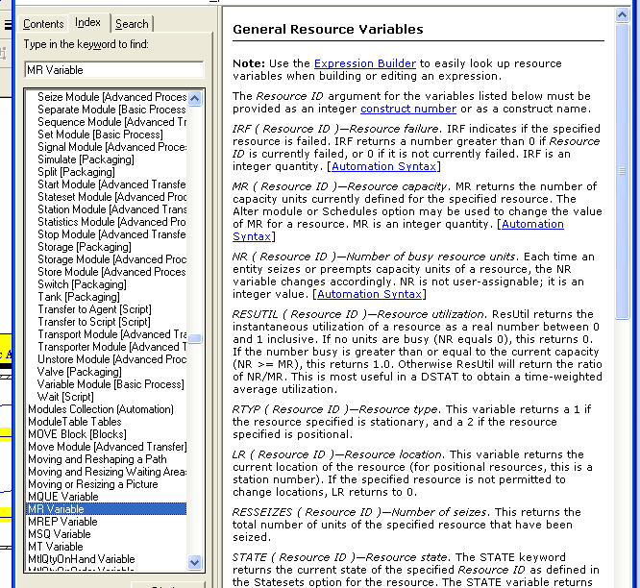
Additional information is available on the individual variable
names if you want it:

Slide 39
Tools for Finding Logic Errors and Checking Model Accuracy
The Run Controller is useful on monitoring changes that occur during a run.
To set the controller do Run > Run Controller > Command (or push the Command button on the Run Interaction toolbar).
There are many commands that can be used, but let's try a few which can be selected.
After selecting a command, press the Insert Command button to insert the command into the window.
Explore the different options that are available.
Some examples follow – but there are a lot of features here.

Slide 40
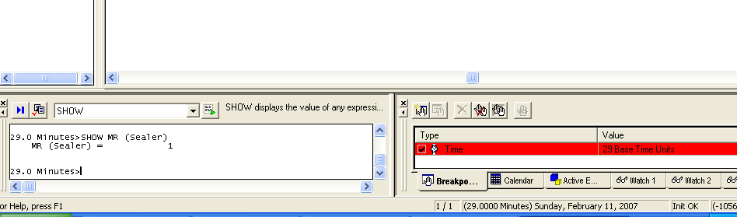
Example
Set a breakpoint at time 29.
Run to the break and select Show.
Insert the command into the window and type after the SHOW, MR (Sealer). This will tell you that the Sealer currently has a capacity of 1.

Slide 41
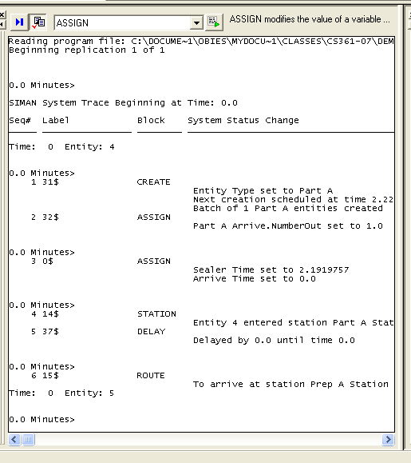
Example
At any point in the run, invoke the Run Controller and push the Enable Block Trace button.
By using the Step function you can see a trace of what is happening.
This example starts the trace at the beginning.

Slide 42
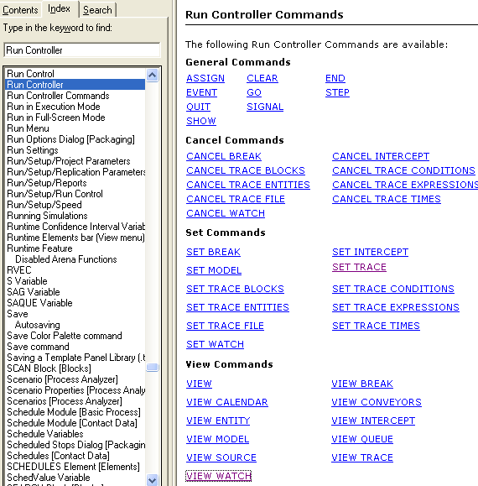
We Could Spend the Rest of the Semester Exploring This Tool – We Won't

Slide 43
Input Analysis: Specifying Model Parameters, Distributions
Section 4.6

Slide 44
Types of Activities Needed for Modeling
Structural modeling: Lays out the fundamental logic of the model
  Logical aspects —
    What are the entities and resources?
    How do entities enter and leave model?
    What paths do entities follow?
This is what we have been doing so far except for the animation aspects.

Slide 45
Types of Activities Needed for Modeling
Quantitative modeling
  Numerical, distributional specifications
    Why use an exponential distribution for interarrival times?
    Why choose a mean of 5 minutes for the distribution and an offset of 3?
  As with structural modeling, we need to observe the system’s operation that we are modeling and obtain real data if possible

Slide 46
A Fundamental Issue: Do we have Deterministic or Random Input?
Deterministic: nonrandom, fixed values
  Number of units of a resource?
  Entity transfer time?
  Interarrival, processing times?
Random (a.k.a. stochastic): model as a distribution, “draw” or “generate” values to drive simulation
  Transfer, Interarrival, Processing times
  What distribution? What distribution parameters?
  Causes simulation output to be random, too
Don’t just assume randomness — validate!

Slide 47
Collecting Data
Can be hard, expensive, frustrating, boring
  System might not exist
  Data available on the wrong things — might have to change model according to what’s available
  Incomplete, “dirty” data
  Too much data or too little data(!)
Sensitivity of outputs to uncertainty in inputs (sensitivity analysis- how sensitive is the output to changes in input?)
Match model detail to quality of data
Cost — should be budgeted in project
Capture variability in data — model validity
Remember: GIGO - Garbage In, Garbage Out!

Slide 48
Using Data: Alternatives and Issues
You could use data “directly” in the simulation
  Read actual observed values to drive the model inputs (interarrivals, service times, part types, …)
  All values will be “legal” and realistic
  But you can never go outside your observed data!
  May not have enough data for long or many runs
  Computationally slow (reading disk files)
Or, you could fit probability distribution to data
  “Draw” or “generate” synthetic observations from this distribution to drive the model inputs
  We’ve done it this way so far
  Can go beyond observed data (good and bad)
  May not get a good “fit” to data — validity?

Slide 49
Fitting Distributions via the Arena Input Analyzer
Assume:
  Have sample data: Independent and Identically Distributed (IID) list of observed values from the actual physical system
  Want to select or fit a probability distribution for use in generating inputs for the simulation model
We will use the Arena Input Analyzer
  Separate application accessible through Program Files or
  Accessible via Tools menu in Arena

Slide 50
The Input Analyzer
What can the Input Analyzer do?
It is a powerful and versatile tool that can be used in many ways:
  To determine the quality of the fit of a probability distribution functions to input data.
  To fit specific distribution functions to a data file to allow you to compare distribution functions or to display the effects of changes in parameters for the same distribution.
  To generate sets of random data that can then be analyzed using the software’s distribution-fitting features.

Slide 51
Fitting Distributions via the Arena Input Analyzer
"Fitting" means deciding on a distribution form (exponential, gamma, empirical, etc.) and estimating its parameters
Many tests exist for determining how good the fit is between your data and a specific curve:
  Maximum likelihood, moment matching, least squares, …
  Arena assess goodness of fit via a process called hypothesis testing
    Hypothesis: H₀: the fitted distribution adequately represents the data
  Arena uses two statistical tests, a Chi-square test and a Kolmogorov-Smirnov (K-S) goodness of fit test
A very important statistic is the p-value obtained from the test used.

Slide 52
Fitting Distributions
A p-value is calculated for both the Chi-square test and K-S test in Arena when you try for a fit between data and a distribution.
p-value- Assuming the fitted distribution is "the truth", this is the probability of finding a data set that's more inconsistent with the fitted distribution than the one you have.
        Interpretation
0 <= p <= 1 (since it is a probability)
A low p-value (< ~0.05) says the fit is not good.
A high p-value is not proof of a good fit, but it does say you have a better chance of a good fit ---i.e. there is a lack of evidence against the fit not being good.
So, you want high p-values for any distribution you try to fit to your data.

Slide 53
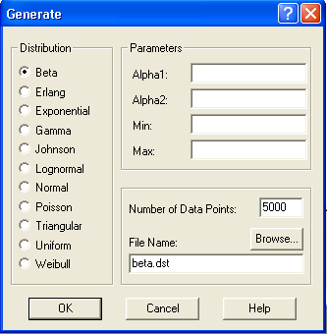
Data Files for the Input Analyzer
Open input analyzer: Tools/Input Analyzer
Can generate “fake” data files to play with
  File/New ... new input window
  File/Data File/Generate New … menu

Slide 54
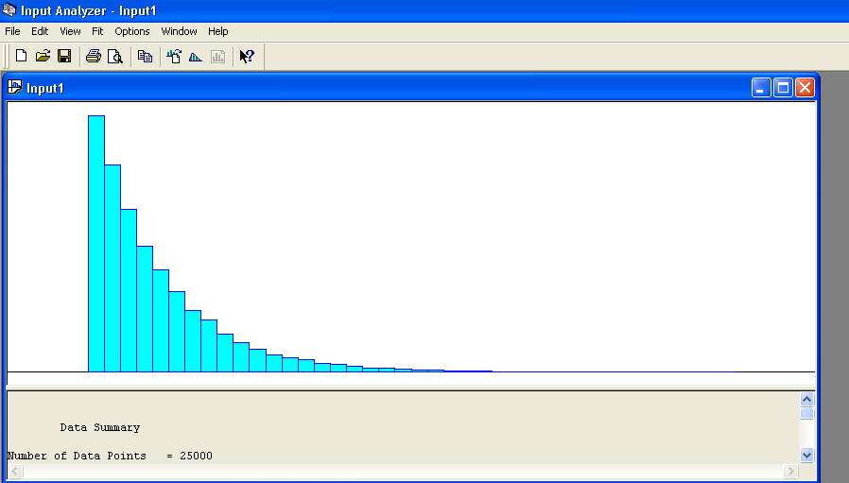
Data Files for the Input Analyzer
Example:
  Generate for an Exponential distribution with mean 5 and offset 3, and sample size of 25,000:

Slide 55
  Use the fit/fit all option to see what is chosen automatically for you.
  Using 5000 points and the same data,
    Fit each of the beta, exponential, normal, and triangular distributions to this data (fit/beta etc.)
    Eyeball each of these first to see how good the fit is.
    Check the statistics for each and observe the p-value (window/curve fit summary)

Slide 56
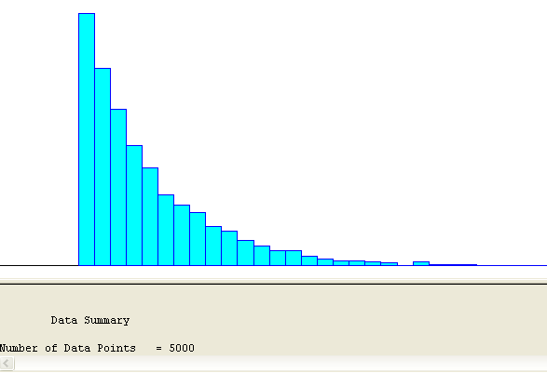
Example
Generate an exponential curve with mean = 4, offset = 2, and 5000 points

Slide 57
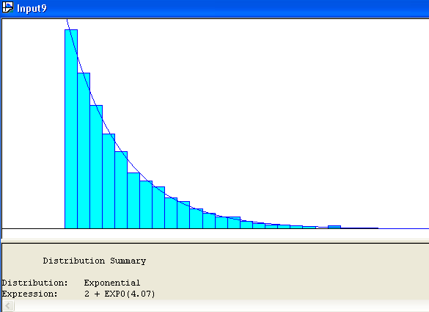
Option Fit/Fit All Yields:

Slide 58
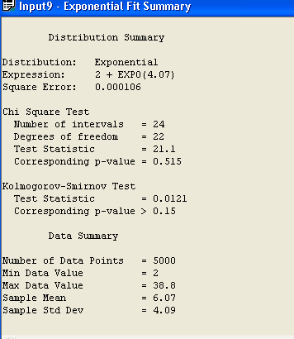
Option Window/Curve Fit Summary Yields:
Note the p-values for both tests are high so there is a strong probability this is a good fit.

Slide 59
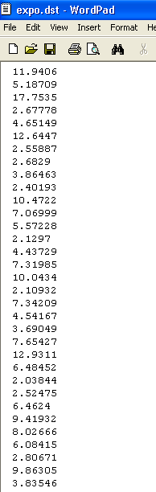
The data file that is generated can be saved and used for runs.
The default name of the file is expo.dat, although you can change the name.

Slide 60
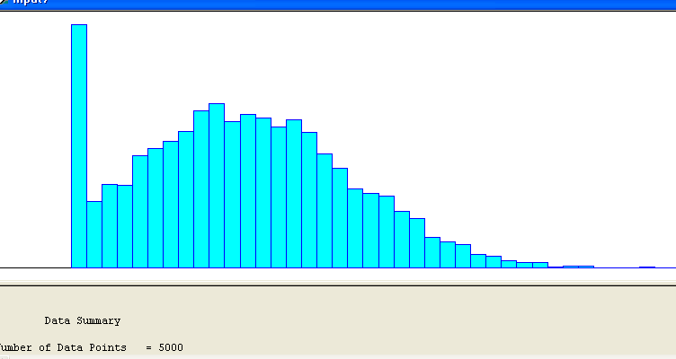
Example – Can Obtain Results That Aren't Definitive
Generate 5000 points for a normal distribution with mean 3 and standard deviation 2:

Slide 61
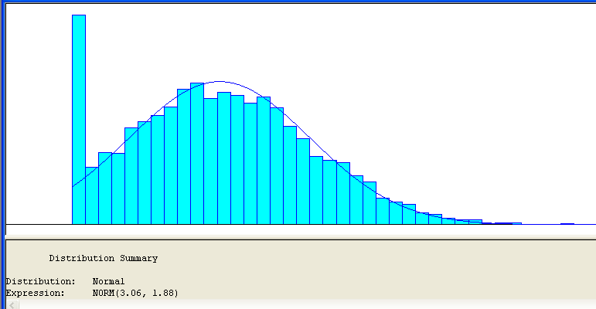
Fit/Fit All Option Produces:

Slide 62
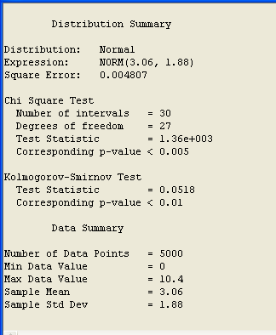
Window > Curve Fit Summary Yields:
Note this is not a great fit as the p-value for both tests is low.
The problem is that the normal curve with a low mean of 3, really needs negative values generated.

Slide 63
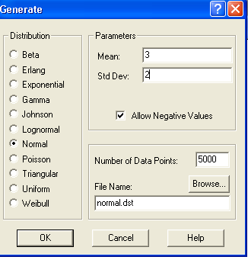
Allow Negative Values, But Use the Same Parameters – Normal Curve, Mean 3, Standard Deviation 2, 5000 points

Slide 64
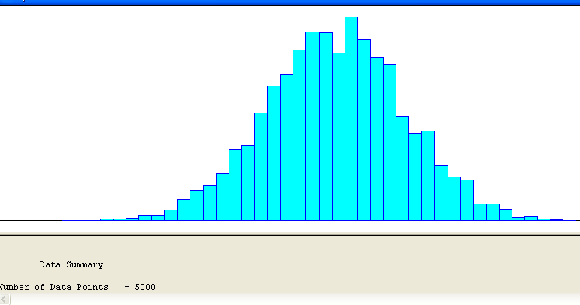
Generate

Slide 65
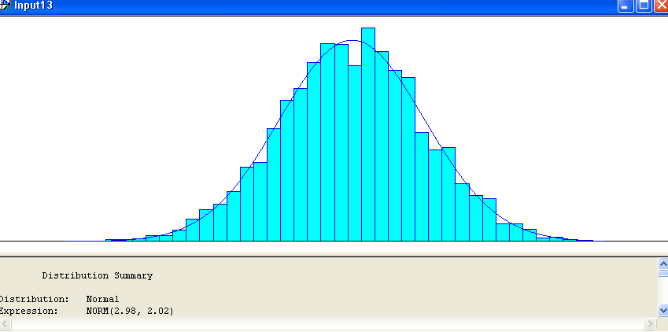
Fit All

Slide 66
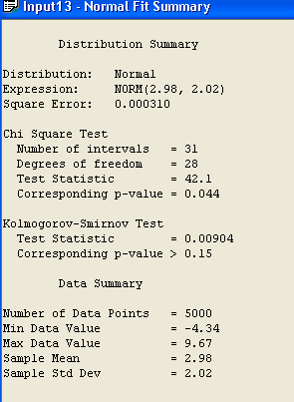
Summary
Note the p-values

Slide 67
Using the Input Analyzer on Real Data
Suppose you collect real data for a model you have constructed.
Often you can use that data to determine a probability distribution that fits your real data closely.
Then you can use the probability distribution for making runs instead of the real data.
As a probability distribution can generate an arbitrary number of data points, this says you are not restricted by a small number of real data points.

Slide 68
This Assumes That ---
1) The future will mimic the past
2) You can obtain a good fit to your real data
3) The data for your runs really is probabilistic
4) The probability distribution for your real data is one of the distributions supported by Arena.
  Although, by going into the innards of Arena, you can add probability distributions by programming

Slide 69
Data Files for the Input Analyzer
For your own data:
Create the data file (editor, word processor, spreadsheet, ...)
  Must be plain ASCII text (save as text or export)
  Data values separated by white space (blanks, tabs, linefeeds)
  Otherwise free format
Open data file from within Input Analyzer
  File/New menu or
  File/Data File/Use Existing … menu or
  Get histogram, basic summary of data
  To see data file: Window/Input Data menu

Slide 70
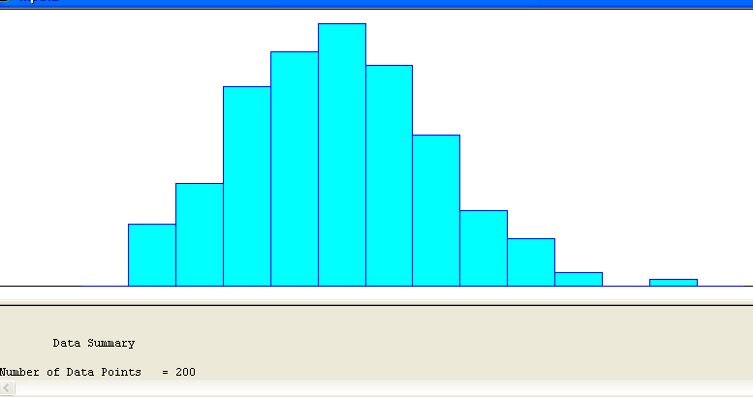
Using 200 Collected Data Points in mydata.dat

Slide 71
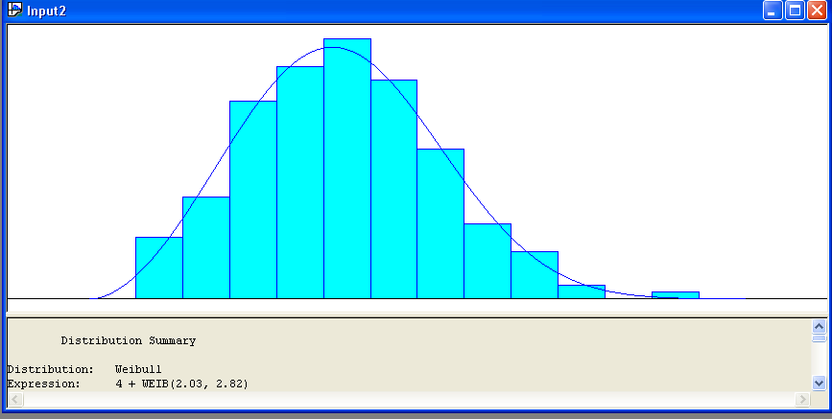
Now Proceed as Before – Fit All

Slide 72
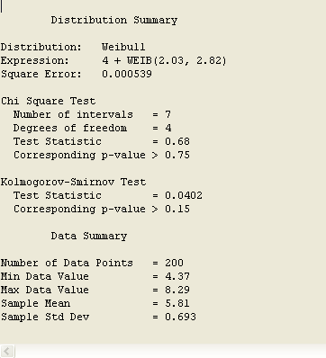
Check Summary for p-value
Looks good!
So we'll enter the expression
4 + WEIB(2.03,2.82)
into Arena where the data is needed.
Caution: Remember the p-values do NOT guarantee that this is a good fit – it only says it is highly likely we can't do better!!!

Slide 73
The Fit Menu
Fits distributions, does goodness-of-fit tests
Fit a specific distribution form
  Plots density over histogram for visual “test”
  Gives exact expression to Copy and Paste (Ctrl+C, Ctrl+V) into simulation model
  May include “offset” depending on distribution
  Gives results of goodness-of-fit tests
    Chi square, Kolmogorov-Smirnov tests
    Most important part: p-value, always between 0 and 1:
      Probability of getting a data set that’s more inconsistent with the fitted distribution than the data set you actually have, if the the fitted distribution is truly “the truth”
      “Small” p (< 0.05 or so): poor fit (try again or give up)

Slide 74
The Fit Menu (cont’d.)
Fit all Arena’s (theoretical) distributions at once
  Fit/Fit All menu or
  Returns the minimum square-error distribution
    Square error = sum of squared discrepancies between histogram frequencies and fitted-distribution frequencies
    Can depend on histogram intervals chosen: different intervals can lead to different “best” distribution
  Could still be a poor fit, though (check p value)

Slide 75
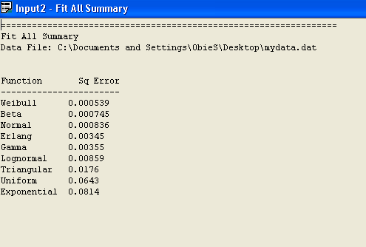
To see all distributions, ranked: Window/Fit All Summary

Slide 76
Choosing a Distribution
A fitted theoretical distribution is one generated by a mathematical formula.
These are the ones we have been considering so far.
Use your input data and the various fitting techniques (eyeballing, Fit All, examine p-values, look at least square data etc.) to choose the fit you wish to use.
High p-values (0.10 or greater) suggest a theoretical distribution may fit provided your sample isn't too small!
Once you decide on a fit that you are willing to accept, you can transfer the exact expression for the distribution to Arena by selecting Edit > Copy Expression , opening the dialog box needing an expression, and pasting the expression (Ctrl/v) into the field,

Slide 77
Suppose You Don't Like the Fit?
You may choose to do a discrete or continuous empirical distribution.
Some guidelines for going this way will be discussed shortly, but basically this allows you to sometimes do a better job of capturing the characteristics of the data.
An empirical distribution: We divide the actual data into groupings and calculate the proportion of values in each group.
  This method uses statistical techniques for determining a histogram.
Choose the Empirical option from the Fit menu.
You probably want to adjust how many probability/value pairs will be calculated by selecting Options > Parameters > Histogram

Slide 78
Which Distribution Should Be Used?
Also need to choose between continuous and discrete data distributions
  Continuous distributions in Arena are:
    Exponential, triangular, Weibull, Erlang, beta, gamma, lognormal, uniform, normal
    They return any real-valued quantity within a range for the bounded types.
    They usually are used to represent time durations in a model.
  Discrete distributions in Arena are:
    Johnson, Poisson
    They only return integer-valued quantities
    They usually are used to describe the number of events that occur in an interval of time or the distribution of randomly varying batch sizes.

Slide 79
Which Distribution Should Be Used?
Or you can “Fit” Empirical distribution (continuous or discrete): Fit/Empirical
  Can interpret results as a Discrete or Continuous distribution
    Discrete: Define pairs (Cumulative Probability, Value) representing histogram of data values
    Continuous: Arena will linearly interpolate within the data range according to these pairs (so you can never generate values outside the range, which might be good or bad)

Slide 80
Some Issues in Fitting Input Distributions
Not an exact science — no “right” answer
Consider theoretical vs. empirical
Choosing a theoretical fit distribution
  May get a good fit from theoretical distribution if the histogram of your data appears to be
    Fairly uniform
    Has a single hump
    Doesn't have large gaps from missing data
  However, there still may be a number of possible choices where the goodness-of-fit statistics don't differ by much.
    In this case, you can consider some other issues in choosing which distribution to use ….

Slide 81
Additional Issues for Choosing a Fitted Distribution
1. Select between bounded and unbounded distributions:
  Example: Often process times can be modeled by either a triangular or a normal distribution.
  The triangular distribution is bounded and the normal distribution is unbounded.
  During a long run, both distributions may produce similar results.
  However, the normal distribution could cause very large values to be generated and, if the mean is close to 0 and no negative values are to be used, then maybe too many 0 values will be generated.
  If a distribution generates a negative value and that doesn't make sense (i.e. for a process time or an interarrival time), then Arena assigns a value of 0.

Slide 82
Additional Issues for Choosing a Fitted Distribution
2. How easily can you adjust parameters for the distribution?
  If you plan to change the model slightly, you may want to keep the same distribution function, but modify the parameters.
  Example: The Weibull and exponential distributions can both be used to model interarrival times.
  However, it is easy to adjust the parameter to the exponential distribution (namely the mean), then it is for the Weibull function (whose mean, as we will see, are a complex function of its parameters.)

Slide 83
Additional Issues for Choosing a Fitted Distribution
3.You might want to run the model with different choices and see how the results are affected.
4. Your data produces multiple peaks or there are several outliers.
  Bimodal data is one with two peaks.
  Outliers are data which is extremely high or extremely low relative to the other data.
  Obviously, the first thing to do is to check your data and make sure you recorded it correctly!
  The next approach is to split your data.

Slide 84
Splitting Your Data
Divide your data into two or more subsets before using the Input Analyzer.
For each subset, fit a distribution to it.
Try to change the model logic to account for the two different types of data – perhaps one set occurs at one time (say at lunch in a restaurant model) when the model is running and the other set occurs at another time (say at dinner).
Now you can use two (or more if necessary) different fitted distributions during longer runs.
Caution: Don't fine tune this too much, however. Too many subsets is not a good representation usually.
Be guided by the real system as to what seems feasible.

Slide 85
More on Splitting Your Data
You can use the Input Analyzer to help you split the data.
Open the data file mydata1.dat
Use Options > Parameters > Histogram to select the number of intervals that allows you to determine cut points. (Try 13 for this file.)
Clearly this file is bimodal.
Choose the left side by keeping the low value fixed and experimenting with the high value to try and split at the lowest point between the two peaks.
Repeat with the right side.
In both cases, note the number of points in each subset.

Slide 86
More on Splitting Your Data
Suppose you find 203 points in the first set and 297 points in the second.
Now generate using the first fitted distribution
203/500 of times and generate using the second fitted distribution 297/500 of times.
Note that you could use a Decide module to choose which distribution is to be used for a subsequent Assign module.
Caution: More than 3 subsets of data is probably pushing this too much!

Slide 87
Empirical Distributions
  Consider using an empirical distribution if the histogram of your data appears to be
    Multi-modal and doesn't split easily.
    There are a number of data points that have a value that's significantly different from the main set of observations
    Or, you just can't divide the data into two to three subsets because the data is all over the place.
    Try for a fitted distribution if at all possible, however.

Slide 88
Some Issues in Fitting Input Distributions
Consider range of distribution
  Infinite both ways (e.g., normal)
  Positive (e.g., exponential, gamma)
  Bounded (e.g., beta, uniform)
Consider ease of parameter manipulation to affect means, variances
Simulation model sensitivity analysis
  How does an input change affect the output?
Outliers, multi-modal data
  Maybe split data set?

Slide 89
No Data?
Happens more often than you’d like.
  System doesn't exist
  Data collection is too expensive
  Data collection would be disruptive
  You can't obtain cooperation or clearance to collect the data.
Some possibilities to still be able to run a simulation that "makes sense":
  Interview “experts” to determine behavior.
  Perform some sensitivity analysis to see how changes affect your model.
    If small changes drastically change the results, your model is very sensitive.
    Look carefully at the range of values, the minimum, the maximum, and the medium.

Slide 90
No Data?
  Be familiar with which distributions tend to be used for different operations in simulations.
  We'll investigate these with a class exercise in which we study the different distributions.
  For example:
    Interarrival times, time to machine failure
      Often use Exponential— still need some value for mean
    Activity times
      Often use Triangular
    Little known about the process
      Often use Uniform
  Number of “random” events in an interval: Poisson
  Sum of independent “pieces”: Normal
  Product of independent “pieces”: Lognormal

Slide 91
No Data?
First look at these distributions as the parameter for these are fairly easy to understand and they provide a range of characteristics for many modeling applications:
  Exponential
  Triangular
  Normal
  Uniform
Realize the examples in the textbook have been chosen to suggest possible distributions for various activities.
Various characteristics of some of the distributions are discussed in detail on pages 184-5 of the textbook.

Slide 92
Cautions on Using Normal Distributions
Probably most familiar distribution – normal “bell curve” used widely in statistical inference
But it has infinite tails in both directions … in particular, has an infinite left tail so can always (theoretically) generate negative values
  Many simulation input quantities (e.g., time durations) must be positive to make sense – Arena truncates negatives to 0
If mean, μ, is big relative to standard deviation σ, then P(negative) value is small … one in a million
But in simulation, one in a million can happen
Moral – avoid normal distribution as input model

Slide 93
Nonstationary Arrival Processes
External events (often arrivals) whose rate varies over time
  Lunchtime at fast-food restaurants
  Rush-hour traffic in cities
  Telephone call centers
  Seasonal demands for a manufactured product
Although this topic is quite specialized, it can be critical to model this nonstationarity for model validity
  Ignoring peaks, valleys can mask important behavior
  Can miss rush hours, etc.
Good model: Nonstationary Poisson process

Slide 94
Nonstationary Arrival Processes (cont’d.)
Two issues for using this :
  How to specify/estimate the rate function
  How to generate from it properly during the simulation (will be discussed in Chapters 5, 11 …)
Several ways to estimate rate function — we’ll just do the piecewise-constant method
  Divide time frame of simulation into subintervals of time over which you think rate is fairly flat
  Compute observed rate within each subinterval
  Be very careful about time units!
    Model time units = minutes
    Subintervals = half hour (= 30 minutes)
    45 arrivals in the half hour; rate = 45/30 = 1.5 per minute

Slide 95
Multivariate and Correlated Input Data
Usually we assume that all generated random observations across a simulation are independent (though from possibly different distributions)
Sometimes this isn’t true:
  A “difficult” part requires long processing in both the Prep and Sealer operations
  This is positive correlation
Ignoring such relations can invalidate model
We will ignore the problems here for now and revisit this topic shortly.

Slide 96
Class Exercise to Increase Familiarity with Different Probability Distributions

