Slide 1

Modeling Detailed Operations
Chapter 5

Slide 2
What We’ll Do ...
Model 5-1: Simple call center
  Lower-level modeling, Advanced Process panel
  Three-way decisions, Variables, Expressions, Storages
  Blocks panel
  Terminating vs. steady-state operation
  Logical (“fake”) entities
  Terminating Condition in Run > Setup
Model 5-2: Enhanced call center
  Nonstationary Poisson arrival process
  Sets – Resource, Counter
  New Statistic data module Types
    Counter, Time Persistent

Slide 3
What We’ll Do
Model 5-3: Enhanced call center with more output performance measures
  New Statistic data module Type
    Output
  Additional variable resources – look at staffing levels
Model 5-4: (s, S) inventory
  Not queueing
  Choose to use low-level Blocks, Elements panels (SIMAN)
    Can be done with higher-level panels

Slide 4
Model 5-1: Simple Call Center Setup
One phone number for customers to call in
  26 trunk lines, one needed for each call (incoming or outgoing, talking or on hold)
  Arriving call finding no free trunk lines gets busy signal, goes away
    Count number of such rejected calls
Calls arrive with interarrivals ~ EXPO (0.857) min.
  First call arrives at time 0
Three incoming call types
  Initial recording to decide ~ UNIF (0.1, 0.6) min.
  Tech support (76%), sales (16%), order status (8%)

Slide 5
Model 5-1: Simple Call Center Setup
Tech-support calls
  For product type 1 (25%), 2 (34%), or 3 (41%)
  Needs qualified tech-support person
    Two for type 1, three for type 2, three for type 3
      No crossover to another type ... change in Model 5-2
    Separate FIFO queues for each type
    Conversation time ~ TRIA (3, 6, 18) min. for all types
  Then leaves system
Sales calls
  All the same
  Four sales staff, all the same
    One FIFO queue feeding all sales staff
  Conversation time ~ TRIA (4, 15, 45)
  Then leaves system

Slide 6
Model 5-1: Simple Call Center Setup
Order-status calls
  All the same
  Handled automatically by phone system
    No limit on number in process at a time, except for trunk-line limit
  “Conversation” time ~ TRIA (2, 3, 4)
  After “conversation,” 15% of callers opt to talk to a person
    Routed to sales staff
    Sales calls have higher priority than these (non-preemptive)
Center receives calls 8am – 6pm
  Must terminate arrival process at 6pm
  Operate past 6pm if necessary to “flush out” all calls

Slide 7
Model 5-1: Simple Call Center Setup
Output performance measures
  Number of calls attempted, rejected, completed
  By call type – total time in system
  By resource – time on hold, number of calls on hold
  Resource utilization – personnel, trunk lines
Terminating or steady-state
  Time frame of interest for each replication
    Terminating – specific starting, stopping conditions (this model)
      Stopping conditions could be of several forms – fixed time, count, condition (here)
    Steady-state – output performance measures are a limit as simulated time → ∞
    Choice usually depends on intent of study, not on model logic

Slide 8
New Modeling Issues
Simulation is different in some ways –
  Service operation instead of a manufacturing one
Balking and rejecting
  In our scenario, if all 26 lines are busy, the customer's call is rejected and the customer leaves the system.
  If an entity leaves voluntarily it is called balking; otherwise it is called rejecting.
There are two ways to handle balking/rejection in Arena:

Slide 9
Handling Balking/Rejecting
Method 1:
  Employ a Queue from the Blocks panel and define the queue capacity at 0.
  An entity (which is an incoming call in this scenario) enters the 0-capacity and attempts to seize 1 unit of a resource called "Trunk Line"
  If the unit is available, it is allocated to the call and the call enters the system.
  If the unit is not available, the entity attempts to stay in the queue.
  But, the queue has capacity 0 so the call would be balked from the queue and disposed of.

Slide 10
Handling Balking/Rejecting
Method 2:
  Have an arriving entity use a Decide module to check whether a unit of the "Trunk Line" resource is available.
  The entity is allowed to proceed and seize the resource if it is available.
  Otherwise, the entity is sent to a balking section in the model.
  We'll use the second method.
  We will want to count how often this happens.

Slide 11
Model 5-1: Simple Call Center Data Structures -
Variables
We may wish to re-use data in several places
  Define once, global to whole model
  Redefine once – modeling generality, user efficiency
Arena Variables
  Allow users to define their own global variables to store numbers (not formulas)
  Define and initialize in the Variable data module (Basic Process)
  Can change during run (Assign module, other ways)
  Arena (through version 11.0) supports scalar, 1-d array (vector), 2-d array (matrix) data structures.
  Version 11.0 supports strings.

Slide 12
Model 5-1: Simple Call Center Data Structures - Expressions
Arena Expressions – generalize Variables
  Can be user-defined
  Store formulas that allow the association of a mathematical expression with a name
    Can use math operations, numbers, random variates, Attributes, Variables, ... in forming the formula
  Define in Expression data module (Advanced Process)
  Scalar, 1-d array (vector), 2-d array (matrix) through version 11 and strings in version 11 only.

Slide 13
Model 5-1: Simple Call Center Data Structures - Storages
Arena Storages
  Storages allow a user to animate entities that fall outside the normal animation features we have used so far, namely
    An entity on a Resource
    An entity in a Queue
    An entity moving along a Route
  Suppose an entity arrival that is delayed before it can proceed to the next module, but you don't want to show the entity moving along, for example, a Route.
  Storages were designed to handle this situation.

Slide 14
Model 5-1: Simple Call Center Data Structures - Storages
A Storage holds a non-ordered set of entities waiting for an event to occur.
  That event might be the arrival of a requested transporter after a predefined delay time.
  Think of a Storage as a variable that we can increment and decrement and, with the added feature, we can animate the entities that are in Storage.
There are 2 ways to place an entity in a Storage and then remove it.
  Use the Store and Unstore modules in the Advanced Process panel.
  Use a module, such as the Delay module, which has field to enter a Storage ID.
    The Delay module is in the Blocks panel.
  Both methods will be demonstrated in this chapter.

Slide 15
Terminating vs Steady State
Most (but not all) simulations are either terminating or steady state simulations.
A terminating simulation is one which the model dictates specific starting and stopping conditions.
  Our models so far have been of this type where we often varied the stopping time.
A steady state simulation is one in which we are assuming we would like an infinite run where the starting conditions don't matter.
  An example would be an emergency department in a hospital.
  Of course, we really can't do infinite runs so we must stop the simulation at some point.

Slide 16
Terminating vs Steady State
Which is chosen, is primarily driven by what the goal of the study is as some models can be viewed as either terminating or steady state models.
  Example: Fast food restaurant that opens at 9am and closes at 11pm.
    If we are interested in the daily operational issues of the restaurant, we'd probably analyze the system as a terminating system.
    But, if we are interested only in the operation during pre-designated rush hours, we might assume a stationary arrival process at the peak arrival rate and analyze the system as a steady state system.
  One problem with steady state simulations is deciding when the run is long enough to exhibit characteristics we wish to study.

Slide 17
Which for the Call Center? Terminating or Steady State?
This version of the Call Center seems to start and end empty and idle.
Thus, modeling it as a terminating system makes sense.
In Chapter 7 we will see how to do statistical analysis on terminating simulations.
In Chapter 8 we will see how to do statistical analysis on steady state simulations.

Slide 18
Modeling Approach
Generally you should use the highest level panels that will do what you need.
However, if you can't capture the necessary detail that you need to answer your questions, you may find you have to drop further down in the Arena hierarchy.
Remember- the name of the game is to answer questions about an existing or proposed system that will enable decisions to be made effectively.

Slide 19
Model 5-1: Modeling Panels We'll Use in this Chapter
Basic Process
  Highest, fastest modeling level, usually the place to start
  Ones we have used the most so far
  Often sufficient for many models
  Even if you need other panels, you probably will still use the basic ones from this panel, namely Create, Process, Decide, Assign, Record, Batch, Separate, and Dispose.
  Note that we haven't even explored all of these.

Slide 20
Model 5-1: Modeling Panels We'll Use in this Chapter
Advanced Process
  Augments the Basic Process panel
  Smaller building elements, other functions, more detail
  Allows for more detail than the Basic Process panel.
  Example: The sequence Seize – Delay –Release basically is the same as a Process module, but provides for more flexibility.
  One feature of this panel is you can put modules together in almost any combination.
  Consequently, some experienced modelers begin with this level as they believe it makes the logic more transparent to the user who may not understand modeling.

Slide 21
Model 5-1: Modeling Panels We'll Use in this Chapter
Advanced Transfer
  Entity movement, material handling are the focus
  Often use when transporters, conveyors, or entity movement is required.
  There is some similarity with the Advanced Process panel, partly because of the way this software grew over the years.

Slide 22
Model 5-1: Modeling Panels We'll Use in this Chapter
Blocks, Elements
  Lowest modeling level
  Part of the SIMAN simulation language template
  They provide the basic functionality that was used to create all of the other panels
  Repeats some capabilities of higher-level panels such as Basic Process, Advanced Process, and Advanced Transfer.
  Some functions available only here such as while loops, combined probabilistic and logic branching, and automatic search features.
  Be careful – some of the names of modules are duplicates of higher level modules, but their functions are different.
  Blocks and Element modules are different in color from those in other panels.

Slide 23
Model 5-1: Modeling Panels
With the lower level panels, you have more things to worry about as you are moving much closer to a bare boned computer language.
At the lowest level you can also interface with Visual Basic or C although this can be tricky.
There are other special-purpose panels – not being used
  These are license-dependent
  Many are custom designed by Rockwell for various companies and some are then made available for others to purchase.

Slide 24
How We Will Proceed in Building the Model
1) Create arrivals and direct to service
2) Arrival cutoff logic
3) Technical support calls
4) Sales calls
5) Order-status calls
6) System exit and run setup
7) Animation

Slide 25
Caution
As with all classroom development, it often looks fairly simple because a neat, logical, linear progression is made.
That normally doesn't happen – you move back and forth from one task to another rather often as you think of different things that need to be handled.
The hope is that the more modeling you see, the easier it becomes for you to construct a model by yourself.

Slide 26
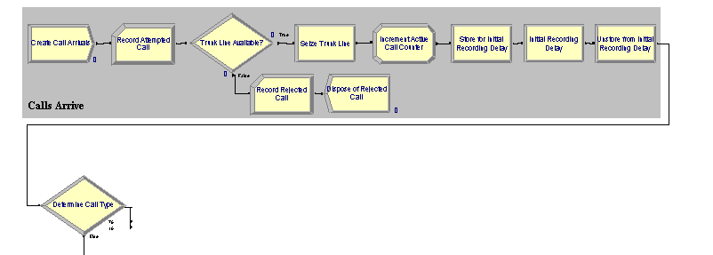
Model 5-1: Simple Call Center
Create Arrivals and Direct to Service

Slide 27
Model 5-1: Simple Call Center
Create Arrivals and Direct to Service
Create attempted calls
  Entity type Incoming Call, change later
  Max Arrivals = MaxCalls, Variable initialized to 999999
    At 6pm (time 600 minutes) change this to 1 to cut off arrivals ... later
Entity data module
  Incoming Call Entity Type already there
  For Initial Picture, select Picture.Black Ball
Record module for an attempted call
  Add 1 to Counter Name Attempted Calls
  Results – Category Overview report, User Specified

Slide 28
Model 5-1: Simple Call Center
Create Arrivals, Direct to Service
Decide module – Trunk Line Available?
  Type = 2-way by Condition
    Select (logical) Expression for “If”
      NR() is number of units of that resource that are busy now
      MR() is number of units of that resource that exist now
  False – Record rejected call counter, Dispose
Alternate strategy – Queue module from Blocks panel ... details in text

Slide 29
Model 5-1: Simple Call Center
Create Arrivals and Direct to Service – Decide
  True:
    Seize a unit of Trunk Line Resource – Release later
      Resources data module for Trunk Line and other Resource levels
    Increment Variable Total WIP for number of active calls
      Used in stopping rule at or after 6pm to sense if system is empty
    Store module (Advanced Process panel) to enable entity animation during next Delay module
      Add Storage animation separately, identify with this logical storage by name
      Storage data module – entry made there by Store module
    Delay module to listen to initial recording, make selection
      Could have used Process module, but this is simpler, faster
    Unstore module to make entity animation disappear

Slide 30
Model 5-1: Simple Call Center
Create Arrivals and Direct to Service
Decide module – Determine Call Type
  Three-sided coin flip – Type = N-way by Chance
    Add button for more sides of coin being flipped
    Get new exit point for each Add, plus one for Else
    Note that probabilities are entered as percentages (0-100, not 0-1)
    Last entry is “else”
Direct call to one of tech support, sales, or order-status areas
Backed each area with colored box
Alternative way to organize – Submodels

Slide 31
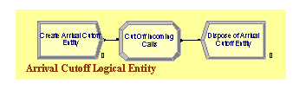
Model 5-1: Simple Call Center
Arrival-Cutoff Logic
Note that these modules seem to be disconnected from the rest of the logic.
They are in the sense that no entity flows through them and also through other modules.
Basically, one entity is created which does it job of changing a variable and then it is disposed.

Slide 32
Model 5-1: Simple Call Center
Arrival-Cutoff Logic
Used to “choke off” arrival stream at 6pm, but allow processing of already admitted entities to continue.
Create a single “logical” (fake) entity at time 600 min. (6pm)
  Overkill on making sure just one is created
    Time Between Arrivals = 999999 min., Max Arrivals = 1
Assign module to set Variable MaxCalls to 1
  Recall use of MaxCalls for Max Arrivals in Create module for attempted calls
Dispose of this single logical entity
Creative use of such “logical” (a.k.a. “fake”) entities enhances modeling flexibility, power, detail

Slide 33
Model 5-1: Simple Call Center
Arrival-Cutoff Logic
We could have used a Decide module that the arrivals would enter right after the Create module.
The Decide module would check to see if the current simulation time was less than 600.
  If it was, the entity would be allowed to continue.
  If not, it would go to a Dispose module.
This other approach was taken in order to introduce the concept in modeling with a logical entity that doesn't exist physically, but is used to control some logic in the model.
This technique can be quite useful.

Slide 34
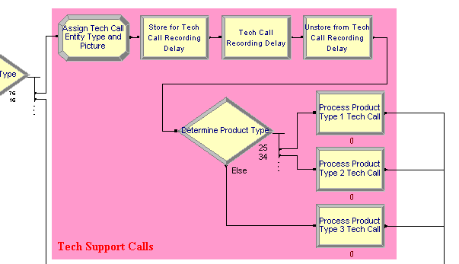
Model 5-1: Simple Call Center
Tech-Support Calls

Slide 35
Model 5-1: Simple Call Center
Tech-Support Calls - Logic
Assign entity type and picture
Delay for recording – store, delay, unstore so we can show this in the animation
Determine call type and direct appropriately
Seize technical support resource
Delay for service
Release technical support resource
Send to system exit

Slide 36
Model 5-1: Simple Call Center
Tech-Support Calls
Entity arrives from a Decide module which determines the call type
Assign module
  Change Entity Type for separating out in results
  Change Entity Picture for animation
Store – Delay – Unstore for recording, product type selection
Decide module for product type
  Different three-sided coin flip
  Direct to appropriate Process module for that product type
Process modules for tech-support service
  Seize-Delay-Release
  Seize a unit from appropriate multi-unit Resource
  Use Tech Time defined in Expression data module
Proceed to system exit logic ... later

Slide 37
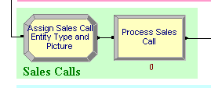
Model 5-1: Simple Call Center
Sales Calls
Logic for this one is trivial:
Assign entity type and picture
Seize sales call resource
Delay for service
Release sales call resource

Slide 38
Model 5-1: Simple Call Center
Sales Calls
An arriving sales call is sent to an Assign module – change Entity Type, Picture
It then proceeds to a Process module
  Seize-Delay-Release
  Seize a unit of Sales Resource

Slide 39
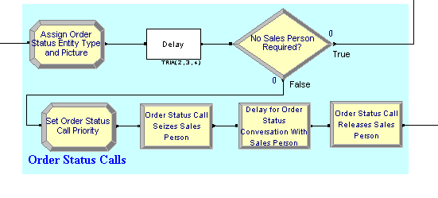
Model 5-1: Simple Call Center
Order-Status Calls

Slide 40
Model 5-1: Simple Call Center
Order-Status Calls - Logic
Assign entity type and picture
Delay for automated call
If customer wants to speak to a real person
  Set customer priority
  Seize sales person
  Delay for call
  Release sales person

Slide 41
Model 5-1: Simple Call Center
Order-Status Calls
Handled automatically so initially they don't require a resource other than one unit of Trunk Line
Assign module – change Entity Type, Picture
As before, we want to show the call on the animation so we could use Store-Delay-Unstore as we did previously.
This time, for illustration purposes, we'll use another approach.
Use the Delay module from the Blocks panel
  Includes Store/Unstore logic – alternative to earlier method
    No automatic entry in Storage data module, so must enter manually
Decide module
  No sales person required – go directly to system-exit logic

Slide 42
One Problem
In our initial problem description, the order-status calls are routed to the sales staff where they will wait with a lower priority than sales calls.
Thus, if an order-status call is in a queue waiting for a sales person and a new sales call enters the system, that later call will be given priority over the one in the queue – but it can't preempt a call being serviced.
How do we handle this situation?
We must digress and see how Arena allocates resources to waiting entities.
We should know how this is handled when all entities are of the same priority and in the same queue.
Then the type of queue (i.e. FIFO) dictates who receives a resource if it is available.

Slide 43
Resource Allocation
There are several possibilities:
  1) An entity requests a resource and the resource is available.
    Simple case – the entity grabs the resource.
  2) A resource becomes available and there are entities requesting it in only one queue.
    Arena uses the ranking that the queue has to decide which entity is allocated the resource.
    Arena uses four ranking options which the modeler chooses:
      FIFO – time-based
      LIFO – time-based
      Low Value First – modeler specifies attribute
      High Value First – modeler specifies attribute

Slide 44
Resource Allocation
  3) A resource becomes available and there are entities requesting the resource in more than one queue.
    This situation is more complicated.
    Arena first checks the seize priorities.
      If one of the seize priorities is a smaller number (i.e. of higher priority) than the rest, the resource is allocated to the first entity in the queue preceding that seize.
      In our current situation, we could use this method by going to the Process module we used in our sales call logic and change the Priority selection to High(1).

Slide 45
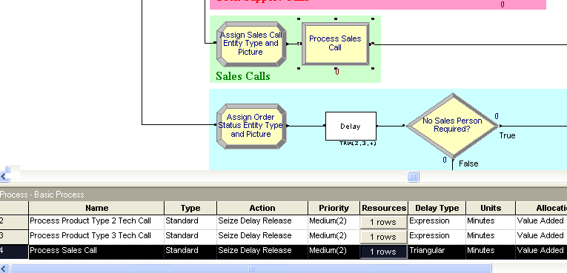
Resource Allocation

Slide 46
Resource Allocation
      Once we change the Priority for the that Process module, we would use another Process module to seize the sales resource for our order-status calls and set its Priority selection to Medium(2) or Low(3) .
      This would solve the problem.
      However, let's explore another way.
  If all priorities are equal, Arena uses a default tie-breaking rule and the resource is allocated based on the entity that has waited the longest regardless of the queues involved.
  This means you have a FIFO tie-breaking rule among the merger of all the queues involved.

Slide 47
Resource Allocation
  That means that if your queues are ranked according to the earliest due date, then the entity that met that criterion might not always be allocated the resource.
    For example, a late job might have just entered a queue, but an early job may be at the front of another queue and has been waiting earlier.
    This situation causes a problem.
  Arena provides a solution by allowing a shared queue to be allocated that allows the queue to be shared by two or more seize activities.
  Thus all entities wanting a resource will be placed in the same queue independent of their seize activities and Arena will handle the bookkeeping to make sure when an entity seizes a resource, it will continue later along the proper path.

Slide 48
Resource Allocation
In our model, each sales call and only a few (15%) order-status calls will require a unit of the Sales resource.
We'll use a shared queue to place these.
This is not necessary, but it provides us with two advantages:
  We can collect composite statistics based on the total number of calls waiting for a Sales resource
  When we animate the queue, we can show the two different entities in it.
We did not assign the sales calls a priority so these will default initially to 0.
We will then use an Assign module to define a new attribute, Sales Call Priority, and set it to 1 for those calls requesting to talk to a human.

Slide 49
Resource Allocation
We send the entity to a Seize module rather than a Process module in order be able to change the default queue name.
Recall – so we don't lose the trees for the forest:

Slide 50
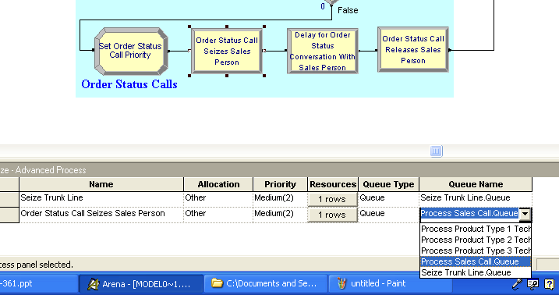
Resource Allocation
How do we make this a shared queue?
Step 1: Choose the Seize module and from drop down menu, select the name of the queue Process Sales Call.queue

Slide 51
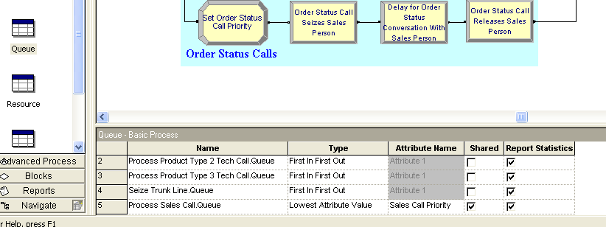
Resource Allocation
Step 2: Open the Queue data module in the Basic Process panel and check the Shared box.
Step 3: Select the Lowest Attribute Value option for Type and this will allow you to select an Attribute Name.
Select Sales Call Priority.
Now both a sales call and an order-status call can reside in the same queue.

Slide 52
After Resource Allocation
Both the sales calls and order-status call entities can reside in the same queue.
Since the sales call entities have a priority of 0, they will be allocated an available sales resource first.
An order-status call entity will be allocated an available resource only if there are no sales call entities in the queue.
After seizing a resource, the entity enters a Delay module with a delay of TRIA(3,5,10) minutes.
Next it is sent to a Release module (in Advance Process panel).
After leaving this module, it is sent to the system exit point.

Slide 53
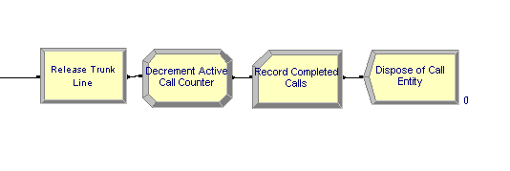
Model 5-1: Simple Call Center
System Exit
All calls of all types come here when finished
Release module – release the unit of Trunk Line resource seized upstream
Assign module – decrement Total WIP variable
Record module – increment Completed Calls counter
Dispose of call

Slide 54
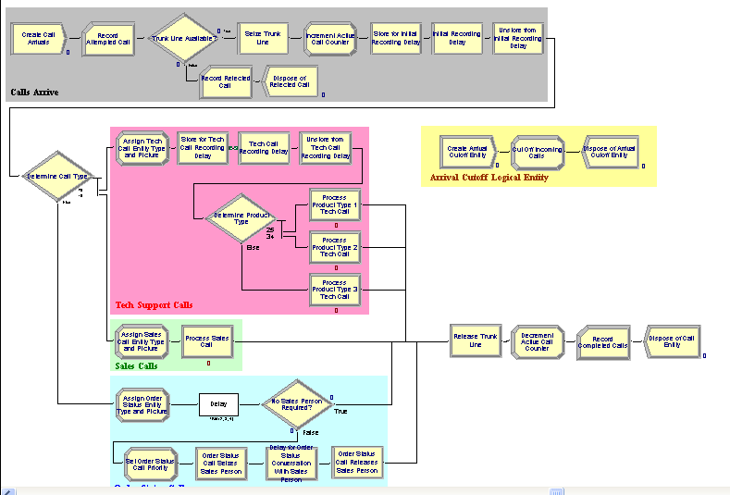
Model 5-1: Simple Call Center

Slide 55
Model 5-1: Simple Call Center
Run > Setup
Replication Parameters tab (other tabs as usual)
Base Time Units = Minutes
Replication Length = Infinite (the default)
Terminating Condition field: TNOW >= 600.0 && Total WIP == 0
Arena
clock
Variable
Greater than
or equal to 600
minutes, (6pm)
Variable we
maintained
in model
Equality
test for
zero
Logical
“and”
It’s 6pm or later and there are no calls in the system.
Could have used NR(Trunk Line) instead of Total WIP

Slide 56
Model 5-1: Simple Call Center Animation
Place three Storage animations
  Initial Recording Delay, Tech Call Recording Delay, Order Status Delay
  Select proper Identifier in each from pull-down list
  Graphic behaves like Queue animations
Four Queue animations
  Three tech-support call product types, sales
  Came with four Process modules specifying Seize
Resource animations for three tech-support types, sales Resources
  Multi-unit Resource animations, as in Models 4-3, 4-4

Slide 57
Model 5-1: Simple Call Center Animation
Variable animations for WIP at tech calls, sales
  For tech calls, Arena variable to animate is
  Process Product Type 1 Tech Call.WIP, etc. – pull-down list
  For sales calls, must include order-status calls seeking a real person:
  NR(Sales) + NQ(Process Sales Call.Queue)
Plot number of trunk lines busy,
NR(Trunk Line)
Labeling, background boxes as in model logic

Slide 58
Model 5-1: Simple Call Center Results (one replication ... sample of size only one!!)
Trunk-lines-busy plot
  Starts, ends at 0 – startup, termination logic
  Capped at 26 during run
735 attempted calls (User Specified section)
  644 completed, other 91 rejected
Sometimes see mixture of sales (green), order-status (blue) entities in sales queue
Other “usual” outputs
  Times in system – separated out by call type
  Queue lengths, times in queue – separated out by resource
  Resource utilizations – normalized to [0, 1] by capacity

Slide 59
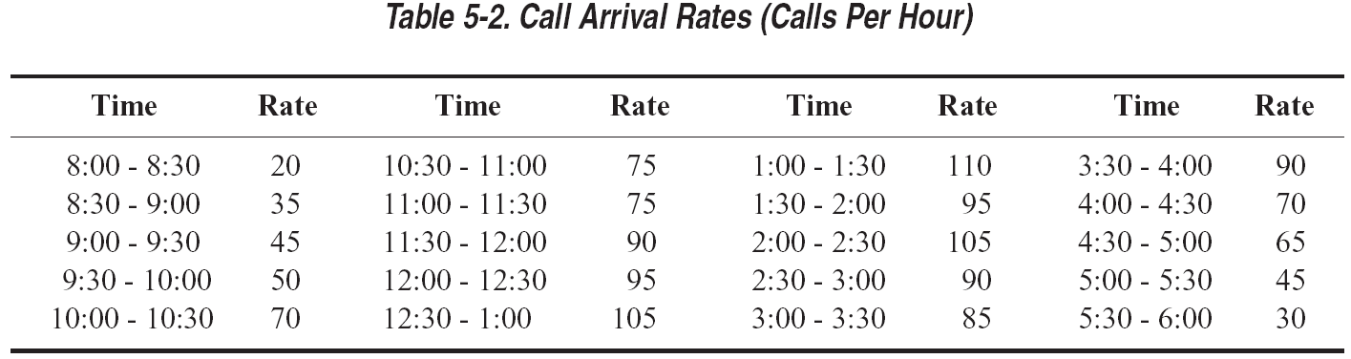
Model 5-2: Enhanced Call Center
We collect data on the calls per hour for each 30-minute period and find the call-arrival rates are given by this table:

Slide 60
Model 5-2: Enhanced Call Center
Our staffing is more complicated and realistic.
Our original model assumed constant staffing levels for our sales and technical-support areas.
Now we assume the staffing level actually varies over the day.
We assume there are six sales people with the staggered daily schedules summarized as 1@60, 3@60,4@90,5@60,6@60,5@60,6@90,5@30,3@60, and 2@60 given as the number of people at a time period in minutes.
Our technical support employees work an 8 hour day with 30 minutes off for lunch (which is not counted in the 8 hour day)
There are 11 technical support people, but not all are qualified to work on all products.
The technical support schedules are given on the next slide.

Slide 61
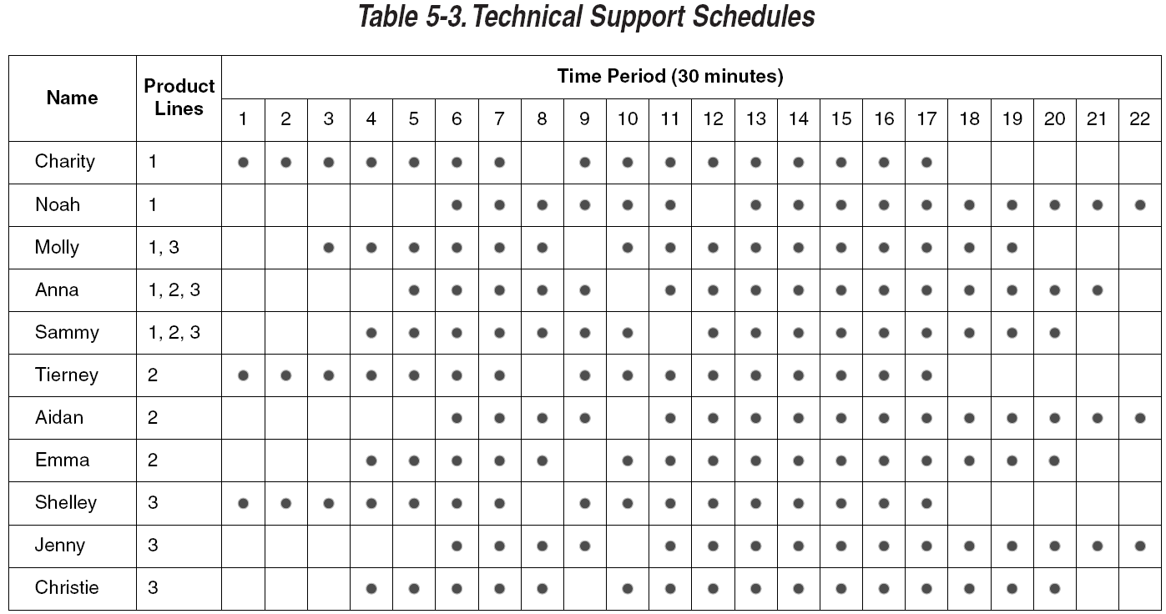
Model 5-2: Enhanced Call Center
Sales-staff size varies over day
  Data in text, Schedule data module, Sales Schedule
Tech-support staff are partially cross-trained, work complicated schedule:
Will use Arena Sets concept to implement this cross training

Slide 62
Model 5-2: Enhanced Call Center
One more complication: 4 % of technical calls require further investigation after completion of the phone call.
These questions are forwarded to another technical group, outside the boundaries of our model and they prepare a response estimated to take EXPO(60) minutes.
The resulting response is sent back to the same technical support person who answered the original call.
That person then calls the customer which takes TRIA(2,4,9) minutes.
The returned calls require one of the 26 trunk lines and receive priority over incoming calls.
If a returned call is not completed on the same day the original call was received, it is carried over to the next day.

Slide 63
Model 5-2: Enhanced Call Center
We need to be mindful of what questions we are asking that are driving the construction of our model.
One obvious question is should we consider changing staffing levels or the number of trunk lines in order to increase customer satisfaction.
This will mean that we may want to add counters to our model so we can count the number of rejected calls that occur during each hour of operation, not just at the end.

Slide 64
Model 5-2: Enhanced Call Center
A New Concept
We have been using one type of interarrival time in past models.
  We assumed an arrival process in which arrivals occurred one at a time, were independent of one another, and the average rate was constant over time.
  That implies that we have exponential interarrival times with fixed mean.
  These are called stationary Poisson processes.
For this model, we will assume the mean arrival rate is a function of time – i.e. it is not constant over time.

Slide 65
Model 5-2: Enhanced Call Center
A New Concept
When the mean arrival rate is a function of time, we often model these type of arrivals as a non-stationary Poisson process.
The way you might first think to model this is to use a Create module with an exponential distribution using a user-defined variable as a mean Value, and chance the Value every 30 minutes.
  This would be approximately correct if the rate change between periods is rather small.
  But, if the rate change is large, the results can be terribly far off.
  See the example on pages 227-228 in text.

Slide 66
Non-stationary Poisson Arrival Times
The Create module in Arena allows us to handle this.
We won't go into how this is handled internally, but the basic idea is explained in section 12.3.
Basically, the software uses a modified and sped up 1975 algorithm due to Cinlar which is briefly explained in the Help topic, "Non-Stationary Exponential Distribution."
Typically these type of interarrival times are given in tables as shown in the earlier slide:

Slide 67
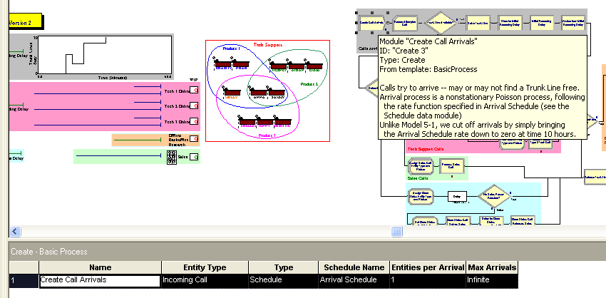
Non-stationary Poisson Arrival Times
Click on the Create module and select Schedule for Type. The Schedule Name will be tied to the next entries.

Slide 68
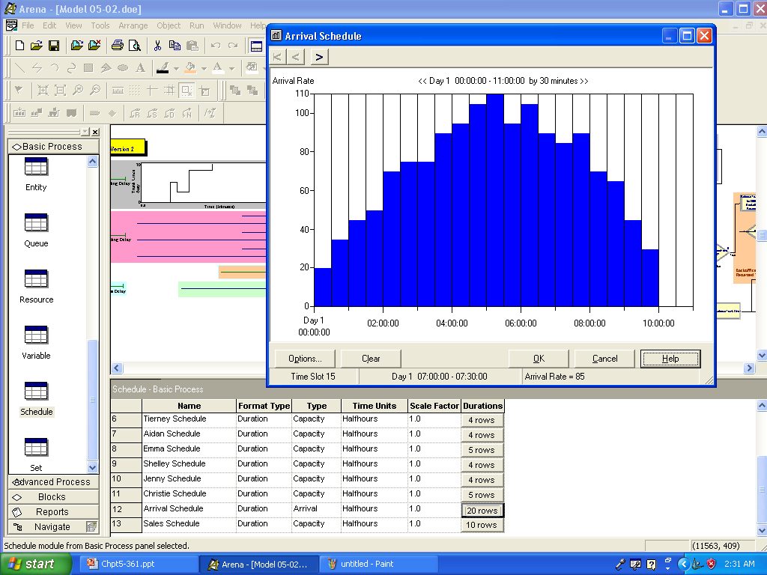
Establish Schedule for Arrivals

Slide 69
Model 5-2: Enhanced Call Center
Another New Concept
The second new concept is the need to have an entity arrive at a location or station and select from one of several similar, but not quite identical, objects.
A typical situation is making a selection from a pool of resources that we view as the same, but we want to distinguish in some way, i.e. by name.
For example, suppose you have three operators who have different names, but each can perform the same kind of service. (Note this is different from the airport homework situation where we didn't care which airline agent was chosen – they were all essentially identical.)

Slide 70
Arena's Sets
Arena's Set module in the Basic Process Panel provides for the concept of a set.
A set in Arena is a group of objects of the same type that can be referenced by a common name (called the set name) and a set index.
The objects in the set are called the members of the set.
All members of the set must be the same type.
You can collect almost any type of object into a set
An object can be the member of more than one set.
You may have as many sets as you wish.
These properties are very similar to those possessed by mathematical sets.

Slide 71
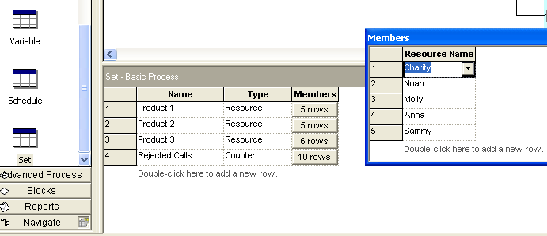
Modeling the Staffing Requirements
Sets are easy to define in Arena
We define 3 resource sets:

Slide 72
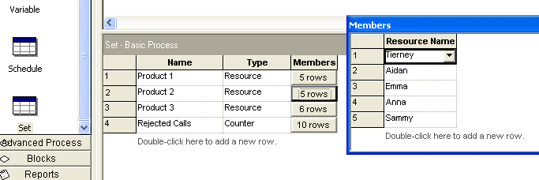
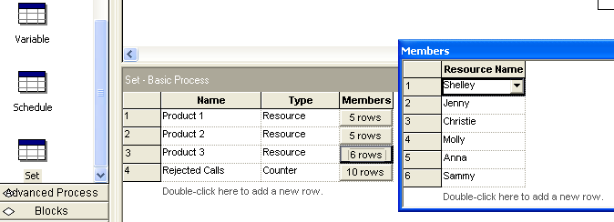

Slide 73
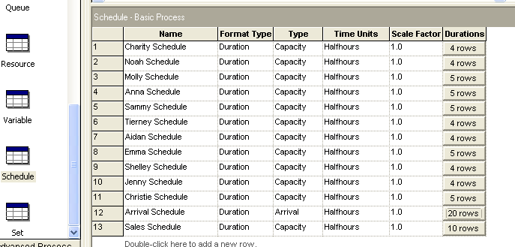
Specifying Work Schedules
We need to establish a schedule for each individual:

Slide 74
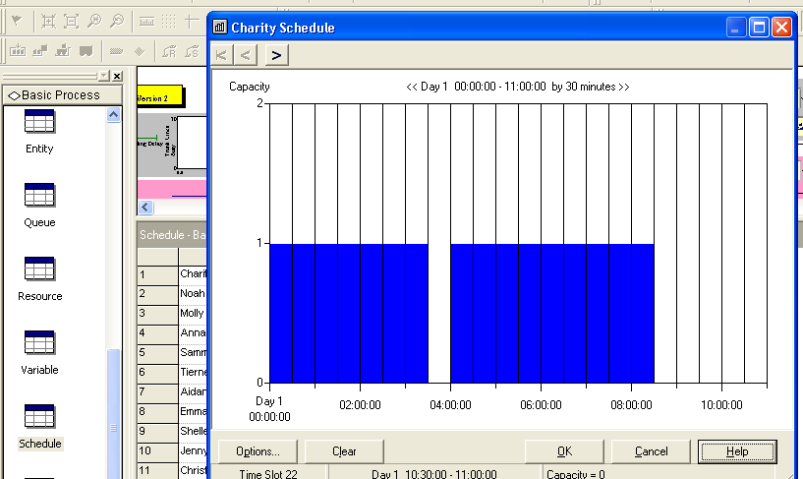
For One Person

Slide 75
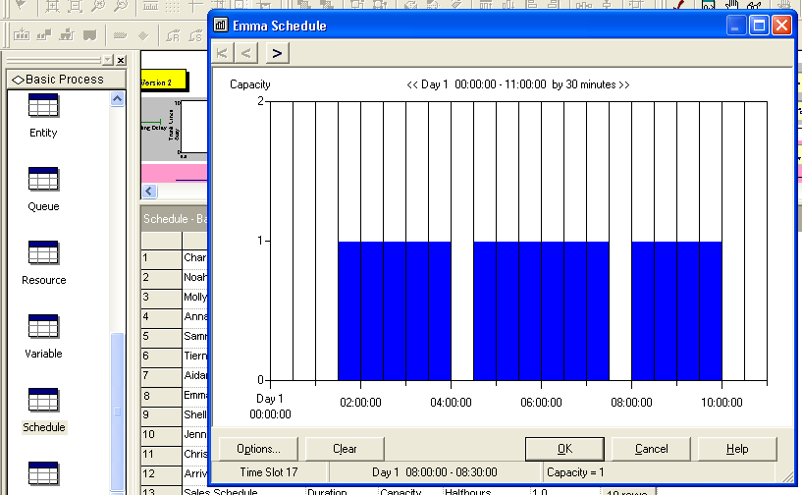
Need for Each Person

Slide 76
Caution
Be sure every schedule covers the entire 660 minutes of each day.
If you enter too short a schedule, the graphical schedule editor does not assume a 1 day schedule, but just starts repeating it when it runs out of data.

Slide 77
Model 5-2: Enhanced Call Center - Recall
4% of tech-support calls cannot be handled during the call and need offline back-office research
  Original call ends, same original talk-time distribution, gives up its trunk line, but not counted (yet) as completed
  Case sent to back office (outside model boundaries), takes EXPO (60) minutes to resolve
    Offline research may be carried over night, completed on a later day
  Answer goes back to same tech-support person who took original call, with higher priority than incoming calls, but still might have to queue for this person
  This tech-support person requests a trunk line for outgoing call, higher priority than incoming calls, but still might have to queue, talks for TRIA (2 ,4 ,9) min., call is now completed
  Track number of each product type after research is done

Slide 78
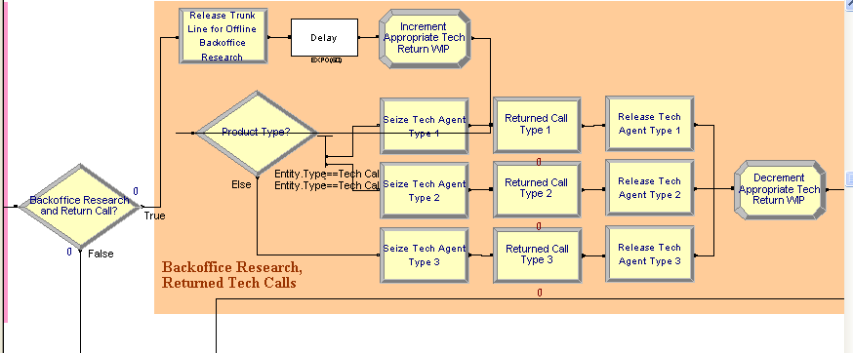
Handling Backoffice Research and Returned Tech Calls

Slide 79
Logic for This Section
If customer call requires further investigation
  Release trunk line resource
  Delay for back office research
  Increment Tech Return WIP variable
  Determine product type and direct
  Seize technical support resource
  Seize trunk line resource
  Delay for return-call service
  Release trunk line resource
  Release technical support resource
  Decrement Tech Return WIP variable
Send to system exit

Slide 80
Handling Backoffice Research and Returned Tech Calls
If any of the 4% calls which are sent to this section is not finished during the run, theoretically they would be handled the next day.
Because we are modeling only one day, they would just disappear with this approach.
After the Delay when the research is done outside of the model, we increment the 1-dimensional array variable, Tech Return WIP, using the value of the attribute, Tech Call Type, as the index.
The next few slides show us how to define a 1-D array and use its index for incrementing.

Slide 81
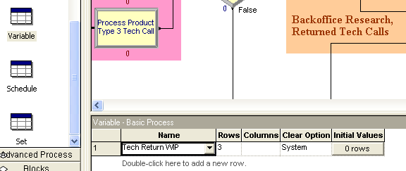
First, Create an 1-D array With 3 Elements
We don't need it here, but you can assign initial values.

Slide 82
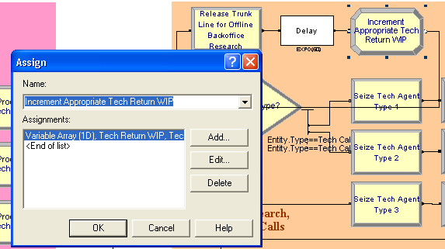
Then define the Variable Array(1D) Tech Return WIP, in the Assign module

Slide 83
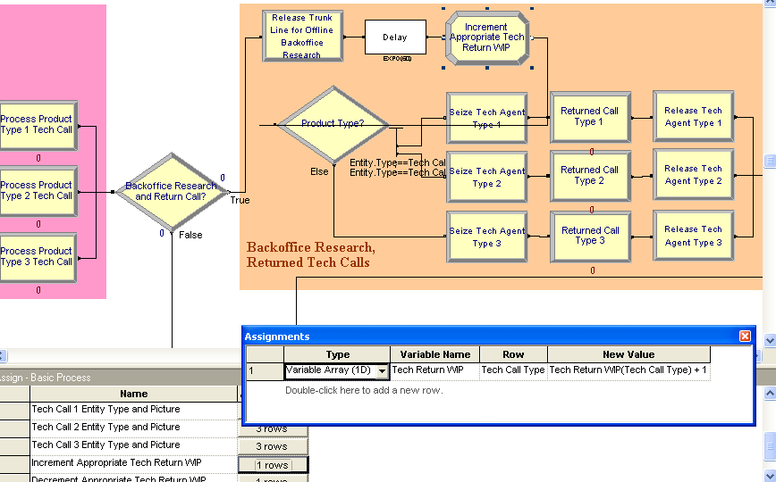
Increment the Variable Tech Return WIP Using the Attribute Tech Call Type as the Index

Slide 84
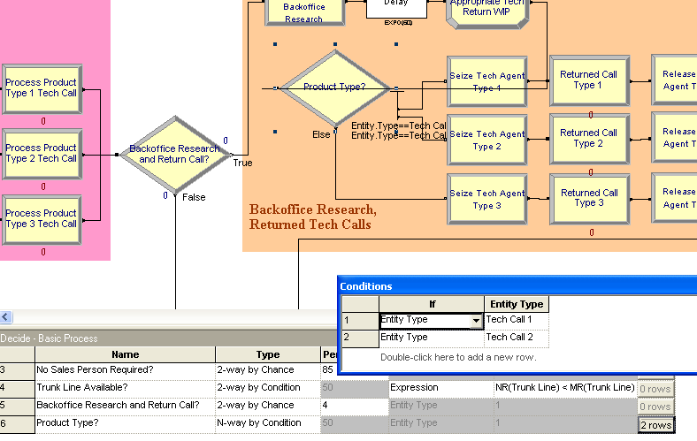
Handling Backoffice Research and Returned Tech Calls
We sense the product type with an N-way by Condition test in the "Product Type?" Decide module and then direct the return call to the proper branch.

Slide 85
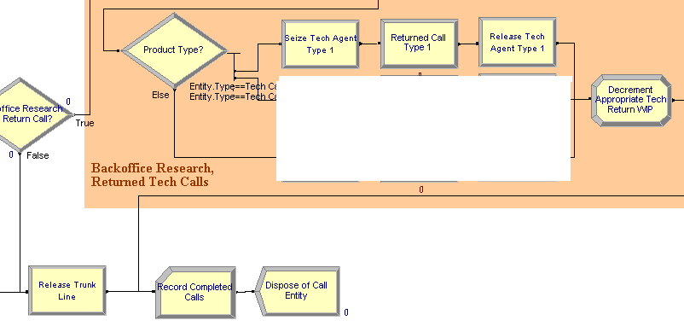
Looking at the Logic for One Product Only Right Now

Slide 86
In Return-call Situation Still – But Looking Only at Logic for Product 1 Calls
The return-call entity must seize a trunk line and the appropriate tech support person – that is the one who took the original call.
In the Seize module, the return tech support call for product Type 1 seizes from the appropriate Resource Set of tech support people.
Queueing is possible here so we will use a separate queue to show this in the animation.
We'll set a Seize priority of High(1) since outgoing return calls take priority over incoming calls.
Note- we seize the person first.
Only in the next module do we seize the trunk line.

Slide 87
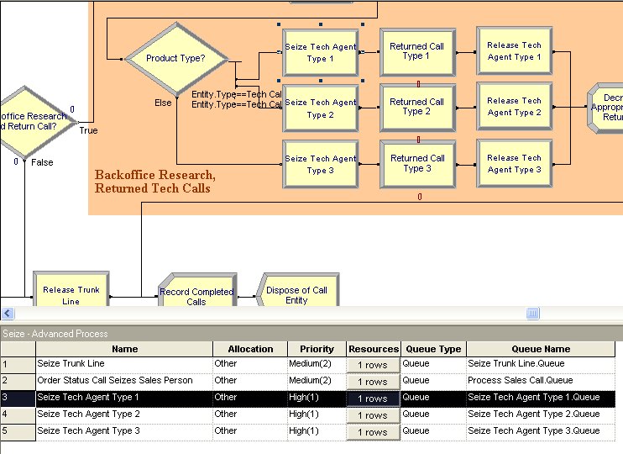
In Return-call Situation Still – But Looking Only at Logic for Product 1 Calls

Slide 88
Handling Backoffice Research and Returned Tech Calls
But, we had to keep track of who handled the original call in order to use the proper agent.
We'll use a set to model the returned technical support calls and store the set index of the specific resource allocated from the selected technical support staff, so we’ll know which individual needs to return the call, if necessary.

Slide 89
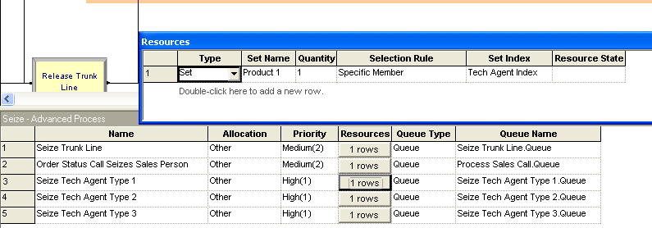
Using a Set to Grab the Correct Tech Agent

Slide 90
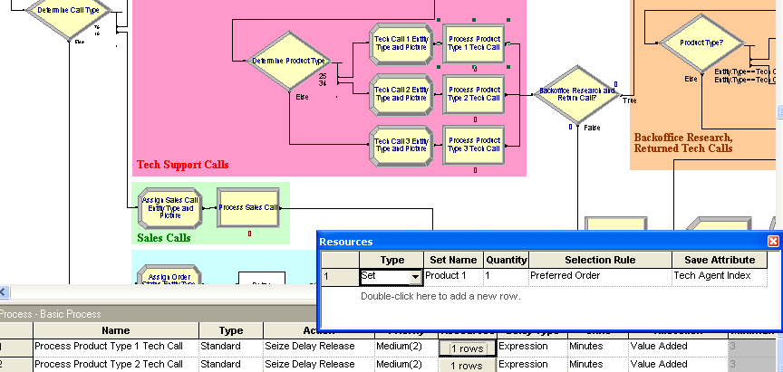
Where Was Tech Agent Index Set?

Slide 91
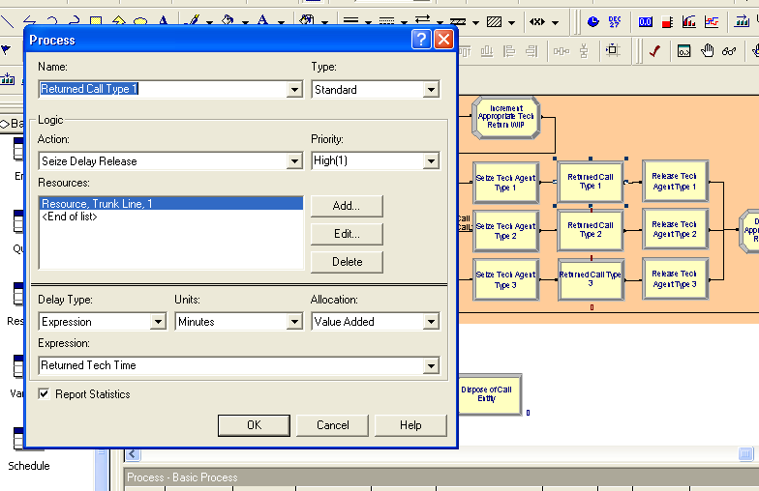
Now Seize the Trunk Line

Slide 92
Waiting for a Trunk Line
Still in a queue, but the animation will show the entity in the Resource's animation seize area.
Once the call is completed, the specified tech support person is released with a Release module.
Interesting note: The developers of this example made the following observation:
  Initially, used a single Process module to seize both the tech support person and the trunk line at the same time.
  When the model was run, they realized that the return calls were waiting a long time before they were processed.
  If you take the approach that both resources must be available at the same time for success to occur, you can run into problems.
  The system will allocate any desired resource to other entities first.
  Best to seize one resource and hang onto it until you get the other one – i.e. be selfish.

Slide 93
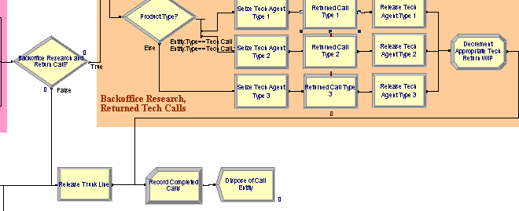
The Rest of the Logic for Returned Calls
This is straight forward and should be able to be followed easily.

Slide 94
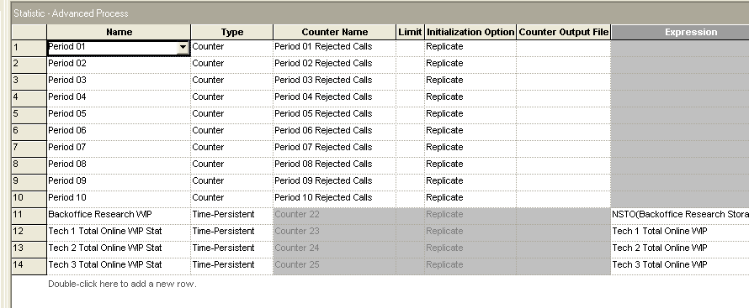
Statistics Module in Advanced Process
This is a data module that allows us to collect some statistics that are not collected by default (more info to right of each row.)

Slide 95
Model 5-2: Enhanced Call Center
Modifying the Model
Statistic data module
  Ten Counter-type statistics, discussed earlier
  Four Time-Persistent statistics to track expressions
    Backoffice Research WIP to track total number of cases in research, via NSTO(Backoffice Research Storage)
    Tech 1 Total Online WIP Stat, etc., to track number of that product type in back office via Expression Tech 1 Total Online WIP, etc., defined in Expression data module as
Process Product Type 1 Tech Call.WIP + Tech Return WIP(1), etc.
No changes needed in sales-calls or order-status-calls section of Model 5-1

Slide 96
Model 5-2: Enhanced Call Center
Run > Setup
Call-arrivals, termination, Run > Setup
  Create module
    Type = Schedule, Schedule Name = Arrival Schedule
  Delete the entire arrival-cutoff section from Model 5-1
    Arrival Schedule cuts off arrivals at 6pm, via 0 rate

Slide 97
Model 5-2: Enhanced Call Center
Modifying the Model
  Delete Total WIP variable used to terminate Model 5-1
    Use built-in NR(Trunk Line) instead in Terminating Condition
    Delete Assign modules used to manage Total WIP
  Record module for rejected calls
    Index into Counter Set Rejected Calls with index
    AINT((TNOW/60) + 1)
    which is 1 for first hour, 2 for second hour, etc. (AINT truncates decimals toward zero)

Slide 98
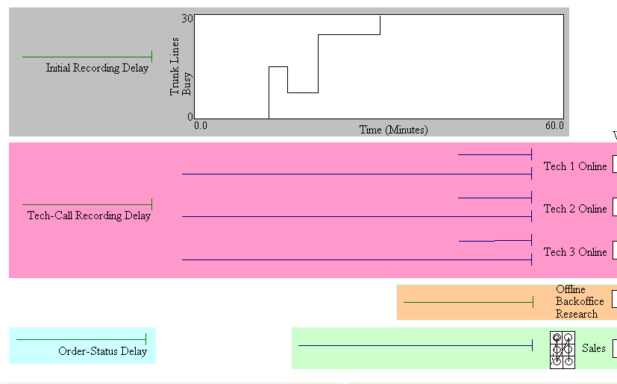
Animation –Some Basically Same as Model 5-1

Slide 99
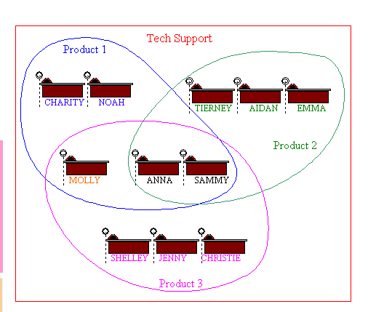
But, Added Some
Note: This shows the sets as a Venn Diagram which clearly shows who is in what set and where the overlaps occur.

Slide 100
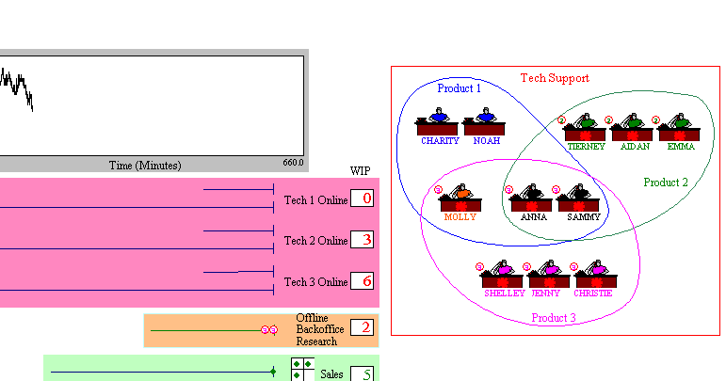
During the Run

Slide 101
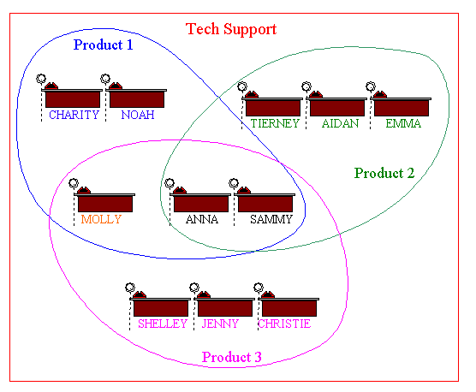
At Initialization

Slide 102
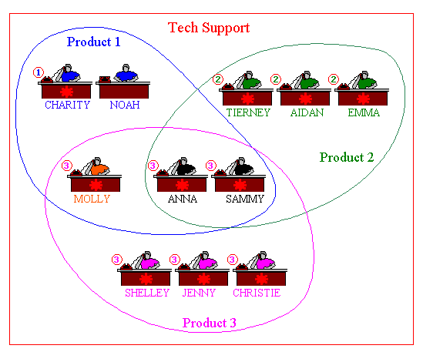
Representing Busy/Idle

Slide 103
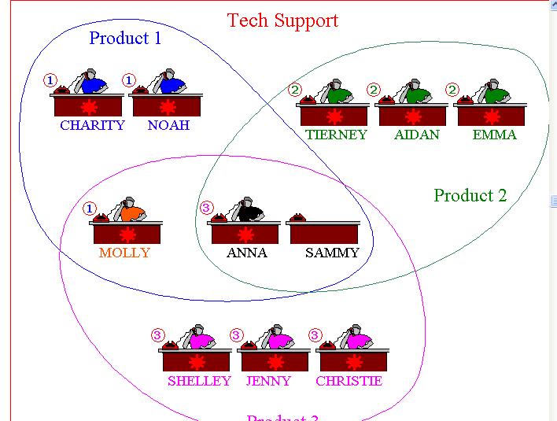
Note How a Break is Represented by an Empty Desk

Slide 104
Model 5-2: Enhanced Call Center
Modifying the Model
Animation
  Delete Tech 1, Tech 2, and Tech 3 resource animations
  Change variables in three tech-support WIP displays to track total number of tech-support calls of that type present
  New back-office storage animation, variable animation for number present
  A new queue for each tech-support product type for return calls waiting for service
  Added a resource animation (from a .plb library) for each individual tech-support person
    Grouped by product type, colors for capabilities
Results
  Most rejected calls in hours 5-8 ... increase staff then?

Slide 105
Model 5-3: Overall Call-Center Statistics Setup
Develop an overall operational-cost measure
  Two cost categories – staffing/resource, and poor service
Also develop overall measure of service, % of calls rejected
Also add options for increased staffing, improvement
Make 5 replications, focus on weekly costs
  IID replications, so will not carry over back-office research

Slide 106
Model 5-3: Overall Call-Center Stats
Staffing/Resource Costs
Resource data module – hourly costs for people
  $20/hr. for each sales staffer
  $18/hr. - $20/hr. for each tech-support, depending on skill
  These salary costs paid when on duty, busy or idle
  Summing, get $12,820/week (details in text)
  View all this existing staff as fixed

Slide 107
Model 5-3: Overall Call-Center Stats
Staffing/Resource Costs
Increase sales, tech-support staff noon-4pm
  Variable New Sales = number of new sales staff
    $17/hr., 4 hrs./day, 5 days/week, so $340/week for each additional staff
    Schedule data module to add capacity – edit via dialog or spreadsheet, not graphical editor
    Resource (Sales) already exists in Resource data module

Slide 108
Model 5-3: Overall Call-Center Stats
Staffing/Resource Costs
  Variables New Tech 1, etc., and New Tech All for number of new tech-support people qualified as named
    $16/hr. for each one-product staff, $18/hr. for each all-product staff
      $320/week for each single-product staff, $360/week for each all-product staff
    New entries in Resource data module
      Larry, Moe, Curly, Hermann for 1, 2, 3, All
    Schedule data module to add capacity – dialog or spreadsheet edit

Slide 109
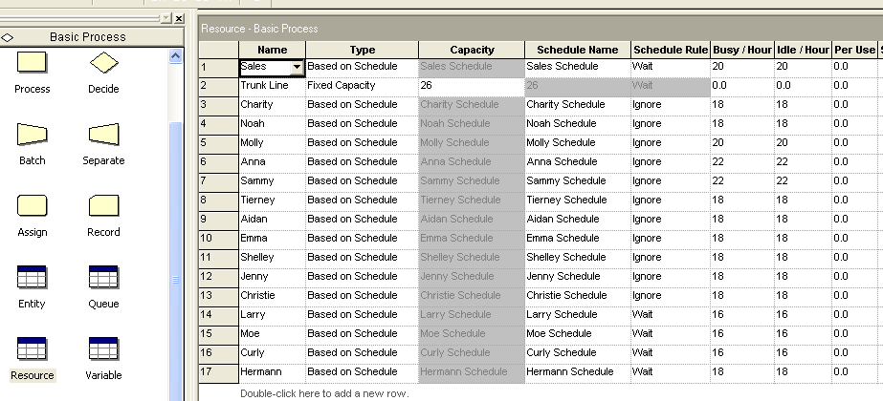
Resource Module

Slide 110
Model 5-3: Overall Call-Center Stats
Staffing/Resource Costs
Maybe increase number of trunk lines beyond 26
  $98/week flat fee for each trunk line
Define Expression New Res Cost for all resource costs:
New Sales*340
+ (New Tech 1 + New Tech 2 + New Tech 3)*320
+ New Tech All*360
+ 98*MR(Trunk Line)
  This does not depend on simulation results, only on setup

Slide 111
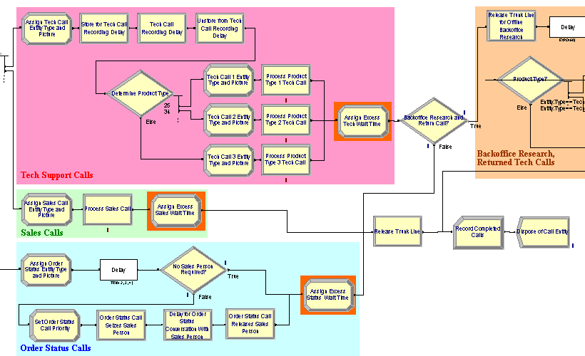
Very Few Changes to Logic
See Orange Modules

Slide 112
Model 5-3: Overall Call-Center Stats
Customer-Dissatisfaction Costs
Incur cost for caller wait on hold, past a threshold
  3 min. for tech, 1 min. for sales, 2 min. for order-status
  Beyond threshold, incur per-min. costs of
  $0.368 for tech, $0.818 for sales, $0.346 for order-status
    In practice, such costs are difficult to estimate
  Three new Assign modules (orange backing) accumulate “excess” (beyond threshold) wait times on hold
    Tech support (other two are similar): Variable
    Excess Tech Wait Time increased by
    MAX(ENTITY.WAITTIME - 3, 0)
      ENTITY.WAITTIME is built-in Arena attribute holding all wait times (including in queues) so far ... luckily, there were none before the preceding Process module

Slide 113
Model 5-3: Overall Call-Center Stats
Customer-Dissatisfaction Costs
  At end, multiply excess wait times by per-min. costs, multiplied by 5 (to put on a weekly basis)
    5 × $0.368 = $1.84 for tech, 5 × $0.818 = $4.09 for sales,
    5 × $0.346 = $1.73 for order-status

Slide 114
Model 5-3: Overall Call-Center Stats
Overall Output Performance Measures
Statistic data module, Total Cost entry
  Type = Output, computed only at end of replication
  New Res Cost
  + Excess Sales Wait Time * 4.09
  + Excess Status Wait Time * 1.73
  + Excess Tech Wait Time * 1.84
  + 12820
Statistic data module, Percent Rejected entry
  Counter Total Rejected Calls accumulated in new Record module in call-arrival area (orange backing)
    Already accumulating hour by hour, but this is total over the day
  Type = Output
  100 * NC(Total Rejected Calls) / NC(Attempted Calls)
    NC is Arena function that returns the value of that counter

Slide 115
Model 5-3: Overall Call-Center Stats
Replication Conditions
Run > Setup > Replication Parameters,
Initialize Between Replications
  Statistics? System? Details in text
  Default is both – only way to get truly IID replications
    Destroys overnight tech-support research jobs, but to do otherwise would complicate model – so accept
Run > Setup > Project Parameters
  Turned off all but Costing Statistics Collection, for speed
    Costing required to get ENTITY.WAITTIME

Slide 116
Model 5-3: Overall Call-Center Stats
Results
Results from five replications
  Base Case – no additional staff, still 26 trunk lines
  Total Cost = $22,500.07
  Percent Rejected = 12.9%
  Add 3 of each of five staff types, 3 more trunk lines
  Total Cost = $22,668.69
  Percent Rejected = 1.6%
We'll use this in Chapter 6 for analyzing runs
  Statistical precision
  Compare several alternatives, select best
  Search for configuration that minimizes cost, subject to upper limit on percent rejected
Average over 5 replications
Conf. int. half-widths in output
Is this better?

