Slide 1

Statistical Analysis of Output from Terminating Simulations
Chapter 6

Slide 2
What We’ll Consider ...
What is the time frame of simulations?
How do we determine a strategy for data collection and analysis?
Confidence intervals – how do we use them?
How do we compare two alternative scenarios?
We will compare many alternatives via the Arena Process Analyzer (PAN)
Very important: We will search for an optimal alternative with a tool named OptQuest

Slide 3
Introduction
Random input leads to random output (RIRO)
Run a simulation (once) — what does it mean?
  Was this run “typical” or not?
  Variability from run to run (of the same model)?
  Is this variability acceptable?
We need to perform statistical analysis of the output data
  From a single model configuration
  From two or more different configurations
  Search for an optimal configuration

Slide 4
Statistical analysis of output is often ignored
  This is a big mistake – no idea of precision of results
  Not hard or time-consuming to do this – it just takes a little planning and thought, then some (cheap) computer time
  IRCs should definitely do a statistical analysis of their output.

Slide 5
Time Frame of Simulations
Terminating: Specific starting, stopping conditions
  Run length will be well-defined (and finite)
Steady-state: Long-run (technically forever)
  Theoretically, initial conditions don’t matter (but practically they usually do)
  Not clear how to terminate a simulation run
Which time frame is chosen is really a question of intent of the study
The choice has a major impact on how output analysis is done
Sometimes it’s not clear which is appropriate
Initially: Terminating (steady-state in Chapter 7)

Slide 6
Strategy for Data Collection and Analysis
From now until changed, we will assume we have a terminating case.
For terminating case , make statistically independent and identically distributed (IID) replications
  Done by doing the following:
  Run > Setup > Replication Parameters: Number of Replications field
  Check both boxes (system-state variables and the statistical accumulators) for Initialize Between Replications
  This will clear these at the end of each replication and each replication will start afresh.

Slide 7
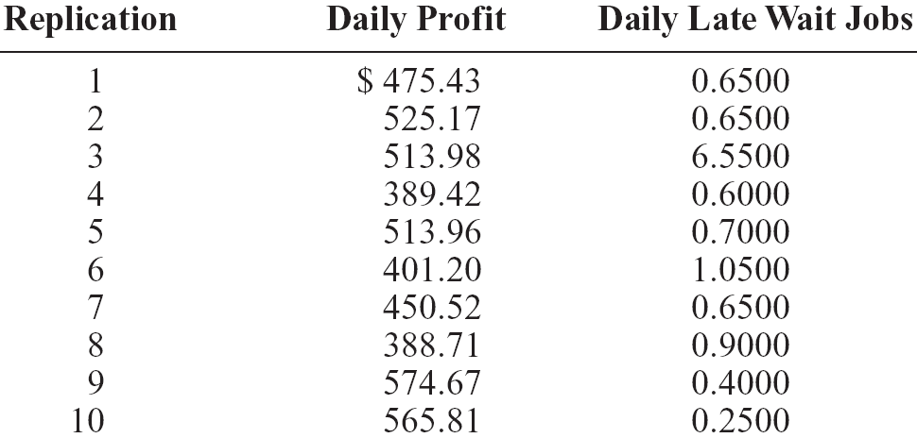
Strategy for Data Collection and Analysis
This will produce separate results for each replication in Category by Replication report
  Example: Model 5-2; Daily Profit, Daily Late Wait Jobs; 10 replications

Slide 8
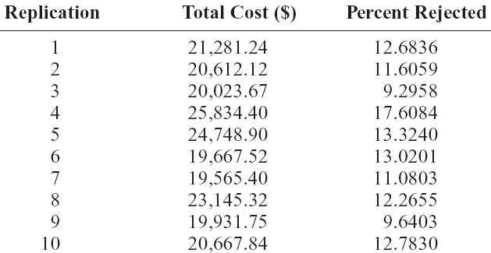
Strategy for Data Collection and Analysis
Example: Model 5-3, but for 10 replications
(= Model 6-1) – Table 6-1 in text
Note
cross-replication
variability

Slide 9
Strategy for Data Collection and Analysis
Category Overview report will have some statistical-analysis results of the output across the replications
How do we decide how many replications?
  Trial and error (now)
  Approximate number for acceptable precision (shortly)
  Sequential sampling (Chapter 12- which we won't do in this course)
Replications take time so turn off animation altogether for max speed when doing analysis
  Run > Run Control > Batch Run (No Animation)

Slide 10

Collecting Data in Files
You don't want to cut and paste to get data available for analysis.
The Category Overview report will provide some of the data.
It is also handy to create binary .dat files that can be fed into the Arena Output Analyzer, a separate application we will discuss shortly.
You do this in the Statistics data module by specifying file names in the Output File column on the right of each row that has Output as the Type selection.
This file will then contain the kind of data listed in Table 6-1 on slide 8, but in binary form so you won't be able to read it.

Slide 11
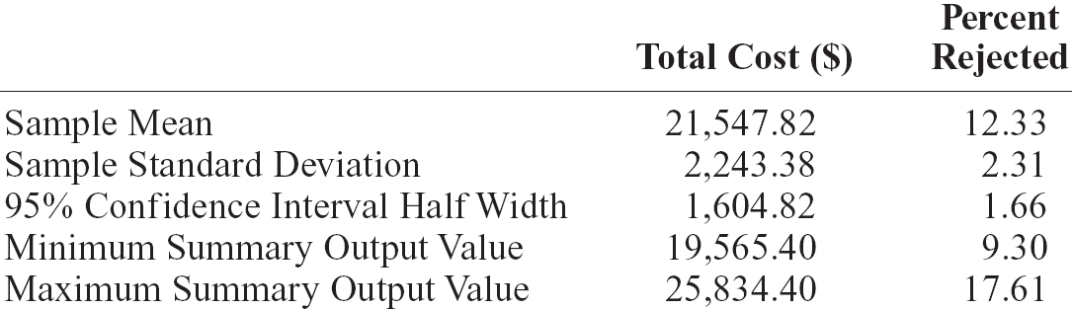
Confidence Intervals for Terminating Systems
Using formulas in Chapter 2, viewing the cross-replication summary outputs as the basic data:
Possibly most useful part: 95% confidence interval on expected values
This information (except standard deviation) is in Category Overview report
  If > 1 replication, Arena uses cross-replication data as above

Slide 12
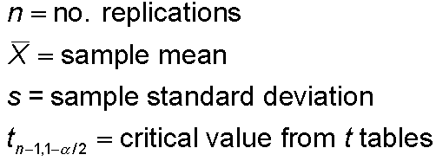


Half Width and Number of Replications
Prefer smaller confidence intervals — precision
Notation:
Confidence interval:
Half-width =
Can’t control t or s
Must increase n — how much?
Should be obvious we need to increase n in order to try and reduce the half-width
Want this to be “small,” say
< h where h is prespecified

Slide 13



Reducing the Half Width and Choosing the Number of Replications
Set half-width = h, solve for
Not really solving for n (t, s depend on n)
Approximation:
  Almost exact: Replace t by z, corresponding normal critical value
  But, it is hard to determine z₁.
  If we pretend that the current s will hold for larger samples, an easier approximation to use is
s = sample standard
deviation from “initial”
number n₀ of replications
h₀ = half width from “initial” number n₀ initial replications

Slide 14
Estimate the Number of Replications Needed
Application to Model 6-1
  From initial 10 replications, 95% half-width on Daily Profit was ±1605 (1604.82 to be exact, but exactness at this fine a level is not needed – so round)
    Let’s get this down to ±500 or less
  First formula:
  n ≅ 1.96²(2243.38²/500²) = 77.3, so 78
  where 2243.38 is the sample standard deviation s,
  500 is the desired half width confidence interval h, and
  1.96 must be obtained from a table.
  So, we'll use the second formula.

Slide 15
Estimate the Number of Replications Needed
Using the second formula to solve the problem:
  From initial 10 replications, 95% half-width on Daily Profit was ±1605 (1604.82 to be exact, but exactness at this fine a level is not needed – so round)
    Let’s get this down to ±500 or less
  where n₀ is the number of initial replications,
  h₀ is the initial confidence interval half width was found, and h is the new desired half width
  Second formula: n ≅ 10(1605²/500²) = 103.0, so 103
  Obviously this is easier to calculate and as long as replications aren't too expensive to run, this imprecision is OK.

Slide 16
Why You Want a Smaller Confidence Interval
With the original confidence interval, the mean was $21,547.82 with a standard deviation of $2243.38 for Model 6-1.
This yields a 95% confidence interval with half width $1604.71.
That means there could be a 7.4% error (1604.71/21547.82) in any one run.
Since you are estimating costs, do you want that large a possible error?
The second formula is easy to calculate and produces a very conservative estimate of the number of replication runs you should make once you decide on the half width you wish to use.

Slide 17
Modify Model 6-1 to Obtain More Replications
Chose Run > Run Control > Batch Run (No Animation) for speed
In Run > Setup > Replication Parameters, changed Number of Replications to 103 (conservative based on previous calculation)
Obtain Total Cost of $22257.35 ± 455.27 (Overshot a bit, but in this direction, not bad.)
Percent Rejected with 103 replications :
11.7733 ± 0.67

Slide 18
Interpretation of Confidence Intervals - Reminder
Interval with random (data-dependent) endpoints that’s supposed to have stated probability of containing, or covering, the expected valued
  “Target” expected value is a fixed, but unknown, number
  Expected value = average of infinite number of replications
Not an interval that contains, say, 95% of the data
  That’s a prediction interval … useful too, but different
Usual formulas assume normally-distributed data
  Never true in simulation
  Might be approximately true if output is an average, rather than an extreme

Slide 19
Half Width and Number of Replications – Some Further Quick Observations
The value of n grows quadratically as h decreases
i.e. to reduce the half-width to half its initial value, we need about four times as much data.
Some other cautions:
  In the Category Overview Report, the Half Width entries are accurate only up to 100 replications.
  This is due to a limitation within Crystal Reports, not Arena.
  Recall a .out file is produced. The values there are accurate.

Slide 20
Central Limit Theorem
This is one of the cornerstones of statistical theory.
Basically says we'll be pretty much OK in terms of actual confidence that we are close to our desired confidence intervals if n is "large".
But, how large?
The answer to that question is hard as it depends on how close our data is to a normal distribution.
This closeness can be checked out somewhat by the methods we used earlier in studying distributions although the text authors do this just to show in Figure 6-2 (page 272) that the distribution is somewhat close to a normal curve.
Modify Model 6-2 to make Model 6-3.

Slide 21
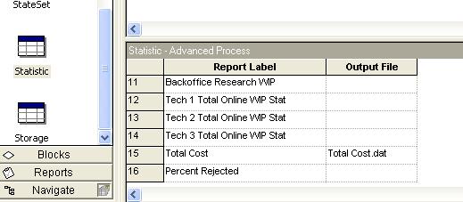
Modifications to Model 6-2 to Model 6-3
Set replication number to 1000.
Output the 1000 individual Total Cost values to a file called Total Cost.dat by naming this file in the Output File column in the Statistic data module.

Slide 22
Total Cost.dat is a Binary File
We can't read binary files, only text files.
Try to read Total Cost.dat in Notepad or Wordpad
We can't; so we need to convert it using an application program we will explore in more depth later, the Output Analyzer, if you want to see it for so some reason.
The Total Cost.dat file should be in the folder in which you ran Model 6-3.
The Output Analyzer should be in the folder where Arena was created, unless you changed the directory.
Easiest approach: Make a shortcut for Input Analyzer, the Output Analyzer, and probably Process Analyzer on your desktop by going through Start.

Slide 23
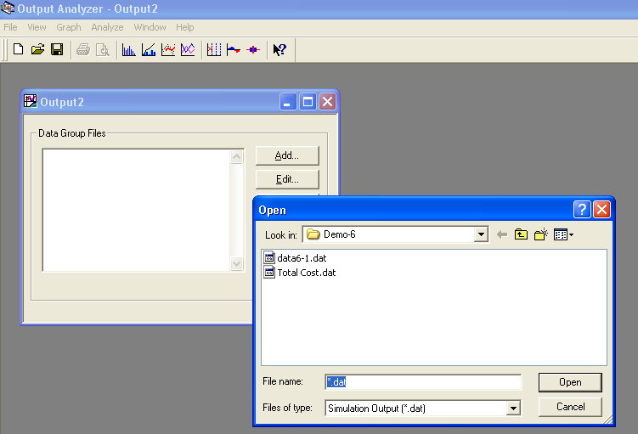
Converting an Arena Binary File into a Text File
File > New > Add > Select Total Cost.dat > Open

Slide 24
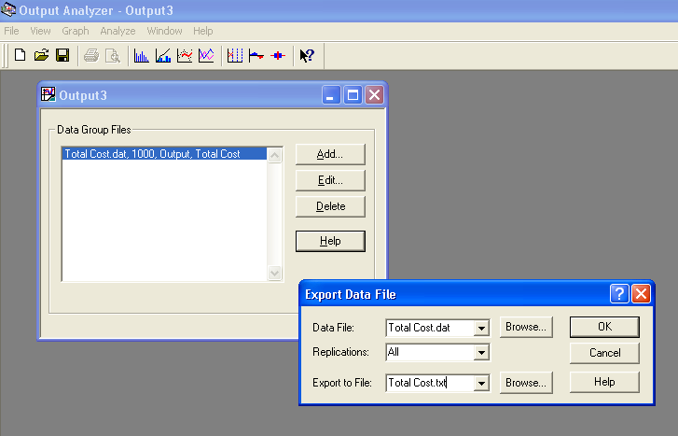
Converting an Arena Binary File into a Text File
File > Data File > Export >Type new name, Total Cost.txt

Slide 25
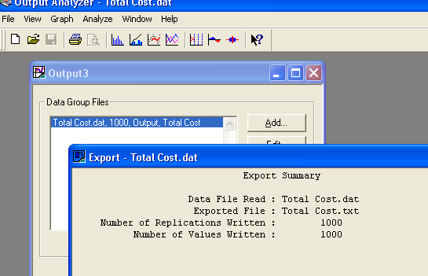
Converting an Arena Binary File into a Text File
After clicking OK, the following message will appear and Total Cost.txt will be a text file.
Now look at Total Cost.txt in Notepad or Wordpad.

Slide 26
Checking if Data Output is Close to Normal So Central Limit Theorem Holds
Once the text file is obtained, some of the extra data must be eliminated.
This is a tedious step done by pulling the data into a spreadsheet and massaging it.
I don't recommend worrying about that.
Basically, the authors point out that some theory in the form of a more general version of the central limit theorem and a lot of simulation theory suggest that if the value you are obtaining from each individual replication is a sum or average, as opposed to an extreme value, then the standard normal-theory statistical inference methods is fairly safe.
The file produced, Total Cost, is a "sum" form so it can use Arena's normal-theory-based statistical methods.

Slide 27
Half Width and Number of Replications – Some Further Observations
The value of n grows quadratically as h decreases
i.e. to reduce the half-width to half its initial value, we need about four times as much data.
Some other cautions:
  In the Category Overview Report, the Half Width entries are accurate only up to 100 replications.
  This is due to a limitation within Crystal Reports, not Arena.
  Recall a .out file is produced. The values there are accurate.

Slide 28
Comparing Alternatives
Normally a simulation is used because someone wants to compare different versions (alternatives, scenarios) of the same general model.
Usually they want to compare alternative configurations, layouts, staffing, timings, etc.
The changes can be as simple as making a single parameter different to as complex as having totally different logic.
Initially we'll just compare two scenarios and then we will see how to handle multiple scenarios and compare them.

Slide 29
Comparing Two Scenarios
Model 6-4
  Model 6-3, except reduce to 110 replications, add file Total Cost.dat to Statistic module, Output column, Total Cost row
    Similarly for percent rejected
  These changes save the output statistics to these files for each replication
We use two scenarios:
  Base case – all input as for the original Model 5-3, no extra resources
  More-resources case – Add 3 trunk lines (29), 3 each of New Sales, New Tech 1, New Tech 2, New Tech 3, and New Tech All
We ask what is the affect on the total cost, percent rejected?

Slide 30
Comparing Two Scenarios
Do one run on each case with no replications.
Total cost outputs:
  Base case: $21,281.24
  More resources case: $23,306.75
Percent Rejected:
  Base case: 12.6836
  More resources case: 0.2833
Strictly eyeballing this, for a rather small additional cost, we looked as if we provided much better service.
But, you should realize by now, basing a judgment like this on one run with no statistical analysis of the result is dangerous and can lead to erroneous conclusions.

Slide 31
Comparing Two Scenarios
A reasonable approach (but not the best idea)
  Make one run, no replications, on both and look at the confidence intervals on expected outputs from each alternative, see if they overlap.
  If they don't overlap, this exercise suggests the perceived differences are statistically significant.
Look at Total Cost:
  Base case:
  22241.71 ± 413.52, or [21828.12, 22655.16]
  More-resources case:
  24560.12 ± 315.93, or [24244.19, 24876.05]
But this doesn’t allow for a precise, efficient statistical conclusion because we have done only one run.
Moreover, what if we do many runs and find sometimes the intervals overlap and sometimes they don't?
No overlap

Slide 32
Compare Means via Output Analyzer
Output Analyzer is a separate application that operates on .dat files produced by Arena
  Launch separately from Windows, not from Arena
To save output values (Expressions) of entries in Statistic data module (Type = Output) – enter filename.dat in Output File column
  We do this for both Total Cost and Percent Rejected in both Model 5-3 and Model 6-4 and do 110 replications – a bit more than needed so we will agree with the text.
  Remember, these .dat files are binary … can only be read by Output Analyzer

Slide 33
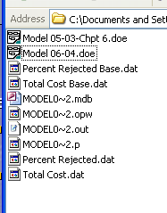
Compare Means via Output Analyzer
Each run will overwrite these file names
  So, either change the names here or in the operating system before the next run
  I prefer to change them in the model file so I won't forget and overwrite them.
  After the two runs you would see:

Slide 34
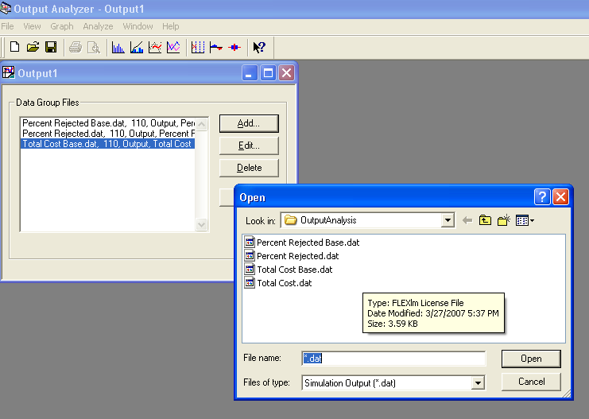
Compare Means via Output Analyzer
Start Output Analyzer, open a new data group: File > New
  Basically, a list of .dat files that you select if of current interest
  Select all 4 files that were created.
  You can save this data group for later use – .dgr file extension – to avoid having to do the selection again.

Slide 35
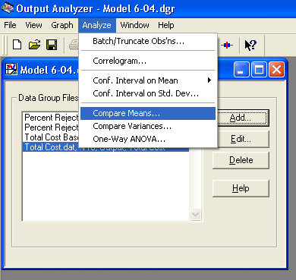
Compare Means via Output Analyzer
Analyze > Compare Means menu option

Slide 36
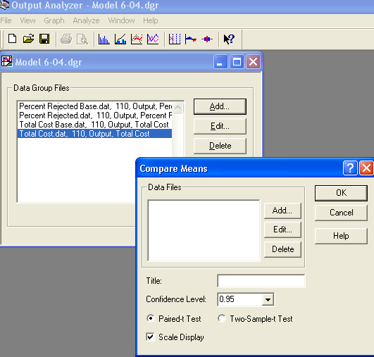
Compare Means via Output Analyzer
Press Add on dialog box Compare Means that appears.

Slide 37
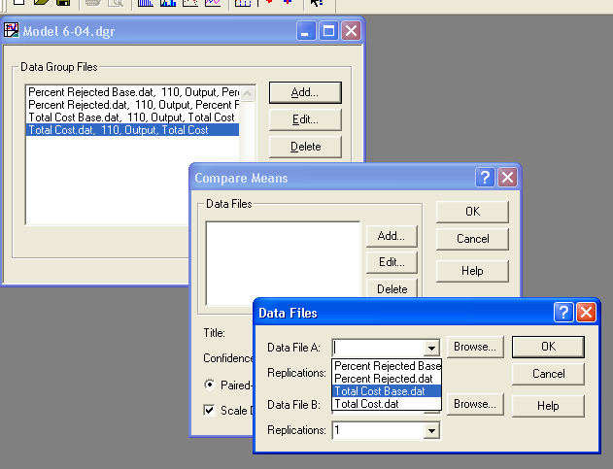
Compare Means via Output Analyzer
Select both of the files to compare using the drop down menus

Slide 38
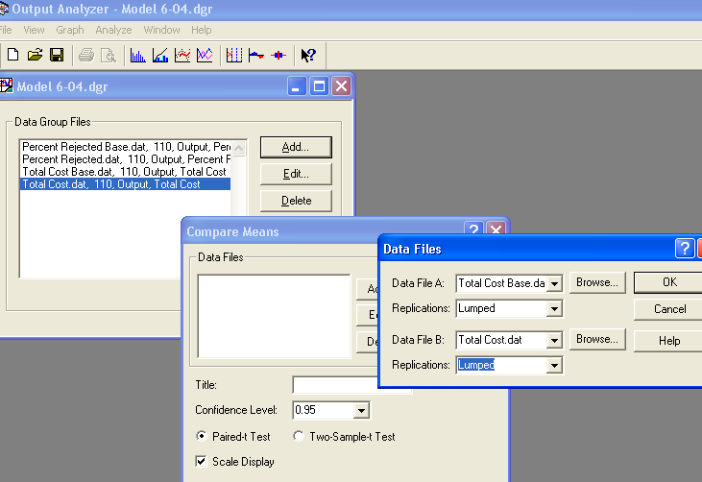
Compare Means via Output Analyzer
Add data files … “A” and “B” for the two alternatives
Select “Lumped” for Replications field

Slide 39
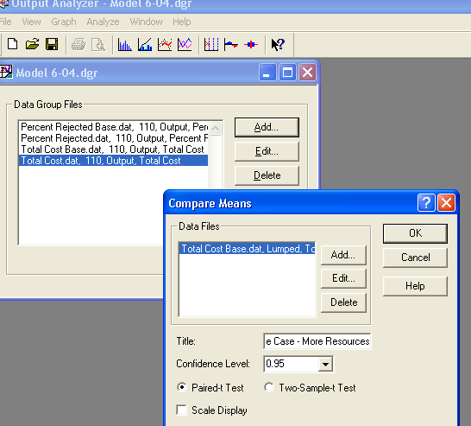
Compare Means via Output Analyzer
After clicking OK on Data Files dialog box, on the Compare Means dialog box set: title, confidence level, accept Paired-t Test, do not Scale Display since the two output performance measures have different units

Slide 40
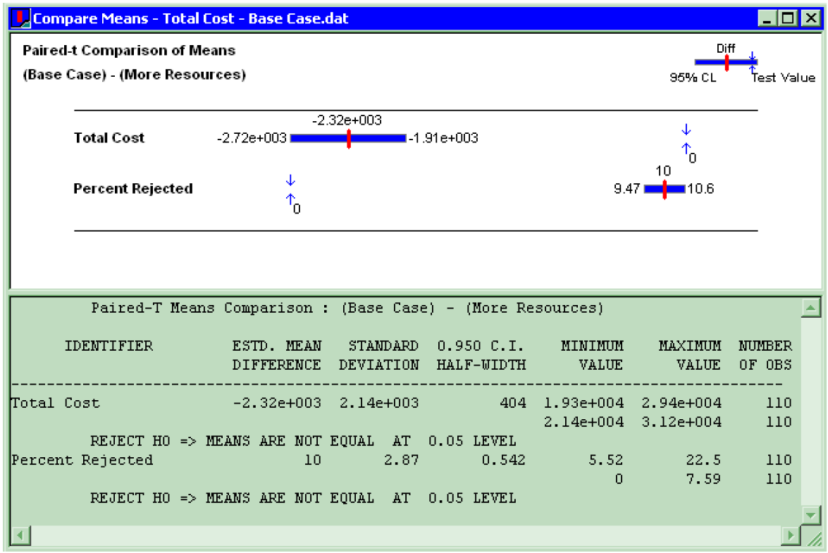
Compare Means via Output Analyzer
Results: The Output Analyzer computes the mean of A – mean of B.
Confidence intervals on differences both miss 0
  Conclude that there is a (statistically) significant difference on both output performance measures

Slide 41
Evaluating Many Scenarios with the Process Analyzer (PAN)
With (many) more than two scenarios to compare, two problems are
  Simple mechanics of making many parameter changes, making many runs, keeping track of many output files
  Statistical methods for drawing reliable, useful conclusions
Process Analyzer (PAN) addresses these
PAN operates on program (.p) files – produced when .doe file is run (or just checked)
Start PAN from Arena (Tools > Process Analyzer) or via Windows
PAN runs on its own, separate from Arena

Slide 42
PAN Scenarios
A scenario in PAN is a combination of:
  A program (.p) file (produced when the .doe file is run)
  Set of input controls that you choose
    Chosen from Variables and Resource capacities – think ahead
    You fill in specific numerical values
  Set of output responses that you choose
    Chosen from automatic Arena outputs or your own Variables
    Values initially empty … to be filled in after run(s)

Slide 43
PAN Scenarios
  To create a new scenario in PAN, double-click where indicated, get Scenario Properties dialog
    Specify Name, Tool Tip Text, .p file, controls, responses
    Values of controls initially as in the model, but you can change them in PAN – this is the real utility of PAN
    Duplicate (right-click, Duplicate) scenarios, then edit for a new one
  Think of a scenario as a row

Slide 44
PAN Projects and Runs
A project in PAN is a collection of scenarios
  Program files can be the same .p file, or .p files from different model .doe files
  Controls, responses can be the same or differ across scenarios in a project – usually will be mostly the same
  Think of a project as a collection of scenario rows – a table
  Can save as a PAN (.pan extension) file

Slide 45
PAN Projects and Runs
Select scenarios in project to run (maybe all)
PAN runs selected models with specified controls
PAN fills in output-response values in table
  Equivalent to setting up, running them all “by hand” but much easier, faster, less error-prone
We'll use Model 06-05.doe which is just the former model with the output files no longer listed in the statistics module.
Run it so Model 06-05.p is produced.

Slide 46
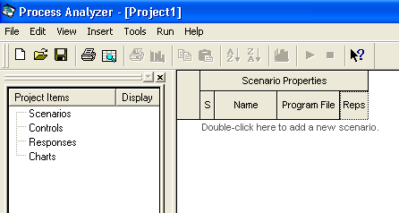
Start the Process Analyzer (PAN) and Select File > New

Slide 47
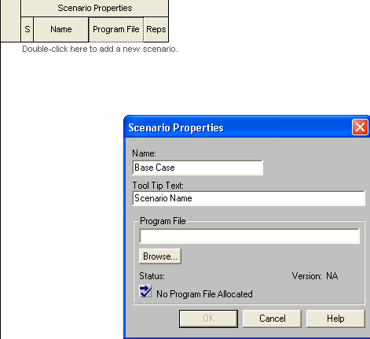
Double-click to Add a New Scenario – Set Name as Base Case

Slide 48
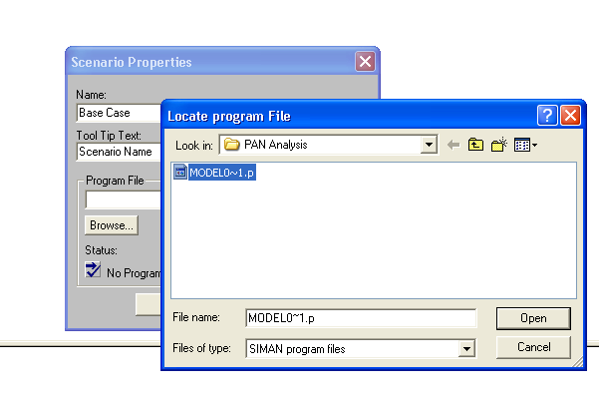
Browse for Model0~1.p (Model -6-05.p) and Open It

Slide 49
Set Controls and Responses
Six controls – all data type Integer
  Resources > capacity of Trunk Line
  User Specified > New Tech 1, New Tech 2,
  New Tech 3, New Tech All, New Sales
  These are variables we will change when we set up and run various scenarios
Responses – both from User Specified
  Total Cost, Percent Rejected
  These are the results we want to see when we run various scenarios.

Slide 50
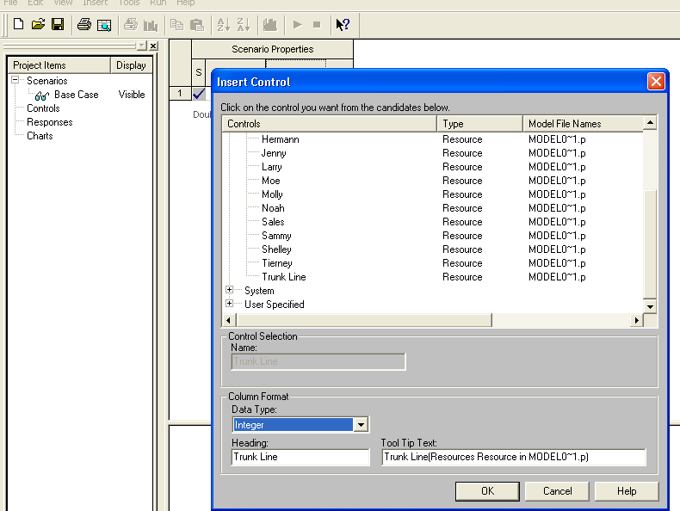
Use Insert > Control to Enable Controls to be Selected

Slide 51
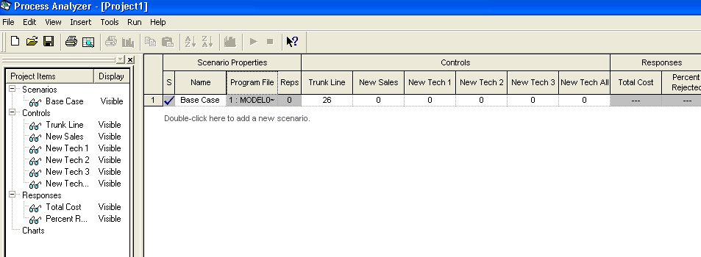
Repeat with Insert > Responses

Slide 52
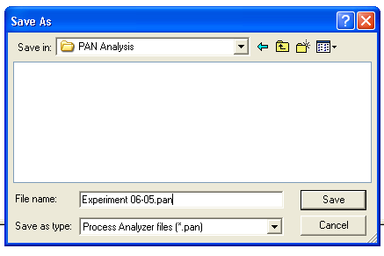
Save as a .pan File

Slide 53
Setting Up More Scenarios
You can repeat this for more scenarios.
But, if a new scenario is somewhat similar to this one, the easiest approach is to duplicate it and then edit the duplicated scenario.
  Right-click in the scenario number on the left and select Duplicate Scenario(s) from the menu.
But, first, let's see what we might want to consider as scenarios – i.e. "what if" situations.

Slide 54
Model 6-5 for PAN Experiments We'll Try
Experimental (non-base-case) scenarios
  Suppose you get $1360 more per week for more resources (Note- in the errata, this is corrected to $1360, not $1300 as in the text.)
    Must spend all $1360 on a single type of resource; could get
      13 more trunk lines @ $98 each
      4 more of any one of the single-product tech-support people @ $320 each
      3 more of the all-product tech-support people @ $360 each
      4 more sales people @ $340 each

Slide 55
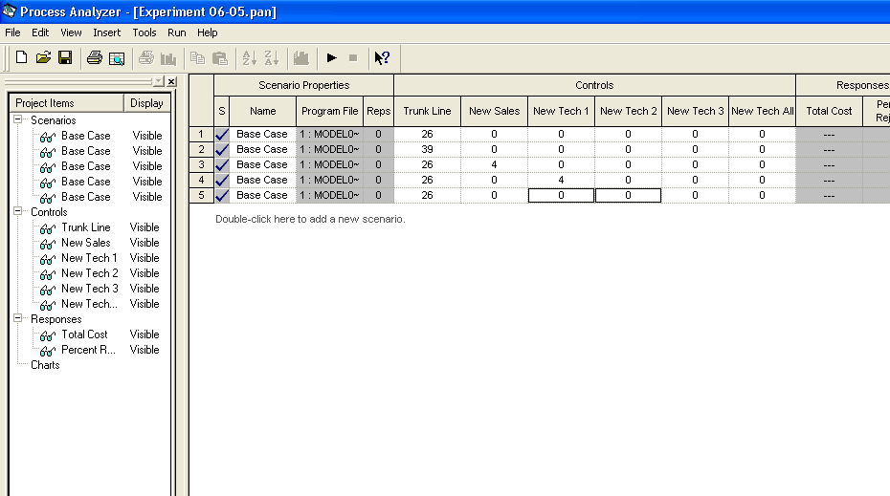
Some of the Duplications, But Not Completed Yet

Slide 56
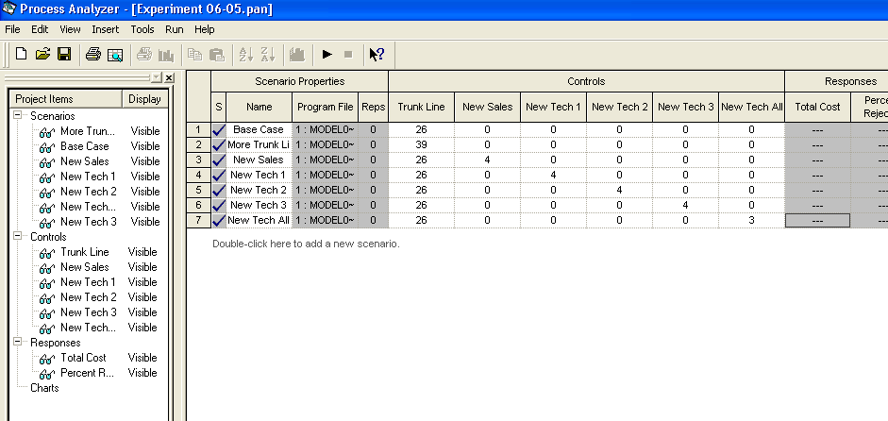
Change Names by Right-clicking and Bringing Up Scenario Properties
Change Values for Each Scenario

Slide 57
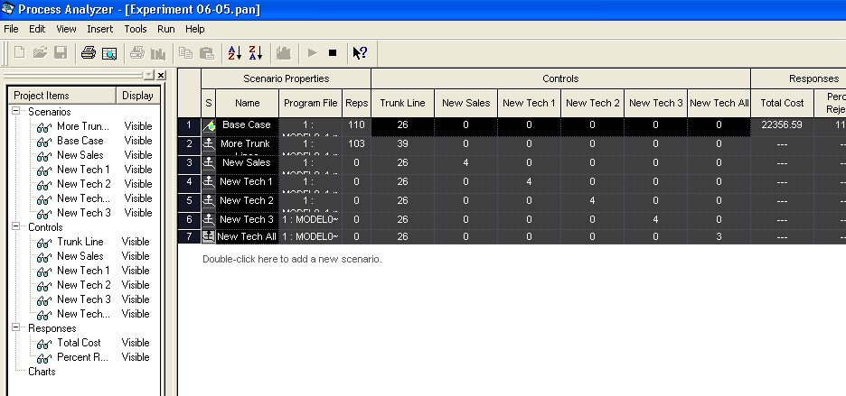
Fill In Values; Select All to Run by Ctrl/Shift and Clicking on Number; Select Run > Go
On 2nd Scenario Run

Slide 58
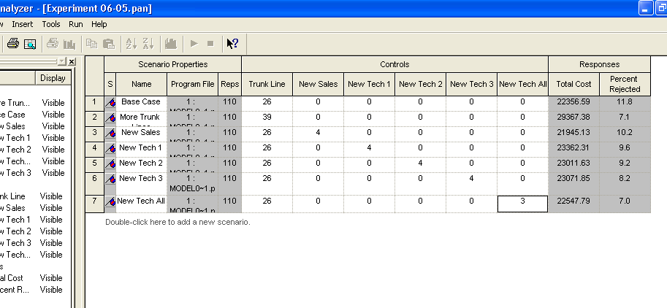
All Runs Complete – Note Last Line is Different Than Text –Eyeball the Results

Slide 59
Statistical Comparisons with PAN
Model 6-5 scenarios were made with 110 replications each
  Better than one replication, but what about statistical validity of comparisons, selection of “the best”?
Select Total Cost column, Insert > Chart (or right-click on column, then Insert Chart)
  Chart Type: Box and Whisker
  Next, Total Cost; Next defaults
  Next, Identify Best Scenarios
    Smaller is Better, Error Tolerance = 0 (not the default)
    Show Best Scenarios; Finish
Repeat for Percent Rejected

Slide 60
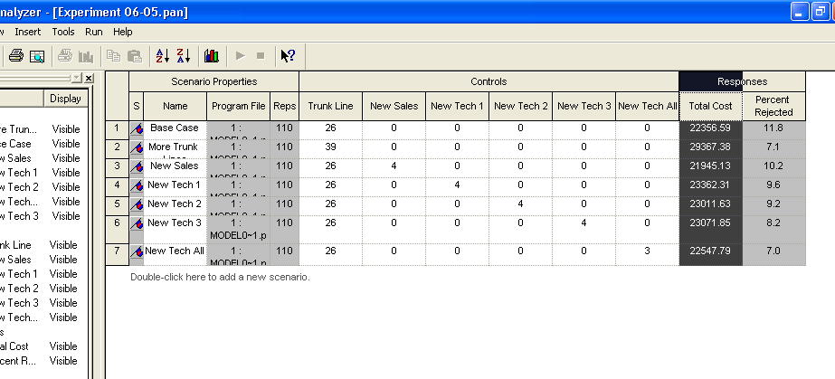
Selection of Total Cost Column for Determining If Differences Are Statistically Significant

Slide 61
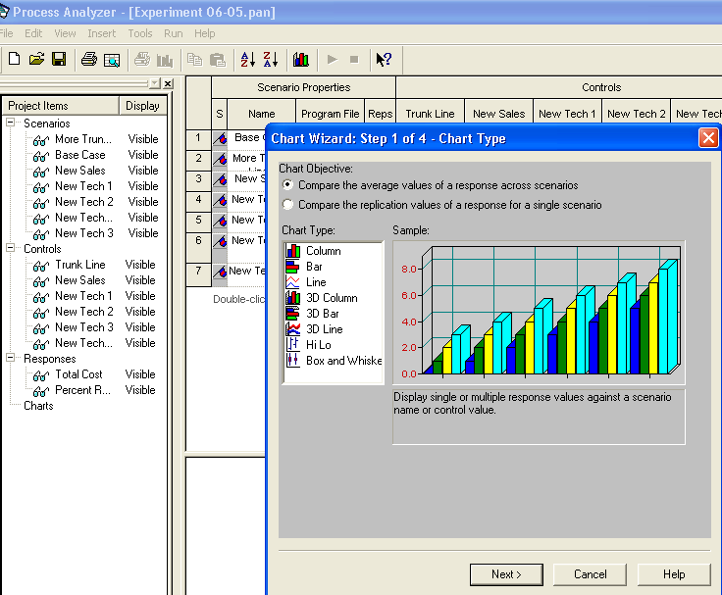
Click on Responses Label Above Total Cost and then Insert > Chart

Slide 62
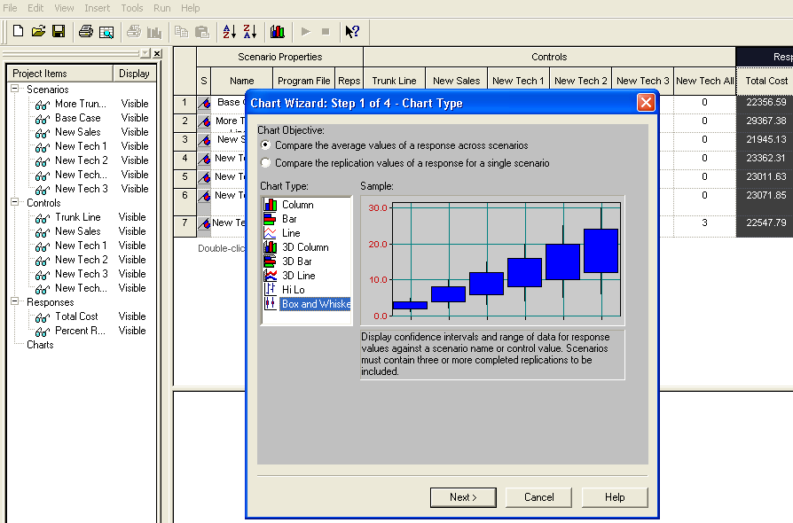
Bar and Whisker Selected

Slide 63
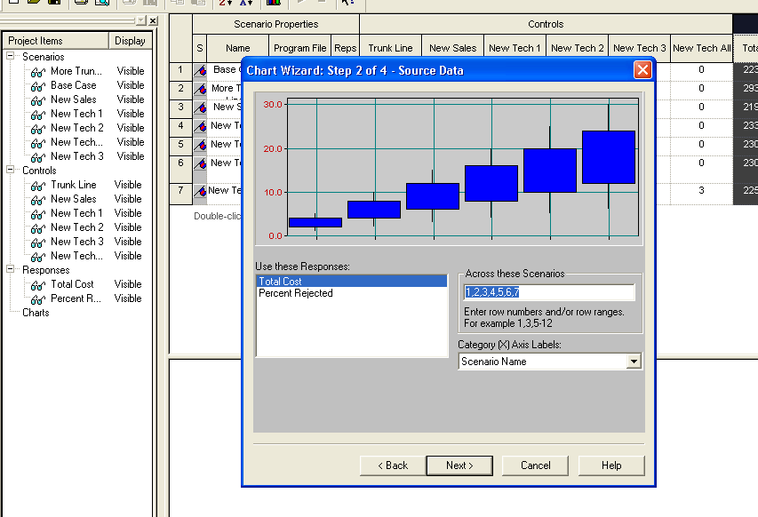
Select Total Cost

Slide 64
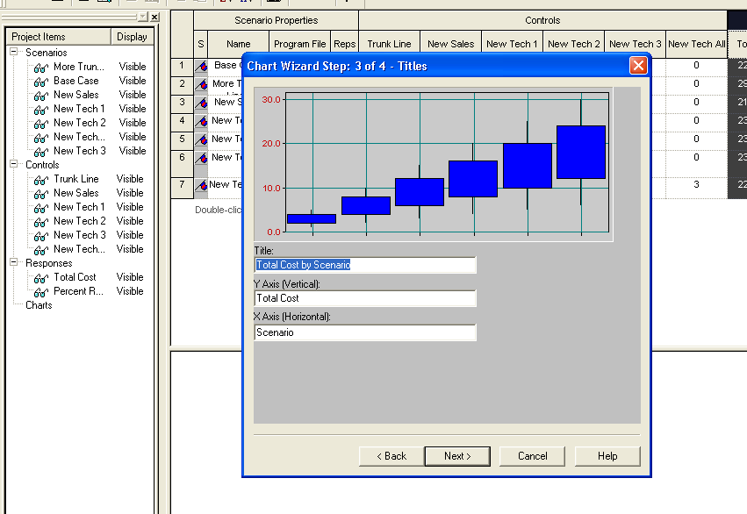
Accept Defaults

Slide 65
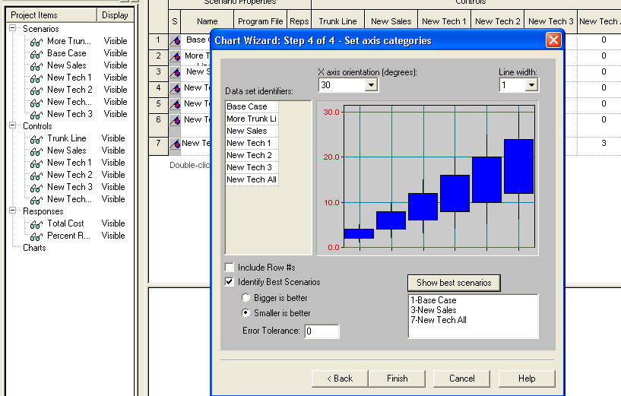
Make Selections and Change Tolerance; Click Show Best Scenarios

Slide 66
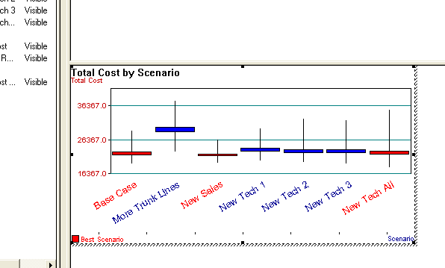
After Resizing Chart That Appears When Finished With Chart Dialogs

Slide 67
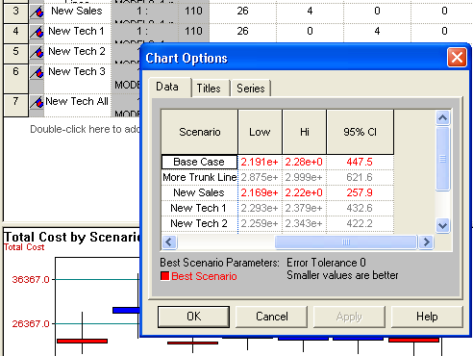
Details Can Be Seen By Right-clicking on the Chart and Selecting the Data Tab

Slide 68
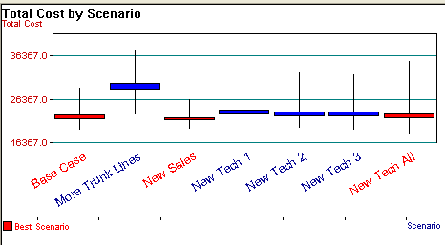
What Does the Chart Say?
Vertical boxes: 95% confidence intervals
Red scenarios statistically significantly better than blues
  More precisely, red scenarios are 95% sure to contain the best one
  Narrow down red set – more replications, or Error Tolerance > 0
  More details in text

Slide 69
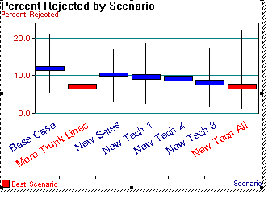
Repeat for %Rejected

Slide 70
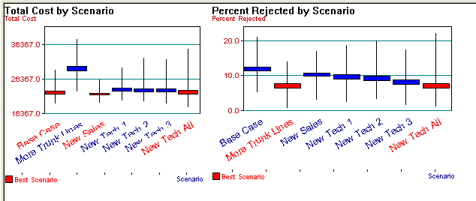
Look At Both of These
Best overall seems to be to add 3 Tech All individuals.

Slide 71
But, Still – Be Cautious
We might want to experiment with various changes such as
  More replications
  Different replications for different scenarios
  A different Error Tolerance
However, it is impossible to run all possible scenarios
Even narrowing some of the choices, as we will see, can result in an unbelievable number of possibilities.
Arena provides one more tool for making statistical judgments – OptQuest – an artificial intelligence-based tool that uses heuristics to search for an optimal scenario.
However, that results are not guaranteed to be optimal - only to be a reasonable choice.

Slide 72
Searching for an Optimal Scenario with OptQuest
Scenarios considered via PAN are just a few of many possible ones you could run
Seek input controls minimizing Total Cost while keeping Percent Rejected ≤ 5
Explore all possibilities – add resources in any combination
New rules:
    26 ≤ number of trunk lines ≤ 50
    Total number of new employees of all five types ≤ 15

Slide 73
Searching for an Optimal Scenario with OptQuest – Formulation
Formulate as an optimization problem:
  Minimize Total Cost
  Subject to
  26 ≤ MR(Trunk Line) ≤ 50
  0 ≤ New Sales + New Tech 1 + New Tech 2 + New Tech 3 + New Tech All ≤ 15
  Percent Rejected ≤ 5
Reasonable start – best acceptable scenario so far
No PAN scenarios satisfied Percent Rejected ≤ 5, so start with more-resources case earlier (29 trunk lines, 3 new employees of each of five types)

Slide 74
Searching for an Optimal Scenario with OptQuest
  Where to go from here? Explore all of feasible six-dimensional space exhaustively?
  No.
  For this problem, choice (decision) variables are discrete, so can enumerate that there are 1,356,600 feasible scenarios – with 110 replications per scenario, would take two months on a 2.1GHz PC

Slide 75
Searching for an Optimal Scenario with OptQuest – Operation
OptQuest searches intelligently for an optimum
  Like PAN, OptQuest ...
    Runs as a separate application
    “Takes over” the running of your model
    Asks you to identify input controls, the output (just one) objective
    The program is a result of a lot of research over many years in how to answer the optimization questions.
    Produced by OptTek Systems

Slide 76
Searching for an Optimal Scenario with OptQuest – Operation
Unlike PAN, OptQuest ...
  Allows you to specify constraints on the input controls
  Allows you to specify “constraints” on outputs
  Decides itself what input-control-value combinations to try
  Uses internal heuristic algorithms (tabu search and scatter search + other methods) to decide how to change the input controls to move toward an optimum configuration
There are various stopping criteria for search
  Default is no significant improvement for 100 scenarios

Slide 77
These Slides Are for Version 10.0

Slide 78
Searching for an Optimal Scenario with OptQuest – Example Version 10.0
We will use Model 6-6 for OptQuest
  It is Model 6-5, but OptQuest requires a finite Replication Length so Model 6-6 is just Model 6-5 with 1000 set for the replications – we'll never go that high
  Make sure Model 6-6 model window is active
Start OptQuest:
Tools > OptQuest for Arena
  New Optimization or Browse for saved one (.opt)

Slide 79
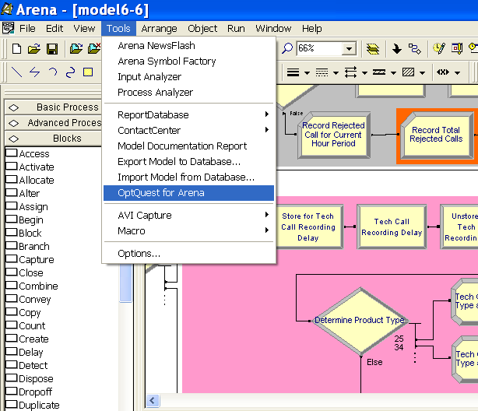
Starting OptQuest Inside Arena with Model 6-6 Already Loaded

Slide 80
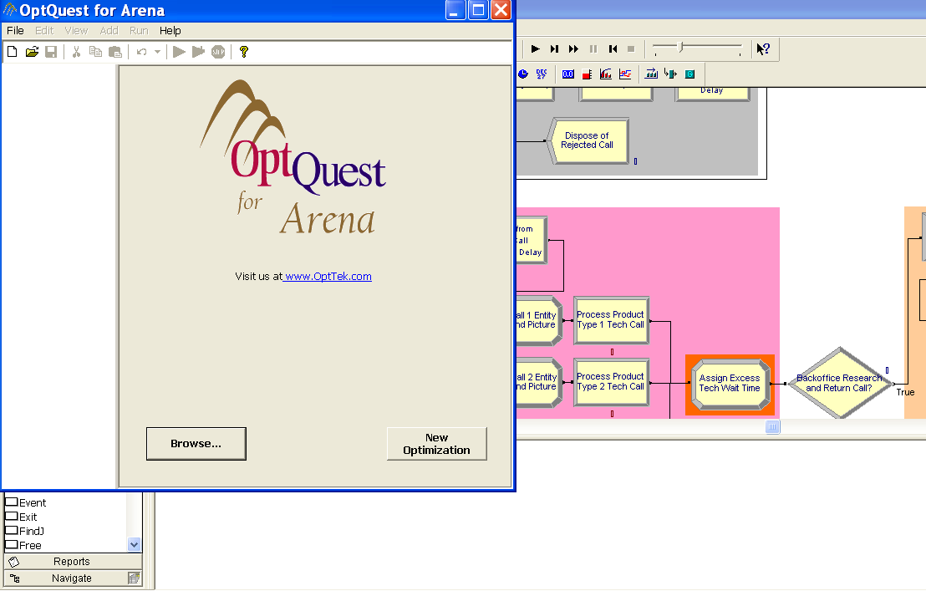
Choose New Optimization When OptQuest Opens

Slide 81
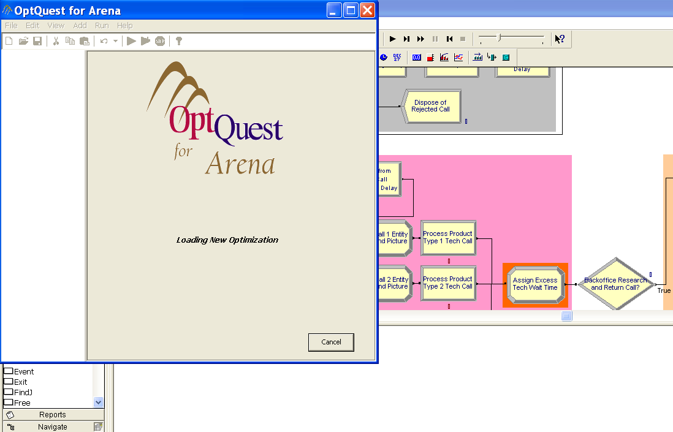
Loading Will Take Some Time So Be Patient

Slide 82
You Will Set Controls, Responses, and Constraints
  Look for the tree on left side
  Use it to expand for Controls and Responses or
    Select View > Controls to expand the controls.
    Select View > Responses to expand the responses.
  When expanded you'll see resources, variables, outputs etc. that Arena defined as well as user-specified ones.
  This handles very much like PAN except you need to set bounds for the variables which are to be varied.
  The controls are the choice variables or decision variables you wish OptQuest to vary as it searches for an optimal solution.
  The responses are normally output variables you wish to minimize or maximize.

Slide 83
Setting the Controls and Responses for Model 6-6
Controls – Resources – Trunk Line
  Integer, Lower Bound = 26, Suggested Value = 29,
  Upper Bound = 50
Controls – User Specified – New Sales
  Integer, Lower Bound = 0, Suggested Value = 3,
  Upper Bound = 15 (as sum of all can't be greater than 15, make sure the upper bound isn't greater than 15.)
  Similarly for others ... open Optimum Seeking 06-06.opt
  Click on “Included” to collect selections at top or bottom
Responses – User Specified – Output
  Check Percent Rejected, Total Cost

Slide 84
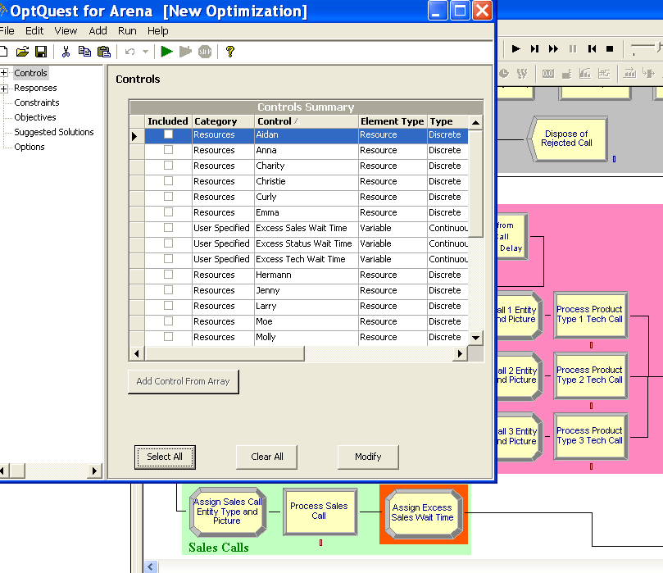
Controls Open

Slide 85
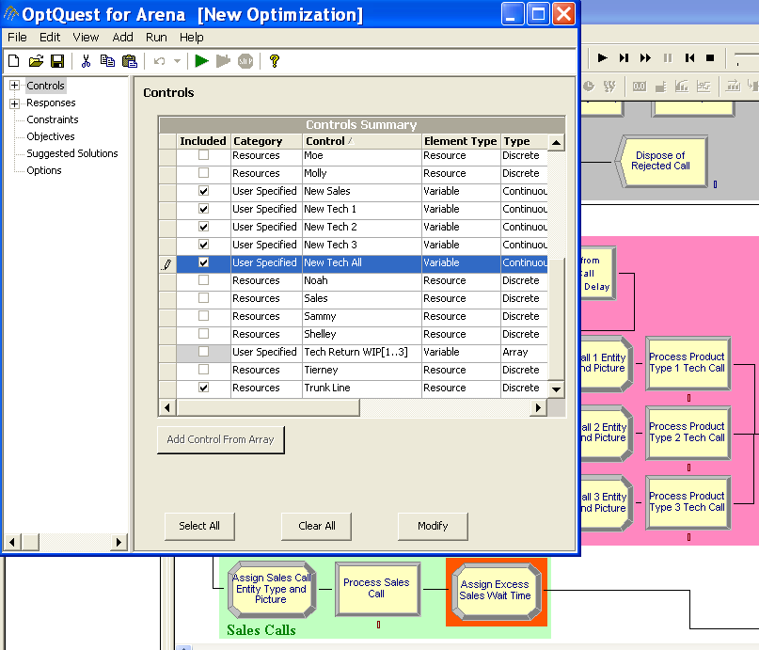
View > Controls and Check Desired Controls (Ones Used in PAN)

Slide 86
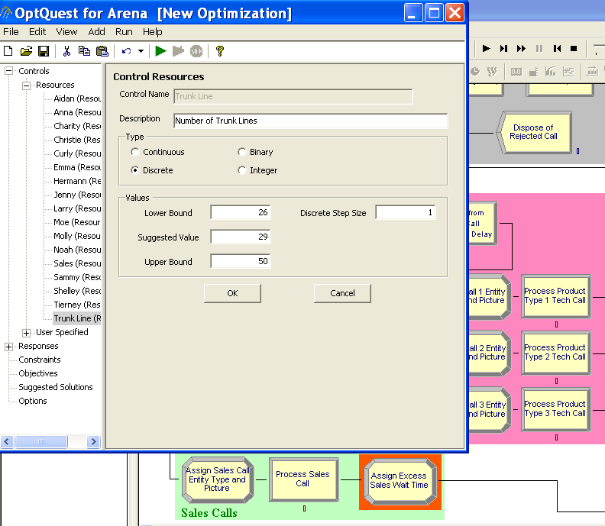
Click on Each Row of Checked Controls to Fill in Bounds to Use (Note: Still Need to Check Integer)

Slide 87
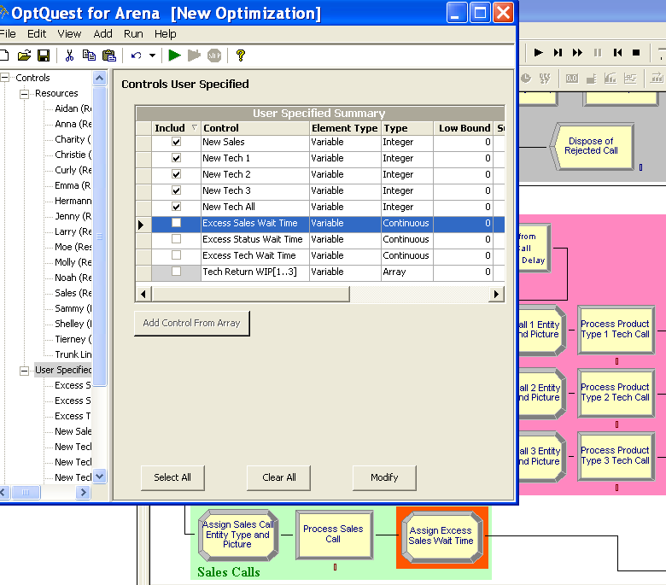
Click Triangle on Top of Included Column to Collect Together at Top (or Bottom)

Slide 88
Setting the Controls and Responses for Model 6-6
Controls – Resources – Trunk Line
  Integer, Lower Bound = 26, Suggested Value = 29,
  Upper Bound = 50
Controls – User Specified – New Sales
  Integer, Lower Bound = 0, Suggested Value = 3,
  Upper Bound = 15 (as sum of all can't be greater than 15, make sure the upper bound isn't greater than 15.)
  Similarly for others ... open Optimum Seeking 06-06.opt
  Click on “Included” to collect selections at top or bottom
Responses – User Specified – Output
  Check Percent Rejected, Total Cost

Slide 89
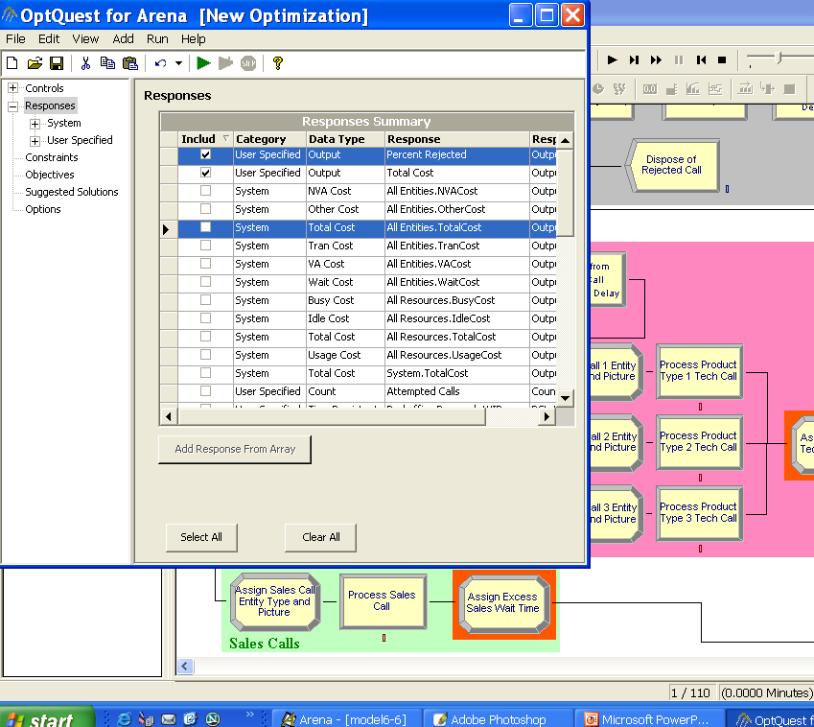
Be Sure to Get the User-specified Responses of Type Output

Slide 90
Recall – This is being Formulated as an Optimization Problem Subject to Some Constraints
  Minimize Total Cost
  Subject to
  26 ≤ MR(Trunk Line) ≤ 50
  0 ≤ New Sales + New Tech 1 + New Tech 2 + New Tech 3 + New Tech All ≤ 15
  Percent Rejected ≤ 5

Slide 91
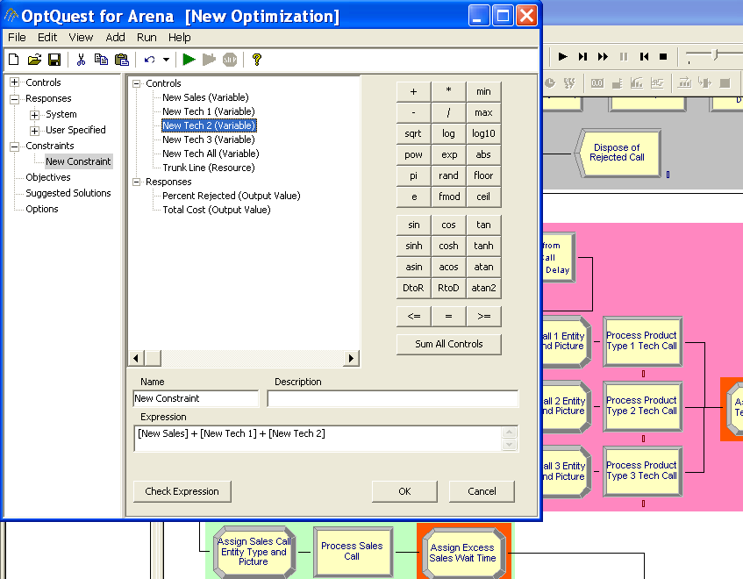
View > Constraints Brings Up a Dialog Box for Setting the Constraints

Slide 92
Searching for an Optimal Scenario with OptQuest – Constraints, Objective
Constraints (Use View > Constraints or tree)
  Add button, then each of first five controls, “+”, then “<= 15”
  Add button, then Percent Rejected, then “<= 5”
Next handle the objectives
  Add button, Total Cost, Minimize radio button
Options
  Stopping rules
  Tolerance for regarding results as “equal”
  Replications per simulation
  Solutions log file location
    Stores all scenarios tried, results – valuable for second best, etc.

Slide 93
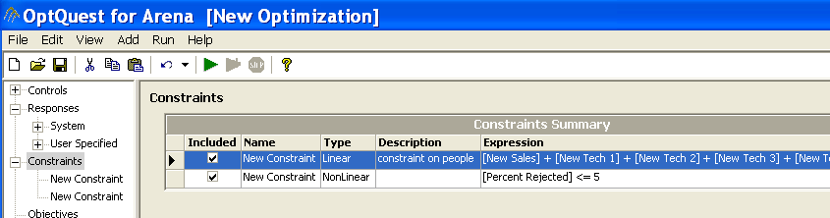
Setting of the Constraints

Slide 94
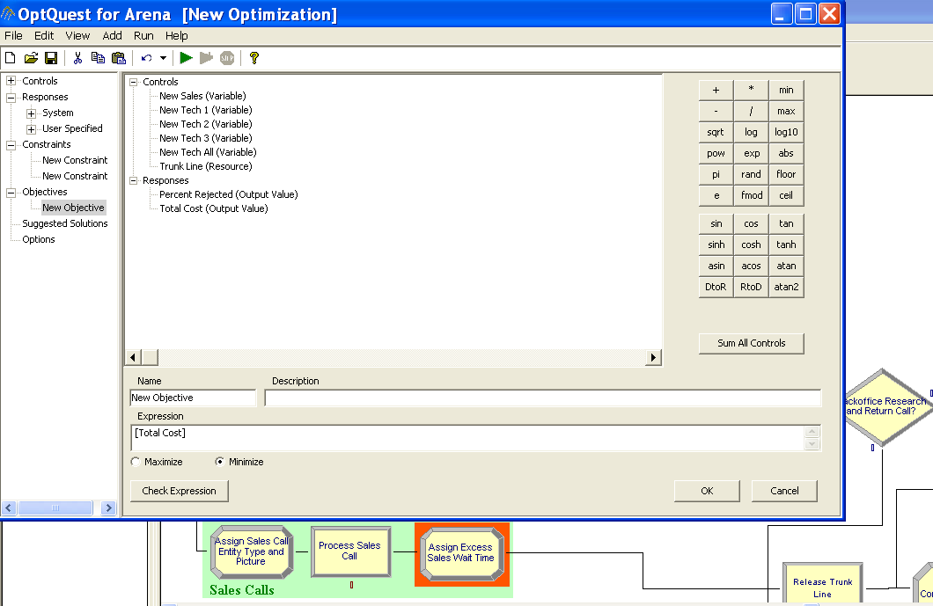
Setting the Objective

Slide 95
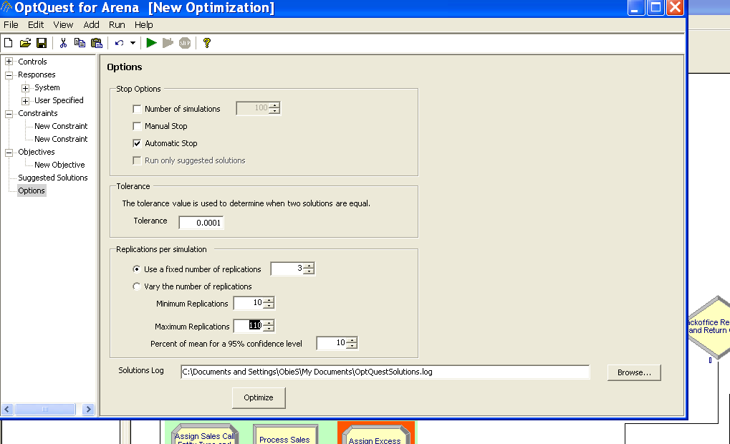
Setting the Options – Be Sure to Set Bounds as These Runs Take a Long Time Under the Best of Conditions – Press Optimize

Slide 96
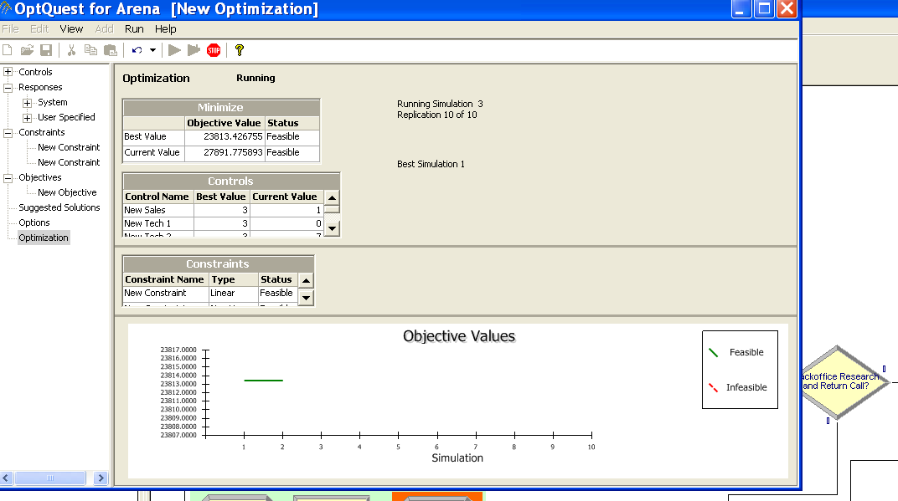
Just After the Start of the Optimize Run – Note What is Shown

Slide 97

Part Way Through the Run – Note Data Provided

Slide 98

And Further Into the Run

Slide 99

And Further – We Wouldn't Know it Yet, But 329 is the Chosen One – We Have to Wait Until 429 Runs to Know This – Why?

Slide 100

Searching for an Optimal Scenario with OptQuest – Run Terminates
Can’t absolutely guarantee a true optimum
  But usually finds a far better configuration than possible by hand
Note the fast progress made at the beginning and then the slow progress after the run has worked for a while
This is typical – known as "harvesting the low hanging fruit."
429 evaluated scenarios comprises 0.03% of the 1,356,600 total possibilities

Slide 101

Click on Best Solutions to See Not Only the Best Solution, But Others in Rank Order

Slide 102

The Optimization File Can Be Saved and Reopened as a .opt File

