Slide 1

Intermediate Modeling and Steady-State Statistical Analysis
Chapter 7

Slide 2
What We’ll Do ...
Model 7-1: A small manufacturing system
  Entity-dependent sequences – a new concept
  How to pay attention to data requirements and availability
  Verification (debugging)
Statistical analysis of steady-state simulations
  Warmup and run length
  Truncated replications
  Batching
  Other methods and goals

Slide 3
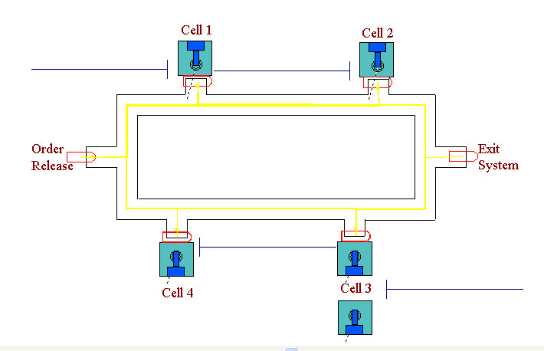
Model 7-1:A Small Manufacturing System
Consists of part arrivals,
four manufacturing cells,
part departures
Cells 1, 2, and 4:
single machine each
Cell 3: two machines —
newer one 20% faster
  Need: way to model non-identical resource units
Circular layout of cells
Parts enter at left, exit at right, travel only clockwise, all transfer times = 2 min. (realistic?)

Slide 4
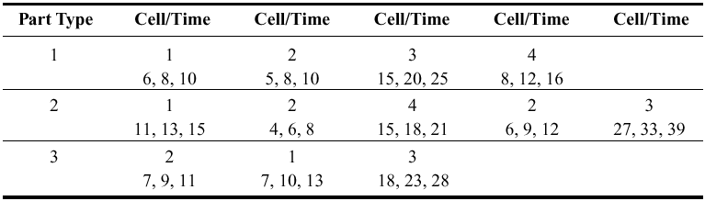
A Small Manufacturing System
Three separate part types
  Interarrivals (all types merged) ~ expo(13) minutes
  26% type 1, 48% type 2, 26% type 3
Different part types follow different routes, have different (triangular) processing times:
Observe utilizations, time/number in queues, cycle times (times in system) by part type
Run for 32 hours
Parameters are for the slow machine at Cell 3.

Slide 5
New Arena Concepts
Non-identical machines at Cell 3
Different entity types follow different process plans
  Previous models – all entities went through same sequence of stations, maybe with Decides for branching
  Now, need process plan with automatic routing by entity type – different Sequence assigned to each entity (like an attribute), and entity follows its own sequence

Slide 6
New Arena Concepts
  We won’t use direct Connect or Routes … instead we tell entities departing from modules to follow their own Sequence
    Could use Connect or Routes, but wouldn’t be able to animate the part flows or show the 2 minute transfers
    Could use delays to model the transfers, but the animation wouldn’t look right
  Arena internally keeps track of where an entity is and where it will go next

Slide 7
The Modeling Approach
Usually there are many ways to build a (correct) Arena model
  And also many ways to do so incorrectly …
Important to think about data structures
  What data are available?
  How will they be stored in the model?
Sequences are nice as they basically provide a schedule and route for an entity of a given type to follow in the system
Sequences are found on the Advance Transfer panel.

Slide 8
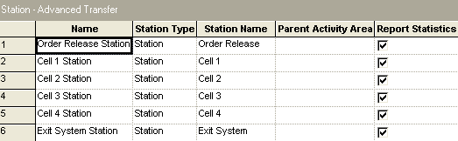
The Modeling Approach
For this model …
  Name stations Cell 1, Cell 2, etc.

Slide 9
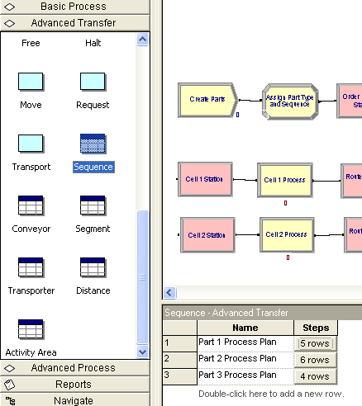
Use Sequence for part transfer (more detail on next slide). Note this is on the Advanced Transfer Panel.

Slide 10
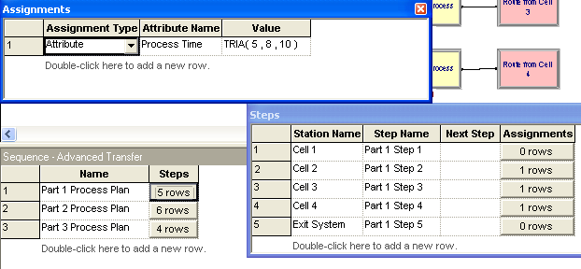
The Modeling Approach
  As part of Sequence definition, can define Attributes
    Set processing times at all cells but Cell 1
    The Steps are entered in order

Slide 11
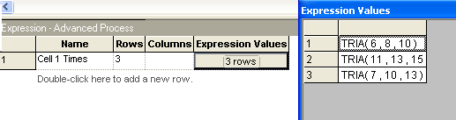
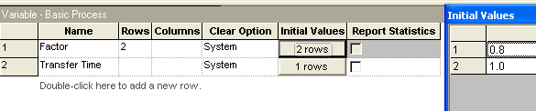
The Modeling Approach
  Use an Expression for processing times at Cell 1
  Use Variables for new-machine speedup at Cell 3 (set to 0.8 and 1.0) , part transfer times (set to 2)

Slide 12
Sets
We’ll use both Sets and Advanced Sets.
Recall:
  The Set module on the Basic Panel allows us to form sets of resources, counters, tallies, entity types, and entity pictures.
  The Advanced Set module on the Advanced Process Panel is needed to form sets of any other Arena objects.
  Why the two approaches?
    The Basic Panel module was developed first
    The Advanced Process Panel was developed later to extend Arena’s capabilities.
    Maintains “upward compatibility”.

Slide 13
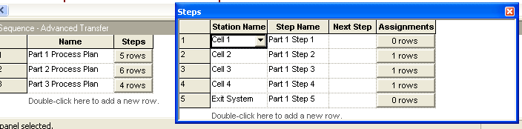
Sequence Data Module- details
Advanced Transfer panel
Double-click for new row for each process plan
  Name for each Sequence
  Open Steps column for subdialog
    Define ordered sequence of Stations to be visited in the Sequence … must have Station Names already defined

Slide 14
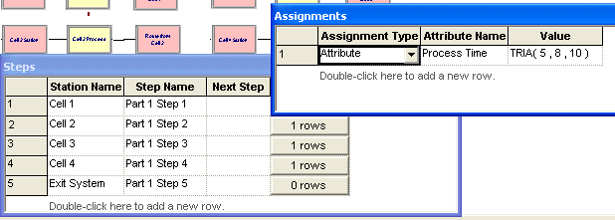
Sequence Data Module- details (continued)
    Double-click to add a new Station to the bottom of the Sequence list; right-click to insert/delete a row
    Name for each step
    Possible Assignments of Attribute, Variable, Pictures, etc. at each station in the Sequence … this is done before transferring the entity to this step in the sequence
    In this model, Attribute assignment used to attach Process Time Attribute to entity for the next Cell (except for Cell 1)

Slide 15
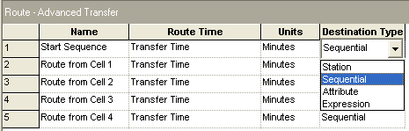
Sequence Data Module (details cont’d.)
Assign Sequence Name to entities that follow it
In Route modules, select Sequential Destination Type (rather than Station)
  Departing entity looks in its own sequence to know where to go next

Slide 16
Sequence Data Module (details cont’d.)
Arena tracks Sequence-following entities via automatic attributes
  Sequence name, NS (or Entity.Sequence)
  Station (where entity is or is going to), M (or Entity.Station)
  JobStep along the sequence, IS (or Entity.JobStep)
Normally, entity is assigned a Sequence, travels its route, then exits
  Can interrupt this sequence, jump forward/backward (tricky)
Remember to define the “exit” station

Slide 17
Expression Data Module (details)
Advanced Process panel
Use for processing times at Cell 1
  Could have done in Sequences, as for other Cells … done this way mostly to illustrate it is possible.
  Clearly there are many ways to do things as we have seen.

Slide 18
Three different part types at Cell 1, so use a vector-valued Expression with three rows
  Name for the expression, Cell 1 Times
  Rows, 3
  Expression Values subdialog
    Cell 1 processing times for the three part types
    Order matters, since index is part type … will reference as
    Cell 1 Times(Part Index) in model
    Note- these are just arrays

Slide 19
Variable Data Module - details
Basic Process panel
Factor variable
  Speed factor at Cell 3 – need a two-row vector
    Assume new (faster) machine is #1, old (slower) machine is #2
    Set to 0.8 for index 1; set to 1.0 for index 2

Slide 20
Variable Data Module - details
Transfer Time variable
  Holds transfer-time constant of 2 minutes between stations
  Just a scalar, not a vector or matrix
  Used for model generality – if all transfer times changed, this makes it easy to implement this change
These are the Initial Values of variables … any entity can change them
  But they’re constant in this model

Slide 21
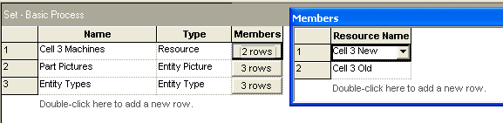
Set Data Module
With Basic Process panel
Define three sets
  1) Resource set, Cell 3 Machines
    For new and old machine (in that order) at Cell 3
    Resource Names – could have already defined them in Resource data module, or can define them here

Slide 22
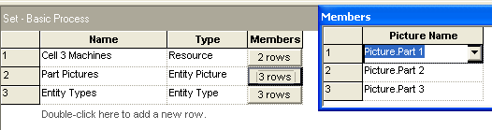
Set Data Module
  2) Entity Picture set, Part Pictures
    To attach to entities once their part type is determined
    Picture Names – could have already defined them elsewhere
    (Edit > Entity Pictures), or can define them here

Slide 23
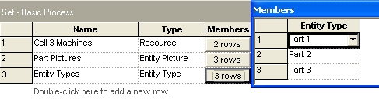
Set Data Module
  3) Entity Type set, Entity Types
    To attach to entities once their part type is determined
    Entity Types – define them here

Slide 24
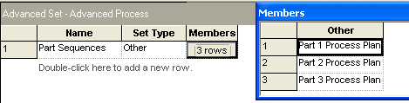
Advanced Set Data Module
On Advanced Process panel
Needed since Set data module does not have “Other” category for Type
  Need to form a set of Sequences to attach the right one to arriving entities once their part type is determined
  Define Name of set to be Part Sequences
  Set Type is “Other”
  Members subdialog – Add rows, type in names in “Other” column (have to remember or look up the Sequence names)

Slide 25
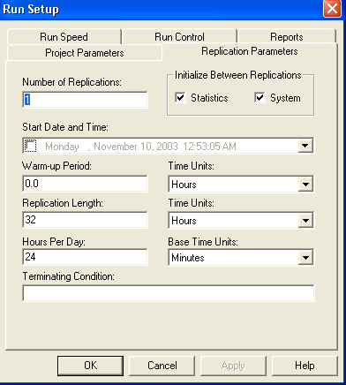
Run > Setup and Edit > Entity Pictures
Run > Setup Dialog
  Replication Parameters Tab
    Replication Length = 32 Hours
    24 Hours/Day
    Base Time Units = Minutes

Slide 26
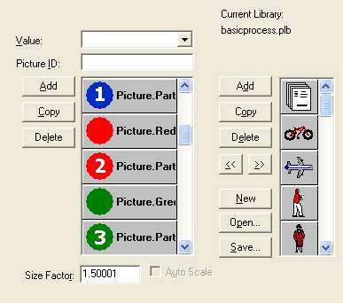
Run > Setup and Edit > Entity Pictures
Edit > Entity Pictures
  Create three custom pictures – Picture.Part 1, Picture.Part 2, Picture.Part 3
  Copy blue, red, and green ball pictures
  Rename them
  Use Picture Editor to put white numbers inside via Text object

Slide 27
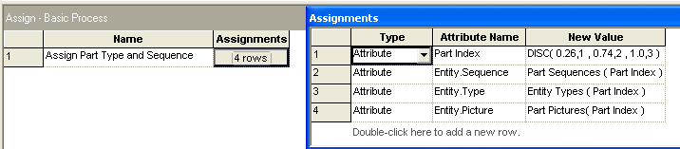
Part Arrivals
Create module for arrival of one part
  One-at-a-time, Time Between Arrivals is exponential with mean 13 minutes
  Don’t know the part type yet …
Assign module for part attributes

Slide 28
Part Arrivals - details
  Part Index = draw from DISC probability distribution
    Pairs cumulative probability, value
  Entity.Sequence = Part Sequences(Part Index)
    Part Index attribute already assigned … order matters
    Index into Part Sequences (Advanced) Set
  Entity.Type = Entity Types(Part Index)
  Entity.Picture = Part Picture(Part Index)

Slide 29
Release Arriving Entity into System
Use previously defined Sequences, assigned to entity via (Advanced) Set of Sequences
Send arriving entity through a Station module to define its current station location
  Station Name = Order Release
  Other five station names already defined via Sequences
Route module to start it on its way
  Route Time = Transfer Time (a Variable previously defined) Minutes
  Destination Type = Sequential
    Arena will direct this entity according to its own sequence
    It just arrived so Arena initializes its JobStep attribute

Slide 30
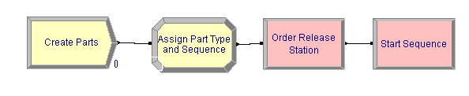
Top Level Logic - summary

Slide 31
Logic for Cell 1
Station module to define the station location
  Station Name = Cell 1, on pull-down list for stations since it was previously defined in Sequences
Cell 1 Process module
  Action = Seize Delay Release
  Resources subdialog
    Type = Resource (not Set … yet)
    Resource Name = Cell 1 Machine, Quantity to seize = 1
  Delay Type = Expression
    Expression = Cell 1 Times(Part Index) Minutes, using the previously-defined Expression Cell 1 Times
Route module from Cell 1
  Destination Type = Sequential
  Station already defined (on incoming side)

Slide 32
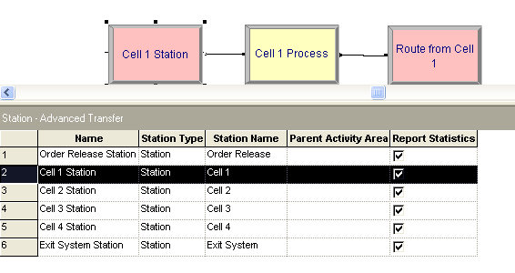
Logic for Cells- Cell 1

Slide 33
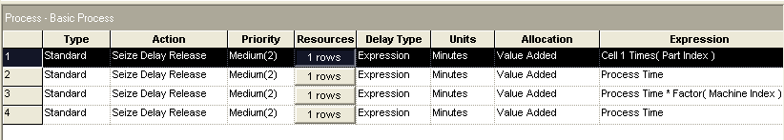
Process Module – Cell 1

Slide 34
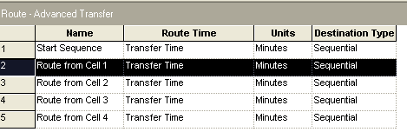
Route Module – Cell 1

Slide 35
Logic for Cells 2 and 4
Incoming Station module – similar to Cell 1
  Except for names of Module and Station
Process module
  Action, Resources, Delay Type – similar to Cell 1
  Expression for Delay time = Process Time
    Attribute defined in Sequence module for each job type at this point in its sequence for Cells 2 and 4
    Note that Part Type 2 visits Cell 2 twice in its sequence, with different delay-time distributions … this data structure is general enough to handle this
Outgoing Route module – similar to Cell 1
  Except for name of Module

Slide 36
Logic for Cell 3
Station, Route modules – similar to Cells 1, 2, 4
Process module
  Action, Delay Type – similar to Cells 1, 2, 4
  Resources subdialog
    Type = Set, Set Name = Cell 3 Machines
    Selection Rule for set = Cyclical
      Maybe Preferred Order would have been better???
    Save Attribute = Machine Index (will be 1 or 2)
  Expression for Delay time =
  Process Time * Factor(Machine Index)
  to multiply by 0.8 if entity gets the new machine (#1), using the preciously-defined vector variable Factor
  See book for alternative (cute) expression that avoids the need for the vector variable Factor

Slide 37
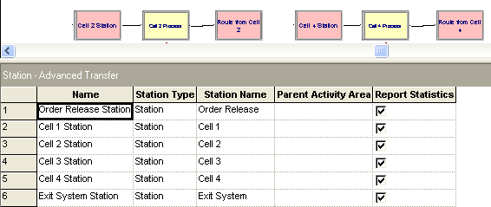
Logic for Cells 2, 4, and 3
Station is same as for Cell 1 Station. The logic is identical, also. Note: This is identical for Cell 4 even though it is not shown here.

Slide 38
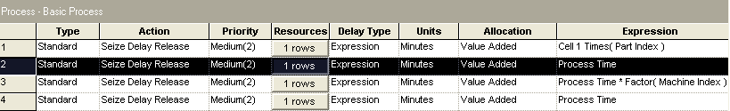
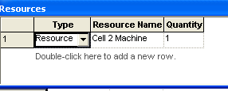
Logic for Cells 2, 4, and 3
Only the Expression is different.
Handles changing machine speed

Slide 39
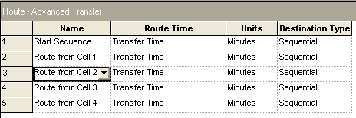
Logic for Cells 2, 4, and 3

Slide 40
Digression: Data Structures
Why an Expression for processing times at Cell 1 rather than entity Attribute assigned in Sequences as for the other cells?
  Frank answer: Just to show the use of Expression
  Could easily have treated Cell 1 like the others
Conversely, could have used Expression for processing times at Cells 3 and 4
  But there would be a problem with Cell 2
    Part 2 visits it twice with different processing-time distributions, so would have to indicate which visit somehow
  Moreover, this is a very small model
Moral: Think carefully about data structures!

Slide 41
Logic for Exiting the System
Station module to define this location
  Station Name = Exit System
Dispose module
  Record Entity Statistics box is checked
  Will generate one of the outputs we want, cycle time (time in system) separated out by part type, since they map onto the entity types for this model
  So don’t need separate Record modules here to collect cycle times
Model would run at this point, give correct output results … but develop animation to show queues, resources, and movement …

Slide 42
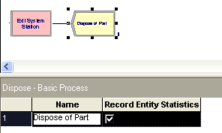
Logic for Exiting the System

Slide 43
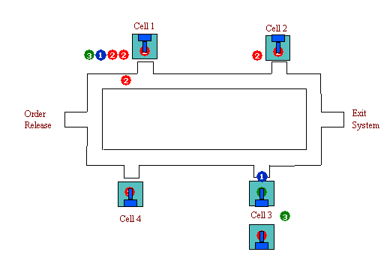
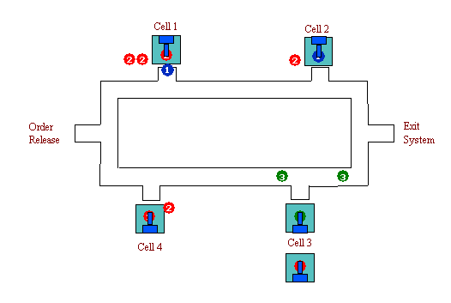
Animation
Pull animation away from logic, data modules
Move, resize, reorient queues for realism
Animate Routes (all movement possibilities)
  Thick “bundles” of routes — Shift key, Snap to Grid
  Heed clockwise direction
  Draw lines to define route “lanes”

Slide 44
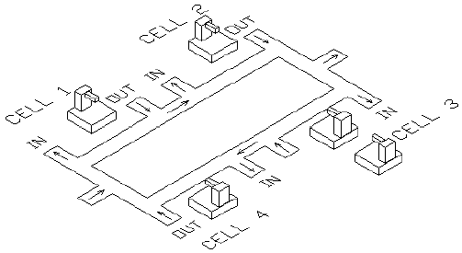
Animation
Can import pictures from different software packages, in particular, a 3D model in AutoCad was used for this model.
Imported and modified AutoCAD .dxf file for backdrop and resource pictures (as described in text)
Fine-tune resource pictures
  Layers for seize point
In animation, note that entities travel at very different rates, pass each other … realistic???

Slide 45
Verification
System → Model → “Code”
Validation: Is Model = System?
Verification: Is “Code” = Model? (debugging)
The Truth: Can never completely verify, especially for large models
Just as with programs, testing is done to expose bugs, NOT to show the program is correct!

Slide 46
Verification (cont’d.)
Some techniques to attempt verification
  Eliminate error messages (obviously)
  Single entity release, Step through logic
  Set Max Arrivals = 1 in Create module and then step through watching its path (see next slide)
    This allows one entity to enter the system and you can trace its behavior using Step.
    i.e. is the part following the proper sequence.

Slide 47
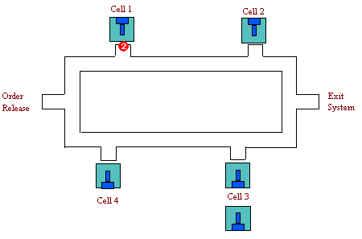
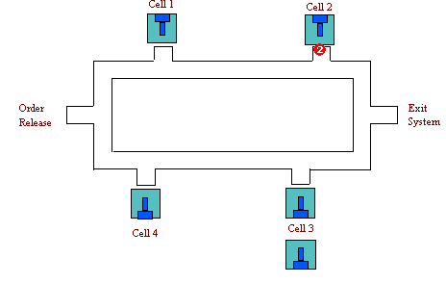
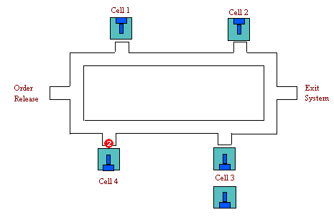
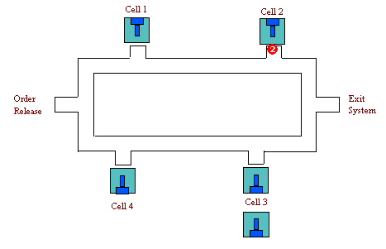
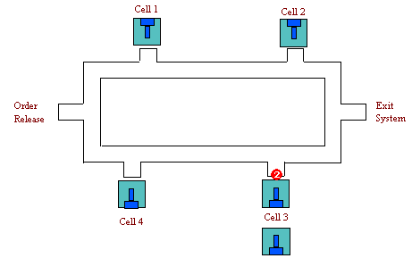
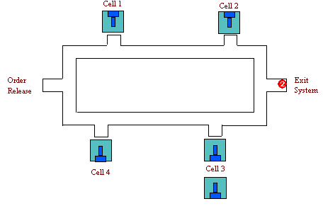
Note: A Part of type 2 is following the path given on page 286- namely cells 1,2,4,2, 3,exit

Slide 48
Verification (cont’d.)
  Replace part-type distribution with a constant
    This generates only one type of part and lets you check the sequence that it will follow.
    Do this for each part-type.
  Replace some or all of the stochastic data with constants.
  Estimate what the correct results should be
  If your estimation doesn’t agree with the results, there is a problem often called the slide-rule decimal placement problem
    Is it your estimation that is at fault?
    Or is the model constructed incorrectly?

Slide 49
Verification (cont’d.)
  “Stress” model under extreme conditions
    Decrease the part interarrival or service times
    Increase the part interarrival or service times
    The changes are for this model.
    In other models, you would want to vary various variables.
  Performance estimation — like Look at generated SIMAN .mod and .exp files
    Run > SIMAN > View

Slide 50
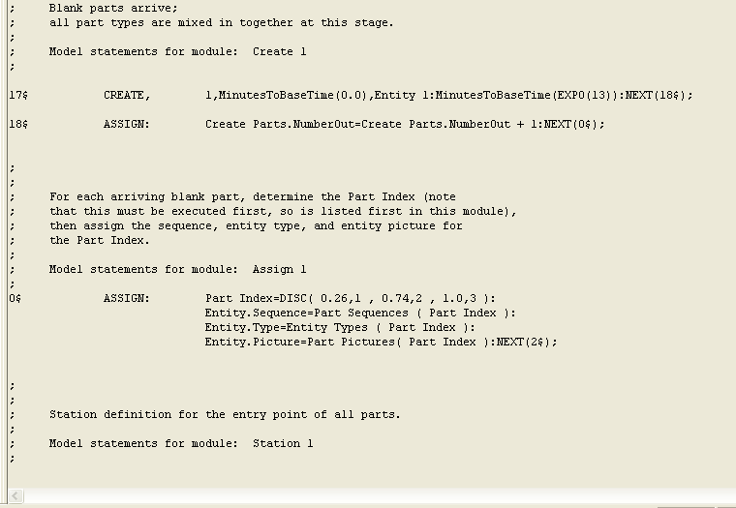
Verification (cont’d.)
Page 1 of the SIMIAN code in *.mod (the model file)

Slide 51
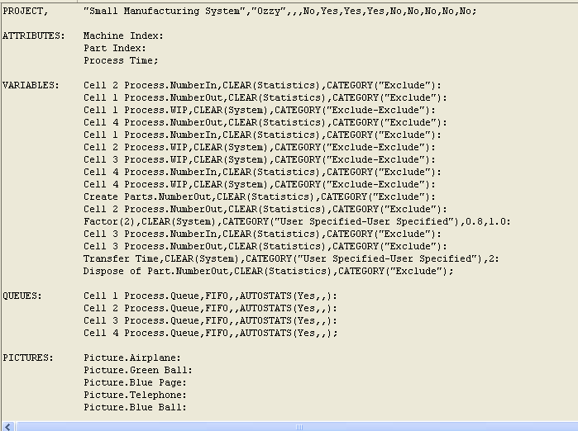
Verification (cont’d.)
Page 1 in *.exp (the experiment file)

Slide 52
Statistical Analysis of Output from Steady-State Simulations
Recall: Difference between terminating, steady-state simulations
  Which is appropriate depends on goal of study, and not so much on the model structure
    Most models could be used for either terminating or steady-state analysis
      For example:
      If you are interested in daily routine behavior, you might want to view the model as terminating
      If you are interested in what happens during rush hour, you might want steady state
    If you have a choice, choose terminating as it is easier to analyze

Slide 53
Statistical Analysis of Output from Steady-State Simulations
Now, assume steady-state is desired for this model
As you might suspect, the simulation run lengths must be long
  There is more of an opportunity for different internal computation orders to be followed by Arena
  These changes can change the numerical results especially if the model has a lot of variability in it
  This underscores the need for a statistical analysis of output

Slide 54
Warm Up and Run Length
Most models start empty and idle
  Empty: No entities are present at time 0
  Idle: All resources are idle at time 0
  In a terminating simulation this is OK if realistic
  In a steady-state simulation, though, this can bias the output for a while after startup
    i.e. the behavior is different until the system “warms up”.
    Bias can go either way
    Usually downward (results are biased low) in queueing-type models that eventually get congested
    Depending on model, parameters, and run length, the bias can be very severe

Slide 55
Warm Up and Run Length (cont’d.)
Remedies for initialization bias
  Better starting state, more typical of steady state
    Throw some entities around the model
    Can be inconvenient to do this in the model
    How do you know how many to throw and where?
      This is what you’re trying to estimate in the first place!
  Make the run so long that bias is overwhelmed
    Might work if initial bias is weak or dissipates quickly
    The problem is you don’t know whether this is the case or not, until you “play” with various runs!

Slide 56
Warm Up and Run Length (cont’d.)
  Let model warm up, still starting empty and idle
    Run > Setup > Replication Parameters: Warm-up Period
      Watch the time units!
    “Clears” all statistics at that end point for summary report, any Outputs-type saved data from Statistic module of results across replications

Slide 57
Warm Up and Run Length (cont’d.)
Warm-up and run length times?
  Most practical idea: preliminary runs, plots
  Simply “eyeball” them
  Be careful about variability — make multiple replications, superimpose plots
  Also, be careful to note “explosions”
Possibility – different Warm-up Periods for different output processes
  To be conservative, take the max
  Must specify a single Warm-up Period for the whole model

Slide 58

Warm Up and Run Length (cont’d.)
Create a single overall output performance measure for Model 7-1, Total WIP, … modify it into Model 7-2
  Measure is time-average total number of parts in system
  Using the Statistic module:
      Animated plots disappear, can’t overlay plots from multiple replications … will use Output Analyzer to plot the saved data

Slide 59
Warm Up and Run Length (cont’d.)
  Speed up the run
    Check Run > Run Control > Batch Run (No Animation)
    Uncheck boxes in Run > Setup > Project Parameters, Dispose module
  Lengthen Replications to 5 days, do 10 Replications

Slide 60
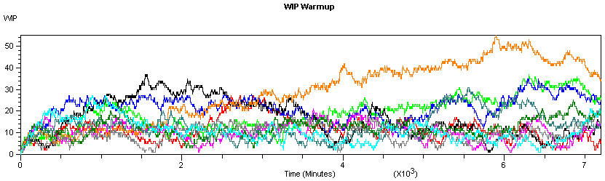
Warm Up and Run Length (cont’d.)
In Output Analyzer
  New data group, Add the file Total WIP History.dat
  Graph > Plot or
  Add Total WIP History.dat, Replications = All, enter Title, axis labels
  No apparent explosion
  Warm-up about 2000 min.; round up to 2 days (2880 min.)

Slide 61
Truncated Replications
If you can identify appropriate warm-up and run-length times, just make replications as for terminating simulations
  Only difference: Specify Warm-up Period in
  Run > Setup > Replication Parameters
  Proceed with confidence intervals, comparisons, all statistical analysis as in terminating case
Model 7-3: modify Model 7-2
  Warm-Up period = 2 Days
  Stick with (total) replication length of 5 Days
  Stick with 10 replications
  Delete Output File in Statistic module

Slide 62
Truncated Replications (cont’d.)
Get cross-replications 95% confidence-interval Half Widths in Reports
  For average Total WIP, got 16.39 ± 6.51
  Without the Warm-up, this was 15.35 ± 4.42
  To sharpen the comparison of the effect of the Warm-up, did 100 (rather than 10) replications with and without it:
    With Warm-up: 15.45 ± 1.18
    Without Warm-up: 14.42 ± 0.86
  Half Widths with Warm-up are larger since each replication is based on the last 3 days, not all 5 days

Slide 63
Truncated Replications (cont’d.)
Want smaller confidence intervals? Have a choice:
  More replications, same length
  Same number of replications, each one longer
    This might be the safer choice to guard against initialization bias

Slide 64
Batching in a Single Run
If model warms up very slowly, truncated replications can be costly
  Have to “pay” warm-up on each replication
An alternative: Just one R E A L L Y long run
  Only have to “pay” warm-up time once
  Problem: Have only one “replication” and you need more than that to form a variance estimate (the basic quantity needed for statistical analysis)
    Big no-no: Use the individual points within the run as “data” for variance estimate
    Usually correlated (not indep.), variance estimate biased

Slide 65
Batching in a Single Run (cont’d.)
Break each output record from the run into a few large batches
  Tally (discrete-time) outputs: Observation-based
  Time-Persistent (continuous-time): Time-based
Take averages over batches as “basic” statistics for estimation: Batch means
  Tally outputs: Simple arithmetic averages
  Time-Persistent: Continuous-time averages

Slide 66
Batching in a Single Run (cont’d.)
Treat batch means as IID
  Key: batch size must be big enough for low correlation between successive batches (details in text)
  Still might want to truncate (once, time-based)

Slide 67

Batching in a Single Run (cont’d.)
Modify Model 7-3 into Model 7-4
  One replication of 50 days (about the same effort as 10 replications of 5 days each)
  A single 2-day Warm-up Period
  Statistic module, save WIP data once again for plot

Slide 68
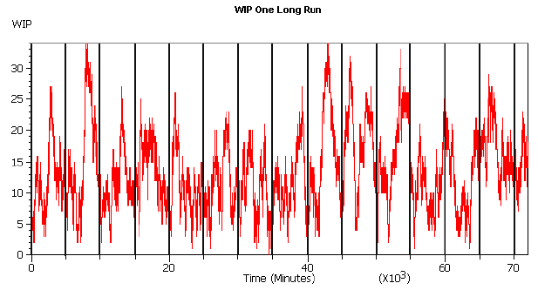
Batching in a Single Run (cont’d.)
How to choose batch size?
Equivalently, how to choose the number of batches for a fixed run length?
Want batches big enough so that batch means appear uncorrelated.

Slide 69
Batching in a Single Run (cont’d.)
Arena automatically attempts to form 95% confidence intervals on steady-state output measures via batch means from within each single replication
  “Half Width” column in reports from one replication
    In Category Overview report if you just have one replication
    In Category by Replication report if you have multiple replications
  Ignore if you’re doing a terminating simulation
  Uses internal rules for batch sizes (details in text)

Slide 70
Batching in a Single Run (cont’d.)
  Won’t report anything if your run is not long enough
    “(Insufficient)” if you don’t have the minimum amount of data Arena requires even to form a confidence interval
    “(Correlated)” if you don’t have enough data to form nearly-uncorrelated batch means, required to be safe

Slide 71
Batching in a Single Run (cont’d.)
Results from Model 7-4:
  Category Overview report, average total WIP: 13.64 ± 1.38
  Half Width considerably smaller than for truncated replications (10 replications, 5 days each, 2-day Warm-ups)
    Here we spend only a total of 2 days warming up, and with truncated replications we spent 10 × 2 = 20 days warming up

Slide 72
Batching in a Single Run (cont’d.)
Can check batch-means half widths during run
  Arena variables THALF(Tally ID), DHALF(Dstat ID)
Can decide on your own batch sizes, form batch means and confidence intervals “by hand” with Output Analyzer
  Why? Use in statistical comparison procedures
  More information in book

Slide 73
What To Do?
Several approaches were discussed for steady-state statistical analysis … many more exist
Opinion:
  Avoid steady-state simulations … look at goal of project
  If you really do want steady-state
    First try Warm-up, truncated replications
    If model warms up slowly, making truncated replications inefficient, consider Arena’s batch-means methods in a single long run with a single Warm-up Period at its beginning … can’t use statistical methods in PAN or OptQuest, though
Other methods, goals – references in text

