Slide 1
Appendix C
Probability and Statistics
A Brief Start on
Appendix C

Slide 2
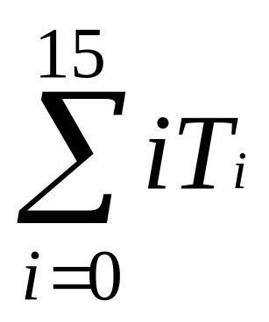
What We’ll Do ...
Ground-up introduction to the probability and statistics necessary to do and understand simulation
A bit of calculus will be introduced
  The meaning of some calculus concepts
  Not the calculating aspects.
I'll assume familiarity with
  Algebraic manipulations
  Summation notation

Slide 3
What We’ll Do ...
Outline
  Probability
    basic ideas
    terminology
  Random variables, distributions, expected values
We'll return to this appendix and some of the concepts in it later.

Slide 4
Probability- Basic ideas
Experiment – activity with uncertain outcome
  Flip coins- Heads? Tails?
  Throw dice- What is on top?
  Pick cards- Suit? Rank?
  Draw balls from urn- Color?
  Drive tomorrow – Time? Accident?
  Operate a (real) call center – Number of calls? Average customer hold time? Number of customers getting busy signal?
  Simulate a call center – same questions as above
Sample space – complete list of all possible individual outcomes of an experiment
  Could be easy or hard to characterize
  May not be necessary to characterize

Slide 5
Probability Basic Ideas (cont’d.)
Event – a subset¹ of the sample space
  Describe by either
    listing outcomes
    “physical” description
    mathematical description
  Usually denote by E, F, E₁, E₂, etc.
  Example: In call center experiment, an event might be any day in which 50 calls are handled.
  Union, intersection, complementation operations make sense because an event is a set:
    E ∪ F, E ∩ F, E^{c}
¹ Technically, in an advanced probability course, you need more than this--- the set must be measureable.

Slide 6
Probability Basic Ideas (cont’d.)
Probability of an event is the relative likelihood that it will occur when you do the experiment
  A real number between 0 and 1 (inclusively)
  Denote by P(E), P(E ∩ F), etc.
  Interpretation – proportion of time the event occurs in many independent repetitions (replications) of the experiment
  May or may not be able to derive a probability

Slide 7

Probability Basic Ideas (cont’d.)
Some properties of probabilities:
  If S is the sample space, then P(S) = 1
    Can have event E ≠ S with P(E) = 1
  If Ø is the empty event (empty set), then P(Ø) = 0
    Can have event E ≠ Ø with P(E) = 0
  If E^{C} is the complement of E, then P(E^{C}) = 1 – P(E)
  P(E ∪ F) = P(E) + P(F) – P(E ∩ F)
  If E and F are mutually exclusive (i.e., E ∩ F = Ø), then P(E ∪ F) = P(E) + P(F)
  If E is a subset of F (i.e., the occurrence in E implies the occurrence in F), then P(E) ≤ P(F)
  If o₁, o₂, … are the individual outcomes in the sample space, then

Slide 8

Probability Basic Ideas (cont’d.)
Conditional probability 
  Knowing that an event F occurred might affect the probability that another event E also occurred
  Basic idea: Reduce the effective sample space from S to F, then measure “size” of E relative to its overlap (if any) in F, rather than relative to S
  Definition (assuming P(F) ≠ 0):
    Read this as "the probability of E given F"

Slide 9
Probability Basic Ideas (cont’d.)
Example: Let
  A denote the event that it rains on a given day
  B denote the event that it is cloudy on a given day
Suppose
  10% of the days are rainy and cloudy, i.e. P(A∩B) = .10
  30% of all days are cloudy, i.e. P(B) = .30
What is the probability that we will select a rainy day, given that we know the day is cloudy?
  i.e. What is P(A|B)?
  P(A|B) = P(A∩B)/P(B) = .1/.3 =1/3
Note: Some probability books write P(A∩B) as P(AB)

Slide 10
Probability Basic Ideas (cont’d.)
E and F are independent if P(E ∩ F) = P(E) P(F)
  Implies P(E|F) = P(E) and P(F|E) = P(F), i.e., knowing that one event occurs tells you nothing about the other
  If E and F are mutually exclusive, are they independent?
    No- this is false if either P(E) or P(F) is nonzero.
    Pf: If E and F are mutually exclusive, this means if E occurs, then F cannot occur and vice versa. Then P(E|F) = 0. But, if P(E) <> 0, then P(E|F) <> P(E). A similar argument follows if P(F) <> 0.

Slide 11
Random Variables
One way of quantifying and simplifying events is to define random variable relating to them.
A random variable (RV) is a number whose value is determined by the outcome of an experiment
  i.e. It is a quantification of an experiment.
  Technically, this is a function or mapping from the sample space to the real numbers which assigns a number to each possible outcome of an experiment.
  But, we can usually define and work with a RV without going all the way back to the sample space.

Slide 12
Random Variables
  Intuitively think: An RV is a number whose value we don’t know for sure but we’ll usually know something about what it can be or it is likely to be.
    We might know its range of possible values.
    We might know its probability is equal to something.
    We might know its probability falls in some range.
  Usually denoted as capital letters: X, Y, W₁, W₂, etc.
The probabilistic behavior of a RV is described by its distribution function --- a concept we will explore shortly.

Slide 13
Discrete vs. Continuous RVs
Two basic “flavors” of RVs, used to represent or model different things
  Discrete
  Continuous
Discrete – can take on only certain separated values (technically a countable number of values)
  Number of possible values could be finite or infinite
  Examples:
    The number of defective bolts in a sample of 10 drawn from industrial production.
    The number of people in the waiting line in a doctor's office.
    The number of malfunctions of an airplane engine over a period of time.

Slide 14
Discrete vs. Continuous RVs
Continuous – can take on any real value in some range
  Number of possible values is always infinite
  Range could be bounded on both sides, just one side, or neither
Examples:
  The height of a human
  The length of life of a human cell
  The amount of sugar in an orange.
  The length of time required to complete an assembly operation in a manufacturing process.
Definitions of probability distributions are different for these two kinds of RVs.

Slide 15
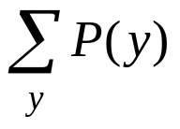
PROBABILITY DISTRIBUTIONS FOR DISCRETE RANDOM VARIABLES
This is a formula, table, or graph that provides the probability associated with each value of the random variable.
It must satisfy the following for random variables y:
  1. 0 <= P(y) <=1
  2. 1 =

Slide 16
PROBABILITY DISTRIBUTIONS FOR DISCRETE RANDOM VARIABLES
Simple example: Consider flipping a coin twice. There are 4 possible events-- HH, HT, TH, TT
  Let y = the number of heads after the toss.
  Here is the probability distribution for y:
    y Sample Points P(y)
    0 TT 1/4
    1 HT, TH 1/2
    2 HH 1/4
Observe this meets our two conditions.

Slide 17
PROBABILITY DISTRIBUTIONS FOR DISCRETE RANDOM VARIABLES
The distribution function can be presented in various ways.
In the previous example, we used a table.
We could have developed a formula such as:
P(y) = C(2,y)/4 where C(2,y) is the number of combinations of 2 things chosen y at a time since
  C(2,0) = 1
  C(2,1) = 2
  C(2,2) = 1
However, we don't always have to develop a formula. A table will do or a graph.

Slide 18
PROBABILITY DISTRIBUTIONS FOR DISCRETE RANDOM VARIABLES
You should think of a graph of a probability distribution as a histogram showing the relative frequencies for each value of y.
Here is the one for our coin toss example:
1/2
1/4
0 1 2
Note that it shows us the relative frequencies of each y occurring.

Slide 19
PROBABILITY DISTRIBUTIONS FOR DISCRETE RANDOM VARIABLES : Another Example
Consider an experiment consisting of tossing a coin until the first head appears.
Let y equal the number of tosses.
Find the probability distribution of y.
The sample points are infinite in number, although this is still a discrete problem:
  H
  TH
  TTH
  TTTH
  etc.
Let E_{i} denote the event with i-1 tails followed by a head.

Slide 20
PROBABILITY DISTRIBUTIONS FOR DISCRETE RANDOM VARIABLES : Another Example (Cont'd)
Consider
  P(E_{i}) y P(y)
  1/2 1 1/2
  1/4 2 1/4 Two independent events so product
  1/8 3 1/8 Three independent events so product
  ....
Does = 1? It is an infinite geometric progression with common ratio 1/2 .
The graph of the distribution looks like:
1/2
where I can't draw the remaining steps as PowerPoint won't let me keep halving the height.

Slide 21
Continuous Distributions
Let X be a continuous RV
  Possibly limited to a range bounded on left or right or both
  No matter how small the range, the number of possible values for X is always (uncountably) infinite
  Not sensible to ask about P(X = x) even if x is in the possible range
  Technically, P(X = x) is always 0
  Instead, describe behavior of X in terms of its falling between two values

Slide 22
PROBABILITY DISTRIBUTIONS FOR CONTINUOUS RANDOM VARIABLES
We cannot assign probabilities to all the sample points associated with a continuous random variable.
Note: It is not just that there are an infinite number of points, as our last example had an infinite number of points. In a sense (which can be made mathematically precise) there are too many points when real numbers are used.
We can use our notion of the graph for the distribution for a discrete random variable to give us a clue as to how to interpret distributions for continuous random variables.
If we had a class with only a few individuals in it, we might obtain a relative frequency histogram when we looked at the probability of a student obtaining a certain score as:

Slide 23
PROBABILITY DISTRIBUTIONS FOR CONTINUOUS RANDOM VARIABLES (Cont'd)
Along the x axis are scores and along the y axis are relative frequencies based on the size of the class. For example, with 30 in the class, the tallest portion might represent 7/30 of class obtained that score.
Suppose now we adjust the area under the curve so the total area is 1. Then the frequencies could represent the probability that a certain score or range of scores would be obtained in the class.

Slide 24
PROBABILITY DISTRIBUTIONS FOR CONTINUOUS RANDOM VARIABLES (Cont'd)
Now we construct a model for this:
  Assume a RV, y, can take values on a real line as below.
  We will distribute one unit of probability along the line much as a person might distribute a handful of sand, each measurement of the population corresponding to a single grain.
  The probability, i.e. grains of sand, will pile up in certain places and the result will be a probability distribution represented perhaps by the graph:
The y axis shows relative frequencies and the x axis might be GPAs.
We build this so the area under the curve is 1. Then we have ...

Slide 25
PROBABILITY DISTRIBUTIONS FOR CONTINUOUS RANDOM VARIABLES (Cont'd)
f(y)
The shaded area represents
P(a < y < b)
a
b
The function f(y) is called the probability distribution or the probability density function for the RV y.
The total area under the curve is 1.
The area lying above a given interval will equal the probability that y will fall in that interval.

Slide 26


Continuous Distributions (cont’d.)
Summary: Probability density function (PDF) is a function f(x) with the following three properties:
  f(x) ≥ 0 for all real values x
  The total area under f(x) is 1
  For any fixed a and b with a ≤ b, the probability that X will fall between a and b is the area under f(x) between a and b.
Fun facts about PDFs
  Observed X’s are denser in regions where f(x) is high
  The height of a density, f(x), is not the probability of anything
  – it can even be > 1
  With continuous RVs, you can be sloppy with weak vs. strong inequalities and endpoints

Slide 27

Continuous Distributions (cont’d.)
Cumulative distribution function (CDF) - probability that the RV will be ≤ a fixed value x:
Properties of continuous CDFs
  0 ≤ F(x) ≤ 1 for all x
  As x → –∞, F(x) → 0
  As x → +∞, F(x) → 1
  F(x) is nondecreasing in x
  F(x) is a continuous function with slope equal to the PDF:
  f(x) = F'(x)
F(x) may or
may not have
a closed-form
formula
These four properties
are also true of
discrete CDFs

Slide 28
Two Questions?
1. How do we choose the appropriate model, i.e. the probability distribution, f(y), that "makes sense" for a given physical situation?
  This is the harder question.
  Certain types of distribution functions are typically used and their properties are studied.
  Given a physical situation, we utilize all the information we can to choose an appropriate modeling distribution function.
    Use general rules as to how to choose.
    Perhaps sample real data, build histograms, and see which kind of curve fits the data best.
    There are techniques in mathematical statistics that can be used, but they are beyond the scope of our work.

Slide 29
Two Questions?
2. How do we calculate the area under the curve corresponding to a given interval?
  Integral calculus.
  Do rectangular approximations.
  Use software that will handle the calculation for you.
  Look up values in tables. Many of these are calculated for much used distribution functions.

Slide 30
ARENA HANDLES THE FOLLOWING PROBABILITY DISTRIBUTIONS
See Appendix D, page 585
Ignore details now- look at general shape of PDF:
  Exponential - page 590
  Gamma - page 591
  Lognormal - page 593
  Normal - page 594
  Poisson- page 595
  Triangular - page 596
  Uniform - page 597
  Others: Beta, Continuous, Erlang, Johnson, Weibull
Parameters must be set to choose the correct shape of the curve.

Slide 31

Discrete Expected Values
A data set has a “center” – the average (mean)
RVs have a “center” – expected value
  Also called the mean or expectation of the RV X
  Other common notation: μ, μ_{X}
  Weighted average of the possible values x_{i}, with weights being their probability (relative likelihood) of occurring
  Example: 2 coin toss, y = number of heads
    E(y) = 0*p(0) + 1*p(1) + 2*p(2) = 0 + 1*(1/2) + 2*(1/4) = 1.
    Says 1 is the "center" of the distribution.

Slide 32
Discrete Expected Values (Cont'd)
  What expectation is not: The value of X you “expect” to get
    E(X) might not even be among the possible values x₁, x₂, …
  What expectation is:
    Repeat “the experiment” many times, observe many X₁, X₂, …, X_{n}
    E(X) is what converges to (in a certain sense) as n → ∞

Slide 33
Discrete Expected Values (Another Example)
8000 lottery tickets are to be sold at $1 each. The prize is $3,000. Person A has purchased two tickets. What is the expected gain for Person A.
Recall the expected value of a RV y is the average of the theoretical population that would result if the lottery were repeated an infinitely large number of times.
A's gain, y, can take on one of two values-
  a loss of $2 (i.e. -$2 gain) or
  a win (i.e. $2998 gain).
Thus, the expected value (or expected gain) is
  (-$2)*(7998/8000) + ($2998)*(2/8000) = -$1.25

Slide 34

Continuous Expected Values
Expectation or mean of X is
  Roughly, a weighted “continuous” average of possible values for X
  Same interpretation as in discrete case: average of a large number (infinite) of observations on the RV X

Slide 35
A LITTLE MORE FROM CHAPTER 2
Section 2.5+

Slide 36
Event-Scheduling Logic via Programming
Clearly well suited to standard programming
Often use “utility” libraries for:
  List processing
  Random-number generation
  Random-variate generation
  Statistics collection
  Event-list and clock management
  Summary and output
Main program ties it together, executes events in order

Slide 37
Simulation Dynamics:
The Process-Interaction World View
Identify characteristic entities in the system
Multiple copies of entities co-exist, interact, compete
“Code” is non-procedural
Tell a “story” about what happens to a “typical” entity
May have many types of entities, “fake” entities for things like machine breakdowns
Usually requires special simulation software
  Underneath, still executed as event-scheduling
The view normally taken by Arena

Slide 38
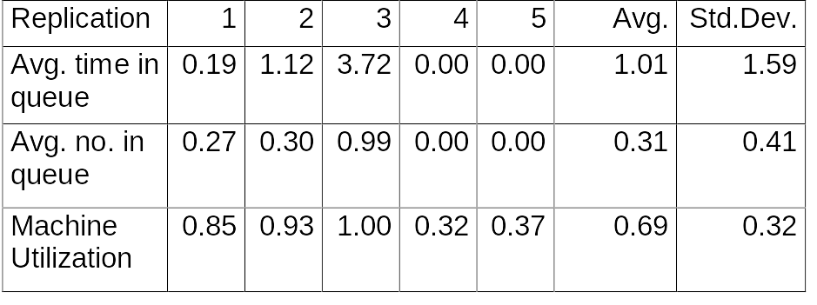
Randomness in Simulation
In the original example, we did just one “replication”—a sample of size one (not worth much)
We might want to made a total of five replications with varying data:

Slide 39
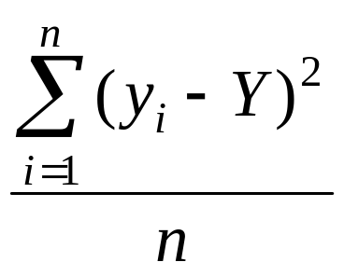
MEASURES OF VARIABILITY
Measures the variability or dispersion of the data.
Simplest measure is the range ---i.e. the difference between the largest and the smallest measurement.
Two other important measures are
  the variance
  the standard deviation
Definition: The variance of a set of n measurements y_{i}, for i=1,2,...n is the average of the square of the deviations of the measurements about their mean Y (or average):

Slide 40
EXAMPLE
Given measurements of 5, 7, 1, 2, 4 we can calculate the variance to be 4.56.
What does this tell us?
Unfortunately, this measure on one set of data doesn't provide us with too much information.
It is true that if the variance is large, there is a lot of variation. But, we need another measure which will provide us with more data about our measurements--- the standard deviation.

Slide 41
The Standard Deviation
Definition: The standard deviation of a set of n measurements y_{i}, i=1,2,...n, is the positive square root of the variance.
This is an important measure because of a theorem due to the Russian mathematician, Tchebysheff:
Theorem: Given a number k greater than or equal to 1 and a set of n measurements y_{i}, i=1,2,...n, at least 1 - 1/k² of the measurements will lie within k standard deviations of their mean.
Note: This is very conservative as it applies to any distribution.
Calculating 1 - 1/k² :
  If k =1, 0
  If k = 2, 3/4
  If k = 3, 8/9
We often let
μ = the mean
σ = the standard deviation

Slide 42
What σ can tell us:
Given a distribution of measurements that is approximately bell-shaped, i.e. a normal curve, the interval
μ ± σ will contain ~ 68% of the measurements
μ ± 2σ will contain ~ 95% of the measurements
μ ± 3σ will contain ~ all of the measurements

Slide 43
Returning to a Former Slide
Randomness in Simulation
In the original example, we did just one “replication”—a sample of size one (not worth much)
We might want to made a total of five replications with varying data:

Slide 44
Comparing Alternatives
Usually, simulation is used for more than just a single model “configuration”
Often want to compare alternatives, select or search for the best (via some criterion)
Simple processing system: What would happen if the arrival rate were to double?
  Cut interarrival times in half
  Rerun the model for double-time arrivals
  Make five replications

Slide 45
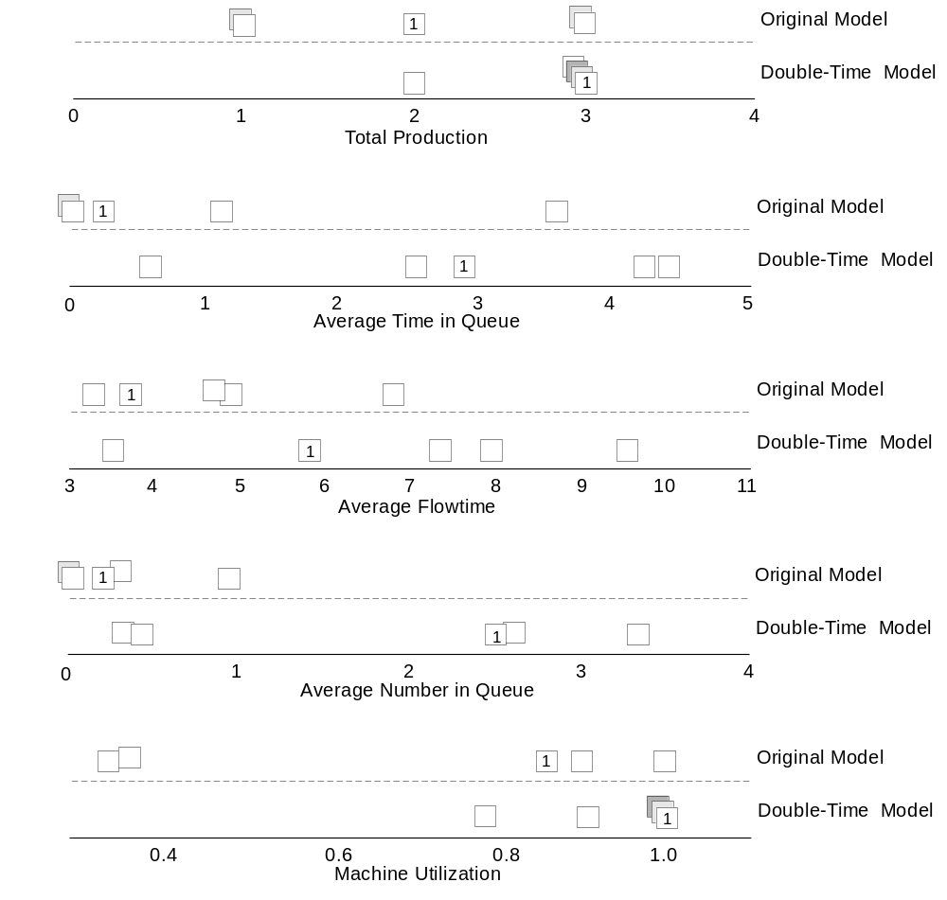
Results: Original vs. Double-Time Arrivals
Note variability
Danger of making decisions based on one (first) replication
Hard to see if there are really differences
Need: Statistical analysis of simulation output data

Slide 46
Where Arena Fits In
Hierarchical structure
  Multiple levels of modeling
  Can mix different modeling levels together in the same model
  Often, start high then go lower as needed
Get ease-of-use advantage of simulators without sacrificing modeling flexibility
Higher
User-Created Templates
Commonly used constructs
Company-specific processes
Company-specific templates
A single
etc.
graphical user
interface
consistent at
Application Solution Templates
any level of
Call$im
modeling
BP$im
Vertical Solutions
etc.
Common Panel
Many common modeling constructs
Very accessible, easy to use
Level of
Reasonable flexibility
Modeling
Arena Template
Professional Edition
Support, Transfer Panels
Access to more detailed modeling for greater
flexibility
Standard Edition
Blocks, Elements Panels
All the flexibility of the SIMAN simulation
SIMAN Template
language
User-Written Visual Basic, C/C++, FORTRAN
Code
The ultimate in flexibility
Lower
C/C++/FORTRAN requires compiler

