Slide 1
Chapter 5
Detailed Modeling and Terminating Statistical Analysis

Slide 2
What We’ll Do ...
Explore lower-level modeling constructs
Model 5-1: A generic call-center system
  Nonstationary arrival process
  Balking, three-way decisions, sets, variables, expressions, submodels, and costing
Debugging
Model 5-2: Animating the call center model
  Plots, global pictures, and storages
Model 5-3: The model with overall performance measures
  Run conditions, model size and speed, overall performance measures

Slide 3
What We’ll Do ... (cont’d)
Statistical analysis of simulation output (terminating systems)
  Time frame of simulations
  Strategy for data collection and analysis
  Confidence intervals
  Comparing two alternatives
  Comparing many alternatives via the Arena Process Analyzer (PAN)
  Searching for and optimal alternative with OptQuest

Slide 4
Generic Call Center (Model 5-1)
Single telephone number, 26 trunk lines
  If all 26 lines busy, caller gets busy signal and goes away
Answered call gets recording asking …
  Technical support? (76% of callers choose this)
  Sales information? (16%)
  Order-status inquiry? (8%)
Time for caller to choose: ~ UNIF (0.1, 0.6)
All times are in minutes in this model

Slide 5
Technical Support Calls
Get second recording asking …
  Product type 1? (25% of tech support callers choose this)
  Product type 2? (34%)
  Product type 3? (41%)
Recording and choosing takes UNIF(0.1, 0.5)
If a qualified tech-support person is available for chosen product, call routed for immediate service
If not, call placed in (electronic) queue, subjected to annoying rock music
All tech support conversations ~ TRIA (3, 6, 18)
When call done, customer exits system

Slide 6
Technical Support Calls (cont’d.)
4% of tech support calls need further assistance after completion of their call
  Questions forwarded to another tech group that prepares a response; time to prepare this response ~ EXPO (60)
  Response sent back to the same tech-support person who took the original call
  This person calls the customer back and talks, which lasts TRIA (2, 4, 9)
  These calls require one of the 26 trunk lines and take priority over incoming calls
  If return call not completed on same day, it’s carried over to the next day

Slide 7
Sales Calls
Call automatically routed to sales staff
Sales staff is separate from tech-support staff
If a sales-staff person is available, call gets immediate service
If not, call placed in (electronic) queue, treated to soothing new-age space music
All sales conversations ~ TRIA (4, 15, 45)
When call done, customer exits system

Slide 8
Order-Status Calls
Automatically handled by phone system — no people
No limit on number handled at a time (but still limited by the 26 trunk lines)
Time for “conversation” ~ TRIA (2, 3, 4)
After call, 15% take option to talk to a real person (the rest exit the system)
  These calls are routed to sales staff
  Have same priority as incoming sales calls
  Conversation durations ~ TRIA (3, 5, 10)
  Then exit the system

Slide 9
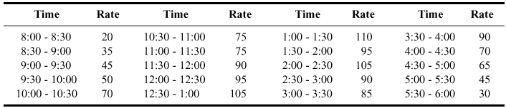
Call Arrivals
Calls accepted from 8 AM until 6 PM
Some staff available until 7 PM
  Incoming calls shut out after 6 PM
  But all calls that entered before 6 PM are answered
Call arrival rate varies substantially over the day
  Data on rate (calls per hour) for each half-hour period:

Slide 10
Staffing
Sales staff: 7 people with staggered schedules
  3 on duty for first 90 minutes (notation: 3@90)
  Then 7@90, 6@90, 7@60, 6@120, 7@120, 4@90
Tech support staff: 11 people variously qualified for the three different product lines
  Work eight-hour days plus 30 minutes off for lunch
  Some people only qualified on one line
  Some people qualified on two or maybe all three lines
  Detailed staffing description and schedule ...

Slide 11
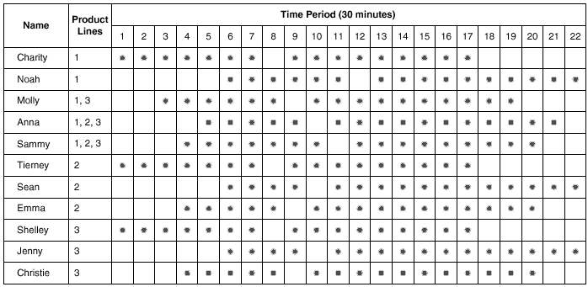
Technical-Support Staff Schedules
Table 5-2, page 169

Slide 12
New Modeling Issues
This is a service (not manufacturing) system
  But can use same modeling capabilities
Nonstationary arrival process
  Arrivals occur one at a time and are independent of one another
  Average rate varies over time (would be constant for a stationary Poisson process)
  Built into Create module (beware of popular-but-wrong methods … details in book)
Balking
  Required because there are only 26 trunk lines
  Entity arrives at queue, which is full (capacity is 0 here)
  Entity departs from system – count these

Slide 13
New Modeling Issues (cont’d.)
Three-way decisions
  Entity or call can go to one of three places in model based on call type
    Similarly, tech-support calls can go to one of three places based on product type
  Capability available in Decide module
Sets
  Groups of similar objects
  Can be referenced by a common set name and index (1, 2, 3, …) into the set
    Can also be referenced by original name, independent of set
  Technical-support staff requires sets
    An object can be a member of more than one set
  Sets data module

Slide 14
New Modeling Issues (cont’d.)
Variables and Expressions
  Can be referenced in model by name
  Can be one- or two-dimensional arrays, indexed by one or two integers
  User-defined Variables
    Store some numerical value (not a formula)
    Can be initialized in Variable data module
    Can be used, reassigned during the simulation run by any entity
  User-defined Expressions
    A name defined by a mathematical expression
    This name can be references anywhere in the model
    Can use constants, Variables, Attributes, system state variables, values from distribution – connected via mathematical operations
      Can use Expression Builder to help define
    Defined in Expression data module (Advanced Process panel)

Slide 15
New Modeling Issues (cont’d.)
Submodels
  Partition simulation model into several smaller submodels
    Can link them together, more manageable pieces
  Just like a normal model view within a submodel
  Submodels can also contain further submodels, etc. – hierarchical structure
  Submodels can be externally connected to other modules or submodels
  Navigate panel in Project Bar shows submodels, under Top-Level Model
Costing
  Automatic time and cost information for entities
    Wait, value-added, non-value-added, transfer, other
  You must enter cost information – Entity and Resource data modules

Slide 16
Key Output Performance Measures
Count balks — no. of attempted incoming calls sent away due to all 26 trunk lines being busy
  Will not model reneging — customers in queue leaving the system if they get sick of waiting
Total time in system, by customer type
Time waiting for a real person, by customer type
Contact time, by customer type
Number of calls waiting, by customer type
Personnel utilization

Slide 17
Animation Requirements
No entity movement to animate here
Can still display queues
To see how well staffing matches up with load, craft appropriate plots vs. time
  Number of calls balked
  Lengths of queues
  Number of idle staff
Strategy to improve performance — alter the staffing schedule, see if it produces a better matchup of the plots

Slide 18
System or Simulation Type
Terminating
  Known starting and stopping conditions – part of model
  Time frame is known (and finite)
Steady-State
  Initial conditions are not always well defined
  No defined stopping condition (theoretically infinite)
  Interested in system response over the long run
Call-center model
  Start at 8 AM and end at 7 PM
    Some Technical support calls are held over, but not many – we’ll ignore this aspect (sort of … fixed below)
  Treat the system as terminating (sort of … see below)

Slide 19
Arena Modeling Panels
Basic Process panel
  Highest level of modeling
Advanced Process panel
  More detailed (and different) modeling capabilities
Advanced Transfer panel
  Material-handling, entity-movement capabilities
Blocks, Elements panels
  Lowest level of modeling capabilities – the underlying SIMAN simulation language itself
  Other panels are created using modules from these panels
  Occasionally needed, but not very often

