Slide 1
Chapter 5- Part 2
Detailed Modeling and Terminating Statistical Analysis

Slide 2
Building the Model
Defining the Data
Submodel Creation
Divide model in sections or submodels
  Increment the Time Period
  Create Arrivals and Direct to Service
  Technical Support Calls
  Technical Support Returned Calls
  Sales Calls
  Order-Status calls
We’ll discuss each of these in turn …

Slide 3
Simulation Replication Data
Project replication parameters
  Run/Setup dialog – Replication Parameters tab
  10 Replications of 11 hours each
  Four options for Initialization Between Replications:
    Initialize system (yes), initialize statistics (yes)
      10 independent and identical replications – no calls carried over
      Reports for each day separately
    Initialize system (yes), initialize statistics (no)
      10 independent and identical replications – no calls carried over
      Cumulative summary reports (day 1, days 1-2, days 1-3, …, days 1-10)
    Initialize system (no), initialize statistics (yes): Selected
      10 continuous days – calls carried over
      Reports are by replication (day)
    Initialize system (no), initialize statistics (no)
      10 continuous days – calls carried over
      Cumulative summary reports

Slide 4
Schedule Data
Schedules
  Enter into Schedule data module
  13 schedules required
    One for each of the 11 technical-support people
    One for the sales staff overall
    The arrival process (Type = Arrival, not Capacity)
  Use Graphical schedule editor (initially)
  Use Edit via Dialog (or Edit via Spreadsheet) if you need trailing zeros in the capacity to fill out the cycling time window
    We need this in this model due to not Initializing System between replications … see book for details

Slide 5
Resource Data
Define resources
  Use Resource data module
  13 resources
    Sales staff
    11 technical support staff
    Trunk Line (single resource with 26 units)
  Enter Schedule Name for all but Trunk Line
    For resources on a Schedule, use Ignore option for Schedule Rule to ensure correct cross-day modeling … details in book
  Add hourly wage under costing data

Slide 6
Sets Data
Use Set data module (Basic Process panel)
Develop three Resource sets for technical support staff
  Product 1
    Charity, Noah, Molly, Anna, Sammy
  Product 2
    Tierney, Sean, Emma, Anna, Sammy
  Product 3
    Shelley, Jenny, Christie, Molly, Anna, Sammy
  Note that Anna and Sammy are in all three sets
  Consistently listed the more versatile staff at the end of the list in each set … “save” them … discussed later

Slide 7
Sets Data (cont’d.)
Develop two Tally sets
  Tech Calls
    Product 1 Call, Product 2 Call, Product 3 Call
  Returned Time
    Return 1 Call, Return 2 Call, Return 3 Call
  Sets used to collect statistics by product type
Develop a Counter set
  Keep track of number of balks per half-hour period
  22 counters – one for each half-hour period
  First defined 22 counters in Statistic data module (Advanced Process panel)

Slide 8
Variables and Expressions Data
Variables
  Use Variable data module to define three variables
    Period (the current time period)
    Busy Per Period (busy signals in current time period)
    Per Period Balk (total balks for last completed time period)
    Note – explicit use of Variables module is required only if you want a Variable to have a non-zero initial value

Slide 9
Expressions Data
Expressions
  Use Expression data module to define three expressions
    Returned Tech Time, for duration of returned tech-support calls: TRIA(2, 4, 9)
    Tech Time, for duration of tech-support calls : TRIA(3, 6, 18)
    Available 1, Available 2, and Available 3
      Sum of currently available, but idle, resources by product type, for staffing plots
      Use Expression Builder … details in book, model

Slide 10
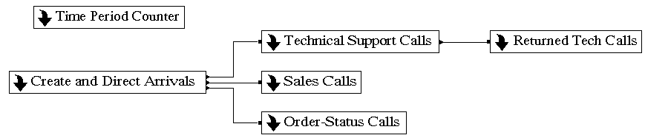
Submodel Creation
Object/Submodel/Add Submodel menu option to create a submodel … we’ll use six submodels
  Define (right-click, then Properties)
    Name
    Number of entry, exit points (could be 0 if there’s no flow interaction)
  Move between submodels: Navigate panel, Named Views, or mouse
    Double-click on a submodel to open it
    When in a submodel, right-click in an empty place, then Close Submodel, to go up

Slide 11
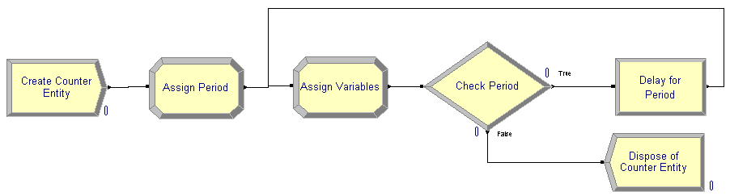
Time Period Counter Submodel
Increments the time period counter
No entry or exit points – interacts via Variables, not flow
Create Counter Entity – Create module
  Time Between Arrivals – 660 minutes (constant)
Assign Period – Assign module
  Initialize Period variable value to zero

Slide 12
Time Period Counter Submodel (cont’d.)
Assign Variables – Assign module
  Increment Period variable for the next half-hour period
  Assign Per Period Balk to Busy Per Period variable value (number of calls balked during previous half hour)
  Set Busy Per Period variable to zero to start balk counting during the half hour starting now

Slide 13
Time Period Counter Submodel (cont’d.)
Check Period – Decide module
  2-Way by Condition
  Determine if there are still more periods in this day (i.e., if Period < 22)
    Yes: Delay for a half hour – Delay module, then loop back
    No: Dispose of entity – Dispose module

Slide 14
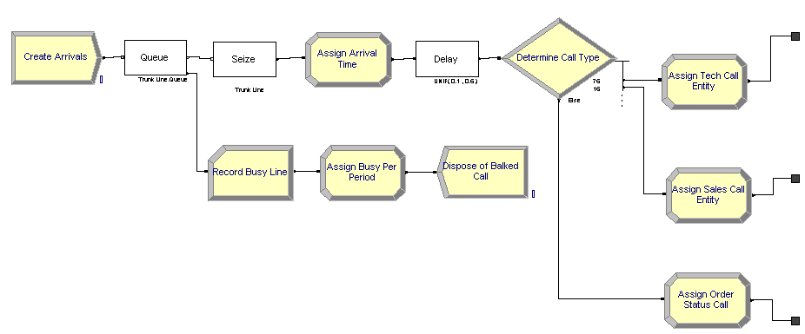
Create and Direct Arrivals Submodel
Creates arrivals, checks for available trunk line, and directs to appropriate type of service
No entry points
Three exit points
  Tech Call, Sales Call, Order Status Call

Slide 15
Submodel Logic
Create arriving calls
  If a trunk line is available – seize one
    Assign Arrival Time attribute (for use downstream)
    Delay to listen to recording
    Determine call type
    Direct call and assign entity type
  Else (all trunk lines are busy)
    Count balked call
    Increment Busy Per Period counter
    Dispose of call

Slide 16
Develop Submodel
Create arriving calls – Create module
  Time Between Arrivals
    Type: Schedule
    Schedule Name: Arrival Schedule
      Was defined when we defined the data for the model
Check for available trunk line
  Queue/Seize module combination (Blocks panel)
  Set queue capacity to zero
    If trunk line available, resource seized in following Seize module
    If no truck line available, entity will automatically balk

Slide 17
Develop Submodel (cont’d.)
Assign arrival time – Assign module
  Use Arena variable TNOW = current simulation clock
Delay for Recording – Delay module
  Used Delay module from Blocks panel
  Be careful of units – no choice here (uses Base Time Units)
Direct call – Decide module
  Use N-way by Chance option
  Enter probabilities as percents (0 – 100)
Assign call type – Assign module
  Assign entity type to call type
  Three modules

Slide 18
Develop Submodel (cont’d.)
Balking entities
  Count balked call – Record module
    Record into counter set Busy Lines
      Set index is the variable Period
  Increment Busy Per Period variable – Assign module
  Dispose of balked call call – Dispose module

Slide 19
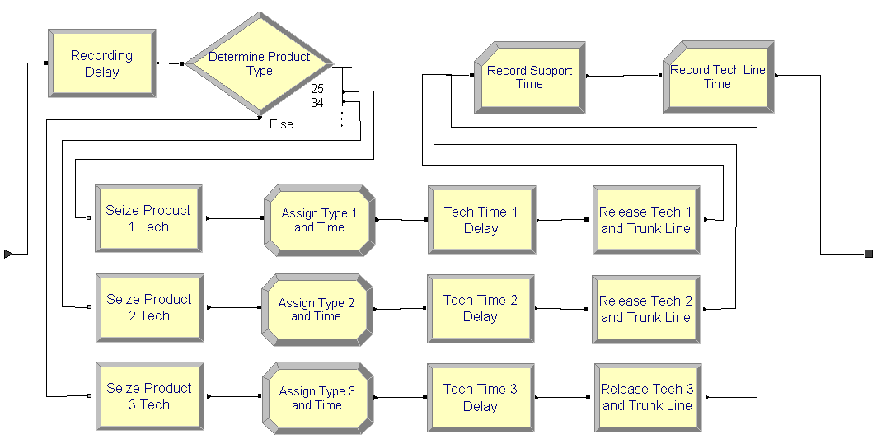
Technical Support Calls Submodel
Logic for servicing technical support calls
One entry point
One exit point – follow-up calls

Slide 20
Submodel Logic
Delay to listen to recording – Delay module
  UNIF(0.1, 0.5) minutes
Determine product type – Decide module
  N-way by Chance
Seize technical support person
  Seize module – Advanced Process panel
  Request from appropriate set for product type
  Preferred order within the set
    Save more versatile employees for other things
  Save set index (particular tech-support person) in attribute Tech Agent Index
    In case returned tech call is needed – get same tech-support person to call customer back

Slide 21
Submodel Logic (cont’d.)
Save product type and call start time – Assign module
  Save type (1, 2, or 3) in attribute Product Type
  Assign value from TNOW to attribute Call Start
Delay for call – Delay module
  Use value from expression Tech Time
Release tech-support person and trunk line
  Release module – Advanced Process panel
  Use set index in attribute Tech Agent Index to release the particular tech-support person assigned from set
  Release the seized unit of Trunk Line resource

Slide 22
Submodel Logic (cont’d.)
Record call and line time – Record module
  Time Interval type
  Tally set Tech Calls
  Set index Product Type
  Records only the time spent during the tech-support conversation (necessary?)
Record tech line time – Record module
  Time Interval type
  Tally Tech Support Line Time (not a Tally set)
  Use Arrival Time attribute set when call first arrived, so this records the total time in the system so far
  Direct to exit point

Slide 23
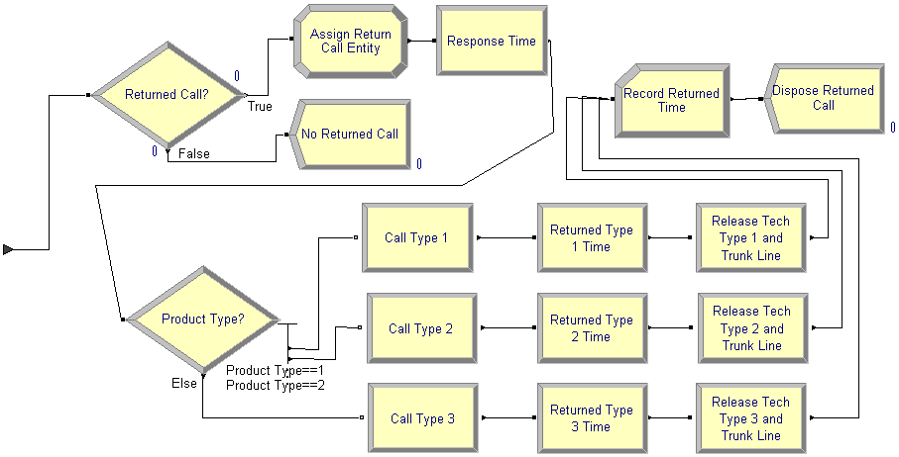
Returned Tech Calls Submodel
Logic for returned tech calls
One entry point, no exit points

Slide 24
Submodel Logic
Check for returned call – Decide module
If no returned call is needed
  Dispose of entity
If a returned call is needed
  Entity Type set to Returned Call – Assign module
  Delay for response time – Delay module
  Direct by product type
    N-way by Condition based on attribute Product Type
  Seize tech-support person and trunk line
    Seize module: Seize specific member of appropriate Resource set
      Use Set Index Tech Agent Index attribute
    Seize Trunk Line

Slide 25
Submodel Logic (cont’d.)
  Delay for call time – Delay module
    Expression Returned Tech Time
  Release tech person and trunk line – Release module
  Record returned time – Record module
    Use beginning-time attribute Arrival Time, defined when call first arrived, so this records total time in system
    Use Tally Set Return Time indexed by Product Type
  Dispose of entity – Dispose module

Slide 26
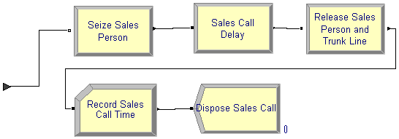
Sales Calls Submodel
Logic for sales calls
One entry point, no exit points
Uses a Shared Queue
  Single queue
  Shared by two or more seize activities
    In this case, the “real” incoming sales calls, as well as those order-status calls requiring more than just the automated response

Slide 27
Submodel Logic
Seize sales person – Seize module
  Shared queue declared in Queue data module
Delay for call – Delay module
Release sales person and Trunk Line – Release module
Record call time – Record module
  Records elapsed time from call’s original arrival until now
Dispose of entity - Dispose module

Slide 28
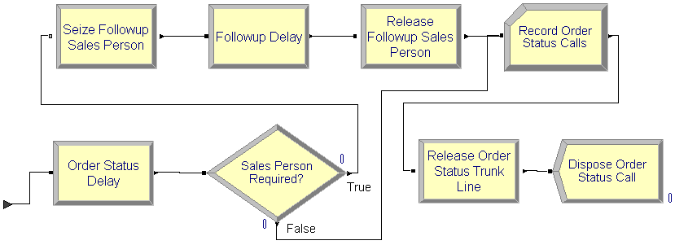
Order-Status Calls Submodel
Logic for order-status calls
One entry point, no exit point
Shared queue used when sales person required

Slide 29
Submodel Logic
Delay for call – Delay module
Decide if Sales person required – Decide module
If sales person is required
  Seize sales person – Seize module, shared queue
  Follow-up delay – Delay module
  Release sales person – Release module
Record call – Record module
  Elapsed time from call’s arrival to system up to now
Release trunk line – Release Module
Dispose of entity – Dispose module

Slide 30
Finding and Fixing Model Errors
Arena picks up “simple” errors in Check phase, and leads you to them via Find and Edit buttons in Errors/Warnings windows
  Undefined variables, attributes, resources
  Unconnected modules
  Duplicate module names
  Typos
Other kinds of errors are more complex, can’t be detected without trying to run — options on Run Interaction toolbar or on Run menu
Only mention capabilities here; see text and demo for details

Slide 31
Finding and Fixing Model Errors (cont’d.)
Run Controller — Command-driven window to control, display details about model operation and underlying SIMAN code
Trace — Follow active modules, selected variables
Highlight active module – highlights the active module during the simulation run
Layers – gives control over what you see during the simulation run

Slide 32
Finding and Fixing Model Errors (cont’d.)
Break on Module; Break — stop run when entity hits a selected module, at a specific time, or when a selected entity is about to become active
Watch — select expressions to display in a window as model runs
Look at reports when model is running or paused
  Remember to close reports windows

