Slide 1
Chapter 5- Part 3
More Detailed Modeling and Terminating Statistical Analysis

Slide 2
REVIEW THE PROBLEM FIRST!

Slide 3
Generic Call Center (Model 5-1)
Single telephone number, 26 trunk lines
  If all 26 lines busy, caller gets busy signal and goes away
Answered call gets recording asking …
  Technical support? (76% of callers choose this)
  Sales information? (16%)
  Order-status inquiry? (8%)
Time for caller to choose: ~ UNIF (0.1, 0.6)
All times are in minutes in this model

Slide 4
Technical Support Calls
Get second recording asking …
  Product type 1? (25% of tech support callers choose this)
  Product type 2? (34%)
  Product type 3? (41%)
Recording and choosing takes UNIF(0.1, 0.5)
If a qualified tech-support person is available for chosen product, call routed for immediate service
If not, call placed in (electronic) queue, subjected to annoying rock music
All tech support conversations ~ TRIA (3, 6, 18)
When call done, customer exits system

Slide 5
Technical Support Calls (cont’d.)
4% of tech support calls need further assistance after completion of their call
  Questions forwarded to another tech group that prepares a response; time to prepare this response ~ EXPO (60)
  Response sent back to the same tech-support person who took the original call
  This person calls the customer back and talks, which lasts TRIA (2, 4, 9)
  These calls require one of the 26 trunk lines and take priority over incoming calls
  If return call not completed on same day, it’s carried over to the next day

Slide 6
Sales Calls
Call automatically routed to sales staff
Sales staff is separate from tech-support staff
If a sales-staff person is available, call gets immediate service
If not, call placed in (electronic) queue, treated to soothing new-age space music
All sales conversations ~ TRIA (4, 15, 45)
When call done, customer exits system

Slide 7
Order-Status Calls
Automatically handled by phone system — no people
No limit on number handled at a time (but still limited by the 26 trunk lines)
Time for “conversation” ~ TRIA (2, 3, 4)
After call, 15% take option to talk to a real person (the rest exit the system)
  These calls are routed to sales staff
  Have same priority as incoming sales calls
  Conversation durations ~ TRIA (3, 5, 10)
  Then exit the system

Slide 8
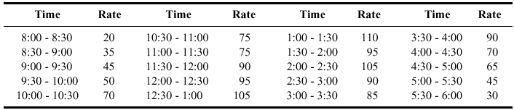
Call Arrivals
Calls accepted from 8 AM until 6 PM
Some staff available until 7 PM
  Incoming calls shut out after 6 PM
  But all calls that entered before 6 PM are answered
Call arrival rate varies substantially over the day
  Data on rate (calls per hour) for each half-hour period:

Slide 9
Staffing
Sales staff: 7 people with staggered schedules
  3 on duty for first 90 minutes (notation: 3@90)
  Then 7@90, 6@90, 7@60, 6@120, 7@120, 4@90
Tech support staff: 11 people variously qualified for the three different product lines
  Work eight-hour days plus 30 minutes off for lunch
  Some people only qualified on one line
  Some people qualified on two or maybe all three lines
  Detailed staffing description and schedule ...

Slide 10
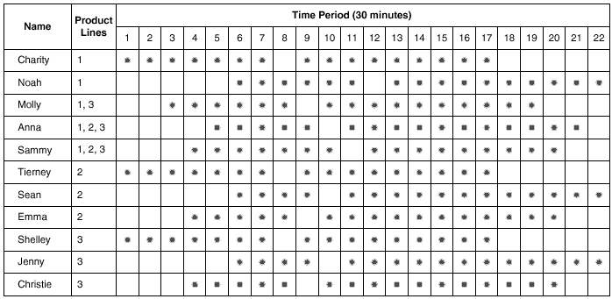
Technical-Support Staff Schedules
Table 5-2, page 169

Slide 11
Model 5-2: Animating the Model
No “normal” entity animation — just plots, queues, a few other “data” animations
Plots (all vs. time on horizontal axis)
  Queue lengths (as in earlier models)
  Balks per period — reason for variable Per Period Balk
  Number of tech support people available for each product type — reason for the “Available” expressions defined in Expressions module
  With multiple plots, configure first one, then copy/edit for others to get consistent look and feel; snap to grid to align
Variable animations for Period and Day

Slide 12
Animating the Model (cont’d.)
Created digital clock “by hand” (details in text)
  Why not ready-made animated clocks? We didn’t reset the system state between replications, so internal clock just keeps increasing
Resource and queue animations
  Just for realism — doesn’t add any analysis value
  Resource button from Animate toolbar
  Take pictures from libraries (.plb files), different states
  Queue button from Animate toolbar
Add various text annotations, boxes, etc.

Slide 13
Animating the Model (cont’d.)
Storages for further animation
  Requires using Delay modules from Blocks panel, not Advanced Process panel
    We did this only for the delay listening to the first recorded message
  Enter a Storage name in the Blocks Delay module (Message 1)
  Storage button from Animate Transfer toolbar
Animated variables
  Number of available trunk lines
  Number of available salespeople
  Number of sales calls in progress

Slide 14
Model 5-3: Model for Analysis with Overall Performance Measure
Modify the call-center model for intensive study
  Different run conditions – to allow valid statistical analysis
  Smaller size – to continue to fit in academic version and make room for other enhancements
  Faster – to allow for extensive analysis
  New overall performance measures to consider both resource costs and customer-oriented performance
Base on Model 5-1 rather than Model 5-2 since the latter adds only animation and we’re now crunching numbers

Slide 15
Run Conditions
Want valid terminating statistical analysis
  New replications must start independently with no model-state carry-over
Run/Setup/Replication Parameters
  Check “Initialize System Between Replications”
    Still check “Initialize Statistics Between Replications”
  Get truly independent and identically distributed replications
  Unreturned tech-support follow-up calls lost – unrealistic
  Compromise – redefine a “replication” to be a five-day work week … Monday-Thursday returned tech-support calls carried over, Friday-night ones lost
    Run/Setup/Replication Parameters: Replication Length = 5 Days, specify 11 Hours Per Day
Run/Run Control – Batch Run (No Animation)

Slide 16
Slimming Down and Speeding Up
Academic version places several different kinds of limits on model “size”
  Max of 150 concurrent entities … though millions could pass through … this limit is not a problem here
  Max of 150 “module instances”
    includes flowchart modules
    each entry (line) in data modules such as Statistic, Schedule, and Variable counts
    … this limit is a problem
  Also need room to add new output performance measures
Slimming down will have the effect of
  Having the model fit in the academic version
  Make the model leaner and quicker even in the full commercial version of Arena

Slide 17
Slimming Down and Speeding Up
Reduce number of module instances
  Eliminate many statistical accumulators
    included getting rid of lines in data modules,
    entire flowchart modules
    unchecking statistical-collection boxes
      This has about the largest runtime saving
    … details are in book
This increased speed by factor of 3 to 4
  Important since this model will be exercised intensively
Note: You can have the same basic model, but have several versions- one animated, one collecting a certain set of information, another collecting another set of information

Slide 18
Overall Performance Measures
Form an overall cost measure – reduce, minimize
  What controllable input parameters affect cost? How?
  Model 5-1 produces many output performance measures, but no overall economic cost for comparing across different configurations.
Two components to cost
  Due to staffing and resources – tangible, measurable
  Due to poor customer service – intangible, hard to measure
    Although not done in this example, this is often handled by defining a code where, say, 5 = excellent service, ...., 1 = poor service.
    Then this numerical value can be manipulated just like money costs.

Slide 19
Overall Performance Measures
Staffing and resource costs
  Hourly salaries: $18 for sales, $16 to $20 for tech-support depending on training (see Resource data module as defined in Model 5-1)
    Salaries are paid whenever person is on duty, whether busy or not
  Get current weekly payroll of $13,110,
  We define this as a new variable, Staff Cost
  Staff Cost will allow us to compare different configurations and their value,

Slide 20
Generalize for More Staff
Try to improve service via more staff
  Will certainly increase staff cost
  Try to improve customer service to make it worthwhile
Base-model results – worst staffing shortfalls are between 11:30AM and 3:30PM
Add sales and tech-support staff for that four-hour period (half-hours 8 through 15)

Slide 21
Additional Sales Staff
Add variable New Sales to be the number of additional salespersons to add in periods 8-15
  Define in Variable data module
  Use in Schedule data module (under Sales Schedule) … add to number of sales staff in base model in periods 8-15
    Must use Edit via Dialog or Spreadsheet since Graphical Schedule Editor cannot handle Variables
Cost for each new salesperson: $15/hour
  Each will work 20 hours/week, so cost $300/week
  Variable New Sales Cost set to 300
  Additional cost is (New Sales) * (New Sales Cost), used in Expression for for new resource cost (New Res Cost)

Slide 22
Additional Tech-Support Staff
Possibly add new tech-support staff for products 1, 2, 3 (only), and for those who can handle all products
  Variables New Tech 1, New Tech 2, New Tech 3
    Named Larrys, Moes, and Curlys, respectively
    Each paid $14/hr * 20 hrs/week = $280/week (variable LMC cost)
  Variable New Tech All
    Named Hermanns
    Each paid $17/hr * 20 hrs/week = $340/week (variable Her cost)
  Resource data module – define resources Larry, Moe, Curly, Hermann … and hourly costs for them (not used)
  Set data module – add Larry, Moe, Curly, Hermann to appropriate resource sets
  Schedule data module – add Larry, Moe, Curly, Hermann schedules … can’t use Graphical Schedule Editor

Slide 23
Changing the Number of Trunk Lines
Each trunk line costs a flat $89/week, including all calls (even long-distance)
Is 26 the right number?
To change it, just edit the Capacity entry in the Resource data module
Add variable Line Cost to be flat value of $89, multiply by number of trunk lines (MR(Trunk Line)) to get weekly cost of trunk lines

Slide 24
Total New Resource Cost
Define an Expression called New Res Cost:
  New Sales * New Sales Cost
  + (New Tech 1 + New Tech 2 + New Tech 3) * LMC Cost¹
  + New Tech All * Her Cost¹
  + Line Cost * MR(Trunk Line)
  ¹Defined on page 22
Does not depend on what happens during simulation … used only at end in Statistic module
Does not include cost of the base-model human staff (sales, tech-support) … viewed as constant for all variants of staffing changes

Slide 25
Costs for Putting Customers on Hold- another kind of cost
Input a cost for making customers wait on hold
  Trade off against resource costs
  Use model to understand, improve, optimize this tradeoff
  Such customer-dissatisfaction costs are hard to quantify
People have a “tolerance” for holding
  Tech-support calls: 3 minutes (variable Tolerance Tech)
  Sales calls: 1 min. (Tolerance Sales)
  Order-status calls: 2 min. (Tolerance Order Status)
Beyond the tolerance point, system incurs cost of
  Tech-support calls: $1.67/min. (variable TWT Cost)
  Sales calls: $3.72/min. (SWT Cost)
  Order-status calls: $1.58/min. (OSWT Cost)

Slide 26
Costs for Putting Customers on Hold (cont’d.)
Accumulate “excess” waiting time (time past tolerance) for each call type
  Assign module when call is done
  Use built-in Arena attribute ENTITY.WAITTIME
    Accumulates total of times in queues as entity goes along, and other “Wait”-allocated times … but there are none upstream in this model so this attribute will have the waiting time on hold
    Requires that Costing box be checked in Run/Setup/Project Parameters
  Variable Excess Tech Wait Time accumulates via adding in for each tech-support call
  MAX( ENTITY.WAITTIME - Tolerance Tech, 0 )
  At end of run, multiply Tech Wait Time by TWT Cost
  Similarly for Sales, Order-Status calls

Slide 27
Total Cost
Adding together all the costs, get the overall economic (cost) performance measure
Total Cost = New Res Cost
+ Excess Sales Wait Time * SWT Cost
+ Excess Status Wait Time * OSWT Cost
+ Excess Tech Wait Time * TWT Cost
+ Staff Cost
This is defined in Statistic data module
  Type = Output – already being computed, just report it
  In Category Overview Report, get via User Specified → Other → Output

Slide 28
Percent-Busy Requirement
Above cost performance measure ignores calls balked away due to no trunk line … busy signal
  Clearly, undesirable – very hard to put a cost on it
  Instead, have a strong goal to limit this to no more than 5% of incoming calls … a model configuration not satisfying this will be deemed unacceptable no matter how attractive (low) the cost may be
  Like a constraint except it’s on an output, not an input … call it a requirement
Compute via two Record modules in arrival submodel to count incoming and balked calls … and Percent Busy line in Statistic module

Slide 29
IMPORTANT Aside
– Generality of Models
We could have done a lot of things in very different ways in this model
  Using Arena’s costing functions more and doing fewer of our own external calculations
  Reparameterize using only “primitive” parameters (e.g., hourly wage rates) and programming Arena to do the calculations
How much of this you do depends on model’s intended use and users
Tradeoff between generality (elegance?) vs. time spent building the model

Slide 30
Results
Define Base case (no more people, 26 trunk lines) and run:
  Total cost (for the week) = $34K
  Percent busy signals = 11% (unacceptable)
Add one resource unit for each type
  New Sales, New Tech 1, New Tech 2, New Tech 3, New Tech All, and go to 27 trunk lines
  Total cost (for the week) = $28K
    Added resources reduced customer waiting time by more than enough to cover their cost
  Percent busy signals = 3% (acceptable)
    Extra trunk line, plus added resources to move calls through
THE BIG QUESTION: Is the modification truly and reliably better???

Slide 31
Statistical Analysis of Output from Terminating Simulations
Random input leads to random output (RIRO)
Run a simulation (once) — what does it mean?
  Was this run “typical” or not?
  Variability from run to run (of the same model)?
Need statistical analysis of output data
  From a single model configuration
  Compare two or more different configurations
  Search for an optimal configuration
Statistical analysis of output is often ignored
  This is a big mistake – no idea of precision of results
  Not hard or time-consuming to do this – it just takes a little planning and thought, then some (cheap) computer time

Slide 32
Time Frame of Simulations
MOST SIMULATIONS ARE EITHER:
Terminating: Specific starting, stopping conditions
  Run length will be well-defined (and finite)
Steady-state: Long-run (technically forever)
  Theoretically, initial conditions don’t matter (but practically they usually do)
  Not clear how to terminate a simulation run
This is really a question of intent of the study, not the internal model logic or its construction.
Has major impact on how output analysis is done
Sometimes it’s not clear which is appropriate
Here: Terminating (We'll look at steady-state in Section 6.3)

Slide 33
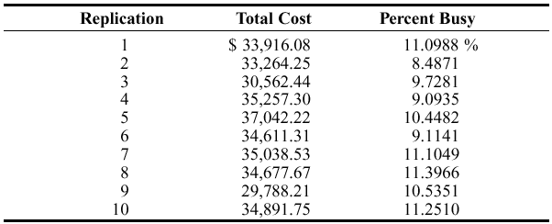
Strategy for Data Collection and Analysis
For terminating case, make statistically IID (Independent and Identically Distributed) replications
  Run/Setup/Replication Parameters: Number of Replications field
  Check both boxes for Initialize Between Replications to get statistically IID replications.
  Get fresh system state and fresh statistical accumulators for each replication.
Separate results for each replication – Category by Replication report for Model 5-3, base case, 10 replications

Slide 34
Strategy for Data Collection and Analysis (cont’d.)
Category Overview report will have some statistical-analysis results of the output across the replications
How do we decide on how many replications to run?
  Trial and error (now)
  Approximate number for acceptable precision (discuss later)
  Sequential sampling (Chapter 11)
Turn off all animation for max speed
  Run/Run Control/Batch Run (No Animation)

Slide 35
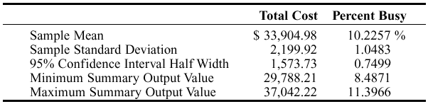
Confidence Intervals for
Terminating Systems
Using formulas in Chapter 2, viewing the cross-replication summary outputs as the basic data:
Possibly most useful part – 95% confidence interval on expected values
This information (except standard deviation) is in Category Overview report
  If > 1 replication specified, Arena uses cross-replication data as above
  Other confidence levels, graphics – Output Analyzer

Slide 36
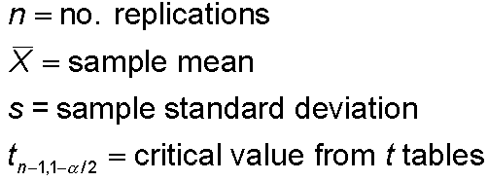


Half Width and Number of Replications
Prefer smaller confidence levels: precision
Notation:
Confidence interval:
Half-width =
Can’t control t or s
Must increase n — how much?
Want this to be “small,” say
< h where h is prespecified

Slide 37



Half Width and Number of Replications (cont’d.)
Set half-width = h, solve for
Not really solved for n (t, s depend on n)
Approximation:
  Replace t by z, corresponding normal critical value
  Pretend that current s will hold for larger samples
  Get
Easier but different approximation:
s = sample standard
deviation from “initial”
number n₀ of replications
n grows quadratically
as h decreases.
h₀ = half width from “initial” number n₀ of replications

Slide 38
Interpretation of Confidence Intervals
Interval with random (data-dependent) endpoints that’s supposed to have stated probability of containing, or covering, the expected valued
  “Target” expected value is a fixed, but unknown, number
  Expected value = average of infinite number of replications
Not an interval that contains, say, 95% of the data
  That’s a prediction interval … useful too, but different
Usual formulas assume normally-distributed data
  Never true in simulation
  Might be approximately true if output is an average, rather than an extreme
  Central limit theorem- says that under rather general conditions, sums and means of samples of random measurements drawn from a population tend to be bell-shaped in repeated samplings

Slide 39
Comparing Two Alternatives
Usually, want to compare alternative system configurations, layouts, scenarios, sensitivity analysis … here just two alternatives
Base case of Model 5-3, vs. adding one resource unit for each type
  New Sales, New Tech 1, New Tech 2, New Tech 3, New Tech All, and go to 27 trunk lines
  Earlier, one run of each suggested big differences … real?
Reasonable but not-quite-right idea: Make confidence intervals on expected outputs from each alternative, see if they overlap
  Doesn’t allow for a precise, efficient statistical conclusion

Slide 40
Results (earlier slide)
Define Base case (no more people, 26 trunk lines) and run:
  Total cost (for the week) = $34K
  Percent busy signals = 11% (unacceptable)
Add one resource unit for each type
  New Sales, New Tech 1, New Tech 2, New Tech 3, New Tech All, and go to 27 trunk lines
  Total cost (for the week) = $28K
    Added resources reduced customer waiting time by more than enough to cover their cost
  Percent busy signals = 3% (acceptable)
    Extra trunk line, plus added resources to move calls through
THE BIG QUESTION: Is the modification truly and reliably better???

Slide 41
Compare Means via the Output Analyzer
Output Analyzer is a separate application that operates on .dat files produced by Arena
  Not installed by default from book CD – need custom install
  Launch separately from Windows, not from Arena
To save output values (Expressions) of entries in Statistic data module (Type = Output) – enter filename.dat in Output File column
  Just did for Total Cost, not Percent Busy
  Will overwrite this file name next time … either change the name here or out in Windows before the next run
  .dat files are binary … can only be read by Output Analyzer

Slide 42
Compare Means via the Output Analyzer (cont’d.)
Start Output Analyzer, open a new data group
  Basically, a list of .dat files of current interest
  Can save data group for later use – .dgr file extension
  Add button to select (Open) .dat files for the data group
Analyze/Compare Means menu option
  Add data files … “A” and “B” for the two alternative
  Select “Lumped” for Replications field
  Title, confidence level, accept Pared-t Test, Scale Display

Slide 43
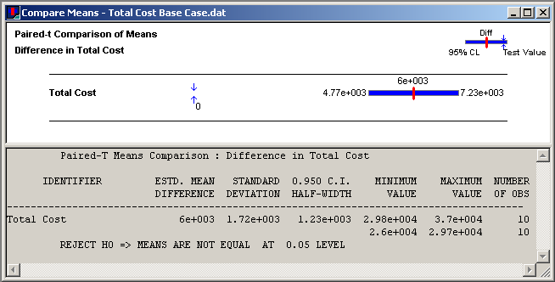
Compare Means via the Output Analyzer (cont’d.)
Results:
Confidence interval on difference misses 0, so conclude that there is a (statistically) significant difference

Slide 44
Evaluating Many Alternatives with the Process Analyzer (PAN)
With (many) more than two alternatives to compare, two problems are
  Simple mechanics of making the possibly many parameter changes, making the runs, keeping track of the many output files
  Statistical methods for drawing reliable and useful conclusions
Process Analyzer (PAN) addresses these
PAN operates on program (.p) files – produced when .doe file is run (or just checked)
Start PAN from Arena (Tools/Process Analyzer) or via Windows
PAN runs on its own, separate from Arena

Slide 45
PAN Scenarios
A scenario in PAN is a combination of:
  A program (.p) file
  Set of input controls that you choose
    Chosen from Variables and Resource capacities – think ahead
    You fill in specific numerical values
  Set of output responses that you choose
    Chosen from automatic Arena outputs or your own Variables
    Values initially empty … to be filled in after run(s)
  To create a new scenario in PAN, double-click where indicated, get Scenario Properties dialog
    Specify Name, Tool Tip Text, .p file, controls, responses
    Values of controls initially as in the model, but you can change them in PAN – this is the real utility of PAN
    Can duplicate (right-click, Duplicate) scenarios, then edit for a new one
  Think of a scenario as a row

Slide 46
PAN Projects and Runs
A project in PAN is a collection of scenarios
  Program files can be the same .p file, or .p files from different model .doe files
  Controls, responses can be the same or differ across scenarios in a project – usually will be mostly the same
  Think of a project as a collection of scenario rows – a table
  Can save as a PAN (.pan extension) file
Select scenarios in project to run (maybe all)
PAN runs selected models with specified controls
PAN fills in output-response values in table
  Equivalent to setting up, running them all “by hand” but much easier, faster, less error-prone

Slide 47
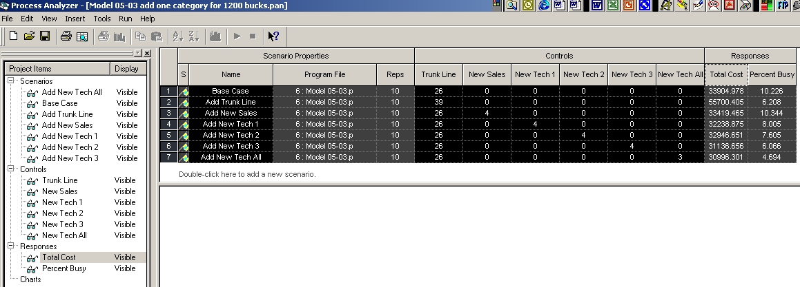
Running Model 5-3 with PAN
Scenarios
  Base case (no additional resources)
  Imagine $1200/week to spend on each additional resource type, one at a time (no mixed enhancements)
  7 scenarios in all (details in book)
  Select all to run (click on left of row, Ctrl-Click or Shift-Click for more)
  To execute, or Run/Go or F5

Slide 48
Statistical Comparisons with PAN
Model 5-3 alternatives were made with 10 replications each
  Better than one replication, but what about statistical validity of comparisons, selection of “the best”?
Select Total Cost column, Insert/Chart (or or right-click on column, then Insert Chart)
  Chart Type: Box and Whisker
  Next, Total Cost; Next defaults
  Next, Identify Best Scenarios
    Smaller is Better, Error Tolerance = 0 (not the default)
    Show Best Scenarios; Finish

Slide 49
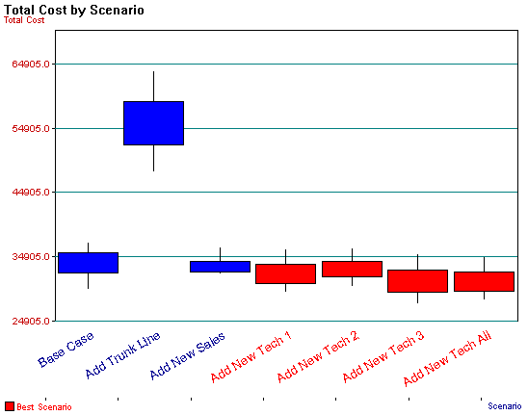
Statistical Comparisons with PAN (cont’d.)
Vertical boxes: 95% confidence intervals
Red scenarios statistically significantly better than blues
  More precisely, red scenarios are 95% sure to contain the best one
  Narrow down red set – more replications, or Error Tolerance > 0
  More details in book

Slide 50
Searching for an Optimal Alternative with OptQuest
The scenarios just considered with PAN are just 7 of many, many possibilities
Try to find input-control values that minimize Total Cost while keeping Percent Busy < 5%
Formulate as an optimization problem:
  Minimize Total Cost
  Subject to 26 ≤ Trunk Lines ≤ 50
  New Sales, New Tech 1, New Tech 2, New Tech 3, New Tech All ≥ 0
  New Sales+New Tech 1+New Tech 2 + New Tech 3+New Tech All ≤ 15
  Percent Busy < 5%
  Reasonable starting place – best acceptable scenario so far: Add 3 New Tech All
  Where to go from here? Explore all of feasible six-dimensional space exhaustively? No.
Objective function is the simulation model
Contractual obligation, space limitation
Nobody’s fired
Space limitation
An output requirement, not an input constraint

Slide 51
OptQuest
OptQuest searches intelligently for an optimum
  Like PAN, OptQuest
    Runs as a separate application … can be launched from Arena
    “Takes over” the running of your model
    Asks that you identify the input controls and the output (just one) response objective

Slide 52
OptQuest
  Unlike PAN, OptQuest
    Asks that you specify constraints on the input controls
    Asks that you specify requirements on outputs
    Decides itself what input-control-value combinations to try
    Uses internal heuristic algorithms to decide how to change the input controls to move toward an optimum configuration
You specify stopping criterion for the search

Slide 53
Using OptQuest
Tools/OptQuest for Arena
New session (File/New or Ctrl+N or )
  Make sure the desired model window is active
Select controls – Variables, Resource levels
  Trunk Line, New Tech 1, 2, 3, and New Tech All
  Bounds: 26 ≤ Trunk Line ≤ 50, others between 0 and 15
  Type is Discrete for all, Input Step Size 1
Constraints – enter
  New Sales + New Tech 1 + New Tech 2 + New Tech 3 + New Tech All <= 15
Objective and Requirement
  Total Cost Response – Select Minimize Objective
  Percent Busy Response – Select Requirement, enter 5 for Upper Bound
  Reorder

Slide 54
Using OptQuest (cont’d.)
Options window – computational limits, procedures
  Time tab – accept Run for 10 minutes default
  Precision tab – vary number of replications from 3 to 10
  Preferences tab – various settings (accept defaults)
Can revisit Controls, Constraints, Objective and Requirements, or Options windows via
Run via wizard (first time through a new project), or Run/Start or
Open View/Status and Solutions and View/Performance Graph to watch progress
Can’t absolutely guarantee a true optimum
  Usually finds far better configuration than possible by hand

