Slide 1
Chapter 5- Part 4
ADDITIONAL TOOLS

Slide 2
Results
Define Base case (no more people, 26 trunk lines) and run:
  Total cost (for the week) = $34K
  Percent busy signals = 11% (unacceptable)
Add one resource unit for each type
  New Sales, New Tech 1, New Tech 2, New Tech 3, New Tech All, and go to 27 trunk lines
  Total cost (for the week) = $28K
    Added resources reduced customer waiting time by more than enough to cover their cost
  Percent busy signals = 3% (acceptable)
    Extra trunk line, plus added resources to move calls through
THE BIG QUESTION: Is the modification truly and reliably better???

Slide 3
Statistical Analysis of Output from Terminating Simulations
Random input leads to random output (RIRO)
Run a simulation (once) — what does it mean?
  Was this run “typical” or not?
  Variability from run to run (of the same model)?
Need statistical analysis of output data
  From a single model configuration
  Compare two or more different configurations
  Search for an optimal configuration
Statistical analysis of output is often ignored
  This is a big mistake – no idea of precision of results
  Not hard or time-consuming to do this – it just takes a little planning and thought, then some (cheap) computer time

Slide 4
Time Frame of Simulations
MOST SIMULATIONS ARE EITHER:
Terminating: Specific starting, stopping conditions
  Run length will be well-defined (and finite)
Steady-state: Long-run (technically forever)
  Theoretically, initial conditions don’t matter (but practically they usually do)
  Not clear how to terminate a simulation run
This is really a question of intent of the study, not the internal model logic or its construction.
Has major impact on how output analysis is done
Sometimes it’s not clear which is appropriate
Here: Terminating (We'll look at steady-state in Section 6.3)

Slide 5
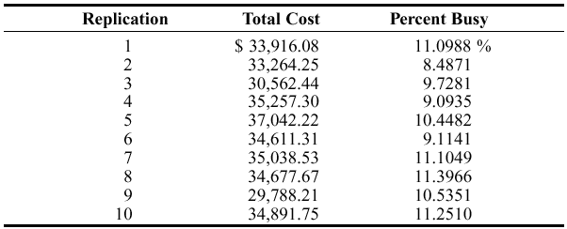
Strategy for Data Collection and Analysis
For terminating case, make statistically IID (Independent and Identically Distributed) replications
  Run/Setup/Replication Parameters: Number of Replications field
  Check both boxes for Initialize Between Replications to get statistically IID replications.
  Get fresh system state and fresh statistical accumulators for each replication.
Separate results for each replication – Category by Replication report for Model 5-3, base case, 10 replications

Slide 6
Strategy for Data Collection and Analysis (cont’d.)
Category Overview report will have some statistical-analysis results of the output across the replications
How do we decide on how many replications to run?
  Trial and error (now)
  Approximate number for acceptable precision (discuss later)
  Sequential sampling (Chapter 11)
Turn off all animation for max speed
  Run/Run Control/Batch Run (No Animation)

Slide 7
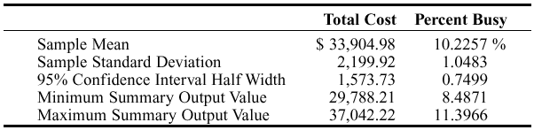
Confidence Intervals for
Terminating Systems
Using formulas in Chapter 2, viewing the cross-replication summary outputs as the basic data:
Possibly most useful part – 95% confidence interval on expected values
This information (except standard deviation) is in Category Overview report
  If > 1 replication specified, Arena uses cross-replication data as above
  Other confidence levels, graphics – Output Analyzer

Slide 8
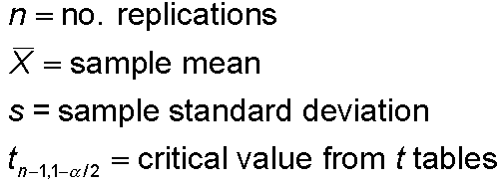


Half Width and Number of Replications
Prefer smaller confidence levels: precision
Notation:
Confidence interval:
Half-width =
Can’t control t or s
Must increase n — how much?
Want this to be “small,” say
< h where h is prespecified

Slide 9



Half Width and Number of Replications (cont’d.)
Set half-width = h, solve for
Not really solved for n (t, s depend on n)
Approximation:
  Replace t by z, corresponding normal critical value
  Pretend that current s will hold for larger samples
  Get
Easier but different approximation:
s = sample standard
deviation from “initial”
number n₀ of replications
n grows quadratically
as h decreases.
h₀ = half width from “initial” number n₀ of replications

Slide 10
Interpretation of Confidence Intervals
Interval with random (data-dependent) endpoints that’s supposed to have stated probability of containing, or covering, the expected valued
  “Target” expected value is a fixed, but unknown, number
  Expected value = average of infinite number of replications
Not an interval that contains, say, 95% of the data
  That’s a prediction interval … useful too, but different
Usual formulas assume normally-distributed data
  Never true in simulation
  Might be approximately true if output is an average, rather than an extreme
  Central limit theorem- says that under rather general conditions, sums and means of samples of random measurements drawn from a population tend to be bell-shaped in repeated samplings

Slide 11
Comparing Two Alternatives
Usually, want to compare alternative system configurations, layouts, scenarios, sensitivity analysis … here just two alternatives
Base case of Model 5-3, vs. adding one resource unit for each type
  New Sales, New Tech 1, New Tech 2, New Tech 3, New Tech All, and go to 27 trunk lines
  Earlier, one run of each suggested big differences … real?
Reasonable but not-quite-right idea: Make confidence intervals on expected outputs from each alternative, see if they overlap
  Doesn’t allow for a precise, efficient statistical conclusion

Slide 12
Results (earlier slide)
Define Base case (no more people, 26 trunk lines) and run:
  Total cost (for the week) = $34K
  Percent busy signals = 11% (unacceptable)
Add one resource unit for each type
  New Sales, New Tech 1, New Tech 2, New Tech 3, New Tech All, and go to 27 trunk lines
  Total cost (for the week) = $28K
    Added resources reduced customer waiting time by more than enough to cover their cost
  Percent busy signals = 3% (acceptable)
    Extra trunk line, plus added resources to move calls through
THE BIG QUESTION: Is the modification truly and reliably better???

Slide 13
Compare Means via the Output Analyzer
Output Analyzer is a separate application that operates on .dat files produced by Arena
  Not installed by default from book CD – need custom install
  Launch separately from Windows, not from Arena
To save output values (Expressions) of entries in Statistic data module (Type = Output) – enter filename.dat in Output File column
  Just did for Total Cost, not Percent Busy
  Will overwrite this file name next time … either change the name here or out in Windows before the next run
  .dat files are binary … can only be read by Output Analyzer

Slide 14
Compare Means via the Output Analyzer (cont’d.)
Start Output Analyzer, open a new data group
  Basically, a list of .dat files of current interest
  Can save data group for later use – .dgr file extension
  Add button to select (Open) .dat files for the data group
Analyze/Compare Means menu option
  Add data files … “A” and “B” for the two alternative
  Select “Lumped” for Replications field
  Title, confidence level, accept Pared-t Test, Scale Display

Slide 15
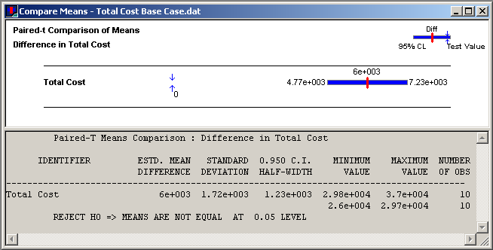
Compare Means via the Output Analyzer (cont’d.)
Results:
Confidence interval on difference misses 0, so conclude that there is a (statistically) significant difference

Slide 16
Evaluating Many Alternatives with the Process Analyzer (PAN)
With (many) more than two alternatives to compare, two problems are
  Simple mechanics of making the possibly many parameter changes, making the runs, keeping track of the many output files
  Statistical methods for drawing reliable and useful conclusions
Process Analyzer (PAN) addresses these
PAN operates on program (.p) files – produced when .doe file is run (or just checked)
Start PAN from Arena (Tools/Process Analyzer) or via Windows
PAN runs on its own, separate from Arena

Slide 17
PAN Scenarios
A scenario in PAN is a combination of:
  A program (.p) file
  Set of input controls that you choose
    Chosen from Variables and Resource capacities – think ahead
    You fill in specific numerical values
  Set of output responses that you choose
    Chosen from automatic Arena outputs or your own Variables
    Values initially empty … to be filled in after run(s)
  To create a new scenario in PAN, double-click where indicated, get Scenario Properties dialog
    Specify Name, Tool Tip Text, .p file, controls, responses
    Values of controls initially as in the model, but you can change them in PAN – this is the real utility of PAN
    Can duplicate (right-click, Duplicate) scenarios, then edit for a new one
  Think of a scenario as a row

Slide 18
PAN Projects and Runs
A project in PAN is a collection of scenarios
  Program files can be the same .p file, or .p files from different model .doe files
  Controls, responses can be the same or differ across scenarios in a project – usually will be mostly the same
  Think of a project as a collection of scenario rows – a table
  Can save as a PAN (.pan extension) file
Select scenarios in project to run (maybe all)
PAN runs selected models with specified controls
PAN fills in output-response values in table
  Equivalent to setting up, running them all “by hand” but much easier, faster, less error-prone

Slide 19
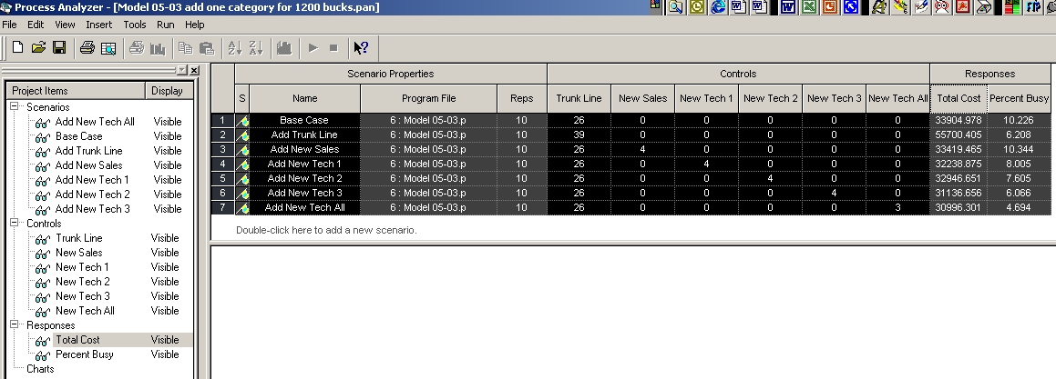
Running Model 5-3 with PAN
Scenarios
  Base case (no additional resources)
  Imagine $1200/week to spend on each additional resource type, one at a time (no mixed enhancements)
  7 scenarios in all (details in book)
  Select all to run (click on left of row, Ctrl-Click or Shift-Click for more)
  To execute, or Run/Go or F5

Slide 20
Statistical Comparisons with PAN
Model 5-3 alternatives were made with 10 replications each
  Better than one replication, but what about statistical validity of comparisons, selection of “the best”?
Select Total Cost column, Insert/Chart (or or right-click on column, then Insert Chart)
  Chart Type: Box and Whisker
  Next, Total Cost; Next defaults
  Next, Identify Best Scenarios
    Smaller is Better, Error Tolerance = 0 (not the default)
    Show Best Scenarios; Finish

Slide 21
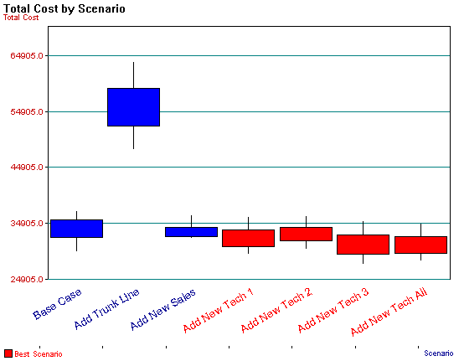
Statistical Comparisons with PAN (cont’d.)
Vertical boxes: 95% confidence intervals
Red scenarios statistically significantly better than blues
  More precisely, red scenarios are 95% sure to contain the best one
  Narrow down red set – more replications, or Error Tolerance > 0
  More details in book

Slide 22
Searching for an Optimal Alternative with OptQuest
The scenarios just considered with PAN are just 7 of many, many possibilities
Try to find input-control values that minimize Total Cost while keeping Percent Busy < 5%
Formulate as an optimization problem:
  Minimize Total Cost
  Subject to 26 ≤ Trunk Lines ≤ 50
  New Sales, New Tech 1, New Tech 2, New Tech 3, New Tech All ≥ 0
  New Sales+New Tech 1+New Tech 2 + New Tech 3+New Tech All ≤ 15
  Percent Busy < 5%
  Reasonable starting place – best acceptable scenario so far: Add 3 New Tech All
  Where to go from here? Explore all of feasible six-dimensional space exhaustively? No.
Objective function is the simulation model
Contractual obligation, space limitation
Nobody’s fired
Space limitation
An output requirement, not an input constraint

Slide 23
OptQuest
OptQuest searches intelligently for an optimum
  Like PAN, OptQuest
    Runs as a separate application … can be launched from Arena
    “Takes over” the running of your model
    Asks that you identify the input controls and the output (just one) response objective

Slide 24
OptQuest
  Unlike PAN, OptQuest
    Asks that you specify constraints on the input controls
    Asks that you specify requirements on outputs
    Decides itself what input-control-value combinations to try
    Uses internal heuristic algorithms to decide how to change the input controls to move toward an optimum configuration
You specify stopping criterion for the search

Slide 25
Using OptQuest
Tools/OptQuest for Arena
New session (File/New or Ctrl+N or )
  Make sure the desired model window is active
Select controls – Variables, Resource levels
  Trunk Line, New Tech 1, 2, 3, and New Tech All
  Bounds: 26 ≤ Trunk Line ≤ 50, others between 0 and 15
  Type is Discrete for all, Input Step Size 1
Constraints – enter
  New Sales + New Tech 1 + New Tech 2 + New Tech 3 + New Tech All <= 15
Objective and Requirement
  Total Cost Response – Select Minimize Objective
  Percent Busy Response – Select Requirement, enter 5 for Upper Bound
  Reorder

Slide 26
Using OptQuest (cont’d.)
Options window – computational limits, procedures
  Time tab – accept Run for 10 minutes default
  Precision tab – vary number of replications from 3 to 10
  Preferences tab – various settings (accept defaults)
Can revisit Controls, Constraints, Objective and Requirements, or Options windows via
Run via wizard (first time through a new project), or Run/Start or
Open View/Status and Solutions and View/Performance Graph to watch progress
Can’t absolutely guarantee a true optimum
  Usually finds far better configuration than possible by hand

