Slide 1

After Chapter 7
Material Not Covered

Slide 2
Reading and Writing Data Files
Reading entity arrivals from a text file
Reading and writing Microsoft Access
and Excel files
Advanced reading and writing

Slide 3

Model Logic to Read Data
File data module (Advanced Process)
  Name: Name referenced in other Arena modules.
  Access Type: Sequential indicates to read in order.
  Operating System File Name: The name used by file system. May be relative or fully qualified.
  End of File Action: What to do when all records are read.

Slide 4
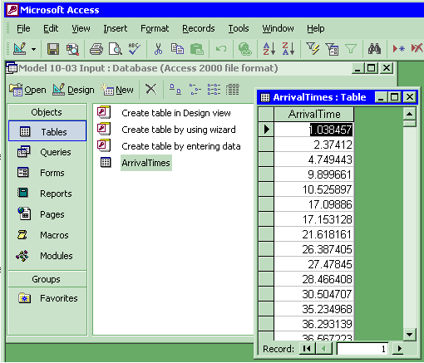
Reading Access Files
Sample Access data
  Model 10-03 Input.mdb
  Table: ArrivalTimes

Slide 5

Reading Access Files
File data module (Advanced Process)
  Access Type: Microsoft Access (*.mdb)
  Operating System File Name: Model 10-03 Input.mdb
  Recordsets: Click to load the Recordsets Editor
Important:
  Never name an access file the same as the model name or it will conflict with the automatic output database file.

Slide 6
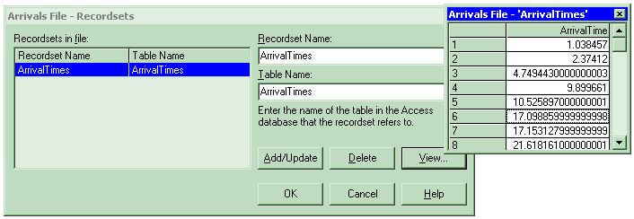
Reading Access Files
Recordsets Editor
  Associates a recordset name with a table
  Table must already exist
  View allows you to see a sample of the real data

Slide 7
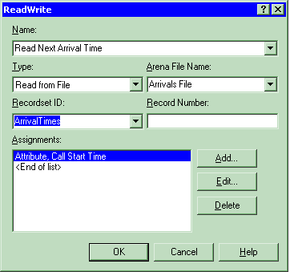
Reading Access Files
ReadWrite module (Advanced Process)
  Recordset ID: Same as defined in Recordsets Editor

Slide 8
Reading Excel Files
Excel is not a relational database but has many similarities:
  An Excel workbook is similar to an Access database file.
  The rows and columns in a rectangular named range in an Excel worksheet are similar to the rows and columns of an Access table.

Slide 9
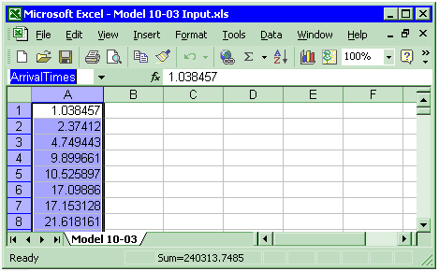
Reading Excel Files
Sample Excel data
  Model 10-03 Input.xls
  Named Range: ArrivalTimes

Slide 10

Reading Excel Files
File data module (Advanced Process)
  Access Type: Microsoft Excel (*.xls)
  Operating System File Name: Model 10-03 Input.xls
  Recordsets: Click to load the Recordsets Editor

Slide 11
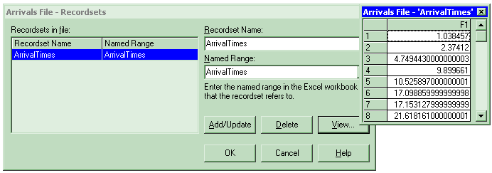
Reading Excel Files
Recordsets Editor
  Associates a recordset name with a named range
  Named range must already exist
  View allows you to see a sample of the real data

Slide 12
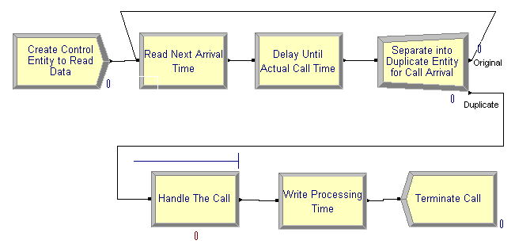
Writing Access and Excel Files
The file:
  The table or named range must already exist.
  An Excel named range should be formatted as numeric.
ReadWrite module:
  Add new module to specify which data to write.

Slide 13
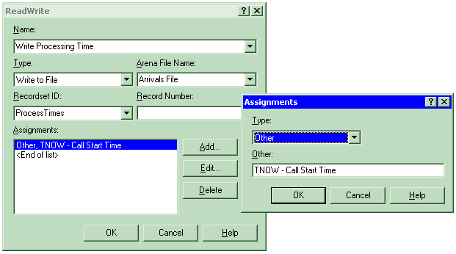
Writing Access and Excel Files
ReadWrite module:
  Use Type of Write To File
  Use Recordset ID as before.

Slide 14
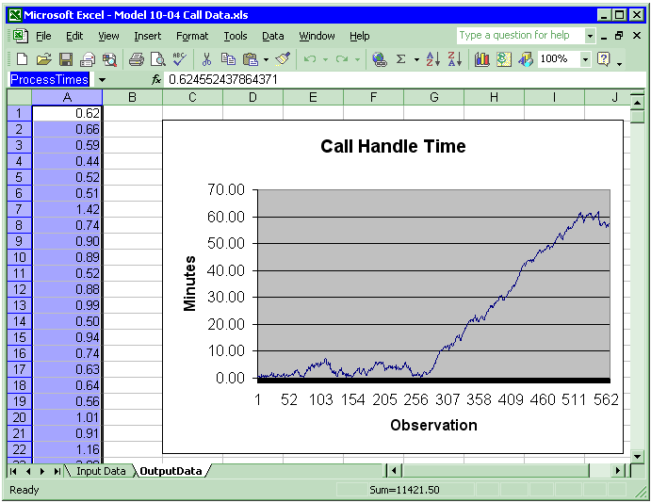
Writing Access and Excel Files
Spreadsheet options:
  You may predefine a plot on the named range and the plot will be built dynamically as data is added to the file.

Slide 15

Advanced Reading and Writing
Formatting can be used to handle text files with fields not delimited by spaces:

Slide 16
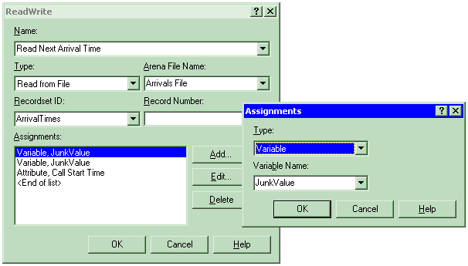
Advanced Reading and Writing
Skip columns in Access & Excel by using dummy variables:

Slide 17
What We’ll Do ...
Reading and Writing Data Files (ReadWrite)
ActiveX™ and Visual Basic® for Applications (VBA)

Slide 18
ActiveX Automation
Program applications to “automate” tasks
  Act on themselves (e.g., macros in Excel)
  Act on other applications (e.g., Arena creating Excel file)
External programming languages
  C++, Visual Basic®, Java, etc.
Visual Basic for Applications (VBA) programming embedded in application
  Microsoft Office®, Visio®, AutoCAD®, Arena®, …
Both types work together (e.g., Arena VBA controlling Excel)

Slide 19
Application Object Model
Objects: application components that can be controlled
Properties: characteristics of objects
Methods: actions performed on or by objects
  Arena Objects Properties Methods
  Application Visible Show
  Model Name, State Close, Go
  View Background Color Zoom In
  …

Slide 20
Visual Basic for Applications (VBA)
Included with Arena
Full Visual Basic programming environment
Code stored with Arena model (.doe) file
UserForms (dialogs) for custom interfaces
Code-debugging tools
Comprehensive online help
Visual Basic Editor window: “child” of Arena (Tools/Show Visual Basic Editor)

Slide 21
Built-in Arena VBA Events
ThisDocument: accesses objects, events in Arena’s object model
Built-in VBA events: locations where VBA code can be activated
  Pre-run events (e.g., DocumentOpen)
  Arena-initiated run events (e.g., RunBegin, RunEndReplication)
  Model/user-initiated run events (e.g., UserFunction, VBA_Block_Fire)
Type code in Visual Basic Editor to populate an event

Slide 22
Arena Macro Recorder
A Macro is a VBA function to perform a task.
Macro recording automatically creates the VBA code to reproduce the actions you take while performing the steps in the task.
Use the Record Macro toolbar to start/stop and pause/resume recording.
Useful for automating repetitive tasks.
Ideal for learning VBA commands and prototyping functions.

Slide 23
Summary
We have just barely scratched the surface of Arena customization and interactions with other software including:
  Reading and writing various types of external data files.
  Visual Basic for Applications
  Interacting with Microsoft Office
  Building custom applications with templates.
There are many other ways of customizing Arena and allowing Arena to interact and exchange data with other software.

Slide 24
Continuous Systems
Discrete systems – State changes occur at isolated points in time called events
Continuous systems – State changes may occur continuously over time
  Flow of fluids and fluid-like materials
  Temperature changes
  Chemical operations
  Biological processes

Slide 25
Continuous Systems
Simple systems (linear)
  Rate of change is constant between events
  Future value can be calculated from starting value and rate
  Can step directly to calculated event
Complex systems (non-linear)
  Rate of change may depend on other continuous processes
  Specialized approaches used to capture change
  Approximates continuous change by making a series of small steps between the usual discrete events

Slide 26
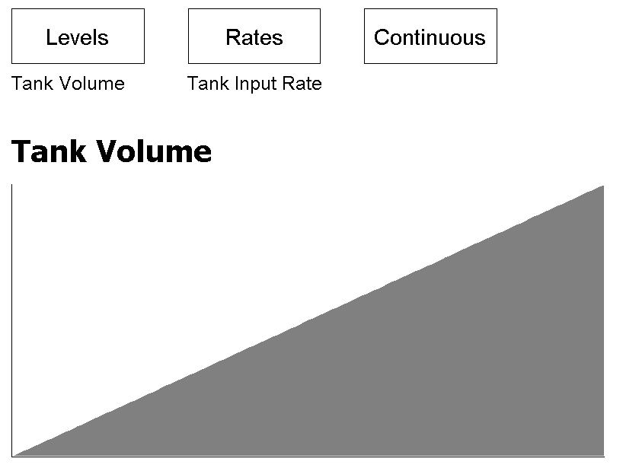
Continuous Systems
Example of simple continuous system filling a tank smoothly over time

Slide 27
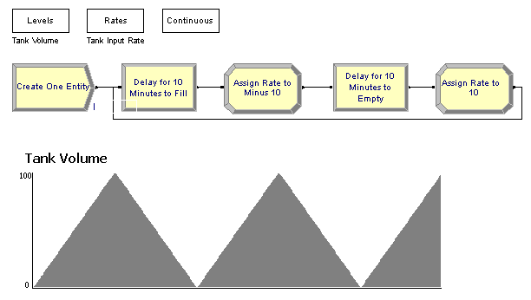
Simple Continuous Systems
Discrete control loop to empty and refill a tank

Slide 28
Combined Discrete/Continuous
Detect Module from Blocks panel “watches” for and helps predict events.
Watches for value of a variable to cross a threshold value (e.g. a tank level reaching its maximum value)
Similar to Create Module in that an entity is created when crossing occurs.

Slide 29
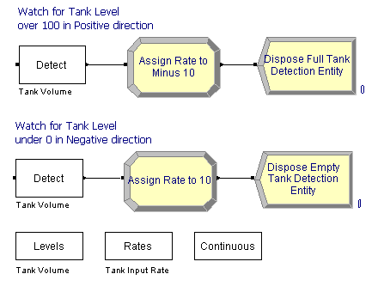
Combined Discrete/Continuous
Fill and empty logic using Detect modules

Slide 30
Complex Systems
Non-linear systems require special algorithms like Runge-Kutta-Fehlberg (RKF).
Step sizes must be set carefully.
Smaller step size will generate more accurate results because Arena will calculate continuous-change variables more often.
Larger step size will run faster, but your error tolerances will need to be set higher.
Many situations (like a gravity fed tank) are actually non-linear, but can be accurately approximated with faster, linear methods.

