Slide 1
What We’ll Do ...
Start Arena
Load, explore, run an existing model
  Basically the same model as for the hand simulation in Chapter 2
  Browse dialogs and menus
  Run the model
  Look at results
Construct the same model from scratch
Tour menus, toolbars, drawing, printing
Help system
Options for running and control

Slide 2
Behavior of Arena, Starting, Exiting
Arena is a true Windows application
  Appearance, operation, functions, are standard
  Interoperability with other software (MS Office, CAD)
  Interact, communicate with other software (Chapter 10)
Installing Arena – Appendix E
Locate icon or shortcut; double-click
  Or, Start > Programs > Rockwell Software > Arena 7.0 > Arena 7.01
  Licensed vs. Academic, Evaluation mode
See File, View, Tools, Help menus
  Other menus present if a model file is open
Toolbars with buttons
  Unless a model file is open, only New model file, Open model file, Template Attach/Detach, Context Help (click it, then click on buttons or menu items)
Tooltips – roll over toolbar buttons for names
Quitting Arena: File > Exit or Alt+F4 or top right X

Slide 3

Opening an Existing Model
File > Open … or button
  Navigate to desired disk/directory
  Click > Open or double-click Model 03-01.doe
  Book models: Rockwell Software\Arena 7.0\Book Examples
  More examples: Rockwell Software\Arena 7.0\Examples
Model window (usually on right side of Arena window)
  Where model is built
  Resize, maximize, minimize, scroll/pan, zoom
  Can have multiple model windows open at once
Cut, Copy, Paste within Arena, and between Arena and other applications (when sensible)
Why the .doe default extension to Arena model filenames?

Slide 4
Flowchart and Spreadsheet Views
Model window split into two views
  Flowchart view
    Graphics
    Process flowchart
    Animation, drawing
    Edit things by double-clicking on them, get into a dialog
  Spreadsheet view
    Displays model data directly
    Can edit, add, delete data in spreadsheet view
    Displays all similar kinds of modeling elements at once
  Many model parameters can be edited in either view
  Horizontal splitter bar to apportion the two views
  View > Split Screen (or push ) to see both flowchart and spreadsheet views (otherwise, get just flowchart view)

Slide 5
Project Bar
Usually down the left edge of Arena window
Hosts panels with modeling building blocks: modules
  Both flowchart and spreadsheet modules
Displays one panel at a time
  Switch to different panels via horizontal buttons
  Panels for Basic Process, Reports (after running), Navigate (to different views within a model or to different hierarchical submodels), … others can be attached (Template Attach button ) for different modeling levels, specialties
Usually docked to left edge but can move, float
Hide it via View > Project Bar or its own small

Slide 6
Status Bar
At very bottom of Arena window
Displays various information sensitive to status
  Coordinates of cursor in “worldspace”
  Simulation clock value, replication number being executed, number of replications to be done, when simulation is running
Hide by clearing (unchecking) View > Status Bar

Slide 7





Moving Around, Up, Down in Flowchart View of Model Window
Underlying world space for model
  (x, y) coordinates, arbitrary units (thousands in each direction)
Pan with scroll bars, arrow keys
Zoom in (down): or + key
Zoom out (up): or – key
See all at min altitude: or * key
Named views
  Save a pan/zoom view for different parts of model
  Assign a Hot key (case-sensitive)
  Access via View > Named Views … or ? key
Display grid ( ), snap to grid ( ) toggles
To navigate via keyboard, the model window must be active ... click in it.

Slide 8
Modules
Basic building blocks of a simulation model
Two basic types: flowchart and data
Different types of modules for different actions, specifications
“Blank” modules are on the Project Bar
  To add a flowchart module to your model, drag it from the Project Bar into the flowchart view of the model window
    Can have many instances of the same kind of flowchart module in your model
  To use a data module, select it (single-click) in the Project Bar and edit in the spreadsheet view of the model window
    Only one instance of each kind of data module in your model, but it can have many entries (rows) in the spreadsheet view
    Can edit via dialog – double-click on number in leftmost column

Slide 9
Flowchart Modules
Describe dynamic processes
  Nodes/places through which entities flow
  Typically connected to each other in some way
Basic Process panel flowchart module types:
  Create, Dispose, Process, Decide, Batch, Separate, Assign, Record
Other panels – many other kinds
Shape like flowcharting (also use colors for hints)
Two ways to edit
  Double-click to open up, then fill out dialogs
  Select (single-click) a module type in model or Project Bar, get all modules of that type in the spreadsheet view

Slide 10
Data Modules
Set values, conditions, etc. for whole model
  No entity flow, no connections
Basic Process panel data module types:
  Entity, Queue, Resource, Variable, Schedule, Set
Other panels – many other kinds
Icons in Project Bar look like little spreadsheets
To use a data module, select it (single-click) in the Project Bar, edit in spreadsheet view
  Can edit via dialog – double-click in leftmost column
  Double-click where indicated to add new row
  Right-click on row, column to do different things
Only one instance of each kind of data module in a model
  But each one can have many entries (rows)

Slide 11
Relations Among Modules
Flowchart and data modules are related via names for objects
  Queues, Resources, Entity types, Variables … others
Arena keeps internal lists of different kinds of names
  Presents existing lists to you where appropriate
  Helps you remember names, protects you from typos
All names you make up in a model must be unique across the model, even across different types of modules

Slide 12
Internal Model Documentation
Data Tips on modules, graphics – hover mouse over object to see
  Default part – generic info on object (name, type)
  User-defined part – right-click on object, select Properties, enter text under Property Description
  Toggle display of Data tips via View > Data Tips
Project Description – Run > Setup > Project Parameters, enter text under Project Description
Model Documentation Report – Tools > Model Documentation Report
  Generates HTML file with model details (can choose which kinds of details to include)

Slide 13
Browsing Through Model 3-1
Open Model 03-01.mod (in Book Examples folder)
Three flowchart modules (Create, Process, Dispose)
Entries in three data modules (Entity, Queue, Resource)
Animation objects
  Resource animation
  Two plots
  Some (passive) labels, artwork

Slide 14
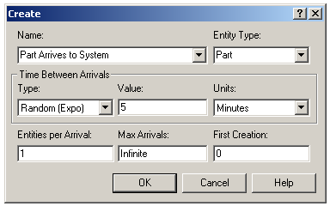
The Create Flowchart Module
“Birth” node for entities
Gave this instance of the Create-type module the Name Part Arrives to System
  If we had other Create modules (we don’t) they’d all have different Names
Double-click on module to open property dialog:

Slide 15
The Create Flowchart Module (cont’d.)
Name – for module (type it in, overriding default)
Entity Type – enter a descriptive name
  Can have multiple Entity Types with distinct names
Time Between Arrivals area
  Specify nature of the time separating consecutive arrivals
  Type – pull-down list with several options
  Value – depends on Type … for Random (Expo) is mean
  Units – time units for Value
Entities per Arrival – constant, random variable, very general “Expression” (more later …)
Max Arrivals – choke off arrivals (from this source) after this many entities
First Creation – time of first arrival (need not be 0)

Slide 16
Editing Flowchart Modules in the Spreadsheet View
Alternative to dialog for each instance of a module type
See all instances of a module type at once
  Convenient for seeing, editing lots of things at once
Selecting a module in either flowchart or spreadsheet view also selects it in the other view
Click, double-click fields to view, edit
Right-click in row to Edit via Dialog, define a user Data Tip (via Properties)
Right-click in expression fields to get Expression Builder for help in constructing complex expressions with Arena variables (more later …)

Slide 17
The Entity Data Module
A data module, so edit in spreadsheet view only
View, edit aspects of different Types of entities in your model (we have just one Type, Part)
Pull-down lists activated as you select fields
Our only edit – Initial Picture for animation
  We picked Picture.Blue Ball from the default list

Slide 18
The Process Flowchart Module
Represents the machine, including the resource, queue, and entity delay time (processing)
Enter Name – Drilling Center
Type – picked Standard to define logic here rather than in a submodel (more later …)
Report Statistics check box at bottom
  To get utilizations, queue lengths, queue waiting times, etc.

Slide 19
The Process Flowchart Module (cont’d.)
Logic area – what happens to entities here
  Action
    Seize Delay Release – entity Seizes some number of units of a Resource (maybe after a wait in queue), Delay itself there for the processing time, then Release the units of the Resource it had Seized – we chose this option
    Could just Delay entity (red traffic light) – no Resources or queueing
    Could also Seize Delay (no Release … Release downstream)
    Could also Delay Release (if Resource had been Seized upstream)
    Priority for seizing – lower numbers mean higher priority
    Different Action choices could allow stringing together several Process modules for modeling flexibility
  Resources – define Resource(s) to be seized, released
    Double-click on row to open subdialog
    Define Resource Name, Quantity of units to be Seized/Released here
    Several Resources present (Add) – entities must first Seize all

Slide 20
The Process Flowchart Module (cont’d.)
Delay Type – choice of probability distributions, constant or general Expression (more later …)
Units – time units for the delay (don’t ignore)
Allocation – how to “charge” delay in costing (more later …)
Prompts on next line – change depending on choice of Delay Type – specify numerical parameters involved
Can also edit in spreadsheet view
  Subdialogs (e.g., Resource here) become secondary spreadsheets that pop up, must be closed

Slide 21
The Resource Data Module
Defining the Drilling Center Resource in the Process module automatically creates an entry (row) for it in the Resource data module
Can edit it here for more options
  Type – could vary capacity via a Schedule instead of having a fixed Capacity
    Would define the Schedule via Schedule data module … more later
  Failures – could cause resource to fail according to some pattern
    Define this pattern via Failure data module (Advanced Process panel) … more later

Slide 22
The Queue Data Module
Specify aspects of the queues in the model
  We only have one, named Drilling Center.Queue (the default name given the Process name)
Type – specifies queue discipline or ranking rule
  If Lowest or Highest Attribute Value, then another field appears where you specify which attribute
Shared – it this queue will be shared among several resources (more later …)
Report Statistics – check to get automatic collection and reporting of queue length, time in queue

Slide 23
Animating Resources and Queues
Got queue animation automatically by specifying a Seize in the Process module
  Entity pictures (blue balls) will line up here in animation
Don’t get Resource animation automatically
  To add it, use Resource button in Animate toolbar … get Resource Picture Placement dialog
    Identifier – link to Resource name in pull-down list
    Specify different pictures for Idle, Busy state
      For pre-defined artwork, Open a picture library (.plb filename extension)
      Scroll up/down on right, select (single-click) a picture on right, select Idle or Busy state on left, then to copy the picture
  To edit later, double-click on picture in flowchart view

Slide 24
The Dispose Flowchart Module
Represents entities leaving model boundaries
Name the module
Decide on Record Entity Statistics (average and maximum time in system of entities exiting here, costing information)
Check boxes for statistics collection and reporting:
  Most are checked (turned on) by default
  Little or no modeling effort to say yes to these
  However, in some models this can slow execution markedly
  Moral – if you have speed problems, clear these if you don’t care about them

Slide 25
Connecting Flowchart Modules
Establishes the (fixed) sequence of flowchart modules through which entities will flow
To make a connection
  Click Connect button (or Object > Connect)
  Cursor changes to cross hairs
  Click on exit point from source module, then entry point on destination module
  Make intermediate clicks for non-straight line in segments
Object menu toggles
  Auto-Connect – automatically connect entry point of newly placed module from exit point of selected module
  Smart Connect – force segments to horizontal/vertical
  Animate Connectors – show entities moving along connectors (zero time for statistics collection)

Slide 26
Dynamic Plots
Trace variables, queues as simulation runs – a kind of “data animation”
Disappear after run is ended (to keep, must save data, postprocess via Output Analyzer — later)
Plot button from Animate toolbar… “Add” for
  Expression to plot (help via Expression Builder … later)
  Min/Max y-axis values (initially guesses, maybe revise)
    Arena can do this automatically and dynamically in Plot dialog
  Number of “corners” to show (# History Points) at a time
  Stepped option (for piecewise-constant curves)
  Colors
In Plot dialog – Time Range (x axis), cosmetics, automatic scaling options
Drop plot in via crosshairs (resize, move later)

Slide 27
Dressing Things Up
Add drawing objects from Draw toolbar
  Similar to other drawing, CAD packages
  Object-oriented drawing tools (layers, etc.), not just a painting tool
Add Text to annotate things
  Control font, size, color, orientation

Slide 28
Setting the Run Conditions
Run > Setup menu dialog – five tabs
  Project Parameters – Title, your name, output statistics, Project Description
  Replication Parameters
    Number of Replications
    Initialization options Between Replications
    Start Date/Time to associate with start of simulation
    Warm-up Period (when statistics are cleared)
    Length of Replication (and Time Units)
    Base Time Units (output measures, internal computations)
    Hours per “Day” (convenience for 16-hour days, etc.)
    Terminating Condition (complex stopping rules)
  Other tabs for animation speed, run conditions, reporting
Terminating your simulation:
  You must specify – part of modeling
  Arena has no default termination
  If you don’t specify termination, Arena will usually keep running forever

Slide 29



Running It
Plain-vanilla run: Click from Standard toolbar (like audio/video players)
  First time or after changes: Check
  Enters run mode — can move around but not edit
  Speed up (> on keyboard) or slow down (<) animation display
  When done, asked if you want to see summary reports
  Click to get out of run mode (can’t edit until you do)
  Can pause run with or Esc key
Other run control, viewing, checking options

Slide 30
Viewing the Reports
Click Yes in the Arena box at the end of the run
  Opens up a new reports window (separate from model window) inside the Arena window
  Project Bar shows Reports panel, with different reports (each one would be a new window)
  Remember to close all reports windows before future runs
Default installation shows Category Overview report – summarizes many things about the run
  Reports have “page” to browse ( and )
  Also, “table contents” tree at left for quick jumps via ,
Times are in Base Time Units for the model

Slide 31
Viewing the Reports – Examples
Entity → Time → Total Time → Part:
  Avg. time in system was 6.4397 min., max was 12.6185
Resource → Usage → Instantaneous Utilization → Drill Press:
  Utilization was 0.9171 (busy 91.71% of the time)
Process → Other → Number In → Drilling Center:
  During the run, 7 parts entered the Drilling Center
Process → Other → Number Out → Drilling Center:
  5 entities left the Drilling Center (so were produced)
Entity → Time → Wait Time → Part:
  Avg. wait time in all queues was 3.0340 min. (counts only entities that left the system, but Queue → Time → Waiting Time → Drilling Center.Queue counts all entities that left this queue, so can differ)
Entity → Other → Wip → Part:
  Average Work in Process was 1.7060, max WIP was 4

Slide 32
Types of Statistics Reported
Many output statistics are one of three types:
  Tally – avg., max, min of a discrete list of numbers
    Used for discrete-time output processes like waiting times in queue, total times in system
  Time-persistent – time-average, max, min of a plot of something where the x-axis is continuous time
    Used for continuous-time output processes like queue lengths, WIP, server-busy functions (for utilizations)
  Counter – accumulated sums of something, usually just nose counts of how many times something happened
    Often used to count entities passing through a point in the model

Slide 33
More on Reports and their Files
Reports we just saw – based on a MS Access database that Arena writes as it runs
  Can be saved and viewed later
  Viewing within Arena done via Crystal Reports to query the Access database
Arena also produces a plain-text summary report (.out filename extension)
  Was in previous versions of Arena, underlying SIMAN simulation language
  Fairly cryptic, but gives quick view of lots of output data
Get multiple reports for multiple replications
“Half Width” columns – for confidence intervals on outputs in long-run simulations … more later

Slide 34
Build It Yourself
Build the same model from scratch – see book for more detail
Handy user-interface tricks:
  Right-click in an empty spot in flowchart view – small box of options, including Repeat Last Action … useful in repetitive editing like placing lots of the same module type
  Ctrl+D or Ins key – duplicates whatever’s selected in flowchart view, offsetting it a bit … usually drag elsewhere and edit
Open a new (blank) model window – name it, save it, maybe maximize it
Attach modeling panels you’ll need to Project Bar if they’re not there

Slide 35
Build It Yourself (cont’d.)
Place and connect flowchart modules
Edit flowchart and data modules as needed
  Experiment with Expression Builder – right-click in expression field
Add plots, animation, artwork
Add named views (? key or View > Named Views)
  Name, hot key (case-sensitive) – useful in big models
Edit Run > Setup dialog
“Displays” in text
  Compact way of saying what needs to be done in a dialog
  Omits Arena defaults
  Shows completed dialogs

Slide 36
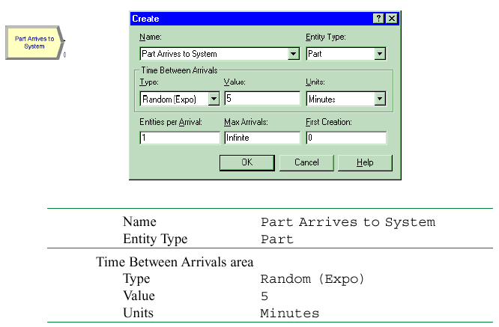
Display for the Create Module

Slide 37
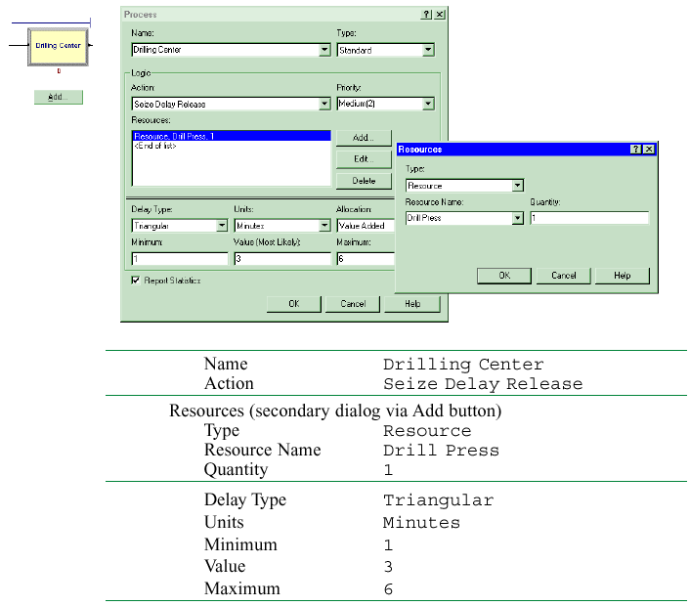
Display for the Process Module

Slide 38
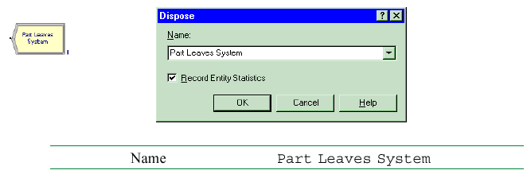
Display for the Dispose Module

Slide 39
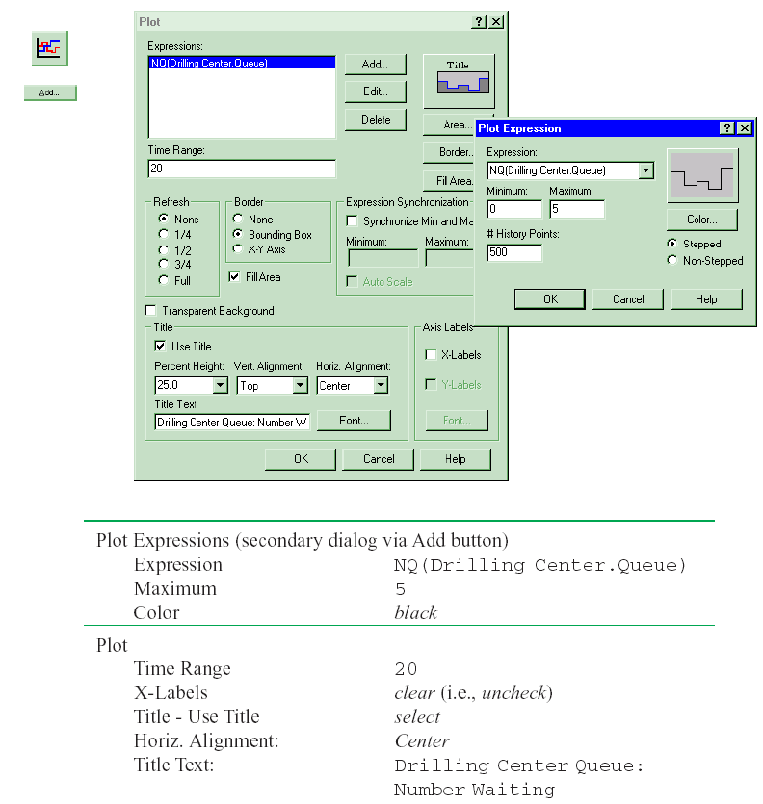
Display for the Queue-Length Plot

Slide 40
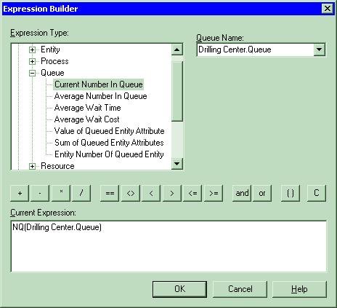
Expression Builder for Queue-Length-Plot Expression

Slide 41
More on Menus – File Menu
Model-file management
Template attach/detach
DXF import (from CAD packages), Visio import
Color palettes
Printing
E-mail open model file
Recent models
Exit from Arena

Slide 42
Edit Menu
Undo/Redo
Cut/Copy/Paste
Paste Link (create OLE link)
Duplicate, Delete selection
Select/Deselect All
Entity Pictures – change content, definition of pictures presented in Entity data module
Calendar Schedules – specify complex time patterns in hierarchies (weeks are made of days, which are made of shifts, etc.), exceptions (holidays), view composite net effect

Slide 43
Edit Menu (cont’d.)
Find – searches all modules and animation objects for a text string … useful for finding wrong names, typos after an error message from Arena
Properties – display internal Arena object properties
Links – to link to other files (spreadsheets, sounds, etc.)
Insert New Object – from other applications (e.g., graphics)
Object – edit object imported from another application

Slide 44
View Menu
Zooming – discussed before
Zoom Factor – step size when zooming
Views – canned Arena views of flowchart view
Named Views – define, change, use views
Grid/Snap/Grid Settings – control grid, snapping
Page breaks – shows page breaks if printed
Data Tips – toggles display of Data Tips
Layers – which objects show up in which mode
Split Screen – toggle for viewing both flowchart and spreadsheet views, or just one of them
Toolbars – decide which toolbars show up
Project/Status Bar – toggle to show up or not

Slide 45
Tools Menu
Separate applications for modeling, analysis
  Arena Symbol Factory – large collection of graphics in categories, use to create graphical symbols for animation
  Input Analyzer – fit probability distributions for input, using field-collected data
  Process Analyzer – run, compare many “scenarios” at once
    Also Output Analyzer … not on menus ... start from Start menu
Special “editions” of Arena (FactoryAnalyzer, Contact Center) – depends on licensing
Model Documentation Report – generate HTML file with many details of this model

Slide 46
Tools Menu (cont’d.)
Import/Export model to/from Database – bring in, save model details to Excel or Access
OptQuest for Arena – separate application that “takes over” running of the model to search for an optimal scenario
Macro – create Visual Basic macros (mini programs), VB editor ... more in Chapter 10
Options – control many aspects of how Arena works, looks

Slide 47
Arrange Menu
For modeling, graphics objects – first select object(s)
Bring object to Front, Send it to Back — for “stacking” effects
Group, Ungroup
Flip around Vertical, Horizontal line
Rotate object (90° clockwise)
Align objects on top, bottom, left, or right edges
Distribute objects evenly (horizontally, vertically)
Flowchart Alignment – arrange flowchart modules (horizontally, vertically)
Snap to Grid the selected object(s)
Change Snap Point on object that gets snapped

Slide 48
Object Menu
Connect tool – changes cursor to cross hairs
Auto-Connect newly placed module to selected module – toggle on/off
Smart Connect – new connections in horizontal/vertical segments rather than one diagonal segment – toggle on/off
Animate Connectors – to show entities moving (at infinite speed for statistics collection)
Submodel – define and manage hierarchical submodels (see Chapter 5)

Slide 49
Run Menu
Setup – control model run conditions
Entries to run, check, pause, step through
Alternatives to watch execution, view results (or errors)
Control how run goes and is displayed
Most capabilities on Run or Run Interaction Toolbar, and will be described a bit later in detail
Access the “code” in the underlying SIMAN simulation language

Slide 50
Window Menu
Cascade, Tile multiple open model windows
Arrange Icons for any minimized model windows
Use system Background Color — use Windows colors rather than Arena settings
List of open model windows

Slide 51
Help Menu
One of several ways to get into Help system
Arena Help Topics – TOC, Index, Search
What’s This? – adds ? to cursor, then click on things for brief description
Release notes – recent changes, requirements
Arena SMART Files – subject-based index to many small (but complete) models that illustrate specific modeling techniques

Slide 52
Help Menu (cont’d.)
List of attached modeling panels – select to get Help on that one
Product Manuals – detailed documents on Arena components
Web links to product support (must be online ...)
Product support/training
Copy protection information for commercial, research, and lab versions
About Arena... – version number, etc.

Slide 53
More on Toolbars
Collections of buttons for “frequent” operations
  Most are duplication of menu entries
  Standard, Draw, Animate, Integration, View, Arrange, Run Interaction, Record Macro, Animate Transfer, Professional
View > Toolbars (or right-click in a toolbar area) to decide which ones show up, which to hide
Toolbars can be torn off (“floating” palettes), or “docked” to an edge of screen
Arena remembers your Toolbar configuration for next time
View > Toolbars > Customize to alter how toolbars and buttons are displayed
See text for run-through description of toolbars and buttons

Slide 54
More on Drawing
Draw via toolbar buttons only (no menus):
Line, Polyline (hold Shift key for 45⁰), Arc, Bézier Curve
Box, Polygon, Ellipse (fill, line, shade)
Text (font, size, style)
Colors for Lines, Fill, Text, Window Background
Line Style, Fill Pattern
By far best way to learn: just play around

Slide 55
Printing
Print all or parts of flowchart view of active model window – supports color
Usual Print, Print Preview, Print Setup (File menu)
Could consume many pages … also prints named views separately
  Print Preview, select only what you want for printing
View > Page Breaks to show how pages will break
Alternative to printing directly from Arena: PrintScreen key — sends screen to clipboard, paste into another application
  Alt+PrintScreen — sends only active window to clipboard
  Could first pass through a paint application to crop, etc.

Slide 56
Help!
Extensive, comprehensive online system – including complete (electronic) manuals
Interlinked via hypertext for cross referencing
Multiple entry points, including Help menu (described above), links to websites
button for context-sensitive help
button in most dialogs
button (What’s This?) for info on items
Tooltips – roll over things, get little sticky note
Examples folder inside Arena 7.0 folder
SMARTs library – small models illustrating points – subject index via Help > Arena Smart Files

Slide 57
More on Running Models
Run Menu; Standard & Run Interaction toolbars
Run > Setup – many options to control the run
  These are attached to the model, and are not global
Run > Go – run simulation “normally” (depends on selections from Run > Run Control and Tools > Options > Run Control)
Run > Step – one “step” at a time (verify, debug)
Run > Fast-Forward – disable animation (faster)
Run > Pause (or Esc key) – freeze run, resume with Go
Run > Start Over – go back to beginning of simulation

Slide 58
More on Running Models (cont’d.)
Run > End – get out of run mode
Run > Check Model – like compiling
Run > Review Errors – for most recent Check
Run > Run Control > Command – bring up interactive command-line window to control run
Run > Run Control > Break – set times, conditions to interrupt for checks, illustration
Run > Run Control > Watch – bring up a window to watch a variable or expression during run

Slide 59
More on Running Models (cont’d.)
Run > Run Control > Break on Module – set/clear break when an entity enters or resumes activity on a module
Run > Run Control > Highlight Active Module – highlight the flowchart module being executed
Run > Run Control > Batch Run (No Animation) – run model with no animation … this is even faster than Fast-Forward … usually used for “production runs” for statistical analysis
Run > SIMAN – view or write the model (.mod) and experiment (.exp) files for the underlying SIMAN model

