Slide 1

FUNDAMENTAL SIMULATION CONCEPTS
Prelude to Arena
CHAPTER 2

Slide 2
Topics/Approach
Underlying simulation ideas, methods, issues
  Software-independent (but setting up for Arena)
Centered basically around an example of a simple processing system described in Sect 2.1, pg 19. (Some numbers are changed)
  Decompose the problem
  Terminology
  Simulation by hand
  Some basic statistical issues
  Overview of a simulation study

Slide 3
The System:
A Simple Processing System
Machine
(Server)
Arriving
Blank Parts
Departing
Finished Parts
7
6
5
4
Queue (FIFO)
Part in Service
General intent:
  Estimate expected production
  Determine the time in the queue, queue length, proportion of time machine is busy
Time units: arbitrary, but …
  Be consistent (simulation doesn’t know)
  Be reasonable (interpretation, roundoff error)

Slide 4
Model Specifics
Initially (time 0) empty and idle
Time units: minutes
Arrival times: 0.00, 6.84, 9.24, 11.94, 14.53
  Interarrival¹ times: 6.84, 2.40, 2.70, 2.59, 0.73
Service times: 4.58, 2.96, 5.86, 3.21, 3.11
Stop when 15 minutes of (simulated) time have passed
¹The time between a part's arrival and that of the next part.

Slide 5
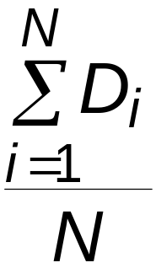
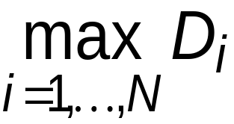
Goals of the Study:
Output Performance Measures
Total production of parts over the run (P)
Average waiting time of parts in queue¹:
Maximum waiting time of parts in queue:
N = no. of parts completing queue wait
D_{i} = waiting time in queue of ith part
Know: D₁ = 0 (why?)
N > 1 (why?)
¹These are called tally statistics as they are tallied when observed.

Slide 6
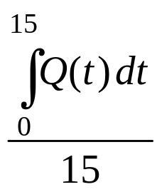
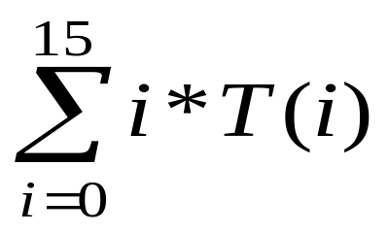
Goals of the Study:
Output Performance Measures (cont’d.)
Time-average number of parts in queue:
Q(t) = number of parts in queue
at time t
This is a weighted average--- i.e. if T(i) is the amount of time that i parts are in the queue, then the numerator in this example is the same as:
If you haven't had calculus, you just have to accept this as true although on the next slide I will try to intuitively explain the integral.

Slide 7
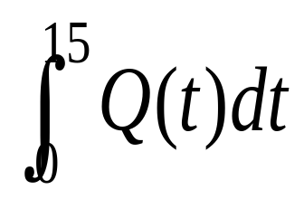
INTUITIVE CALCULUS
Q(t) = number of parts in queue at time t
This is read as "the integral from 0 to 15 of Q(t) ".
The integral calculates the area under the curve Q(t) between 0 and 15.
In Calculus, given Q(t) as a "reasonable" function, you learn to calculate the area specified above. Here, the software will do the calculations for you.
But, I want you to intuitively see why this is the same as
where T(i) is the amount of time that i parts are in the queue

Slide 8
VERY simple example illustrating the equivalence claimed on the last slide:
Assume arrival times of 0, 1, 2 for parts A, B , and C
and a service time of 2 for each part. Then Q(t) would look like:
i Action Queue size
0 A arrives 0
1 B arrives, A on 1
2 C arrives, A out, B on 1
3 B on, no arrivals 1
4 B out, C on 0
Q(t)
A
B
C
Area under Q(t) curve is 3
This is easy to calculate because the function Q is a simple box function.
The other calculation is
2*0 + 3*1= 3
because 2 intervals have 0 in queue and
3 have 1 in queue.

Slide 9
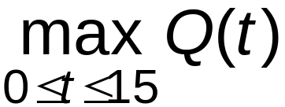
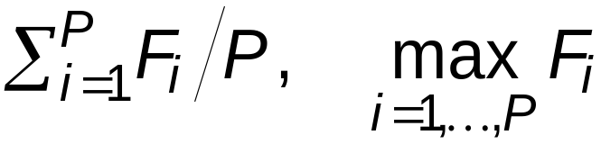
Goals of the Study:
Output Performance Measures (cont’d.)
Maximum number of parts in queue:
Average and maximum flowtime¹ of parts
F_{i} = flowtime of ith part
¹total time in system of a part that completes. This includes time on press plus queue time.
a.k.a. cycle time

Slide 10
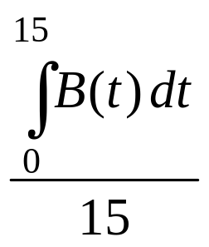
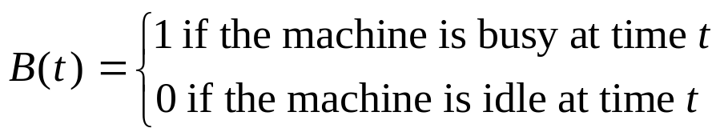
Goals of the Study:
Output Performance Measures (cont’d.)
Utilization of the machine (proportion of time busy)
Many others possible (information overload?)

Slide 11
Analysis Options Other Than Simulation
Educated guessing
  Average interarrival time = 3.05 minutes
  Average service time = 3.94 minutes
In text, using Table 2.1, pg 20, these are calculated for the first listed 10 items of the book example by averaging the appropriate columns. (Check this!)There the first is 4.08 and the second is 3.46.
Our results average over 5 items and are
(6.84+2.4+2.7+2.59+.73)/5 and
(4.58+2.96+5.86+3.21+3.11)/5

Slide 12
In the text, average-interarrival-time > average-service-time
This implies the system will probably operate in a stable way over the long term as queues shouldn't grow unbounded. If these weren't averages, we would never have a queue!
In our example, average-interarrival-time < average-service-time
This implies model will “explode” eventually (but maybe not in 15 minutes)
But, in either case we only have rough estimates as they are only averages. With wide swings on either side of the average, we can't easily predict queue lengths.
Guessing has its limits

Slide 13
Analysis Options (cont’d.)
Queueing theory
  Requires additional assumptions about the model
  Popular, simple model: M/M/1 queue¹
  Assumes:
    Interarrival times are ~ exponential
    Service times are ~ exponential, independent of interarrivals
    E(service) < E(interarrival)
      For the example in the text, this is true, but not for this example.
    Steady-state (long-run, forever)
      Ours will explode, because E(service) ~ 3.94 and E(interarrival) ~ 3.05
¹M = Markovian. 1st is arrival process; 2nd is service time process.
1= single queue
E= expected value of the distribution (See the next slide for details.)

Slide 14
INTUITIVE PROBABILITY
Saying that a process is Markovian says the times are independent of each other and identically distributed draws from an exponential probability distribution.
What do these mean?
  Probability distribution
  Exponential probability distribution
  Identically distributed draws?

Slide 15
Different probability distributions represent different patterns (different relative frequencies) in the occurrence of random variables.
A probability density function (p.d.f. or p.m.f.) is the mathematical or graphical representation of a probability distribution.
  A p.d.f. is for a continuous variable:
    income, volume of water, etc.
  A p. mass f. is for a discrete variable:
    # of redheads in a class, # crimes a day.

Slide 16
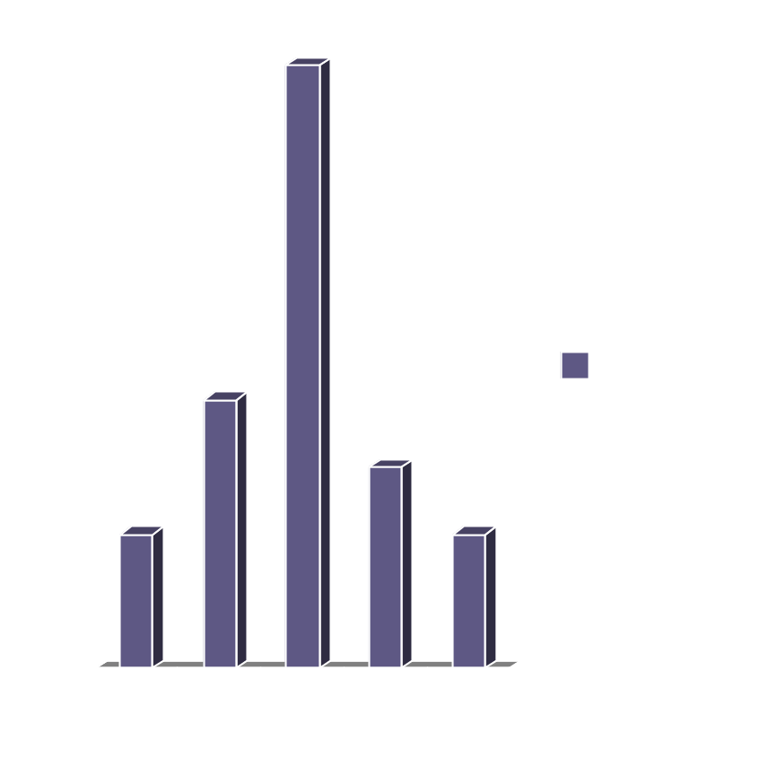
Building a p.m.f.
Random Variable = # of redheads in a class (of 30.)
Go to 200 classes, count how many redheads, and graph the result.
20 classes have no redheads, 40 have 1, etc.

Slide 17
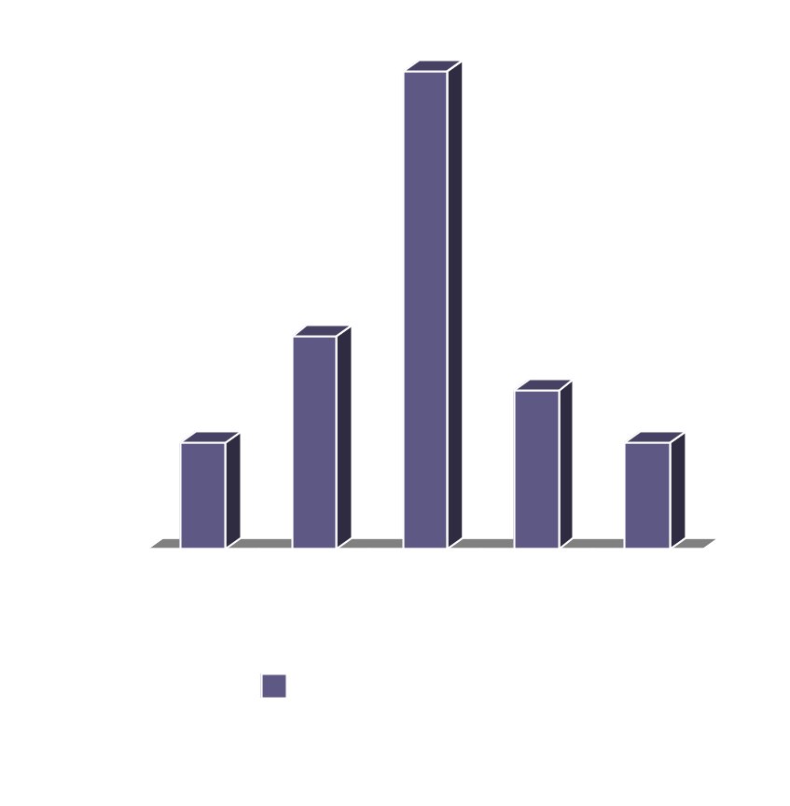
What is the probability of walking into a class with
no redheads (P(X=0))? What is the P(X=1)?
To find the probability divide the number of classes with zero redheads by the total number of classes.
Do this for each value of X and you have a probability distribution.
This looks somewhat like a normal curve (although it isn’t exactly)

Slide 18
An Exponential Distribution would look something like:
Left most is P(X=0), for some X. etc.
An identically distributed draw just means each event has the same probability distribution.

Slide 19
Back to our original statement:
Saying that a process is Markovian says the times are independent of each other and identically distributed draws from an exponential probability distribution
  Contrast this intuitively with a draw
    1) that is identically distributed
    2) from a normal probability distribution.

Slide 20
Choosing the Appropriate Distribution is Important
Exponential distributions are typically used to model interarrival times that are truly random and to model service times that are highly variable.
  Also, used to model the lifetimes of components that fail instantedly, like light bulbs.

Slide 21
Examples of variables with different probability distributions—don’t worry yet what these look like although some are pictures are in Appendix D
# of people absent from class each day.
  (Binomial Distribution -- discrete.)
Amount of corn harvested per acre.
  (Normal Distribution – continuous-pg 630)
Probability your professor is bald.
  (Uniform Distribution, believe it or not. -- discrete. Chosen from a list of profs –pg 633)
# of cars that pass by a store in a given period.
  (Poisson Distribution – discrete-pg 631)

Slide 22
INTUITIVE PROBABILITY
Saying that the expected value of X, E(X), is λ means
  You sample X many times (technically, infinitely many times)
  Observe the values obtained each time
  Compute the average of all the values of X you observe.
  That average should be λ .
It is NOT the value you expect to get when you draw a sample of type X.
As an approximation, you can compute E(service) and E(interarrival) as just the averages we computed earlier.

Slide 23
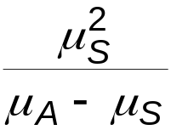
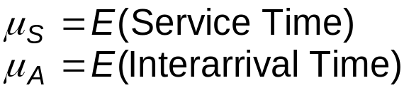
Analysis Options (cont’d.)
    If the assumptions are met for the M/M/1 model (see slide 13) you can obtain exact analytic results; e.g., average waiting time in queue is
  Problems: validity, estimating means, time frame, assumptions not met (or worst, not checked!)
  Viewed by some as useful as first-cut approximation

Slide 24
Mechanistic Simulation
Individual operations (arrivals, service times) will occur exactly as in reality
Movements, changes occur at the right “time,” in the right order
Different pieces interact
Install “observers” to get output performance measures
Concrete, “brute-force” analysis approach
Nothing mysterious or subtle
  But a lot of details, bookkeeping
  Simulation software keeps track for you

Slide 25
Pieces of a Simulation: 1.Entities
“Players” that move around, change status, affect and are affected by other entities
Dynamic objects—get created, move around, leave (maybe- can just circulate)
Usually represent “real” things, but not always.
Can have “fake” entities for modeling “tricks"
  Breakdown demon (arrives and takes the press out of service for a length of time and then restores it)
  break angel (arrives and takes the press off duty permanently)
Our model: entities are the parts being processed
We have only one entity, but many instances or realizations of it.
Usually have multiple realizations floating around
Can have different types of entities concurrently, also

Slide 26
Pieces of a Simulation (cont’d). 2. Attributes
Characteristics of all entities: describe, differentiate
All entities have same attribute “slots” but different values for different entities, for example:
  Time of arrival
  Due date
  Priority
  Color
An attribute value is tied to a specific entity
Like “local” (to entities) variables
Some automatic in Arena, some you define, assign values to, change, and use attributes of your own.

Slide 27
Pieces of a Simulation (cont’d.) 3. Variables
Global
Reflects a characteristic of the system, regardless of entities - can be a constant or can change during run
Needs a name and value, of which there’s only one copy for the whole model
Not tied to entities
Entities can access, change variables. Examples:
    Number of parts in system
    Simulation clock
    Current length of queue
    Status of the drill press
Some built-in by Arena; you can define others

Slide 28
Pieces of a Simulation (cont’d.) 4. Resources
What entities compete for
  People
  Equipment
  Space
An entity seizes a resource, uses it, releases it
Think of a resource being assigned to an entity, rather than an entity “belonging to” a resource
A resource can have several units of capacity
  Seats at a table in a restaurant
  Identical ticketing agents at an airline counter
Number of units of resource can be changed during the simulation

Slide 29
Pieces of a Simulation (cont’d.) 5. Queues
Place for entities to wait when they can’t move on (maybe since the resource they want to seize is not available)
Have names, often tied to a corresponding resource
Can have a finite capacity to model limited space—have to model what to do if an entity shows up to a queue that’s already full
Usually watch the length of a queue, waiting time in it

Slide 30
Pieces of a Simulation (cont’d.) 6. Statistical Accumulators
Variables that “watch” what’s happening
Depend on output performance measures desired
“Passive” in model—don’t participate, just watch
Many are automatic in Arena, but some you may have to set up and maintain during the simulation
At end of simulation, used to compute final output performance measures

Slide 31
Pieces of a Simulation (cont’d.)
Statistical Accumulators for the Example
  Number of parts produced so far
  Total of the times spent in queue so far
  No. of parts that have gone through the queue
  Max time in queue we’ve seen
  Total of flowtimes
  Max flowtime we’ve seen
  Area so far under queue-length curve Q(t)
  Max of Q(t) so far
  Area so far under server-busy curve B(t)

Slide 32
SUMMARY OF PIECES OF SIMULATION
Entities
Attributes- typically input or calculated during run
Variables
Resources
Queues
Statistical Accumulators- typically desired output
Note: Coding in a high level language would require you to handle all of the above with specific code.

Slide 33
QUIDING PRINCIPLE:
All of these 6 components must be specified before attempting a simulation.

Slide 34
Simulation Dynamics: The Event-Scheduling World View
Identify characteristic events—change state
  initialization
  arrivals
  departures
  the end
Decide on logic to: effect state changes for each event type, observe statistics
Keep a simulation clock, future event calendar
Jump from one event to the next, process, observe statistics, update event calendar
Stopping rule

Slide 35
Events and Logic for Our Example
2. Arrival of new part to the system
  Update time-persistent statistical accumulators (from last event to now)
    Area under Q(t)
    Max of Q(t)
    Area under B(t)
  “Mark” arriving part with current time (use later)
  If machine is idle:
    Start processing (schedule departure); Make machine busy; Tally time in queue (0)
  Else (machine is busy):
    Put part at end of queue; Increase queue-length variable
  Schedule the next arrival event

Slide 36
Events and Logic for Our Example
3. Departure (when a service is completed)
  Increment number-produced statistical accumulator
  Compute & tally flowtime (now - time of arrival)
  Update time-persistent statistics
  If queue is non-empty:
    Take first part out of queue, compute & tally its time in queue, begin service (schedule departure event)
  Else (queue is empty):
    Make the machine idle (Note: there will be no departure event scheduled on the future events calendar)

Slide 37
Events and Logic for Our Example
4. The End
  Update time-persistent statistics (to end of the simulation)
  Compute final output performance measures using current values of statistical accumulators
After each event, the event calendar’s top record is removed to see what time it is, what to do
Also must initialize everything 1. initialization (Note: The first event logic discussed was labeled 2. on slide 35)

Slide 38
Further Details for Our Example
Simulation clock (internal in Arena)
Event calendar: List of event records:
  [Entity No., Event Time, Event Type]
  Keep ranked in increasing order on Event Time
  Next event always in top record
  Initially, schedule first Arrival, The End
State variables: describe current status
  Server status B(t) = 1 for busy, 0 for idle
  Number of customers in queue Q(t)
  Times of arrival of each customer now in queue (a list of random length)

Slide 39
Simulation by Hand
Manually track state variables, statistical accumulators
Use “given” interarrival, service times
Keep track of event calendar
“Lurch” clock from one event to the next
Will omit flowtimes, “max” computations here (see text for complete, gory details)

Slide 40
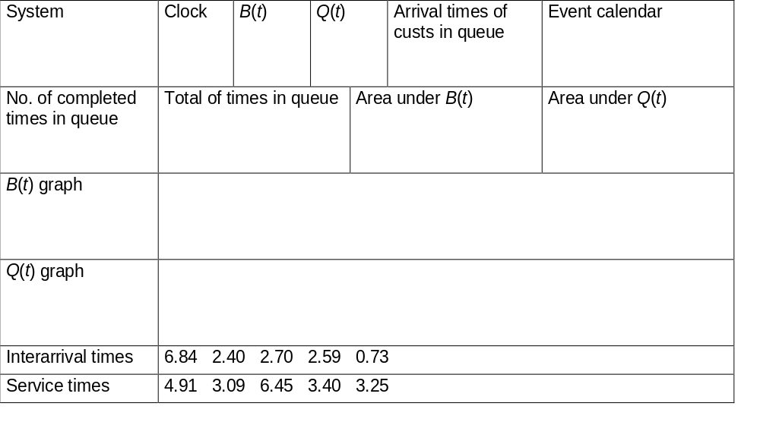
Simulation by Hand:
Setup
1
0
t
3
2
1
0
t

Slide 41
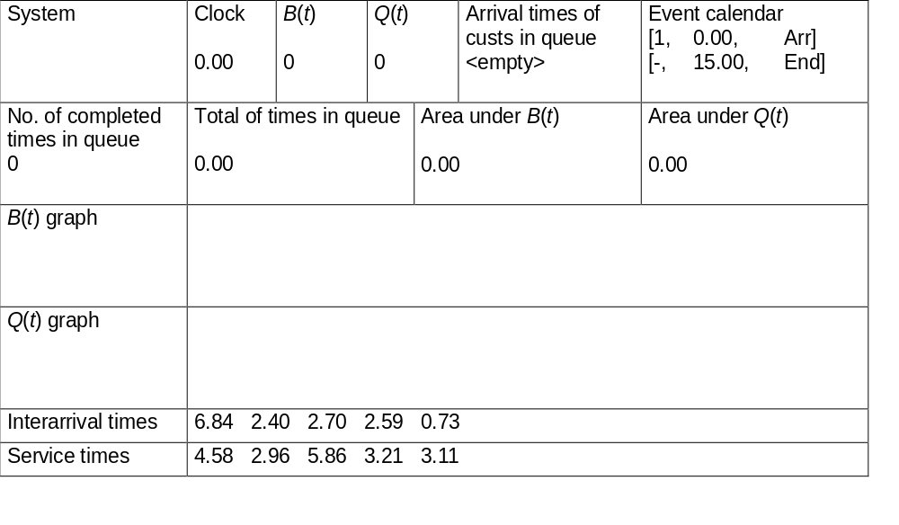
Simulation by Hand:
Initialize at t = 0.00
1
0
t
3
2
1
0
t

Slide 42
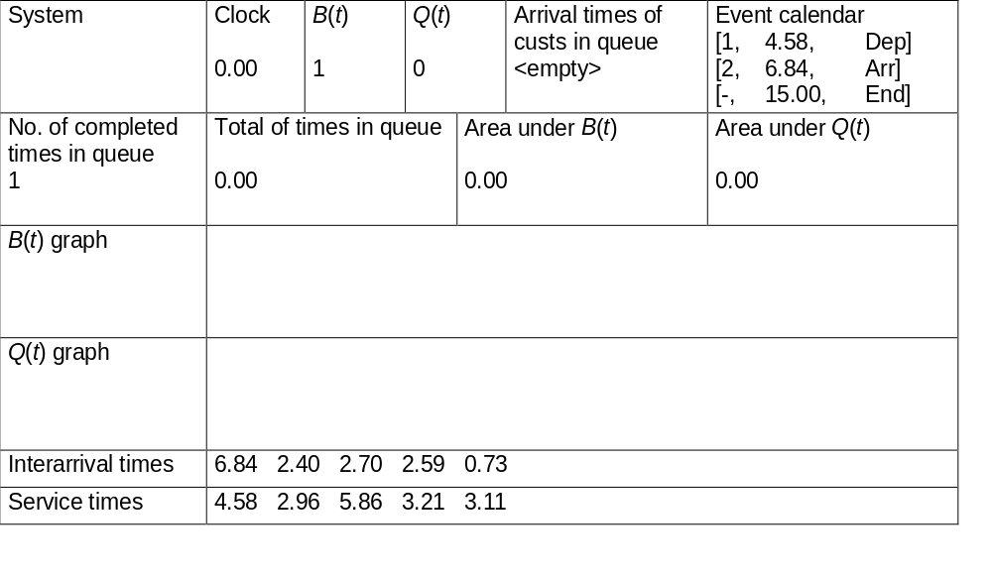
Simulation by Hand:
Arrival of Part 1 at t = 0.00
1
1
0
t
3
2
1
0
t

Slide 43

Simulation by Hand:
Departure of Part 1 at t = 4.58
1
0
t
3
2
1
0
t

Slide 44

Simulation by Hand:
Arrival of Part 2 at t = 6.84
2
1
0
t
3
2
1
0
t

Slide 45

Simulation by Hand:
Arrival of Part 3 at t = 9.24
3
2
1
0
t
3
2
1
0
t

Slide 46
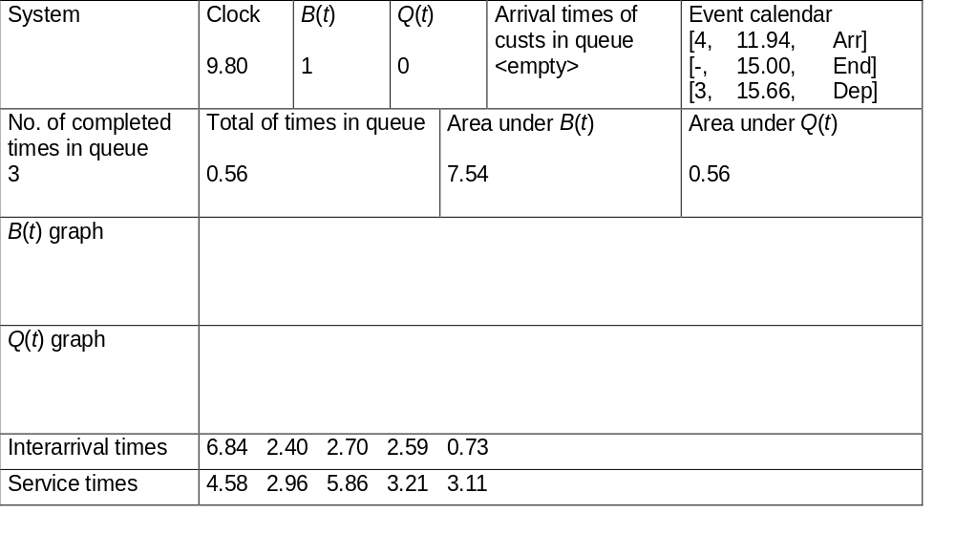
Simulation by Hand:
Departure of Part 2 at t = 9.80
3
1
0
t
3
2
1
0
t

Slide 47

Simulation by Hand:
Arrival of Part 4 at t = 11.94
4
3
1
0
t
3
2
1
0
t

Slide 48
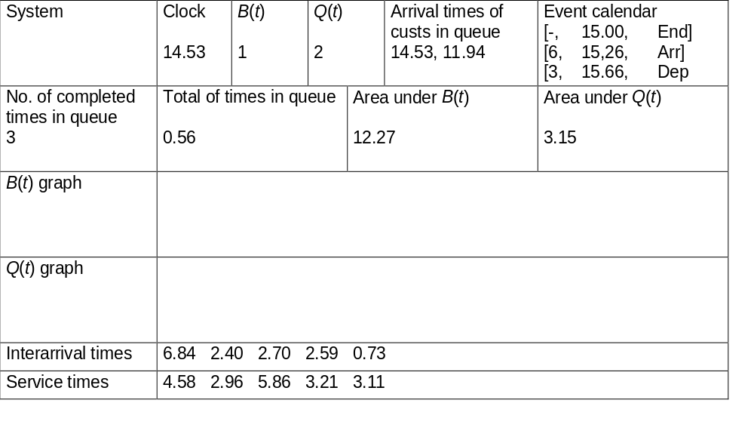
Simulation by Hand:
Arrival of Part 5 at t = 14.53
5
4
3
1
0
t
3
2
1
0
t

Slide 49

Simulation by Hand:
The End at t = 15.00
5
4
3
1
0
t
3
2
1
0
t

Slide 50
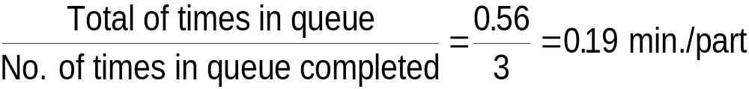
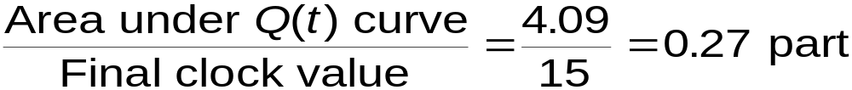
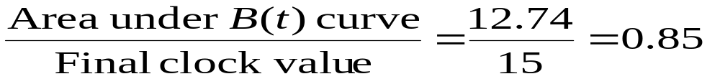
Simulation by Hand:
Finishing Up
Average time in queue:
Time-average number in queue:
Server utilization

Slide 51
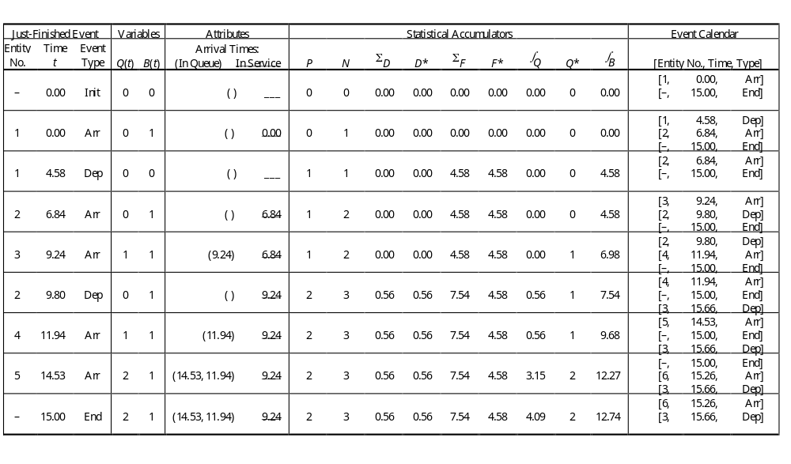
Complete Record of the Hand Simulation
(The book example chart is on pg 31)

Slide 52
The Gory Details for the Book Example
See pages 32-36.
I did this graphically for our example.
Ours used only 5 events and the book example is larger.
As tedious as the example is, fighting your way through it blow by blow will help you understand the process much better.

Slide 53
Event-Oriented Simulation
The example we just did uses this technique
  a master controller keeps track of all events, entities, attributes, variables, and statistical accumulators.
Modeling and computation centers around events, when they occur, and what happens when they occur.
For simple models, this view works well.
But, as models become more complex with lots of events, entities, and resources, this approach can be tedious to follow.

Slide 54
Process-Oriented Simulation
Here we think about what happens to a typical entity as it works its way through the model.
This approach centers on the processes that entities undergo.
The approach is somewhat like flowcharting the logic of a program in a procedure-oriented language.
In this approach, the previous example would be viewed as follows:

Slide 55
Process-oriented View of Example
Create yourself.
Record the current time.
Enter the queue.
Wait in the queue until the drill press is empty – note: the time could be zero.
Seize the drill press and exit the queue.
Compute your time in the queue.
Stay on the drill press for a time equal to your service time.
Release the drill press at the end of your service time.
Increment the production counter accumulator and tally your total time in the system.
Dispose of yourself and go away.

Slide 56
What You Don’t See in Process-Oriented Simulation
This approach requires more behind the scenes help for such things as
  Time advances
  Keeping track of time-persistent statistics
  Obtaining data for output report generation
  etc.

Slide 57
Two approaches in Arena
With Arena,
  You model and design the logic in a process-oriented mode
  But, Arena executes in an event-oriented mode.

Slide 58
Now, before we go any further, let’s look at some runs and build techniques using Arena
Load Model 3-1

