Slide 1

Chapter 4
Modeling Basic Operations and Inputs
Model 4-1

Slide 2
What We’ll Study in Arena
Model 4-1: Electronic assembly/test system
  Modeling approaches
  New Arena modules (Decide, Record)
Model 4-2: Enhanced electronic assembly/test
  Resource Schedules, States, and Failures
  Frequency outputs
  More on utilizations
Model 4-3: Enhancing the animation
  Queues, Entity Pictures, Resource Pictures
  Adding Plots and Variables

Slide 3
What We’ll Study- Some Modeling Concepts
Input analysis
  Specifying input distributions, parameters
  Deterministic vs. random input
  Collecting and using data
  Fitting input distributions via the Input Analyzer
  No data? What to do.
  Nonstationary arrival processes
  Multivariate and correlated input data

Slide 4
RECALL THE TEXTBOOK'S OVERVIEW OF A SIMULATION STUDY (Sect 2.7)
Understand the system.
  Often involves site visits and talking with people.
Be clear about your goals.
  Be realistic. Return to these often during the study.
Formulate the model representation.
  What level of detail is needed?
  Are important characteristics captured.
  Get buy-in for your assumptions.

Slide 5
Translate into modeling software.
  No modeling software is ever an exact fit.
  Be sure you show where a fit is not good.
Verify that your computer representation represents the conceptual model faithfully.
  Probe extreme regions in your input.
  Be sure correct results occur with obvious input.
  Walk through the logic with those familiar with the system.
Validate the model.
  Do input and output distributions match what you observed?
  What statistical tests can be performed?

Slide 6
Design the experiments.
  Plan what it is you want to know from the simulation.
Run the experiments.
Analyze your results.
  Be able to make precise, clear, and accurate statements about what is seen.
Get insight.
  This is easier said than done.
  What further questions are suggested by the results?
  Are you looking at the right things?
Document what you've done.
  Be sure everyone who looks at your results in the future knows your assumptions and how you interpreted results.

Slide 7
Understand the System
We usually don't do modeling for ourselves--- we do it to answer questions for other people.
Thus, systems are usually described to you by someone else.
Understanding a system in the nonacademic setting usually
  involves site visits
  talking with people.
  collecting data or obtaining data from an outside source

Slide 8
Understand the System
Of course, in a classroom setting, the problem statements for a system are usually described to you.
So, we will describe a specific setting (that is still not too complicated) and go through some of the modeling steps.
The goals are to
  Show you some more modeling concepts
  Introduce some more features that you can use in Arena.

Slide 9
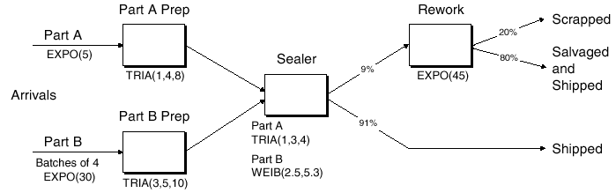
Electronic Assembly/Test System (Model 4-1)
Produce two different sealed electronic units (A, B)
Arriving parts: cast metal cases machined to accept the electronic parts
Part A, Part B – separate prep areas
Both go to Sealer for assembly, testing – then to Shipping (out) if OK, or else to Rework
Rework – Salvage (and Shipped), or Scrap

Slide 10
Data Collected on Part A Suggests:
Interarrivals: exponentially distributed with a mean of 5 minutes
  See page 626, β = 5 – i.e. the mean
  Maybe this was determined
    by observation of the process or,
    because interarrival times are often modeled with an exponential distribution, this was just assumed.

Slide 11
Data Collected on Part A Suggests:
From arrival point outside of the model, Part A proceeds immediately to Part A Prep area
  Process = (machine + deburred + clean) uses the distribution ~ tria (1,4,8) minutes (pg 632, where the numbers are (min, mode, max).
  A triangular distribution is often used when the exact form of the distribution is unknown, but estimates for the min, max, and most likely values are available.

Slide 12
Data Collected on Part A Suggests:
After the Prep process for Part A is completed, the part goes immediately to Sealer
  Process = (assemble + test) with an assumed distribution of ~ tria (1,3,4) min.
  91% pass and go to Shipped;
  Else the part goes to Rework
Rework= (re-process + testing) assumed to be distributed as ~ expo (45)
  80% pass, go to Salvage/Ship; Else go to Scrap

Slide 13
Data Collected on Part B Suggests:
Interarrivals: arrive in batches of 4 from an outside area, expo (30) min.
Upon arrival, batch separates into 4 individual parts
From arrival point, proceed immediately to Part B Prep area
  Process = (machine + deburr +clean) ~ tria (3,5,10)
Rework: (re-process + test) = expo (45) min.
  80% pass, go to Salvage/Ship; Else go to Scrap

Slide 14
Data Collected on Part B Suggests:
Go to Sealer
  Process = (assemble + test) ~ weib (2.5, 5.3) min.
  The distribution weib(β, α) is on pg 634. The Weibull distribution is used for many things, but here it is being used because the distribution is sort of bell shaped for this value of α, but is skewed to the left.
  Note the processing time is different from Part A, though both are processed at the same station
  91% pass, go to Shipped; Else go to Rework

Slide 15
What Are the Client Desires for:
Run Conditions, Output?
Start empty & idle, run for four 8-hour shifts (1,920 minutes)
Collect statistics for each work area on
  Resource utilization
  Number in queue
  Time in queue
For each exit point (Shipped, Salvage/Shipped, Scrap), collect total time in system (a.k.a. cycle time)

Slide 16
Developing a Modeling Approach
Define pieces of model, modules, data structures, control logic
Choose appropriate level of detail – judgment call
Often multiple ways to model and to represent logic

Slide 17
This model requires:
Entities are the individual parts
  two types, A and B
Separate Create modules for two part types
Separate Process modules for each Prep area
Process modules for Sealer and Rework, each followed by a Decide module (2-way choice that provides a Pass or Fail that meets the conditions)
Depart modules for Shipping, Salvage/Shipped, Scrap
Attribute Sealer Time assigned after Creates in Assign modules (parts have different times at the Sealer)
Record modules just before Departs for time in system

Slide 18
Building This Model
New model window in Arena
Attach Basic Process panel (if needed)
Place modules
  Create (x 2)
  Assign (x 2)
  Process (x 4)
  Decide (x 2)
  Record (x 3)
  Dispose (x 3)(Scrap, salvage & ship, ship)
A right click will repeat last action (i.e. place module)
Auto-Connect, or manually connect via
Alternate strategy – place one module at a time, fill it out completely

Slide 19
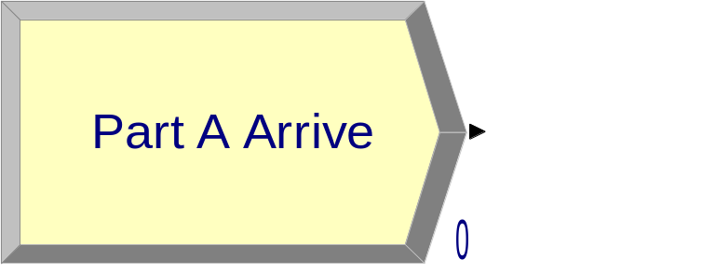
Part A Create Module
Name: Part A Arrive
Entity Type: Part A
Time Between Arrivals
  Type: Random(Expo)
    Pull-down list with options
  Value: 5
  Units: Minutes
    Pull-down list with options
Default what’s not mentioned above
Once these entries are made, they are placed on the list for names of that type (Module Name, Entity Type, etc.) and will appear on future pull-down lists for that type of name.

Slide 20
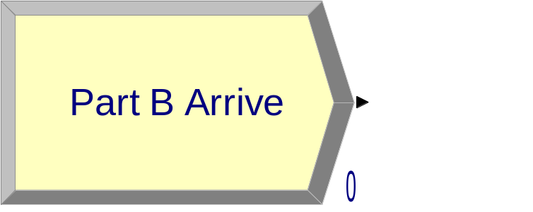
Part B Create Module
Name: Part B Arrive
Entity Type: Part B
Time Between Arrivals
  Type: Random (Expo)
    Pull-down list with options
  Value: 30
  Units: Minutes
    Pull-down list with options
Entities per Arrival: 4

Slide 21
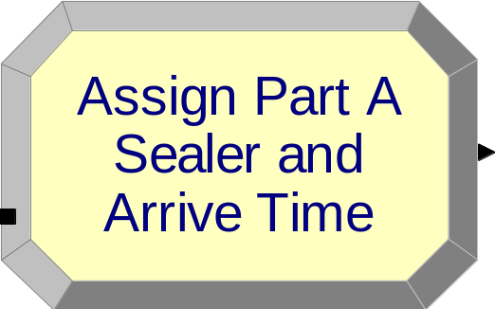
Part A Attributes Assign Module
We've created the arriving parts.
Now we must define Sealer Time differently for each part.
Recall we have two Assign modules available.
Name: Assign Part A Sealer and Arrive Time
Add button:
  Type: Attribute
  Attribute Name: Sealer Time
  New Value: TRIA(1, 3, 4)

Slide 22
Part A Attributes Assign Module (Cont'd)
Add button:
  Type: Attribute
  Attribute Name: Arrive Time
  New Value: TNOW (to compute time in system on exit)
TNOW is the internal Arena variable name for the simulation clock.
Other Arena variable names: See Help → Arena Help Topics → Contents → Using Variables, Functions, and Distributions → Variables

Slide 23
Part B Attributes Assign Module
Name: Assign Part B Sealer and Arrive Time
Add button:
  Type: Attribute
  Attribute Name: Sealer Time
  New Value: WEIB(2.5, 5.3)
Add button:
  Type: Attribute
  Attribute Name: Arrive Time
  New Value: TNOW

Slide 24
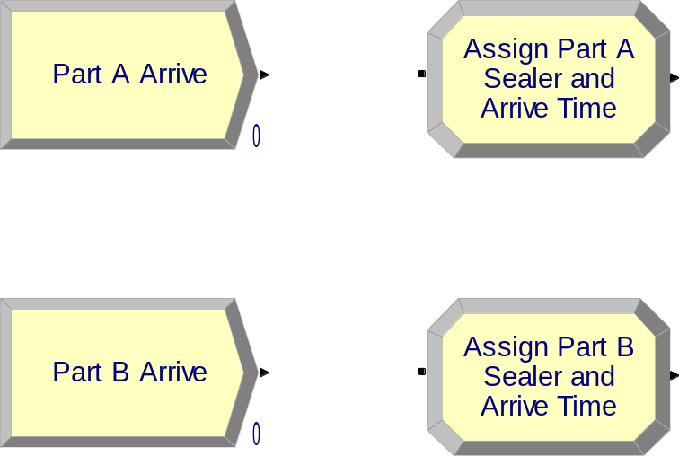
Our Model So Far

Slide 25
Note: Names of Things and Attributes in Arena
Names for things in Arena
  Default names usually suggested
  Names placed on appropriate pull-down lists for future reference
  All names in a model must be unique (even across different kinds of objects)
  Attributes, however, can be the same as long as they are different for the same thing.
  This is not unlike what you have seen in object-oriented programming: Object names are unique, but different objects can have the same attributes.

Slide 26
Process Module Actions
Delay
  Entity just sits here for the specified time; no Resource involved, so multiple entities could be undergoing this Delay simultaneously
Seize Delay
  Entity must first Seize the specified number of units of a Resource (possibility for Queueing if they’re not available), then undergoes the Delay … assume that the entity will Release the Resource units at an other downstream module
Seize Delay Release
  Like Seize Delay, but entity releases Resource units after Delay (what we want in this model)
Delay Release
  Assumes entity had already Seized Resource units at another upstream module, now Delays and Releases Resource units

Slide 27
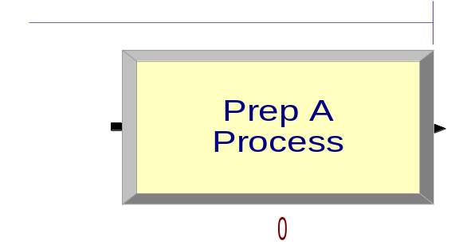
Prep A Process Module
Name: Prep A Process
Action: Seize Delay Release
Resources subdialog (Add button):
  Type: Resource (a pull-down option)
  Resource Name: Prep A
  Quantity: 1 (default)
Delay Type: Triangular
Units: Minutes
Minimum: 1
Value (Most Likely): 4
Maximum: 8
If several Resources were named (Add button), entity would have to Seize them all before the Delay could start.

Slide 28
Prep B Process Module
Name: Prep B Process
Action: Seize Delay Release
Resources subdialog (Add button):
  Type: Resource (a pull-down option)
  Resource Name: Prep B
  Quantity: 1 (default)
Delay Type: Triangular
Units: Minutes
Minimum: 3
Value (Most Likely): 5
Maximum: 10

Slide 29
Sealer Process Module
Name: Sealer Process
Action: Seize Delay Release
Resources subdialog (Add button):
  Type: Resource (a pull-down option)
  Resource Name: Sealer
  Quantity: 1 (default)
Delay Type: Expression
Units: Minutes
Expression: Sealer Time
Recall – Sealer Time attribute was defined upstream for both Parts A and B … now its value is being used … allows for different distributions for A and B.

Slide 30
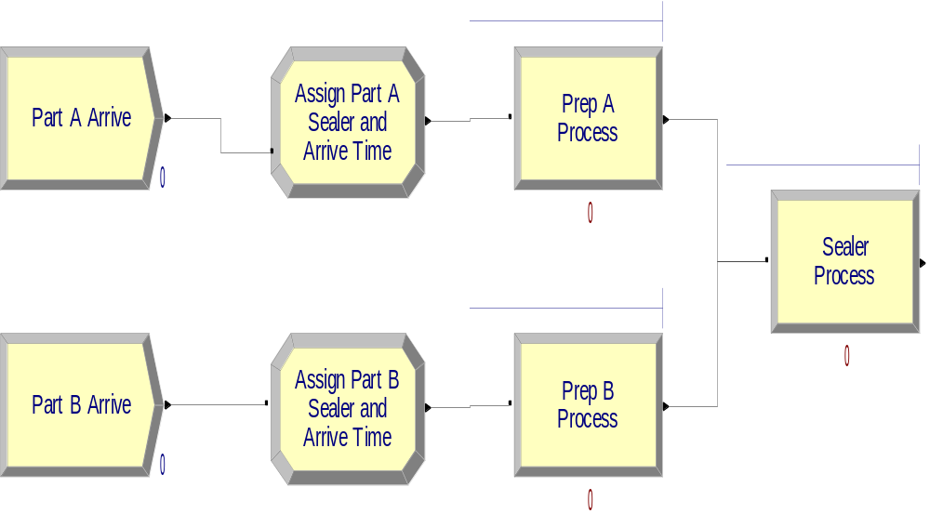
Our Model So Far

Slide 31
Sealer Inspection-Result Decide Module
The Decide module provides for branch points based on conditions (entity Attributes, global Variables) or by chance (multi-sided coin flip)
Name: Failed Sealer Inspection
Type: 2-way by Chance (default)
Percent True: 9
Different exit points for True, False results – connect appropriately downstream
– Note it’s percent true, not probability of true … so “9” means probability of 0.09.
– We arbitrarily decided “true” meant part failed inspection … could have reversed.
– This is a rich, deep, versatile module … explore its Help button

Slide 32
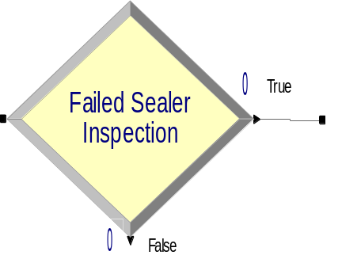
Our Model So Far

Slide 33
Rework Process Module
Name: Rework Process
Action: Seize Delay Release
Resources subdialog (Add button):
  Type: Resource (a pull-down option)
  Resource Name: Rework
  Quantity: 1 (default)
Delay Type: Expression
Units: Minutes
Expression: EXPO(45)
We had to use the general Expression choice for Delay Type since what we want (EXPO) is not directly on the Delay Type pull-down list.

Slide 34
Rework Inspection-Result Decide Module
Name: Failed Rework Inspection
Type: 2-way by Chance (default)
Percent True: 20
We arbitrarily decided “true” meant part failed inspection.

Slide 35
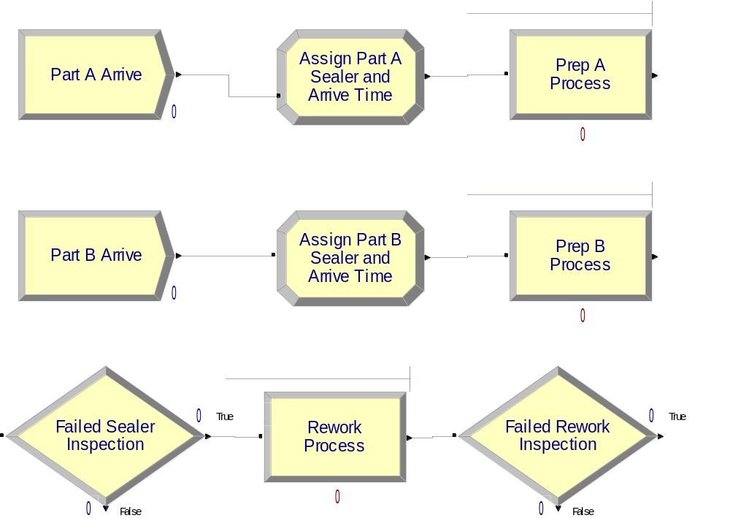
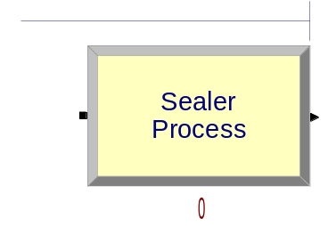
Our Model So Far

Slide 36
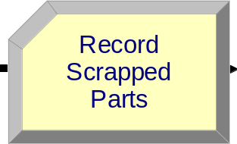
Record Modules
Arena collects many output statistics by default, but sometimes not everything you want
Here, we want time in system (average, max) of parts separated by their exit point (Shipped, Reworked/Shipped, Scrapped)
Record modules can be placed in the flowchart to collect and report various kinds of statistics from within the model as the run passes entities through it.
Used for Tally-type output performance measures (see Chapter 3)

Slide 37
Shipped Parts Record Module
Name: Record Shipped Parts
Type: Time Interval
  This option records the length of time that elapsed up to now (TNOW) from when an entity attribute was marked with a time “stamp” upstream
  There are several other options for Type … explore via Record module’s Help button!
Attribute Name: Arrive Time
  Recall – this attribute was defined as the clock value in the Assign modules instantly after each entity was Created
Tally Name: Record Shipped Parts
  Determines the label in the reports
The other two Record modules –
just like this except for Name and Tally Name.

Slide 38
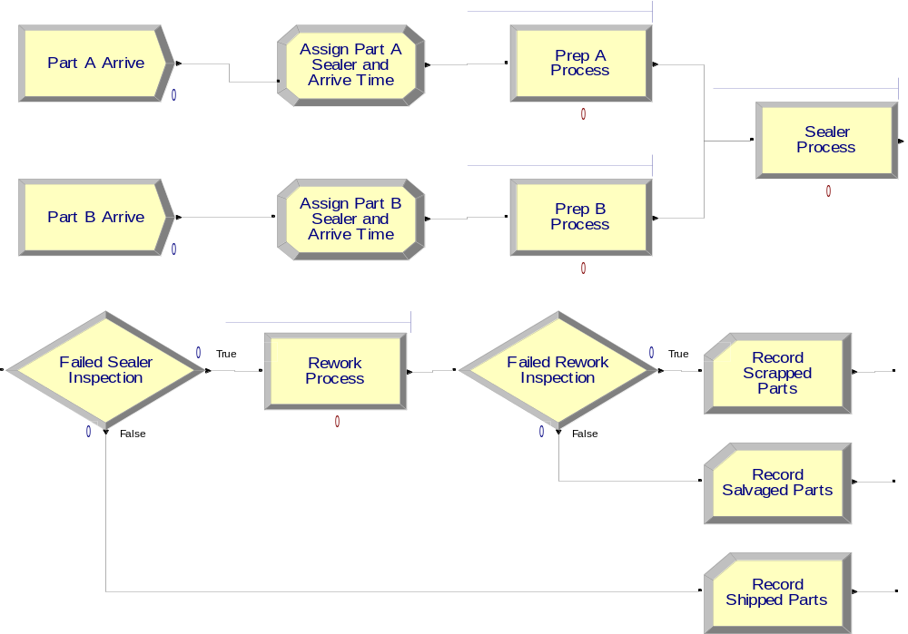
Our Model So Far

Slide 39
Dispose Modules
Use three separate exit points for three separate part disposition (Shipped, Reworked/Shipped, Scrap)
Could have directed all three to a single Dispose module, but having separate ones allows for animation counts of the three dispositions
Also, having separate Dispose modules allows for differentially checking the boxes to Record Entity Statistics
  Produces flow statistics separated by entity type (if Entities Statistics Collection is checked in Run/Setup/Project Parameters), not by final disposition of part … so we did need our Record modules and Arrive Time attribute.

Slide 40
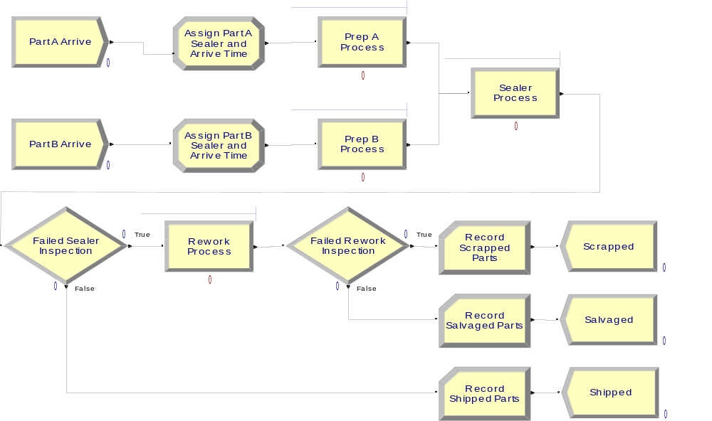
Our Final Model (Except for Setup and Picture Choices)

Slide 41
Run/Setup for Run Control
Without this, the model would run forever – there are no defaults for termination rule since that’s part of your modeling assumptions
Project Parameters tab:
  Fill in Project Title, Analyst Name
  Defaults for Statistics Collection, except we cleared the check box of Entities – not needed for what we want, and would slow execution
Replication Parameters tab:
  Replication length: 32, accept Hours default for Time Units (i.e. 4 eight hour shifts)
  Base Time Units: Minutes for internal arithmetic, units on output reports

Slide 42
Different Part A, B Entity Pictures
Entity data module
  (just single-click on it in Project Bar, edit via spreadsheet only)
Row for each Entity Type (Part A, Part B)
Pull down Initial Picture pull-down menu, select different pictures for each Entity Type
  Edit/Entity Pictures to see, change the list of pictures that’s presented here … more later on this

Slide 43
Running the Model
Check (if desired)
  Find button to help find errors
Go (will automatically pre-Check if needed)
  Some graphics don’t show during run … will return when you End your run … control via View/Layers
  Status Bar shows run progress – replication number, simulation time, simulation status
Animation speed – increase (>), decrease (<)
Pause ( ) or Esc key; to resume
Run/Step ( ) to debug
Run/Fast-Forward ( ) to turn off animation
  Run/Run Control/Batch Run (No Animation) is even faster

Slide 44
Viewing the Results
Counters during animation for modules
  Create, Dispose, Decide – incremented when entity leaves
  Process – number of entities currently in the module
Asked at end if you want to see reports
  What you get depends on Run/Setup/Project Parameters
  Navigate through report with browsing arrows, tree at left
  Tally, Time-Persistent, and Counter statistics
  Avg, Min, Max, and 95% Confidence Interval half-widths
    Confidence intervals are for steady-state expectations … more later
    May not be produced if run is not long enough for reliable stats
Generally difficult/unreliable to draw conclusions from just one run … more later

