Slide 1

Chapter 5
Modeling Detailed Operations – Part 1

Slide 2
What We’ll Do ...
Explore lower-level modeling constructs
Model 5-1: Automotive maintenance/repair shop
  Multi-way decisions, Sets, Variables, Expressions, Submodels, Duplicating entities, Holding entities
  Terminating vs. steady-state simulations
Debugging

Slide 3
What We’ll Do ...
Model 5-2: Enhanced automotive shop model
  Sets and Resource logic, non-stationary arrival process
Model 5-3: A totally different kind of simulation, an inventory simulation
  Built exclusively via SIMAN Blocks, Elements
  This uses the lowest and most detailed modeling levels in Arena

Slide 4
Model 5-1: An Automotive Maintenance and Repair Shop – The Problem
New three-bay suburban satellite facility
Appointments are taken up to three days in advance
No appointments are taken for the current day of the call in
Past data suggests:
The number of calls per day ~ (stationary) Poisson with mean 29 calls/day
  55% of calls schedule an appointment for the next day
  30% for two days out
  15% for three days out

Slide 5
An Automotive Repair and
Maintenance Shop (cont’d.)
If no appointment is available on the desired day, there’s a 90% chance that the caller will want to schedule for the following day
  Other 10% just go away
80% leave vehicle for service, come back later
  Other 20% wait at the shop

Slide 6
An Automotive Repair and
Maintenance Shop (cont’d.)
Wait customers are given an approximate wait time
  Estimated service time (Book Time) + Allowance (1 hour)
Limit of five wait customers per day
Again, past data provides the following:
Book Time ~ 44 + 90*BETA(2, 3) minutes
Actual service time ~ GAMM(Book Time/1.05, 1.05) minutes
Maximum of 24 hours (Book Time) scheduled per day (three bays, eight hours each)

Slide 7
Costs, Revenues
Capital and labor cost = $45/hour/bay
  40-hour work week
Revenue from customer = $78/hour (charged for Book Time, not actual time)
Overtime costs $120/hour
  Maximum of three hours/day/bay

Slide 8
Costs, Revenues
If service can’t be completed that day, the vehicle is held over night and the customer is given a free loaner car
  Loaner car costs the shop $35/day
If service isn’t started that day, the customer takes the car home and returns next day – with no cost to the shop

Slide 9
The Manager of the Dealership is Interested in System Performance
Daily profit
Daily Book Time
Daily actual service time
Daily overtime
Daily number of wait appointments not completed on time
because the reasons for building the new facility were:
Better customer satisfaction.
A profit at the new facility.

Slide 10
Modeling Issues – some new, some just enhancements of things we’ve seen
Service System – not manufacturing
  But can use same modeling capabilities
  Typical service systems are fast-food places, banks, insurance companies, telephone service centers etc.
Multiple-way decisions
  Appointment entities go to one of five waiting queues based on the day of the appointment
  This capability is available in Decide module

Slide 11
Modeling Issues
Sets
  Groups of similar objects
  Reference by a common set name and index into the set (subscript)
    Can also be referenced via their original name
    Arena sets are always ordered
  Service bays will be modeled as a set of resources
    We’ll also use sets for entity pictures and appointment queues
  Define via Sets data module

Slide 12
Modeling Issues (cont’d.)
Variables
  The Variable module allows you to define your own global variables and their initial values
  Can be referenced in model by name
  Can be even one- or two-dimensional arrays, indexed by one or two integers
  User-defined Variables
    Store some numerical value (not a formula)
    Can be initialized in Variable data module
    Can be used, reassigned during the simulation run by any entity
    For example: We could use DAY to keep track of the current day of the week.

Slide 13
Modeling Issues (cont’d.)
Expressions – we have seen limited use of these
  User-defined Expressions
    A name defined by a mathematical expression
    This name can be referenced anywhere in the model
    Can use constants, Variables, Attributes, system state variables, values from distribution – connected via mathematical operations
      Can use Expression Builder to help define
    Defined using Expression data module (Advanced Process panel)

Slide 14
Modeling Issues (cont’d.)
Submodels
  Partition simulation model into several smaller submodels
    Can link them together, more manageable pieces
  Just like a normal model view within a submodel
  Submodels can also contain further submodels, etc. – hierarchical structure
  Submodels can be externally connected to other modules or submodels
  Navigate panel in Project Bar shows submodels, under Top-Level Model

Slide 15
Modeling Issues (cont’d.)
Duplicating entities
  “Cloning” an entity
  Entities often used for control
  Do this via Separate module
Holding entities
  Want to hold entities in a queue until
    A signal is sent by another entity
    A system condition exists
  Hold and Signal modules (Advanced Process panel)
  Here, used to hold customers until the day of scheduled service

Slide 16
Animation Requirements
No entity movement
Can still display queues
Appointments
  Number
  Type
  Book Time hours per day
Bay resources

Slide 17
System or Simulation Type
Basically, two types:
Terminating
  Known starting and stopping conditions – part of model
  Time frame is well-defined in advance (and finite)
  Ex: Store which opens at 8am and closes at 9pm
  Ex: Assembly line that needs to run until an order is filled
Steady-State
  Initial conditions are not always well defined
  No defined stopping condition (theoretically infinite)
  Interested in system response over the long run
  Ex: An emergency room
It’s not always obvious which you need to choose for the model.

Slide 18
Terminating vs Steady State
Of course, when modeling, we still must stop the run somewhere, even if it is modeled as a steady state situation
Sometimes we do a steady state simulation when we really have a terminating situation in order to look for
  Worst case situation
  Peak load situation
Thus, some systems have elements of both types!
  Ex: Fast food place- open at 7am and closes 11pm
    If interested in daily operational issues- analyze as terminating
    If interested in operation during rush that occurs for two hours over lunch, analyze as steady-state system.

Slide 19
Which to Use for Automotive Repair Model?
Starting and ending times known each day
  Some vehicles can be held over from one day to the next
  But we’ll simulate for 20 days (approximately a working month)
We’ll treat the system as terminating even though jobs that are carried over to the next day could affect the starting conditions on that day.

Slide 20
Arena Modeling Panels
Basic Process panel
  Highest level of modeling
Advanced Process panel
  More detailed (and different) modeling capabilities
Advanced Transfer panel
  Material-handling, entity-movement capabilities
Blocks, Elements panels
  Lowest level of modeling capabilities – the underlying SIMAN simulation language itself
Other panels are created using modules from these panels
  Occasionally needed, but not very often

Slide 21
Building the Model - steps
Defining the Data
Submodel Creation
Divide model in sections or submodels
  Generate Appointment Calls
  Make Appointment
  Service Activity
  Update Performance Variables
  Control Logic
We’ll discuss each of these in turn after seeing a run.

Slide 22
Defining the Data

Slide 23
Set Simulation Replication Data
Project replication parameters
  Run/Setup dialog – Replication Parameters tab
  10 Replications of 20 twelve-hour days each
    Note: 20 days = 1 work month (assuming no weekend hours)
Four options for Initialization Between Replications:
  Set yes or no on
    Initialize system (at start of each replication)
    Initialize statistics (at start of each replication)
Basically, these allow us to handle 4 different possible scenarios ...

Slide 24
    Initialize system (yes), initialize statistics (no)
      10 independent, identical replications – vehicles not carried over at end of month
    Initialize system (yes), initialize statistics (yes):
      10 independent, identical replications – vehicles not carried over at end of month
      Reports for each month produced separately, and aggregated
      Cumulative summary reports (month 1, months 1-2, months 1-3, …, months 1-10
    Initialize system (no), initialize statistics (yes)
      10 continuous months – vehicles carried over at end of each month
      Reports are by replication (month)
    Initialize system (no), initialize statistics (no)
      10 continuous months – vehicles carried over at end of each month
      Cumulative summary reports (month 1, months 1-2, months 1-3, …, months 1-10)
      SELECTED 1- although 2 makes sense also

Slide 25
Schedule Data
Enter into Schedule data module – use the Graphical schedule editor as we have before
3 schedules required, one for each of the service bays
    But they’re identical so we need define only one, and use it for all three bays
12-hour schedule
  One-hour down time at the beginning (take appointments, etc.)
  Eight-hour working day
  Three-hour overtime

Slide 26
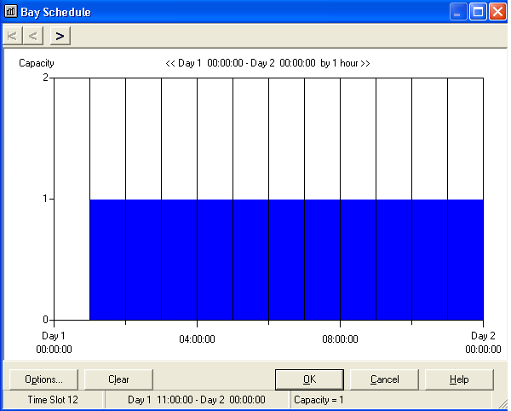

Slide 27
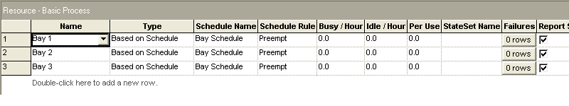
Resources Needed in the Model
Develop three Resources
  Service bays – Bay 1, Bay 2, Bay 3
  The Resources Spreadsheet Window looks like:
We choose Preempt because we want to stop after 8-hrs plus 3 hrs overtime.

Slide 28
Sets Data
Use Set data module
  Note: There are several Set modules
The Set module in the Basic Process panel allows us to form sets of resources, counters, tallies, entity types, and entity pictures
The Set module in the Advanced Process panel allows us to form sets of any other Arena objects
Think of flexible arrays when you use Sets

Slide 29
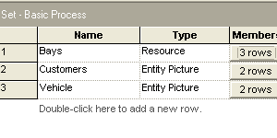
Sets Needed for the Model
We’ll define sets for
  the Bays – which are of Resource type
  Customers and Vehicle pictures – there are two types, those that wait and those leaving vehicles

Slide 30
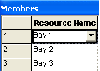
Sets Needed in the Model
Develop a set of Bays
  Service bays – Bays
  The Members Spreadsheet Window for the Bays Set looks like:

Slide 31
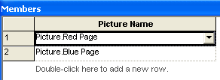
Sets Needed in the Model
Develop two entity picture sets
  Customers
    This would use a red and blue page for the two types
  Vehicles
    This would use a red and blue car for the two types

Slide 32
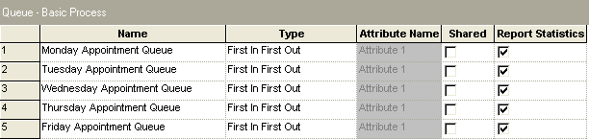
Sets Needed in the Model
Develop one set of 5 queues- one for each day of the week
  Use Advanced Set data module (Advanced Process panel)
  First, define appointment queues – Queue data module

Slide 33
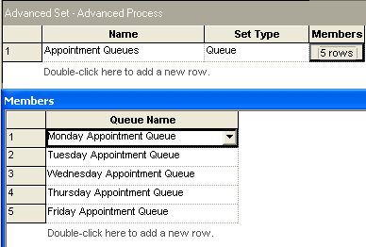
Sets Needed in the Model
  Then, define Appointment Queues set

Slide 34
Variable Data
Use Variable module from Basic Process panel
Note:
  Not needed if the variable is needed by Arena in a module such as the Assign module
  Needed if you have variables that
    Are defined as arrays or
    If you want a non-zero initial value for the variable
Nothing mysterious – just like variables in a programming language

Slide 35
Variable Data
Six control variables
  Day – current day
    initialized to 4 – why later
  Day Load – current number of appointment hours per day
    arrayed variable, 5 rows
  Max Load – maximum appointment hours per day
    initialized to 24
  Max Wait – maximum number of wait customers per day
    initialized to 5
  Wait Load – current number of wait jobs per day
    arrayed variable, 5 rows
  Calls Per Day – average number of calls per day
    initialized to 25

Slide 36
Variable Data (cont’d.)
Five output variables
  Day Book Time – total book time hours processed
  Day Actual time – total actual service time processed
  Day Overtime – total overtime hours
  Day OT – total number of vehicles held over night
  Day Wait Late – total number of late wait jobs
Four control-logic variables
  Work Day – the current work day
  Day Start Time – starting time of current day
  Day End Time – ending time of current day
  Wait Allowance – wait allowance time
    Initialized to 1 (hour)

Slide 37
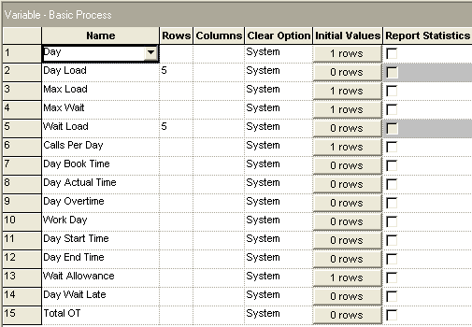

Slide 38
Expression Data
Three expressions – could have entered the distributions at the point needed, but by naming the expressions, we identify their purpose:
  Book Time Expression – returns the service book time (in hours)
  Entered as:
  AINT(44+90*BETA(2,3))/ 60
    AINT is an Arena mathematical function to truncate the above expression to the next lower integer.
    Dividing by 60 converts the time to hours

Slide 39
Expression Data
Wait Priority Expression
  Returns 1 for wait customer, 2 for leave customer
  Entered as:
    DISC (0,20,1,1,0,2) returns
      1 with probability 0.20 and
      2 with probability 0.80
Actual Service Time Expression
  Returns the actual service time based on the Book Time
    When we generate the Book Time, we store it in an attribute of the entity Book Time.
    We’ll use
      GAMM (Book Time/1.05, 1.05)

Slide 40
Output Data
Use Statistic data module – see formulas in book
Five output values
  Daily Book Time – daily average book time processed
  Daily Actual Time – daily average actual time processed
  Daily Overtime – daily average overtime
  Daily Late Wait Jobs – daily average number of late wait jobs
  Daily Profit – average daily profit
All are of type Output, so will be computed only at the end of the simulation

Slide 41
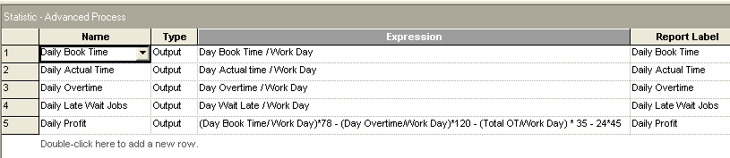

Slide 42

Submodel Creation
Object/Submodel/Add Submodel menu option
(or ) to create a submodel … we’ll use five submodels as shown above.
When originally created, the name will be
Submodel x
where x is the number of the created submodel.

Slide 43
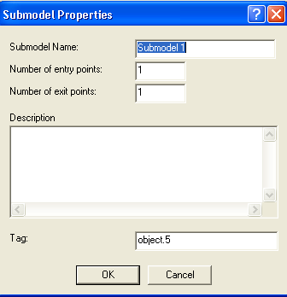
Submodel Creation
  Define
  (right-click, then Properties)
    Name
    Number of entry, exit points (could be 0 if there’s no flow interaction)
    Note: This sets the connectors in the top level logic diagram
  Move between submodels: Navigate panel, Named Views, or mouse
    Double-click on a submodel to open it
    When in a submodel, right-click in an empty place, then Close Submodel to go up

Slide 44
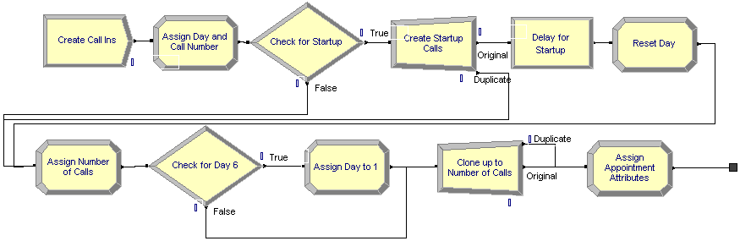
Generate Appointment Calls Submodel
Generates the daily appointment calls and forwards them to the next submodel which attempts to make appointments
No entry point – one exit point
First day of simulation is different as initial startup appointments must be made
  Generate three duplicates to make appointments for the initial three days which are handled differently

Slide 45
Submodel Logic
After the startup period, create one entity each morning (one every 12 hours to start the appointments)
The entities in this module are customer calls
The first call acts as a trigger for subsequent calls
Increment Day & set Call Number attribute to 1

Slide 46
Submodel Logic- continue with start of replication
If at start of replication (TNOW < 1)
  Day was initialized to 4 (Thurs.) so it’s now 5 (Fri.)
  Create three duplicate entities for next Mon., Tues., Wed. appointments
    Send the three duplicates immediately to *** on next slide to schedule initial 3 days out (Mon., Tues., Wed.)
    Delay original entity (representing the first call coming in today) a bit so duplicates will do the future scheduling first, and reset Day back to 1 for calls coming in on Monday

Slide 47
Submodel Logic- continue with bottom line of flowchart
***
  Assign number of calls (N) for this day
  If Day is 6 (Saturday), set it back to 1 (Monday)
  Create N - 1 duplicate entities
  Assign appointment attributes

Slide 48
Generate Appointment Calls Submodel
(after first day)
Create a single entity each day (every 12 hours)
Assign Number of Calls for this day
Increment Day variable
Create duplicates (Number of Calls – 1)
  Separate module for “cloning”

Slide 49
Generate Appointment Calls Submodel
(cont’d.)
Assign call attributes (after cloning to make them distinct)
  Day Inc – first feasible appointment day out (1, 2, or 3)
  Priority – wait (1) or leave (2)
  Book Time
  Try Day – first day of week customer wants appointment
  Entity.Picture – from picture set Customers
Be sure to remember that entities exiting this submodel are individual calls

Slide 50
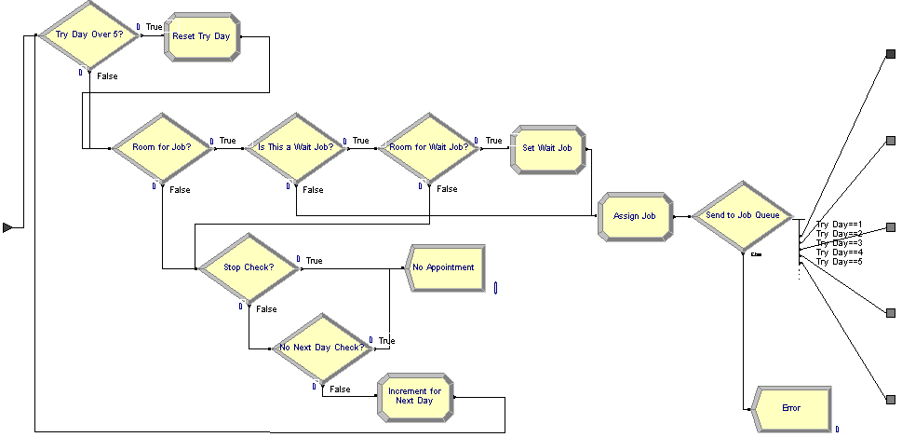
Make Appointment Submodel

Slide 51
Make Appointment Submodel (cont’d.)
One entry point
  From Generate Appointment Calls Submodel
Five exit points
  Corresponds to five appointment days
Arriving entity is a customer call wanting to make an appointment
Contains checks to see if customer can make an appointment

Slide 52
Make Appointment Submodel (cont’d.)
Check for valid Try Day value
  If not 1 through 5, subtract 5 from it
Check for room in schedule
  Is Book Time + Day Load(Try Day) <= Max Load?
  If not, check for next day
Check for Wait job
  If this is a wait job, check for room
    Is Wait Load(Try Day) < Max Wait?
    If not, check for next day
    Otherwise, increase Wait Load variable by 1

Slide 53
Make Appointment Submodel (cont’d.)
Assign Job
  Increase Variable Day Load(Try Day) by Book Time
Send to appropriate job queue
  Decide module based on appointment day
  Send to one of five exit points
  Error trap should never be taken

Slide 54
Make Appointment Submodel (cont’d.)
Appointment not possible – check for next day
  If Day Inc variable >= 3, no next day (dispose)
  Decide module with 90% chance of next day
    Increment Day Inc and Try Day variables and start over
    Otherwise, dispose

Slide 55
Make Appointment Submodel (cont’d.)

Slide 56
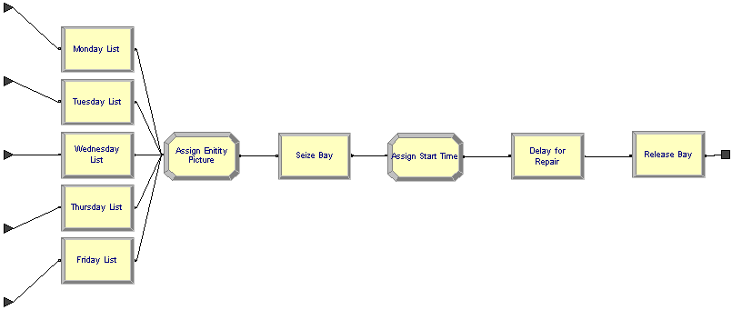
Service Activity Submodel

Slide 57
Service Activity Submodel (cont’d.)
Five entry points
  Corresponding to five appointment days
One exit point
  Service complete, send to Update Performance Variables submodel
Arriving entity is a customer appointment
Holds entity until service day
Actual vehicle service

Slide 58
Service Activity Submodel (cont’d.)
Arriving entity enters via customer appointment queue
  One of five Hold modules
  Entities are released based on a signal sent from the Control Logic submodel
    Signal value of variable Day is sent at the start of each work day
Assign new picture from picture set Vehicle
  Based on service type – attribute Priority
Assign current time to attribute Arrive Time

Slide 59
Service Activity Submodel (cont’d.)
Seize service bay
  From resource set Bays
Assign service start time to attribute Start Time
Delay for actual service time
Release service bay
Exit submodel

Slide 60
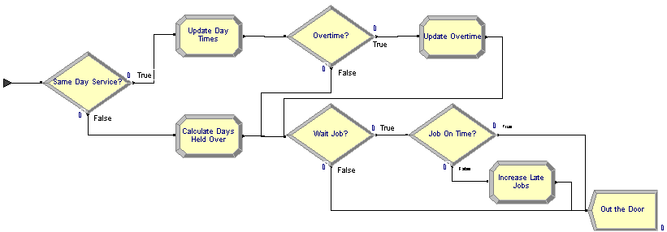
Update Performance Variables
Submodel
One entry point
  Completed service entity
No exit points
Updates the performance variables
Disposes of entity

Slide 61
Update Performance Variables
Submodel (cont’d.)
Check for same-day service – was job started on a previous day?
  Same day
    Update Day Book Time and Day Actual Time variables
    Check for overtime
      Overtime – update Day Overtime variable
    Check for wait job
      If yes, check for wait job on time
        If yes, dispose; if no, update Day Wait Late variable
      If no, dispose

Slide 62
Update Performance Variables
Submodel (cont’d.)
  Not same day
    Calculate days held over – attribute Days Held
    Update Day Book Time, Day Actual Time, Day Overtime, and Total OT variables
    Repeat wait job check (above)

Slide 63

Control Logic Submodel
No exit or entry points
Causes current day’s appointments to be released for service
Updates control variables
Somewhat like a hardware interrupt signal generator

Slide 64
Control Logic Submodel (cont’d.)
Create control entity
  One every 12 hours – one each day
  Offset first creation by 0.9999 hours (see text for details)
“Broadcast” Signal = current value of variable Day
  Causes the day’s appointments to be released for service
Reset Wait Load and Day Load variables for current day to zero
Update Work Day, Day Start Time, and Day End Time variables
Dispose of control entity

Slide 65
Animating the Automotive Shop Model
No “normal” entity movement
  Entities queue to queue to resource jump from
Appointment and service-bay queues
  Queue button from Animate toolbar
Appointment queue variables
  Number of appointments
  Book Time hours
  Number of Wait appointments
Resource animation
  Resource button from Animate toolbar
  Take pictures from libraries (.plb files), different states
Add various text annotations, boxes, etc.

Slide 66
Animating the Automotive Shop Model
(cont’d.)
Created digital clock “by hand” (details in text)
  Could have used ready-made animated clock
    Only because day is 12 hours
Current day of week
  Global variable
  Use Global button from Animate toolbar
  Trigger value based on variable Day
  Text picture contains week day name
    Monday through Friday

Slide 67
Finding and Fixing Model Errors
Arena picks up “simple” errors in Check phase, and leads you to them via Find and Edit buttons in Errors/Warnings windows
  Undefined variables, attributes, resources
  Unconnected modules
  Duplicate module names
  Typos
  But, as with all error messages, they are not obvious clues to the real problem

Slide 68
Finding and Fixing Model Errors (cont’d.)
Other kinds of errors are more complex, can’t be detected without trying to run
  Options on Run Interaction toolbar or on Run menu
  Only mention capabilities here
  We’ll do a class exercise next time
Run Controller
  Command-driven window to control, display details about model operation and underlying SIMAN code
Highlight active module
  Highlights the active module during the simulation run

Slide 69
Finding and Fixing Model Errors (cont’d.)
Layers
  Gives control over what you see during the simulation run
Break on Module; Break
  Stop run when entity hits a selected module, at a specific time, or when a selected entity is about to become active
Watch
  Select expressions to display in a window as model runs
Look at reports when model is running or paused
  Remember to close reports windows!
More on this topic next time plus Model 5-2.

Slide 70
Limits on the Academic Version
Academic version places several different kinds of limits on model “size”
  Max of 150 concurrent entities … though millions could pass through … this limit normally not a problem
  Max of 150 “module instances” … includes flowchart modules, and each entry (line) in data modules … this limit is often a problem
  Also need room to add new output performance measures
Reduce the number of module instances
  Eliminate many statistical accumulators … including getting rid of lines in data modules, entire flowchart modules, and unchecking stat-collection boxes
  More later on this
Usually this will increase the speed by factor of 3 to 4
  Important since we often want many replications and the model will be exercised intensively

Slide 71
Model 5-2:
Enhancing the Automotive Shop Model
New Elements
  Bays are more specialized in what they can handle:
    All jobs can be done in Bays 2 & 3 (60%)
    Bay 1 can only handle a subset (40%)
  Not all customers arrive on time
    60% to 70% arrive on time (uniform distribution)
  Some customers never show up

