Slide 1

Chapter 5
Modeling Detailed Operations – Part 2

Slide 2
Model 5-2:
Enhancing the Automotive Shop Model
New Elements
  Bays are more specialized in what they can handle
    All jobs can be done in Bays 2 & 3 (60%)
    Bay 1 can only handle a subset (40%)
  Not all customers arrive on time
    60% to 70% arrive on time (uniform distribution)
  Some customers never show up

Slide 3
New Modeling Issues
Sets
  Overlapping Resource Sets
    Set Bays contains Resources Bay 1, Bay 2, and Bay 3
    Set Bays 2 or 3 contains Resources Bay 2 and Bay 3
Resource Logic
  Multiple queues requesting the same resource
    Seize priority
    Tie breaker is entity waiting the longest
    Shared queues
    See text for details

Slide 4
New Modeling Issues (cont’d.)
We have a nonstationary Poisson arrival process
  Arrivals occur one at a time and are independent of one another
  Expected rate varies over time (would be constant for a stationary Poisson process)
  Generation capability is built into Create module
    Type = Schedule
    Specify arrival-rate function in Schedule model
    Limited to piecewise-constant arrival-rate functions
  Used for late customer arrivals

Slide 5
Changes to Model 5-1
Add/change logic to account for difference in service bay capabilities
Add/change logic for new customer arrival process

Slide 6
Service-Bay Logic Changes
Generate Appointment Calls submodel
  Add assignment for Job Type attribute
    1 if job can be serviced in any bay
    2 if only bays 1 or 2
    Generate via DISC(0.60,1, 1.0,2)
Change picture set Vehicle
  Put yellow doors on new job types (see text for details)

Slide 7
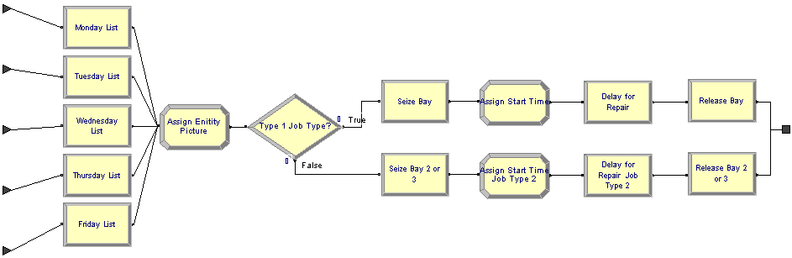
Service-Bay Logic Changes (cont’d.)
  Modify logic in Service Activity submodel
  Assign new picture using the following to choose one of four pictures:
  Vehicle(Priority + (AINT(Job Type/2))*2)
  which we examine in more detail ....

Slide 8
Service-Bay Logic Changes (cont’d.)
  Vehicle(Priority + (AINT(Job Type/2))*2)
Picture set is modified to the following:
  Red – priority 1 and job type 1
  Blue – priority 2 and job type 1
  Blue with yellow door – priority 2 and job type 1
  Red with yellow door- priority 2 and job type 2
    Priority 1 cars are wait cars
    Priority 2 cars are left cars
    Job type 1 can be serviced in any bay
    Job type 2 must be serviced in bay 2 or 3

Slide 9
Service-Bay Logic Changes (cont’d.)
Insert Decide module
  Direct entity based on attribute Job Type
  If Job Type = 1, send to existing logic
  If Job Type = 2, send to new logic
    New logic copy of existing logic
    Change resource set to Bays 2 or 3
Change queue rankings
  Queue data module
  Lowest Attribute Value First
    Based on the attribute Priority

Slide 10
Service-Bay Logic Changes (cont’d.)
Change seize priorities
  Existing Logic: (Priority*10) +1
  New logic: Priority*10
Resulting queue priorities
  Priority 1 and Job Type 1 with a Seize priority of 11
  Priority 2 and Job Type 1 with a Seize priority of 21
  Priority 1 and Job Type 2 with a Seize priority of 10
  Priority 2 and Job Type 2 with a Seize priority of 20

Slide 11
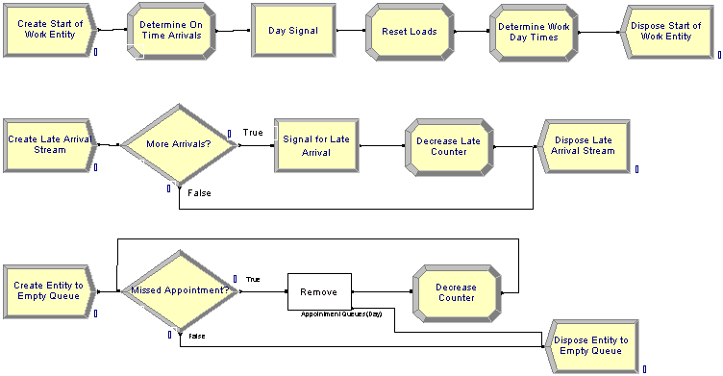
Customer Arrival Process
Change Control Logic submodel

Slide 12
Customer Arrival Process (cont’d.)
On-time customers
  Insert new Assign module
    Variable On Time
    ANINT( UNIF(0.60,0.70) * NQ(Appointment Queues(Day)))
    Variable Late
      NQ(Appointment Queues(Day)) - On Time
    Variable Total Late
      Total Late + Late
  Change Signal module
    Set signal Limit to variable On Time
    Only the on-time customers are released from appointment queue

Slide 13
Customer Arrival Process (cont’d.)
Late-arriving customers
  Arrive in first two hours after start of service
  Not all customers show up for appointment
  Data in 15-minute time periods (8 periods)
  Use Create module with arrival Type of Schedule
Add new schedule
  Late Arrival Schedule
  48 time periods (12 hours)
  First four and last 36 have zero arrival rate

Slide 14
Customer Arrival Process (cont’d.)
Late arrival logic
  Create late arrival entity
    Start one hour into day
  Check appointment queue
    Entity in queue, signal with Limit of 1 to release customer
    No entity in queue, dispose of entity
No-show customer logic
  Create control entity three hours into day
  Check appointment queue
    Entity in queue
      Remove first entity and send back to check
    No entity in queue
      Dispose of entity

Slide 15
Model 5-3:
An (s, S) Inventory Simulation
Different kind of model – not queueing
Will use modules from the Blocks and Elements panels exclusively – SIMAN simulation language
  Doing this mostly just to demonstrate this capability
  Could be done with higher-level panels we’ve been using
Company carries a single discrete item (widgets) in inventory
I(t) = inventory level (an integer) at time t days past the beginning of the simulation; I(0) = 60
Run simulation for 120 round-the-clock days

Slide 16
Customer Demands Against Inventory
Customer interarrival times ~ exponential with mean 0.1 day (round the clock)
  First arrival not at time 0 but after an interarrival time past 0
Demand size is discrete random variable
  1, 2, 3, 4 with respective probabilities
  0.167, 0.333, 0.333, 0.167

Slide 17
Customer Demands Against Inventory
If enough items are physically on hand in inventory to satisfy a demand, customer gets demand and leaves
If demand > number of items on hand, customer gets whatever is there and the rest of the demand is backlogged (I(t) becomes negative)
  If I(t) was already negative, it just goes more negative

Slide 18
Inventory Review, Replenishment
“Take inventory” at beginning of each day
  So at exactly times 0, 1, 2, ..., 119 (not 120 ... see below)
  Two managerially-chosen constant integers s = 20 and
  S = 40 (must have s < S if we change these values)
  If I(t) ≥ s, do nothing until next inventory evaluation exactly one day later
  If I(t) < s, order S – I(t) items from supplier (order “up to” S)
  Order does not arrive instantly from supplier, but after a delivery lag (a.k.a. lead time) ~ UNIF(0.5, 1.0) day, so sometime during the last half of the day of ordering
    In the meantime, inventory level could fall further from additional demands, so inventory level will not necessarily pop up to S when the order arrives, but to something less than S

Slide 19
Cost Structure
The company, Bucky, is interest in the average total operating cost per day of the system over 120 days.
Costs consist of 3 components:
Average ordering cost per day
  When an order is placed, incur a fixed cost of $32, plus an incremental cost of $3 per item ordered
  If no order is placed at the beginning of a month, there’s no ordering cost, not even the fixed cost
  At end of simulation, divide total of ordering costs by 120

Slide 20
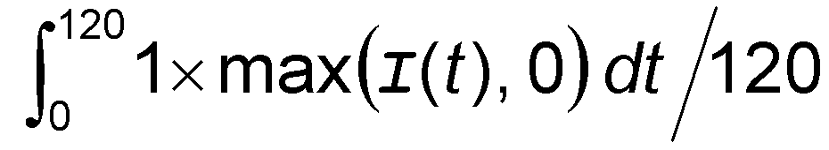
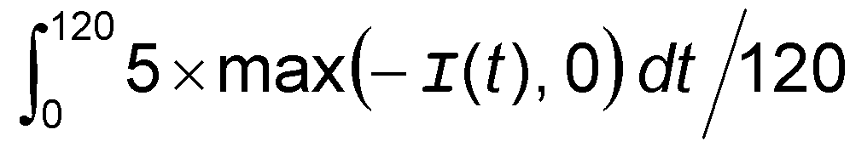
Cost Structure
Numerator is total cost over all days
Average holding cost per day
  Whenever I(t) > 0, incur $1 per day per item on hand
  Average holding cost =
Average shortage cost per day
  Whenever I(t) < 0, incur $5 per day per item in backlog
  Average shortage cost =

Slide 21
Cost Structure (cont’d.)
During periods when I(t) = 0 there’s neither holding nor shortage cost incurred
Overall performance measure
= Average total cost per day
= sum of average ordering, holding, and shortage costs per day
Don’t evaluate inventory at time 120
  We might order and incur an ordering cost then, but order will never arrive
  We’ll fudge this by stopping the run at time 119.9999, but an Exercise 5-19 asks you to do it right

Slide 22
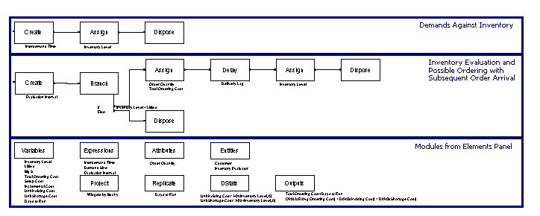
The Model – Note the Difference

Slide 23
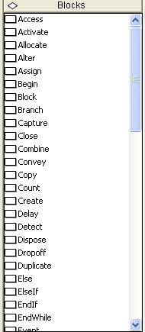
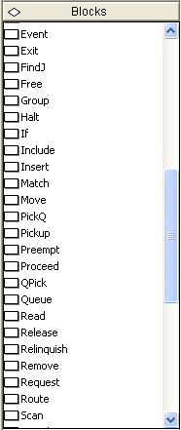
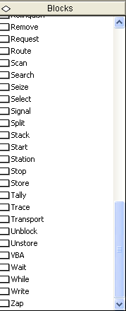
Data Structures
Use Blocks, Elements panels exclusively
  Even for Variables, Expressions, Attributes, Entities, statistics collection, and run control

Slide 24
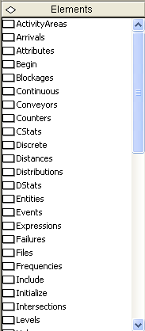
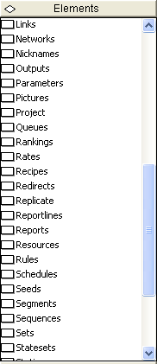
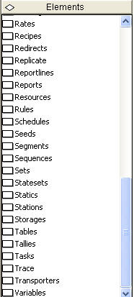
Data Structures

Slide 25
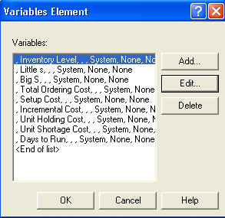
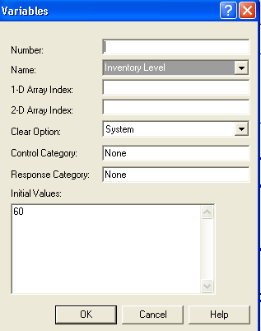
Data Structures
Variables Element (initialized, or default to 0 initially)

Slide 26
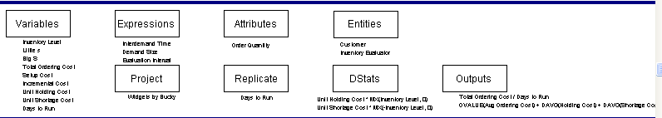
Data Structures

Slide 27
Variables Element
  Inventory Level = I(t), changes during run, initialized to 60
  Little s = s = 20
  Big S = S = 40
  Total Ordering Cost accumulator
  Setup Cost = 32
  Incremental Cost = 3
  Unit Holding Cost = 1
  Unit Shortage Cost = 5
  Days to Run = 119.9999 (The Fudge)

Slide 28
Data Structure (cont’d.)
Expressions element
  Define Interdemand Time, Demand Size, Evaluation Interval, Delivery Lag
    Note cumulative probabilities in DISC function for Demand Size
Attributes, Entities elements
  Just to define these objects
Project, Replicate elements
  Similar to Run > Setup
DStats element
  To ask for accumulation of integrals for total holding, shortage costs

Slide 29
Data Structure (cont’d.)
Outputs element
  Two entries, both of Data type “Output” so that they’re executed only at end of run, and reported
  Avg Ordering Cost computed
  Avg Total Cost added up
    OVALUE returns most recent value
    DAVG returns time-persistent average

Slide 30

Logic for Customer Demands
Against Inventory

Slide 31
Logic for Customer Demands
Against Inventory
Create block for arrival
  Entity Type is Customer
  Uses Interdemand Time Expression
  First Creation after an Interdemand Time
Assign block to decrement Inventory Level by a Demand Size
  Demand Size was defined as an Expression
  Backlogging naturally happens
Dispose block for customer exit
  If backlogged, is accounted for automatically in the (simple) definition and tracking of Inventory Level

Slide 32
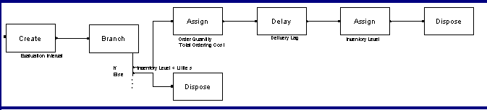
Inventory Evaluation Logic

Slide 33
Inventory Evaluation
Create block for Inventory Evaluator entities
  First Creation at time 0 – evaluate inventory at start of run
  Interval is Evaluation Interval, defined as Expression
Branch block – somewhat like Decide module
  To determine whether to place an order now
  Add “branches,” each evaluated as true or false

Slide 34
Inventory Evaluation
  Clone of incoming entity sent out along each “true” branch, but at most Max Number of Branches will be sent out
    So we set Max Number of Branches to 1 (default is ∞)
  First branch of type “If” – if “true” we want to order
  Second branch of type “Else” – if “true” it means that the first branch was “false” so we don’t order – just Dispose

Slide 35
Placing an Order
If we exit the Branch block via the top “If” branch, it must be that I(t) < s so we want to order up to S
Assign block
  Define Order Quantity Attribute
    Could have made this a Variable in this model with these parameters, but it’s more general for it to be an Attribute ... why??
  Increment Total Ordering Cost Variable

Slide 36
Placing an Order
Delay block for Delivery Lag
Assign block to increment Inventory Level by the Order Quantity
Dispose block

Slide 37
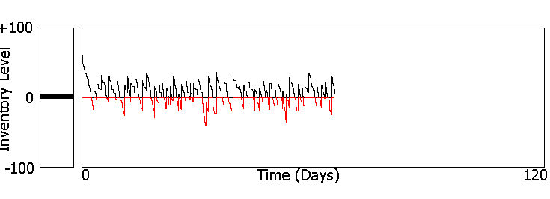
Animation
Plot with separate “in the black” and “in the red” curves
  If in backlog, red curve will be plotted in negative direction due to its Expression
Pair of Level (“thermometer”) animations
  Fill Direction for “in the red” is Down

