Slide 1

Statistical Analysis of Output from Terminating Simulations
Chapter 6

Slide 2
What We’ll Consider ...
What is the time frame of simulations?
How do we determine a strategy for data collection and analysis?
Confidence intervals – how do we use them?
How do we compare two alternative scenarios?
We will compare many alternatives via the Arena Process Analyzer (PAN)
Very important: We will searching for an optimal alternative with a tool named OptQuest

Slide 3
Introduction
Random input leads to random output (RIRO)
Run a simulation (once) — what does it mean?
  Was this run “typical” or not?
  Variability from run to run (of the same model)?
  Is this variability acceptable?
We need to perform statistical analysis of the output data
  From a single model configuration
  From two or more different configurations
  Search for an optimal configuration

Slide 4
Statistical analysis of output is often ignored
  This is a big mistake – no idea of precision of results
  Not hard or time-consuming to do this – it just takes a little planning and thought, then some (cheap) computer time

Slide 5
Time Frame of Simulations
Terminating: Specific starting, stopping conditions
  Run length will be well-defined (and finite)
Steady-state: Long-run (technically forever)
  Theoretically, initial conditions don’t matter (but practically they usually do)
  Not clear how to terminate a simulation run
Which time frame is chosen is really a question of intent of the study
The choice has a major impact on how output analysis is done
Sometimes it’s not clear which is appropriate
Initially: Terminating (steady-state in Section 7.2)

Slide 6
Strategy for Data Collection and Analysis
From now until changed, we will assume we have a terminating case.
For terminating case , make statistically independent and identically distributed (IID) replications
  Done by doing the following:
  Run > Setup > Replication Parameters: Number of Replications field
  Check both boxes (system-state variables and the statistical accumulators) for Initialize Between Replications
  This will clear these at the end of each replication and each replication will start afresh.

Slide 7
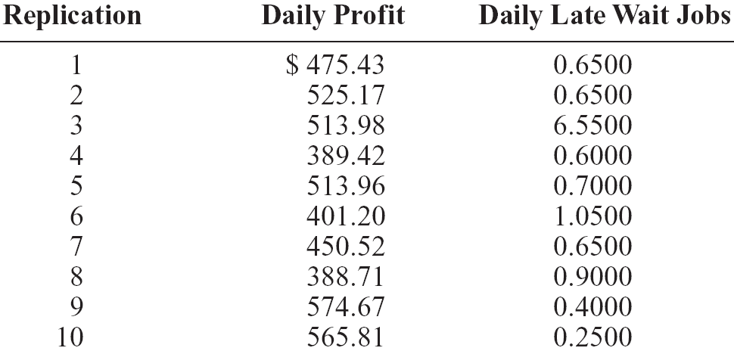
Strategy for Data Collection and Analysis
This will produce separate results for each replication in Category by Replication report
  Example: Model 5-2; Daily Profit, Daily Late Wait Jobs; 10 replications

Slide 8
Strategy for Data Collection and Analysis (co
Category Overview report will have some statistical-analysis results of the output across the replications
How do we decide how many replications?
  Trial and error (now)
  Approximate number for acceptable precision (shortly)
  Sequential sampling (Chapter 12)
Replications take time so turn off animation altogether for max speed when doing analysis
  Run > Run Control > Batch Run (No Animation)

Slide 9
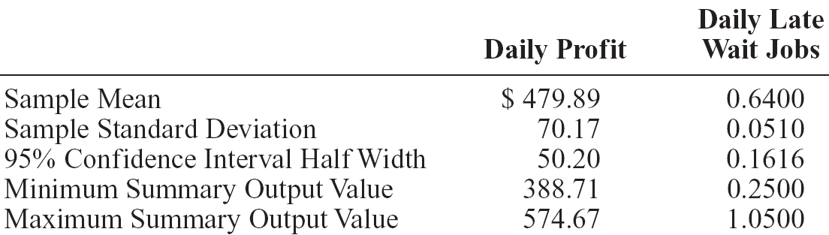
Confidence Intervals for Terminating Systems
Using formulas in Chapter 2, view the cross-replication summary output as the basic data:
Possibly most useful part – 95% confidence interval on expected values
This information (except standard deviation) is in Category Overview report
  If more than 1 replication is specified, Arena uses cross-replication data as above
  Other confidence levels, graphics – Output Analyzer

Slide 10
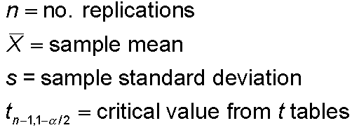


Half Width and Number of Replications
Prefer smaller confidence intervals — precision
Notation:
Confidence interval:
Half-width =
Can’t control t or s
Must increase n — how much?
Should be obvious we need to increase n in order to try and reduce the half-width
Want this to be “small,” say
< h where h is prespecified

Slide 11



Reducing the Half Width and Choosing the Number of Replications
Set half-width = h, solve for
Not really solving for n (t, s depend on n)
Approximation:
  Almost exact: Replace t by z, corresponding normal critical value
  But, it is hard to determine z₁.
  If we pretend that the current s will hold for larger samples, an easier approximation to use is
s = sample standard
deviation from “initial”
number n₀ of replications
h₀ = half width from “initial” number n₀ initial replications

Slide 12
Half Width and Number of Replications
The value of n grows quadratically as h decreases
i.e. to reduce the half-width to half its initial value, we need about four times as much data.
Some other cautions:
  In the Category Overview Report, the Half Width entries are accurate only up to 100 replications.
  This is due to a limitation within Crystal Reports, not Arena.
  Recall a .out file is produced. The values there are accurate.

Slide 13
Half Width and Number of Replications
Application to automotive repair shop
  From initial 10 replications, 95% half-width on Daily Profit was ±$50.20 ... let’s get this down to ±$20 or less
  First formula: n ≅ 1.96²(70.17²/20²) = 47.3, so 48
  Second formula: n ≅ 10(50.20²/20²) = 63.0, so 63
  Modified Model 5-2 into Model 6-1
    Checked Run > Run Control > Batch Run (No Animation) for speed
    In Run > Setup > Replication Parameters, changed Number of Replications to 100 (conservative based on above)
  Got 492.63 ± 14.71, satisfying criterion

Slide 14
Review: Interpretation of Confidence Intervals
Interval with random (data-dependent) endpoints that’s supposed to have stated probability of containing, or covering, the expected valued
  “Target” expected value is a fixed, but unknown, number
  Expected value = average of infinite number of replications
Not an interval that contains, say, 95% of the data
  That’s a prediction interval … useful too, but different from a confidence interval

Slide 15
Review: Interpretation of Confidence Intervals- Cautions
Usual formulas assume normally-distributed data
  Almost never true in simulation
  Might be approximately true if output is an average, rather than an extreme
  Central limit theorem:
    A cornerstone of statistical theory
    Says we are basically OK (i.e. the confidence level is close to that which is stated) if n is “large”.
    But, how large?
  Robustness, coverage, precision – see further cautions in book (pg 263+)

Slide 16
Comparing Two Alternatives
Usually compare alternative system scenarios, configurations, layouts, sensitivity analysis
  For now, just two alternatives ... more later
Model 6-3
  Model 6-1, but add file Daily Profit.dat to Statistic module, Output column, Daily Profit row
  Saves this output statistic to this file for each replication

Slide 17
Comparing Two Alternatives
  So, we produce two versions
    Base case – all inputs as originally defined
    More-bookings case – Change Max Load from 24 to 28 hours (allow more bookings per day ... increase utilization, profit? Maybe)
    The thinking is that by increasing the number of bookings, we might increase the Daily Profit.

Slide 18
Of course, such changes may have more than expected impact:
Overtime pay will be increased. Will this cut significantly into profits?
We may obtain a higher count of cars that are promised for a certain day and they are not delivered (would hurt customer goodwill)
Might have to pay more for loaner cars.
So, not clear what the impact of a change in time would be on the profit.

Slide 19
Comparing Two Alternatives (cont’d.)
Reasonable but not-quite-right idea
  Make confidence intervals on expected outputs from each alternative, see if they overlap
  Base case:
  492.63 ± 13.81, or [478.82, 506.44]
  More-bookings case:
  564.53 ± 22.59, or [541.94, 567.12]
  But this doesn’t allow for a precise, efficient statistical conclusion
No
Overlap

Slide 20
Compare Means via the Output Analyzer
Output Analyzer is a separate application that operates on .dat files produced by Arena
  Launch separately from Windows, not from Arena
To save output values (Expressions) of entries in Statistic data module (Type = Output) – enter filename.dat in Output File column
  Just did the last runs for Daily Profit, not Daily Late Wait Jobs
  Will overwrite this file name next time … either change the name here or out in Windows before the next run
  .dat files are binary … can only be read by the Output Analyzer

Slide 21
Compare Means via the Output Analyzer
Start Output Analyzer, open a new data group
  Basically, a list of .dat files of current interest
  Can save data group for later use – .dgr file extension
  Add button to select (Open) .dat files for the data group
Analyze > Compare Means menu option
  Add data files … “A” and “B” for the two alternatives
  Select “Lumped” for Replications field
  Title, confidence level, accept Paired-t Test, Scale Display

Slide 22
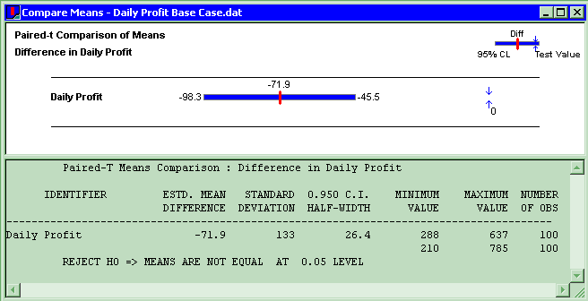
Compare Means via the Output Analyzer
Results:
Confidence interval on difference misses 0, so conclude that there is a (statistically) significant difference

Slide 23
Evaluating Many Alternatives with the Process Analyzer (PAN)
With (many) more than two alternatives to compare, two problems are
  Simple mechanics of making many parameter changes, making many runs, keeping track of many output files
  Statistical methods for drawing reliable and useful conclusions
Process Analyzer (PAN) addresses these
PAN operates on program (.p) files – produced when .doe file is run (or just checked)
Start PAN from Arena (Tools > Process Analyzer) or via Windows
PAN runs on its own, separate from Arena

Slide 24
PAN Scenarios
A scenario in PAN is a combination of:
  A program (.p) file
  Set of input controls that you choose
    Chosen from Variables and Resource capacities – think ahead
    You fill in specific numerical values
  Set of output responses that you choose
    Chosen from automatic Arena outputs or your own Variables
    Values initially empty … to be filled in after run(s)

Slide 25
PAN Scenarios
  To create a new scenario in PAN, double-click where indicated, get Scenario Properties dialog
    Specify Name, Tool Tip Text, .p file, controls, responses
    Values of controls initially as in the model, but you can change them in PAN – this is the real utility of PAN
    Duplicate (right-click, Duplicate) scenarios, then edit for a new one
  Think of a scenario as a row

Slide 26
PAN Projects and Runs
A project in PAN is a collection of scenarios
  Program files can be the same .p file, or .p files from different model .doe files
  Controls, responses can be the same or differ across scenarios in a project – usually will be mostly the same
  Think of a project as a collection of scenario rows – a table
  Can save as a PAN (.pan extension) file

Slide 27
PAN Projects and Runs
Select scenarios in project to run (maybe all)
PAN runs selected models with specified controls
PAN fills in output-response values in table
  Equivalent to setting up, running them all “by hand” but much easier, faster, less error-prone

Slide 28
Model 6-4 for PAN Experiments
Same as Model 6-3 except remove Output File entry in Statistic module
  PAN will keep track of outputs itself, so this is faster
Controls – set up a formal 2³ factor experiment
Responses
  Daily Profit
  Daily Late Wait Jobs
Control (factor) | “−” Level | “+” Level
Max Load | 20 | 40
Max Wait | 1 | 7
Wait Allowance | 0.5 | 2.0
2³ = 8 Scenarios
Also do Base Case
Not required to do a designed experiment with PAN, but this is more informative than haphazard fooling around

Slide 29
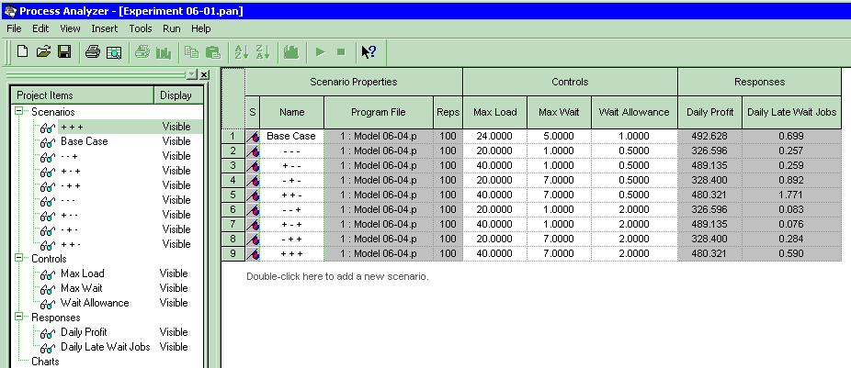
Running Model 6-4 with PAN
Scenarios
  Select all to run (click on left of row, Ctrl-Click or Shift-Click for more)
  To execute, or Run > Go or F5
What to make of all this?
Statistical meaningfulness?

Slide 30
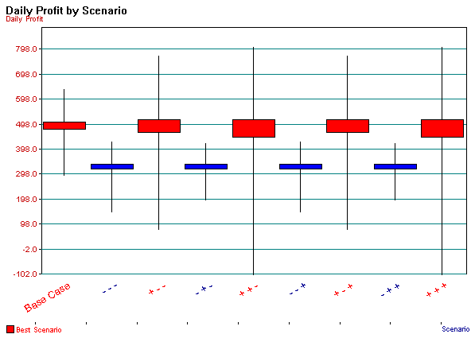
Statistical Comparisons with PAN (cont’d.)
Vertical boxes: 95% confidence intervals
Red scenarios statistically significantly better than blues
  More precisely, red scenarios are 95% sure to contain the best one
  Narrow down red set – more replications, or Error Tolerance > 0

Slide 31
Statistical Comparisons with PAN
Model 6-4 alternatives were made with 100 replications each
  Better than one replication, but what about statistical validity of comparisons, selection of “the best”?
Select Total Cost column, Insert > Chart (or or right-click on column, then Insert Chart)
  Chart Type: Box and Whisker
  Next, Total Cost; Next defaults
  Next, Identify Best Scenarios
    Bigger is Better, Error Tolerance = 0 (not the default)
    Show Best Scenarios; Finish

Slide 32
A Follow-Up PAN Experiment
From 2³ factor experiment, it’s clear that Max Load matters the most, and bigger appears better
  It’s factor 1, varying between “−” and “+” in each scenario as ordered there, creating clear down/up/down/up pattern
  Could also see this by computing main effects estimates
    Consult an experimental-design text
Eliminate other two factors (fix them at their base-case levels) and study Max Load alone
  Let it be 20, 22, 24, ..., 40
  Set up a second PAN experiment to do this, created chart as before

Slide 33
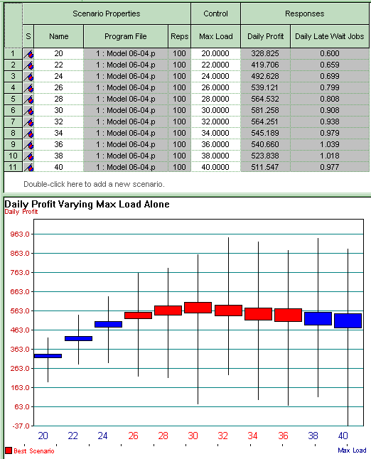
A Follow-Up PAN Experiment
Here, profit-maximizing Max Load is about 30
But Daily Late Wait Jobs keeps increasing (worsening) as Max Load increases
  At profit-maximizing Max Load = 30, it’s 0.908 job/day, which seems bad since we only take 5 wait jobs/day
  Would like to require that it be at most 0.75 job/day ... still want to maximize Daily Profit

Slide 34
Searching for an Optimal Alternative with OptQuest
The scenarios we’ve considered with PAN are just a few of many possibilities
Seek input controls maximizing Daily Profit while keeping Daily Late Wait Jobs ≤ 0.75
Formulate as an optimization problem:
  Maximize Daily Profit
  Subject to 20 ≤ Max Load ≤ 40
  1 ≤ Max Wait ≤ 7
  0.5 ≤ Wait Allowance ≤ 2.0
  Daily Late Wait Jobs < 0.75
Objective function is the simulation model
Constraints on the input control (decision) variables
An output requirement, not an input constraint
Could also have constraints on linear combinations of input control variables (but we don’t in this problem)

Slide 35
Searching for an Optimal Alternative with OptQuest
  Reasonable starting place – best acceptable scenario so far: (the base case, actually)
  Where to go from here? Explore all of feasible three-dimensional space exhaustively?
    No.

Slide 36
OptQuest
OptQuest searches intelligently for an optimum
  Like PAN, OptQuest
    Runs as a separate application … can be launched from Arena
    “Takes over” the running of your model
    Asks that you identify the input controls and the output (just one) response objective

Slide 37
OptQuest
  Unlike PAN, OptQuest
    Allows you to specify constraints on the input controls
    Allows you to specify requirements on outputs
    Decides itself what input-control-value combinations to try
    Uses internal heuristic algorithms to decide how to change the input controls to move toward an optimum configuration
You specify stopping criterion for the search

Slide 38
Using OptQuest
Tools > OptQuest for Arena
New session (File > New or Ctrl+N or )
  Make sure the desired model window is active
Select controls – Variables, Resource levels
  Max Load, Lower Bound = 20, Upper Bound = 40
  Max Wait, Lower Bound = 1, Upper Bound = 7, Discrete (Input Step Size 1)
  Wait Allowance, Lower Bound = 0.5, Upper Bound = 2

Slide 39
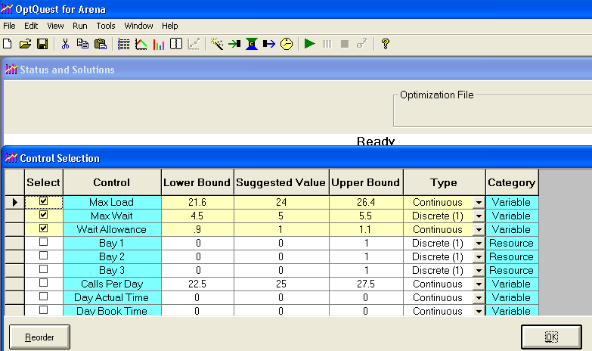
Setting Controls Section

Slide 40
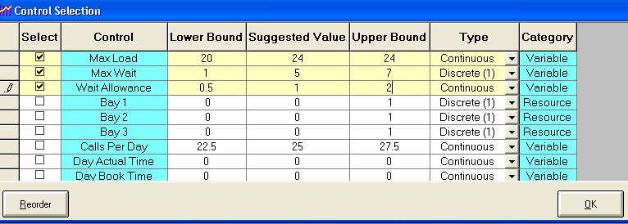
Setting Bounds in Controls Section

Slide 41
Using OptQuest
Constraints – none here other than earlier Bounds
Objective and Requirement
  Daily Profit Response – Select Maximize Objective
  Daily Late Wait Jobs Response – Select Requirement, enter 0.75 for Upper Bound

Slide 42
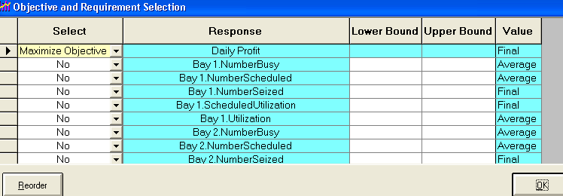
Setting Objectives

Slide 43
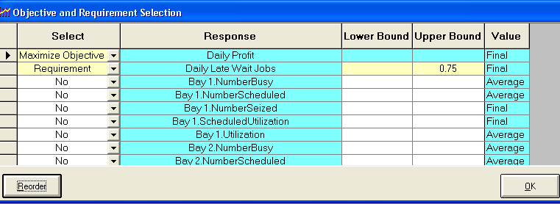
Setting Requirements

Slide 44
Using OptQuest (cont’d.)
Options window – computational limits, procedures
  Time tab – run for 20 minutes
  Precision tab – vary number of replications from 10 to 100
  Preferences tab – various settings (accept defaults)
Can revisit Controls, Constraints, Objective and Requirements, or Options windows via

Slide 45
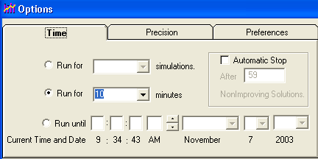
Setting Options

Slide 46
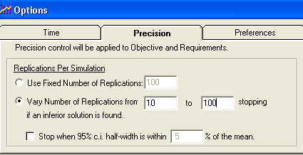
Setting Options

Slide 47
Using OptQuest (cont’d.)
Run via wizard (first time through a new project), or Run > Start or
View > Status and Solutions and
View > Performance Graph to watch progress
Can’t absolutely guarantee a true optimum
  Usually finds far better configuration than possible by hand

Slide 48
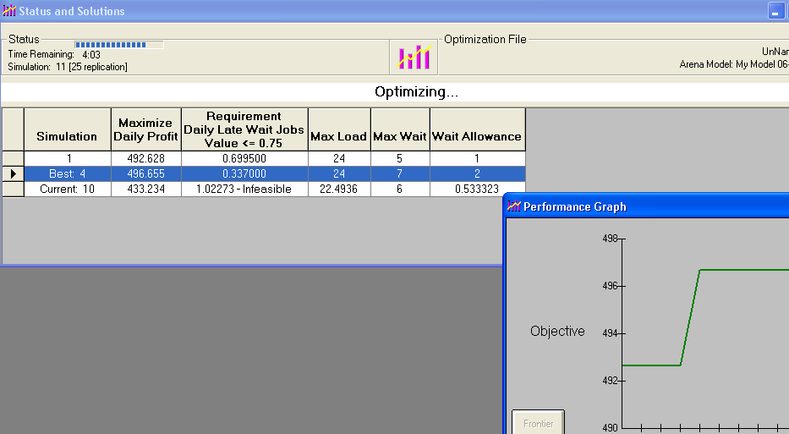
Running Simulations with OptQuest

Slide 49
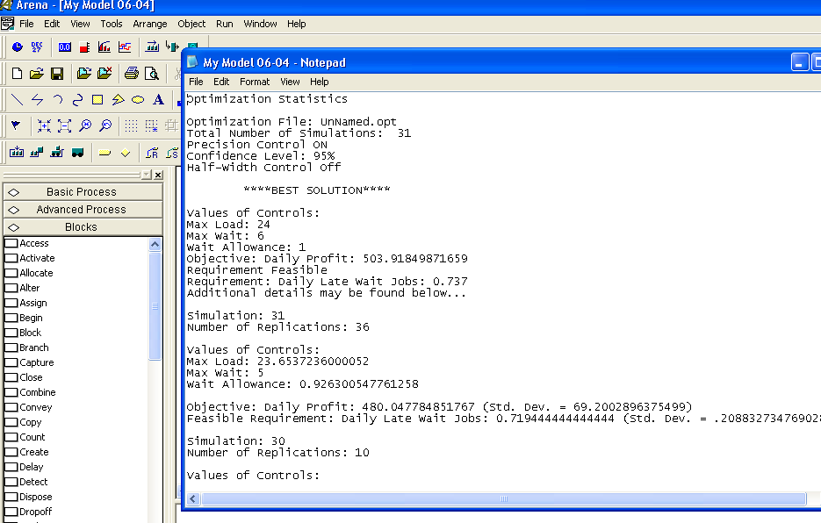
Saving Data in Log File

