Slide 1
Parallel (and Distributed) Computing Overview
Chapter 1
Motivation and History

Slide 2
Outline
Motivation
Modern scientific method
Evolution of supercomputing
Modern parallel computers
Seeking concurrency
Data clustering case study
Programming parallel computers

Slide 3
Why Faster Computers?
Solve compute-intensive problems faster
  Make infeasible problems feasible
  Reduce design time
Solve larger problems in same amount of time
  Improve answer’s precision
  Reduce design time
Gain competitive advantage

Slide 4
Concepts
Parallel computing
  Using parallel computer to solve single problems faster
Parallel computer
  Multiple-processor system supporting parallel programming
Parallel programming
  Programming in a language that supports concurrency explicitly

Slide 5
MPI
Main Parallel Language in Text
MPI = “Message Passing Interface”
Standard specification for message-passing libraries
Libraries available on virtually all parallel computers
Free libraries also available for networks of workstations or commodity clusters

Slide 6
OpenMP
Another Parallel Language in Text
OpenMP an application programming interface (API) for shared-memory systems
Supports higher performance parallel programming of symmetrical multiprocessors

Slide 7
Classical Science
Nature
Observation
Physical
Experimentation
Theory

Slide 8
Modern Scientific Method
Nature
Observation
Numerical
Simulation
Physical
Experimentation
Theory

Slide 9
Grand Challenge to Computational Science Categories (1989)
Quantum chemistry, statistical mechanics, and relativistic physics
Cosmology and astrophysics
Computational fluid dynamics and turbulence
Materials design and superconductivity
Biology, pharmacology, genome sequencing, genetic engineering, protein folding, enzyme activity, and cell modeling
Medicine, and modeling of human organs and bones
Global weather and environmental modeling

Slide 10
Weather Prediction
Atmosphere is divided into 3D cells
Data includes temperature, pressure, humidity, wind speed and direction, etc
  Recorded at regular time intervals in each cell
There are about 5×10³ cells of 1 mile cubes.
Calculations would take a modern computer over 100 days to perform calculations needed for a 10 day forecast
Details in Ian Foster’s 1995 online textbook
  Design & Building Parallel Programs
  (available soon)

Slide 11
Evolution of Supercomputing
Supercomputers – Most powerful computers that can currently be built. Note: This definition is time dependent.
Uses during World War II
  Hand-computed artillery tables
  Need to speed computations
  Army funded ENIAC to speedup calculations
Uses during the Cold War
  Nuclear weapon design
  Intelligence gathering
  Code-breaking

Slide 12
Supercomputer
General-purpose computer
Solves individual problems at high speeds, compared with contemporary systems
Typically costs $10 million or more
Traditionally found in government labs

Slide 13
Commercial Supercomputing
Started in capital-intensive industries
  Petroleum exploration
  Automobile manufacturing
Other companies followed suit
  Pharmaceutical design
  Consumer products

Slide 14

50 Years of Speed Increases
Today
> 1 trillion flops
One Billion Times Faster!
ENIAC
350 flops

Slide 15
CPUs 1 Million Times Faster
Faster clock speeds
Greater system concurrency
  Multiple functional units
  Concurrent instruction execution
  Speculative instruction execution

Slide 16
Systems 1 Billion Times Faster
Processors are 1 million times faster
Combine thousands of processors
Parallel computer
  Multiple processors
  Supports parallel programming
Parallel computing allows a program to be executed faster

Slide 17
Microprocessor Revolution
Speed (log scale)
Micros
Supercomputers
Moore's Law
Mainframes
Minis
Time

Slide 18
Some Modern Parallel Computers
Caltech’s Cosmic Cube (Seitz and Fox)
Commercial copy-cats
  nCUBE Corporation
  Intel’s Supercomputer Systems Division
  Lots more
Thinking Machines Corporation
  Built the Connection Machines (e.g., CM2)

Slide 19
Copy-cat Strategy
Microprocessor
  1% speed of supercomputer
  0.1% cost of supercomputer
Parallel computer = 1000 microprocessors
  10 x speed of supercomputer
  Same cost as supercomputer

Slide 20
Why Didn’t Everybody Buy One?
Supercomputer ≠ Σ CPUs
  Computation rate ≠ throughput
  Inadequate I/O
Software
  Inadequate operating systems
  Inadequate programming environments

Slide 21
After the “Shake Out”
IBM
Hewlett-Packard
Silicon Graphics
Sun Microsystems

Slide 22
Commercial Parallel Systems
Relatively costly per processor
Primitive programming environments
  Rapid evolution
  Software development could not keep pace
Focus on commercial sales
Scientists looked for alternative

Slide 23
Beowulf Concept
NASA (Sterling and Becker)
Commodity processors
Commodity interconnect
Linux operating system
Message Passing Interface (MPI) library
High performance/$ for certain applications
Communication network speed is quite low compared to the speed of the processors
  Many applications are dominated by communications

Slide 24
Advanced Strategic Computing Initiative
U.S. nuclear policy changes
  Moratorium on testing
  Production of new nuclear weapons halted
  Stockpile of existing weapons maintained
Numerical simulations needed to guarantee safety and reliability of weapons
U.S. ordered series of five supercomputers costing up to $100 million each

Slide 25
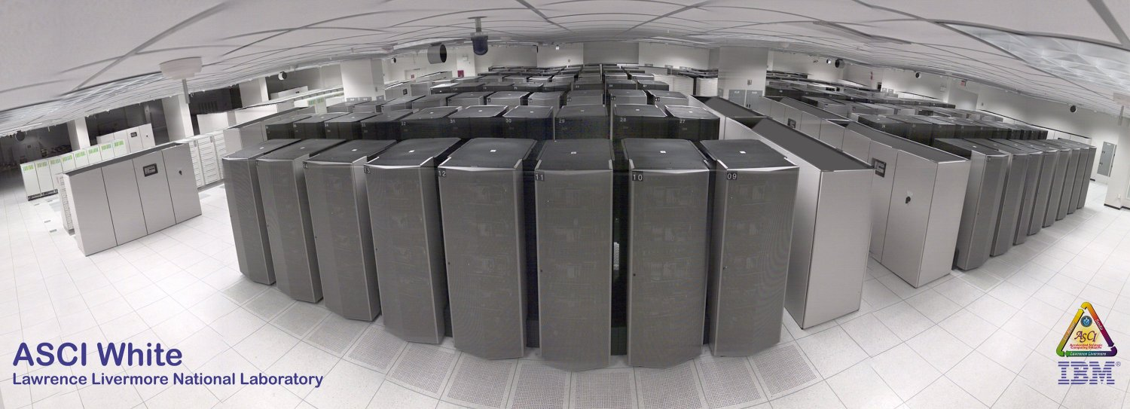
ASCI White (10 teraops/sec)
Third in ASCI series
IBM delivered in 2000

Slide 26
Some Definitions
Concurrent - Events or processes which seem to occur or progress at the same time.
Parallel –Events or processes which occur or progress at the same time
  Parallel programming (also, unfortunately, called concurrent programming), is a computer programming technique that provides for the execution of operations concurrently, either within a single computer, or across a number of systems.
  In the latter case, the term distributed computing is used.

Slide 27
Flynn’s Taxonomy
Instruction stream
Data stream
Single vs. multiple
Four combinations
  SISD
  SIMD
  MISD
  MIMD

Slide 28
SISD
Single Instruction, Single Data
Single-CPU systems
Note: co-processors don’t count
  Functional
  I/O
Example: PCs

Slide 29
SIMD
Single Instruction, Multiple Data
Two architectures fit this category
  Pipelined vector processor
  (e.g., Cray-1)
  Processor array
  (e.g., Connection Machine)

Slide 30
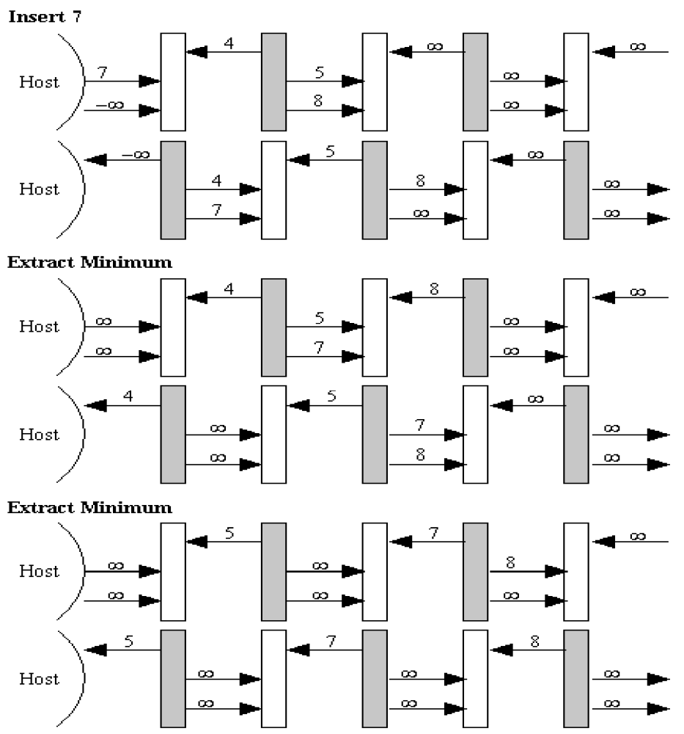
MISD
Multiple
Instruction,
Single Data
Example:
systolic array

Slide 31
MIMD
Multiple Instruction, Multiple Data
Multiple-CPU computers
  Multiprocessors
  Multicomputers

Slide 32
Seeking Concurrency
Several Different Ways Exist
Data dependence graphs
Data parallelism
Functional (or control) parallelism
Pipelining

Slide 33
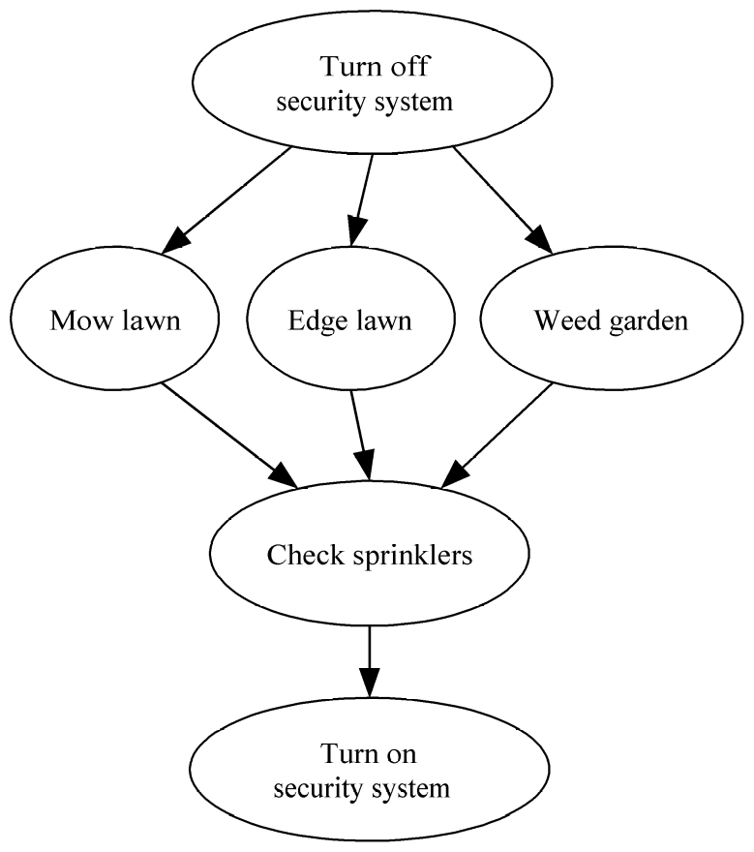
Data Dependence Graph
Directed graph
Vertices = tasks
Edges = dependences
Edge from u to v means that task u must finish before task v can start.

Slide 34
Data Parallelism
All tasks apply same operations to different elements of a data set
Example:
Okay to perform operations concurrently
On SIMDs, accomplished by having all active processors execute the same operations synchronously.
for i ← 0 to 99 do
a[i] ← b[i] + c[i]
endfor

Slide 35
Data Parallelism
A common way to support data parallel programming on MIMDs is to use SPMD (single program multiple data) programming as follows:
  Processors (or tasks) executing the same block of instructions concurrently but asynchronously
  No communication or synchronization occurs within these concurrent instruction blocks.
  Instruction blocks are normally followed by synchronization or communication steps

Slide 36
Data Parallelism Features
Each Processor performs the same data computation on different data sets
Computations can be performed either synchronously or asynchronously
Grain Size is the average number of computations performed between communication synchronization steps
  See Quinn textbook, page 411
Data parallel programming usually results in smaller grain size computation
  SIMD computation is considered to be fine-grain
  MIMD data parallelism is usually considered to be medium grain

Slide 37
Functional/Control/Job Parallelism
Independent tasks apply different operations to different data elements
First and second statements execute concurrently
Third and fourth statements execute concurrently
a ← 2
b ← 3
m ← (a + b) / 2
s ← (a² + b²) / 2
v ← s - m²

Slide 38
Control Parallelism Features
Problem is divided into different non-identical tasks
Tasks are divided between the processors so that their workload is roughly balanced
Parallelism at the task level is considered to be coarse grained parallelism

Slide 39
Data Dependence Graph
Can be used to identify data parallelism and job parallelism.
See Figure 1.3(b)
Most realistic jobs contain both parallelisms
  Can be viewed as branches in data parallel tasks

Slide 40
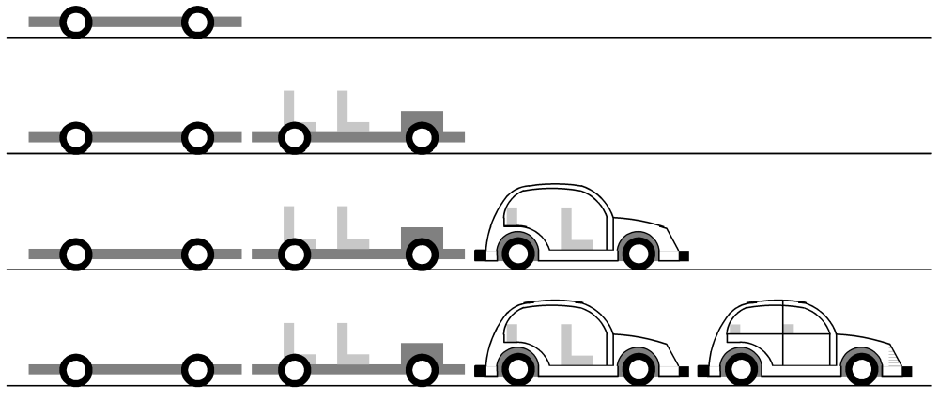
Pipelining
Divide a process into stages
Produce several items simultaneously

Slide 41
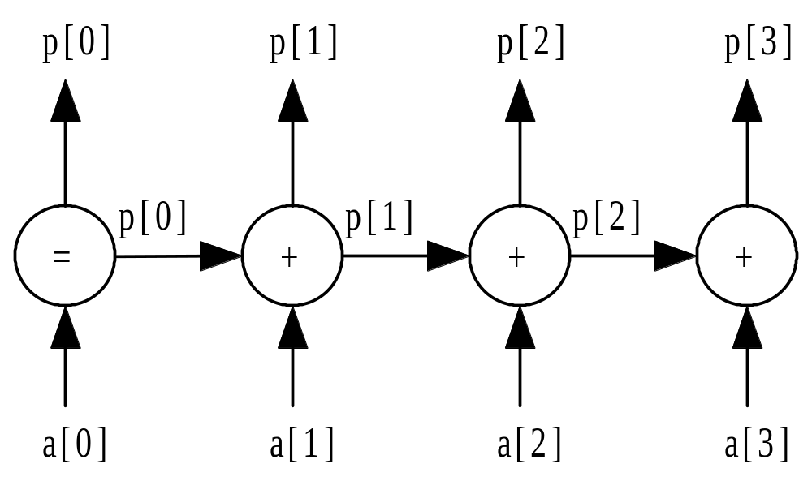

Partial Sums Pipeline

Slide 42
Data Clustering
Data mining - Process of Searching for meaningful patterns in large data sets
Data clustering - Organizing a data set into clusters of “similar” items
Data clustering can speed retrieval of items closely related to a particular item.

Slide 43
Document Vectors
Moon
The Geology of Moon Rocks
The Story of Apollo 11
A Biography of Jules Verne
Alice in Wonderland
Rocket

Slide 44
Document Clustering

Slide 45
Clustering Algorithm
Compute document vectors
Choose initial cluster centers
Repeat
  Compute performance function
  Adjust centers
Until function value converges or max iterations have elapsed
Output cluster centers

Slide 46
Data Parallelism Opportunities
Operation being applied to a data set
Examples
  Generating document vectors
  Picking initial values of cluster centers
  Finding closest center to each vector on each repetition

Slide 47
Functional Parallelism Opportunities
Draw data dependence diagram
Look for sets of nodes such that there are no paths from one node to another

Slide 48
Data Dependence Diagram
Build document vectors
Choose cluster centers
Compute function value
Adjust cluster centers
Output cluster centers

Slide 49
Functional Parallelism Tasks
The only independent sets of vertices are
  Those representing generating vectors for documents and
  Those representing initially choosing cluster centers
These two set of tasks could be performed concurrently

Slide 50
Programming Parallel Computers
Extend compilers: Translate sequential programs into parallel programs
Extend languages: Add parallel operations
Add parallel language layer on top of sequential language
Define totally new parallel language and compiler system

Slide 51
Strategy 1: Extend Compilers
Parallelizing compiler
  Detect parallelism in sequential program
  Produce parallel executable program
Focus on making Fortran programs parallel
  Builds on the results of billions of dollars and millenia of programmer effort in creating (sequential) Fortran programs
  “Dusty Deck” philosophy

Slide 52
Extend Compilers (cont.)
Advantages
  Can leverage millions of lines of existing serial programs
  Saves time and labor
  Requires no retraining of programmers
  Sequential programming easier than parallel programming

Slide 53
Extend Compilers (cont.)
Disadvantages
  Parallelism may be irretrievably lost when programs written in sequential languages
  Performance of parallelizing compilers on broad range of applications still up in air

Slide 54
Extend Language
Add functions to a sequential language
  Create and terminate processes
  Synchronize processes
  Allow processes to communicate

Slide 55
Extend Language (cont.)
Advantages
  Easiest, quickest, and least expensive
  Allows existing compiler technology to be leveraged
  New libraries can be ready soon after new parallel computers are available

Slide 56
Extend Language (cont.)
Disadvantages
  Lack of compiler support to catch errors
  Easy to write programs that are difficult to debug

Slide 57
Add a Parallel Programming Layer
Lower layer
  Core of computation
  Process manipulates its portion of data to produce its portion of result
Upper layer
  Creation and synchronization of processes
  Partitioning of data among processes
A few research prototypes have been built based on these principles

Slide 58
Create a Parallel Language
Develop a parallel language “from scratch”
  occam is an example
Add parallel constructs to an existing language
  Fortran 90
  High Performance Fortran
  C*

Slide 59
New Parallel Languages (cont.)
Advantages
  Allows programmer to communicate parallelism to compiler
  Improves probability that executable will achieve high performance
Disadvantages
  Requires development of new compilers
  New languages may not become standards
  Programmer resistance

Slide 60
Current Status
Low-level approach is most popular
  Augment existing language with low-level parallel constructs
  MPI and OpenMP are examples
Advantages of low-level approach
  Efficiency
  Portability
Disadvantage: More difficult to program and debug

Slide 61
Summary (1/2)
High performance computing
  U.S. government
  Capital-intensive industries
  Many companies and research labs
Parallel computers
  Commercial systems
  Commodity-based systems

Slide 62
Summary (2/2)
Power of CPUs keeps growing exponentially
Parallel programming environments changing very slowly
Two standards have emerged
  MPI library, for processes that do not share memory
  OpenMP directives, for processes that do share memory

