Slide 1
Chapter 2 – Part 1
Parallel Architectures

Slide 2
Outline
Flynn’s Taxonomy – covered in Chpt 1 slides
Interconnection networks
Processor arrays
Multiprocessors
Multicomputers

Slide 3
Interconnection Networks
Uses of interconnection networks
  Connect processors to shared memory
  Connect processors to each other
Interconnection media types
  Shared medium
  Switched medium
Different interconnection networks define different parallel machines.
The interconnection network’s properties influence the type of algorithm used for various machines as it affects how data is routed.

Slide 4
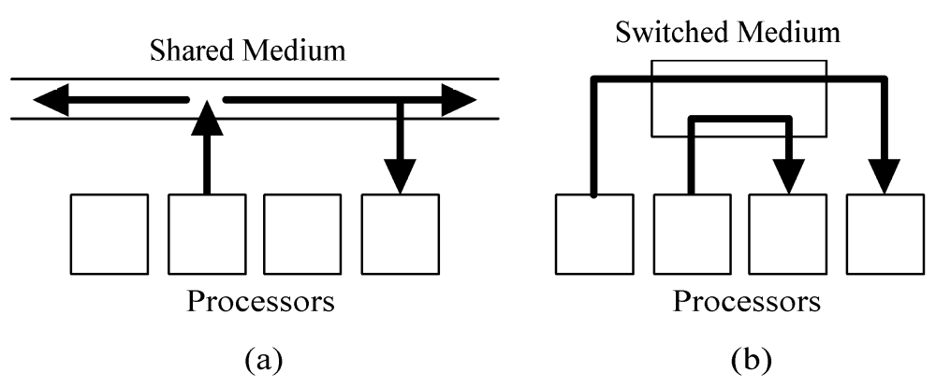
Shared versus Switched Media

Slide 5
Shared Medium
Allows only message at a time
Messages are broadcast
Each processor “listens” to every message
Arbitration is decentralized
Collisions require resending of messages
Ethernet is an example

Slide 6
Switched Medium
Supports point-to-point messages between pairs of processors
Each processor has its own path to switch
Advantages over shared media
  Allows multiple messages to be sent simultaneously
  Allows scaling of the network to accommodate the increase in processors

Slide 7
Switch Network Topologies
View switched network as a graph
  Vertices = processors or switches
  Edges = communication paths
Two kinds of topologies
  Direct
  Indirect

Slide 8
Direct Topology
Ratio of switch nodes to processor nodes is 1:1
Every switch node is connected to
  1 processor node
  At least 1 other switch node
Indirect Topology
Ratio of switch nodes to processor nodes is greater than 1:1
Some switches simply connect to other switches

Slide 9
Evaluating Switch Topologies
Terminology
We need to evaluate 4 characteristics of a network in order to help us understand their effectiveness in implementing efficient parallel algorithms on a machine with a given network.
These are
  The diameter
  The bisection width
  The edges per node
  The constant edge length
We’ll define these and see how they affect algorithm choice.
Then we will investigate several different topologies and see how these characteristics are evaluated.

Slide 10
Evaluating Switch Topologies
Terminology
Diameter – Largest distance between two switch nodes.
  Low diameter is good
  It puts a lower bound on the complexity of parallel algorithms which requires communication between two arbitrary pairs of nodes.

Slide 11
Evaluating Switch Topologies
Terminology
Bisection width – The minimum number of edges between switch nodes that must be removed in order to divide the network into two halves (within 1 node if the number of processors is odd.)
High bisection width is good.
In algorithms requiring large amounts of data movement, the size of the data set divided by the bisection width puts a lower bound on the complexity of an algorithm,
Actually proving what the bisection width of a network is can be quite difficult.

Slide 12
Evaluating Switch Topologies
Terminology
Number of edges / node
  It is best if the number of edges/node is a constant independent of network size as that allows more scalability of the system to a larger number of nodes.
Constant edge length? (yes/no)
  Again, for scalability, it is best if the nodes and edges can be laid out in 3D space so that the maximum edge length is a constant independent of network size.

Slide 13
We Need to Recall a Few Complexity Concepts From CPSC 171
Whenever we can define a count as a function of the size, n, of a problem, we can characterize that count in terms of complexity classes.
Definition: We say a function f(n) is in O(g(n)), if and only if that there are positive constants c and n₀ such that
f(n) ≤ cg(n) for n ≥ n₀
O(n) is read as big-oh of n.
This notation can be used to separate counts into complexity classes that characterize the size of the count.
We can use it for any kind of counting functions such as timings, bisection widths, etc.

Slide 14
Big-Oh Notation (§1.2)
Example:
We claim: 2n + 10 is O(n)
  We want to find c and n₀ such that 2n + 10 ≤ cn for n ≥ n₀
    Start with 2n + 10 ≤ cn
    (c − 2) n ≥ 10
    n ≥ 10/(c − 2) (The yellow is scratchwork!)
  Proof: Pick c = 3 and n₀ = 10. Then, for n ≥ n₀ = 10,
  2n + 10 ≤ 3n since n ≥ 10/(3−1)
Note the values are not unique!

Slide 15
Big-Oh Example
Example:
Show the function n² is not O(n)
  We want
    n² ≤ cn
    n ≤ c
  The above inequality cannot be satisfied since c must be a constant

Slide 16
Big-Oh and Growth Rate
The big-Oh notation gives an upper bound on the growth rate of a function
The statement “f(n) is O(g(n))” means that the growth rate of f(n) is no more than the growth rate of g(n)
We can use the big-Oh notation to rank functions according to their growth rate
Assume: | f(n) is O(g(n)) | g(n) is O(f(n))
g(n) grows more | Yes | No
f(n) grows more | No | Yes
Same growth | Yes | Yes

Slide 17
Big-Oh Rules
If is f(n) a polynomial of degree d, then f(n) is O(n^{d}), i.e.,
  Drop lower-order terms
  Drop constant factors
Use the smallest possible class of functions
  Say “2n is O(n)” instead of “2n is O(n²)”
Use the simplest expression of the class
  Say “3n + 5 is O(n)” instead of “3n + 5 is O(3n)”

Slide 18
Asymptotic Analysis
Asymptotic analysis determines the big-Oh notation
To perform the asymptotic analysis
  We find the worst-case count as a function of the input size
  We express this function with big-Oh notation
Example:
  We determine that algorithm arrayMax executes at most 7n − 2 primitive operations
  We say that algorithm arrayMax “runs in O(n) time”
Since constant factors and lower-order terms are eventually dropped anyhow, we can disregard them when counting. This means a bit of slop is OK as long as you don’t mess up the counts involving n.

Slide 19
Relatives of Big-Oh
big-Omega
  f(n) is Ω(g(n)) if there is a constant c > 0
  and an integer constant n₀ ≥ 1 such that
  f(n) ≥ cg(n) for n ≥ n₀
  Intuitively, this says up to a constant factor, f(n) asymptotically is greater than or equal to g(n)
big-Theta
  f(n) is Θ(g(n)) if there are constants c’ > 0 and c’’ > 0 and an integer constant n₀ ≥ 1 such that c’g(n) ≤ f(n) ≤ c’’•g(n) for n ≥ n₀
  Intuitively, this says up to a constant factor, f(n) and g(n) are asymptotically the same.
  Note: This is the concept I introduced in cpsc 171.

Slide 20
Relatives of Big-Oh
little-oh
  f(n) is o(g(n)) if, for any constant c > 0, there is an integer constant n₀ ≥ 0 such that f(n) ≤ cg(n) for n ≥ n₀
  Intuitively, this says f(n) is, up to a constant, asymptotically strictly less than g(n).
little-omega
  f(n) is ω(g(n)) if, for any constant c > 0, there is an integer constant n₀ ≥ 0 such that f(n) ≥ cg(n) for n ≥ n₀
  Intuitively, this says f(n) is, up to a constant, asymptotically strictly greater than g(n).
  These are not used as much as the earlier definitions, but they round out the picture.

Slide 21
Summary for Intuition for Asymptotic Notation
big-Oh
  f(n) is O(g(n)) if f(n) is asymptotically less than or equal to g(n)
big-Omega
  f(n) is Ω(g(n)) if f(n) is asymptotically greater than or equal to g(n)
big-Theta
  f(n) is Θ(g(n)) if f(n) is asymptotically equal to g(n)
little-oh
  f(n) is o(g(n)) if f(n) is asymptotically strictly less than g(n)
little-omega
  f(n) is ω(g(n)) if is asymptotically strictly greater than g(n)

Slide 22
A MORE PRECISE DEFINITION OF O, Θ
(only for those with calculus backgrounds)
Definition: Let f and g be functions defined on the positive real numbers with real values.
We say g is in O(f) if and only if
lim g(n)/f(n) = c
n -> ∞
for some nonnegative real number c--- i.e. the limit exists and is not infinite.
Definition: We say f is in Θ(g) if and only if
f is in O(g) and g is in O(f)
Note: Often to calculate these limits you need L'Hopital's Rule.

Slide 23
Why Asymptotic Behavior is Important
1) Allows us to compare counts on large sets.
2) Helps us understand the maximum size of input that can be handled in a given time, provided we know the environment in which we are running.
3) Stresses the fact that even dramatic speedups in hardware do not overcome the handicap of an asymtotically slow algorithm.

Slide 24
Recall: ORDER WINS OUT
The TRS-80
Main language support: BASIC - typically a slow running language
For more details on TRS-80 see:
http://mate.kjsl.com/trs80/
The CRAY-YMP
Language used in example: FORTRAN- a fast running language
For more details on CRAY-YMP see:
http://ds.dial.pipex.com/town/park/abm64/CrayWWWStuff/Cfaqp1.html#TOC3

Slide 25
CRAY YMP TRS-80
with FORTRAN with BASIC
complexity is 3n³ complexity is 19,500,000n
microsecond (abbr µsec) One-millionth of a second.
millisecond (abbr msec) One-thousandth of a second.
n is:
10
100
1000
2500
10000
1000000
3 microsec
200 millisec
3 millisec
2 sec
3 sec
20 sec
50 sec
50 sec
49 min
3.2 min
95 years
5.4 hours

Slide 26
Evaluating Switch Topologies
Many have been proposed and analyzed. We will consider six well known ones:
  2-D mesh
  binary tree
  hypertree
  butterfly
  hypercube
  shuffle-exchange
Those in yellow have been used in commercial parallel computers.

Slide 27
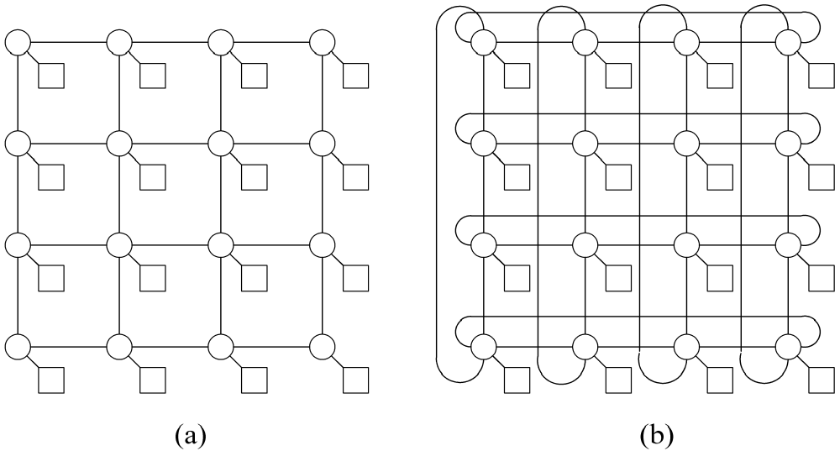
2-D Meshes
Note: Circles represent switches and squares represent processors in all these slides.

Slide 28
2-D Mesh Network
Direct topology
Switches arranged into a 2-D lattice or grid
Communication allowed only between neighboring switches
Variants allow wraparound connections between switches on edge of mesh

Slide 29
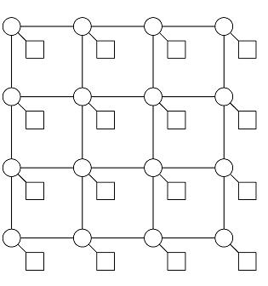
Evaluating 2-D Meshes
(Assuming as square as possible)
n = number of processors
Diameter:
  Θ(n^{1/2})
  Places a lower bound on algorithms that require processing with arbitrary nodes sharing data.
Bisection width:
  Θ(n^{1/2})
  Places a lower bound on algorithms that require distribution of data to all nodes.
Number of edges per switch:
  4 (note: max)
Constant edge length?
  Yes
Does this scale well?
  Yes

Slide 30
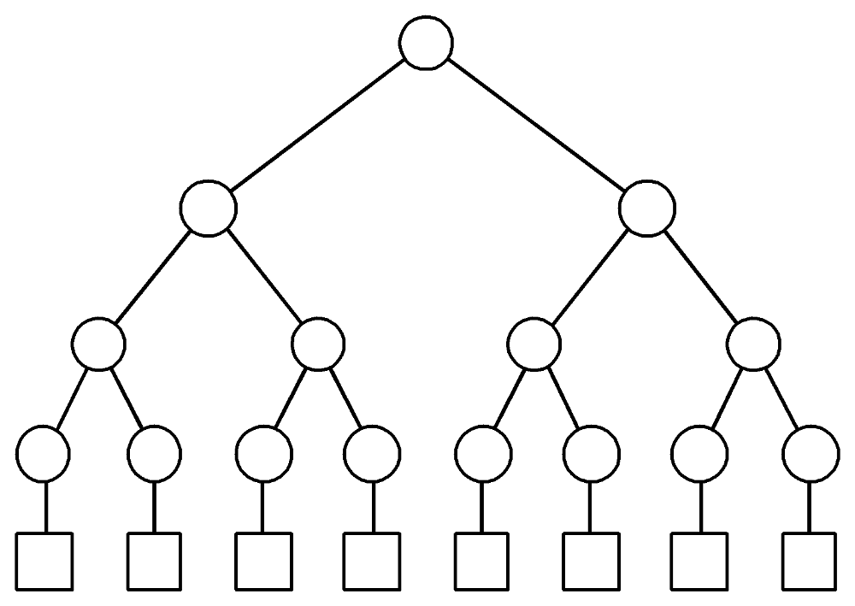
Binary Tree Network
Indirect topology
n = 2^{d} processor nodes, 2n-1 switches, where d= 0,1,... is the number of levels
i.e. 2³ = 8 processors on bottom and
2(3) – 1 = 15 switches

Slide 31
Evaluating Binary Tree Network
Diameter:
  2 log n
  Note- this is low
Bisection width:
  1, the lowest possible number
Edges / node:
  3
Constant edge length?
  No
Does this scale well?
  No

Slide 32
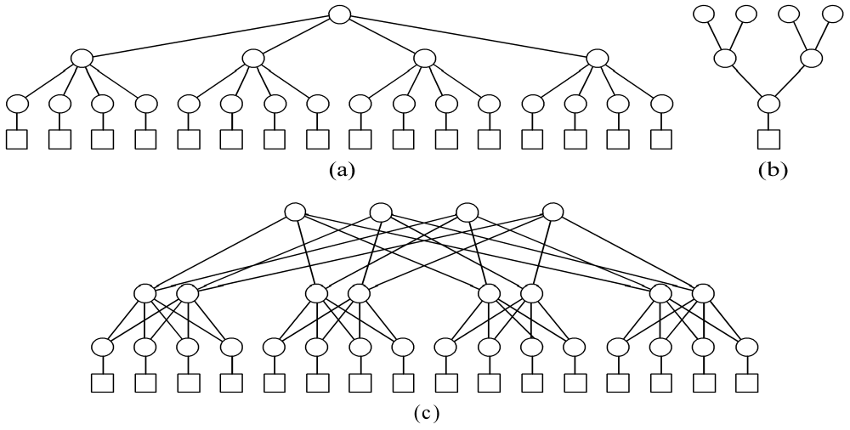
Hypertree Network (of degree 4 and depth 2)
Front view: 4-ary tree of height 2
(b) Side view: upside down binary tree of height d
(c) Complete network

Slide 33
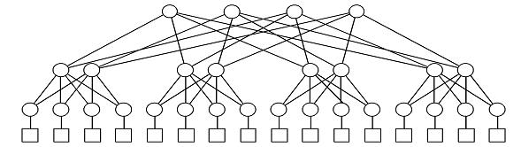
Hypertree Network
Indirect topology
Note- the degree k and the depth d must be specified.
This gives from the front a k-ary tree of height d.
From the side, the same network looks like an upside down binary tree of height d.
Joining the front and side views yields the complete network.

Slide 34
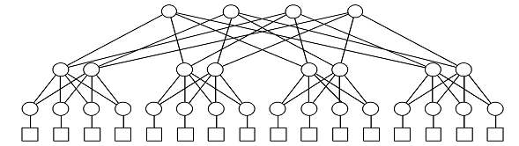
Evaluating 4-ary Hypertree – n =16 processors
Diameter:
  log n
  shares the low diameter of binary tree
Bisection width:
  n / 2
  better than binary tree’s
Edges / node:
  6
Constant edge length?
  No

Slide 35
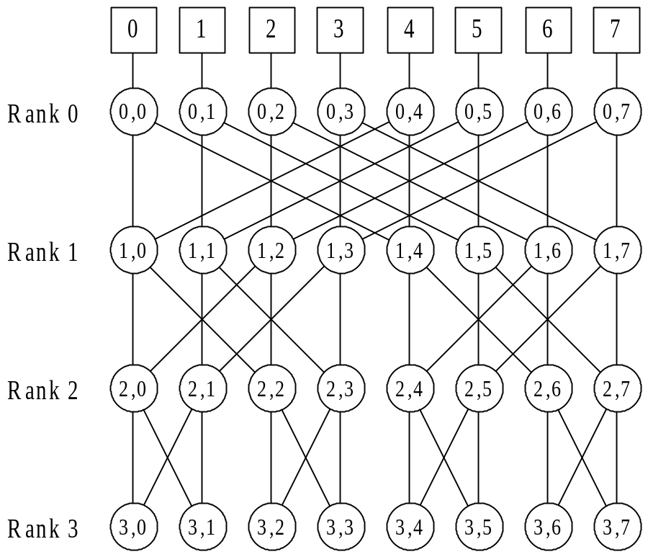
Butterfly Network
A 2³ = 8 processor butterfly network with 8*4=32 switching nodes
Indirect topology
n = 2^{d} processor
nodes connected
by n(log n + 1)
switching nodes
As complicated as this switching network appears to be, it is really quite simple as it admits a very nice routing algorithm!
Note: The bottom switches wrap back around to the processors.
The rows are called ranks.

Slide 36
Building 2³ Butterfly Network
There are 8 processors.
Have 4 ranks (i.e. rows) with 8 switches per rank.
Connections:
  Node(i,j), for i > 0, is connected to two nodes on rank i-1, namely node(i-1,j) and node(i-1,m), where m is the integer found by inverting the ith most significant bit in the binary d-bit representation of j.
  For example, suppose i = 2 and j = 3. Then node (2,3) is connected to node (1,3).
  To get the other connection, 3 = 011₂. So, flip 2nd significant bit – i.e. 001₂ and connect node(2,3) to node(1,1) --- NOTE: There is an error on pg 32 on this example.

Slide 37
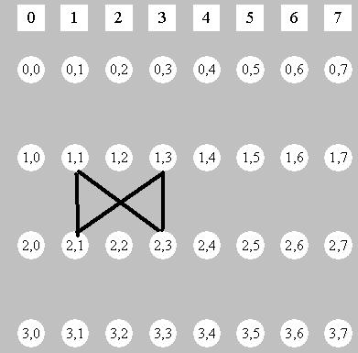
Why It Is Called a Butterfly Network
Walk cycles such as node(i,j), node(i-1,j), node(i,m), node(i-1,m), node(i,j) where m is determined by the bit flipping as shown and you “see” a butterfly:

Slide 38
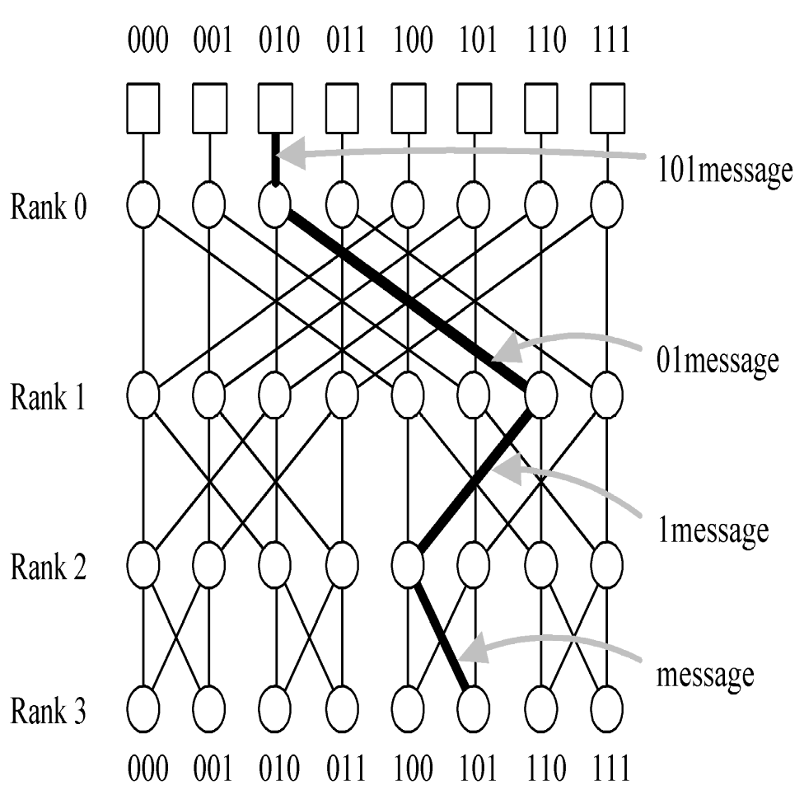
Butterfly Network Routing
Send message from processor 2 to processor 5.
Algorithm:
0 means ship left;
1 means ship right.
1) 5 = 101. Pluck off leftmost bit 1 and send “01msg” to right.
2) Pluck off leftmost bit 0 and send “1msg” to left.
3) Pluck off leftmost bit 1 and send “msg” to right.

Slide 39
Evaluating the Butterfly Network
Diameter:
  log n
Bisection width:
  n / 2
Edges per node:
  4 (even for d  3)
Constant edge length?
  No – as rank decreases,
  grows exponentially

Slide 40
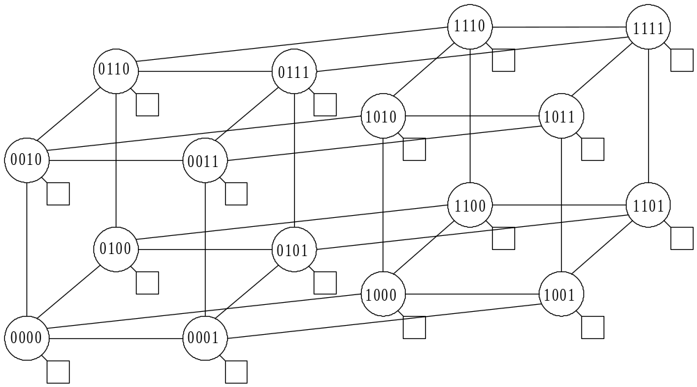
Hypercube (or binary n-cube) n = 2^{d} processors and n switch nodes
Butterfly with the columns of switch nodes collapsed into a single node.

Slide 41
Hypercube (or binary n-cube) n = 2^{d} processors and n switch nodes
Direct topology
2 x 2 x … x 2 mesh
Number of nodes is a power of 2
Node addresses 0, 1, …, 2k-1
Node i is connected to k nodes whose addresses differ from i in exactly one bit position.
Example: k = 0111 is connected to 1111, 0011, 0101, and 0110

Slide 42
Growing a Hypercube
Note: For d = 4, it is a 4-dimensional cube.

Slide 43
Evaluating Hypercube Network
Diameter:
  log n
Bisection width:
  n / 2
Edges per node:
  log n
Constant edge length?
  No.
The length of the longest edge increases as n increases.

Slide 44
Routing on the Hypercube Network
Example: Send a message from node 2 = 0010 to node 5 = 0101
The nodes differ in 3 bits so the shortest path will be of length 3.
One path is
0010 → 0110 →
0100 → 0101
obtained by flipping one bit at a time.
As with the butterfly network, bit flipping helps you route on this network.

Slide 45
A Perfect Shuffle
A permutation that is produced as follows is called a perfect shuffle:
Given a power of 2 cards, numbered 0, 1, 2, ..., 2^{d} -1, write the card number with d bits. By left rotating the bits with a wrap, we calculate the position of the card after the perfect shuffle.
Example: For d = 3, card 5 = 101. Left rotating and wrapping gives us 011. So, card 5 goes to position 3. Note that card 0 = 000 and card 7 = 111, stay in position.

Slide 46
Shuffle-exchange Network Illustrated
0
1
2
3
4
5
6
7
Direct topology
Number of nodes a power of 2
Nodes have addresses 0, 1, …, 2k-1
Two outgoing links from node i
  Shuffle link to node LeftCycle(i)
  Exchange link to node [xor (i, 1)] -

Slide 47
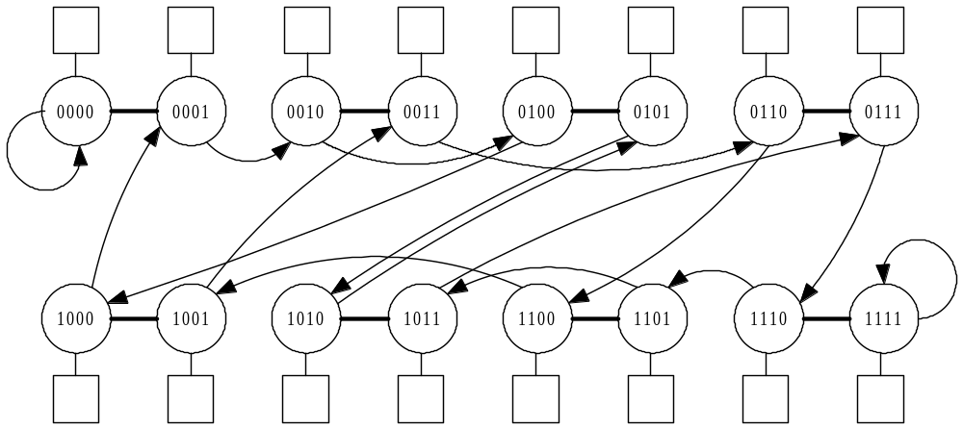
Shuffle-exchange Addressing – 16 processors
No arrows on line segment means it is bidirectional. Otherwise, you must follow the arrows.
Devising a routing algorithm for this network is interesting and will be a homework problem.

Slide 48
Evaluating the Shuffle-exchange
Diameter:
2log n - 1
Bisection width:
≈ n / log n
Edges per node:
2
Constant edge length?
  No

Slide 49
Comparing Networks
All have logarithmic diameter
except 2-D mesh
Hypertree, butterfly, and hypercube have bisection width n / 2
All have constant edges per node except hypercube
Only 2-D mesh keeps edge lengths constant as network size increases
Shuffle-exchange is a good compromise- fixed number of edges per node, low diameter, good bisection width.

