Slide 1
A SIMD MACHINE
ASC - Part 1
Both a Language and an Architecture

Slide 2
Historical Remarks
Recall that all active processors of a SIMD computer must simultaneously access the same memory location.
These locations can be viewed as components of a vector.
SIMD machines are sometimes called vector computers [Jordan,et.al.] or processor arrays [Quinn 94,04] based on their ability to execute vector and matrix operations efficiently.

Slide 3
Historical Remarks
SIMD computers that focus on vector operations usually
  support some vector and possibly matrix operations in hardware, and
  limit or provide less support for non-vector type operations involving “vector components”.
The inner loops of some sequential algorithms consist only of performing the same operation on a set of disjoint data items.
  These are easy to parallelize using a SIMD by assigning each data item to a different processor and having each operation performed simultaneously.

Slide 4
SIMD Execution Style
The traditional (SIMD, vector, processor array) execution style ([Quinn 94, pg 62], [Quinn 2004, pgs 37-43]:
  The sequential processor that broadcasts the commands to the rest of the processors is called the front end or control unit.
  The front end is a general purpose CPU that stores the program and the data that are not manipulated in parallel.
  The front end normally executes the sequential portions of the program.

Slide 5
SIMD Execution Style
  Each processing element has a local memory that can not be directly accessed directly by the host or other processing elements.
  Collectively, the individual memories of the processing elements (PEs) store the vector data that is processed in parallel.
  When the front end encounters an instruction whose operand is a vector, it issues a command to the PEs to perform the instruction in parallel.
  Although the PEs execute in parallel, some units can be allowed to skip any particular instruction.
  SIMDs are also called MPPs (massively parallel processors – although there is a specific machine named MPP. )

Slide 6
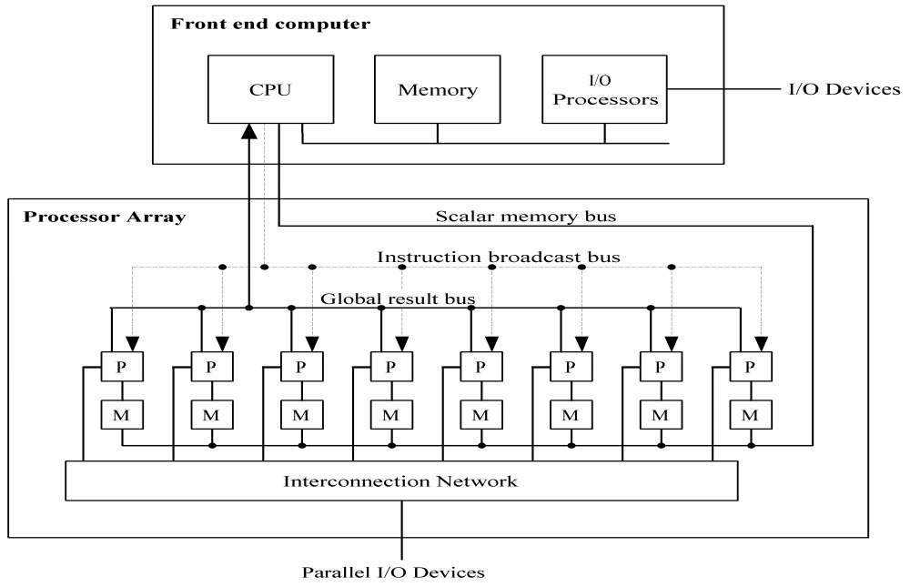
Possible Architecture for a Generic SIMD

Slide 7
Real SIMD Architectures
An early SIMD computer designed for vector and matrix processing was the Illiac IV computer built at the University of Illinois. [Jordan et. al., pg 7].
The CRAY-1 and the Cyber-205 use pipelined arithmetic units to support vector operations and are viewed as pipelined SIMDs ([Jordan, et al, p7], [Quinn 94, pg 61-2], [Quinn 2004, pg37).

Slide 8
Real SIMD Architectures
The MPP, DAP, the Connection Machines CM-1 and CM-2, MasPar MP-1 and MP-2 are examples of SIMD computers given in [Akl, pg 8-12]
  The MP-1 and Connection Machines are briefly discussed there.
Quinn [1994, pg 63-67] discusses the Connection Machine CM-200, a smaller & updated CM-2.
Professor Batcher at Kent State was the chief architect for the STARAN and the MPP (Massively Parallel Processor) and an advisor for the ASPRO (small, second generation STARAN)

Slide 9
Today’s SIMDs
Many SIMDs are being embedded in SISD machines.
Others are being build as part of hybrid architectures.
Others are being build as special purpose machines, although some of them could classify as general purpose.
Much of the recent work with SIMD architectures is proprietary.

Slide 10
A Company Trying to Build an Inexpensive SIMD
WorldScape is building a COTS SIMD.
The architecture is changing rapidly as they are in development.
See http://www.wscapeinc.com/
There is quite a bit of information about their work on the above site.

Slide 11
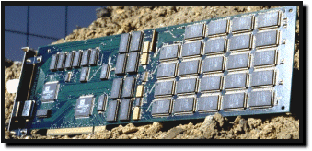
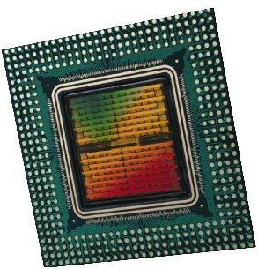
An Example of a Hybrid SIMD
Embedded Massively Parallel Accelerators
  Systola 1024: PC add-on board with 1024 processors
  Fuzion 150: 1536 processors on a single chip
  Other accelerators: Decypher, Biocellerator, GeneMatcher2, Kestrel, SAMBA, P-NAC, Splash-2, BioScan
(Slides 10-12 are due to Prabhakar R. Gudla (U of Maryland) at a CMSC 838T Presentation, 4/23/2003.)

Slide 12

Hybrid Architecture
Systola1024
Systola1024
Systola1024
Systola1024
Systola1024
Systola1024
Systola1024
Systola1024
High speed Myrinet switch
Systola1024
Systola1024
Systola1024
Systola1024
Systola1024
Systola1024
Systola1024
Systola1024
  combines SIMD and MIMD paradigm within a parallel architecture ⇒ Hybrid Computer

Slide 13

Architecture of Systola 1024
Instruction Systolic Array:
  32 × 32 mesh of processing elements
  wavefront instruction execution
RAM NORTH
RAM WEST
program memory
Controller
host computer bus
ISA
Interface processors

Slide 14
SIMDs Embedded in SISDs
Intel's Pentium 4 includes what they call MMX technology to gain a significant performance boost
IBM and Motorola incorporated the technology into their G4 PowerPC chip in what they call their Velocity Engine.
Both MMX technology and the Velocity Engine are the chip manufacturer's name for their proprietary SIMD processors and parallel extensions to their operating code.
This same approach is used by NVidia and Evans & Sutherland to dramatically accelerate graphics rendering.

Slide 15
Special Purpose SIMDs in the
Bioinformatics Market
Paracel, Inc. (acquired by Celera Genomics for $283 million in March of 2000)
  Paracel's systems are based on a proprietary SIMD processor packaged as an integrated system with proprietary software algorithms.
  One of their machines is called GeneMatcher.
TimeLogic, Inc
  Has DeCypher, a reconfigurable SIMD.

Slide 16
MASC
Several professors and their graduate students at Kent State University are designing a SIMD machine with special properties:
MASC (Multiple ASsociative Computing)
We will discuss and work with an early version of this machine, the ASC, and program it using a simulator.
The STARAN and the ASPRO fully support ASC in hardware. The MPP supports it some in hardware and some in software.
Working with ASC will let you develop some SIMD style algorithms and write programs.
Dr. Baker is working with theoretical models of the machine. Dr. Walker is working with the hardware design of the machine. Advisors involved are Dr. Batcher and Dr. Potter.

Slide 17
Comparisons of SIMD and MIMD
Features
Reference: [Roosta, pg 10]
Less hardware than MIMDs as they have only one control unit.
Less memory needed than MIMD
  Only one copy of the instructions need to be stored
  Allows more data to be stored in memory, which reduces movement of data between primary and secondary storage.

Slide 18
Comparisons of SIMD and MIMD
Features -continued
Less startup time in communicating between PEs.
Some people believe the single instruction stream and synchronization of PEs make SIMD applications easier to program, understand, and debug.
Control flow operations and scalar operations can be executed on the control unit while PEs are executing other instructions.

Slide 19
Comparisons of SIMD and MIMD
Features -continued
  MIMD architectures require explicit synchronization primitives, which create a substantial amount of additional overhead.
  During a communication operation between PEs,
    PEs send data to a neighboring PE in parallel and in lock step
    the entire communication operation is executed synchronously
  Less complex hardware is needed in a SIMD since no message decoder is needed in PEs
    MIMDs need a message decoder in each PE.

Slide 20
Associative Computing
Overview
  The ASC model – Primer is linked off our website as a PDF file.
  Language designed for the ASC model
  Some ASC Programs
  Introduction to the ASC simulator and how to run ASC programs
  Note: MASC is an extension of the ASC model which allows for multiple instruction streams. We won’t look at this model.

Slide 21
Associative Computing References
Note: KSU papers listed below are available usually on a website:
http://www.cs.kent.edu/~parallel/PACL/
Right now it is under construction.
Maher Atwah, Johnnie Baker, and Selim Akl, An Associative Implementation of Classical Convex Hull Algorithms, Proc of the IASTED International Conference on Parallel and Distributed Computing and Systems, 1996, 435-438
Johnnie Baker and Mingxian Jin, Simulation of Enhanced Meshes with MASC, a MSIMD Model, Proc. of the Eleventh IASTED International Conference on Parallel and Distributed Computing and Systems, Nov. 1999, 511-516.

Slide 22
Associative Computing References
Mingxian Jin, Johnnie Baker, and Kenneth Batcher, Timings for Associative Operations on the MASC Model, Proc. of the 15th International Parallel and Distributed Processing Symposium, (Workshop on Massively Parallel Processing, San Francisco, April 2001.
Jerry Potter, Johnnie Baker, Stephen Scott, Arvind Bansal, Chokchai Leangsuksun, and Chandra Asthagiri, An Associative Computing Paradigm, Special Issue on Associative Processing, IEEE Computer, 27(11):19-25, Nov. 1994. (Note: MASC is called ‘ASC’ in this article.)
Jerry Potter, Associative Computing - A Programming Paradigm for Massively Parallel Computers, Plenum Publishing Company, 1992

Slide 23
Downloads for ASC Simulator
There is a compiler and a simulator at the following site:
http://www.cs.kent.edu/~parallel/PACL/downloads.htm
These will install in a Windows environment.
They are on the C-106 machines.

Slide 24
Associative Computers
Associative Computer: A SIMD computer with certain additional features supported in hardware.
These additional features can be supported (less efficiently) in traditional SIMDs in software.
The name “associative” is due to its ability to locate items in the memory of PEs by content rather than location.

Slide 25
ASC
The STARAN Computer (Goodyear Aerospace, early 1970’s) and later the ASPRO provided an architectural model for associative computing embodied in the ASC model.
Associative computing extends the data parallel paradigm to a complete computational model.
Provides a practical model that supports massive parallelism.

Slide 26
Picture of ASC Computer
On
lot
Busy-
idle
Make
Color
Year
Model
Price
PE1
Dodge
red
1994
1
1
PE2
0
0
PE3
Ford
blue
1996
1
1
IS
PE4
0
Ford
white
1998
1
PE5
0
0
PE6
0
0
PE7
Subaru
red
1997
1
1
Make, Color – etc. are Fields the programmer establishes
Various data types are supported. Some examples will show string data, but they are not supported in the simulator.

Slide 27
Basic Properties of ASC
Instruction Stream
  The IS has a copy of the program and can broadcast instructions to cells in unit time
Cell Properties
  Each cell consists of a PE and its local memory
  All cells listen to the IS
  A cell can be active, inactive, or idle
    Inactive cells listen but do not execute IS commands until reactivated
    Idle cells contain no essential data and are available for reassignment
    Active cells execute IS commands synchronously

Slide 28
Basic Properties of ASC
Responder Processing
  The IS can detect if a data test is satisfied by any of its responder cells in constant time (i.e., any-responders?).
  The IS can select an arbitrary responder in constant time (i.e., pick-one).
  These timings are justified by implementations using a resolver in paper by Jin, Baker, & Batcher.

Slide 29
Basic Properties of ASC
Constant Time Global Operations (across PEs)
  Logical OR and AND of binary values
  Maximum and minimum of numbers
  Associative searches
Communications
  There are at least two real or virtual networks
    PE communications network
    IS broadcast/reduction network (which could be implemented as two separate networks)

Slide 30
Basic Properties of ASC
  Communications can be supported by various techniques
    actual networks such as 2D mesh
    bus networks
    shared memory
Control Features
  PEs and the IS and the networks all operate synchronously, using the same clock
Observation: The ASC properties that are unusual for SIMDs are the constant time operations:
  Constant time responder processing
  Constant time global operations

Slide 31
The Associative Search
On
lot
Busy-
idle
Make
Color
Year
Model
Price
PE1
Dodge
red
1994
1
1
PE2
0
0
PE3
Ford
blue
1996
1
1
IS
PE4
0
Ford
white
1998
1
PE5
0
0
PE6
0
0
PE7
Subaru
red
1997
1
1
IS asks for all cars that are red and on the lot.
PE1 and PE7 respond by setting a mask bit in their PE.

Slide 32
Characteristics of Associative Programming
Consistent use of style of programming called data parallel programming
Consistent use of global associative searching and responder processing
Usually, frequent use of the constant time global reduction operations: AND, OR, MAX, MIN
Broadcast of data using IS bus allows the use of the PE network to be restricted to parallel data movement.

Slide 33
Characteristics of Associative Programming
Tabular representation of data – think 2D arrays
Use of searching instead of sorting
Use of searching instead of pointers
Use of searching instead of the ordering provided by linked lists, stacks, queues
Promotes an highly intuitive programming style that promotes high productivity
Uses structure codes (i.e., numeric representation) to represent data structures such as trees, graphs, embedded lists, and matrices.
We’ll see examples of the above.
  Ref: Nov. 1994 IEEE Computer article.
  Also, see “Associative Computing” book by Potter.

Slide 34
Languages Designed for the ASC
The ASC language was designed by Jerry Potter for ASC.
  Based on C and Pascal
  Initially designed as a parallel language.
  Avoids compromises required to extend an existing sequential language
    E.g., avoids unneeded sequential constructs such as pointers
  Implemented on several SIMD computers
    Goodyear Aerospace’s STARAN
    Goodyear/Loral’s ASPRO
    Thinking Machine’s CM-2
    WaveTracer

Slide 35
Languages Designed for the ASC
ACE is a higher level language that uses natural language syntax; e.g., plurals, pronouns.
Anglish is an ACE variant that uses an English-like grammar (e.g., “their”, “its”)
An OOPs version of ASC for the MASC was planned (by Potter and his students), but not implemented
Language References:
  ASC Primer – Copy available on our website
  “Associative Computing” book by Potter [11] – some features in this were never implemented

Slide 36
Algorithms and Programs Implemented in ASC
A wide range of algorithms implemented in ASC without the use of the PE network:
  Graph Algorithms
    minimal spanning tree
    shortest path
    connected components
  Computational Geometry Algorithms
    convex hull algorithms (Jarvis March, Quickhull, Graham Scan, etc)
    Dynamic hull algorithms

Slide 37
Algorithms and Programs Implemented in ASC
  String Matching Algorithms
    all exact substring matches
    all exact matches with “don’t care” (i.e., wild card) characters.
  Algorithms for NP-complete problems
    traveling salesperson
    2-D knapsack.
  Data Base Management Software
    associative data base
    relational data base

Slide 38
ASC Algorithms and Programs
  A Two Pass Compiler for ASC – not the one we will be using. This compiler uses parallelism.
    first pass
    optimization phase
  Two Rule-Based Inference Engines - AI
    OPS-5 interpreter
    PPL (Parallel Production Language interpreter)
  A Context Sensitive Language Interpreter
    (OPS-5 variables force context sensitivity)
  An associative PROLOG interpreter

Slide 39
ASC Algorithms and Programs
There are numerous programs in ASC that use a PE network;
  2-D Knapsack Algorithm using a 1-D mesh
  Image Processing algorithms using 1-D mesh
  FFT (Fast Fourier Transform) using Flip Network
  Matrix Multiplication using 1-D mesh
  An Air Traffic Control Program (using Flip network connecting PEs to memory)
    Demonstrated using live data at Knoxville in mid 70’s.

Slide 40
Example 1 - MST
A graph has nodes labeled by some identifying letter or number and arcs which are directional and have weights associated with them.
Such a graph could represented a map where the nodes are cities and the arc weights representing the mileage between two cities.
A B
C D
E
3
5
2
4
5

Slide 41
The MST Problem
The MST problem assumes the weights are positive, the graph is connected, and seeks to find the minimal spanning tree,
i.e. a subgraph that is a tree¹,
that includes all nodes (i.e. it spans), and
where the sum of the weights on the arcs of the subgraph is the smallest possible weight (i.e. it is minimal).
Why would an algorithm solving this problem be useful?
Note: The solution may not be unique.
¹ A tree is a set of points called vertices, pairs of distinct vertices called edges, such that (1) there is a sequence of edges called a path from any vertex to any other, and (2) there are no circuits, that is, no paths starting from a vertex and returning to the same vertex.

Slide 42
An Example
2
A
B
7
4
3
6
F
G
C
5
1
2
3
2
6
I
4
H
2
8
E
D
1
As we will see, the algorithm is simple.
The ASC program is quite easy to write.
A SISD solution is a bit messy because of the data structures needed to hold the data about the problem

Slide 43
An Example – Step 0
2
A
B
7
4
3
6
F
G
C
5
1
2
3
2
6
I
4
H
2
8
E
D
1
We will maintain three sets of nodes whose membership will change during the run.
The first, V1, will be nodes selected to be in the tree.
The second, V2, will be candidates for the current step to be in V1.
The third, V3, will be nodes not considered yet.

Slide 44
An Example – Step 0
2
A
B
7
4
3
6
F
G
C
5
1
2
3
2
6
I
4
H
2
8
E
D
1
V1 nodes will be in red with their selected edges being in red also.
V2 nodes will be in yellow with their candidate edges in yellow also.
V3 nodes and edges will remain white.

Slide 45
An Example – Step 1
2
A
B
7
4
3
6
F
G
C
5
1
2
3
2
6
I
4
H
2
8
E
D
1
Select an arbitrary node to place in V1, say A.
Put into V2, all nodes incident with A.

Slide 46
An Example – Step 2
2
A
B
7
4
3
6
F
G
C
5
1
2
3
2
6
I
4
H
2
8
E
D
1
Choose the edge with the smallest weight and put its node, B, into V1. Mark that edge with red also.
Retain the other edge-node combinations in the “to be considered” list.

Slide 47
An Example – Step 3
2
A
B
7
4
3
6
F
G
C
5
1
2
3
2
6
I
4
H
2
8
E
D
1
Add all the nodes incident to B to the “to be considered list”.
However, note that AG has weight 3 and BG has weight 6. So, there is no sense of including BG in the list.

Slide 48
An Example – Step 4
2
A
B
7
4
3
6
F
G
C
5
1
2
3
2
6
I
4
H
2
8
E
D
1
Add the node with the smallest weight that is colored yellow and add it to V1.
Note the nodes and edges in red are forming a subgraph which is a tree.

Slide 49
An Example – Step 5
2
A
B
7
4
3
6
F
G
C
5
1
2
3
2
6
I
4
H
2
8
E
D
1
Update the candidate nodes and edges by including all that are incident to those that are in V1 and colored red.

Slide 50
An Example – Step 6
2
A
B
7
4
3
6
F
G
C
5
1
2
3
2
6
I
4
H
2
8
E
D
1
Select I as its edge is minimal. Mark node and edge as red.

Slide 51
An Example – Step 7
2
A
B
7
4
3
6
F
G
C
5
1
2
3
2
6
I
4
H
2
8
E
D
1
Add the new candidate edges.
Note that IF has weight 5 while AF has weight 7. Thus, we drop AF from consideration at this time.

Slide 52
An Example – after several more passes we have …
2
A
B
7
4
3
6
F
G
C
5
1
2
3
2
6
I
4
H
2
8
E
D
1
Note that when CH is added, GH is dropped as CH has less weight.
Also, BC is dropped for the same type of reasoning. As there are no more nodes to be considered, i.e. no more in V3, we see the last two nodes and edges are included in the final solution.

Slide 53
An Example – the final solution
2
A
B
7
4
3
6
F
G
C
5
1
2
3
2
6
I
4
H
2
8
E
D
1
The subgraph is clearly a tree – no cycles and connected.
The tree spans – i.e. all nodes are included.
While not obvious, it can be shown that this algorithm produces a minimal spanning tree.
The algorithm is known as Prim’s Algorithm for MST.

Slide 54
The ASC Program vs a SISD solution in , say, C, C++, or Java
First, think about how you would write the program in C or C++.
I think you will find you need some way of maintaining the sets as lists using pointers or references.
In ASC, pointers and references are not even supported as they are not needed.
The implementation of MST in ASC, basically follows the outline I provided to the problem, but first, we need to learn a bit more about the language ASC.
An ASC manual is on the web site.

