Slide 1
Parallel (and Distributed) Computing Overview
Chapter 1
Motivation and History

Slide 2
Outline
Motivation
Modern scientific method
Evolution of supercomputing
Modern parallel computers
Seeking concurrency
Data clustering case study
Programming parallel computers

Slide 3
Why Faster Computers?
Solve compute-intensive problems faster
  Make infeasible problems feasible
  Reduce design time
Solve larger problems in same amount of time
  Improve answer’s precision
  Reduce design time
Gain competitive advantage

Slide 4
Concepts
Parallel computing
  Using parallel computer to solve single problems faster
Parallel computer
  Multiple-processor system supporting parallel programming
Parallel programming
  Programming in a language that supports concurrency explicitly

Slide 5
MPI
Main Parallel Language in Text
MPI = “Message Passing Interface”
Standard specification for message-passing libraries
Libraries available on virtually all parallel computers
Free libraries also available for networks of workstations or commodity clusters

Slide 6
OpenMP
Another Parallel Language in Text
OpenMP an application programming interface (API) for shared-memory systems
Supports higher performance parallel programming of symmetrical multiprocessors

Slide 7
Classical Science
Nature
Observation
Physical
Experimentation
Theory

Slide 8
Modern Scientific Method
Nature
Observation
Numerical
Simulation
Physical
Experimentation
Theory

Slide 9
Grand Challenge to Computational Science Categories (1989)
Quantum chemistry, statistical mechanics, and relativistic physics
Cosmology and astrophysics
Computational fluid dynamics and turbulence
Materials design and superconductivity
Biology, pharmacology, genome sequencing, genetic engineering, protein folding, enzyme activity, and cell modeling
Medicine, and modeling of human organs and bones
Global weather and environmental modeling

Slide 10
Weather Prediction
Atmosphere is divided into 3D cells
Data includes temperature, pressure, humidity, wind speed and direction, etc
  Recorded at regular time intervals in each cell
There are about 5×10³ cells of 1 mile cubes.
Calculations would take a modern computer over 100 days to perform calculations needed for a 10 day forecast
Details in Ian Foster’s 1995 online textbook
  Design & Building Parallel Programs
  (available soon)

Slide 11
Evolution of Supercomputing
Supercomputers – Most powerful computers that can currently be built. Note: This definition is time dependent.
Uses during World War II
  Hand-computed artillery tables
  Need to speed computations
  Army funded ENIAC to speedup calculations
Uses during the Cold War
  Nuclear weapon design
  Intelligence gathering
  Code-breaking

Slide 12
Supercomputer
General-purpose computer
Solves individual problems at high speeds, compared with contemporary systems
Typically costs $10 million or more
Traditionally found in government labs

Slide 13
Commercial Supercomputing
Started in capital-intensive industries
  Petroleum exploration
  Automobile manufacturing
Other companies followed suit
  Pharmaceutical design
  Consumer products

Slide 14

50 Years of Speed Increases
Today
> 1 trillion flops
One Billion Times Faster!
ENIAC
350 flops

Slide 15
CPUs 1 Million Times Faster
Faster clock speeds
Greater system concurrency
  Multiple functional units
  Concurrent instruction execution
  Speculative instruction execution

Slide 16
Systems 1 Billion Times Faster
Processors are 1 million times faster
Combine thousands of processors
Parallel computer
  Multiple processors
  Supports parallel programming
Parallel computing allows a program to be executed faster

Slide 17
Microprocessor Revolution
Speed (log scale)
Micros
Supercomputers
Moore's Law
Mainframes
Minis
Time

Slide 18
Some Modern Parallel Computers
Caltech’s Cosmic Cube (Seitz and Fox)
Commercial copy-cats
  nCUBE Corporation
  Intel’s Supercomputer Systems Division
  Lots more
Thinking Machines Corporation
  Built the Connection Machines (e.g., CM2)

Slide 19
Copy-cat Strategy
Microprocessor
  1% speed of supercomputer
  0.1% cost of supercomputer
Parallel computer = 1000 microprocessors
  10 x speed of supercomputer
  Same cost as supercomputer

Slide 20
Why Didn’t Everybody Buy One?
Supercomputer ≠ Σ CPUs
  Computation rate ≠ throughput
  Inadequate I/O
Software
  Inadequate operating systems
  Inadequate programming environments

Slide 21
After the “Shake Out”
IBM
Hewlett-Packard
Silicon Graphics
Sun Microsystems

Slide 22
Commercial Parallel Systems
Relatively costly per processor
Primitive programming environments
  Rapid evolution
  Software development could not keep pace
Focus on commercial sales
Scientists looked for alternative

Slide 23
Beowulf Concept
NASA (Sterling and Becker)
Commodity processors
Commodity interconnect
Linux operating system
Message Passing Interface (MPI) library
High performance/$ for certain applications
Communication network speed is quite low compared to the speed of the processors
  Many applications are dominated by communications

Slide 24
Advanced Strategic Computing Initiative
U.S. nuclear policy changes
  Moratorium on testing
  Production of new nuclear weapons halted
  Stockpile of existing weapons maintained
Numerical simulations needed to guarantee safety and reliability of weapons
U.S. ordered series of five supercomputers costing up to $100 million each

Slide 25
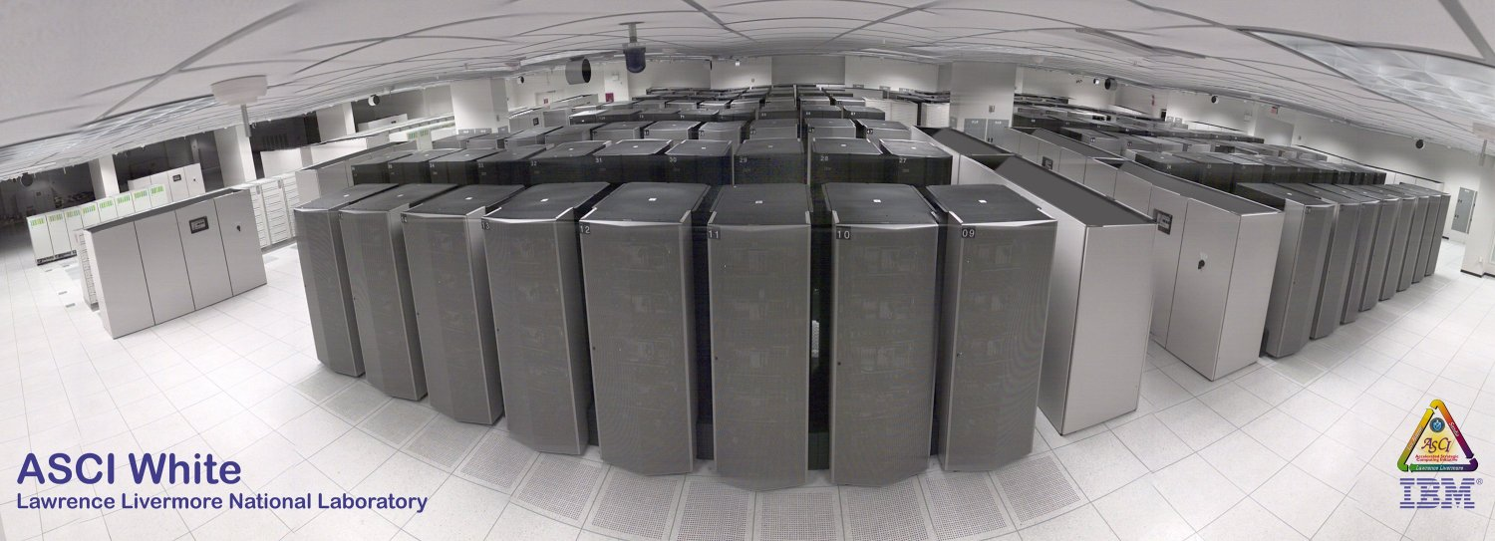
ASCI White (10 teraops/sec)
Third in ASCI series
IBM delivered in 2000

Slide 26
Some Definitions
Concurrent - Events or processes which seem to occur or progress at the same time.
Parallel –Events or processes which occur or progress at the same time
  Parallel programming (also, unfortunately, called concurrent programming), is a computer programming technique that provides for the execution of operations concurrently, either within a single computer, or across a number of systems.
  In the latter case, the term distributed computing is used.

Slide 27
Flynn’s Taxonomy
Best known classification scheme for parallel computers.
Depends on parallelism it exhibits with its
  Instruction stream
  Data stream
  A sequence of instructions (the instruction stream) manipulates a sequence of operands (the data stream)
The instruction stream (I) and the data stream (D) can be either single (S) or multiple (M)
Four combinations: SISD, SIMD, MISD, MIMD

Slide 28
SISD
Single Instruction, Single Data
Single-CPU systems
  i.e., uniprocessors
Note: co-processors don’t count
Concurrent processing allowed
  Instruction prefetching
  Pipelined execution of instructions
Functional parallel execution
Example: PCs

Slide 29
SIMD
Single instruction, multiple data
One instruction stream is broadcast to all processors
Each processor (also called a processing element or PE) is very simplistic and is essentially an ALU;
  PEs do not store a copy of the program nor have a program control unit.
Individual processors can be inhibited from participating in an instruction (based on a data test).

Slide 30
SIMD (cont.)
All active processor executes the same instruction synchronously, but on different data
On a memory access, all active processors must access the same location in their local memory.
The data items form an array and an instruction can act on the complete array in one cycle.

Slide 31
SIMD (cont.)
Quinn calls this architecture a processor array
  An example is the Connection Machine CM2
Quinn also considers a pipelined vector processor to be a SIMD
  This is a somewhat non-standard use of the term.
  An example is the Cray-1

Slide 32
How to View a SIMD Machine
Think of soldiers all in a unit.
A commander selects certain soldiers as active – for example, every even numbered row.
The commander barks out an order that all the active soldiers should do and they execute the order synchronously.

Slide 33
MISD
Multiple instruction, single data
Quinn argues that a systolic array is an example of a MISD structure (pg 55-57)
Some authors include pipelined architecture in this category
This category does not receive much attention from most authors so we won’t do much with it.
We will briefly see what a systolic array is later.

Slide 34
MIMD
Multiple instruction, multiple data
Processors are asynchronous, since they can independently execute different programs on different data sets.
Communications are handled either by use of message passing or through shared memory.
Considered by most researchers to contain the most powerful, least restricted computers.

Slide 35
MIMD (cont.)
Have very major communication costs that are often ignored when
  comparing to SIMDs
  when computing algorithmic complexity
A common way to program MIMDs is for all processors to execute the same program.
  Called SPMD method (for single program, multiple data)
  Usual method when number of processors are large.
  Data Parallel programming style for MIMDs

Slide 36
Multiprocessors
(Shared Memory MIMDs)
All processors have access to all memory locations .
The processors access memory through some type of interconnection network.
  This type of memory access is called uniform memory access (UMA) .
Most multiprocessors have hierarchical or distributed memory systems in order to provide fast access to all memory locations.
  This type of memory access is called nonuniform memory access (NUMA).

Slide 37
Multiprocessors (cont.)
Normally, fast cache is used with NUMA systems to reduce the problem of different memory access time for PEs.
  This creates the problem of ensuring that all copies of the same date in different memory locations are identical.
Symmetric Multiprocessors (SMPs) are currently a popular example of shared memory multiprocessors where all nodes are the same machine.

Slide 38
Multicomputers
(Message-Passing MIMDs)
Processors are connected by an interconnection network
Each processor has a local memory and can only access its own local memory.
Data is passed between processors using messages, as dictated by the program.
A common approach to programming multiprocessors is to use a message passing language (e.g., MPI, PVM)
The problem is divided into processes that can be executed concurrently on individual processors. Each processor is normally assigned multiple processes.

Slide 39
Multicomputers
Programming disadvantages of message-passing
  Programmers must make explicit message-passing calls in the code
  This is low-level programming and is error prone.
  Data is not shared but copied, which increases the total data size.
  Data Integrity: difficulty in maintaining correctness of multiple copies of data item.

Slide 40
Multicomputers
Programming advantages of message-passing
  No problem with simultaneous access to data.
  Allows different PCs to operate on the same data independently.
  Allows PCs on a network to be easily upgraded when faster processors become available.
Mixed “distributed shared memory” systems
  Lots of current interest in a cluster of SMPs.

Slide 41
Seeking Concurrency
Several Different Ways Exist
Data dependence graphs
Data parallelism
Functional (or control) parallelism
Pipelining

Slide 42
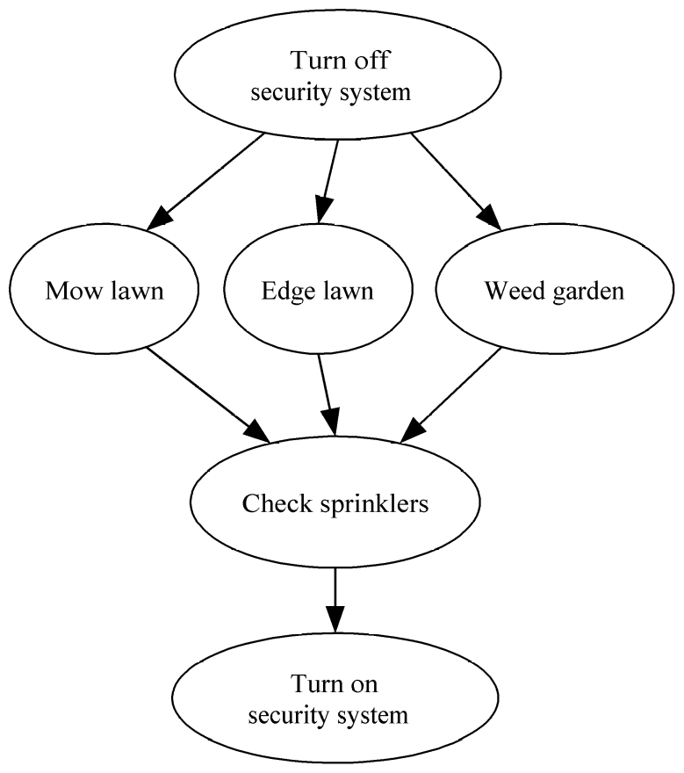
Data Dependence Graph
Directed graph
Vertices = tasks
Edges = dependences
Edge from u to v means that task u must finish before task v can start.

Slide 43
Data Parallelism
All tasks apply same operations to different elements of a data set
Example:
Okay to perform operations concurrently
On SIMDs, accomplished by having all active processors execute the same operations synchronously.
for i ← 0 to 99 do
a[i] ← b[i] + c[i]
endfor

Slide 44
Data Parallelism
A common way to support data parallel programming on MIMDs is to use SPMD (single program multiple data) programming as follows:
  Processors (or tasks) executing the same block of instructions concurrently but asynchronously
  No communication or synchronization occurs within these concurrent instruction blocks.
  Instruction blocks are normally followed by synchronization or communication steps

Slide 45
Data Parallelism Features
Each processor performs the same data computation on different data sets
Computations can be performed either synchronously or asynchronously
Grain Size is the average number of computations performed between communication synchronization steps
  See Quinn textbook, page 411
Data parallel programming usually results in smaller grain size computation
  SIMD computation is considered to be fine-grain
  MIMD data parallelism is usually considered to be medium grain

Slide 46
Functional/Control/Job Parallelism
Independent tasks apply different operations to different data elements
First and second statements execute concurrently
Third and fourth statements execute concurrently
a ← 2
b ← 3
m ← (a + b) / 2
s ← (a² + b²) / 2
v ← s - m²

Slide 47
Control Parallelism Features
Problem is divided into different non-identical tasks
Tasks are divided between the processors so that their workload is roughly balanced
Parallelism at the task level is considered to be coarse grained parallelism

Slide 48
Data Dependence Graph
Can be used to identify data parallelism and job parallelism.
See page 11.
Most realistic jobs contain both parallelisms
  Can be viewed as branches in data parallel tasks
  No path from vertex u to vertex v? Have job parallelism and the tasks can be done concurrently.
  - Tasks can be divided between different data streams (i.e. employees)? Have data parallelism and the larger tasks can be subdivided into smaller ones.

Slide 49
For example, Mow lawn becomes
Mow N lawn
Mow S lawn
Mow E lawn
Mow W lawn
If 4 people are available
and people are available
for Edge Lawn and Weed
Garden, then we can use
data parallelism to provide
more concurrency,

Slide 50
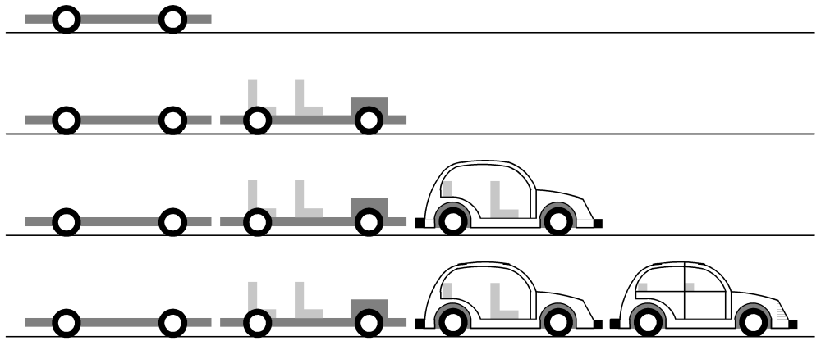
Pipelining
Divide a process into stages
Produce several items simultaneously

Slide 51
Compute Partial Sums
Consider the for loop:
p[0] ← a[0]
for i ← 1 to 3 do
  p[i] ← p[i-1] + a[i]
  endfor
This computes the partial sums:
  p[0] ← a[0]
  p[1] ← a[0] + a[1]
  p[2] ← a[0] + a[1] + a[2]
  p[3] ← a[0] + a[1] + a[2] + a[3]
The loop is not data parallel as there are dependencies.
However, we can stage the calculations as follows and achieve some parallelism.

Slide 52

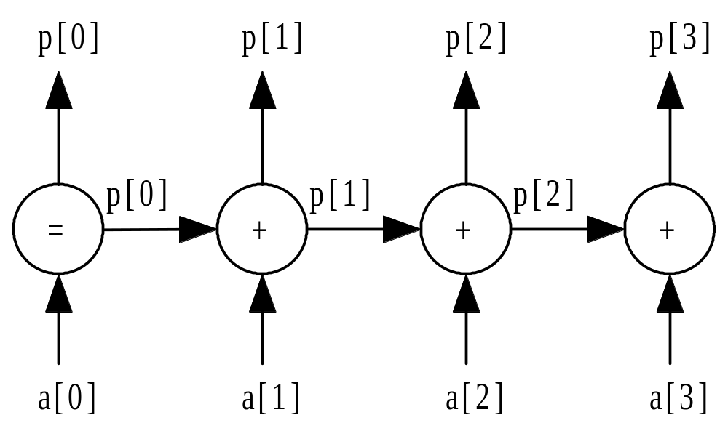
Partial Sums Pipeline

Slide 53
Data Clustering Example
Data mining - Process of searching for meaningful patterns in large data sets
Data clustering - Organizing a data set into clusters of “similar” items
Data clustering can speed retrieval of items closely related to a particular item.

Slide 54
Document Vectors
Moon
The Geology of Moon Rocks
The Story of Apollo 11
A Biography of Jules Verne
Alice in Wonderland
Rocket

Slide 55
Document Clustering

Slide 56
Clustering Algorithm
Compute document vectors
Choose initial cluster centers
Repeat
  Compute performance function which evaluates “goodness of fit”
  Adjust centers
Until function value converges or max iterations have elapsed
Output cluster centers

Slide 57
Data Parallelism Opportunities
Operation being applied to a data set
Examples
  Generating document vectors
  Picking initial values of cluster centers
  Finding closest center to each vector on each repetition

Slide 58
Functional Parallelism Opportunities
Draw data dependence diagram
Look for sets of nodes such that there are no paths from one node to another

Slide 59
Data Dependence Diagram
Build document vectors
Choose cluster centers
Compute function value
Adjust cluster centers
Output cluster centers

Slide 60
Functional Parallelism Tasks
The only independent sets of vertices are
  Those representing generating vectors for documents and
  Those representing initially choosing cluster centers
  i.e. the first two in the diagram.
These two set of tasks could be performed concurrently

Slide 61
Programming Parallel Computers – How?
Extend compilers: Translate sequential programs into parallel programs
Extend languages: Add parallel operations
Add parallel language layer on top of sequential language
Define totally new parallel language and compiler system

Slide 62
Strategy 1: Extend Compilers
Parallelizing compiler
  Detect parallelism in sequential program
  Produce parallel executable program
i.e. Focus on making Fortran programs parallel
  Builds on the results of billions of dollars and millennia of programmer effort in creating (sequential) Fortran programs
  “Dusty Deck” philosophy

Slide 63
Extend Compilers (cont.)
Advantages
  Can leverage millions of lines of existing serial programs
  Saves time and labor
  Requires no retraining of programmers
  Sequential programming easier than parallel programming

Slide 64
Extend Compilers (cont.)
Disadvantages
  Parallelism may be irretrievably lost when programs written in sequential languages
  Performance of parallelizing compilers on broad range of applications still up in air

Slide 65
Extend Language
Add functions to a sequential language
  Create and terminate processes
  Synchronize processes
  Allow processes to communicate

Slide 66
Extend Language (cont.)
Advantages
  Easiest, quickest, and least expensive
  Allows existing compiler technology to be leveraged
  New libraries can be ready soon after new parallel computers are available

Slide 67
Extend Language (cont.)
Disadvantages
  Lack of compiler support to catch errors
  Easy to write programs that are difficult to debug

Slide 68
Add a Parallel Programming Layer
Lower layer
  Core of computation
  Process manipulates its portion of data to produce its portion of result
Upper layer
  Creation and synchronization of processes
  Partitioning of data among processes
A few research prototypes have been built based on these principles

Slide 69
Create a Parallel Language
Develop a parallel language “from scratch”
  occam is an example
Add parallel constructs to an existing language
  Fortran 90
  High Performance Fortran
  C*

Slide 70
New Parallel Languages (cont.)
Advantages
  Allows programmer to communicate parallelism to compiler
  Improves probability that executable will achieve high performance
Disadvantages
  Requires development of new compilers
  New languages may not become standards
  Programmer resistance

Slide 71
Current Status
Low-level approach is most popular
  Augment existing language with low-level parallel constructs
  MPI and OpenMP are examples
Advantages of low-level approach
  Efficiency
  Portability
Disadvantage: More difficult to program and debug

Slide 72
Summary (1/2)
High performance computing
  U.S. government
  Capital-intensive industries
  Many companies and research labs
Parallel computers
  Commercial systems
  Commodity-based systems

Slide 73
Summary (2/2)
Power of CPUs keeps growing exponentially
Parallel programming environments changing very slowly
Two standards have emerged
  MPI library, for processes that do not share memory
  OpenMP directives, for processes that do share memory
Various terms have been defined in this section.

