Slide 1
CHAPTER 17- Limitations of Computing
CPSC 171
Professor: Oberta A. Slotterbeck (Obie)
Computer Science Department
Hiram College
obie@hiram.edu

Slide 2
Chapter Goals
Describe the limits that the hardware places on the solution to computing problems
Discuss how the finiteness of the computer impacts the solutions to numeric problems
Discuss ways to ensure that errors in data transmission are detected
Describe the limits that the software places on the solutions to computing problems

Slide 3
Chapter Goals (cont.)
Discuss ways to build better software
Describe the limits inherent in computable problems themselves
Discuss the continuum of problem complexity from problems in Class P to problems that are unsolvable

Slide 4
Algorithm Complexity

Slide 5
We will investigate the notion of the complexity of an algorithm.
Algorithms consume resources of a computing agent:
TIME: How much time is consumed during the execution of the algorithm?
SPACE: How much additional storage (space), other than that used to hold the input and a few extra variables, is needed to execute the algorithm?

Slide 6
How Will We Measure The Time For An Algorithm?
Code the algorithm and run it on a computer?
  What machine?
  What language?
  Who codes?
  What data?
Doing this (which is called benchmarking) can be useful, but not for comparing algorithms.
You will do some benchmarking in the lab this week.

Slide 7
Instead, we determine the time complexity of an algorithm and use it to compare that algorithm with others for which we also have their time complexity.
What we want to do is relate
1. the amount of work performed by an algorithm
2. and the algorithm's input size
by a fairly simple formula.

Slide 8
Steps For Determining The Time Complexity Of An Algorithm
1. Determine how you will measure input size. Ex:
  N items in a list
  N x M table (with N rows and M columns)
  Two numbers of length N
2. Choose an operation (or perhaps two operations) to count as a gauge of the amount of work performed. Ex:
  Comparisons
  Swaps
  Copies
  Additions
Normally we don't count input/output time.

Slide 9
Steps For Determining The Time Complexity Of An Algorithm
3. Decide whether you wish to count operations in the
  Best case? - the fewest possible operations
  Worst case? - the most possible operations
  Average case?
    This is harder as it is not always clear what is meant by an "average case". Normally calculating this case requires some higher mathematics such as probability theory.
4. For the algorithm and the chosen case (best, worst, average), express the count as a function of the input size of the problem.

Slide 10
For example, count operations and produce statements such as ...
For n items in a list, counting the operation swap, we find the algorithm performs 10n + 5 swaps in the worst case.
For an n X m table, counting additions, we find the algorithm perform nm additions in the best case.
For two numbers of length n, there are 3n + 20 multiplications in the best case.

Slide 11
STEPS FOR DETERMING THE TIME COMPLEXITY OF AN ALGORITHM
5. Given the formula that you have determined, decide the complexity class of the algorithm.
What is the complexity class of an algorithm?
Question: Is there really much difference between
3n
5n + 20
and 6n -3
especially when n is large?

Slide 12
But, there is a difference, for n large, between
n
n²
and n³
So we try to classify algorithms into classes, based on their counts and simple formulas such as n, n², n³, and others.
Why does this matter?
It is the complexity of an algorithm that most affects its running time---
not the machine or its speed

Slide 13
Order Wins Out – We’ll use 2 machines for an experiment
The TRS-80
Main language support: BASIC - typically a slow running language
For more details on TRS-80 see:
http://mate.kjsl.com/trs80/
The CRAY-YMP
Language used in example: FORTRAN- a fast running language
For more details on CRAY-YMP see:
http://ds.dial.pipex.com/town/park/abm64/CrayWWWStuff/Cfaqp1.html#TOC3

Slide 14
CRAY YMP TRS-80
with FORTRAN with BASIC
complexity is 3n³ complexity is 19,500,000n
n is:
10
100
1000
2500
10000
1000000
3 microsec
200 millisec
3 millisec
2 sec
3 sec
20 sec
50 sec
50 sec
49 min
3.2 min
95 years
5.4 hours

Slide 15
Trying to maintain an exact count for an operation isn't too useful.
Thus, we group algorithms that have counts such as
n
3n + 20
1000n - 12
0.00001n +2
together. We say algorithms with these type of counts are in the class O(n) -
read as the class of big O-of-n or
all algorithms of magnitude n or
all order-n algorithms

Slide 16
Similarly, algorithms with counts such as
n² + 3n
1/2n² + 4n - 5
1000n² + 2.54n +11
are in the class O(n²).
Other typical classes are those with easy formulas in n such as
1
n³
2^{n}
lg n k = lg n if and only if 2^{k} = n

Slide 17
lg n k = lg n if and only if 2^{k} = n
lg 4 = ?
lg 8 = ?
lg 16 = ?
lg 10 = ?
Note that all of these are base 2 logarithms. You don't use any logarithm table as we don't need exact values (except on powers of 2).
The major classes typically used are
O(1), O(n), O(n²), O(n³), O(lg n), O(n lg n), O(2^{n})

Slide 18
ANOTHER COMPARISON
n =
order 10 50 100 1,000
lg n 0.0003 sec 0.0006 sec 0.0007 sec 0.001 sec
n 0.001 sec 0.005 sec 0.01 sec 0.1 sec
n² 0.01 sec 0.25 sec 1 sec 1.67 min
2^{n} 0.1024 sec 3570 years 4 x 10¹⁶ why centuries? bother?
Does order make a difference?
You bet it does, but not on tiny problems.
On large problems, it makes a major difference and can
even predict whether or not you can execute the algorithm.

Slide 19
Why not just build a faster computing agent?
Why not use parallel computing agents?
No matter what we do, the complexity (i.e. the order) of the algorithm has a major impact!!!
So, can we compare two algorithms and say which is the better one with respect to time?
Yes, provided we do several things:

Slide 20
Comparing Two Algorithms With Respect To Time
1. Count the same operation for both.
2. Decide whether this is a best, worst, or average case.
2. Determine the complexity class for both, say O(f) and O(g) for the chosen case.
3. Then, for large problems, data that is for the case you analyzed, and no further information:
  If f = g, then they are essentially the same.
  If f < g, choose the O(f) algorithm.
  Otherwise, choose the O(g) algorithm.

Slide 21
More Precise DefinitionsL
(only for those with calculus backgrounds)
Definition: Let f and g be functions defined on the positive real numbers with real values.
We say g is in O(f) if and only if
lim g(n)/f(n) = c
n -> ∞
for some nonnegative real number c--- i.e. the limit exists and is not infinite.
We say f is in Θ(g) if and only if
f is in O(g) and g is in O(f)
Note: Often to calculate these limits you need L'Hopital's Rule.

Slide 22
Big-O Analysis – quick summary
A function of the size of the input to the operation (for instance, the number of elements in the list to be summed)
We can express an approximation of this function using a mathematical notation called order of magnitude, or Big-O notation

Slide 23
Big-O Analysis
f(N) = N⁴ + 100N² + 10N + 50
Then f(N) is of order N⁴—or, in Big-O notation, O(N⁴).
For large values of N, N⁴ is so much larger than 50, 10N, or even 100 N² that we can ignore these other terms

Slide 24
Big-O Analysis
Common Orders of Magnitude
  O(1) is called bounded time
    Assigning a value to the ith element in an array
    of N elements
  O(log₂N) is called logarithmic time
    Algorithms that successively cut the amount of data to be processed in half at each step typically fall into this category
    Finding a value in a list of sorted elements using the binary search algorithm is O(log₂N)

Slide 25
Big-O Analysis
  O(N) is called linear is called linear time
    Printing all the elements in a list of N elements is O(N)
  O(N log₂N)
    Algorithms of this type typically involve applying a logarithmic algorithm N times
    The better sorting algorithms, such as Quicksort, Heapsort, and Mergesort, have
    N log₂N complexity

Slide 26
Big-O Analysis
  O(N²) is called quadratic time
    Algorithms of this type typically involve applying a linear algorithm N times. Most simple to understand sorting algorithms such as the Selection Sort and Bubble Sort are O(N²) algorithms

Slide 27
Analyze the Selection Sort
Let n be the number of elements we are sorting.
Let’s count comparisons:
The first time through the list, we do n-1 comparisons to find the smallest element.
The second time through the list, we do n-2 comparisons to find the smallest element.
We continue doing this n-1 times.
So the number of comparisons is
1 + 2 + + (n-2) + (n-1)
We use Euler’s method to simplify this (See the board) to show this is O(n²).

Slide 28
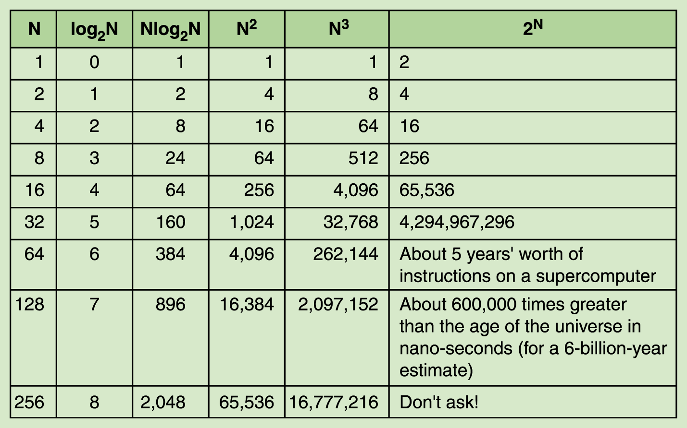
Big-O Analysis
  O(2^{N}) is called exponential time
Table 17.2 Comparison of rates of growth

Slide 29
Big-O Analysis
  O(n!) is called factorial time
    The traveling salesperson graph algorithm is a factorial time algorithm
    Algorithms whose order of magnitude can be expressed as a polynomial in the size of the problem are called polynomial-time algorithms
    All polynomial-time algorithms are defined as being in Class P

Slide 30
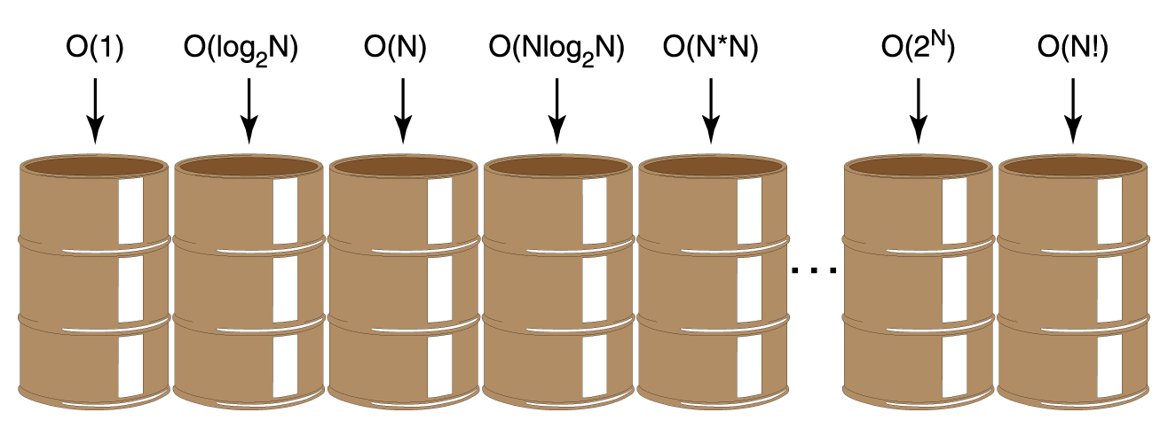
Big-O Analysis
Figure 17.3 Orders of complexity

Slide 31
Turing Machines

Slide 32
Turing Machines
Alan Turing developed the concept of a computing machine in the 1930s
A Turing machine, as his model became known, consists of a control unit with a read/write head that can read and write symbols on an infinite tape.

Slide 33
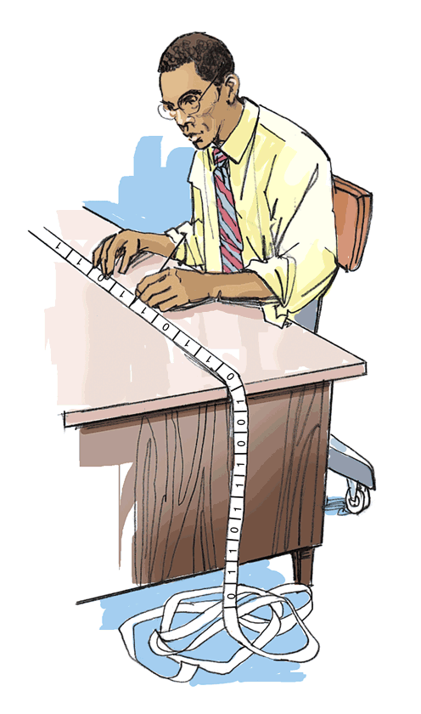
Turing Machines
Why is such a simple machine (model) of any importance?
  It is widely accepted that anything that is intuitively computable can be computed by a Turing machine
  If we can find a problem for which a Turing-machine solution can be proven not to exist, then the problem must be unsolvable
Figure 17.4 Turing machine processing

Slide 34
Halting Problem
It is not always obvious that a computation (program) halts
The Halting problem: Given a program and an input to the program, determine if the program will eventually stop with this input
This problem is unsolvable

Slide 35
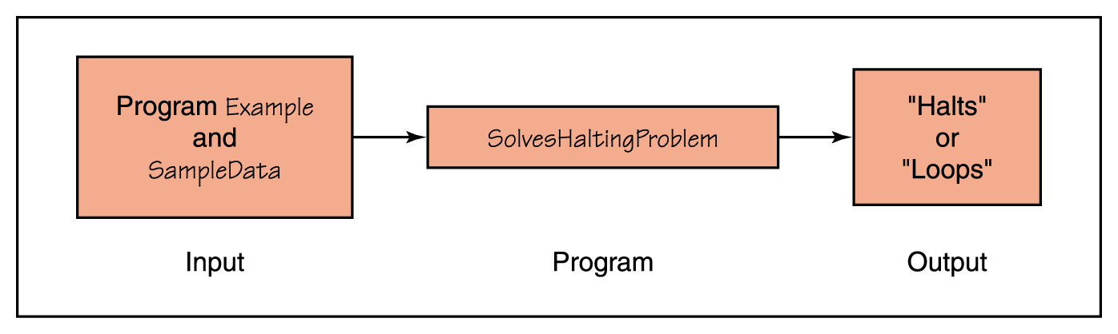
Halting Problem
Assume that there exists a Turing-machine program, called SolvesHaltingProblem that determines for any program Example and input SampleData whether program Example halts given input SampleData
We will show that such an assumption leads to a fallacy.
Figure 17.5 Proposed program for solving the Halting problem

Slide 36

Halting Problem
We can give a program a copy of itself as data.
This is not so strange as you might first think as programs and data are just bit patterns. Moreover, a compiler is an program that takes another program as data.
Now, if SolvesHaltingProblem exists, it should be able to determine either “Halts” or “Loops”.

Slide 37
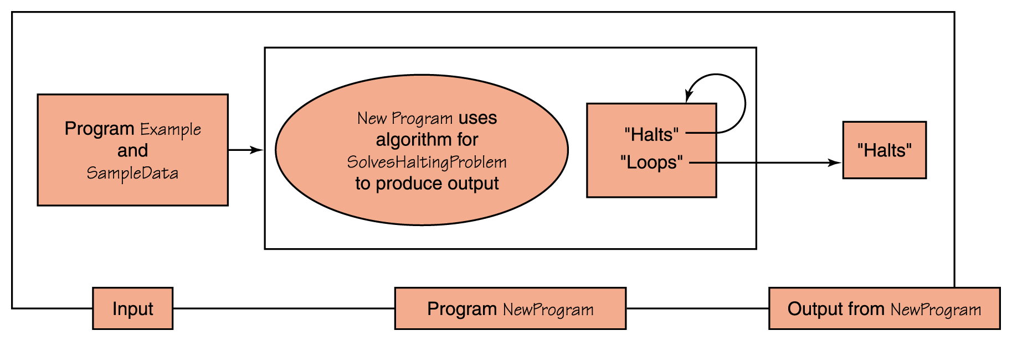
Halting Problem – next step: Construct NewProgram

Slide 38
Halting Problem – Summary of last slide
Now let’s construct a new program, NewProgram, that takes program Example as both program and data and uses the algorithm from SolvesHaltingProblem to write “Halts” if Example halts and “Loops” if it does not halt
Let’s now apply program SolvesHaltingProblem to NewProgram, using NewProgram as data
  If SolvesHaltingProblem prints “Halts”,
  program NewProgram goes into an infinite loop
  If SolvesHaltingProblem prints “Loops”, program NewProgram prints “Halts” and stops
  In either case, SolvesHaltingProblem gives the wrong answer

Slide 39
P, NP, and NP-Complete Algorithms

Slide 40
Interesting Theoretical Problems Whose Solutions Might Help Us With Practical Problems
An algorithm is said to be a polynomial time algorithm (or a polynomial algorithm) if it is in O(n^{k}), for k a positive integer.
However, when k becomes larger than 3, the timing is so poor that the algorithm is not terribly useful on very, large data sets.
Sometimes when k is large, we develop algorithms that produce approximate results.

Slide 41
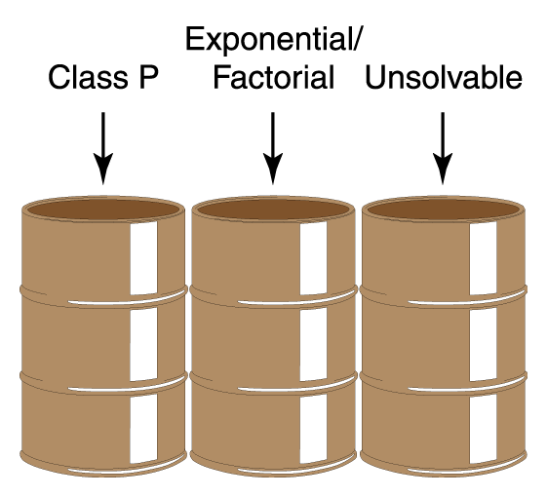
New Classes
Let’s reorganize our bins, combining all polynomial algorithms in a bin labeled Class P.
The algorithms in the middle bin have known solutions, but they are called intractable because for data of any size they simply take too long to execute.
The right bin includes problems that are unsolvable – i.e. no algorithm can solve them.
We have seen one such problem: The Halting Problem.
There are other unsolvable problems.
Figure 17.8 A reorganization of algorithm classification

Slide 42
The Class NP
A problem is said to be in Class NP if it can be solved with a sufficiently large number of processors in polynomial time – i.e. the number of processors is unbounded.
There are a class of algorithms called NP-complete problems with the property that if a polynomial time solution with one processor can be found for any member of the class, then such a solution exists for every member of the class.
NP-complete algorithms are in the class NP, but they can be transformed into each other by polynomial algorithms.

Slide 43
Some NP-complete Problems
The Traveling Salesperson Problem
The Bin-Packing Problem
  Given fixed capacity bins and objects of varying volumes. What is the minimum number of bins needed to pack all the objects in the bins?
  Special case: What is the minimum number of CDs needed to fit n songs of varying lengths on the CDs.
The 0-1 Knapsack Problem
  Given a knapsack and objects of varying value. How can you pack the knapsack to maximize the value of the objects you take.
  Note: If you can use fractional parts of items, the problem is not NP-complete.

Slide 44
One of the Big Questions in Computer Science.
We know that P ⊆ NP.
But, is P = NP?
i.e. Can we either prove that all NP algorithm also have polynomial algorithms or
does there exist at least one NP algorithm for which no polynomial algorithm can ever exist.
Much of the work has concentrated on the NP-complete class since if any one of those problems have a polynomial algorithm, then all of them will.
Many practical, useful problems fall in the NP-complete class.

Slide 45
Limits on Arithmetic

Slide 46
Limits on Arithmetic
There are limitations imposed by the hardware on the representations of both integer numbers and real numbers
  If the word length is 32 bits, the range of integer numbers that can be represented is -2,147,483,648 to 2,147,483,647 or 2³² numbers.
    Example to explain the seeming imbalance between positive and negative numbers:
    With 2-bit numbers we have
    1) The non-negative numbers are 00, 01 i.e. 1 is largest
    2) The negative numbers are 10 (-2) and 11(-1).
    So, the range is -2 to 1.
  Any integer outside this range cannot be handled by the hardware arithmetic operations.

Slide 47
Limits on Arithmetic
  There are software solutions, however, that allow programs to overcome these limitations
  For example, we could represent a very large number as a list of smaller numbers
  For example, 1874 could be viewed as a list of distinct numbers 1, 8, 7, 4 or even a list of numbers 18 and 74.
    With this approach the programmer must provide programs to add, subtract, multiply, and divide these large integers.

Slide 48
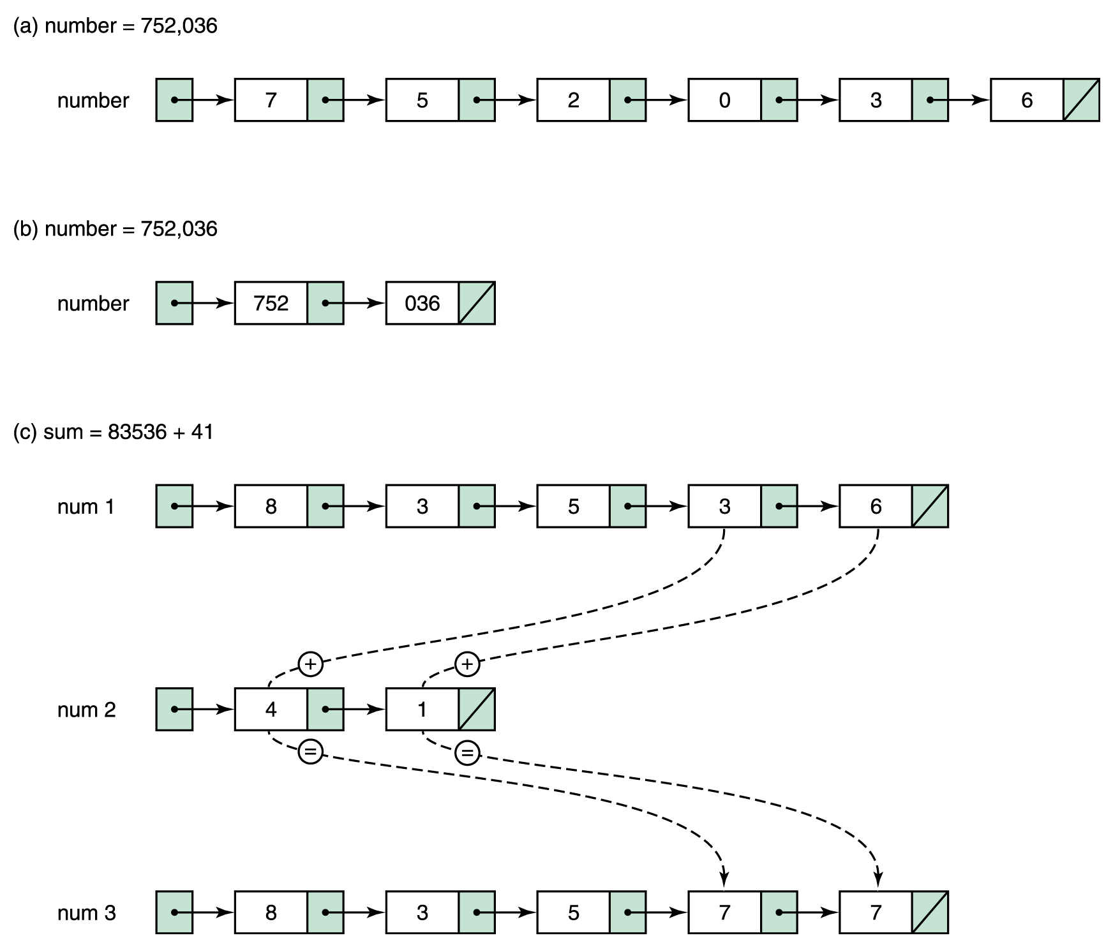
Limits on Arithmetic
Figure 17.1 Representing very large numbers

Slide 49
Limits on Arithmetic
Recall real numbers are stored by the hardware as an integer representing the mantissa and the exponent along with some convention that indicates where the radix point is.
Let’s assume that we have a computer in which each memory location is the same size and is divided into a sign plus five decimal digits
When a real variable is declared or a real constant is defined, the number stored there has both a whole number part and a fractional part

Slide 50
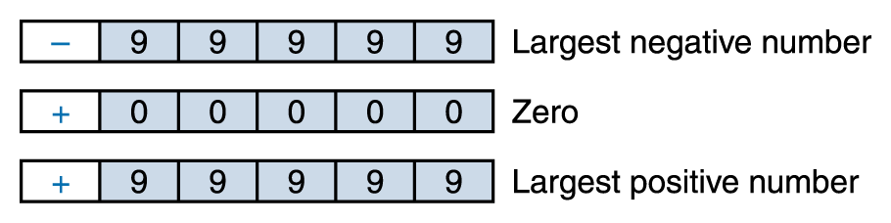
Limits on Arithmetic
The range of the numbers we can represent with five digits is -99,999 through +99,999:

Slide 51

Limits on Arithmetic
The precision (the maximum number of digits that can be represented) is five digits, and each number within that range can be represented exactly
What happens if we allow one of these digits (let’s say the leftmost one, in red) to represent an exponent?
For example, let
  represents the number +2,345 * 10³

Slide 52
Limits on Arithmetic
The range of numbers we can now represent is much larger:
-9,999 * 10⁹ to +9,999 * 10⁹
or
-9,999,000,000,000 to +9,999,000,000,000
However, we can represent only four significant digits
This means there are huge gaps between numbers, especially as we move away from zero.
If we try to represent a number in one of those gaps, we must approximate it with a number at one end or another of the gap.

Slide 53
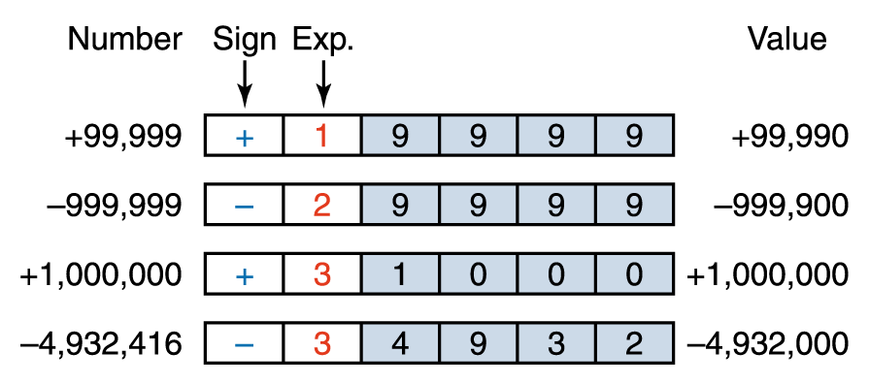
Limits on Arithmetic
The four leftmost digits are correct, and the balance of the digits are assumed to be zero
We lose the rightmost, or least significant, digits

Slide 54
Limits on Arithmetic
To extend our coding scheme to represent real numbers, we need to be able to represent negative exponents.
For example
  4,394 * 10⁻² = 43.94
  or
  22 * 10⁻⁴ = 0.0022

Slide 55
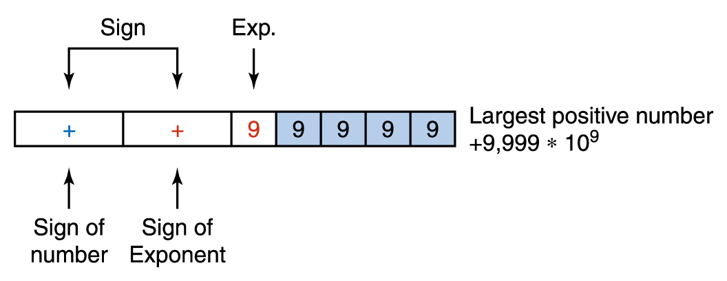
Limits on Arithmetic
Add a sign to the left of it to be the sign of the number itself

Slide 56
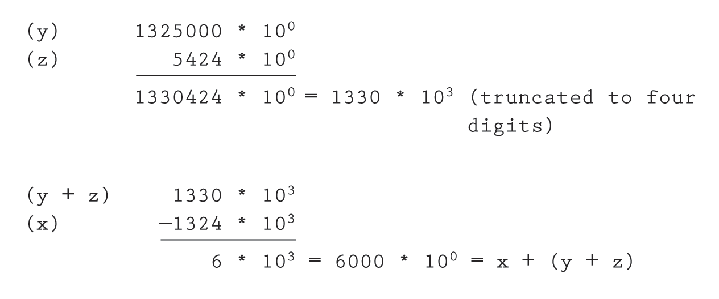
Limits on Arithmetic
But, x + (y + z) should be 6424.
This is called representational error or round-off error

Slide 57
Limits on Arithmetic
In addition to representational errors, there are two other problems to watch out for in floating-point arithmetic: underflow and overflow
  Underflow is the condition that arises when the absolute value of a calculation gets too small to be represented – i.e. it is too close to zero so it is represented as a zero.
  Overflow is the condition that arises when the absolute value of a calculation gets too large to be represented

Slide 58
Limits on Arithmetic
Another type of error that can happen with floating-point numbers is called cancellation error
This error happens when numbers of widely differing magnitudes are added or subtracted

Slide 59
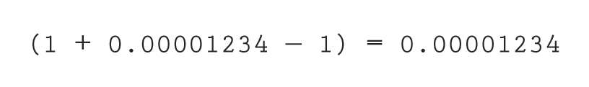
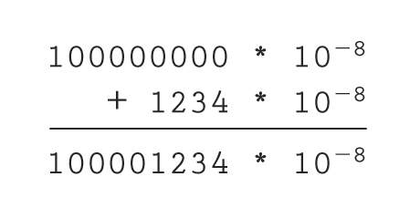
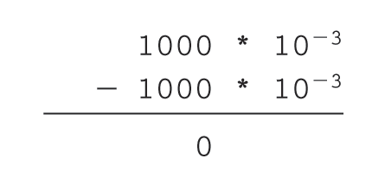
Limits on Arithmetic
With four-digit accuracy, this becomes 1000 * 10⁻³.
Now the computer subtracts 1:
The result is 0, not .00001234

Slide 60
Limits on Communication

Slide 61
Limits on Communications
Error-detecting codes determine that an error has occurred during the transmission of data and then alert the system
Error-correcting codes not only determine that an error has occurred but try to determine what the correct value actually is

Slide 62
Limits on Communications
Parity bits are used to detect that an error has occurred between the storing and retrieving of a byte or the sending and receiving of a byte
  A parity bit is an extra bit that is associated
  with each byte
  This bit is used to ensure that the number
  of 1 bits in a 9-bit value (byte plus parity bit) is odd (or even) across all bytes

Slide 63
Limits on Communications
Odd parity requires the number of 1s in a byte plus parity bit to be odd
For example
  If a byte contains the pattern 11001100, the parity bit would be 1, thus giving an odd number of 1s
  If the pattern were 11110001, the parity bit would be 0, giving an odd number of 1s
Even parity uses the same idea, but the number of 1 bits must be even

Slide 64
Limits on Communications
Check digits
  A software variation of the same scheme is to sum the individual digits of a number, and then store the unit’s digit of that sum with the number
  For example, given the number 34376, the sum of the digits is 23, so the number would be stored as 3437623
  Credit card numbers include check digits.
Error-correcting codes
  If enough information about a byte or number is kept, it is possible to deduce what an incorrect bit or digit must be

Slide 65
The Complexity of Software

Slide 66
The Complexity of Software
All software contains errors
  The problem, particularly with commercial software, is the complexity of the software.
  Software testing can demonstrate the presence of bugs but cannot demonstrate their absence!
    As we find problems and fix them, we raise our confidence that the software performs as it should.
    But we can never guarantee that all bugs have been removed by just testing the software.

Slide 67
Software Engineering
In Chapter 6, we outlined three stages of computer problem solving
  Develop the algorithm
  Implement the algorithm
  Maintain the program
When we move from small, well-defined tasks to large software projects, we need to add two extra layers on top of these
  Software requirements and specifications

Slide 68
Software Engineering
Software requirements are broad, but precise, statements outlining what is to be provided by the software product
Software specifications are a detailed description of the function, inputs, processing, outputs, and special features of a software product

Slide 69
Software Engineering
Two verification techniques effectively used by programming teams are:
  Design or code walk-throughs
  Inspections
A guideline for the number of errors per lines of code that can be expected
  Standard software: 25 bugs per 1,000 lines
  of program
  Good software: 2 errors per 1,000 lines
  Space Shuttle software: < 1 error per 10,000 lines

Slide 70
Formal Verification
The verification of program correctness, independent of data testing, is an important area of theoretical computer science research
Formal methods have been used successfully in verifying the correctness of computer chips and a few compilers.
It is hoped that success with formal verification techniques at the hardware level can lead eventually to success at the software level

Slide 71
Notorious Software Errors
AT&T Down for Nine Hours
  In January of 1990, AT&T’s long-distance telephone network came to a screeching halt for nine hours, because of a software error in the electronic switching systems
Therac-25
  Between June 1985 and January 1987, six known accidents involved massive overdoses by the Therac-25, leading to deaths and serious injuries
  There was only a single coding error, but tracking down the error exposed that the whole design was seriously flawed

Slide 72
Notorious Software Errors
Launched in July of 1962, the Mariner 1 Venus probe veered off course almost immediately and had to be destroyed
The problem was traced to the following line of Fortran code:
  DO 5 K = 1. 3
The period should have been a comma.
An $18.5 million space exploration vehicle was lost because of this typographical error

Slide 73
Intuit's MacInTax leaks financial secrets: 1995
Intuit's tax software for Windows and Macintosh has suffered a series of bugs, including several that prompted the company to pledge to pay any resulting penalties and interest.
The scariest bug was discovered in March 1995: the code included in a MacInTax debug file allowed Unix users to log in to Intuit's master computer, where all MacInTax returns were stored.
From there, the user could modify or delete returns.
.

Slide 74
New Denver airport misses its opening: 1995
The Denver International Airport was intended to be a state-of-the-art airport, with a complex, computerized baggage-handling system and 5,300 miles of fiber-optic cabling.
Unfortunately, bugs in the baggage system caused suitcases to be chewed up and drove automated baggage carts into walls.
The airport eventually opened 16 months late,
$3.2 billion over budget,
and with a mainly manual baggage system.

Slide 75

WHY DOES SOFTWARE HAVE BUGS?
(Some reasons --- but not all)
Miscommunication
No communication
Software complexity
Programming errors
Poor requirements
Changed requirements
Time pressures
Changed environments
Poorly documented code
Misuse of tools
Errors in system support software
Poor planning
Egos
Lack of experience
Featuritis
Inadequate testing

Slide 76
SOFTWARE COMPLEXITY
GUI interfaces
MDI environments
Client/server applications
Distributed applications
Data communications
Enormous databases
Sheer size
Object-oriented techniques (if not well-engineered)
Event-driven logic
Heterogeneous hardware
Multiple software vendors

