Slide 1
Chapter 2- Part 2
Parallel Architectures

Slide 2
Outline
Flynn’s Taxonomy – covered in Chapter 1 slides
Interconnection networks – covered in Chapter 2 - Part 1 slides
Processor arrays
Multiprocessors
Multicomputers

Slide 3
Some References
Selim Akl, The Design and Analysis of Parallel Algorithms, Prentice Hall, 1989 (earlier textbook).
G. C. Fox, What Have We Learnt from Using Real Parallel Machines to Solve Real Problems? Technical Report C3P-522, Cal Tech, December 1989. (Included in part in more recent books co-authored by Fox.)
A. Grama, A. Gupta, G. Karypis, V. Kumar, Introduction to Parallel Computing, Second Edition, 2003 (first edition 1994), Addison Wesley.
Michael Quinn, Parallel Programming in C with MPI and OpenMP, McGraw Hill,2004 (Current Textbook), Section 2.3

Slide 4
References - continued
Michael Quinn, Parallel Computing: Theory and Practice, McGraw Hill, 1994, Ch. 1,2
Sayed Roosta, “Parallel Processing & Parallel, Ch. 2, Algorithms” by Ch. 1, Reference on overview of SIMDs.
Fundamentals of Parallel Processing: Algorithms, Architectures, Languages, Harry Jordan, Gita Alaghband, Prentice Hall, 2003, Ch 1 & 3.

Slide 5
Historical Notes on SIMDs
Recall that all active processors of a SIMD computer must simultaneously access the same memory location.
These locations can be viewed as components of a vector.
SIMD machines are sometimes called vector computers [Jordan,et.al.] or processor arrays [Quinn 94,04] based on their ability to execute vector and matrix operations efficiently.

Slide 6
SIMDs
SIMD computers that focus on vector operations usually
  support some vector and possibly matrix operations in hardware, and
  limit or provide less support for non-vector type operations involving “vector components”.
SIMD computers that focus on vector operations usually
  support some vector and possibly matrix operations in hardware, and
  limit or provide less support for non-vector type operations involving “vector components”.

Slide 7
Vector Computers
Vector computer: Instruction set includes operations on vectors as well as scalars
Two ways to implement vector computers
  Pipelined vector processor: streams data through pipelined arithmetic units
  Processor array: many identical, synchronized arithmetic processing elements

Slide 8
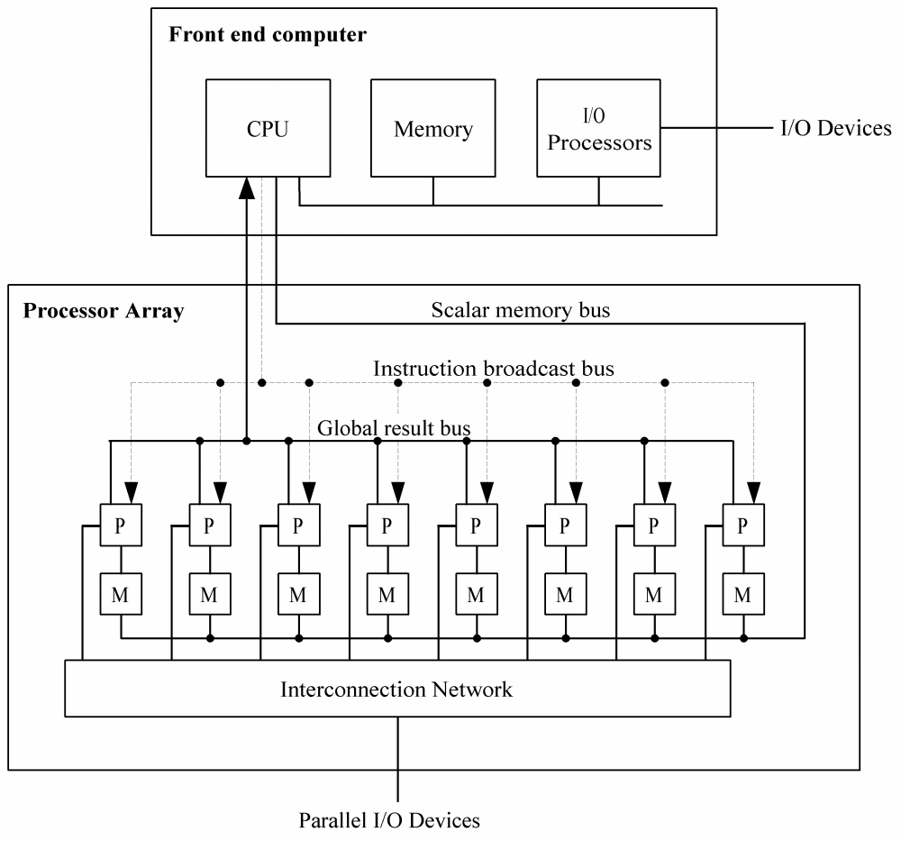
Why Processor Arrays?
Historically, high cost of a control unit
Scientific applications have data parallelism

Slide 9
Data/instruction Storage
Front end computer
  Holds and runs program
  Data manipulated sequentially
Processor array
  Data manipulated in parallel

Slide 10
Processor Array Performance
Performance: work done per time unit
Performance of processor array
  Speed of processing elements
  Utilization of processing elements

Slide 11
Performance Example 1
1024 processors
Each adds a pair of integers in 1 μsec (1 microsecond or one millionth of second or 10⁻⁶ second.)
What is the performance when adding two 1024-element vectors (one per processor)?

Slide 12

Performance Example 2
512 processors
Each adds two integers in 1 μsec
What is the performance when adding two vectors of length 600?
Since 600 > 512, 88 processor must add two pairs of integers.
The other 424 processors add only a single pair of integers.

Slide 13
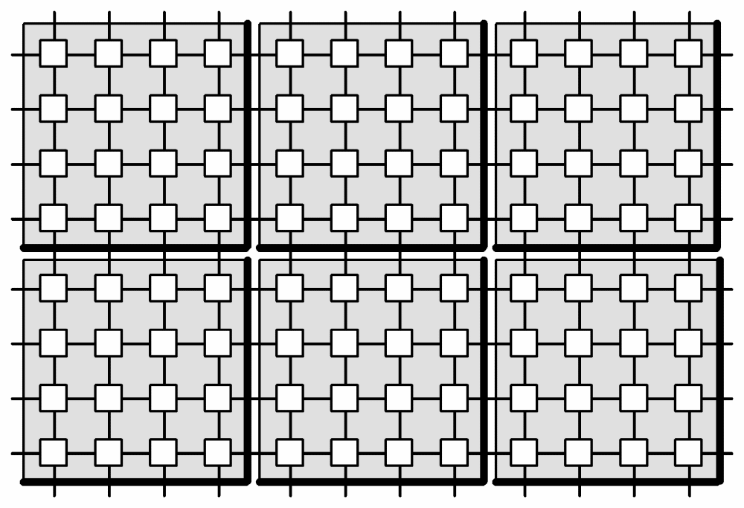
Example of a 2-D Processor Interconnection Network in a Processor Array
Each VLSI chip has 16 processing elements.
Each PE can simultaneously send a value to a neighbor.
PE = processor element

Slide 14
SIMD Execution Style
The traditional (SIMD, vector, processor array) execution style ([Quinn 94, pg 62], [Quinn 2004, pgs 37-43]:
  The sequential processor that broadcasts the commands to the rest of the processors is called the front end or control unit.
  The front end is a general purpose CPU that stores the program and the data that are not manipulated in parallel.
  The front end normally executes the sequential portions of the program.
  Each processing element has a local memory that can not be directly accessed by the host or other processing elements.

Slide 15
SIMD Execution Style
  Collectively, the individual memories of the processing elements (PEs) store the vector data that is processed in parallel.
  When the front end encounters an instruction whose operand is a vector, it issues a command to the PEs to perform the instruction in parallel.
  Although the PEs execute in parallel, some units can be allowed to skip any particular instruction.

Slide 16
Masking on Processor Arrays
All the processors work in lockstep except those that are masked out (by setting the mask bit).
The conditional if-then-else is different for processor arrays:
  Every processor tests to see if its data meets the negation of the boolean condition.
  If it does, it sets its mask bit so those processors will not take place in the operation initially.
  On the unmasked processors, execute the THEN part.
  Flip the mask bits and perform the ELSE part on those processors.

Slide 17
if (COND) then A else B

Slide 18
if (COND) then A else B

Slide 19
if (COND) then A else B

Slide 20
SIMD Machines
An early SIMD computer designed for vector and matrix processing was the Illiac IV computer [Jordan et. al., pg 7] built at the University of Illinois,
The CRAY-1 and the Cyber-205 use pipelined arithmetic units to support vector operations and can be viewed as a pipelined SIMD ([Jordan, et al, p7], [Quinn 94, pg 61-2], [Quinn 2004, pg37).
The MPP, DAP, the Connection Machines CM-1 and CM-2, MasPar MP-1 and MP-2 are examples of SIMD computers given in [Akl, pg 8-12]

Slide 21
SIMD Machines
Quinn [1994, pg 63-67] discusses the Connection Machine CM-200, a smaller & updated CM-2.
Professor Batcher at Kent State University was the chief architect for the STARAN and the MPP (Massively Parallel Processor) and an advisor for the ASPRO (small, second generation ASPRO in the spy planes.)

Slide 22
SIMD Machines - today
WorldScape are producing a COTS (commodity off the shelf) SIMD which is not a true SIMD as the hardware doesn’t synchronize every step, but it can be efficiently synchronized unlike MIMDs.
Uses millions of processors.
Their machine is programmed like a SIMD.
Their machines are representative of several efforts in this area.
The U.S. Navy has observed that their machines process radar faster than others.
Another application is in genome sequencing.

Slide 23
Arguments Supporting SIMDs
Reference: [Roosta, pg 10]
Less hardware than MIMDs as they have only one control unit. Control units are complex.
Less memory needed than MIMD
  Only one copy of the instructions need to be stored
  Allows more data to be stored in memory, which reduces movement of data between primary and secondary storage.
Less startup time in communicating between PEs.

Slide 24
Arguments Supporting SIMDs
Single instruction stream and synchronization of PEs make SIMD applications easier to program, understand, & debug.
Control flow operations and scalar operations can be executed on the control unit while PEs are executing other instructions.
MIMD architectures require explicit synchronization primitives, which create a substantial amount of additional overhead.

Slide 25
Arguments Supporting SIMDs
During a communication operation between PEs,
  PEs send data to a neighboring PE in parallel and in lock step
  the entire communication operation is executed synchronously
Less complex hardware in SIMD since no message decoder is needed in PEs
  MIMDs need a message decoder in each PE.

Slide 26
SIMD Shortcomings
(with some rebuttals)
As listed in our textbook [i.e., Quinn 2004]. Similar statements are found in [Grama, et. al].
Not all problems are data-parallel
  While true, most problems seem to have data parallel solutions.
  In [Fox, et.al.], the observation was made that in their study of current parallel applications, most were data parallel by nature, but often had points where significant branching occurred.

Slide 27
SIMD Shortcomings
(with some rebuttals)
Speed drops for conditionally executed code
  Processors in both MIMD & SIMD normally have to do a significant amount of ‘condition’ testing
  For an if-then-else statement with execution times for the “then” and “else” parts being roughly equal, about ½ of processors are idle during its execution
    With additional branching, the average number of active processors can become higher.
    With SIMDs, only one of these branches can be executed at a time.
    This reason justifies the study of multiple SIMDs (or MSIMD).

Slide 28
SIMD Shortcomings
(with some rebuttals)
(cont) Speed drops for conditionally executed code
  In [Fox, et.al.], the observation was made that for the real applications surveyed, the MAXIMUM number of active branches at any point in time was about 8.
  The cost of the extremely simple processors used in a SIMD are extremely low
    Programmers used to worry about ‘full utilization of memory’ but stopped this after memory cost became insignificant overall.

Slide 29
SIMD Shortcomings
(with some rebuttals)
Don’t adapt to multiple users well.
  This is true to some degree for all parallel computers.
  If usage of a parallel processor is dedicated to a important problem, it is probably best not to risk compromising its performance by ‘sharing’
  This reason also justifies the study of multiple SIMDs (or MSIMD).
  SIMD architecture has not received the attention that MIMD has received and can benefit from further research.

Slide 30
SIMD Shortcomings
(with some rebuttals)
Do not scale down well to “starter” systems that are affordable.
  This point is arguable and its ‘truth’ is likely to vary rapidly over time
  WorldScape/ClearSpeed currently sells a very economical SIMD board that plugs into a PC.

Slide 31
SIMD Shortcomings
(with some rebuttals)
Relies on custom VLSI for processors and expense of control units has dropped
  Reliance on COTS (Commodity, off-the-shelf parts) has dropped the price of MIMDS
  Expense of PCs (with control units) has dropped significantly
  However, reliance on COTS has fueled the success of ‘low level parallelism’ provided by clusters and restricted innovative parallel architecture research for well over a decade.
  There is strong evidence that the period of continual dramatic increases in speed of PCs and clusters is ending.
  Continued rapid increases in parallel performance in the future will be necessary in order to solve important problems that are beyond our current capabilities.

Slide 32
Multiprocessors
Multiprocessor: multiple-CPU computer with a shared memory
Same address on two different CPUs refers to the same memory location
Avoids three problems of processor arrays
  Can be built from commodity CPUs
  Naturally support multiple users
  Maintain efficiency in conditional code

Slide 33
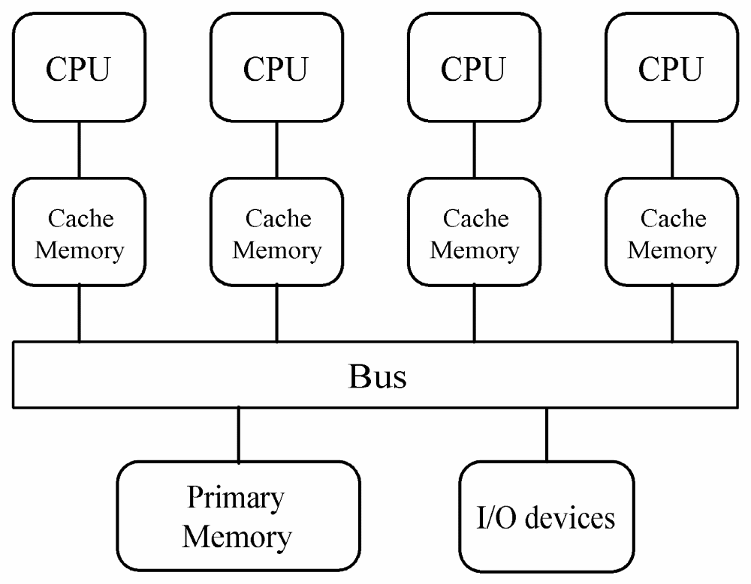
Centralized Multiprocessor

Slide 34
Centralized Multiprocessor
Straightforward extension of uniprocessor
Add CPUs to bus
All processors share same primary memory
Memory access time same for all CPUs
  Uniform memory access (UMA) multiprocessor
  Symmetrical multiprocessor (SMP)

Slide 35
Private and Shared Data
Private data: items used only by a single processor
Shared data: values used by multiple processors
In a multiprocessor, processors communicate via shared data values

Slide 36
Problems Associated with Shared Data
Cache coherence
  Replicating data across multiple caches reduces contention among processors for shared data values.
  But - How can we ensure different processors have the same value for same address?
  The cache coherence problem is when an obsolete value is still stored in a processor’s cache.
  Let’s see how this can happen ...

Slide 37
Cache-coherence Problem
Memory
X
7
Cache
Cache
CPU A
CPU B

Slide 38
Cache-coherence Problem
Memory
Read from memory is not a problem.
X
7
7
CPU A
CPU B

Slide 39
Cache-coherence Problem
Memory
X
7
7
7
CPU A
CPU B

Slide 40
Cache-coherence Problem
Write to main memory is a problem.
Memory
X
2
2
7
CPU A
CPU B

Slide 41

Write Invalidate Protocol
A cache control monitor
snoops the bus to see
which cache block is
being requested by
other processors.
X
7
7
7
CPU A
CPU B

Slide 42
Write Invalidate Protocol
X
7
Intent to write X
7
7
Before a write can occur, all copies of data at that address are declared invalid.
CPU A
CPU B

Slide 43
Write Invalidate Protocol
X
7
Intent to write X
7
CPU A
CPU B

Slide 44
Write Invalidate Protocol
When another processor tries to read from this location in cache, it receives a cache miss error and will have to refresh from main memory.
X
2
2
CPU A
CPU B

Slide 45
Problems Associated with Shared Data
Synchronization – various kinds are needed for processes to cooperate
  Mutual exclusion –
    Definition- At most one process can be engaged in an activity at any time.
    Example – only one processor can write to the same address in main memory at the same time.
    We say that process must mutually exclude all others while it performs.
  Barrier –
    Definition – Guarantees that no process will proceed beyond a designated point, the barrier, until every process reaches that point.

Slide 46
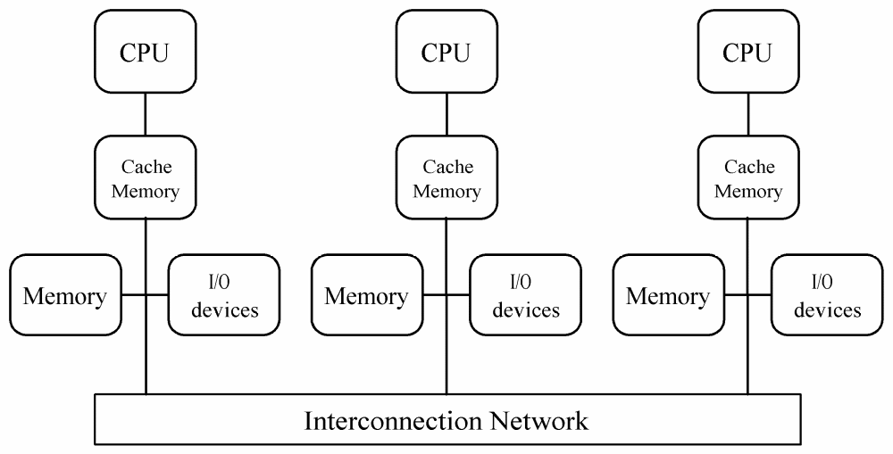
Distributed Multiprocessor

Slide 47
Distributed Multiprocessor
Distribute primary memory among processors
Increase aggregate memory bandwidth and lower average memory access time
Allows greater number of processors
Also called non-uniform memory access (NUMA) multiprocessor

Slide 48
Cache Coherence
Some NUMA multiprocessors do not support it in hardware
  Only instructions and private data are stored in cache
  Policy creates a large memory access time variance
Implementation more difficult
  No shared memory bus to “snoop”
  Directory-based protocol needed

Slide 49
Directory-based Protocol
Distributed directory contains information about cacheable memory blocks
One directory entry for each cache block
Each entry has
  Sharing status
  Which processors have copies

Slide 50
Sharing Status
Uncached
  Block not in any processor’s cache
Shared
  Cached by one or more processors
  Read only
Exclusive
  Cached by exactly one processor
  Processor has written block
  Copy in memory is obsolete

Slide 51
Directory-based Protocol - step1
Interconnection Network
Directory
Directory
Directory
Local Memory
Local Memory
Local Memory
Cache
Cache
Cache
CPU 0
CPU 1
CPU 2

Slide 52
Directory-based Protocol – step 2
Interconnection Network
Bit Vector
X
U 0 0 0
Directories
Memories
X
7
Caches
CPU 0
CPU 1
CPU 2

Slide 53
CPU 0 Reads X – step 3
Interconnection Network
Read Miss
X
U 0 0 0
Directories
Memories
X
7
Caches
CPU 0
CPU 1
CPU 2

Slide 54
CPU 0 Reads X –step 4
Interconnection Network
X
S 1 0 0
Directories
Memories
X
7
Caches
CPU 0
CPU 1
CPU 2

Slide 55
CPU 0 Reads X –step 5
Interconnection Network
X
S 1 0 0
Directories
Memories
X
7
Caches
X
7
CPU 0
CPU 1
CPU 2

Slide 56
CPU 2 Reads X – step 6
Interconnection Network
X
S 1 0 0
Directories
Memories
X
7
Read Miss
Caches
X
7
CPU 0
CPU 1
CPU 2

Slide 57
CPU 2 Reads X – step 7
Interconnection Network
X
S 1 0 1
Directories
Memories
X
7
Caches
X
7
CPU 0
CPU 1
CPU 2

Slide 58
CPU 2 Reads X – step 8
Interconnection Network
X
S 1 0 1
Directories
Memories
X
7
Caches
X
7
X
7
CPU 0
CPU 1
CPU 2

Slide 59
CPU 0 Writes 6 to X – step 9
Interconnection Network
Write Miss
X
S 1 0 1
Directories
Memories
X
7
Caches
X
7
X
7
CPU 0
CPU 1
CPU 2

Slide 60
CPU 0 Writes 6 to X – step 10
Interconnection Network
X
S 1 0 1
Directories
Invalidate
X
7
Memories
Caches
X
7
X
7
CPU 0
CPU 1
CPU 2

Slide 61
CPU 0 Writes 6 to X – step 11
Interconnection Network
X
E 1 0 0
Directories
Memories
X
7
Caches
X
6
CPU 0
CPU 1
CPU 2

Slide 62
CPU 1 Reads X – step 12
Interconnection Network
Read Miss
X
E 1 0 0
Directories
Memories
X
7
Caches
X
6
CPU 0
CPU 1
CPU 2

Slide 63
CPU 1 Reads X – step 13
Interconnection Network
Switch to Shared
X
E 1 0 0
Directories
Memories
X
7
Caches
X
6
CPU 0
CPU 1
CPU 2

Slide 64
CPU 1 Reads X – step 14
Interconnection Network
X
E 1 0 0
Directories
Memories
X
6
Caches
X
6
CPU 0
CPU 1
CPU 2

Slide 65
CPU 1 Reads X – step 15
Interconnection Network
X
S 1 1 0
Directories
Memories
X
6
Caches
X
6
X
6
CPU 0
CPU 1
CPU 2

Slide 66
CPU 2 Writes 5 to X – step 16
Interconnection Network
X
S 1 1 0
Directories
Memories
Write Miss
X
6
Caches
X
6
X
6
CPU 0
CPU 1
CPU 2

Slide 67
CPU 2 Writes 5 to X - step 17
Interconnection Network
Invalidate
X
S 1 1 0
Directories
Memories
X
6
Caches
X
6
X
6
CPU 0
CPU 1
CPU 2

Slide 68
CPU 2 Writes 5 to X –step 18
Interconnection Network
X
E 0 0 1
Directories
Memories
X
6
Caches
X
5
CPU 0
CPU 1
CPU 2

Slide 69
CPU 0 Writes 4 to X – step 19
Interconnection Network
Write Miss
X
E 0 0 1
Directories
Memories
X
6
Caches
X
5
CPU 0
CPU 1
CPU 2

Slide 70
CPU 0 Writes 4 to X – step 20
Interconnection Network
X
E 1 0 0
Directories
Memories
Take Away
X
6
Caches
X
5
CPU 0
CPU 1
CPU 2

Slide 71
CPU 0 Writes 4 to X – step 21
Interconnection Network
X
E 0 1 0
Directories
Memories
X
5
Caches
X
5
CPU 0
CPU 1
CPU 2

Slide 72
CPU 0 Writes 4 to X – step 22
Interconnection Network
X
E 1 0 0
Directories
Memories
X
5
Caches
CPU 0
CPU 1
CPU 2

Slide 73
CPU 0 Writes 4 to X – step 23
Interconnection Network
X
E 1 0 0
Directories
Memories
X
5
Caches
X
5
CPU 0
CPU 1
CPU 2

Slide 74
CPU 0 Writes 4 to X – step 24
Interconnection Network
X
E 1 0 0
Directories
Memories
X
5
Caches
X
4
CPU 0
CPU 1
CPU 2

Slide 75
CPU 0 Writes Back X Block – step 25
Interconnection Network
Data Write Back
X
E 1 0 0
Directories
X
X
5
Memories
4
Caches
X
4
CPU 0
CPU 1
CPU 2

Slide 76
CPU 0 Writes Back X Block – step 26
Interconnection Network
X
U 0 0 0
Directories
Memories
X
4
Caches
CPU 0
CPU 1
CPU 2

Slide 77
Multicomputer
Distributed memory multiple-CPU computer
Same address on different processors refers to different physical memory locations
Processors interact through message passing

Slide 78
Typically, Two Flavors of Multicomputers
Commercial multicomputers
  Custom switch network
  Low latency (the time it takes to get a response from something.
  High bandwidth (data path width) across processors
Commodity clusters
  Mass produced computers, switches and other equipment
  Use low cost components
  Message latency is higher
  Communications bandwidth is lower

Slide 79
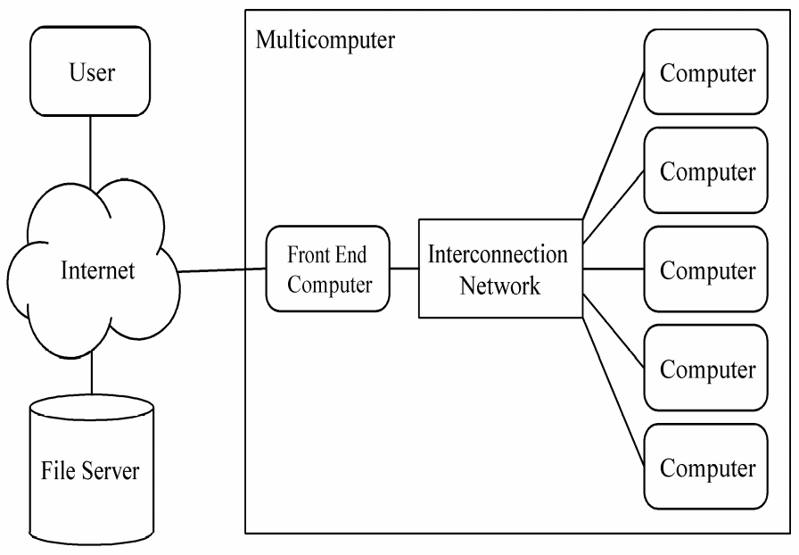
Asymmetrical MC Advantages
Back-end processors dedicated to parallel computations ⇒ Easier to understand, model, tune performance
Only a simple back-end operating system needed ⇒ Easy for a vendor to create

Slide 80
Asymmetrical MC Disadvantages
Front-end computer is a single point of failure
Single front-end computer limits scalability of system
Primitive operating system in back-end processors makes debugging difficult
Every application requires development of both front-end and back-end program

Slide 81
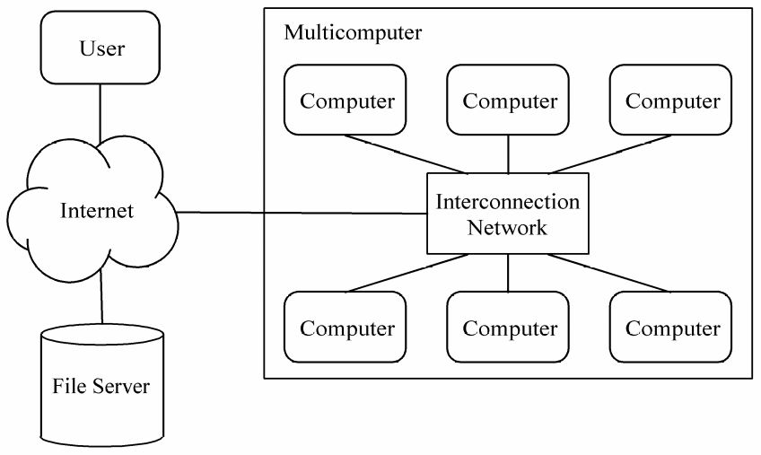
Symmetrical MC Advantages
Alleviate performance bottleneck caused by single front-end computer
Better support for debugging
Every processor executes same program

Slide 82
Symmetrical MC Disadvantages
More difficult to maintain illusion of single “parallel computer”
No simple way to balance program development workload among processors
More difficult to achieve high performance when multiple processes on each processor

Slide 83
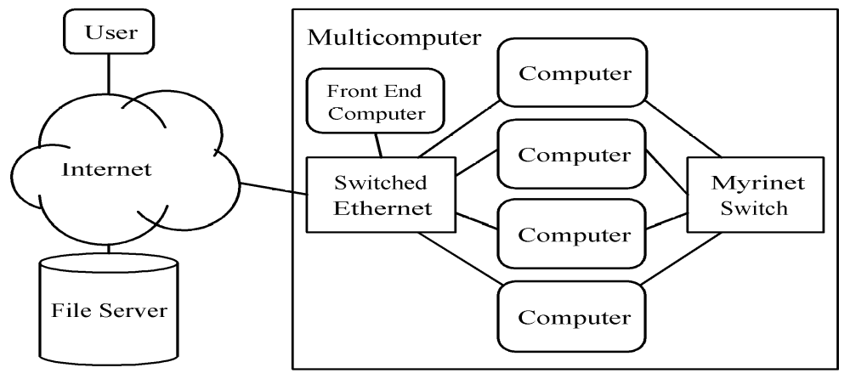
ParPar Cluster, A Mixed Model
Mixed model
Incorporates both assymetrical and symetrical designs.

Slide 84
Commodity Cluster
Co-located computers
Dedicated to running parallel jobs
No keyboards or displays
Identical operating system
Identical local disk images
Administered as an entity

Slide 85
Network of Workstations
Dispersed computers
First priority: person at keyboard
Parallel jobs run in background
Different operating systems
Different local images
Checkpointing and restarting important

Slide 86
Summary
Commercial parallel computers appeared
in 1980s
Multiple-CPU computers now dominate
Small-scale: Centralized multiprocessors
Large-scale: Distributed memory architectures (multiprocessors or multicomputers)

