Slide 1
Chapter 3
Parallel Algorithm Design

Slide 2
Outline
Task/channel model of Ian Foster
  Predominately for distributed memory parallel computers
Algorithm design methodology
Expressions for expected execution time
Case studies

Slide 3
Task/Channel Model
Parallel computation = set of tasks
A task consists of a
  Program
  Local memory
  Collection of I/O ports
Tasks interact by sending messages through channels
  A task can send local data values to other tasks via output ports
  A task can receive data values from other tasks via input ports.
The local memory contains the program’s instructions and its private data

Slide 4
Task/Channel Model
A channel is a message queue that connects one task’s ouput port with another task’s input port.
Data values appear in input port in the same order in which they are placed in the output queue.
A task is blocked if a task tries to receive a value at an input port and the value isn’t available.
The blocked task must wait until the value is received.
But, a process sending a message is never blocked even if previous messages it has sent on the channel have not been received yet.
Thus, receiving is a synchronous operation and sending is an asynchronous operation.

Slide 5
Task/Channel Model
Local accesses of private data are assumed to be easily distinguished from nonlocal data access done over channels.
Thus, we should think of local accesses as being faster than nonlocal accesses.
In this model:
  The execution time of a parallel algorithm is the period of time a task is active.
  The starting time of a parallel algorithm is when all tasks simultaneously begin executing.
  The finishing time of a parallel algorithm is when the last task has stopped executing.

Slide 6
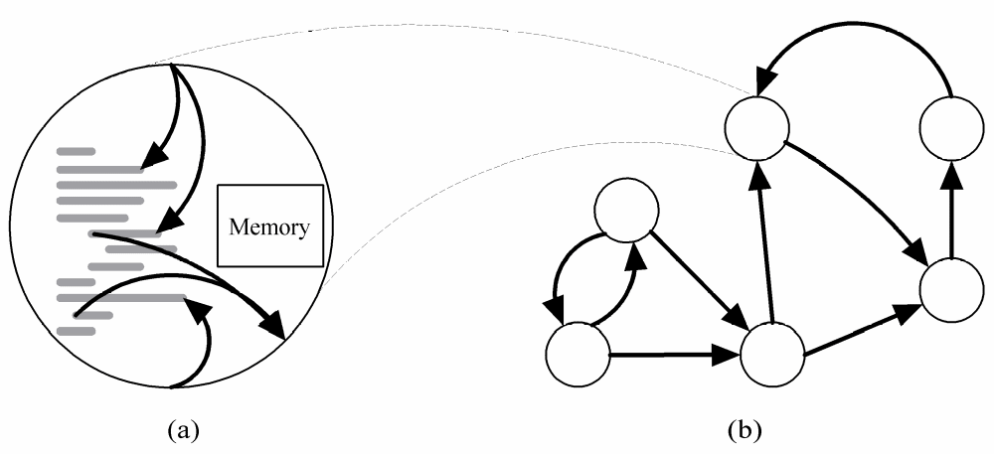
Task/Channel Model
Task
Channel
This model can be used for multiprocessors and multicomputers.

Slide 7
Multiprocessors - recall
Definition unique to Quinn (see Pg 43)
Multiple asynchronous CPU’s with a common shared memory.
Usually called a
  shared memory multiprocessors or
  shared memory MIMDs
An example is
  the symmetric multiprocessor (SMP)
  Also called a centralized multiprocessor
Quinn feels his terminology is more logical.

Slide 8
Multicomputer - recall
Definition unique to Quinn (See pg 49)
Multiple CPUs with local memory that are connected together.
Connection can be by interconnection network, bus, ether net, etc.
Usually called a
  Distributed memory multiprocessor or
  Distributed memory MIMD
Quinn feels his terminology is more logical

Slide 9
Foster’s Design Methodology
Ian Foster has proposed a 4-step process for designing parallel algorithms for machines that fit the task/channel model.
It encourages the development of scalable algorithms by delaying machine-dependent considerations until the later steps.
The 4 design steps are called:
  Partitioning
  Communication
  Agglomeration
  Mapping

Slide 10
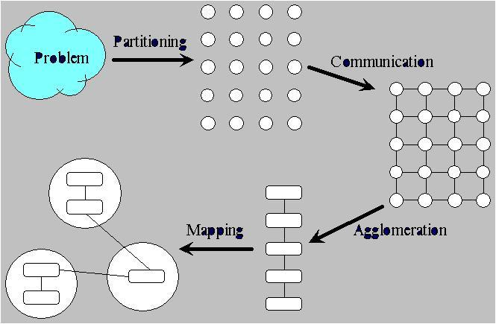
Foster’s Methodology

Slide 11
Partitioning
Partitioning: Dividing the computation and data into pieces
Domain decomposition – one approach
  Divide data into pieces
  Determine how to associate computations with the data
  Focus on the largest and most frequently accessed data structure
Functional decomposition – another approach
  Divide computation into pieces
  Determine how to associate data with the computations
  This often yields tasks that can be pipelined.

Slide 12
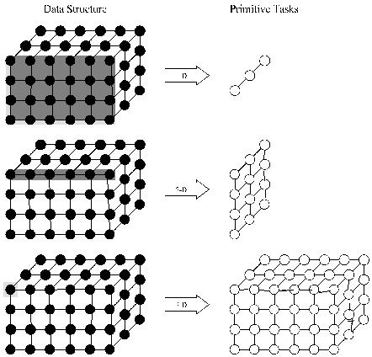
Example Domain Decompositions
Think of the primitive tasks as processors.
In 1st, each 2D slice is mapped onto a processor using 3 processors.
In second, a 1D slice is mapped onto a processor.
In last, an element is mapped onto a processor
The last is usually preferred.

Slide 13
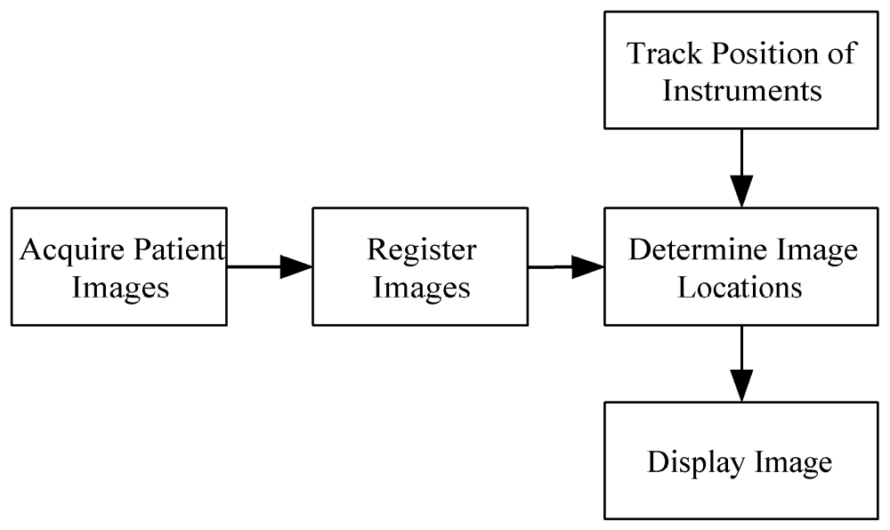
Example Functional Decomposition

Slide 14
Partitioning Checklist for Evaluating the Quality of a Partitioning
At least 10x more primitive tasks than processors in target computer
Minimize redundant computations and redundant data storage
Primitive tasks are roughly the same size
Number of tasks an increasing function of problem size
Remember – we are talking about MIMDs here which typically have a lot less processors than SIMDs.

Slide 15
Foster’s Methodology

Slide 16
Communication
Determine values passed among tasks
There are two kinds of communication:
Local communication
  A task needs values from a small number of other tasks
  Create channels illustrating data flow
Global communication
  A significant number of tasks contribute data to perform a computation
  Don’t create channels for them early in design

Slide 17
Communication
This is something sequential algorithms do not have do.
It is part of the overhead associated with MIMD machines especially when processors have to be coordinated,
SIMD algorithms invest little time in communication because much of the data movement is between the control unit and the PEs or because data is moved in lockstep (i.e. synchronously) along the interconnection network,

Slide 18
Communication Checklist for Judging the Quality of Communications
Communication operations should be balanced among tasks
Each task communicates with only a small group of neighbors
Tasks can perform communications concurrently
Task can perform computations concurrently

Slide 19
Foster’s Methodology

Slide 20
What We Have Hopefully at This Point – and What We Don’t Have
The first two steps look for parallelism in the problem.
However, the design obtained in this way probably won’t map well onto a real machine.
If the number of tasks greatly exceed the number of processors, we could have a great deal of overhead.
Now we have to decide what type of computer we are targeting
  Is it a centralized multiprocessor or a multicomputer?
  How must we combine tasks in order to map them effectively onto processors?

Slide 21
Agglomeration
Agglomeration: Grouping tasks into larger tasks
Goals
  Improve performance
  Maintain scalability of program
  Simplify programming – i.e. reduce software engineering costs.
In MPI programming, the goal is often to create one agglomerated task per processor
The goal is to lower communication overhead.
By agglomerating primitive tasks that communicate with each other, communication is eliminated as the needed data is local to a processor.

Slide 22
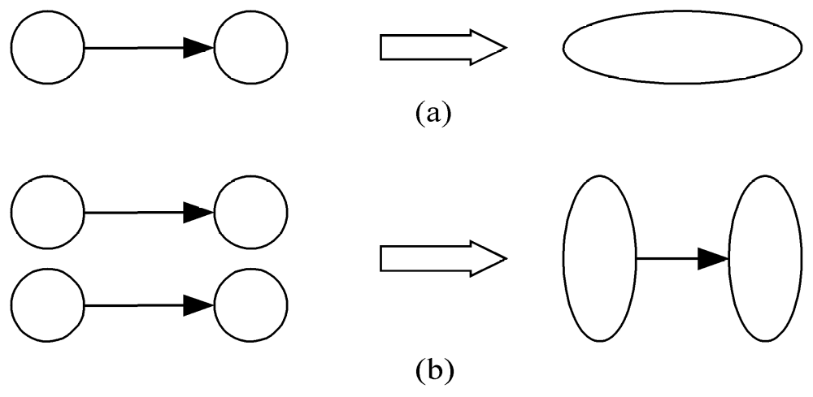
Agglomeration Can Improve Performance
It can eliminate communication between primitive tasks agglomerated into consolidated task
It can combine groups of sending and receiving tasks

Slide 23
Scalability
We are manipulating a 3D matrix of size 8 x 128 x 256.
Our target machine is a centralized multiprocessor with 4 CPUs.
Suppose we agglomerate the 2nd and 3rd dimensions. Can we run on our target machine?
  Yes- because we can have tasks which are each responsible for a 2 x 128 x 256 submatrix.
  Suppose we change to a target machine that is a centralized multiprocessor with 8 CPUs. Could our previous design basically work.
  Yes, because each task could handle a 1 x 128 x 256 matrix.

Slide 24
Scalability
  However, what if we go to more than 8 CPUs? Would our design change if we had agglomerated the 2nd and 3rd dimension for the 8 x 128 x 256 matrix?
  Yes.
This says the decision to agglomerate the 2nd and 3rd dimension in the long run is not a good idea as the code portability to more CPUs is impaired.

Slide 25
Reducing Software Engineering Costs
Software Engineering – the study of techniques to bring very large projects in on time and on budget.
One purpose of agglomeration is to look for places where existing sequential code for a task might exist,
Use of that code helps bring down the cost of developing a parallel algorithm from scratch.

Slide 26
Agglomeration Checklist for Checking the Quality of the Agglomeration
Locality of parallel algorithm has increased
Replicated computations take less time than communications they replace
Data replication doesn’t affect scalability
Agglomerated tasks have similar computational and communications costs
Number of tasks increases with problem size
Number of tasks suitable for likely target systems
Tradeoff between agglomeration and code modifications costs is reasonable

Slide 27
Mapping
Mapping: The process of assigning tasks to processors
Centralized multiprocessor: mapping done by operating system
Distributed memory system: mapping done by user
Conflicting goals of mapping
  Maximize processor utilization – i.e. the average percentage of time the system’s processors are actively executing tasks necessary for solving the problem.
  Minimize interprocessor communication

Slide 28
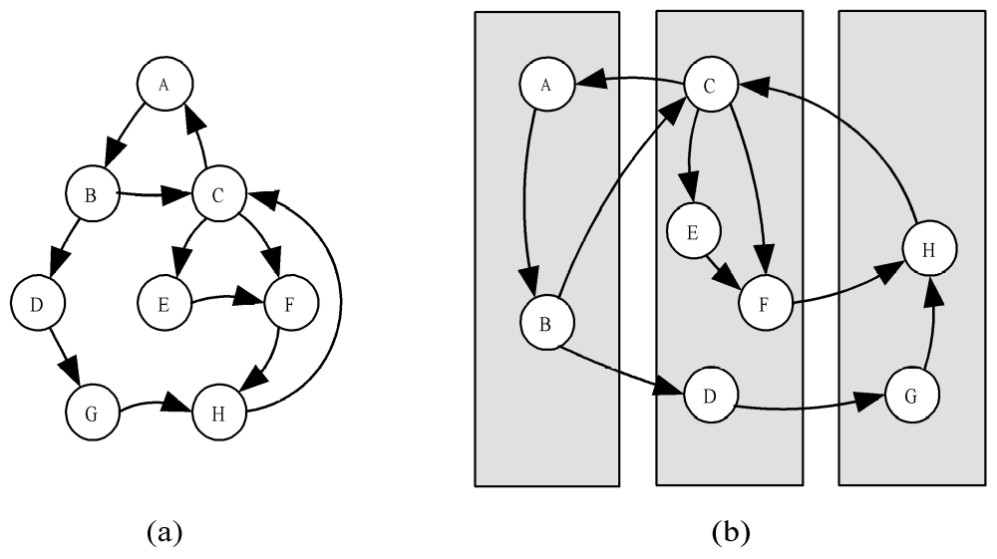
Mapping Example
(a) is a task/channel graph showing the needed communications over channels.
(b) shows a possible mapping of the tasks to 3 processors.

Slide 29
Mapping Example
If all tasks require the same amount of time and each CPU has the same capability, this mapping would mean the middle processor will take twice as long as the other two..

Slide 30
Optimal Mapping
Optimality is with respect to processor utilization and interprocessor communication.
Finding an optimal mapping is NP-hard.
Must rely on heuristics applied either manually or by the operating system.
It is the interaction of the utilization and communication that is important.
For example, with p processors and n tasks, putting all tasks on 1 processor makes interprocessor communication zero, but utilitzation is 1/p.

Slide 31
A Mapping Decision Tree (see pg 72)
Static number of tasks
  Structured communication
    Constant computation time per task
      Agglomerate tasks to minimize communications
      Create one task per processor
    Variable computation time per task
      Cyclically map tasks to processors
  Unstructured communication
    Use a static load balancing algorithm
Dynamic number of tasks
  Frequent communication between tasks
    Use a dynamic load balancing algorithm
  Many short-lived tasks. No internal communication
    Use a run-time task-scheduling algorithm

Slide 32
Mapping Checklist to Judge the Quality of a Mapping
Consider designs based on one task per processor and multiple tasks per processor.
Evaluate static and dynamic task allocation
If dynamic task allocation chosen, the task allocator (i.e., manager) is not a bottleneck to performance
If static task allocation chosen, ratio of tasks to processors is at least 10:1

Slide 33
Case Studies
Boundary value problem
Finding the maximum
The n-body problem
Adding data input

Slide 34
Boundary Value Problem

Slide 35
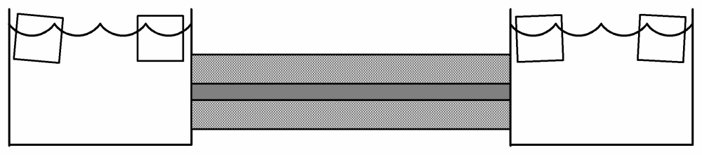
Boundary Value Problem
Ice water
Rod
Insulation
Problem:
The ends of a rod of length 1are in contact with ice water at 0⁰ C. The initial temperature at distance x from the end of the rod is 100sin(Πx). (These are the boundary values.)
The rod is surrounded by heavy insulation. So, the temperature changes along the length of the rod are a result of heat transfer at the ends of the rod and heat conduction along the length of the rod.
We want to model the temperature at any point on the rod as a function of time.

Slide 36
Over time the rod gradually cools.
A partial differential equation (PDE) models the temperature at any point of the rod at any point in time.
PDEs can be hard to solve directly, but a method called the finite difference method is one way to approximate a good solution using a computer.
The derivative of f at a point s is defined by the limit: lim f(x+h) – f(x)
h→0 h
If h is a fixed non-zero value (i.e. don’t take the limit), then the expression is called a finite difference.

Slide 37
Finite differences approach differential quotients as h goes to zero.
Thus, we can use finite differences to approximate derivatives.
This is often used in numerical analysis, especially in numerical ordinary differential equations and numerical partial differential equations, which aim at the numerical solution of ordinary and partial differential equations respectively.
The resulting methods are called finite-difference methods.

Slide 38
An Example of Using a Finite Difference Method for an ODE (Ordinary Differential Equation)
Given f’(x) = 3f(x) + 2, use the fact that
f(x+h) – f(x) approximates f’(x)
h
to iteratively calculate an approximation to f’(x).
In our case, a finite difference method finds the temperature at a fixed number of points in the rod at various time intervals.
The smaller the steps in space and time, the better the approximation.

Slide 39
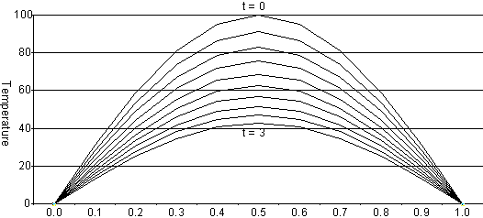
Rod Cools as Time Progresses
A finite difference method computes these temperature approximations (vertical axis) at various points along the rod (horizontal axis) for different times between 0 and 3.

Slide 40
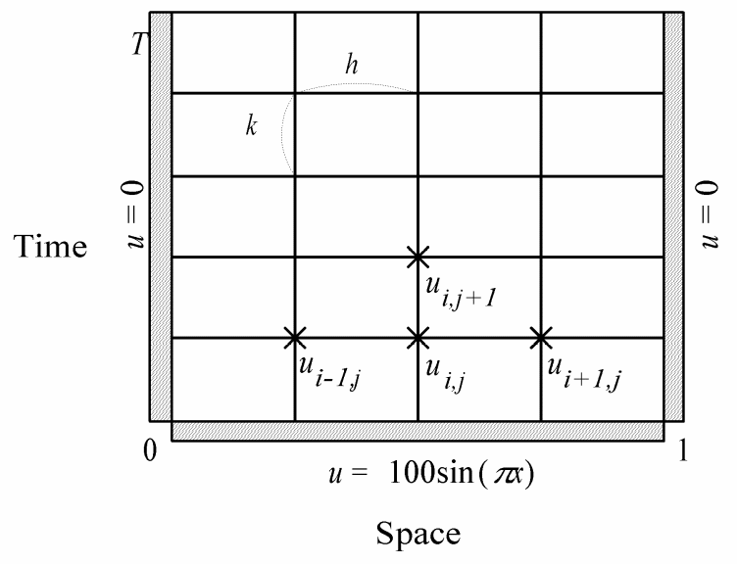
The Finite Difference Approximation Requires the Following Data Structure
A matrix is used where columns represent positions and rows represent time.
The element u(i,j) contains the temperature at position i on the rod at time j.
At each end of the rod the temperature is always 0. At time 0, the temperature at point x is 100sin(Πx)

Slide 41
Finite Difference Method Actually Used
We have seen that for small h, we may approximate f’(x) by
    f’(x) ~ [f(x + h) – f(x)] / h
It can be shown that in this case, for small h,
    f’’(x) ~ [f(x + h) – 2f(x) + f(x-h)]
Let u(i,j) represent the matrix element containing the temperature at position i on the rod at time j.
Using above approximations, it is possible to determine a positive value r so that
u(i,j+1) ~ ru(i-1,j) + (1 – 2r)u(i,j) + ru(i+1,j)
In the finite difference method, the algorithm computes the temperatures for the next time period using the above approximation.

Slide 42
Partitioning
This one is fairly easy to identify initially.
There is one data item (i.e. temperature) per grid point in matrix.
Let’s associate one primitive task with each grid point.
A primitive task would be the calculation of u(i,j+1) as shown on the last slide.
This gives us a two-dimensional domain decomposition.

Slide 43
Communication
Next, we identify the communication pattern between primitive tasks.
Each interior primitive task needs three incoming and three outgoing channels because to calculate
u(i,j+1) = ru(i-1,j) + (1 – 2r)u(i,j) + ru(i+1,j)
the task needs u(i-1,j), u(i,j), and u(i+1,j).
– i.e. 3 incoming channels and
u(i,j+1) will be needed for 3 other tasks
- i.e. 3 outgoing channels.
Tasks on the sides don’t need as many channels, but we really need to worry about the interior nodes.

Slide 44
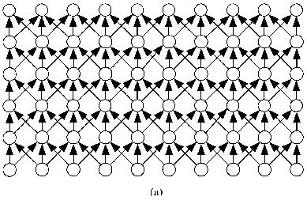
Agglomeration
We now have a task/channel graph of:
It should be clear this is not a good situation even if we had enough processors.
The top row depends on values from bottom rows.
Be careful when designing a parallel algorithm that you don’t think you have parallelism when tasks are sequential.

Slide 45

Collapse the Columns in the 1st
Agglomeration Step
This task/channel graph represents each task as computing one temperature for a given position and time.
This task/channel graph represents each task as computing the temperature at a particular position for all time steps.

Slide 46
We Still May Have Mapping Difficulties
This graph shows only a few intervals. We are using one processor per task.
For the sake of a good approximation, we may want many more intervals than we have processors.
We go back to the decision tree on page 72 to see if we can do better when we want more intervals than we have available processors.
Note: On a SIMD with an interconnection network (which the ASC emulator doesn’t have), we could probably stop here as we could possibly have enough processors.

Slide 47
Use Decision Tree Pg 72
The number of tasks is static once we decide on how many intervals we want to use.
The communication pattern among the tasks is regular – i.e. structured.
Each task performs the same computations.
Therefore, the decision tree says to create one task per processor by agglomerating primitive tasks so that computation workloads are balanced and communication is minimized.
So, we will associate a contiguous piece of the rod with each task by dividing the rod into n pieces of size h, where n is the number of processors we have.

Slide 48

Pictorially
Our previous task/channel graph assumed 10 processors, one per interval:
If we now assume 3 processors, we would now have:
Note this maintains the possibility of using some kind of nearest neighbor interconnection network and eliminates unnecessary communication.
What interconnection networks would work well?

Slide 49
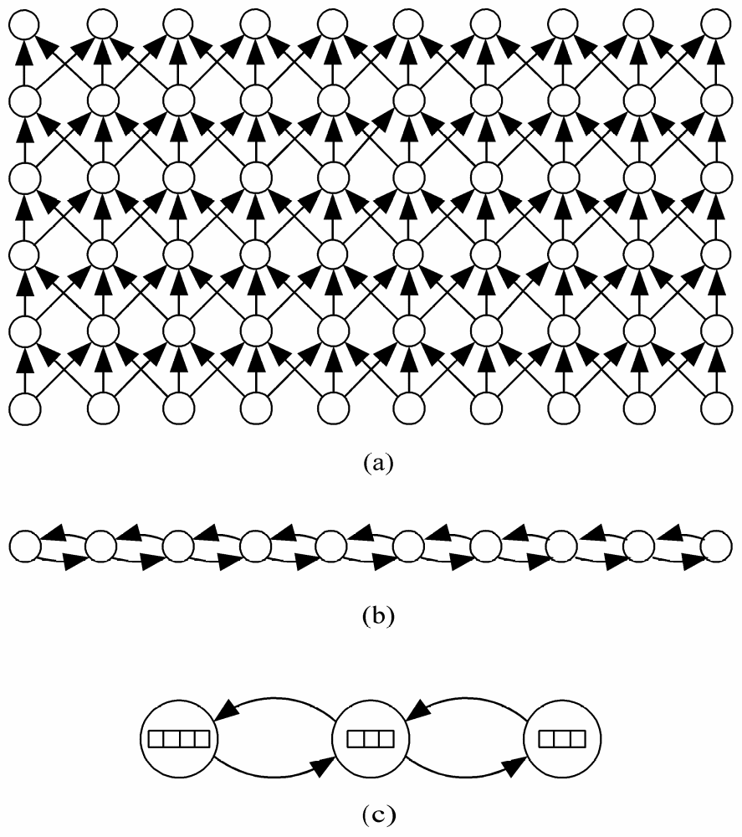
Agglomeration and Mapping
Agglomeration
and Mapping

Slide 50
Sequential execution time
Notation:
χ – time to update element u(i,j)
n – number of intervals on rod
  There are n-1 interior positions
m – number of time iterations
Then, the sequential execution time is
m (n-1) χ

Slide 51
Parallel Execution Time
Notation (in addition to ones on previous slide):
p – number of processors
λ – time to send (receive) a value to (from) another processor
In task/channel model, a task may only send and receive one message at a time, but it can receive one message while it is sending a message.
Consequently, a task requires 2λ time to send data values to its neighbors, but it can receive the two data values it needs from its neighbors at the same time.
So, we assume each processor is responsible for roughly an equal-sized portion of the rod’s intervals.

Slide 52
Parallel Execution Time For Task/Channel Model
Then, the parallel execution time is for one iteration is
χ ⎡(n-1)/p⎤ +2λ
and an estimate of the parallel execution time for all m iterations is
m (χ ⎡(n-1)/p⎤ +2λ)
where
χ – time to update element u(i,j)
n – number of intervals on rod
m – number of time iterations
p – number of processors
λ – time to send (receive) a value to (from) another processor
Note that ⎡s ⎤ means to round up to the nearest integer.

Slide 53
Comparisons (n = #intervals; m = time )
n-1 | m | Sequential | Task/Channel with p << n-1 | SIMD with p = n-1
 |  | m (n-1) χ | m (χ ⎡(n-1)/p⎤ +2λ) | m (χ +2λ¹)
48 | 100 | 4800χ p = 1 | 600χ + 200λ p = 8 | 100χ + 200λ p = 48
48 | 100 | ditto | 300χ + 200λ p = 16 | 100χ + 200λ p = 48
8K | 100 | ~(800K)χ | ~800χ + 200λ p = 1000 | 100χ + 200λ p = 8K
64K | 100 | ~(6400K)χ | ~6400χ + 200λ p = 1000 | 100χ + 200λ p = 64K
¹For a SIMD, communications are quicker than for a message passing machine as a packet doesn’t have to be built.

Slide 54
Finding the Maximum
Designing the Reduction Algorithm

Slide 55
Evaluating the Finite Difference Method (FDM) Solution for the Boundary Value Problem
The FMD only approximates the solution for the PDE.
Thus, there is an error in the calculation.
Moreover, the FMD tells us what the error is.
If the computed solution is x and the correct solution is c, then the error is |(x-c)/c| at a given interval m.
Let’s enhance the algorithm by computing the maximum error for the FDM calculation.
However, this calculation is an example of a more general calculation, so we will solve the general problem instead.

Slide 56
Reduction Calculation
We start with any associative operator ⊕. A reduction is the computation of the expression
a₀ ⊕ a₁ ⊕ a₂ ⊕ … ⊕ a_{n-1}
Examples of associative operations:
  Add
  Multiply
  And, Or
  Maximum, Minimum
On a sequential machine, this calculation would require how many operations?
  n – 1 i.e. the calculation is Θ(n).
  How many operations are needed on a parallel machine?
  For notational simplicity, we will work with the operation +.

Slide 57
Partitioning
Suppose we are adding n values.
First, divide the problem as finely as possible and associate precisely one value to a task.
Thus we have n tasks.
Communication
We need channels to move the data together in a processor so the sum can be computed.
At the end of the calculation, we want the total in a single processor.

Slide 58
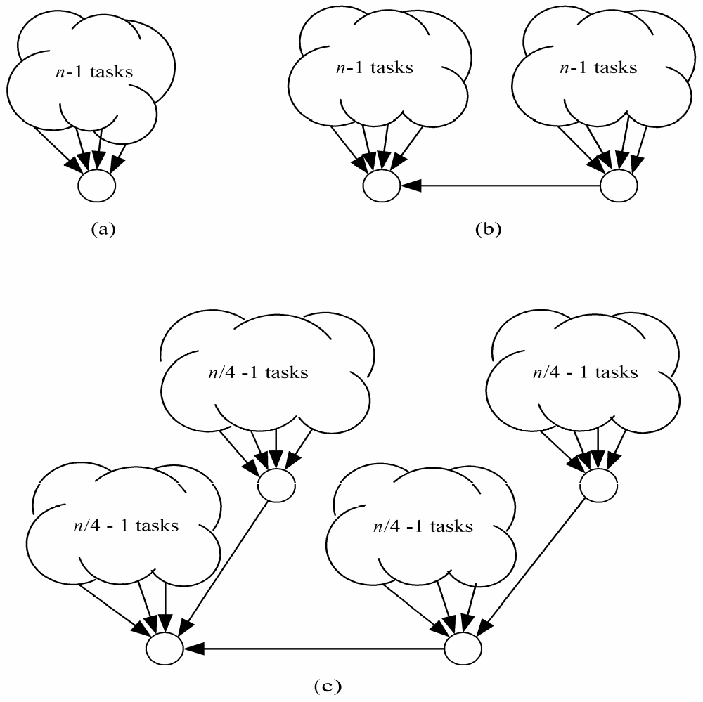
Communication
The brute force way would be to have one task receive all the other n-1 values and perform the additions.
Obviously, this is not a good way to go. In fact, it will be slower than the sequential algorithm because of the communication overhead!
Its time is (n-1)(λ + χ) where λ is the communication cost to send and receive one element and χ is the time to perform the addition.
The sequential algorithm is only (n-1)χ!

Slide 59

Parallel Reduction Evolution
Let’s Try
The timing is now (n/2)(λ + χ) + λ

Slide 60

Parallel Reduction Evolution
But, Why Stop There?
The timing is now (n/4)(λ + χ) + 2λ

Slide 61
If We Continue With This Approach
We have what is called a binomial tree communication pattern.
It is one of the most commonly encountered communication patterns in parallel algorithm design.
Now you can see why the interconnection networks we have seen are typically used.

Slide 62
The Hypercube and Binomial Trees

Slide 63
The Hypercube and Binomial Trees
An 8 node bionomial tree is
a subgraph of the 8 node
hypercube

Slide 64
Finding Global Sum
Using 16 Task/Channel Processors
Start with one number per processor.
Half send values and half receive and add.
4
2
0
7
-3
5
-6
-3
8
1
2
3
-4
4
6
-1

Slide 65
Finding Global Sum
1
7
-6
4
4
5
8
2

Slide 66
Finding Global Sum
8
-2
9
10

Slide 67
Finding Global Sum
17
8

Slide 68
Finding Global Sum
Binomial Tree
25

Slide 69
What If You Don’t Have a Power of 2?
For example, suppose we have 2^{k} + r numbers where r < 2^{k} ?
In the first step, r processors send values and r tasks receive values and add their values.
Now r tasks become inactive and we proceed as before.
Example: With 6 numbers.
  Send 2 numbers to 2 other tasks and add them.
  Now you have 4 tasks with numbers assigned.
So, if the number of tasks n is a power of 2, reduction can be performed in log n communication steps. Otherwise, we need ⎡log n⎤ + 1.
Thus, without lose of generality, we can assume we have a power of 2 for the communication steps.

Slide 70
Agglomeration and Mapping
We will assume that the number of processors p is a power of 2.
For task/channel machines, we’ll assume p << n (i.e. p is much less than n).
Using the mapping decision tree on page 72, we see we should minimize communication and create one task per processor since we have
Static number of tasks
  Structured communication
    Constant computation time per task

Slide 71
Original Task/Channel Graph
4
2
0
7
-3
5
-6
-3
8
1
2
3
-4
4
6
-1

Slide 72
Agglomeration to 4 Processors Initially
This Minimizes Communication
But, we want a single task per processor
So, each processor will run the sequential algorithm and find its local subtotal before communicating to the other tasks ...

Slide 73
Agglomeration and Mapping Complete
sum
sum
sum
sum

Slide 74
Analysis of Reduction Algorithm
Assume n integers are divided evenly among the p tasks, no task will handle more than ⎡n/p⎤ integers.
The time needed to perform concurrently their subtasks is
  (⎡n/p⎤ - 1) χ where χ is the time to perform the binary operation.
We already know the reduction can be performed in ⎡log p⎤ communication steps.
The receiving processor must wait for the message to arrive and add its value to the received value. So each reduction step requires λ + χ time.
Combining all of these, the overall execution time is
  (⎡n/p⎤ - 1) χ + ⎡log p⎤ (λ + χ )
  What would happen on a SIMD with p = n?

Slide 75
The n-Body Problem
Designing the All-Gather Operation

Slide 76
The n-Body Problem
Some problems in physics can be solved by performing computations on all objects in a data set and, consequently, simulating various actions.
For example, in the n-body problem, we simulate the motion of n particles of varying mass in two dimensions.
We iterate to compute the new position and velocity vector of each particle, given the position of all the other particles.
In the following example, every particle asserts a gravitational pull on every other particle. We assume the white particle has a particular position and velocity vector. It’s future position is influenced by the gravitational forces of the other two particles.

Slide 77
The n-body Problem

Slide 78
The n-body Problem
Assumption: Objects are restricted to a plane (2D version). Initial arrows show the velocity vectors.

Slide 79
Partitioning
Use domain partitioning
Initially, assume one task per particle
Task has particle’s position, velocity vector
Iteration
  Get positions of all other particles
  Compute new position, velocity

Slide 80
Gather
The gather operation is a global communication that takes a dataset distributed among different tasks and collects the items into a single task.
Reduction computes a single result from data elements. This just brings them together.

Slide 81
All-gather
The all-gather is similar, but at the end of the operation, every task has a copy of the entire dataset.

Slide 82
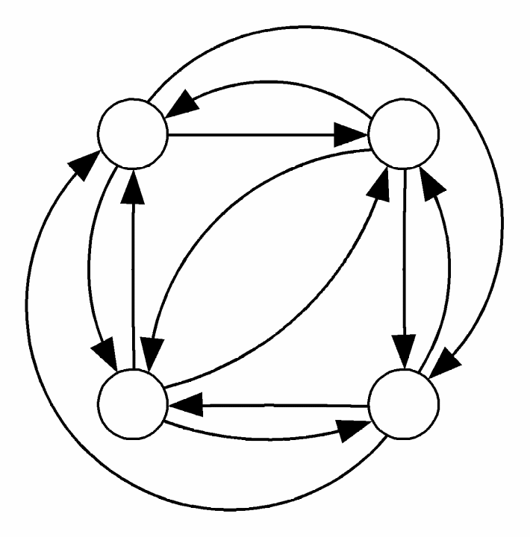
A Task/Channel Graph for All-gather
One way to implement: Use a complete graph for all-gather – i.e. create a channel from every task to every other task.
But, inspired by our work with the reduction algorithm, we should be looking for a logarithmic solution.

Slide 83
Developing an All-gather Algorithm
With two particles, just exchange so both hold 2 particles:
With 4 particles, we do the following:
  Do a simple exchange of 1 particle between task 0 and 1 and in parallel between 2 and 3.
  Now task 0 exchanges its pair of particles with task 2 and task 1 exchanges its pair of particles with task 3.
  At this point, all tasks will have 4 particles.

Slide 84
Scheme For All-gather for 4 Particles
Step 1 exchanges as above. Only 1 particle is moved, just as in reduction.

Slide 85
Scheme For All-gather for 4 Particles
Step 2 exchanges as above. Note that in this step 2 particles are moved.

Slide 86
Scheme For All-gather for 4 Particles

Slide 87
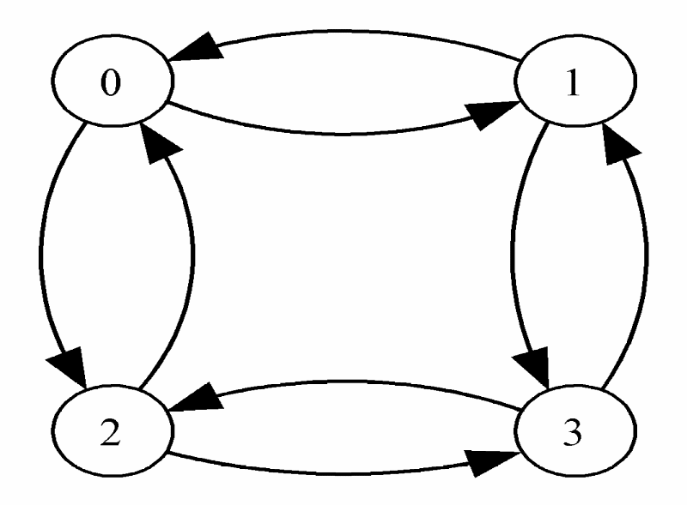
Channel/Task Graph for All-gather for 4 Particles
A logarithmic number of steps are needed for every processor to acquire all values if we use a hypercube.
You can see the hypercube is what is needed if you extend this scheme to 8 particles.
In the i th exchange, messages have length 2^{i-1}.

Slide 88
Analysis of Algorithm
In previous examples, we assumed themessage length was 1 and it took λ units oftime to send or receive a message independent of message length.
That is unrealistic. Now we will let
  λ = latency – i.e. time to initiate a message
  β = bandwidth – i.e. number of data items that can be send down a channel in one unit of time
  Now we let λ + n/β represent the communication time – i.e. the time required to send a message containing n data items.
  Obviously, as bandwidth increases, communication time decreases.

Slide 89
The Execution Time of the Algorithm
On the last slide we saw that λ + n/β is the communication time to send a message of n data items
Therefore, the communication time for each iteration is
log p
Σi=1 (λ + (2^{i-1}n/(βp)) = λlog p + (n(p-1) /(βp)
Each task performs the computation on n/p elements. Let χ be the time needed for this computation. Then the computation time for each iteration is
    (χn)/p
Combining these results we have the expected parallel execution time per iteration is the sum of the yellow items.

Slide 90
Adding Data Input

Slide 91
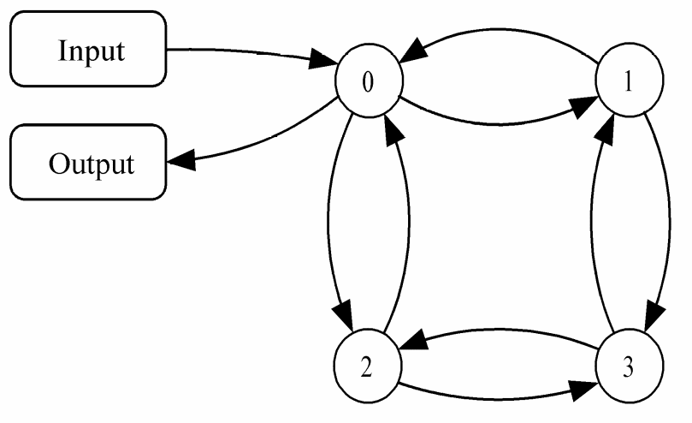
How Is I/O Handled?
I/O can be a bottleneck on a parallel system.
Commercial parallel computers can have parallel I/O systems, but commodity clusters usually use external file servers storing ordinary UNIX files.
So, we will assume a simple task is responsible for handling the I/O and we add new channels for the file I/O.
Note we are not adding a task, but assigning additional tasks to task 0.

Slide 92
The I/O Task
The data file is opened and the positions (2 numbers) and the velocities (2 numbers) are read for each of the n particles.
Let λ_{io} + n/β_{io} model the time needed to input or output n data elements.
Then reading the positions and velocities of all n particles requires time λ_{io} + 4n/β_{io} .
(Note typo on pg 87, last entry before 3.2 Communication.)

Slide 93
Communication
Now we need a gather operation in reverse – i.e. a scatter operation.
We need to move the data to each of the processors.
A global scatter can be used to break up input and send each task its data
Not an efficient algorithm due to unbalanced work load.

Slide 94
Scatter in log p Steps
Input
data
½ Input
¼ Input
¼ Input
First I/O task sends ½ of its data to another task
Repeat
  Each active task send ½ of its data to a previously inactive task.
Note: This is similar to what we have done several times.

Slide 95
The Entire n-Body Calculation
Input and output are assumed to be sequential operations.
After input, in the n-body problem, the particles are scattered using the second scatter operation.
The desired number of iterations are performed as noted earlier.
To perform output, the particles must be gathered at the end with the all-gather operation.
The expected overall execution time of the parallel computation is performed in section 3.7.3 and is left to the reader as we have done this thing before. See the next 3 slides for a summary of the steps.

Slide 96
I/O Time
Input requires opening data file and reading for each of n bodies
  its position ( a pair of coordinates)
  its velocity (a pair of values)
The time needed to input and output data for n bodies is
  2(λ_{io} + 4n/β_{io})

Slide 97
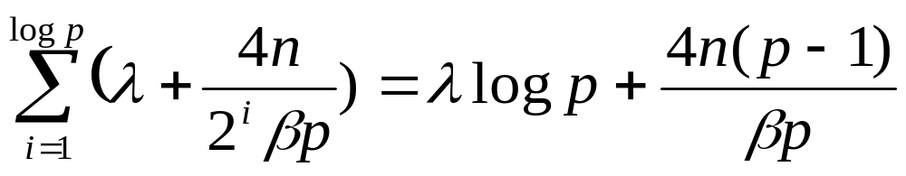
Parallel Running Time
Scatter/gather communication time for I/O
Scattering particles at the beginning of the computation and gathering them at the end requires time
  2(λ log p + 4n(p - 1)/(βp)

Slide 98
Parallel Running Time (cont.)
Each iteration of the parallel algorithm requires an all-gather of the particles’ positions, with approximate execution time of
  λ log p + 2n(p-1) /(βp)
If χ is the time required for to compute the new positions of particles the execution time is
  χ ⎡n/p⎤ (n-1) ----(? why the n-1 term)
If the algorithm executes m iterations, then the expected overall execution time is
+ (2) + m[ (3) + (4)]
  where (i) denotes formula i from slides.

Slide 99
Summary: Task/Channel Model
Parallel computation
  Set of tasks
  Interactions through channels
Good designs
  Maximize local computations
  Minimize communications
  Scale up

Slide 100
Summary: Design Steps
(due to I. Foster)
Partition computation
Agglomerate tasks
Map tasks to processors
Goals
  Maximize processor utilization
  Minimize inter-processor communication

Slide 101
Summary: Fundamental Algorithms Introduced
Reduction
Gather
Scatter
All-gather

Slide 102
Communication Analysis Definitions
Latency (denoted by λ) is the time needed to initiate a message.
Bandwidth (denoted by β) is the number of data items that can be sent over a channel in one time unit.
Sending a message with n data items requires λ + n/β time.

Slide 103
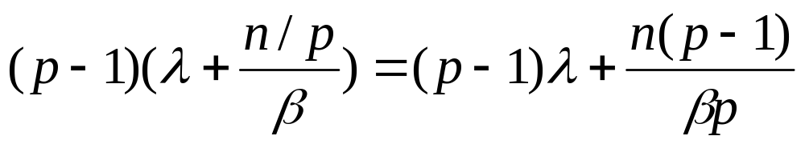
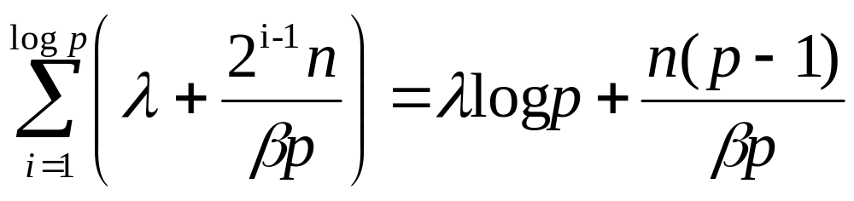
Summary: Communication Time
Complete graph
Hypercube

